Slide 1
Reduce Attrition strategy
TAJAR Inc : Tori, Andy, Jodi, An, Rajat
August 7, 2018

Slide 2
Introduction
Attrition comes as a high cost to companies. The cost of interviewing, training, productivity, and negative impacts on morale are just a few.
This report will focus on the following based on our analysis:
The top 3 factors that contribute to attrition
Job role specific trends
Recommendations to mitigate attrition

Slide 3
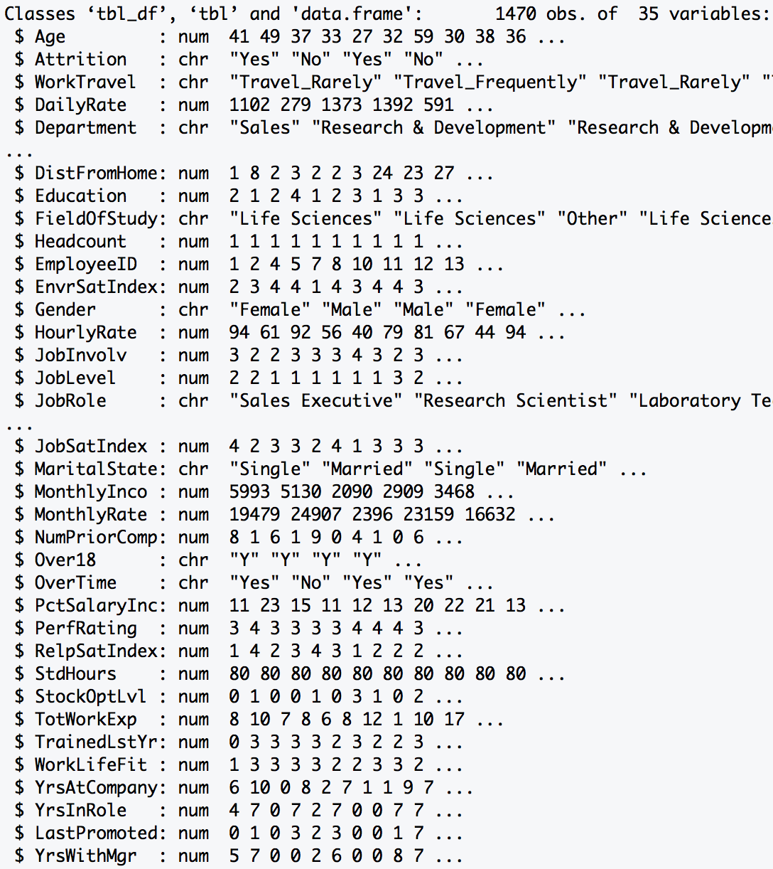
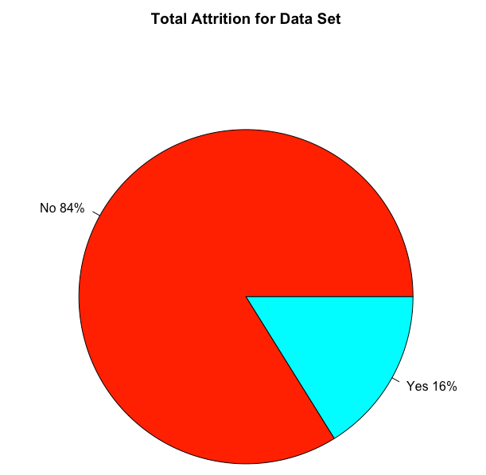
Data Source
Summary: The dataset provided required minimal tidying. There was no missing data (i.e. NA). It
included both personal and professional data on employee from various departments.
Data Dimension
Total Observations: 1470
Total Variables : 35
Data Class Type
Numeric : 25
Character : 10
1233
Length > 12 Variables
23
237
Excluded Variables:
HeadCount, EmployeeID, Over18, StdHours

Slide 4
Methodology – Random Forest
RAJAT to provide content

Slide 5
Top 7 Factors of Attrition
 | Min. | 1st Qu. | Median | Mean | 3rd Qu. | Max.
Monthly Income | 1009.00 | 2911.00 | 4919.00 | 6502.93 | 8379.00 | 19999.00
Age | 18 | 30 | 36 | 36.9 | 43 | 60
Distance From Home | 1 | 2 | 7 | 9.19 | 14 | 29
Percent Salary Increase | 11 | 12 | 14 | 15.2 | 18 | 25
Total Work Experience | 0 | 6 | 10 | 11.3 | 15 | 40
Years at Company | 0 | 3 | 5 | 7.01 | 9 | 40
Number of Prior Comapany | 0 | 1 | 2 | 2.69 | 4 | 9
for every 1 year increase in age for males there is a 256.70 dollars increase in monthly income with an r2 of 0.2424 and for every 1 year increase in age for females there is a 255.74 dollars increase in monthly income with an r2 of 0.2547

Slide 6
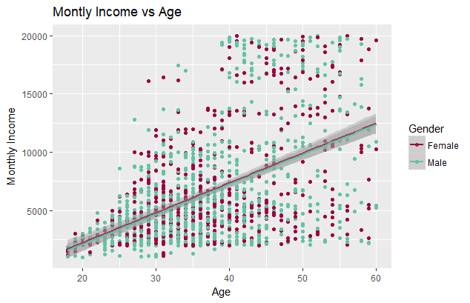
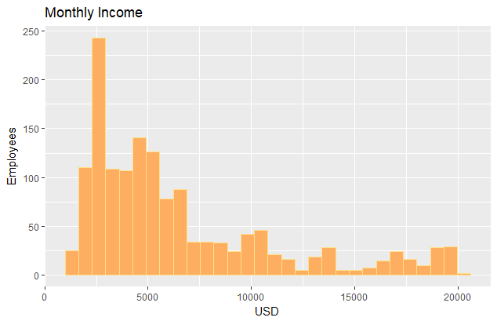
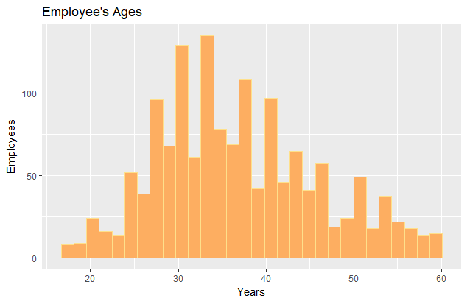
Relationships of the first two Factors
Employees’ income is very left skewed.
Employees’ age is normally distributed.
For every 1 year increase in age for males there is a 256.70 dollars increase in monthly income with an r2 of 0.2424 and or every 1 year increase in age for females there is a 255.74 dollars increase in monthly income with an r2 of 0.2547

Slide 7
How to mitigate attrition
Whole Team Provides content

Slide 8
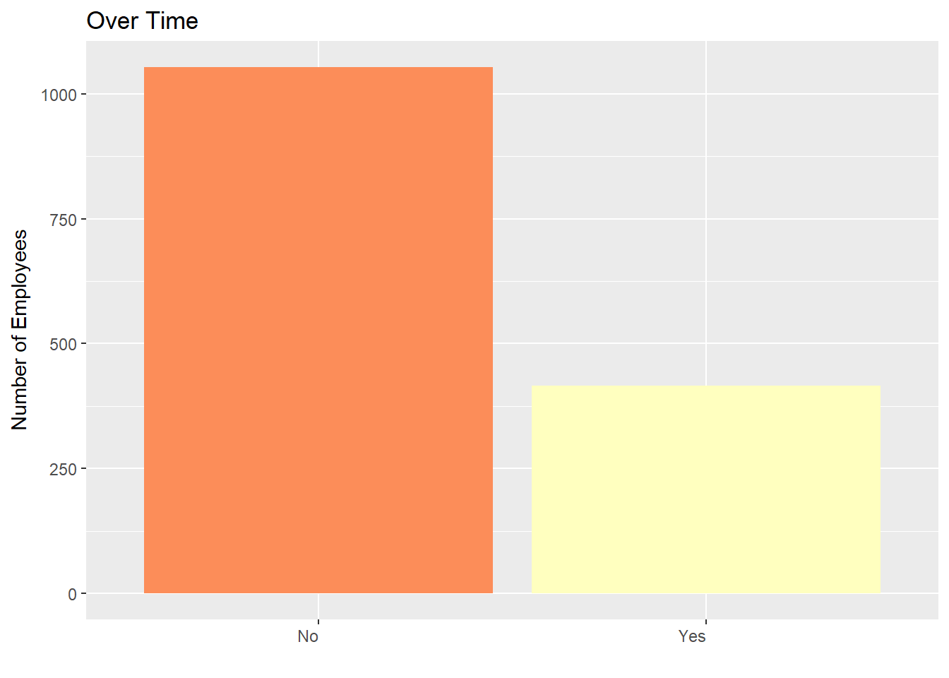
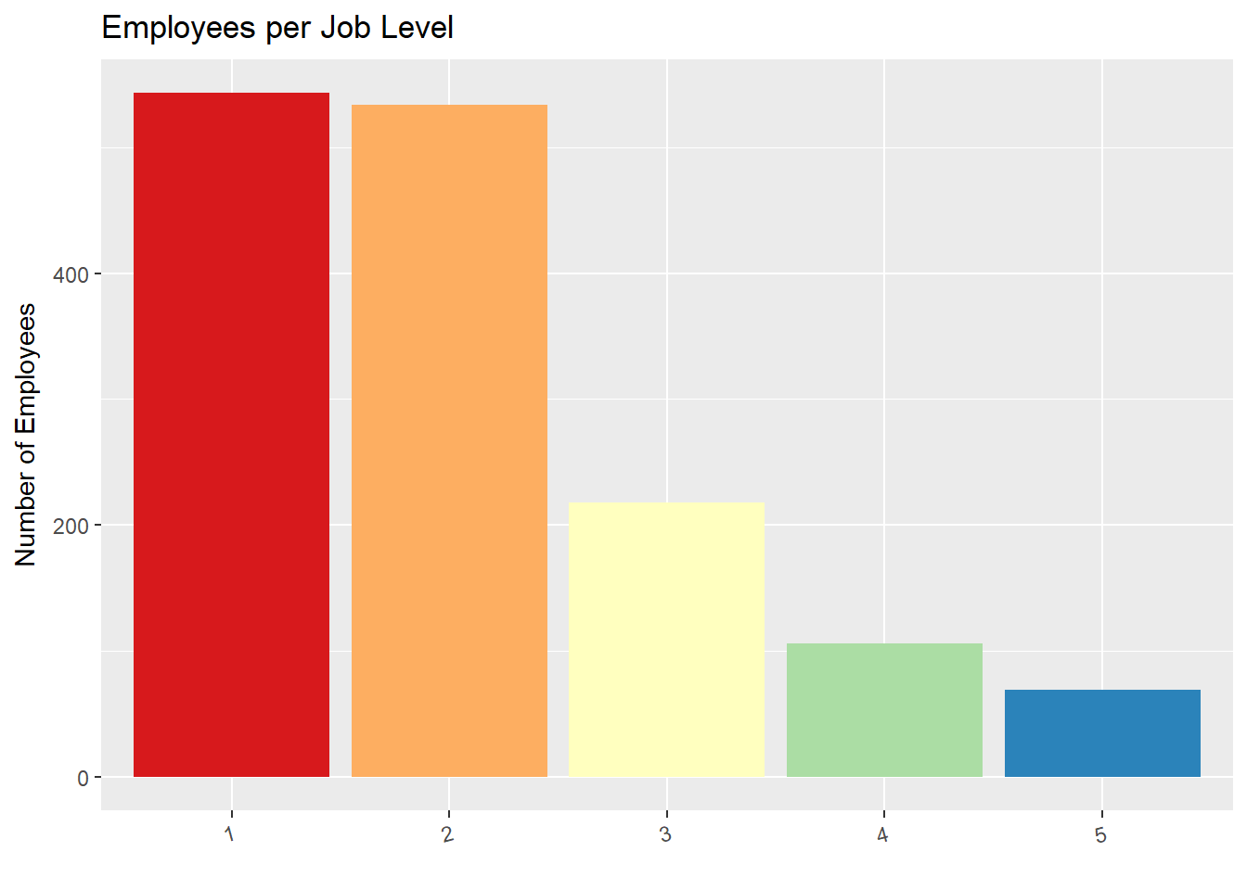
Top Two Factors Attributed to Company’s Attrition

