Slide 1
Reduce Attrition strategy
TAJAR Inc : Tori, Andy, Jodi, An, Rajat
August 7, 2018

Slide 2
Agenda
Business Objectives
Data Sourced
Methodology
Evaluation/Results
Summary

Slide 3
Business Objectives

Slide 4
Introduction
Attrition comes as a high cost to companies. The cost of interviewing, training, productivity, and negative impacts on morale are just a few.
This report will focus on the following based on our analysis:
The top 3 factors that contribute to attrition
Job role specific trends
Recommendations to mitigate attrition

Slide 5
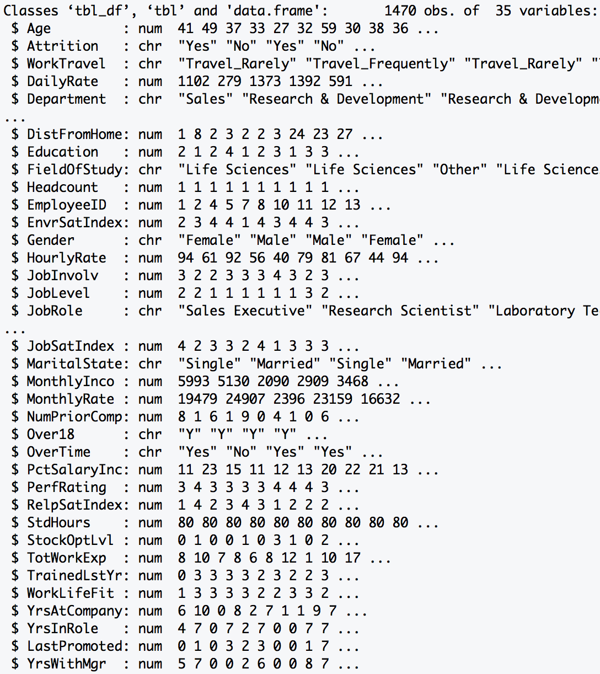
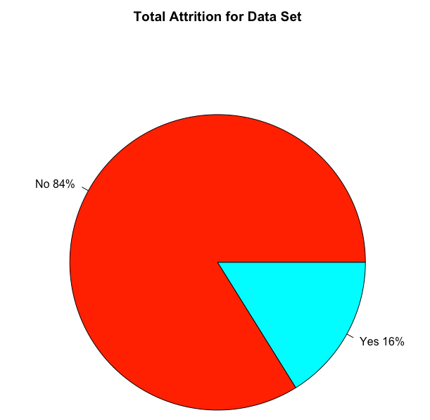
Data Source
Summary: The dataset provided required minimal tidying. There was no missing data (i.e. NA). It
included both personal and professional data on employee from various departments.
Data Dimension
Total Observations: 1470
Total Variables : 35
Data Class Type
Numeric : 25
Character : 10
1233
Length > 12 Variables
23
237
Excluded Variables:
HeadCount, EmployeeID, Over18, StdHours

Slide 6
Methodology – Random Forest
RAJAT to provide content

Slide 7
Top 7 Factors of Attrition
 | Min. | 1st Qu. | Median | Mean | 3rd Qu. | Max.
Monthly Income | 1009.00 | 2911.00 | 4919.00 | 6502.93 | 8379.00 | 19999.00
Age | 18 | 30 | 36 | 36.9 | 43 | 60
Distance From Home | 1 | 2 | 7 | 9.19 | 14 | 29
Percent Salary Increase | 11 | 12 | 14 | 15.2 | 18 | 25
Total Work Experience | 0 | 6 | 10 | 11.3 | 15 | 40
Years at Company | 0 | 3 | 5 | 7.01 | 9 | 40
Number of Prior Comapany | 0 | 1 | 2 | 2.69 | 4 | 9

Slide 8
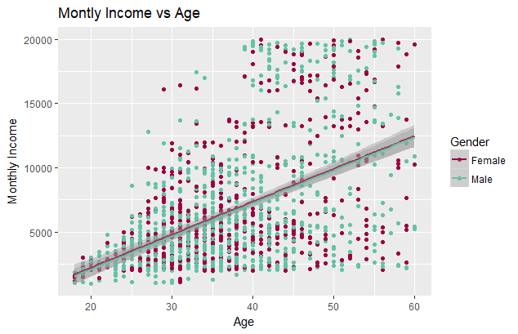
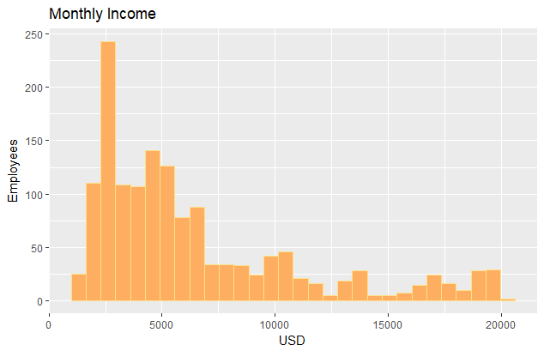
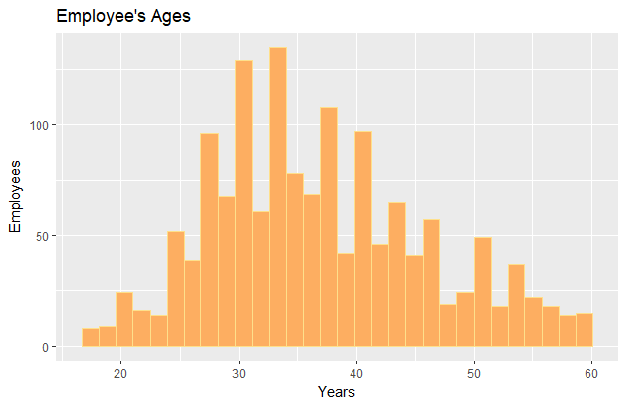
Monthly income and age
Employees’ income is very left skewed.
Employees’ age is normally distributed.
For every 1 year increase in age for males there is a $256.70 increase in the average monthly income( R² of 0.2424) and for every 1 year increase in age for females there is a $255.74 increase in the average monthly income (R² of 0.2547).

Slide 9
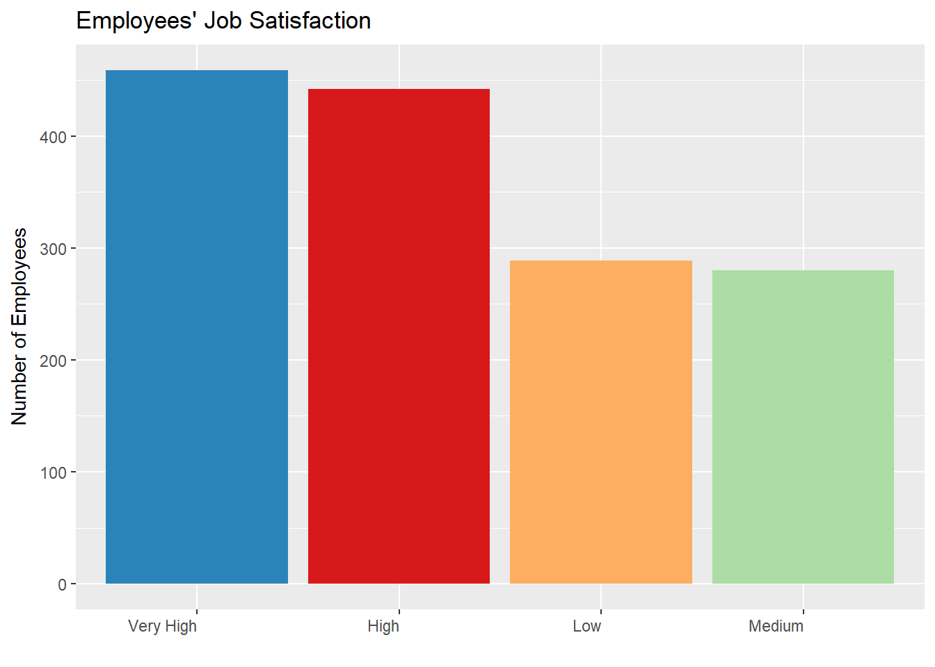
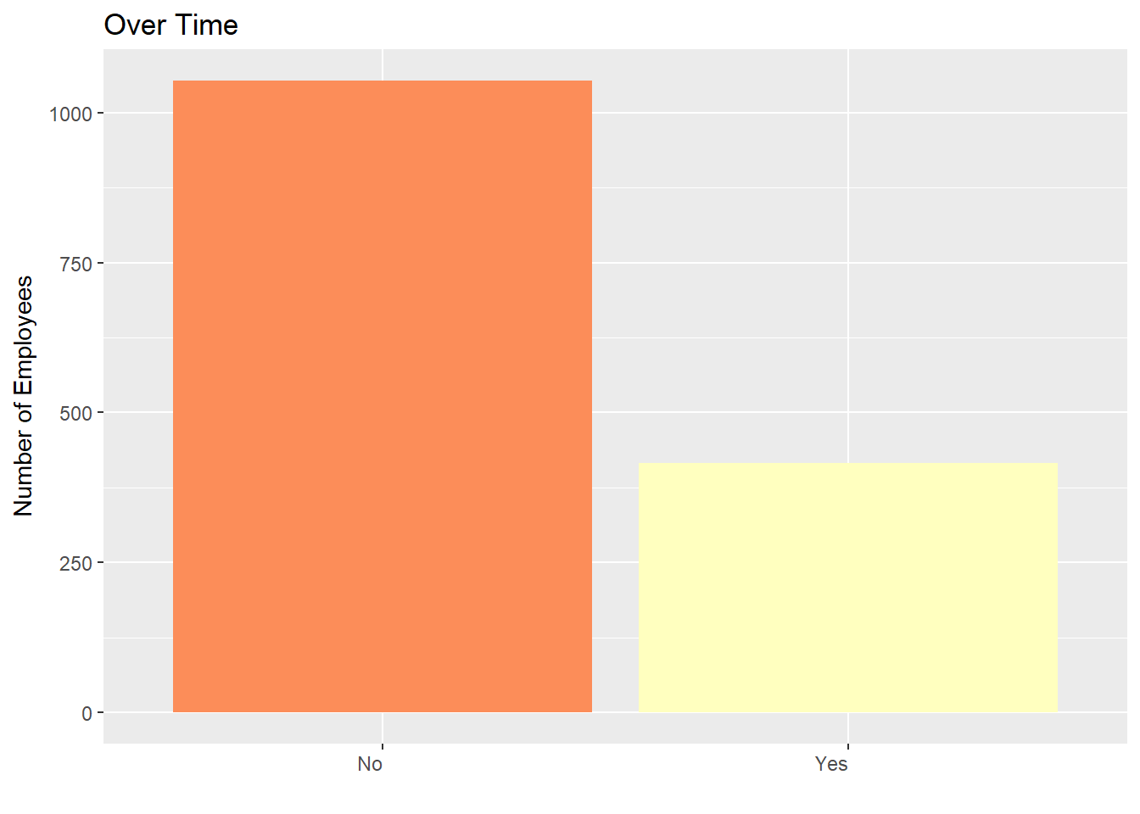
Top Two Factors Attributed to Company’s Attrition

Slide 10
Life Satisfaction
**Jodi Will enter visual here by noon Monday (promise!). I will be looking at Those that worked overtime against Work Life balance self reporting. ☺

Slide 11
Other findings
Tell me about any job role specific trends that may exist in the data set

Slide 12
How to mitigate attrition
**Content in Progress (by Jodi) – feel free to add. I will finalize Monday morning!
We recommend that the HR team further review…….
Stock Options…
Job Role…
Overtime…

Slide 13
Questions?
Thank you for your time today!

