Slide 1
Reduce Attrition strategy
TAJAR Inc : Tori, Andy, Jodi, An, Rajat
August 7, 2018

Slide 2
Agenda
Introduction/Business Objectives
Data Source/Demographics
Methodology
Evaluation/Results
Summary

Slide 3
Introduction
Attrition comes as a high cost to companies. The cost of interviewing, training, productivity, and negative impacts on morale are just a few.
This report will focus on the following based on our analysis:
The top 3 factors that contribute to attrition
Methodology
Job role-specific and general trends
Recommendations to mitigate attrition

Slide 4
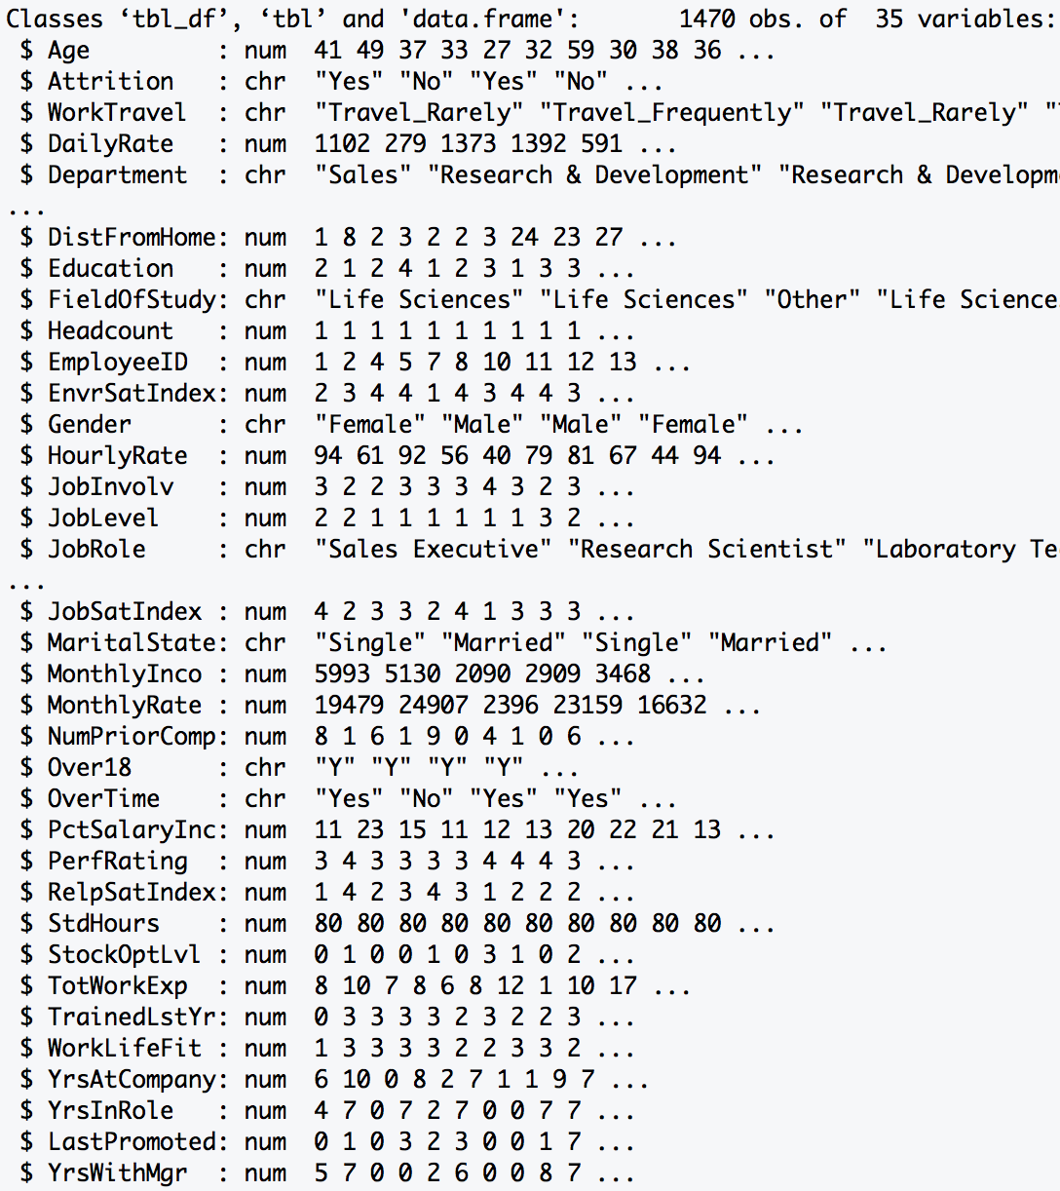
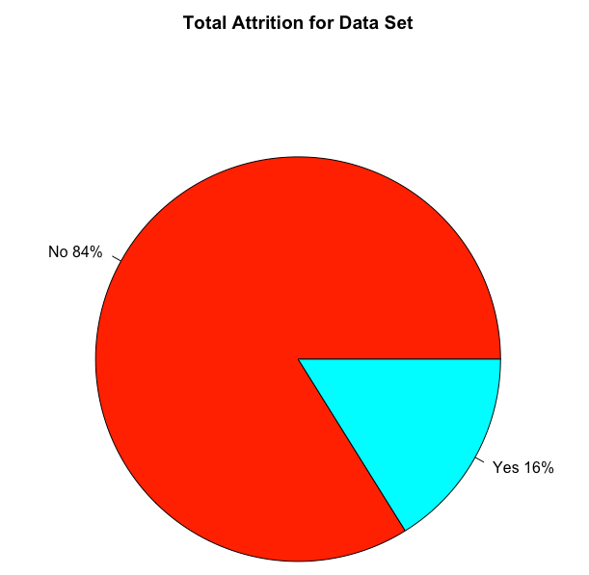
Data Source
Summary: The dataset provided required minimal tidying. There was no missing data (i.e. NA). It
included both personal and professional data on employee from various departments.
Data Dimension
Total Observations: 1470
Total Variables : 35
Data Class Type
Numeric : 25
Character : 10
1233
Length > 12 Variables
23
237
Excluded Variables:
HeadCount, EmployeeID, Over18, StdHours

Slide 5
Data Source/DEMOGRAPHICS
Include a few more pictures and graphs of our EDA and descriptive statistics on this slide- match the rmd

Slide 6
Methodology – ALGORITHMS Considered
Random Forest
Logistics Regression
Conditional Random Forest
RAJAT TO ADD CONTENT ON THE DIFFERENCES, STRENGTHS, AND WEAKNESSES
OF EACH METHOD

Slide 7

Methodology – Conditional Random Forest
Prediction Score: 85.79%
Both Conditional Random Forest (and Logistic Regression) confirm the following top 3 factors:
RAJAT TO ADD ANOTHER CHART
OR INFOGRAPHIC OF SORT

Slide 8
Top 7 Factors FOR Attrition
Does this need updating?
 | Min. | 1st Qu. | Median | Mean | 3rd Qu. | Max.
Monthly Income | 1009.00 | 2911.00 | 4919.00 | 6502.93 | 8379.00 | 19999.00
Age | 18 | 30 | 36 | 36.9 | 43 | 60
Distance From Home | 1 | 2 | 7 | 9.19 | 14 | 29
Percent Salary Increase | 11 | 12 | 14 | 15.2 | 18 | 25
Total Work Experience | 0 | 6 | 10 | 11.3 | 15 | 40
Years at Company | 0 | 3 | 5 | 7.01 | 9 | 40
Number of Prior Comapany | 0 | 1 | 2 | 2.69 | 4 | 9

Slide 9
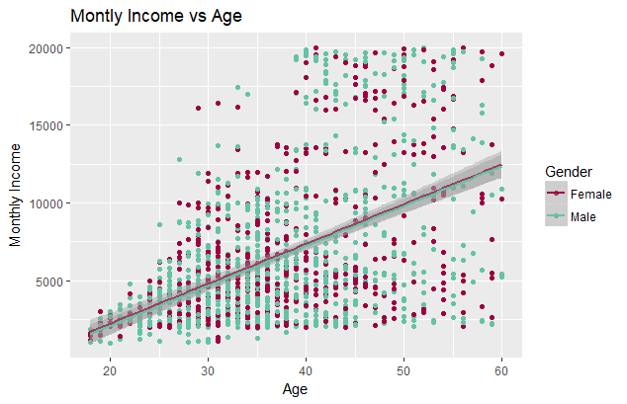
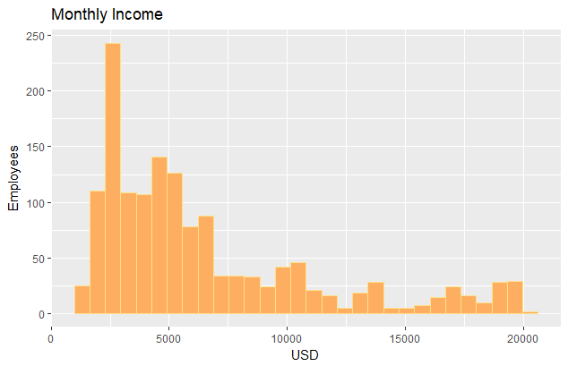
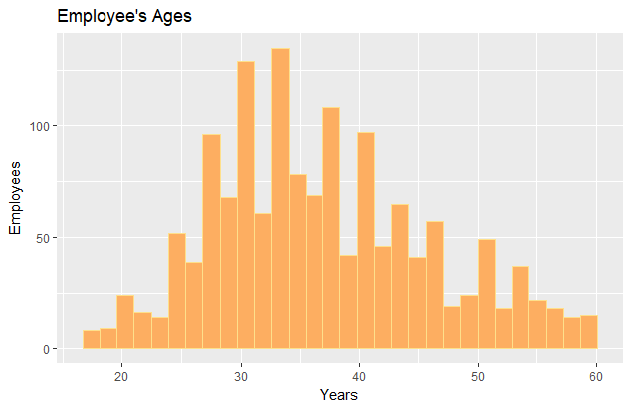
Monthly income and age
Employees’ income is very left skewed.
Employees’ age is normally distributed.
Males: For every 1 year increase in age there is a $256.70 increase in the average monthly income( R² of 0.2424).
Females: For every 1 year increase in age there is a $255.74 increase in the average monthly income (R² of 0.2547).

Slide 10
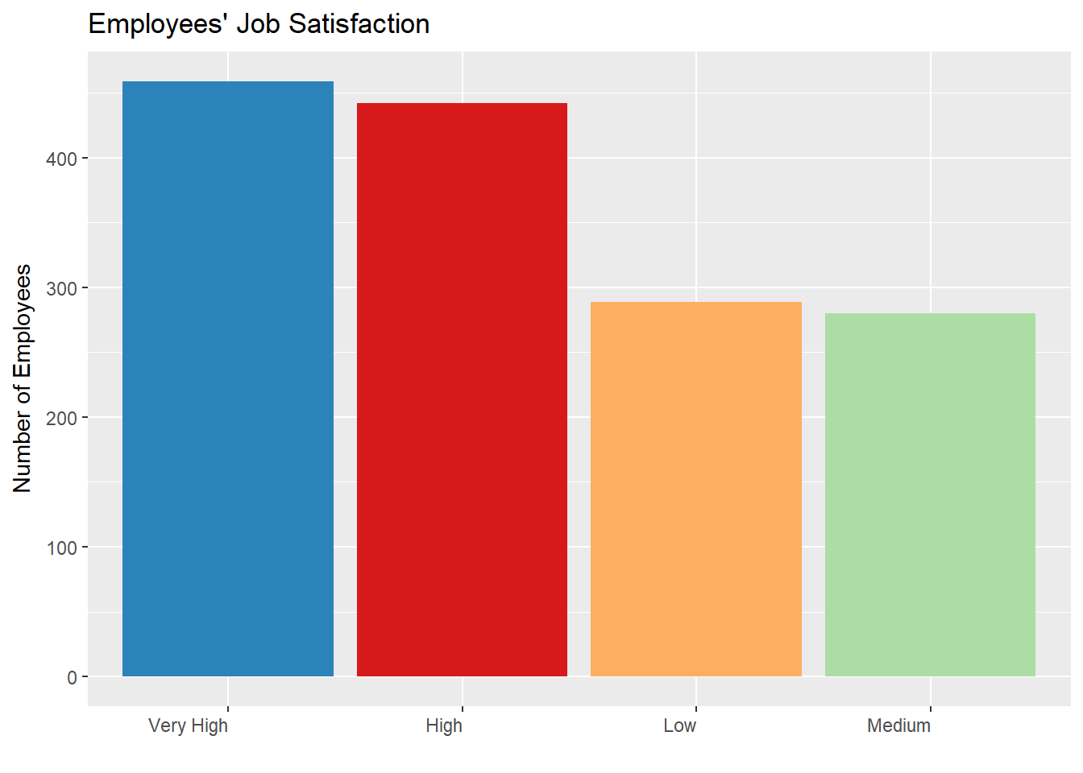
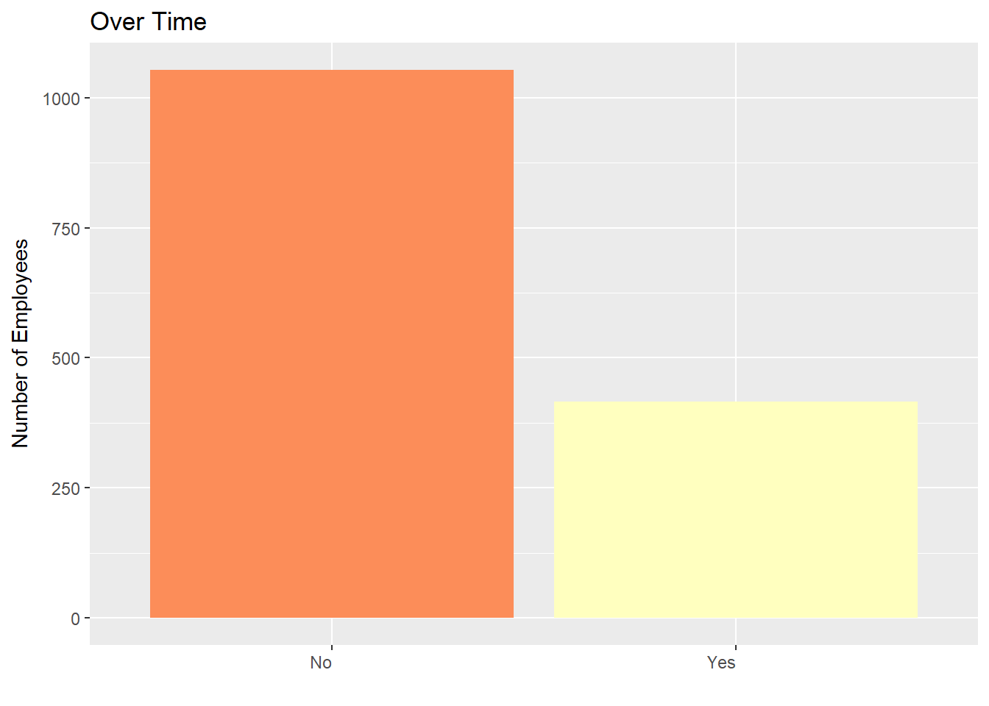
Top Two Factors Attributed to Company’s Attrition
Does this need updating?

Slide 11
Life Satisfaction
**Jodi Will enter visual here by noon Monday (promise!). I will be looking at Those that worked overtime against Work Life balance self reporting. ☺

Slide 12
Other findings
“Tell me about any job role specific trends that may exist in the data set”

Slide 13
How to mitigate attrition
**Content in Progress (by Jodi) – feel free to add. I will finalize Monday morning!
We recommend that the HR team further review…….
Stock Options…
Job Role…
Overtime…
Make sure this conclusion and the conclusion in the rmd match.

Slide 14
CURIOUS? WANT TO LEARN MORE?
The data, and information on our code, our full report, and our methods can be found online at:
https://github.com/R-Chandna/MSDS6306_CaseStudy_2.git

Slide 15
Questions?
Thank you for your time today!

