Slide 1
Reduce Attrition strategy for DDSAnalytics
Team TAJAR : Tori Wheelis, Andy Ho,
Jodi Pafford, An Nguyen, Rajat Chandna
August 7, 2018

Slide 2
Introduction
Attrition comes as a high cost to companies. The cost of interviewing, training, productivity, and negative impacts on morale are just a few.
Employee Benefit News (EBN) reports that it costs employers 33% of a worker's annual salary to hire a replacement if that worker leaves. In dollar figures, the replacement cost is $15,000 per person for an employee earning a median salary of $45,000 a year, according to the Work Institute’s 2017 Retention Report.
The study of 34,000 respondents concluded that 75% of the causes of employee turnover are preventable.
This report will focus on the following based on our analysis:
The top 3 factors that contribute to attrition
Methodology
Job role-specific and general trends
Recommendations to mitigate attrition

Slide 3
Agenda
Introduction/Business Objectives
Data Source/Demographics
Methodology
Evaluation/Results
Summary

Slide 4
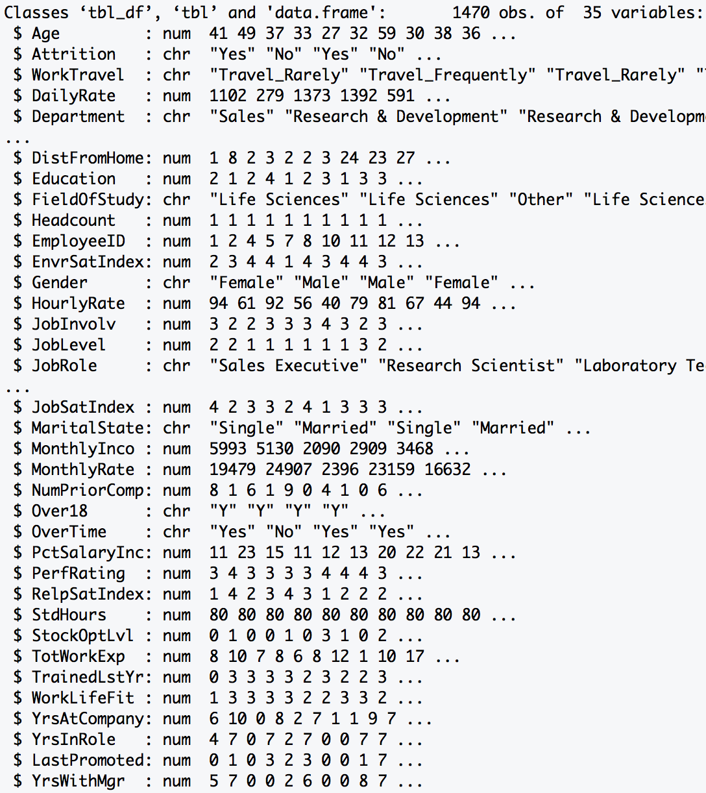
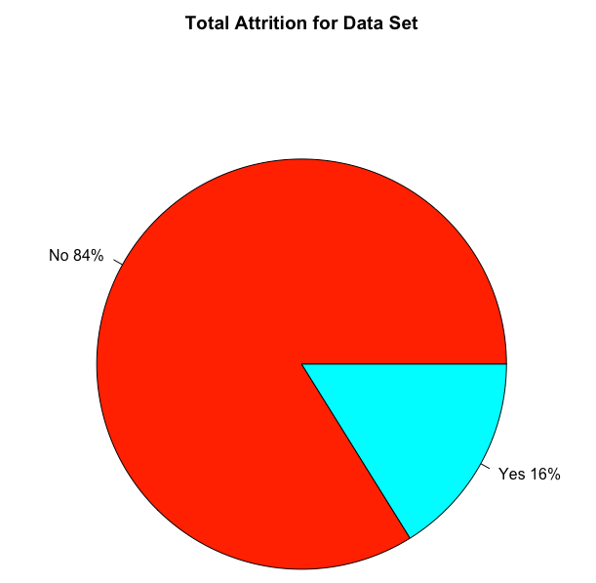
Data Source
Summary: The dataset provided required minimal tidying. There was no missing data (i.e. NA). It
included both personal and professional data on employee from various departments.
Data Dimension
Total Observations: 1470
Total Variables : 35
Data Class Type
Numeric : 25
Character : 10
1233
Length > 12 Variables
23
237
Excluded Variables:
HeadCount, EmployeeID, Over18, StdHours

Slide 5
Data Demographics
Gender
Males: 882
Females: 588
Departments
Human Resources with 63 employees
Research & Development with 961 employees
Sales with 446 employees.
Job Roles
Healthcare Representative
Human Resources
Laboratory Technician
Manager
Manufacturing Director
Research Director
Research Scientist
Sales Executive
Sales Representative

Slide 6
Top Three factors Attributed to Company’s Attrition
Monthly Income
Overtime
Age
The above are the top three in no specific order or ranking. Though it may subjectively seem obvious,
we will spend some time explaining our methodology. It was constructively discussed and debated amongst the team to insure we present the best probable outcome.

Slide 7
Methodology – ALGORITHMS Considered
Random Forest
Builds multiple decision trees and merges
Used OOB obs. for model validation
Conditional Random Forest
Variant of RF by putting various weight on leaf nodes
Produces more unbiased trees
Logistics Regression
Estimates the parameters with binary dependent variable
Non-parametric method
Huge computational resources needed
Cannot model complexity with ease
A parametric method hence inference depends upon fulfilment of model assumptions.
Non-parametric method
Low chances of overfitting as large no. of Obs. in dataset
We started with Random Forest and continued to CRF and Logistics Regression to confirm whether the factors causing attrition were similar between the models.

Slide 8
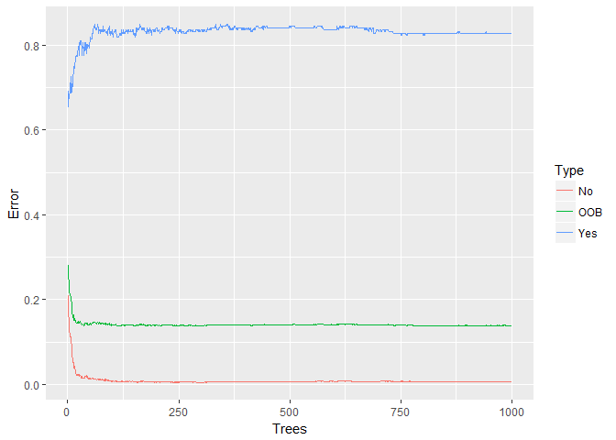
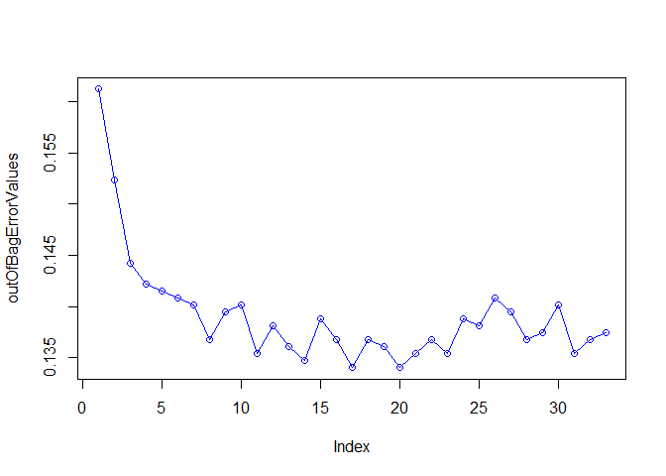
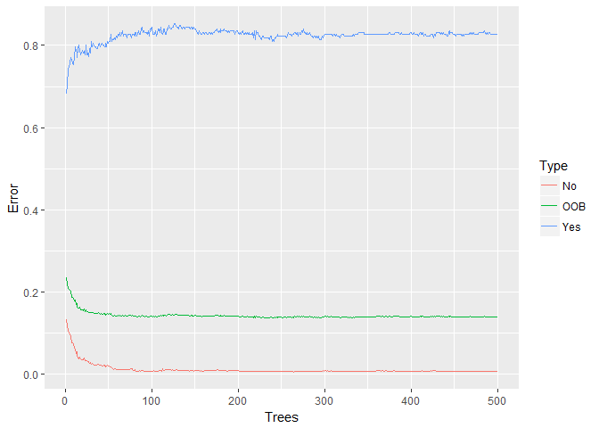
Tuning the Random Forest Algorithm
1000 Trees in Forest were no better than 500 Trees for our Model
In Pursuit of mtry value that results in lowest OOB Error
mtry = 17 yields lowest Out Of Bag error for

Slide 9
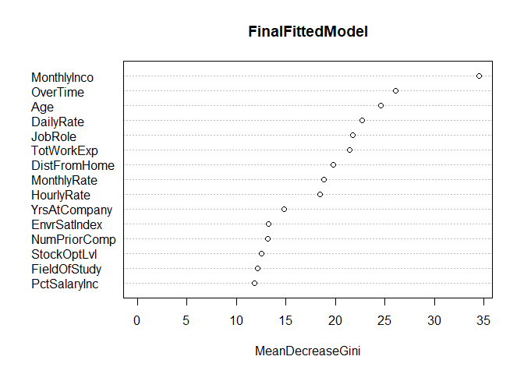

Methodology – Random Forest CONDITIONAL RANDOM FOREST
Random Forest
Accuracy: 86.46% | Out-Of-Bag Error Rate: 13.54 %
Conditional Random Forest
Accuracy: 85.85%
Both Random Forest and Conditional confirm similar factors that causes attrition

Slide 10
Examples Factors provided by Employees
 | Min. | 1st Qu. | Median | Mean | 3rd Qu. | Max.
Monthly Income | 1009.00 | 2911.00 | 4919.00 | 6502.93 | 8379.00 | 19999.00
Age | 18 | 30 | 36 | 36.9 | 43 | 60
Distance From Home | 1 | 2 | 7 | 9.19 | 14 | 29
Percent Salary Increase | 11 | 12 | 14 | 15.2 | 18 | 25
Total Work Experience | 0 | 6 | 10 | 11.3 | 15 | 40
Years at Company | 0 | 3 | 5 | 7.01 | 9 | 40
Number of Prior Company | 0 | 1 | 2 | 2.69 | 4 | 9
Most of the reported data are appropriately spread out and there are no unusually large or small values. As mentioned, four parameters were removed (i.e. Over18, EmployeeID, Headcount, StdHours) since the values were invalid for prediction model.

Slide 11
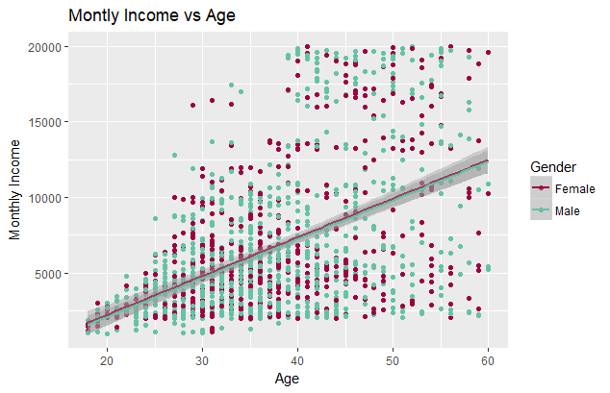
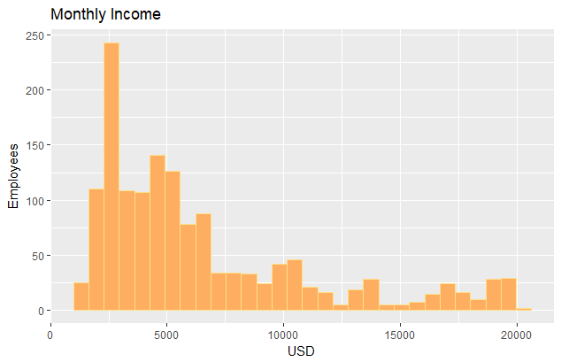
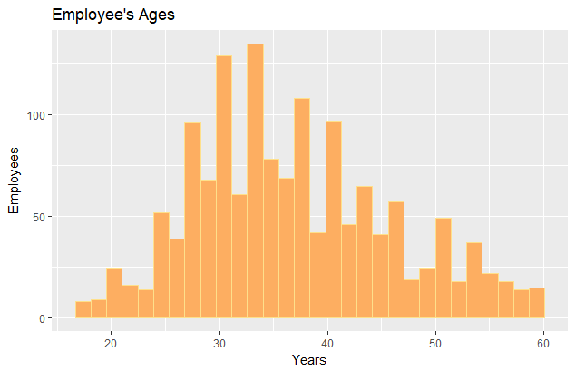
Monthly income and age
Employees’ income is very left skewed.
Employees’ age is normally distributed.
Males: For every 1 year increase in age there is a $256.70 increase in the average monthly income( R² of 0.2424).
Females: For every 1 year increase in age there is a $255.74 increase in the average monthly income (R² of 0.2547).

Slide 12
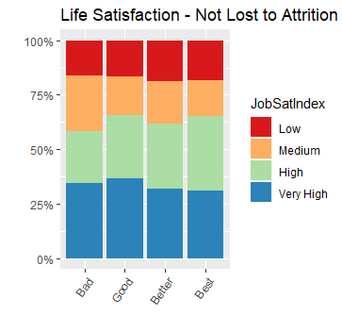
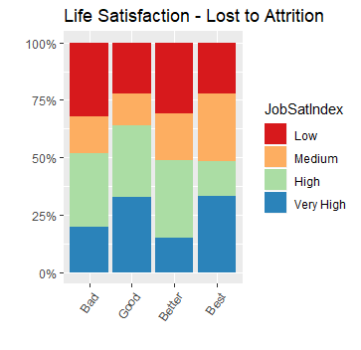
Life Satisfaction
Most employees who stay at the company feel satisfied with their role, even if they feel they don’t have a great Work-Life Balance.
Even with the a self-reported Job Satisfaction Rating at “Very High”, there is still a great loss due to attrition when they are self-reporting a Work-Life Balance of “Bad” or even “Good”.

Slide 13
Other findings- Monthly Income and Job Role
Job Role | Total Number | Number that Left | Attrition Rate | Monthly Income | Average Income
Sales Representative | 83 | 33 | 40% | 2626 | 31,512
Lab. Tech. | 259 | 62 | 24% | 3237 | 38,844
Human Resources | 52 | 12 | 23% | 4236 | 29,232
Sales Executive | 326 | 57 | 17.5% | 6924 | 83,088
Research Scientist | 292 | 47 | 16% | 3240 | 38,880
Manufacturing Director | 145 | 10 | 7% | 7295 | 87,540
Healthcare Rep. | 131 | 9 | 6.9% | 7529 | 90,348
Manager | 102 | 5 | 5% | 17182 | 206,184
Research Director | 80 | 2 | 2.5% | 16034 | 192,408
When separated by Job Role, whether an employee worked overtime did not significantly predict attrition, however, the lower the income, the higher the attrition rate, even when separated by Job Role.

Slide 14
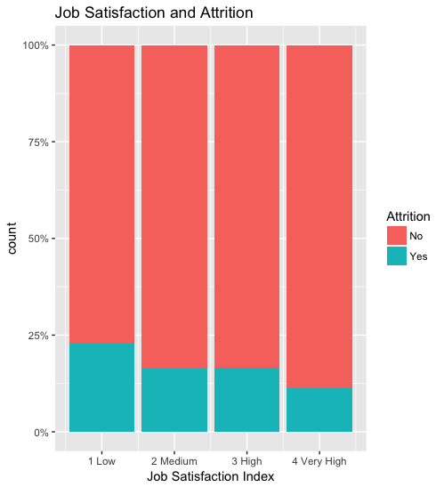
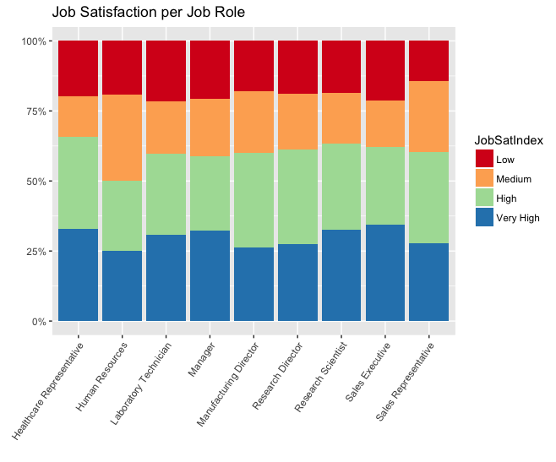
Job Role and Job Satisfaction
Job roles flagged for high attrition were Sales Representatives, Research Scientists, and non-manager Human Resource employees.
Sales department
20.6%
Human Resources 19.0%
Research Develop 13.8%
Apart from HR, the Job Satisfaction per job role remained constant. It would appear that overall, job satisfaction does not have an impact on attrition, except in one notable case.

Slide 15
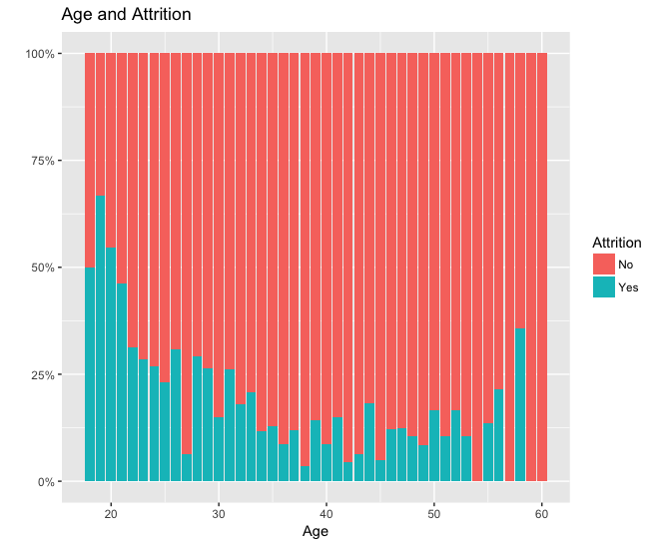
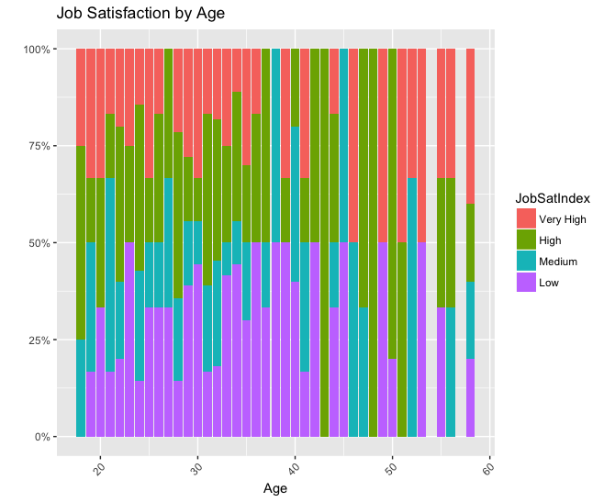
Other findings: Job Satisfaction and Age
Upon closer inspection, while younger employees (18-21 specifically) have a higher attrition, those who left between the ages of 18-21 also have a higher Job Satisfaction Index rating, so they are happier with their jobs.

Slide 16
How to mitigate attrition
Monthly Income
Across the board, an employee’s income weighs heavily on attrition but not entirely practical or financially feasible DDSAnalytics.

Slide 17
Ways to Prevent Turnover
Compensation
Reduce Overtime
Re-evaluate standard working hours
Possibly allow employees to set own hours
Age
Review internal practices for younger employees
Initiate programs to keep them engaged and feel valued
Consider adding other incentives to provide employee more stability
Emphasis on employee appreciation and value

Slide 18
Reference and Conclusion
The data, and information on our code, our full report, and our methods can be found online at:
https://github.com/R-Chandna/MSDS6306_CaseStudy_2.git
Questions?
Thank you for your time today!

