Slide 1
Reduce Attrition strategy
TAJAR Inc : Tori, Andy, Jodi, An, Rajat
August 7, 2018

Slide 2
Agenda
Business Objectives
Data Sourced
Methodology
Evaluation/Results
Summary

Slide 3
Business Objectives

Slide 4
Introduction
Attrition comes as a high cost to companies. The cost of interviewing, training, productivity, and negative impacts on morale are just a few.
This report will focus on the following based on our analysis:
The top 3 factors that contribute to attrition
Job role specific trends
Recommendations to mitigate attrition

Slide 5
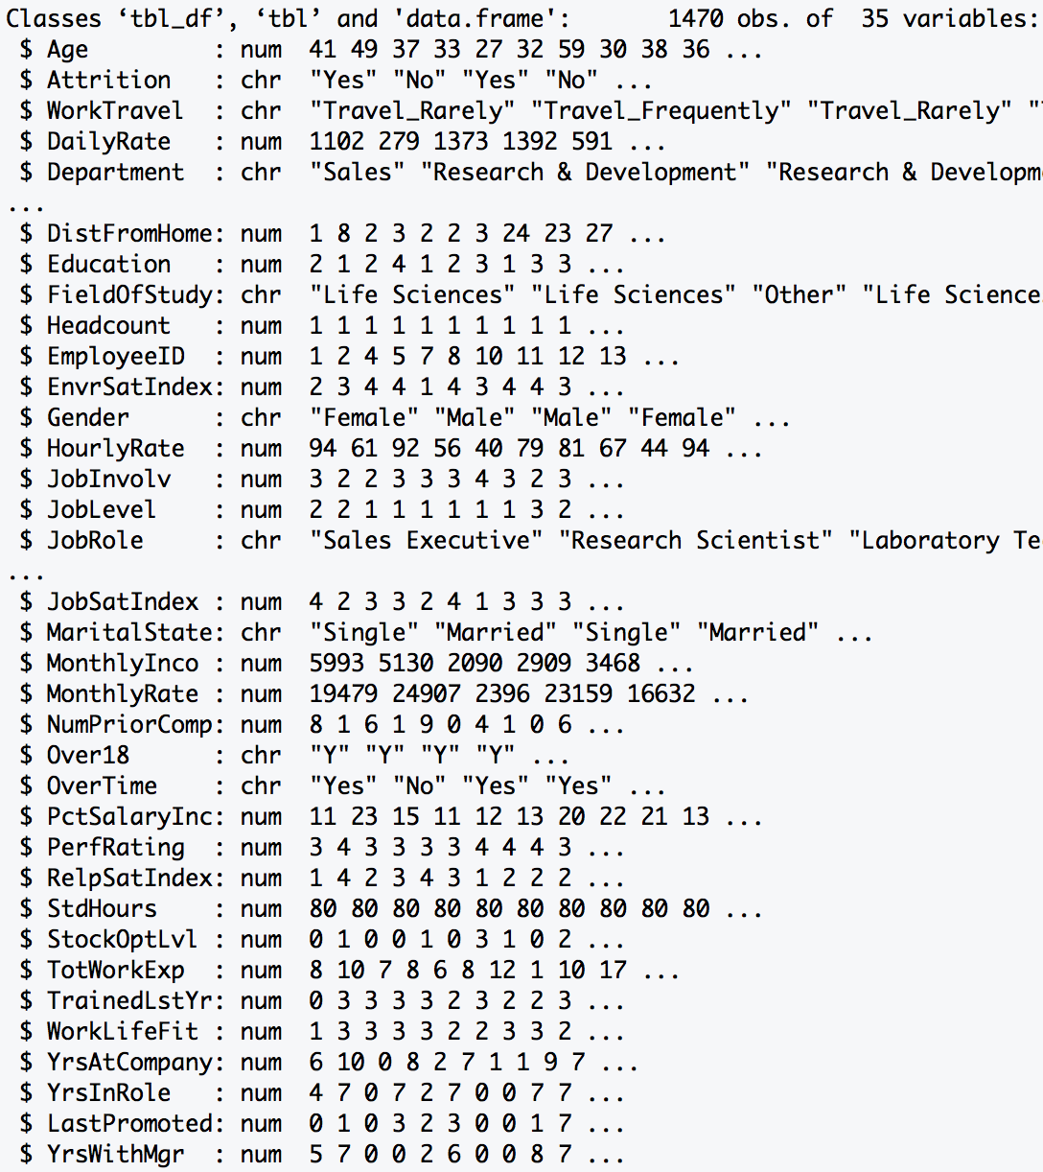
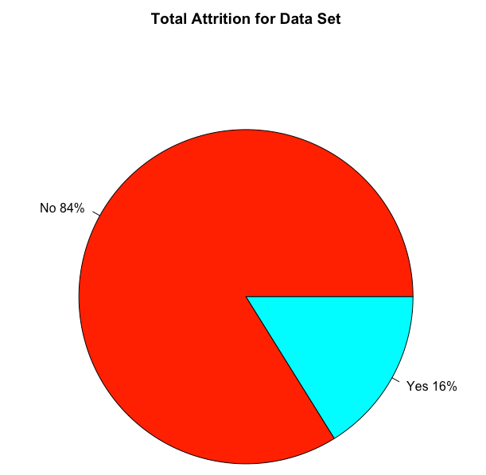
Data Source
Summary: The dataset provided required minimal tidying. There was no missing data (i.e. NA). It
included both personal and professional data on employee from various departments.
Data Dimension
Total Observations: 1470
Total Variables : 35
Data Class Type
Numeric : 25
Character : 10
1233
Length > 12 Variables
23
237
Excluded Variables:
HeadCount, EmployeeID, Over18, StdHours

Slide 6
Methodology – Random Forest
RAJAT to provide content

Slide 7
Top 7 Factors of Attrition
 | Min. | 1st Qu. | Median | Mean | 3rd Qu. | Max.
Monthly Income | 1009.00 | 2911.00 | 4919.00 | 6502.93 | 8379.00 | 19999.00
Age | 18 | 30 | 36 | 36.9 | 43 | 60
Distance From Home | 1 | 2 | 7 | 9.19 | 14 | 29
Percent Salary Increase | 11 | 12 | 14 | 15.2 | 18 | 25
Total Work Experience | 0 | 6 | 10 | 11.3 | 15 | 40
Years at Company | 0 | 3 | 5 | 7.01 | 9 | 40
Number of Prior Comapany | 0 | 1 | 2 | 2.69 | 4 | 9
for every 1 year increase in age for males there is a 256.70 dollars increase in monthly income with an r2 of 0.2424 and for every 1 year increase in age for females there is a 255.74 dollars increase in monthly income with an r2 of 0.2547

Slide 8
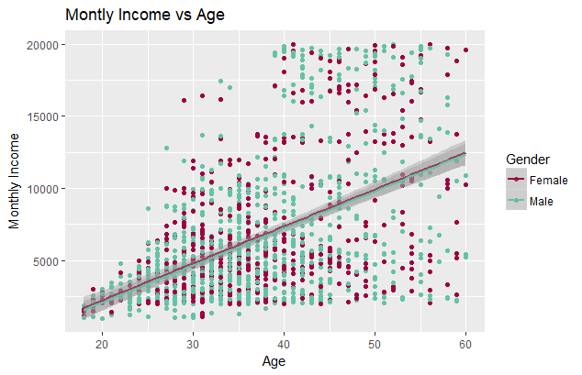
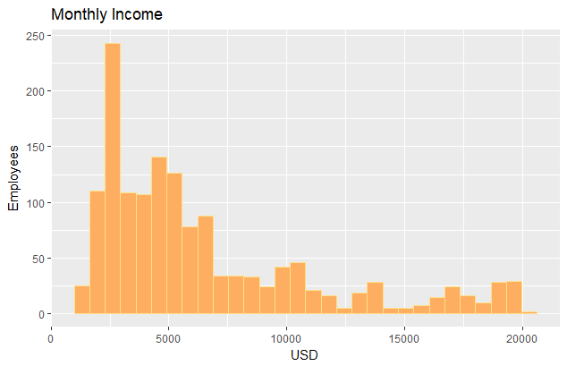
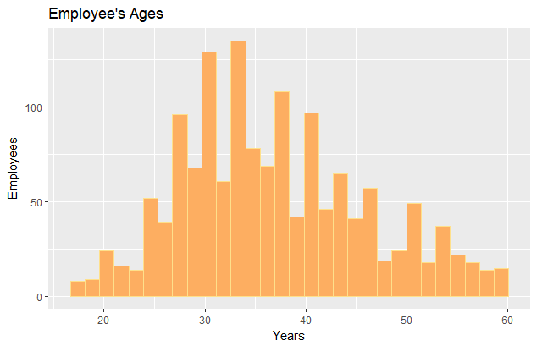
Relationships of the first two Factors
Employees’ income is very left skewed.
Employees’ age is normally distributed.
For every 1 year increase in age for males there is a 256.70 dollars increase in monthly income with an r2 of 0.2424 and or every 1 year increase in age for females there is a 255.74 dollars increase in monthly income with an r2 of 0.2547

Slide 9
How to mitigate attrition
Whole Team Provides content

Slide 10
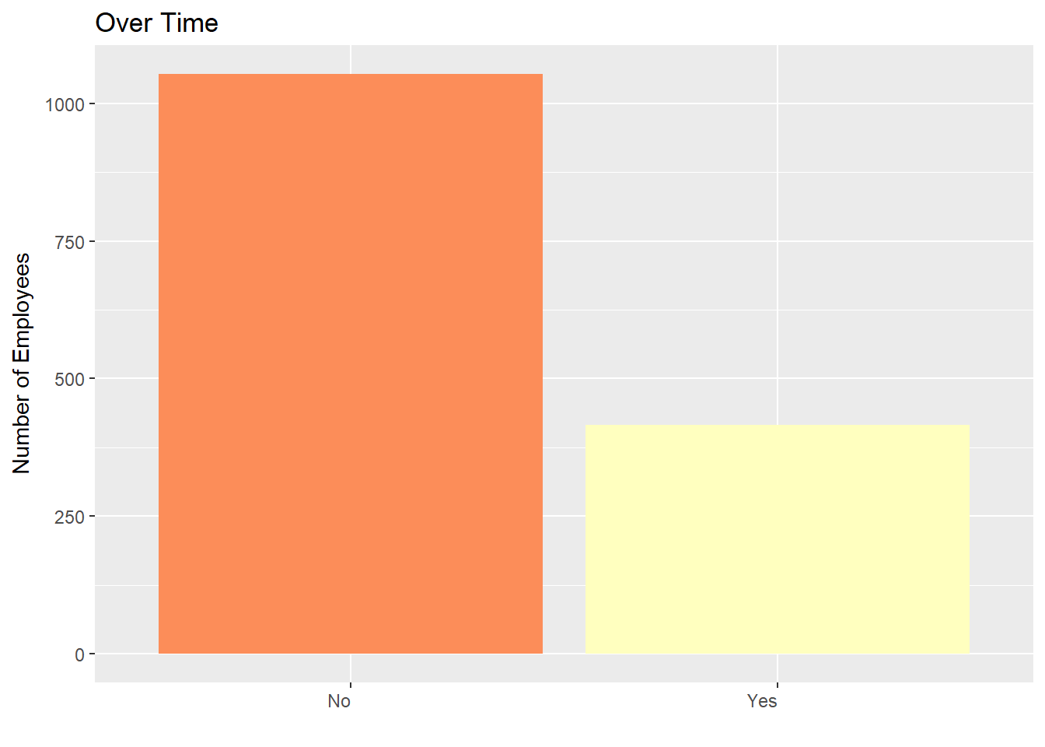
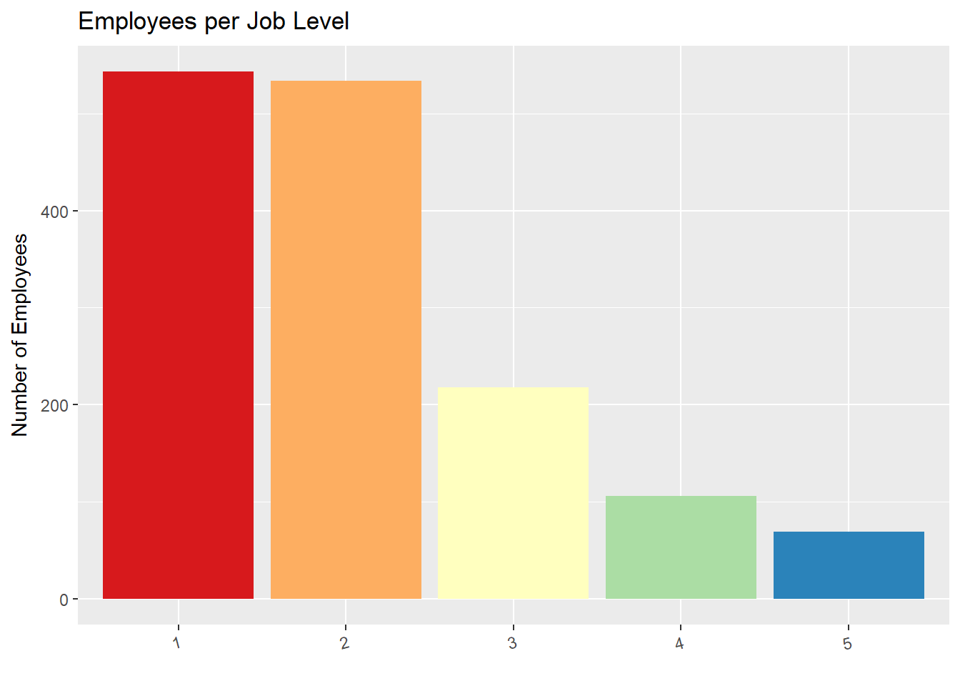
Top Two Factors Attributed to Company’s Attrition

Slide 11
Other findings
Tell me about any job role specific trends that may exist in the data set

Slide 12
Questions?
Thank you for your time today!

