Slide 1
Reduce Attrition strategy
TAJAR Inc : Tori, Andy, Jodi, An, Rajat
August 7, 2018

Slide 2
Agenda
Introduction/Business Objectives
Data Source/Demographics
Methodology
Evaluation/Results
Summary

Slide 3
Introduction
Attrition comes as a high cost to companies. The cost of interviewing, training, productivity, and negative impacts on morale are just a few.
This report will focus on the following based on our analysis:
The top 3 factors that contribute to attrition
Methodology
Job role-specific and general trends
Recommendations to mitigate attrition

Slide 4
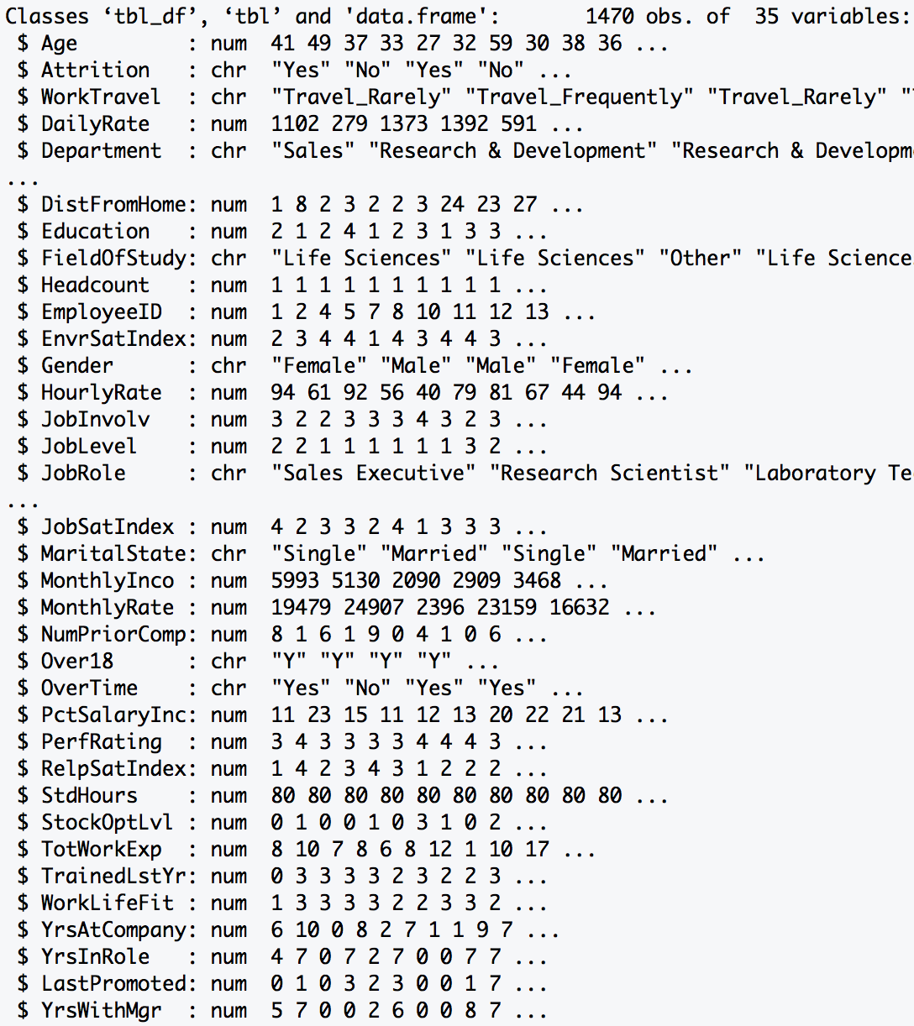
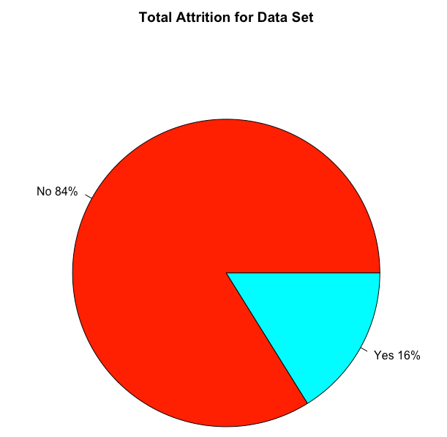
Data Source
Summary: The dataset provided required minimal tidying. There was no missing data (i.e. NA). It
included both personal and professional data on employee from various departments.
Data Dimension
Total Observations: 1470
Total Variables : 35
Data Class Type
Numeric : 25
Character : 10
1233
Length > 12 Variables
23
237
Excluded Variables:
HeadCount, EmployeeID, Over18, StdHours

Slide 5
Data Source/DEMOGRAPHICS
Gender:
Males: 882
Females: 588
Departments:
Human Resources with 63 employees
Research & Development with 961 employees
Sales with 446 employees.
Job Roles:
Healthcare Representative
Human Resources
Laboratory Technician
Manager
Manufacturing Director
Research Director
Research Scientist
Sales Executive
Sales Representative

Slide 6
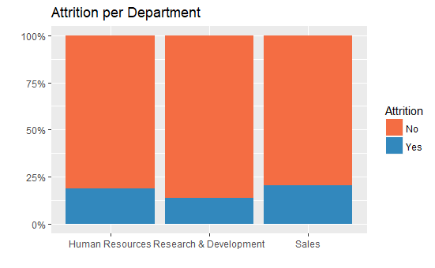
Out of 1470 employees 237 were loss due to attrition
Sales had the highest loss percentage (20.6%)

Slide 7
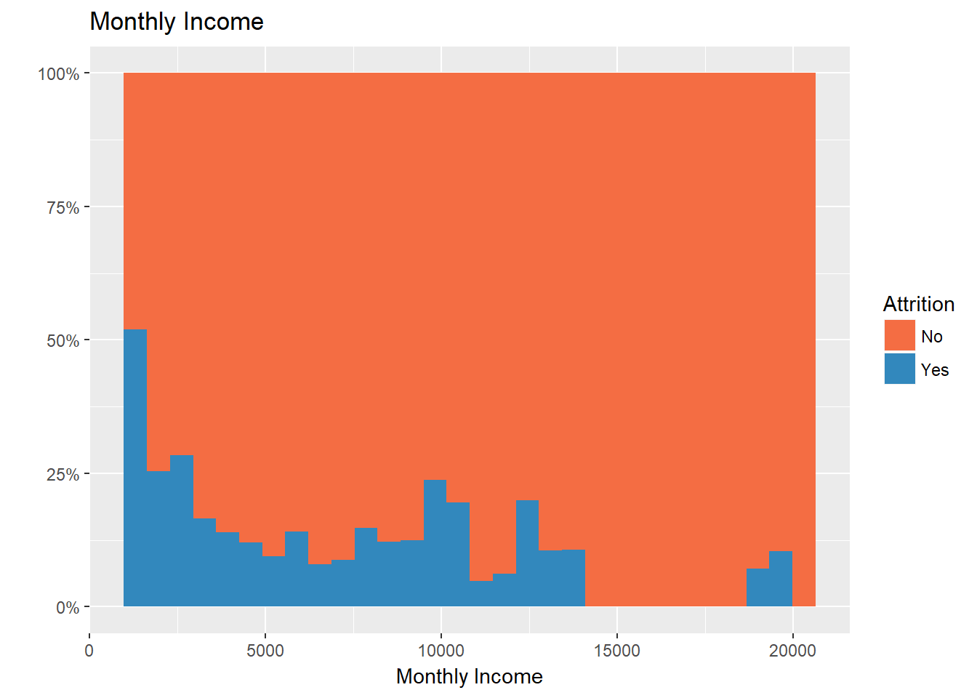
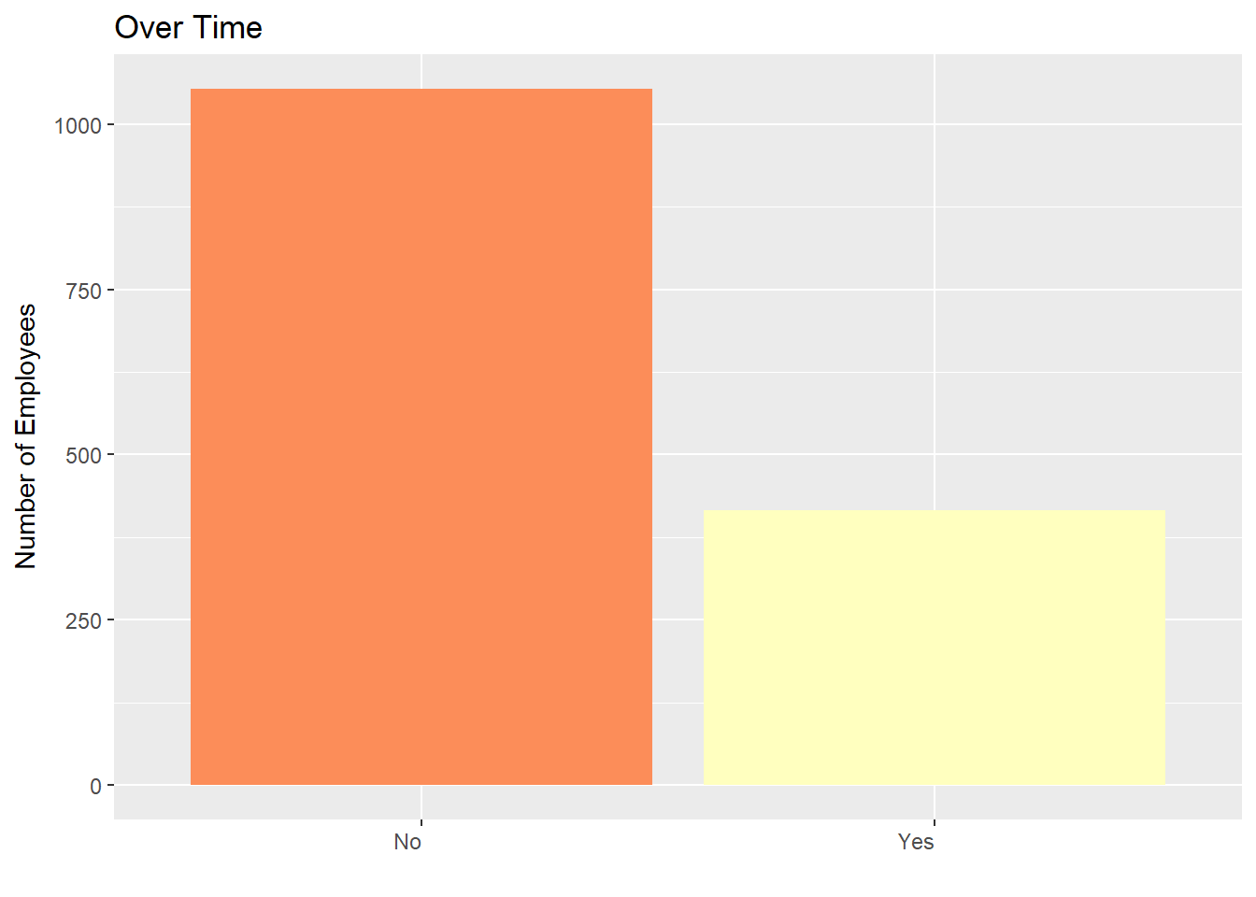
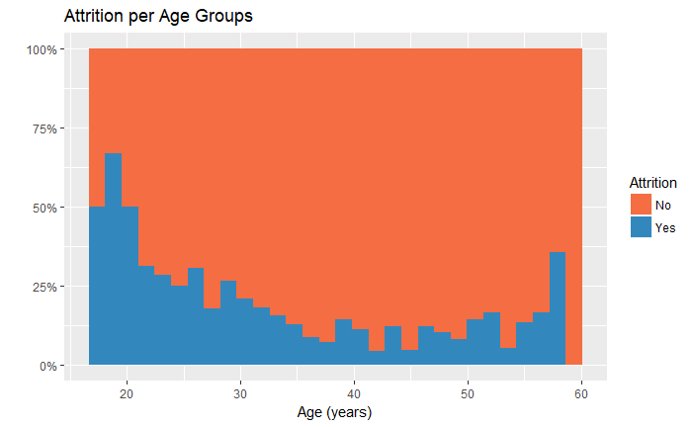
Top Three factors Attributed to Company’s Attrition

Slide 8
Methodology – ALGORITHMS Considered
Random Forest
Logistics Regression
Conditional Random Forest
RAJAT TO ADD CONTENT ON THE DIFFERENCES, STRENGTHS, AND WEAKNESSES
OF EACH METHOD

Slide 9
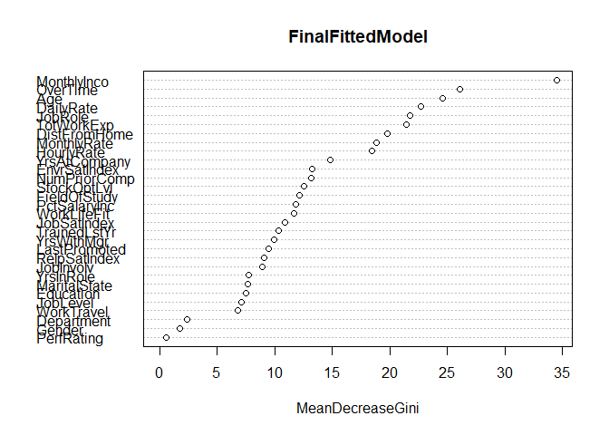
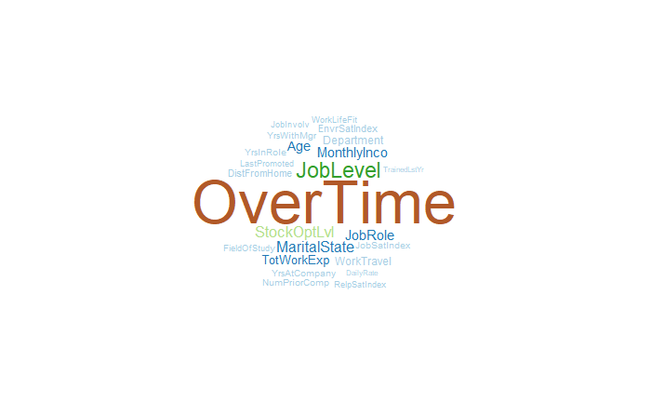
Methodology – Random Forest And CONDITIONAL RANDOM FOREST
Conditional Random Forest: Accuracy: 85.85%
Random Forest: Accuracy: 86.46%
Out-Of-Bag Error Rate: 13.54 %
Both Conditional Random Forest and Random Forest confirm the following top 3 factors:

Slide 10
Examples Factors provided by Employees
 | Min. | 1st Qu. | Median | Mean | 3rd Qu. | Max.
Monthly Income | 1009.00 | 2911.00 | 4919.00 | 6502.93 | 8379.00 | 19999.00
Age | 18 | 30 | 36 | 36.9 | 43 | 60
Distance From Home | 1 | 2 | 7 | 9.19 | 14 | 29
Percent Salary Increase | 11 | 12 | 14 | 15.2 | 18 | 25
Total Work Experience | 0 | 6 | 10 | 11.3 | 15 | 40
Years at Company | 0 | 3 | 5 | 7.01 | 9 | 40
Number of Prior Comapany | 0 | 1 | 2 | 2.69 | 4 | 9

Slide 11
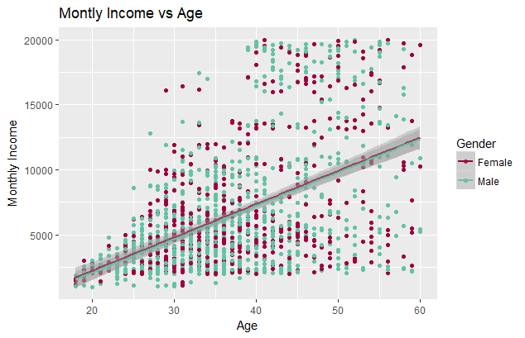
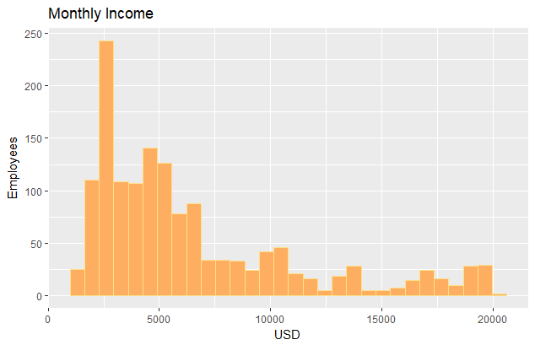
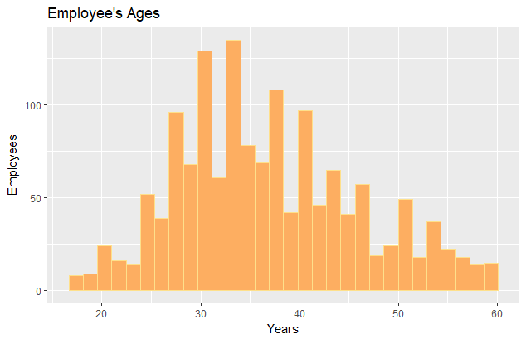
Monthly income and age
Employees’ income is very left skewed.
Employees’ age is normally distributed.
Males: For every 1 year increase in age there is a $256.70 increase in the average monthly income( R² of 0.2424).
Females: For every 1 year increase in age there is a $255.74 increase in the average monthly income (R² of 0.2547).

Slide 12
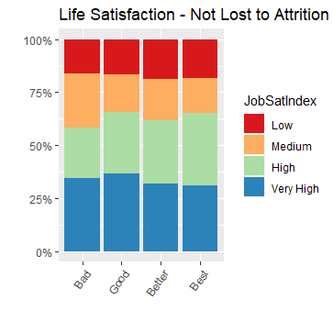
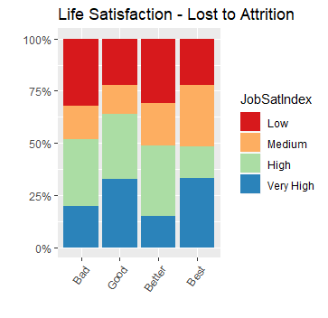
Life Satisfaction
Most employees who stay at the company feel satisfied with their role, even if they feel they don’t have a great Work-Life Balance.
Even with the a self-reported Job Satisfaction Rating at “Very High”, there is still a great loss due to attrition when they are self-reporting a Work-Life Balance of “Bad” or even “Good”.

Slide 13
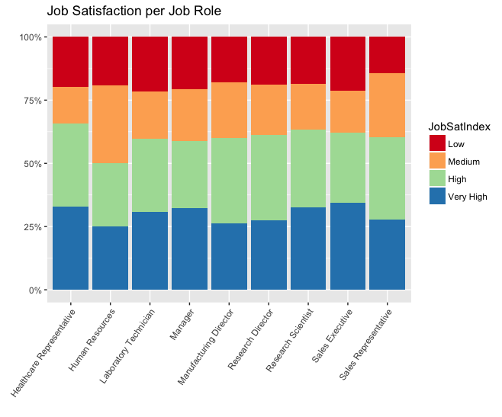
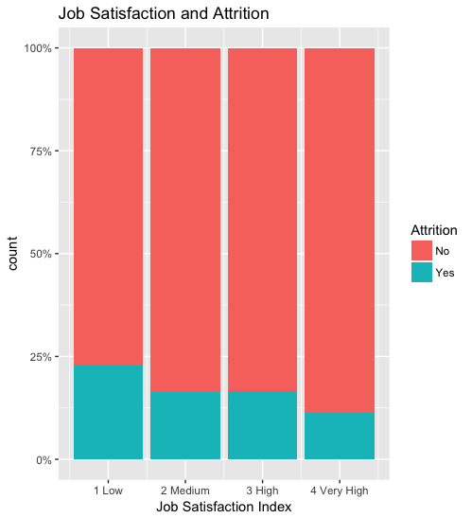
Job Role and job satisfaction
Job roles flagged for high attrition were Sales Representatives, Research Scientists, and non-manager Human Resource employees. Sales department lost ~20.6% employees, followed by Human Resources with a loss of ~19.0% and R&D with ~13.8%
Apart from HR, the Job Satisfaction per job role remained constant. It would appear that overall, job satisfaction does not have an impact on attrition, except in one notable case.

Slide 14
Other findings- Monthly Income and Job Role
Job Role | Total Number | Number that Left | Attrition Rate | Monthly Income | Average Income
Sales Representative | 83 | 33 | 40% | 2626 | 31,512
Lab. Tech. | 259 | 62 | 24% | 3237 | 38,844
Human Resources | 52 | 12 | 23% | 4236 | 29,232
Sales Executive | 326 | 57 | 17.5% | 6924 | 83,088
Research Scientist | 292 | 47 | 16% | 3240 | 38,880
Manufacturing Director | 145 | 10 | 7% | 7295 | 87,540
Healthcare Rep. | 131 | 9 | 6.9% | 7529 | 90,348
Manager | 102 | 5 | 5% | 17182 | 206,184
Research Director | 80 | 2 | 2.5% | 16034 | 192,408
When separated by Job Role, whether an employee worked overtime did not significantly predict attrition, however, the lower the income, the higher the attrition rate, even when separated by Job Role.

Slide 15
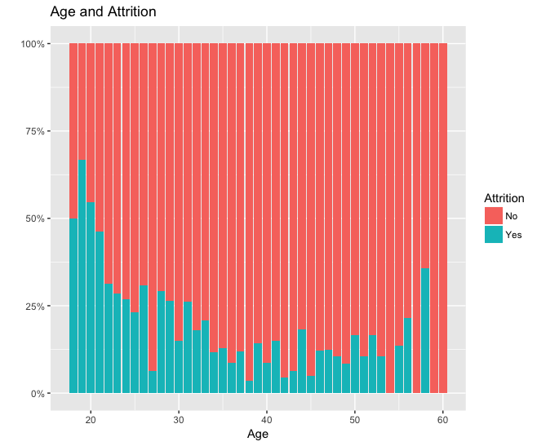
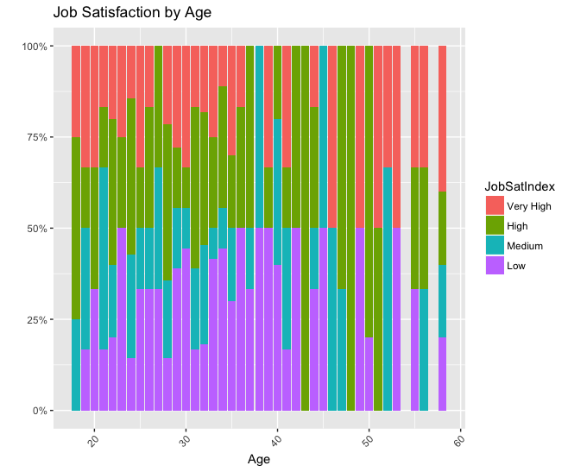
Other findings- job satisfaction and age
Upon closer inspection, while younger employees (18-21 specifically) have a higher attrition, those who left between the ages of 18-21 also have a higher Job Satisfaction Index rating, so they are happier with their jobs.

Slide 16

How to mitigate attrition
Monthly Income
But not practical…

Slide 17

How to mitigate attrition
Compensation – Can the company add other incentives, compensation, etc. other than additional income to make employees feel more valued and more stable financially?
Less overtime – Workers set own hours
Age – Look at your internal practices for younger employees. What are you doing to make them feel valued and keeping them engaged?
Exceptions – In the specific case, identify causes of dissatisfaction within HR and help alleviate burnout.

Slide 18
CURIOUS? WANT TO LEARN MORE?
The data, and information on our code, our full report, and our methods can be found online at:
https://github.com/R-Chandna/MSDS6306_CaseStudy_2.git
Questions?
Thank you for your time today!

