Slide 1
Reduce Attrition strategy
TAJAR Inc : Tori, Andy, Jodi, An, Rajat
August 7, 2018

Slide 2
Agenda
Introduction/Business Objectives
Data Source/Demographics
Methodology
Evaluation/Results
Summary

Slide 3
Introduction/OBJECTIVES
Attrition comes as a high cost to companies. The cost of interviewing, training, productivity, and negative impacts on morale are just a few.
This report will focus on the following based on our analysis:
The top 3 factors that contribute to attrition
Job role-specific and general trends
Recommendations to mitigate attrition

Slide 4
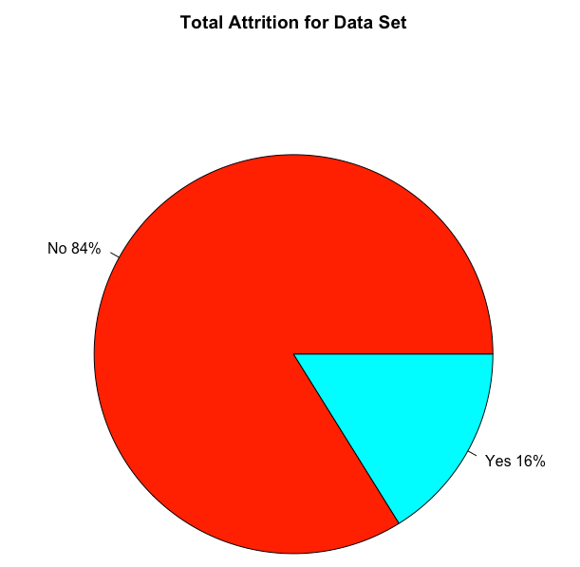
Data Source/DEMOGRAPHICS
Summary:
Self-report data from 1,470 employees from corporate office
Demographics, personal, and professional data
35 variables, including age, gender, job role, work-life balance, etc.
1233
Include a few more pictures and graphs of our EDA and descriptive statistics on this slide and the next- match the rmd
237

Slide 5
Data Source/DEMOGRAPHICS
Include a few more pictures and graphs of our EDA and descriptive statistics on this slide- match the rmd

Slide 6
Methodology – Random Forest
RAJAT to provide content- explain in plain language only, an “elevator pitch” of what random forest is and what it told us. Include the actual explanation in the rmd file.

Slide 7
Top 7 Factors FOR Attrition
Does this need updating?
 | Min. | 1st Qu. | Median | Mean | 3rd Qu. | Max.
Monthly Income | 1009.00 | 2911.00 | 4919.00 | 6502.93 | 8379.00 | 19999.00
Age | 18 | 30 | 36 | 36.9 | 43 | 60
Distance From Home | 1 | 2 | 7 | 9.19 | 14 | 29
Percent Salary Increase | 11 | 12 | 14 | 15.2 | 18 | 25
Total Work Experience | 0 | 6 | 10 | 11.3 | 15 | 40
Years at Company | 0 | 3 | 5 | 7.01 | 9 | 40
Number of Prior Comapany | 0 | 1 | 2 | 2.69 | 4 | 9

Slide 8
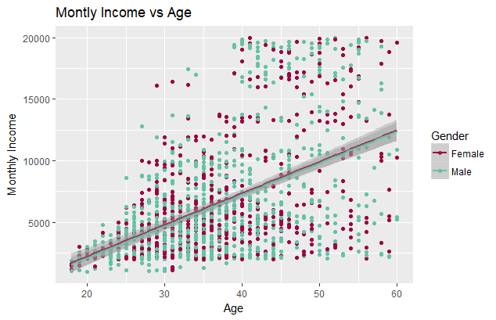
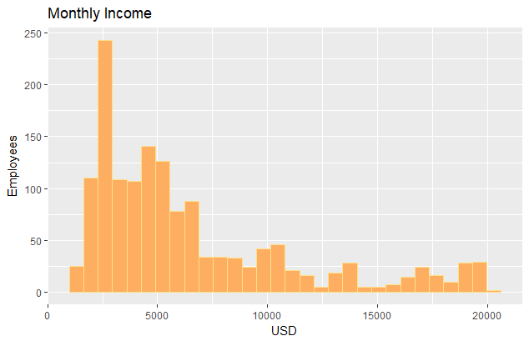
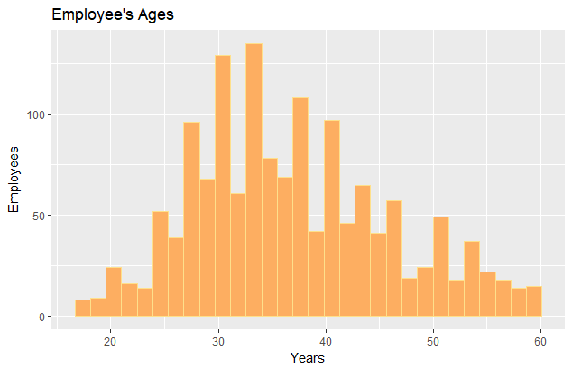
Monthly income and age
Employees’ income is very left skewed.
Employees’ age is normally distributed.
For every 1 year increase in age for males there is a $256.70 increase in the average monthly income( R² of 0.2424) and for every 1 year increase in age for females there is a $255.74 increase in the average monthly income (R² of 0.2547).

Slide 9
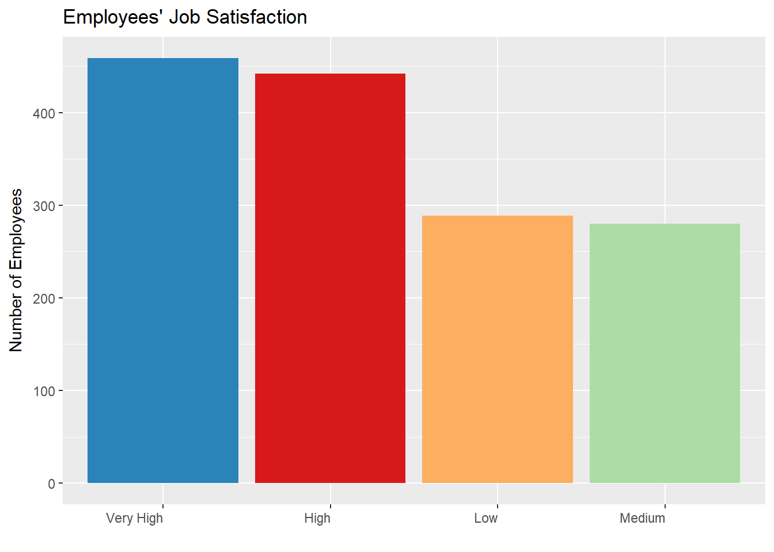
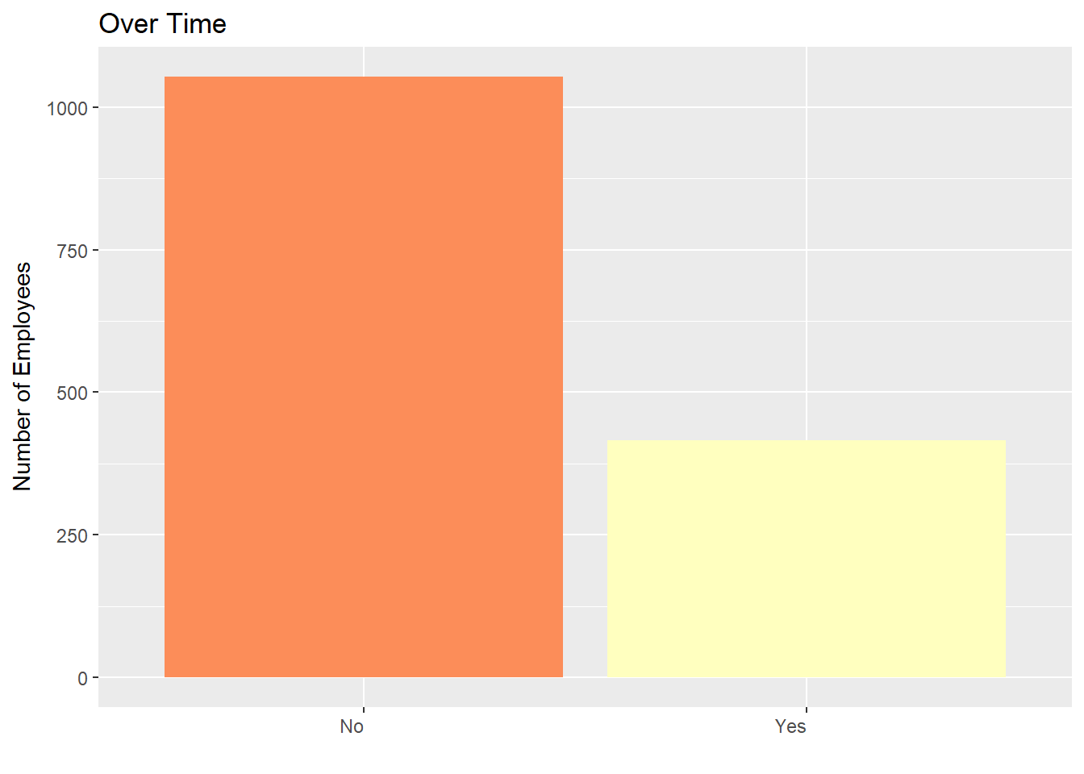
Top Two Factors Attributed to Company’s Attrition
Does this need updating?

Slide 10
Life Satisfaction
**Jodi Will enter visual here by noon Monday (promise!). I will be looking at Those that worked overtime against Work Life balance self reporting. ☺

Slide 11
Other findings
“Tell me about any job role specific trends that may exist in the data set”

Slide 12
How to mitigate attrition
**Content in Progress (by Jodi) – feel free to add. I will finalize Monday morning!
We recommend that the HR team further review…….
Stock Options…
Job Role…
Overtime…
Make sure this conclusion and the conclusion in the rmd match.

Slide 13
CURIOUS? WANT TO LEARN MORE?
The data, and information on our code, our full report, and our methods can be found online at:
https://github.com/R-Chandna/MSDS6306_CaseStudy_2.git

Slide 14
Questions?
Thank you for your time today!

