Slide 1
Analysis of the Closest Pair Problem
CSE 5717 – Big Data Analytics
Fall 2020
Ramon Chavarro & Kirk Heilman

Slide 2
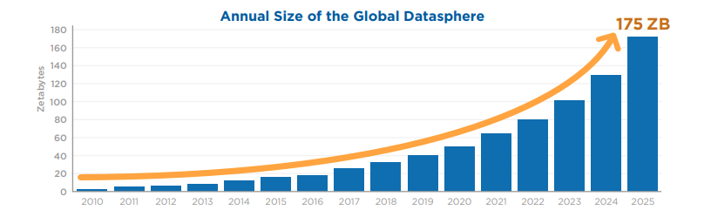
Problem Statement
The amount of data in the world is growing exponentially
As humans progress farther in the field of technology more powerful algorithms will need to be utilized to efficiently analyze large data sets
A classic problem in data science is the “Closest Pair Problem”. In a large 2-D plan of data, what are the two closest points and what is their distance?
Two popular algorithms will be tested & compared to find the more efficient one
In this case, the data the algorithms will be tested on is Starbucks Coffee Shop locations

Slide 3
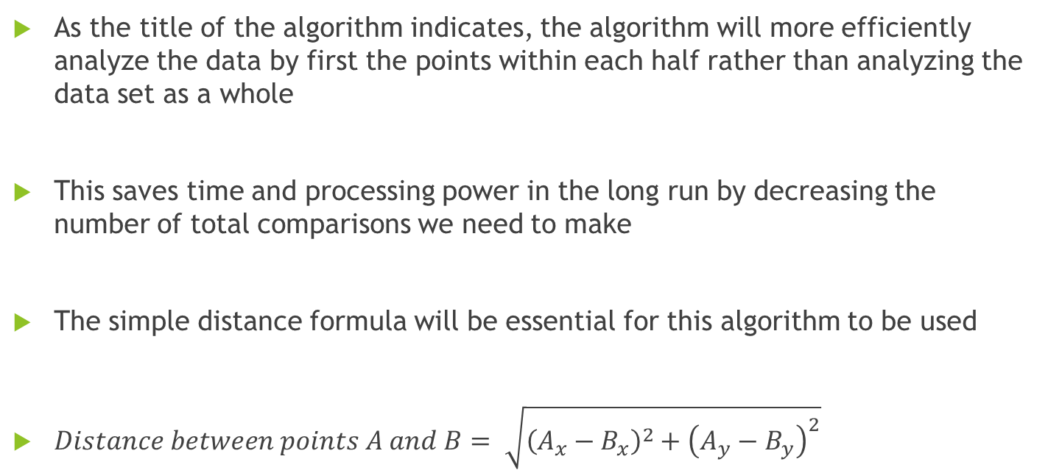
Algorithm #1: Divide & Conquer
As the title of the algorithm indicates, the algorithm will more efficiently analyze the data by first the points within each half rather than analyzing the data set as a whole
This saves time and processing power in the long run by decreasing the number of total comparisons we need to make
The simple distance formula will be essential for this algorithm to be used
$Distance between points A and B= \sqrt{{\left(A_{x}−B_{x}\right)}^{2}+{\left(A_{y}−B_{y}\right)}^{2}}$

Slide 4

Step 1: Divide the Data Set
We will assume the data set is sorted prior to the algorithm
We simply divide the data set into two parts to start
This is down in constant time, so the time complexity for this step is O(1)

Slide 5
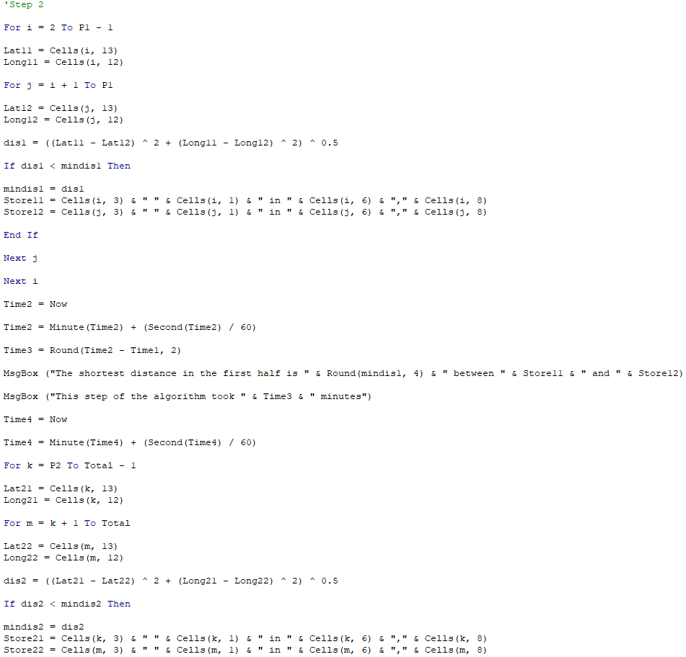
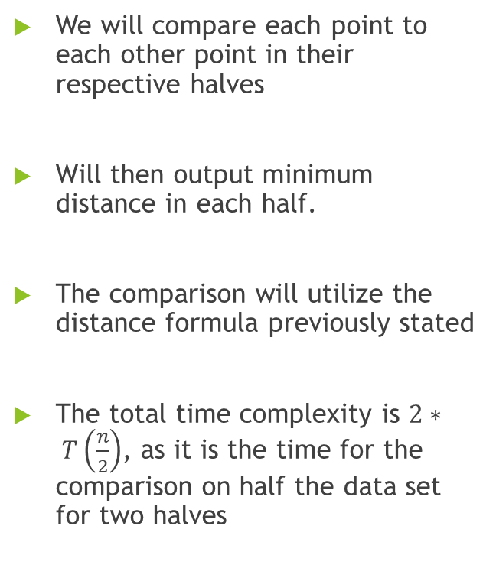
Step 2: Shortest distance in each half
We will compare each point to each other point in their respective halves
Will then output minimum distance in each half.
The comparison will utilize the distance formula previously stated
The total time complexity is $2∗ T\left(\frac{n}{2}\right)$, as it is the time for the comparison on half the data set for two halves

Slide 6
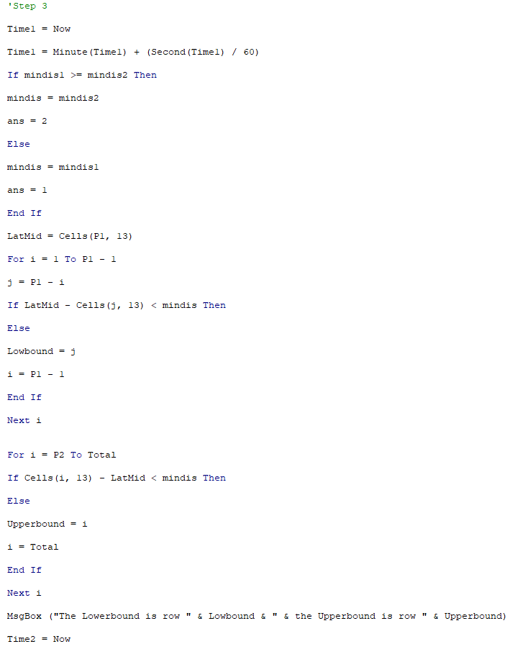
Step 3: Find bounds for final comparison
Using the minimum distance in each half we can find the new bounds for our final comparison
Starting from the median we will exclude any points that are more than our minimum distance in either direction
The total time complexity is O(n) since the worst case scenario is we need to look at every point from the median

Slide 7
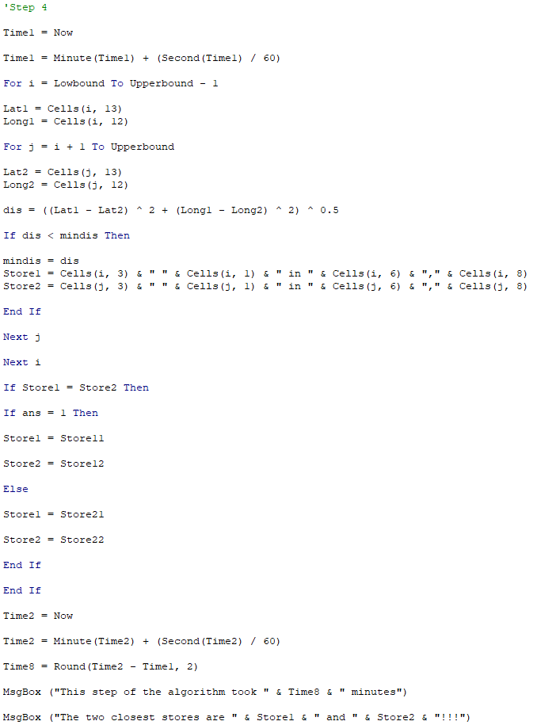
Step 4: Final comparison within new bounds
Using the new bounds, from the median we will repeat step 2 and output the two stores with the shortest distance
If the algorithm does not find a distance shorter than either minimum distance in either half, it will output the previously closest points
The total time complexity is O(n) since the worst case scenario is if our new bounds are 1 to the total data points, meaning we need to compare every point

Slide 8
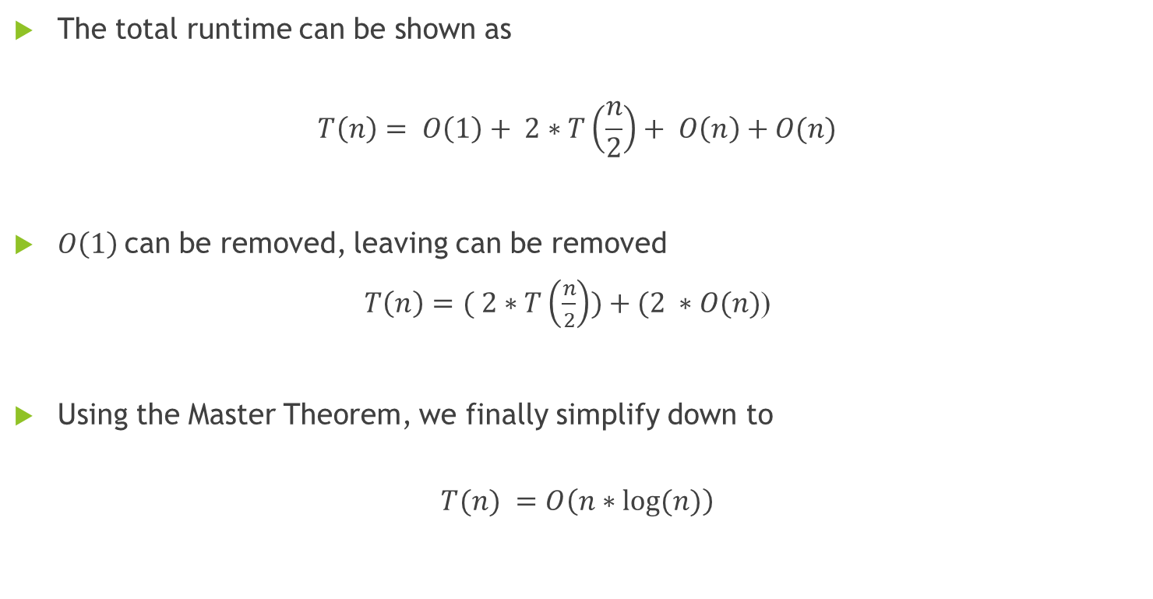
Total Time Complexity for D & C Algorithm
The total runtime can be shown as
$$T\left(n\right)= O\left(1\right)+ 2∗T\left(\frac{n}{2}\right)+ O\left(n\right)+O(n)$$
$O\left(1\right)$can be removed, leaving can be removed
$T\left(n\right)=( 2∗T\left(\frac{n}{2}\right))+(2 ∗O(n)$)
Using the Master Theorem, we finally simplify down to
$$T(n) =O\left(n∗\log{(n)}\right)$$

Slide 9
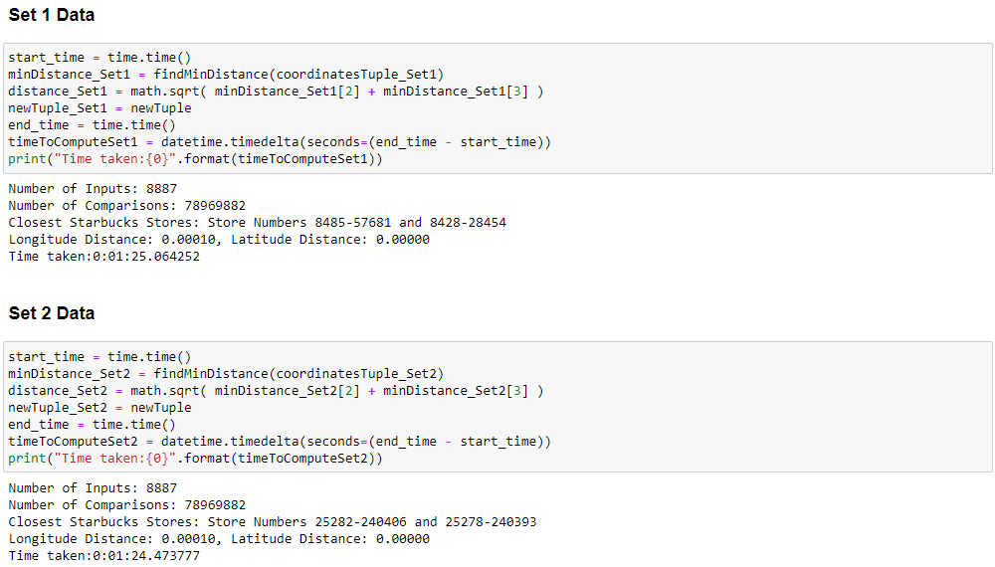
Divide & Conquer using Python

Slide 10
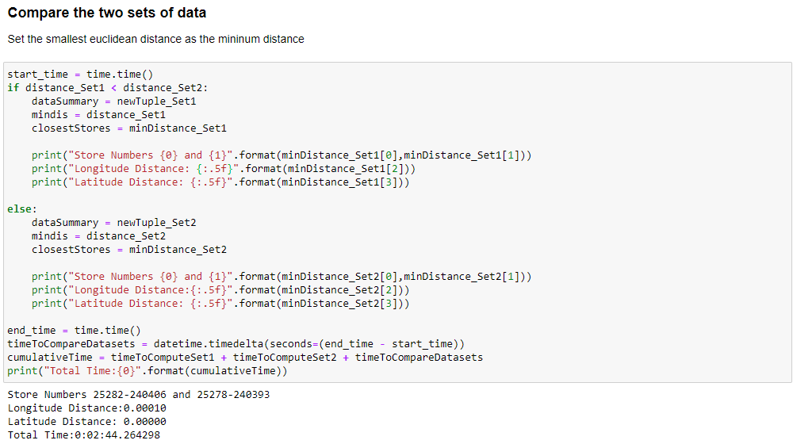
Divide & Conquer – Comparing Sets 1 & 2

Slide 11
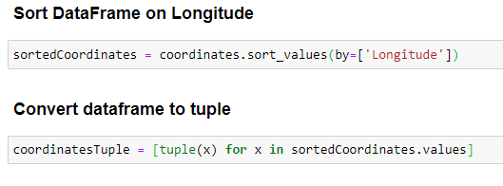
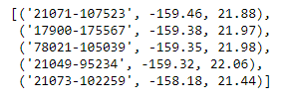
Algorithm #2: Brute Force
The trick to the algorithms in Python is all in data preparation
Filter for Starbucks “Brand” Locations
Check that there are no duplicate Store Numbers
Sort data on Longitude value (x-axis value)
Create immutable tuple values for the Store Number, Longitude & Latitude values
Every point will be compared to every other point in the data set
Sample tuple list

Slide 12
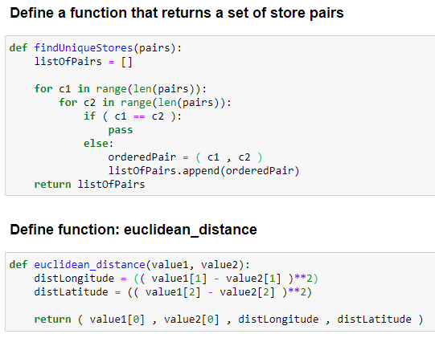
Step 1: Define some functions

Slide 13
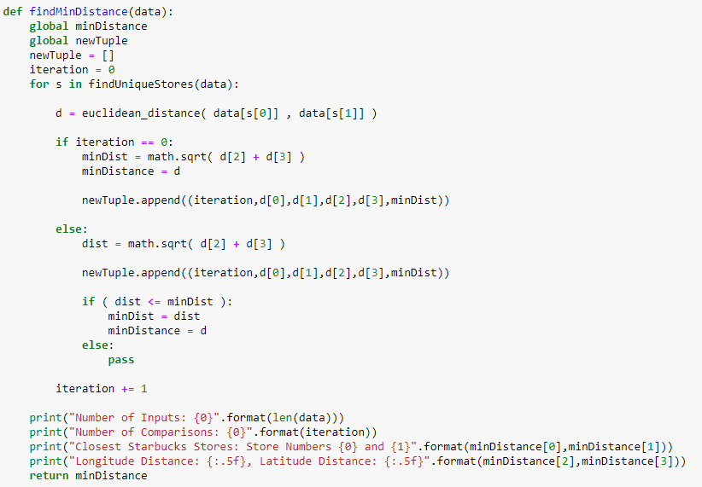
Step 2: Define minimum distance function

Slide 14
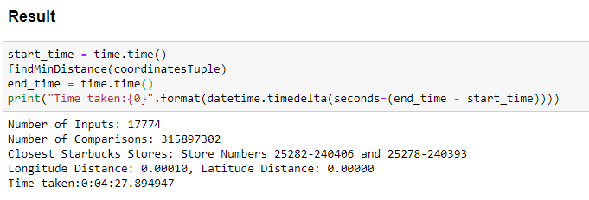
Brute Force Algorithm Results
coorindatesTuple is a list of tuples that contain the Store Number, Longitude and Latitude.
The time it took to calculate and compare 315,897,302 distances was 4.27 minutes.
$$Number of Comparisons: n∗\left(n−1\right)=17,774∗\left(17,774−1\right)=315,897,302$$

Slide 15

Total Time Complexity for Brute Force
The total runtime can be shown as
$$T\left(n\right)=O\left(n^{2}\right)+O\left(n\right)$$
$O\left(n\right)$can be removed since $O\left(n^{2}\right)$ is larger, leaving
$T\left(n\right)=O\left(n^{2}\right)$

Slide 16
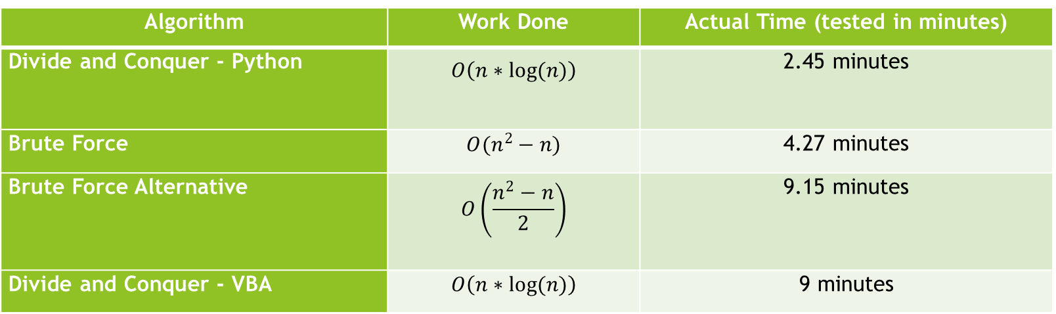
Comparison across algorithms
Algorithm | Work Done | Actual Time (tested in minutes)
Divide and Conquer - Python | $$O\left(n∗\log{(n)}\right)$$ | 2.45 minutes
Brute Force | $$O(n^{2}−n)$$ | 4.27 minutes
Brute Force Alternative | $$O\left(\frac{n^{2}−n}{2}\right)$$ | 9.15 minutes
Divide and Conquer - VBA | $$O\left(n∗\log{(n)}\right)$$ | 9 minutes

