Slide 1
Evolution of Software

Slide 2
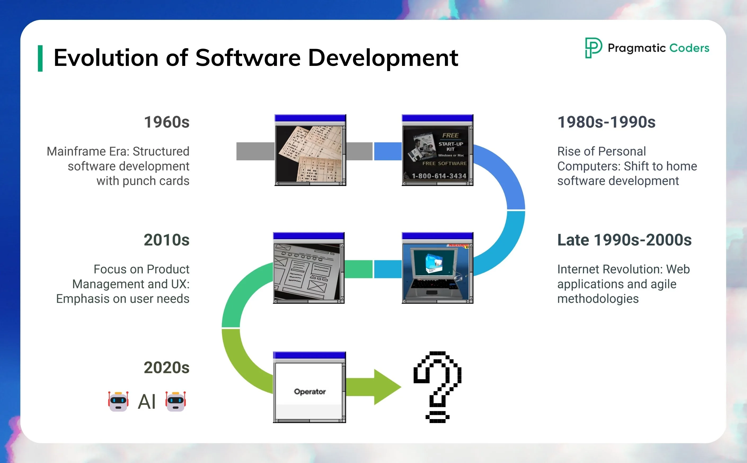

Slide 3
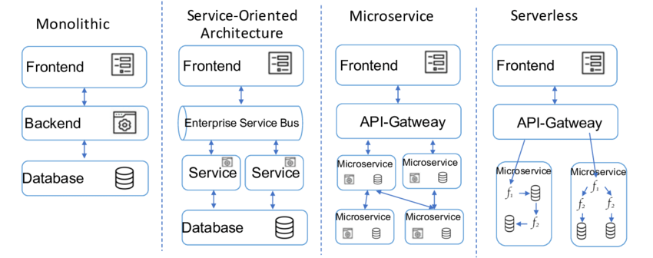
Software Architecture has Also Evolved!
Azure Kubernetes Service

Slide 4
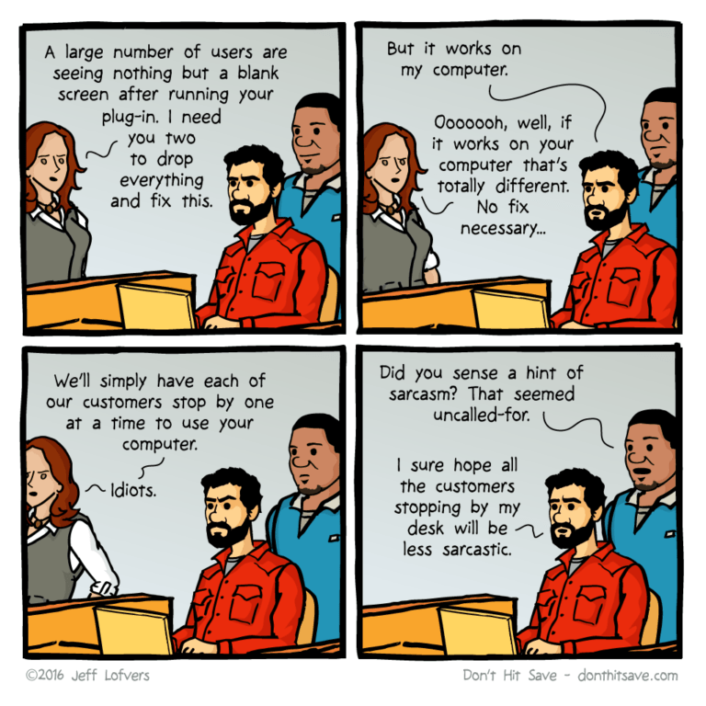
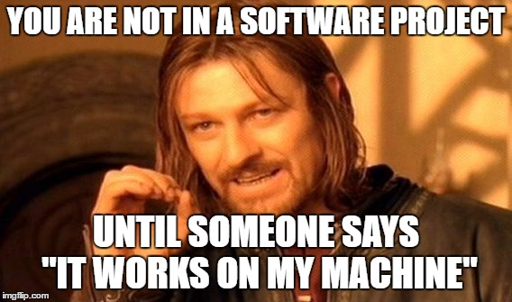
It Works on My Machine – a Software Classic!

Slide 5
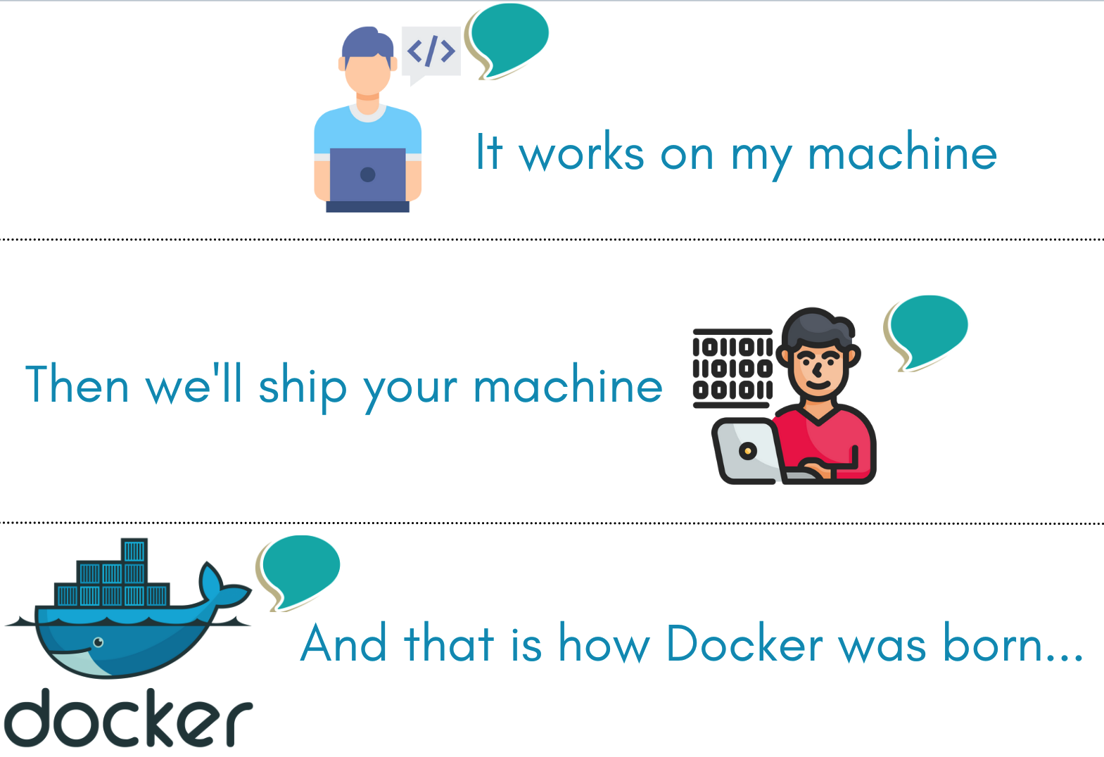
So…………..What is the Problem?
The problem are Virtual Machines – these are hard to manage and replicate

Slide 6
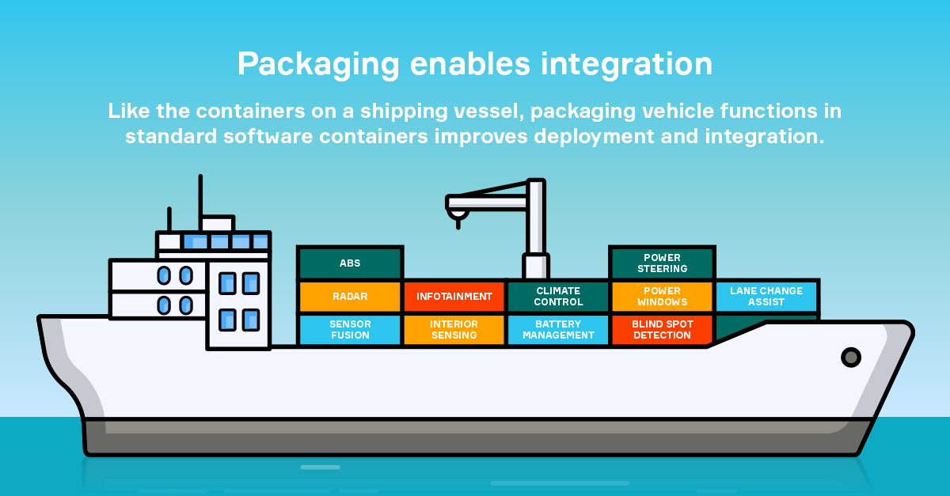
What is Docker….or wait, what is Software Containerisation?
Software containerization is an OS-virtualization method used to deploy and run containers without using a virtual machine (VM). Containers can run on physical hardware, in the cloud, on VMs, and across multiple operating systems.

Slide 7
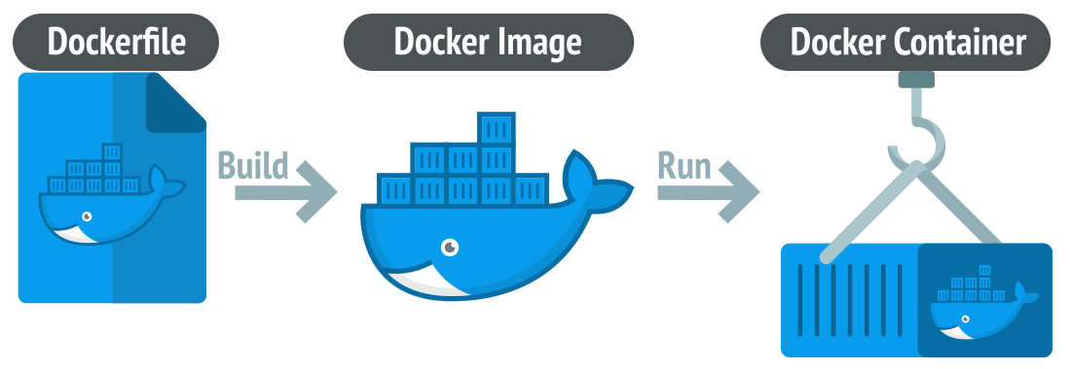
Aha….now what about Docker?
Docker is a containerization platform used to develop, ship, and run containers. Docker doesn't use a hypervisor, and you can run Docker on your desktop or laptop if you're developing and testing applications. The desktop version of Docker supports Linux, Windows, and macOS. For production systems, Docker is available for server environments, including many variants of Linux and Microsoft Windows Server 2016 and above. Many clouds, including Azure, support Docker.

Slide 8
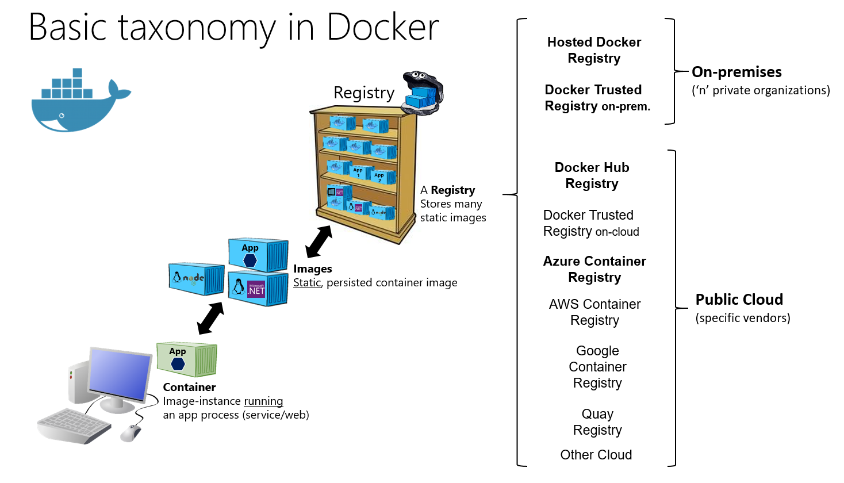
I heard something about Docker Images too…...
A container image is immutable. Once you've built an image, you can't change it. The only way to change an image is to create a new image. This feature is our guarantee that the image we use in production is the same image used in development and QA.
A container image is a portable package that contains software. It's this image that, when run, becomes our container. The container is an image's in-memory instance.

Slide 9
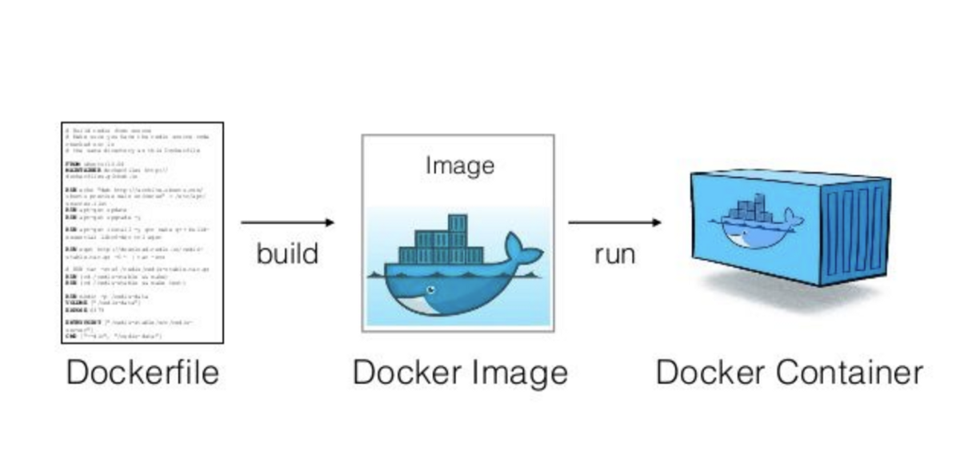
Just a Quick Recap…..That was a Lot!!!!

Slide 10
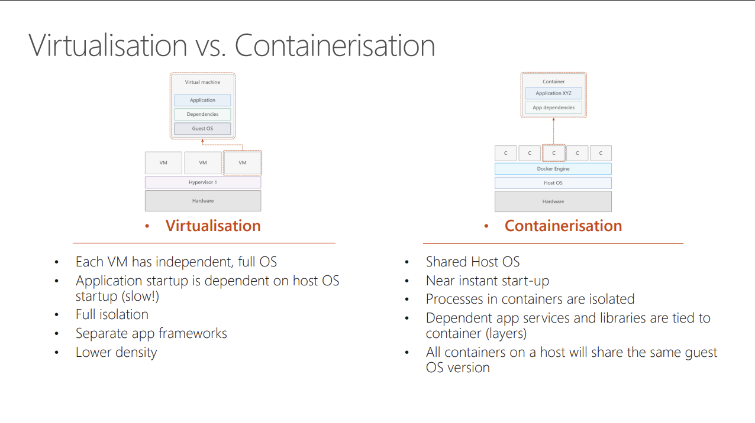

Slide 11
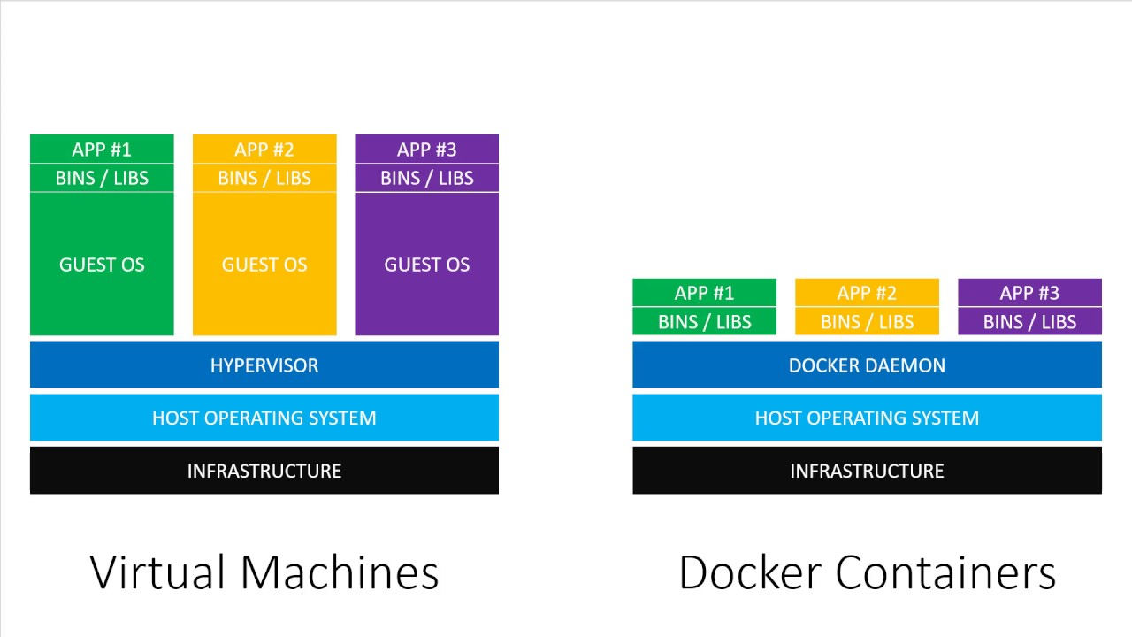
Docker Containers v/s VM….who wins?
🔹 1. Architecture Overhead
Virtual Machines include a full Guest OS per app, which increases resource overhead.
Docker Containers share the host OS kernel, avoiding the need for separate OS instances.

Slide 12
Docker Containers v/s VM….who wins?
🔹 2. Boot Time and Efficiency
VMs take longer to boot because each VM boots an OS.
Containers are lightweight and fast to start since they don't need to boot a separate OS.

Slide 13
Docker Containers v/s VM….who wins?
🔹 3. Resource Utilization
VMs are heavier due to multiple OS instances and require more memory and CPU.
Containers are more efficient, using fewer system resources, leading to higher density deployments.

Slide 14
Docker Containers v/s VM….who wins?
🔹 5. Portability
Containers are more portable due to their lightweight, consistent runtime environment.
VMs are less portable and more environment-dependent.

Slide 15
Docker Containers v/s VM….who wins?
🔹 7. DevOps and CI/CD
Containers are more aligned with DevOps practices and microservices architecture, allowing faster development, testing, and deployment.
VMs are better suited for monolithic apps or legacy systems requiring full OS environments.

Slide 16

The Winner is……..
Docker…..Docker….Docker!

