Slide 1
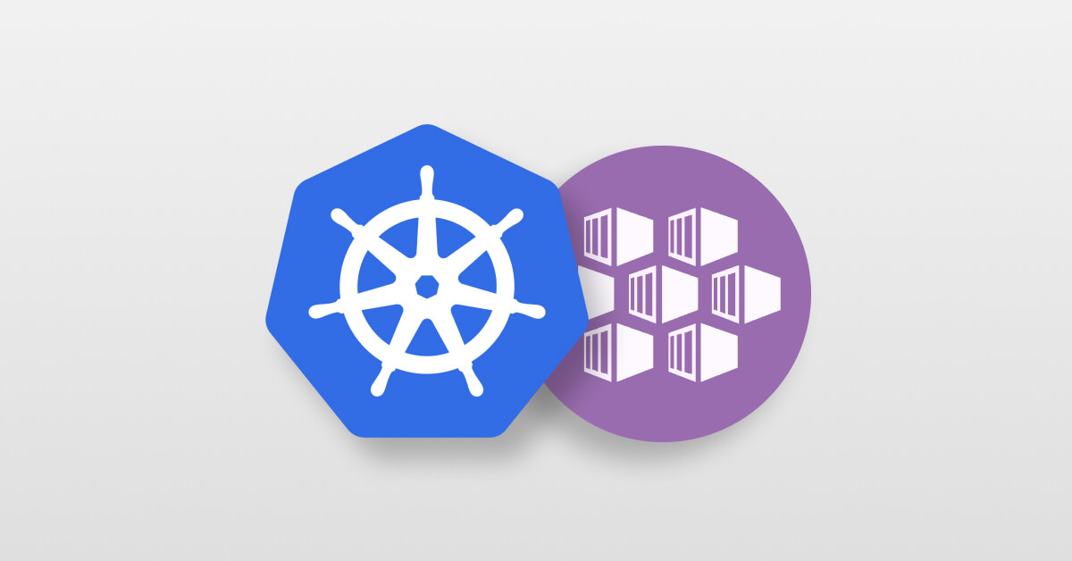
Introduction to Kubernetes (K8S) And Azure Kubernetes Service (AKS)

Slide 2
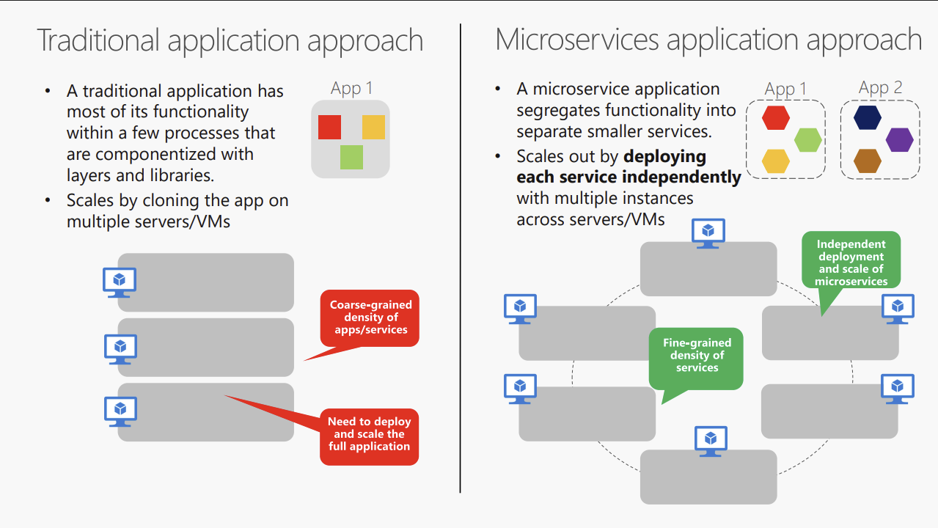
Just a Quick Recap…..

Slide 3
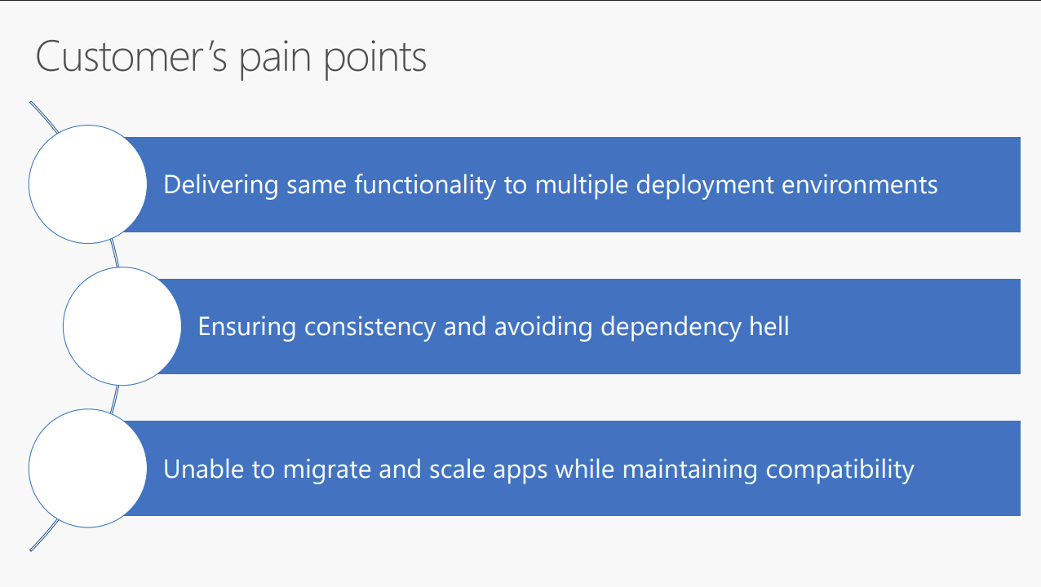
Containers
Containers
Kubernetes

Slide 4
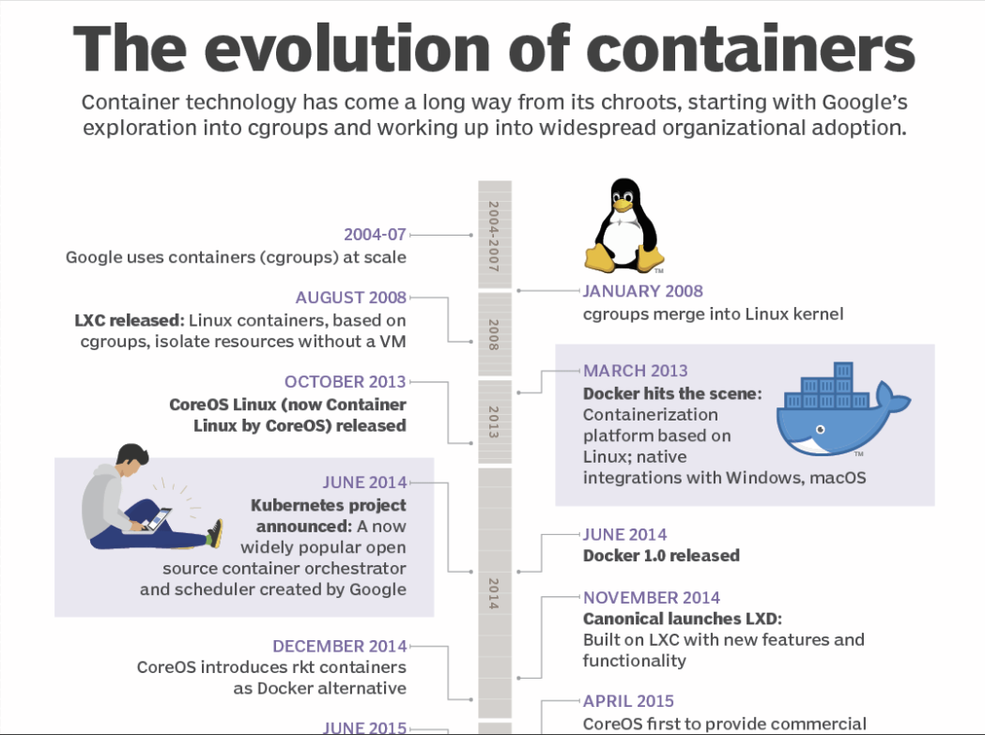

Slide 5
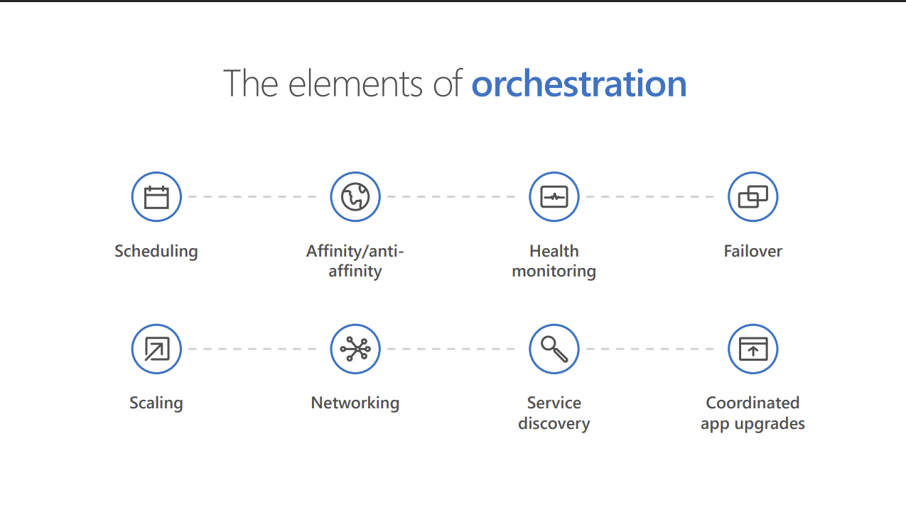
K8S = Container Orchestration

Slide 6
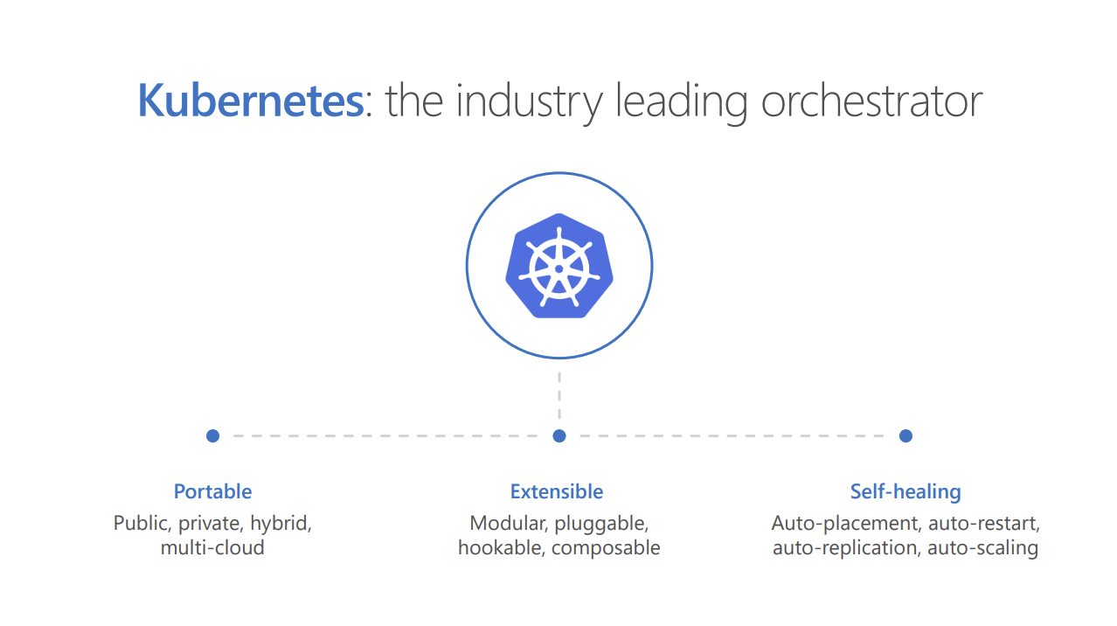

Slide 7
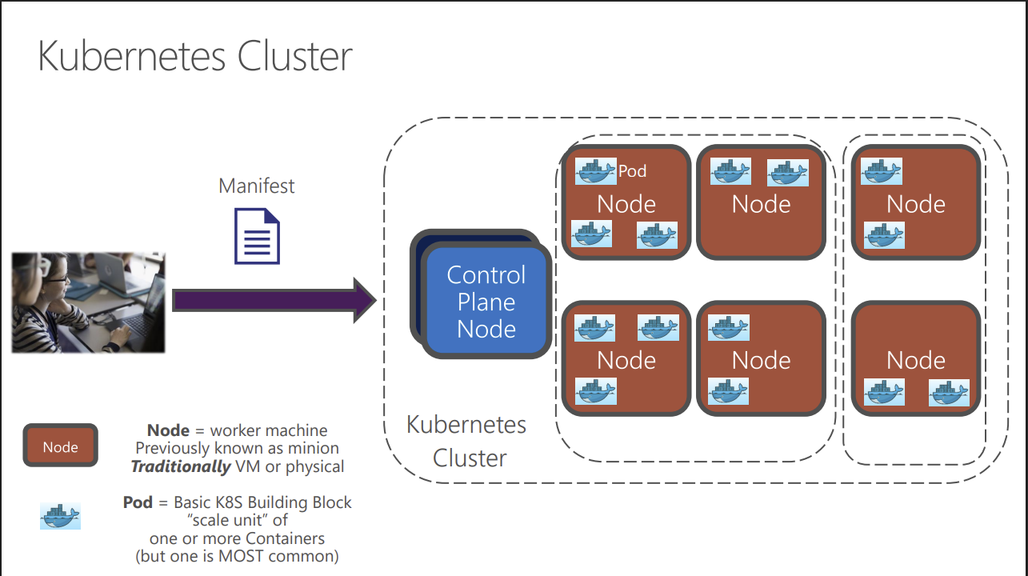
The K8S Architecture…

Slide 8
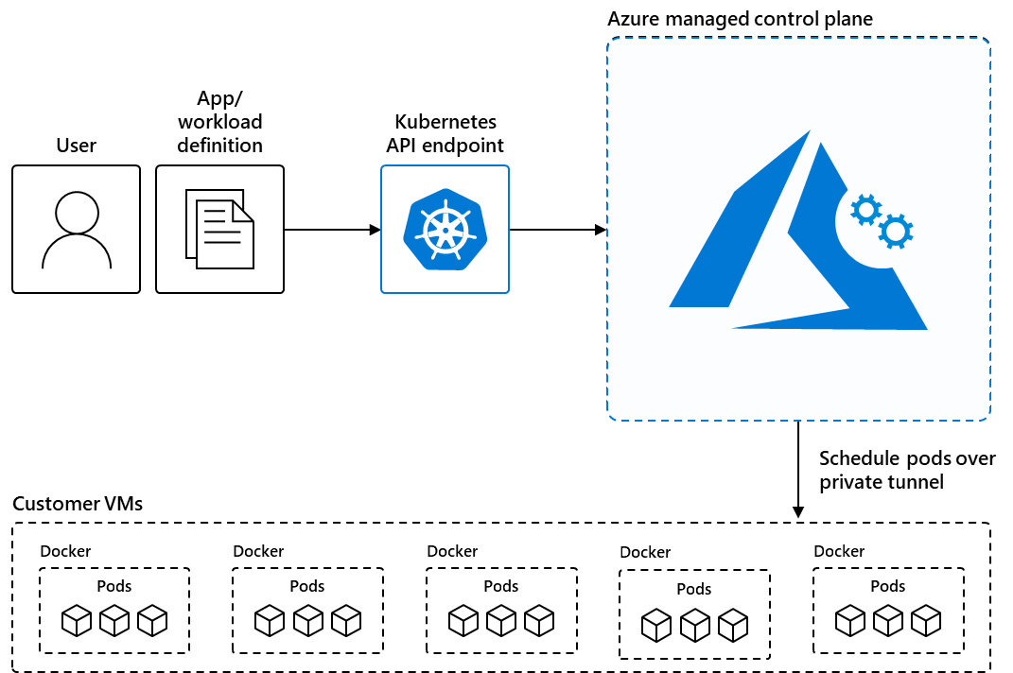
How Managed K8S on Azure Works……
When you create an AKS cluster, Azure automatically creates and configures a control plane for you at no cost.
The Azure platform manages the AKS control plane, which is responsible for the Kubernetes objects and worker nodes that you deploy to run your applications.
Azure takes care of critical operations like health monitoring and maintenance, and you only pay for the AKS nodes that run your applications.

Slide 9
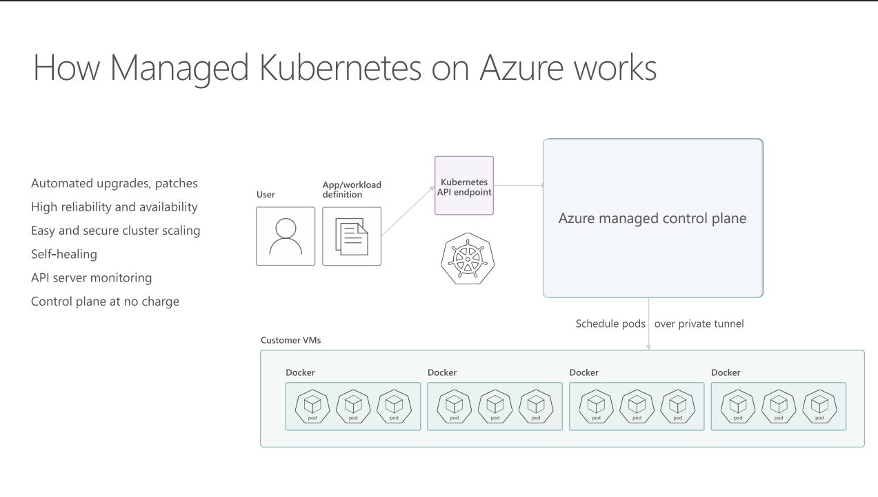
Another Visual to Understand a bit Better…

Slide 10
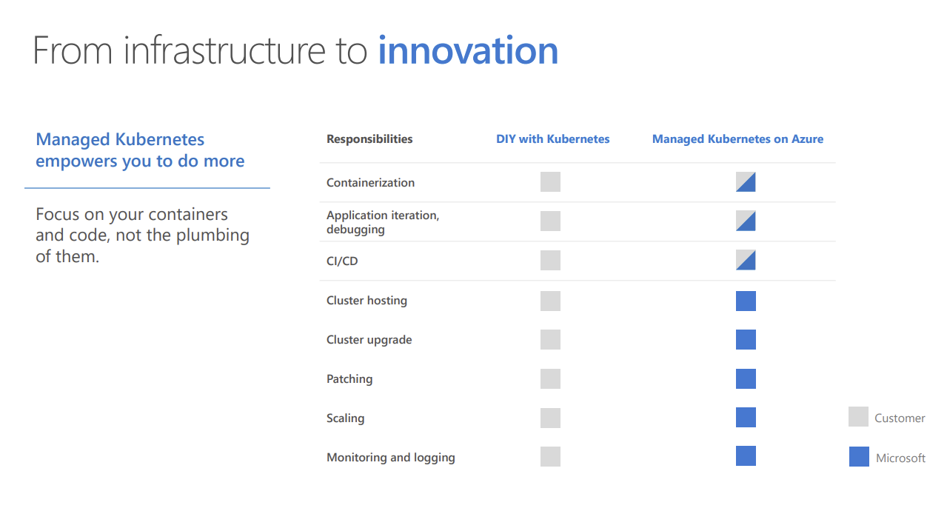
My Work v/s Microsoft’s Work…..

Slide 11
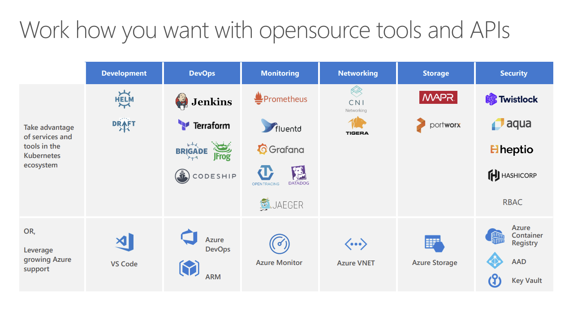

Slide 12
