Slide 1
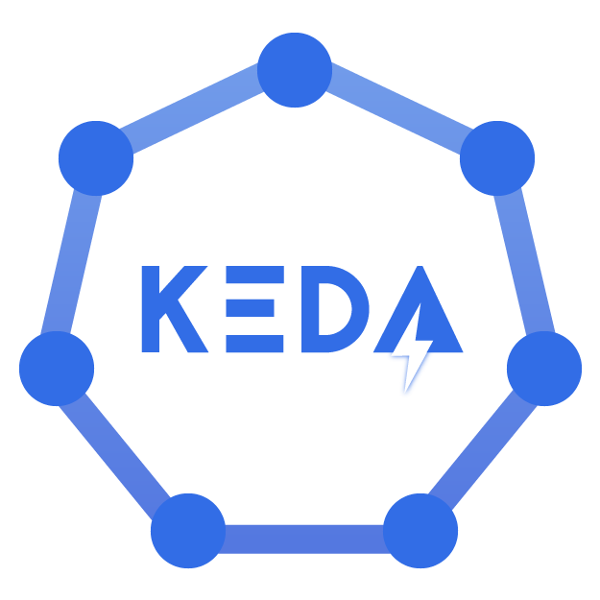
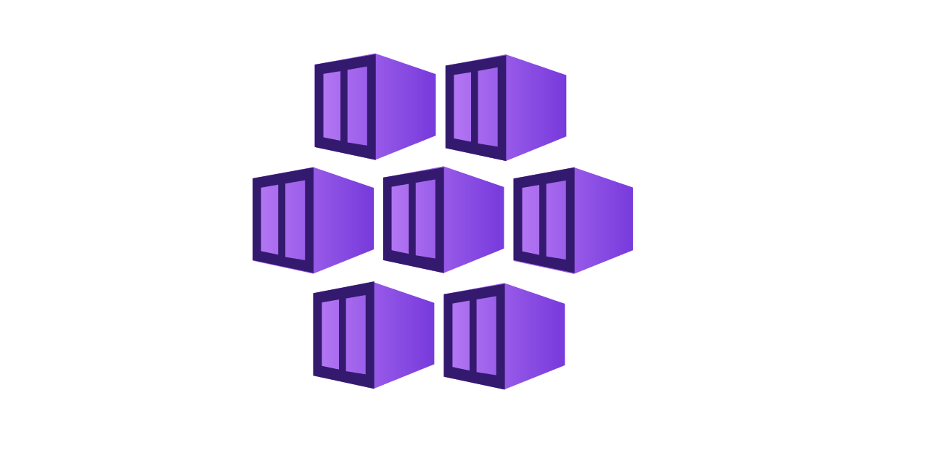
Event Driven Scaling in AKS
(KEDA – Kubernetes Event Driven Autoscaling)

Slide 2
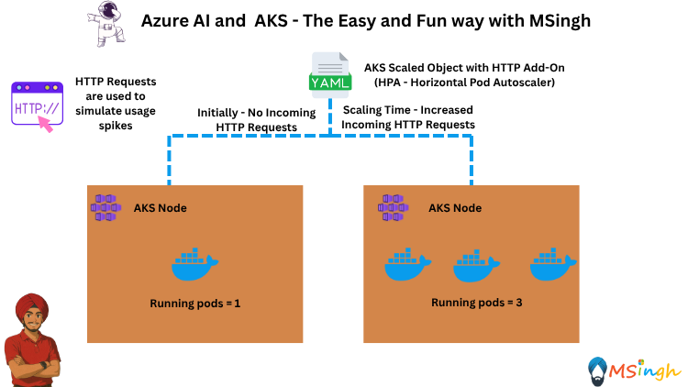
🚀 Scenario: Scaling an Azure AI Chat App in AKS using KEDA
📍 Setting: You’ve deployed an AI chat app on Azure Kubernetes Service (AKS). Most of the day, traffic is 💤 low, but during events or product launches, traffic spikes 📈 like crazy. You don’t want to keep extra pods running when no one’s using it.
❌ Without KEDA
No native way to scale on HTTP pending requests or queue length.
✅ With KEDA
KEDA = Event-driven autoscaling. You can scale before your pods are overloaded by tracking things like HTTP requests in flight.

Slide 3
Scaler Type 1: HPA (Horizontal Pod Autoscaler)
📌 Definition: Automatically adjusts pod replicas in a Kubernetes workload based on metrics.
📊 Metrics: Supports CPU/memory by default, can use custom or external metrics (e.g., via KEDA).
⚙️ Function: Periodically checks metrics, compares to a target, and scales pods up/down.
⏱️ Speed: Scales up fast (~15s) and scales down slower (default 5 minutes).
🤝 With KEDA: KEDA supplies external metrics to HPA and manages the HPA object for event-driven scaling.

Slide 4
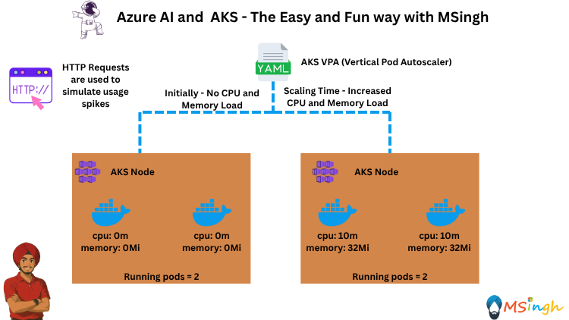
Scaler Type 2: VPA (Vertical Pod Autoscaler)
📌 Definition: Automatically adjusts CPU and memory requests/limits for containers in a pod based on observed usage.
📊 Metrics: Monitors historical and real-time resource usage to recommend or apply changes.
⚙️ Function: Ensures pods have enough resources without over-provisioning, improving efficiency.
🔄 Pod Restart: Changing requests/limits usually requires restarting pods, so scaling is less instant than HPA.
🤝 With HPA: VPA handles resource sizing, while HPA handles pod count; they can work together carefully to avoid conflicts.

Slide 5
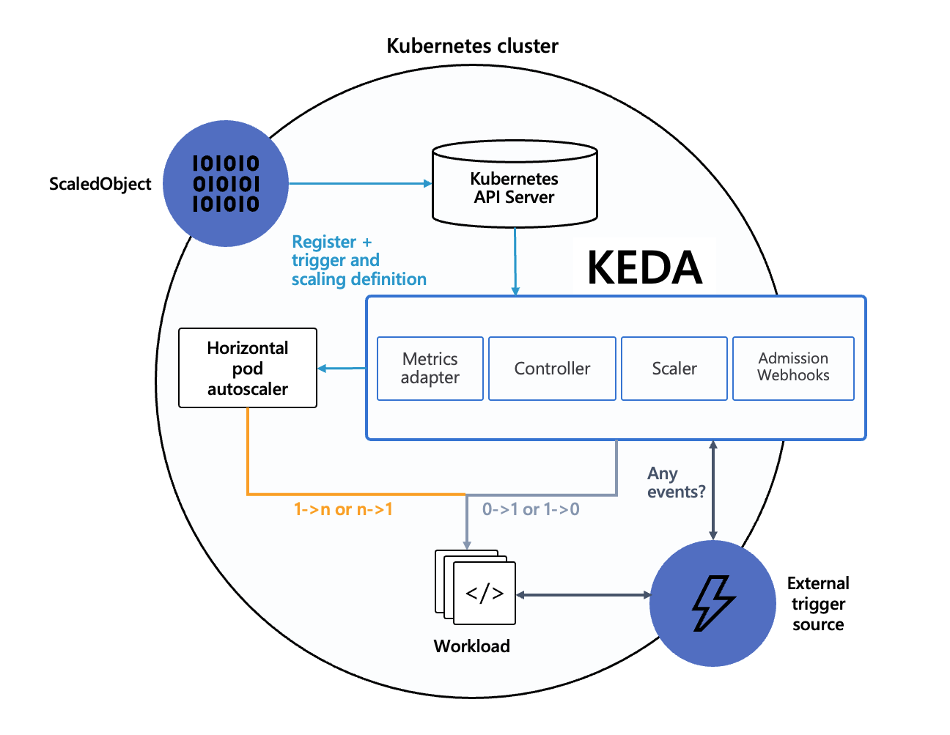
Understanding the KEDA Architecture
This is a Custom Resource (CRD) that you define in Kubernetes.
It contains:
Trigger definition
Scaling rules (You register this object in Kubernetes → it’s stored in the Kubernetes API Server.
📈 Scaler → Connects to the external trigger source (e.g., Azure Service Bus, Kafka, HTTP interceptor) to fetch metrics.
🛡 Admission Webhooks → Validate and mutate ScaledObjects on creation.
📊 Metrics Adapter → Feeds custom/external metrics (like pending HTTP requests) to Kubernetes’ Horizontal Pod Autoscaler (HPA).
🧠 Controller → Watches for ScaledObjects and orchestrates scaling logic.

Slide 6
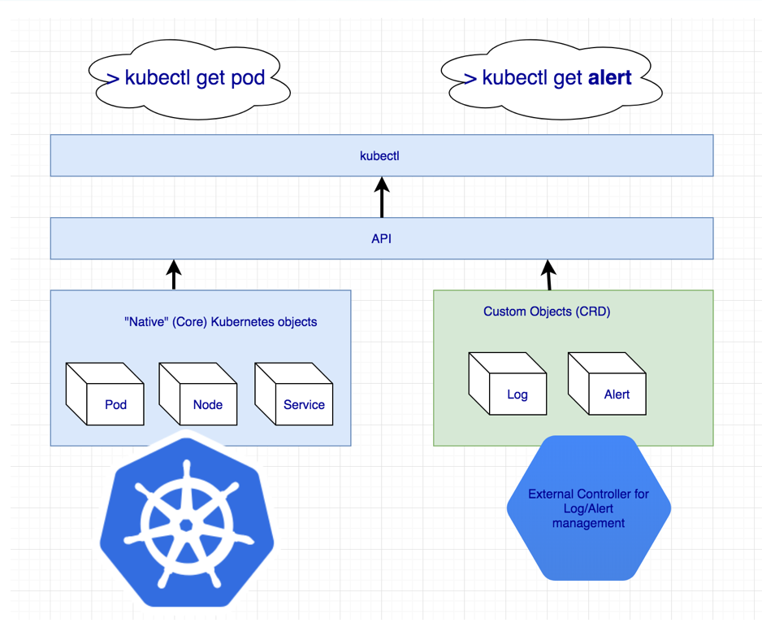
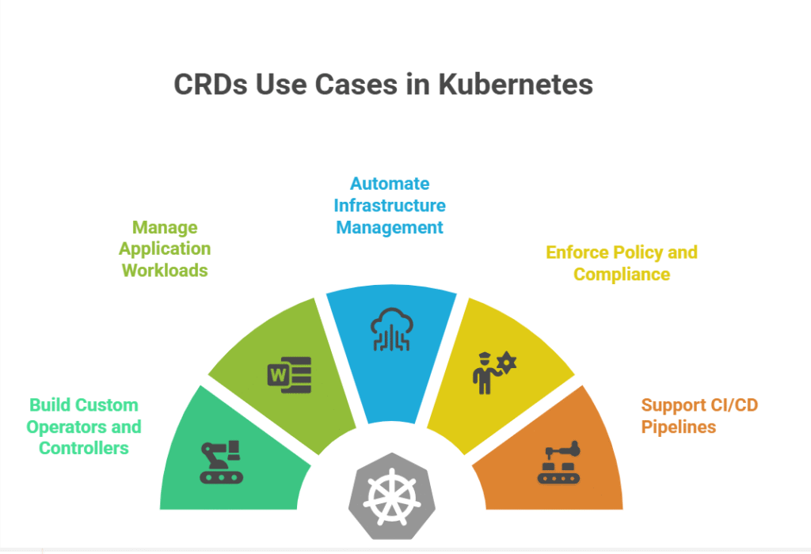
Understanding CRDs (Custom Resource Definitions)
CRD (Custom Resource Definition) = a way to tell Kubernetes:
“I’m adding a new type of object with its own schema and rules.”
Once you define a CRD, you can create instances of it called Custom Resources (CRs), and controllers can watch them to do work.
KEDA is basically an implementation of the Kubernetes CRD + Controller pattern — it just specializes in event-driven autoscaling.
KEDA is not a built‑in part of Kubernetes.
It’s an add‑on (an Operator) that you install into your cluster.

Slide 7
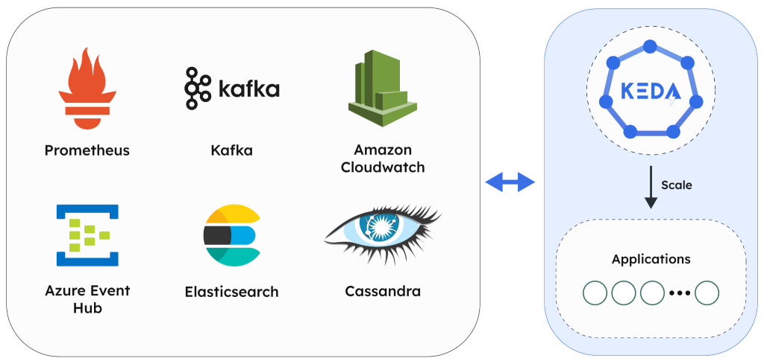
KEDA Trigger Types with Cloud Service Providers

Slide 8
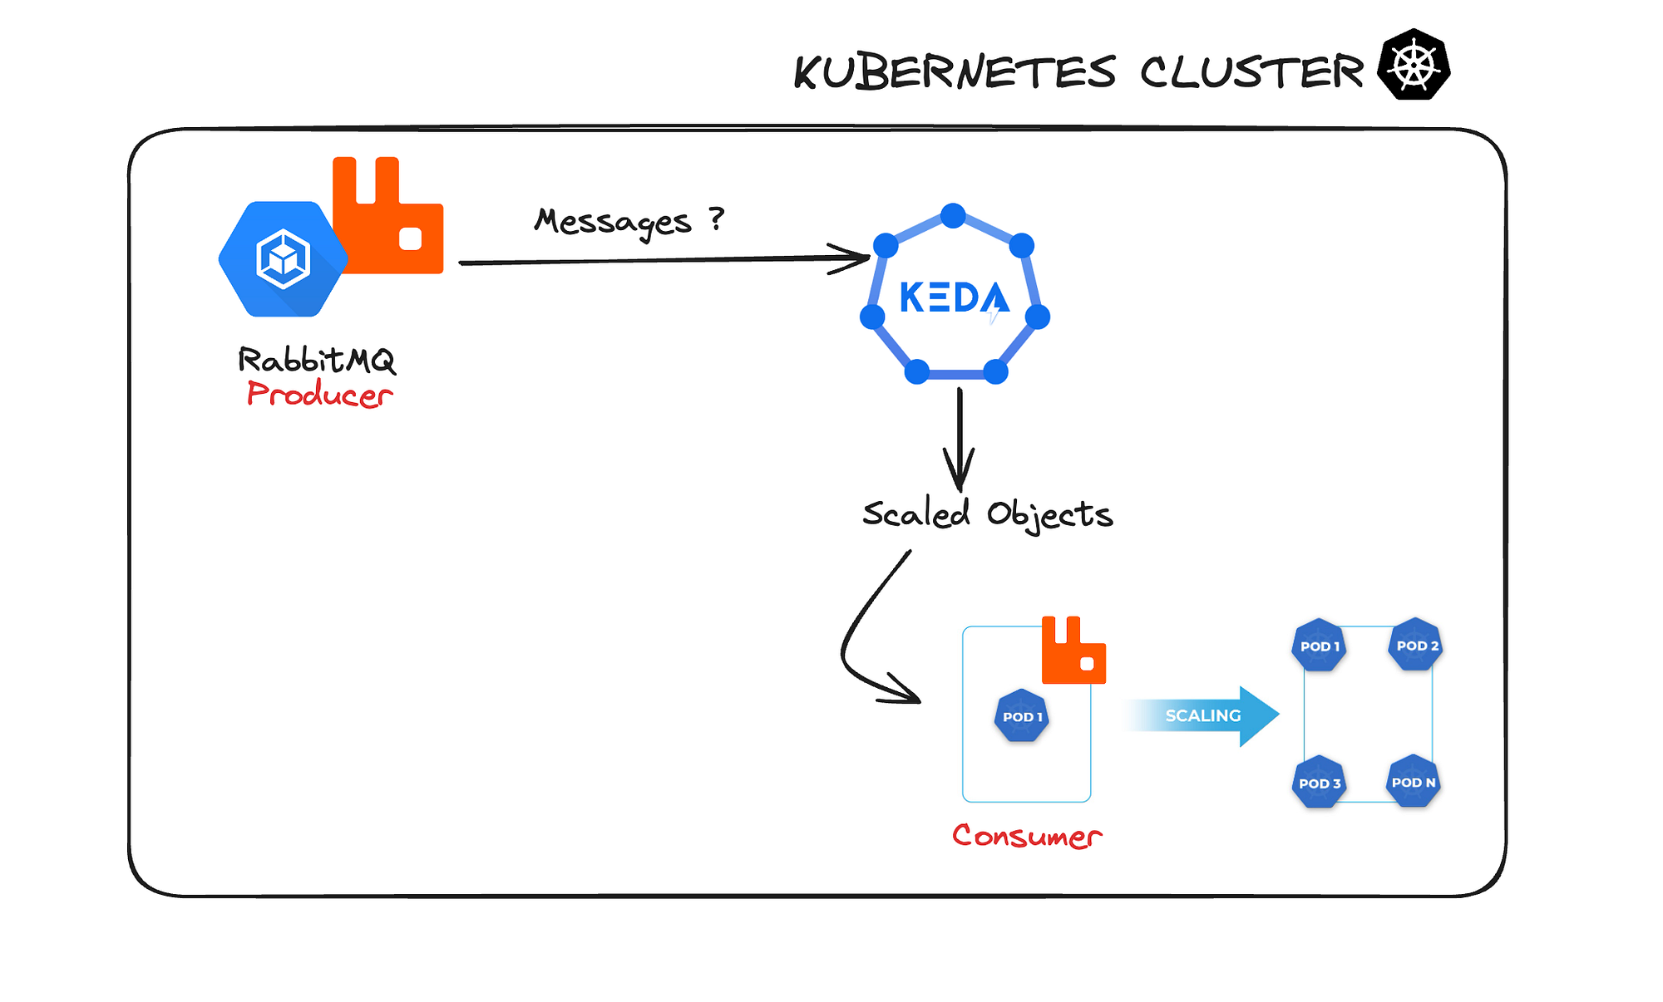
Some Use Cases…..

Slide 9
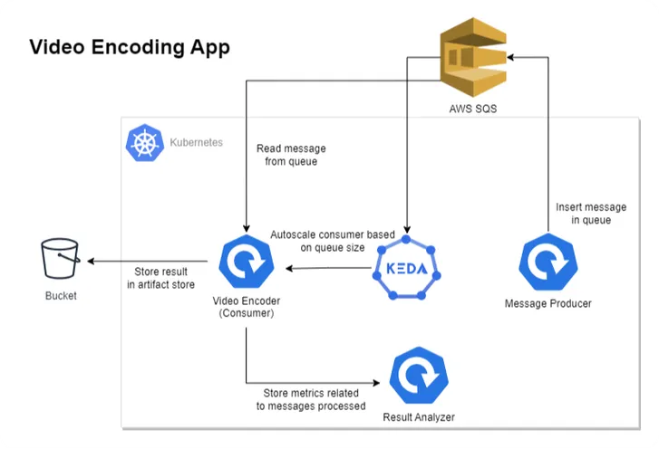


Azure Queue
Azure Blob Store

