Slide 1
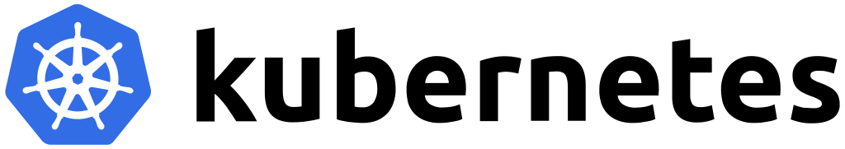
K8S Architecture
(The Fun Way ☺)

Slide 2
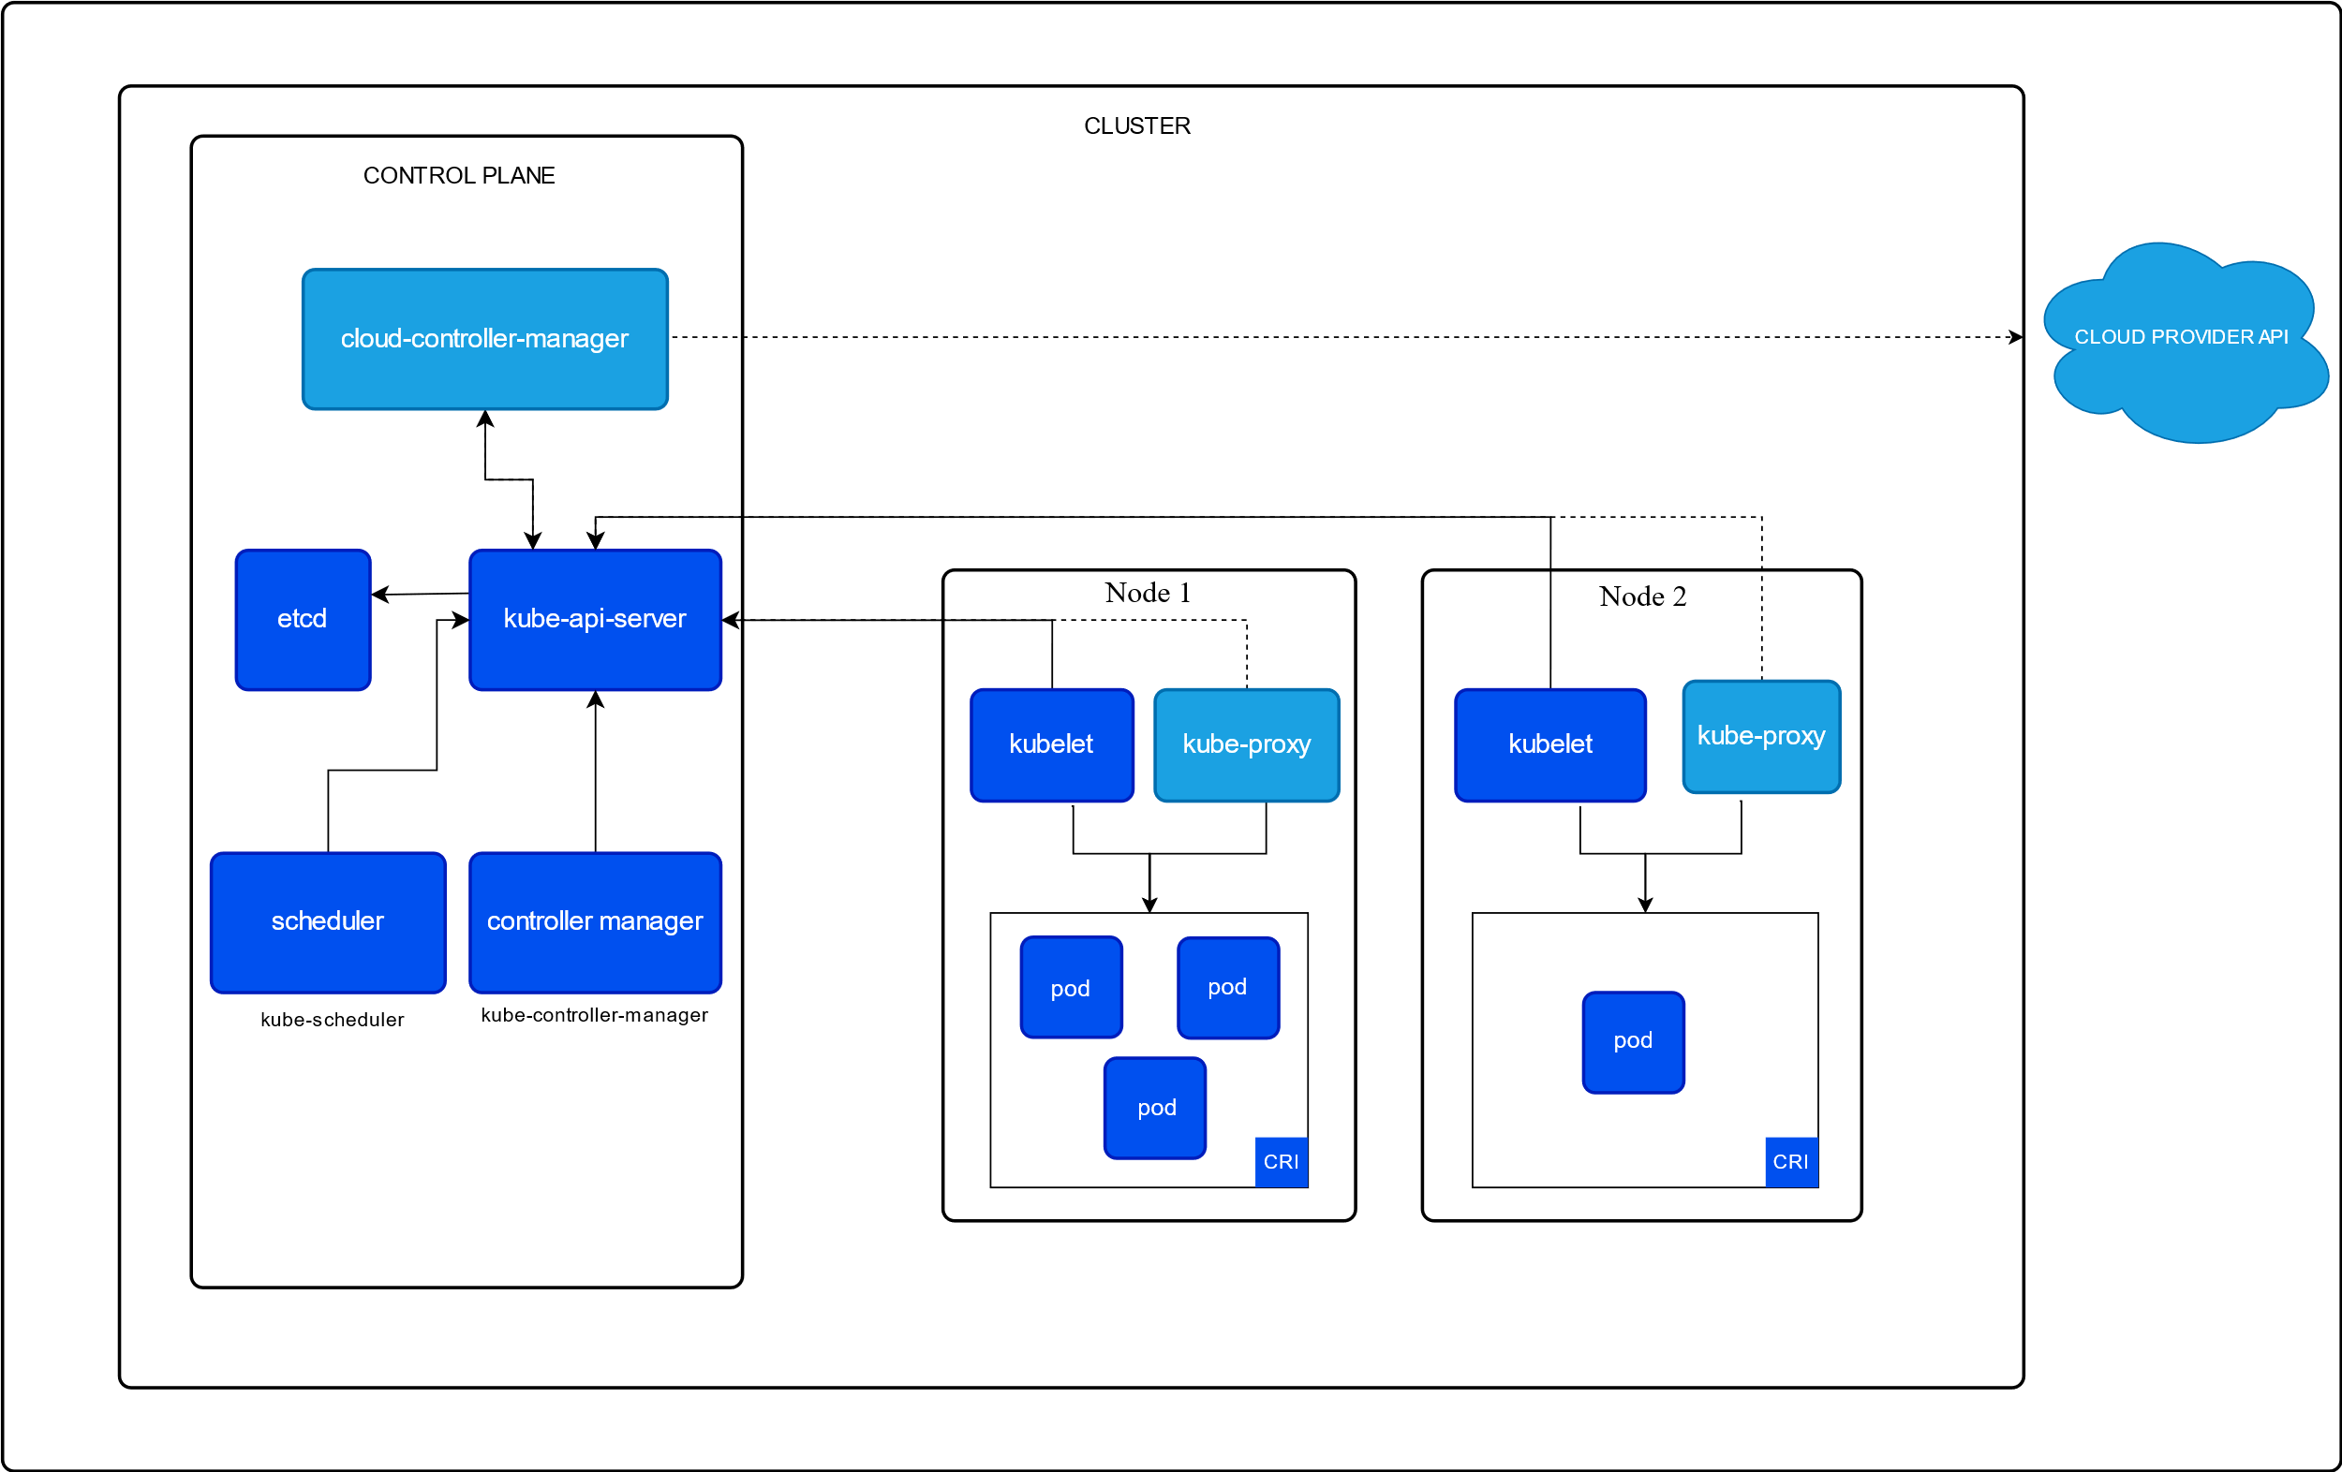

Slide 3
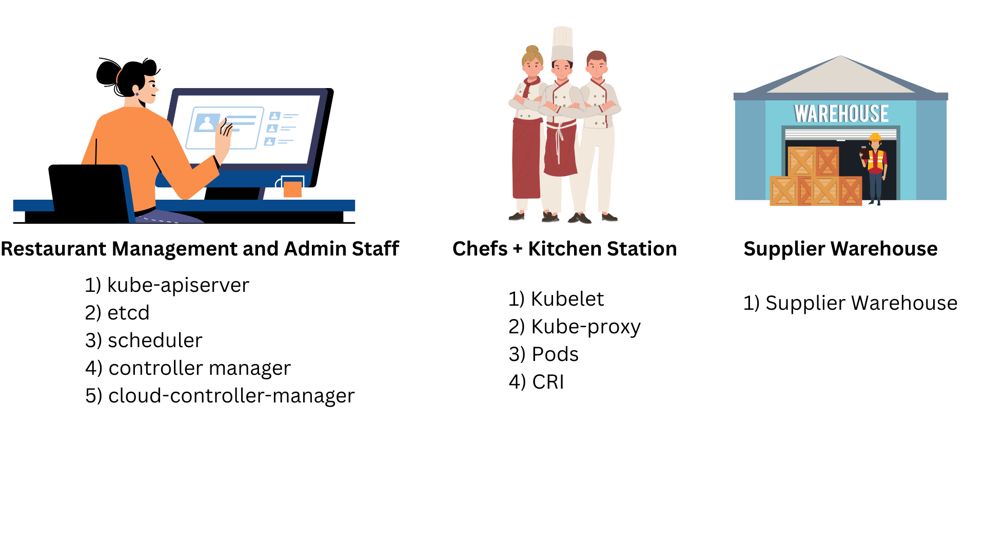
K8S – Restaurant Analogy

Slide 4
Restaurant Management and Admin Staff = The Control Plane
Kubeapi-server:📞 Reception Desk
Takes customer (API) orders and sends them to the kitchen or management.
Cloud-Controller-Manager:📦 Vendor Liaison
Talks to cloud vendors (Cloud Provider API) for resources like delivery and logistics.
Etcd:📒 Reservation Logbook:
Stores all data about the restaurant (menu, bookings, table states, etc).
Scheduler: 🧑‍💼 Head Waiter:
Decides which waiter (node) serves which customer (pod).
Controller Manager: 🛎️ Restaurant Manager
Ensures everything is running (e.g., restocking, replacing staff if needed).

Slide 5
Chefs + Kitchen Stations = Nodes
Kubelet: 👨‍🍳 Station Chef
Gets orders from the head waiter (scheduler) and cooks (runs pods).
Kube-proxy: 🚦 Kitchen Coordinator
Handles communication inside and outside the kitchen (network rules).
Pods: 🍲 Dishes Being Cooked
The actual meals (applications/containers) that customers ordered
CRI: Cooking Tools
The actual kitchen equipment used to cook (Docker, Containerd, etc.)

Slide 6
Supplier Warehouse = Cloud Provider API
Cloud Provider API: Supplier Warehouse
Provides ingredients and resources when the restaurant runs low

Slide 7
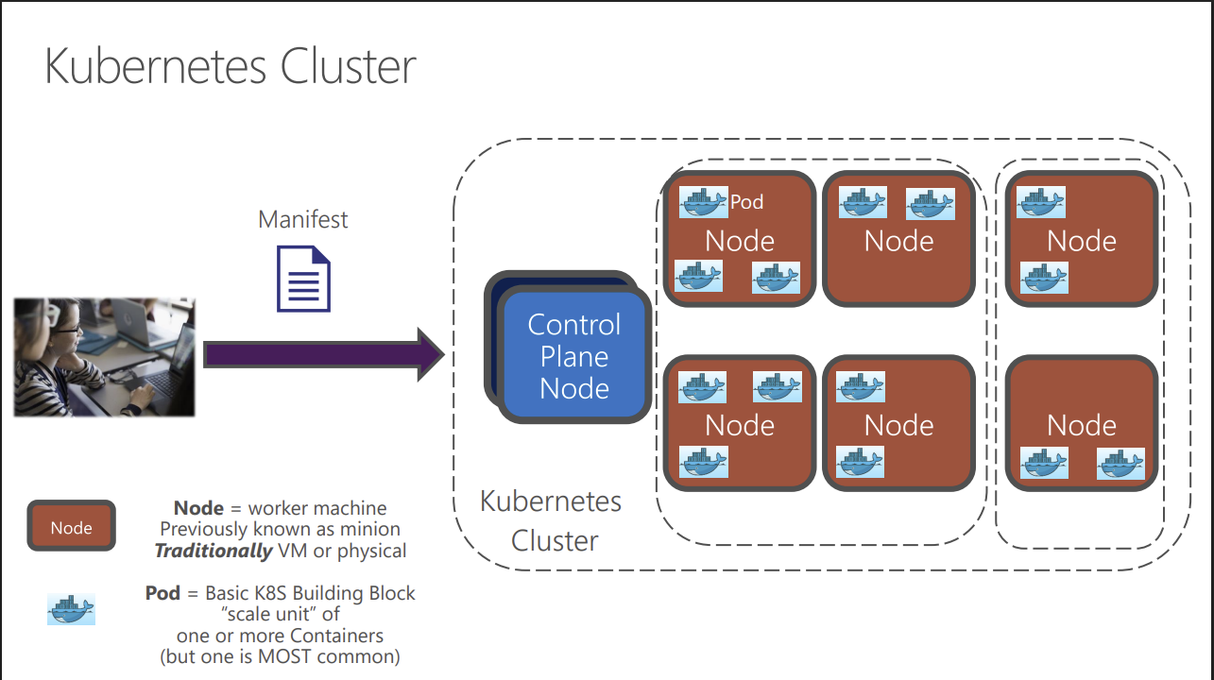
Whole Workflow in a Nutshell

