Slide 1
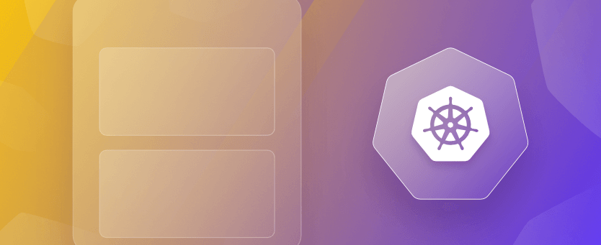
Multi-Container Design Patterns in K8S

Slide 2
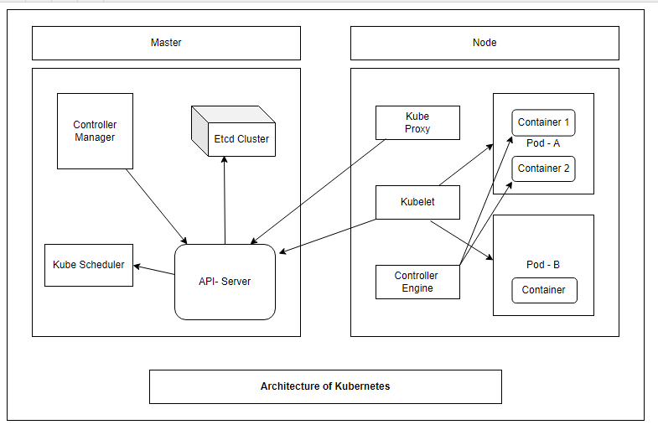
Pods are the simplest building blocks of a Kubernetes Cluster and can run multiple containers thus giving rise to “Multi-Container Design Patterns”.
There are mainly two types of “Multi-Container Design Patterns” :
Init Container Design Pattern.
Sidecar Container Design Pattern.

Slide 3
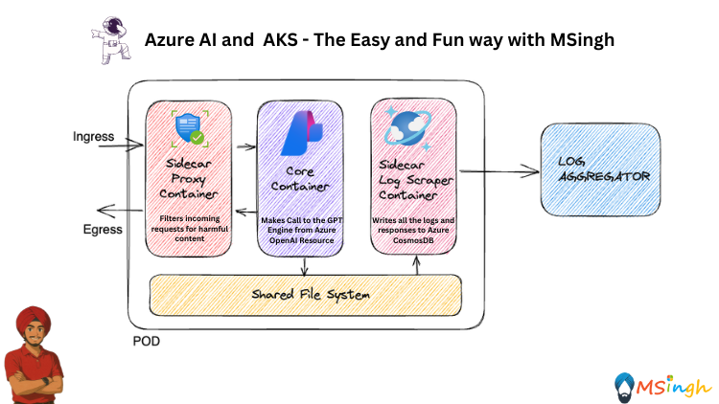
✨ Sidecar Container: Consider a Scenario...
🔹 Imagine you're building an AI-powered chatbot service using Azure OpenAI and deploying it to AKS.
🔹 You’ve got your Core Container that talks to the Azure OpenAI GPT endpoint — that’s your brain.
🔹 But you realize:
🚫 You need to filter harmful content before it hits GPT.
📜 You need to log all requests and responses for auditing and compliance.
💾 And you want to do this without bloating your main application code.
🔹 So, you introduce sidecar containers:
🛡 Sidecar Proxy Container: Sits in front, intercepting requests, filtering out inappropriate content before reaching the core logic.
📥 Sidecar Log Scraper Container: Sits beside, monitoring shared volumes, and shipping logs to Azure CosmosDB.

Slide 4
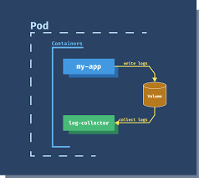
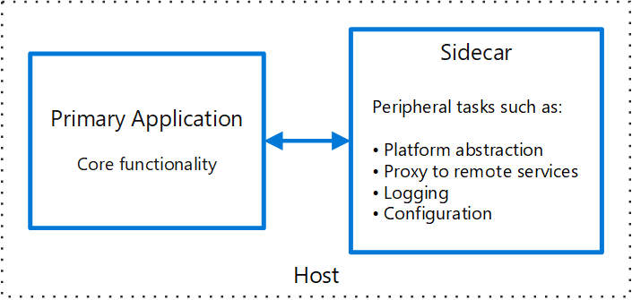
What are Sidecar Containers…..?
This pattern is named Sidecar because it resembles a sidecar attached to a motorcycle. In the pattern, the sidecar is attached to a parent application and provides supporting features for the application.
The Primary work of a sidecar container is to improve the functionality of the main container

Slide 5
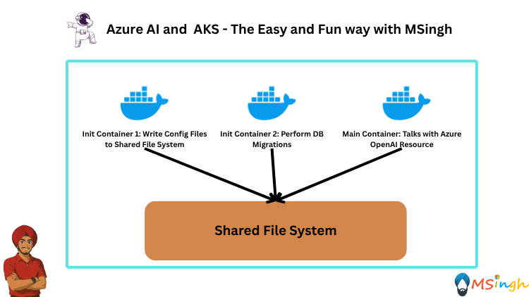
✨ Init Container: Consider a Scenario…….
🔹 Imagine you're deploying a powerful AI app on AKS — it runs GPT calls, connects to a database, and exposes a React frontend.
🔹 You’re ready to deploy, but there’s a problem:
❌ Your main app needs config files from a blob storage.
❌ It depends on database schema migrations before it can start.
❌ And your app crashes if those things aren’t ready.
🔹 So what do you do?
🔹 You use Init Containers — little containers that run before your main app starts.
🧱 In This Scenario:
⚙️ Init Container 1: Downloads config files from Azure Blob Storage and places them in a shared volume.
🧬 Init Container 2: Applies database migrations using a lightweight Python or Flyway script.
🚀 Only after both Init Containers succeed, your main application container starts — now fully ready to perform.

Slide 6
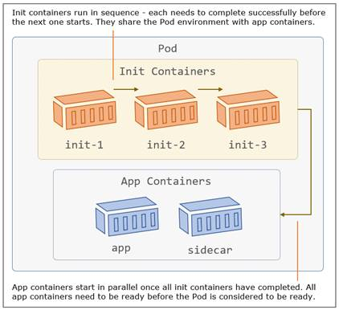
What are Init Container….?
Init Containers are special containers that run before the main application containers in a pod start.
They are designed to perform initialization tasks, such as setting up configuration files, initializing databases, or any other operation necessary for the proper functioning of the application.
Sequential Execution: Init Containers run sequentially and complete their tasks before the primary containers start.
Fail and Restart: If an Init Container fails to execute successfully, the entire pod initialization fails, and the pod restarts until the Init Containers complete successfully.

