Slide 1
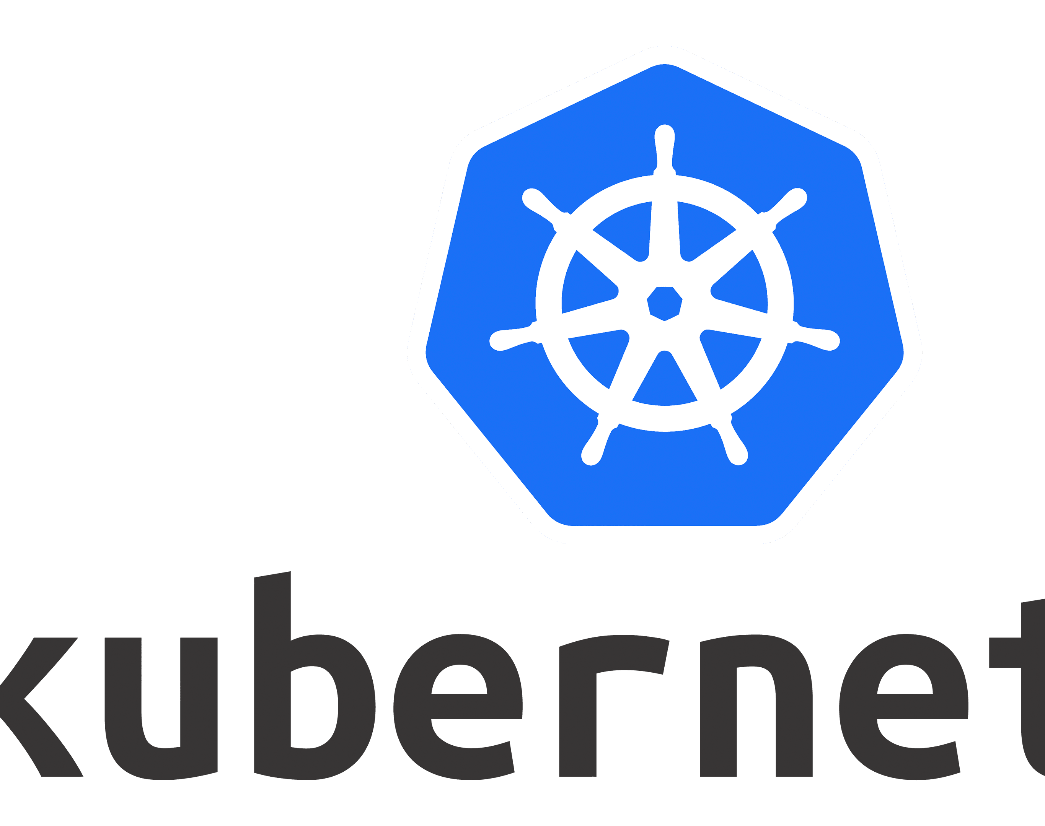
ConfigMaps and Secrets

Slide 2
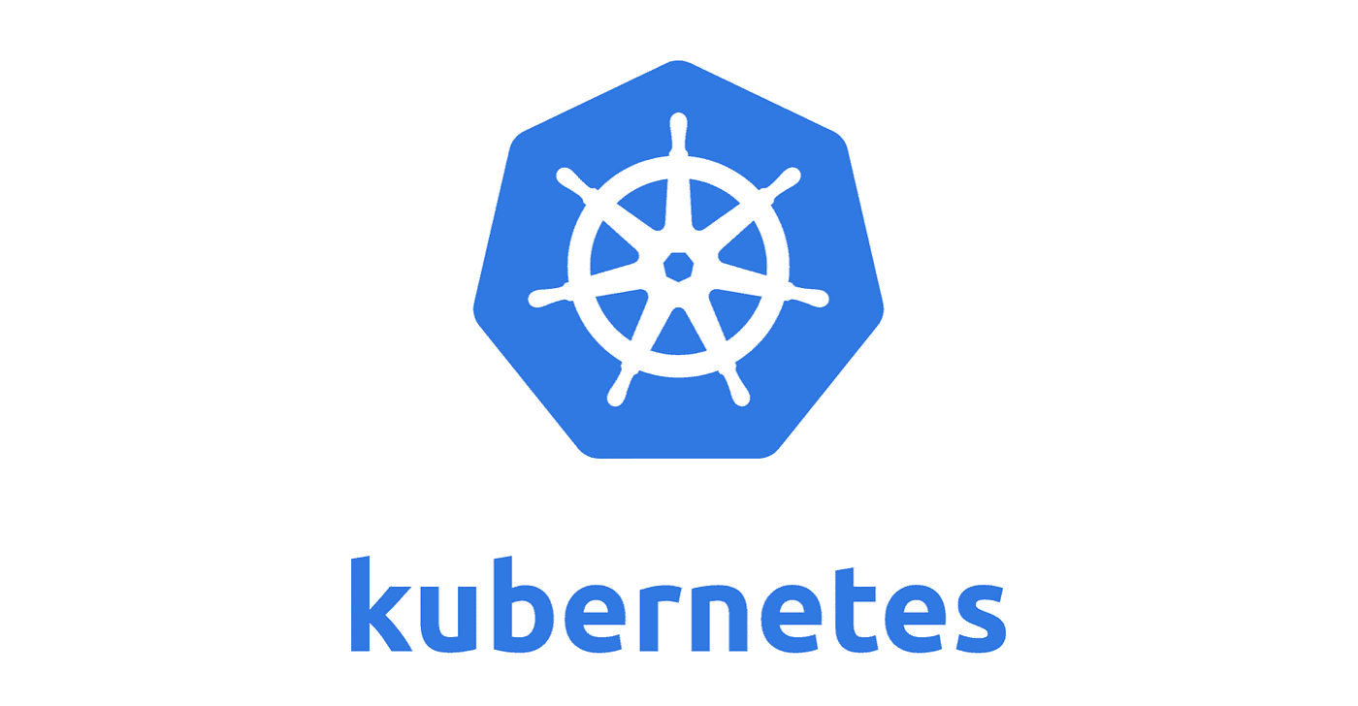

Take a Scenario……
You are developing a ChatGPT like application with a frontend and backend.
The backend is a simple Python Flask or FAST API application that connects to the Azure OpenAI service to throw requests to the GPT Engine.
But to run the backend application, you need to configure some environment variables namely: “azure_openai_endpoint”, “azure_openai_api_key” and the “model_name” – all of which needs to be passed when creating a container out of the image stored in ACR (Azure Container Registry).
Too store these environment variables in the AKS cluster itself, you would use “ConfigMaps” and “Secrets”.
Azure OpenAI Chat Backend
{
“azure_openai_endpoint”: “”,
“azure_openai_api_key”:””,
“model_name”:””
}

Slide 3
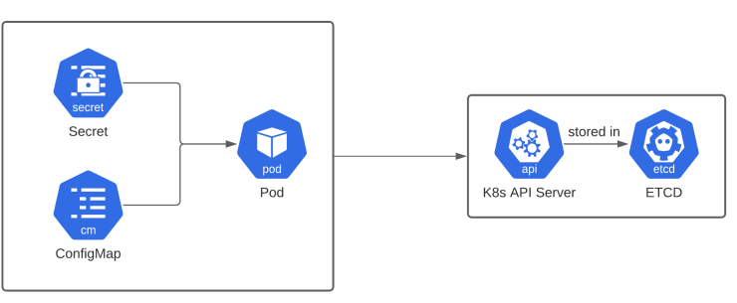
A ConfigMap is an API object used to store non-confidential data in key-value pairs. Pods can consume ConfigMaps as environment variables, command-line arguments, or as configuration files in a volume.
A Secret is an object that contains a small amount of sensitive data such as a password, a token, or a key. Such information might otherwise be put in a Pod specification or in a container image. Using a Secret means that you don't need to include confidential data in your application code.

Slide 4
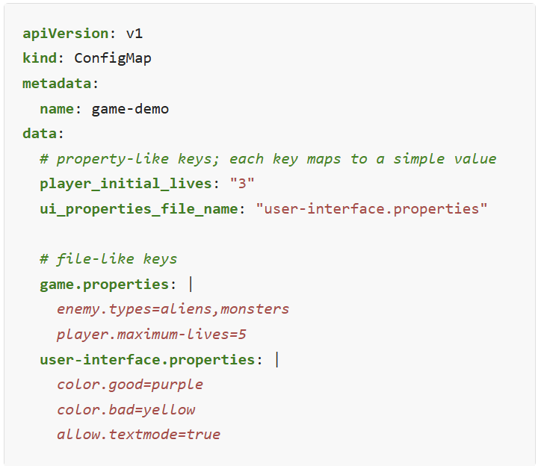
Creating a ConfigMap

Slide 5
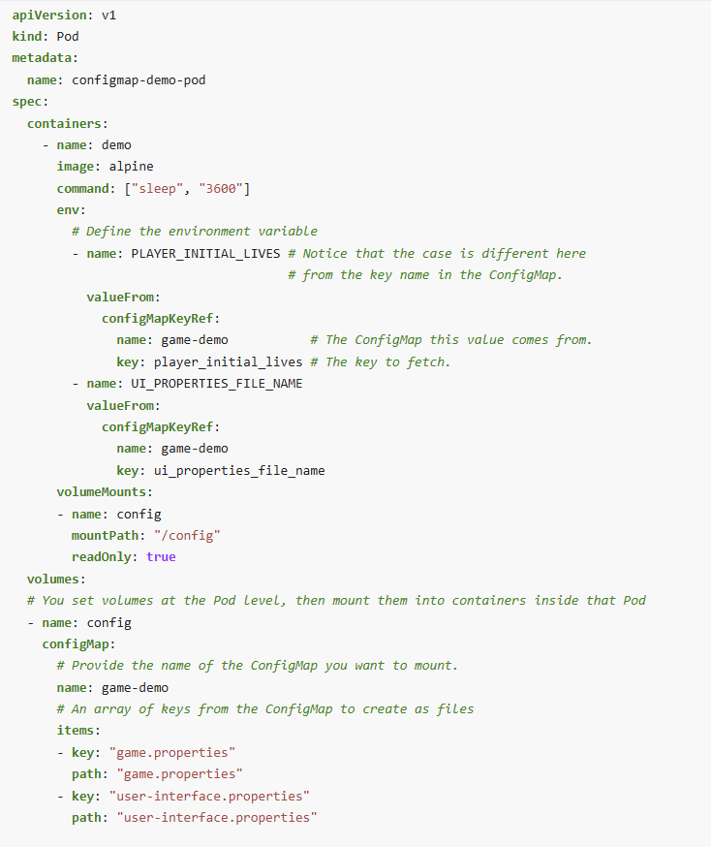
Using a ConfigMap

Slide 6
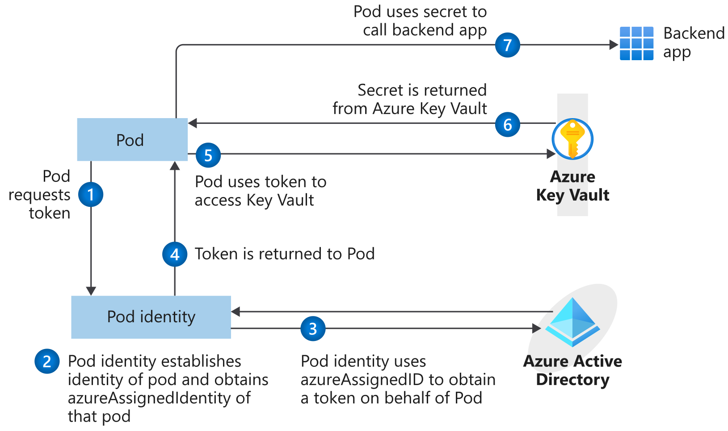
Food for Thought – Azure Key Vault as Secret Store

