Slide 1
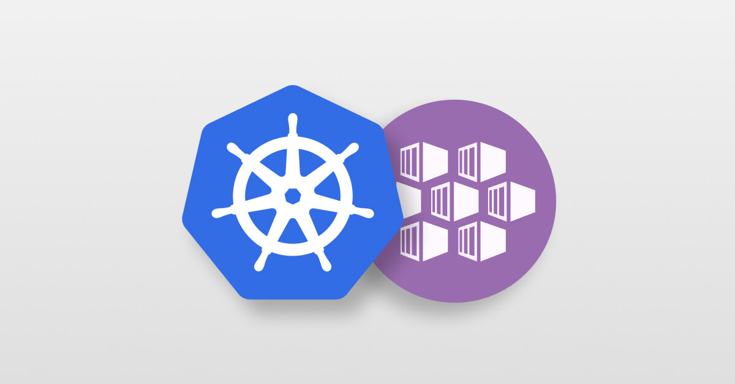
Persistent Volumes and Claims

Slide 2
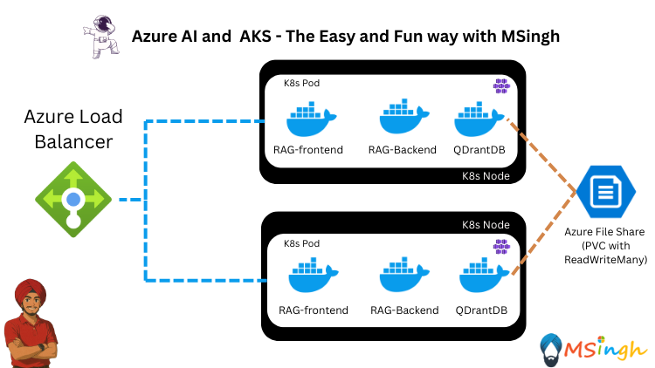
Imagine a Scenario……..
🎯 Imagine this: You’re building a powerful AI chatbot for enterprise search using a RAG pipeline on Azure Kubernetes Service.
Your pipeline includes:
🔍 A document ingestion service (PDFs, DOCX, emails)
🧬 An embedding service that converts text to vectors
📦 A vector database like Qdrant, Weaviate, or FAISS
💬 A fast LLM service that responds to user queries
Everything is containerized and running smoothly on AKS.
This is where PVCs save the day.
You attach a Persistent Volume Claim to your vector database pod, which mounts Azure Disks or Azure Files as reliable, cloud-based storage. Now:
Even if the pod crashes or is rescheduled, the indexed vectors stay safe
Your pipeline doesn’t need to recalculate embeddings
Query latency stays low, and you don’t lose hours of processing
But here's the catch...
Whenever your pods restart — especially your vector database — your embeddings and indexed documents disappear. That’s because containers are ephemeral. They lose their file system state unless you persist it somewhere.

Slide 3
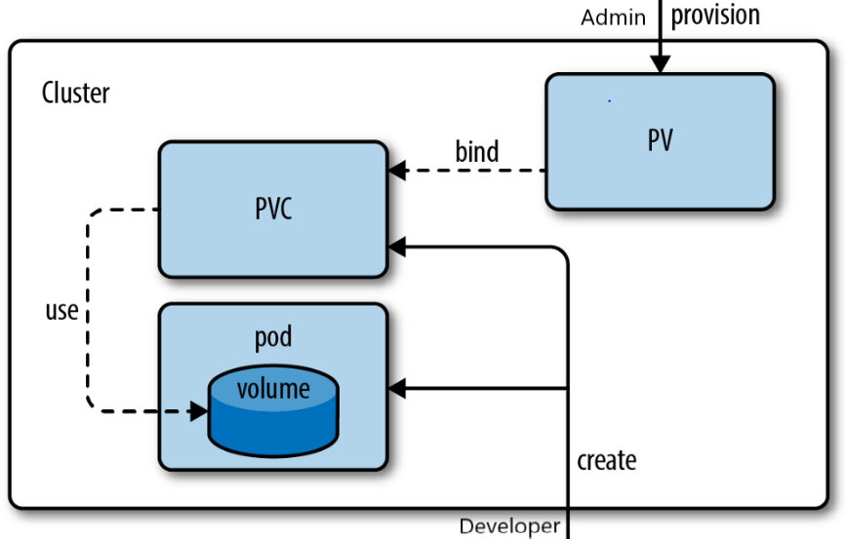
PVs (Persistent Volumes) and PVCs (Persistent Volume Claims)
A PersistentVolume (PV) is a piece of storage in the cluster that has been provisioned by an administrator or dynamically provisioned using Storage Classes.
A PersistentVolumeClaim (PVC) is a request for storage by a user. It is similar to a Pod. Pods consume node resources and PVCs consume PV resources.
Cluster administrators need to be able to offer a variety of PersistentVolumes that differ in more ways than size and access modes, without exposing users to the details of how those volumes are implemented. For these needs, there is the StorageClass resource.

Slide 4
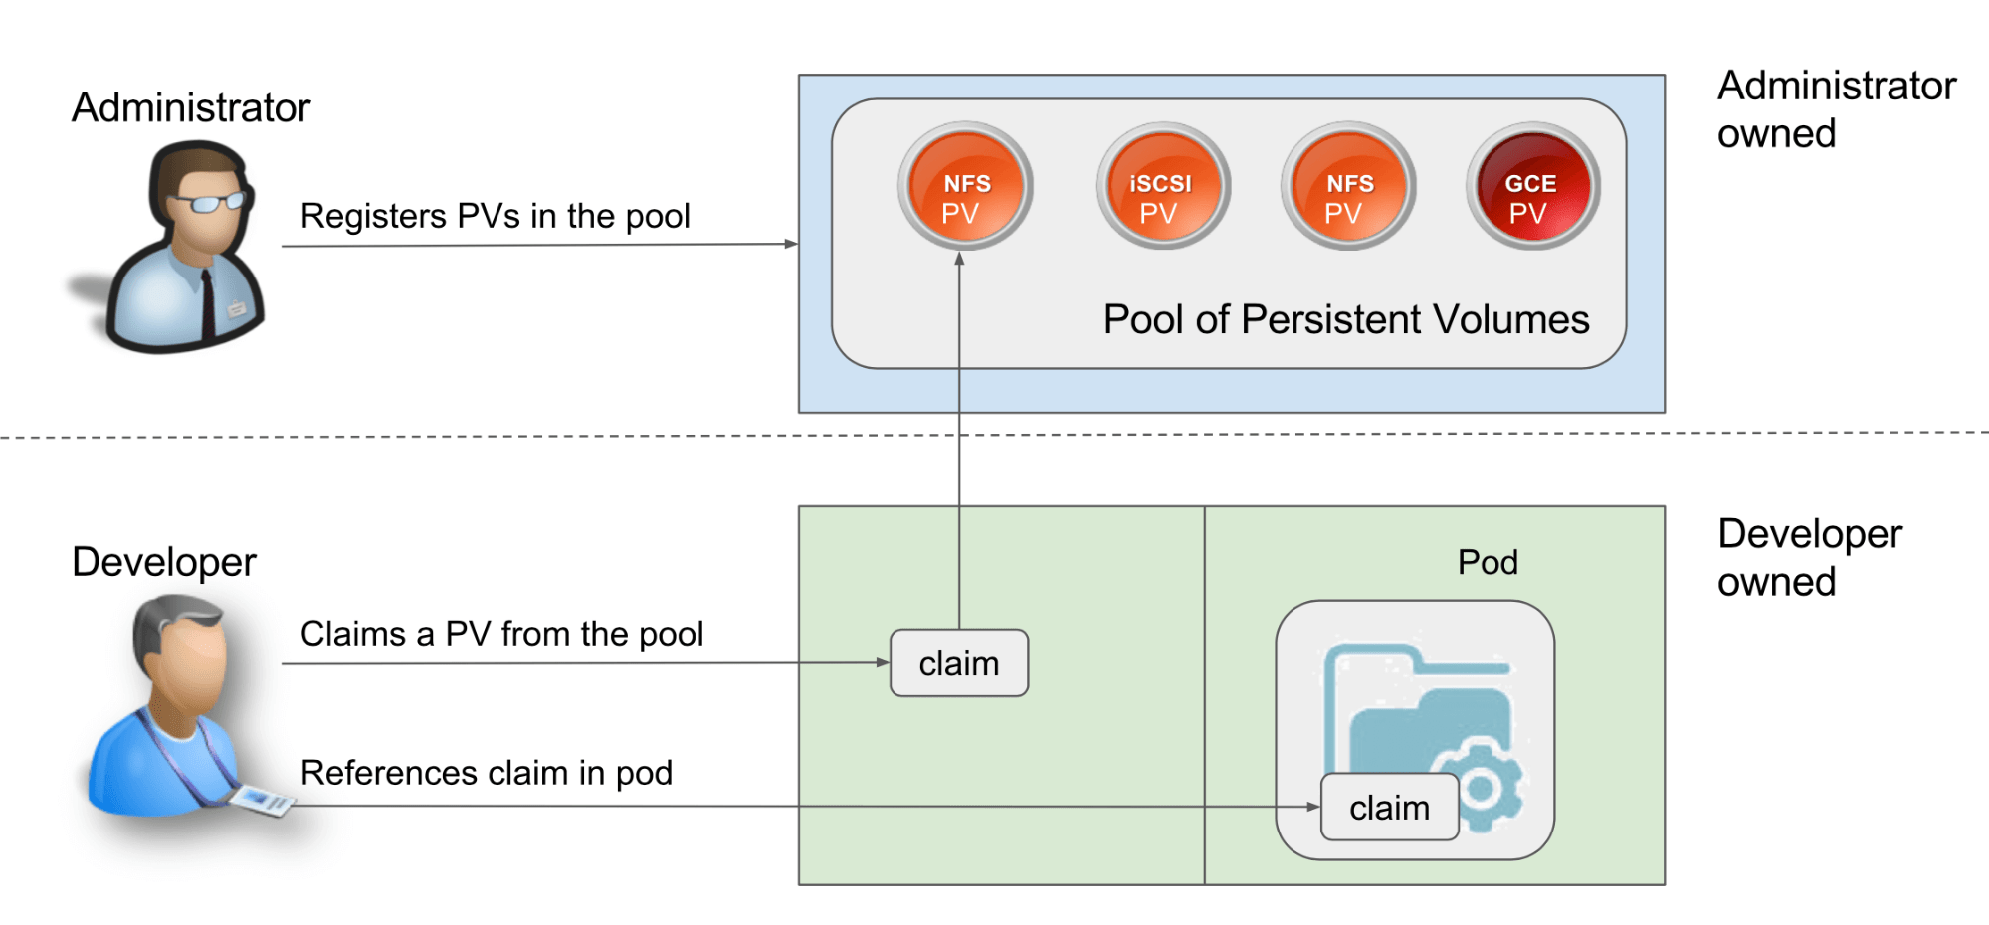
Lifecycle of a Volume and a Claim
Static Provisioning: A cluster administrator creates a number of PVs. They carry the details of the real storage, which is available for use by cluster users. They exist in the Kubernetes API and are available for consumption
Dynamic Provisioning: When none of the static PVs the administrator created match a user's PersistentVolumeClaim, the cluster may try to dynamically provision a volume specially for the PVC.

Slide 5
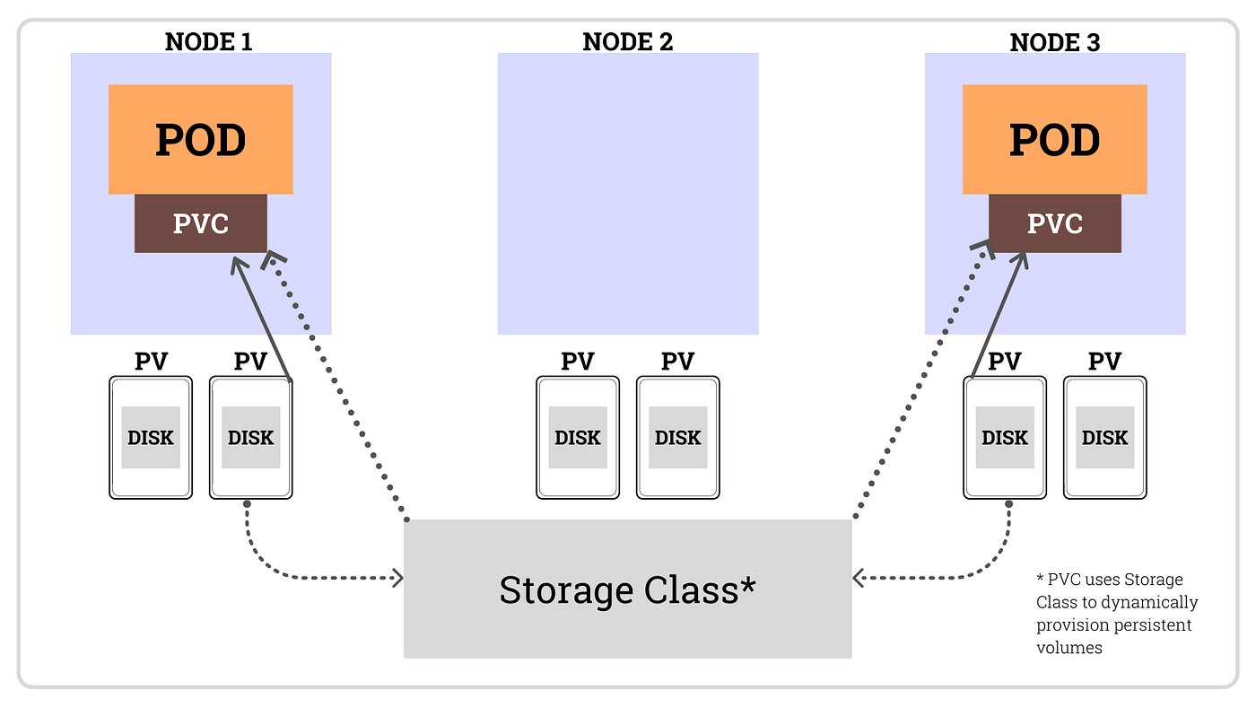
Binding Operations for PVs and PVCs
In Kubernetes, PVC is what your app requests, and PV is the actual storage resource available in the cluster. Think of it like this:
PVC = “I need 10Gi of storage that’s ReadWriteOnce”
PV = “Here’s a 10Gi Azure Disk that supports ReadWriteOnce”
Kubernetes automatically finds a match and binds the PVC to the PV.
A control loop in the control plane watches for new PVCs, finds a matching PV (if possible), and binds them together.
If a PV was dynamically provisioned for a new PVC, the loop will always bind that PV to the PVC.
Otherwise, the user will always get at least what they asked for, but the volume may be in excess of what was requested.
A PVC to PV binding is a one-to-one mapping,

Slide 6
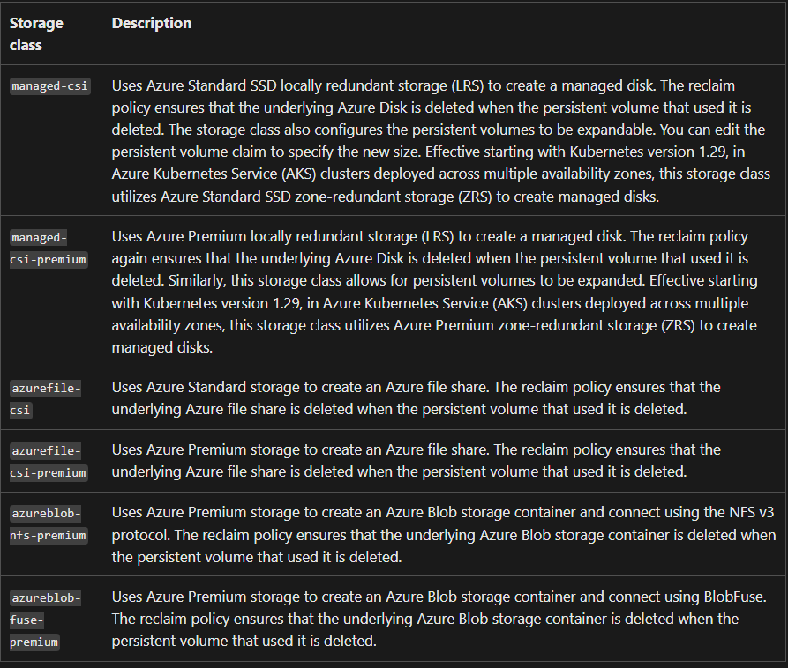
Container Storage Interface Classes in AKS for PVs
In Azure Kubernetes Service (AKS), CSI (Container Storage Interface) classes refer to drivers that enable Kubernetes to dynamically provision and manage storage on Azure.

Slide 7
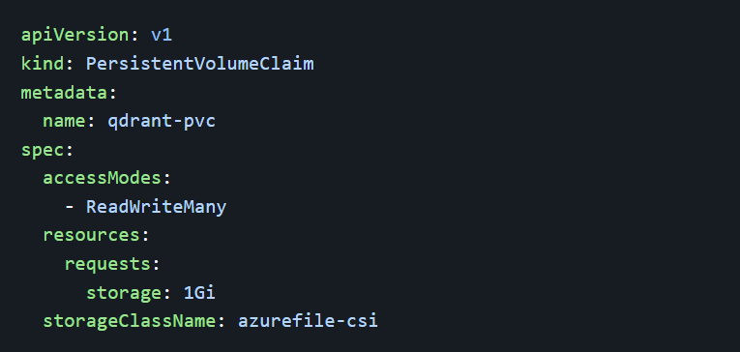
Defining a PVC – Dynamic Provisioning

Slide 8
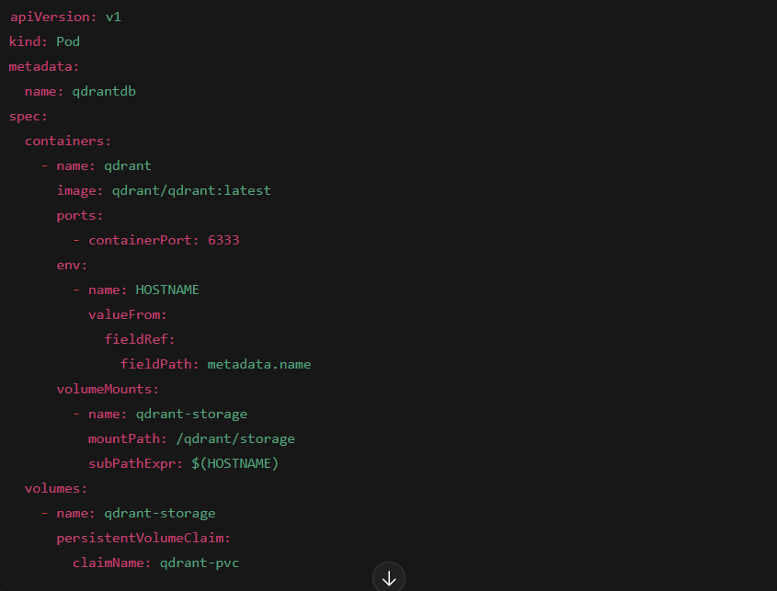
Using a PVC as a VolumeMount for a Pod

Slide 9
Unheard Points about PVCs and PVs
A Single PVC can bind to a single PV. Although multiple pods could use a single PVC as a mode to read and write data to the PV if the policy is set to [“ReadWriteMany”]
If a PVC is deleted then the PV stays but it cannot be consumed by other PVCs or different sets of PVCs without manual intervention of cleaning the data in the PVs due to “retain” policy configuration; its done this way for safety and security purposes.

