Slide 1
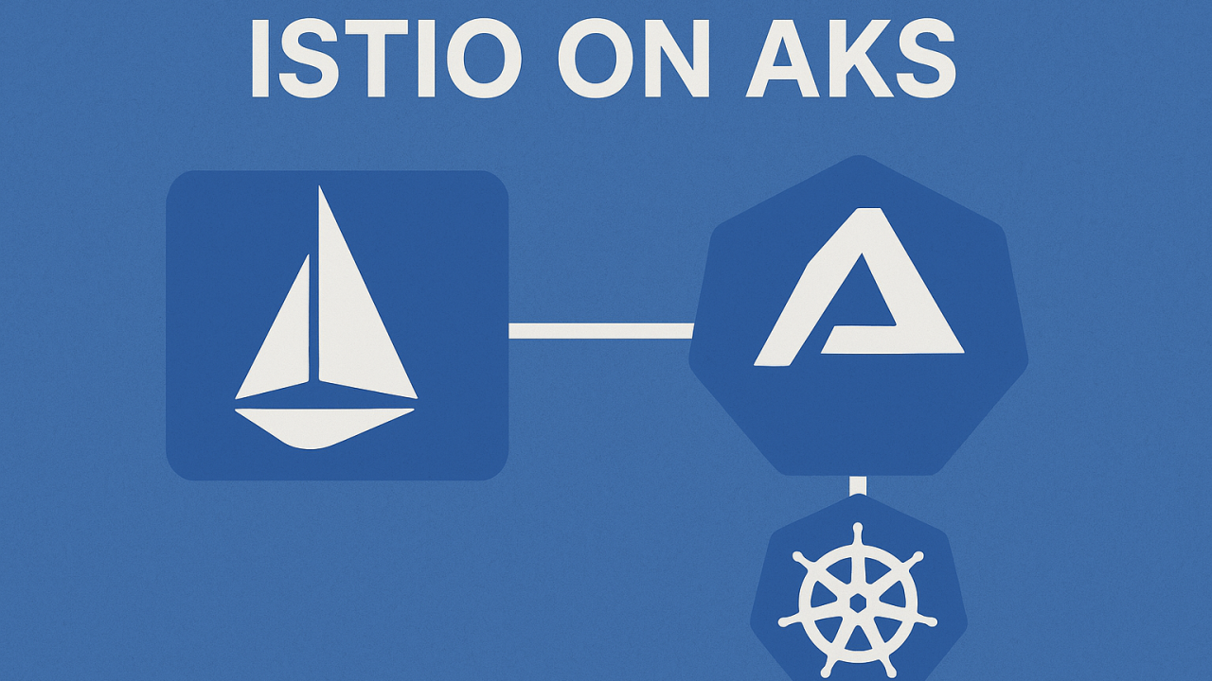
Istio Service Mesh on AKS

Slide 2
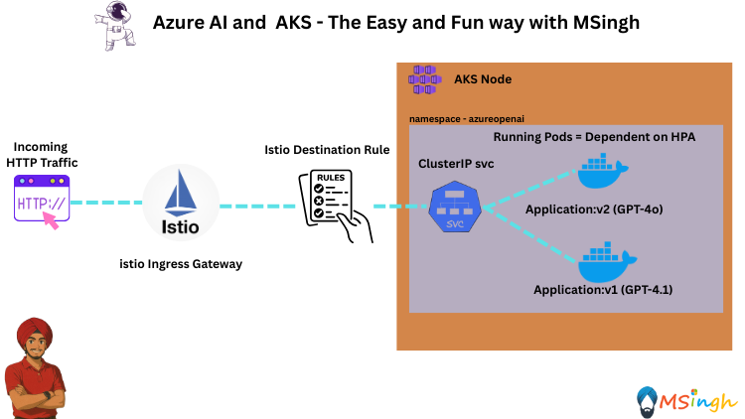
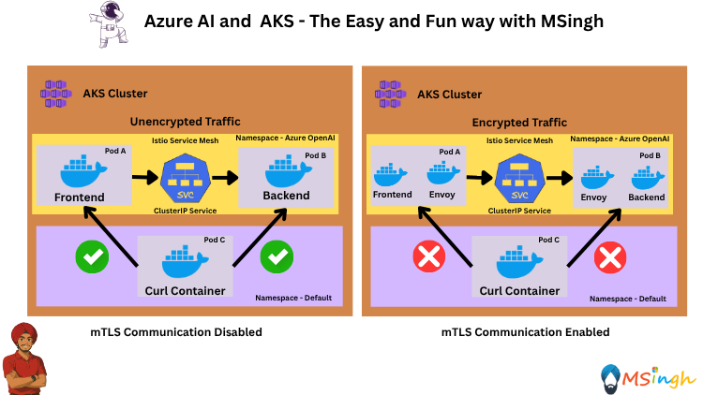
🔍Consider a Scenario…..
You’re the AKS platform owner at GreenCart 🛒. A new AI-powered Checkout v2 🤖 is ready while v1 still runs in prod. The plan:
🚀 Zero downtime rollout → start 10% traffic to v2, then increase.
🔒 Security → mTLS between services, only ingress via Istio Gateway.
🛡 Resilience → retries, timeouts, circuit breaking for flaky payments 💳.
📊 Observability → track error rate & latency, rollback if SLOs fail.
Your tasks:
1️⃣ Mesh-enable only checkout & payments namespaces.
2️⃣ Create DestinationRule subsets (v1, v2) & weighted VirtualService.
3️⃣ Apply mTLS 🔐, resilience policies ⚙, and rate limits 🚦.
4️⃣ Monitor 📈 & instantly flip back to v1 if needed ⏪.

Slide 3
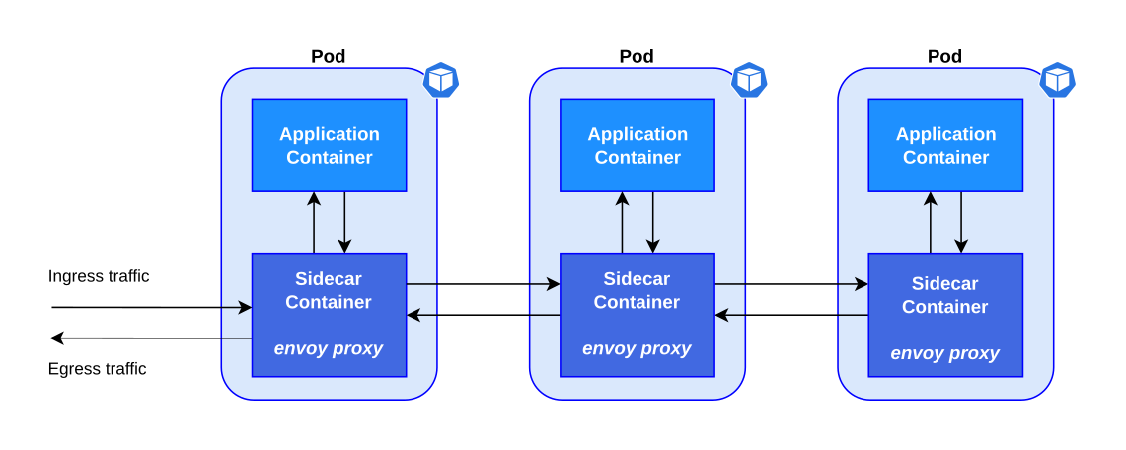
Why Do you need Istio?
Its powerful control plane brings vital features, including:
Secure service-to-service communication in a cluster with TLS encryption
Automatic Load Balancing for HTTP, gRPC, WebSocket and TCP traffic.
Automatic metrics, logs and rules collection.
Advanced Software Architecture Patterns like circuit-breaker, ingress routing through gateway, canary deployments etc,
Modern applications are typically architected as distributed collections of microservices, with each collection of microservices performing some discrete business function.
A service mesh is a dedicated infrastructure layer that you can add to your applications. It allows you to transparently add capabilities like observability, traffic management, and security, without adding them to your own code.
Istio is an open-source service mesh that layers transparently onto existing distributed applications.

Slide 4
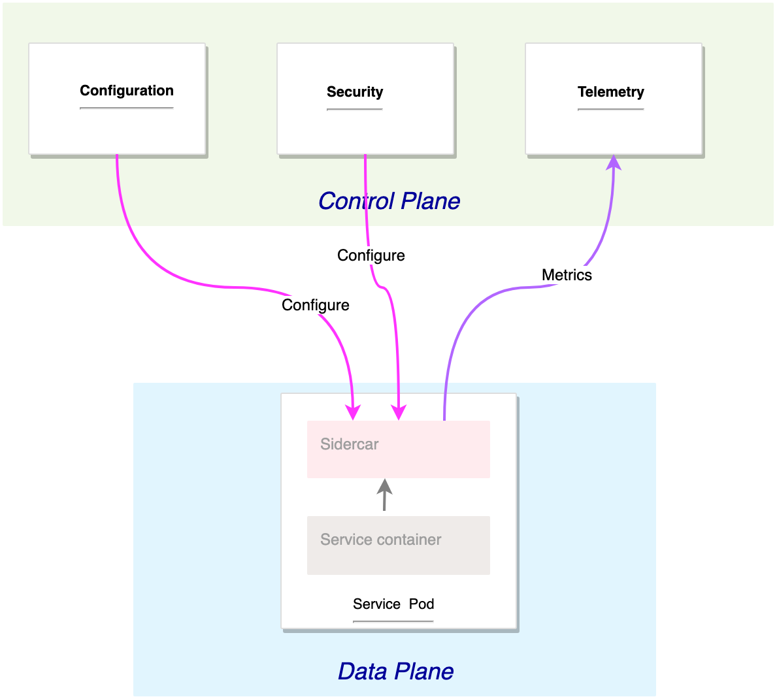
Istio Architecture
An Istio service mesh is logically split into a data plane and a control plane.
The control plane manages and configures the proxies to route traffic.
The data plane is composed of a set of intelligent proxies (Envoy) deployed as sidecars. These proxies mediate and control all network communication between microservices. They also collect and report telemetry on all mesh traffic.

Slide 5
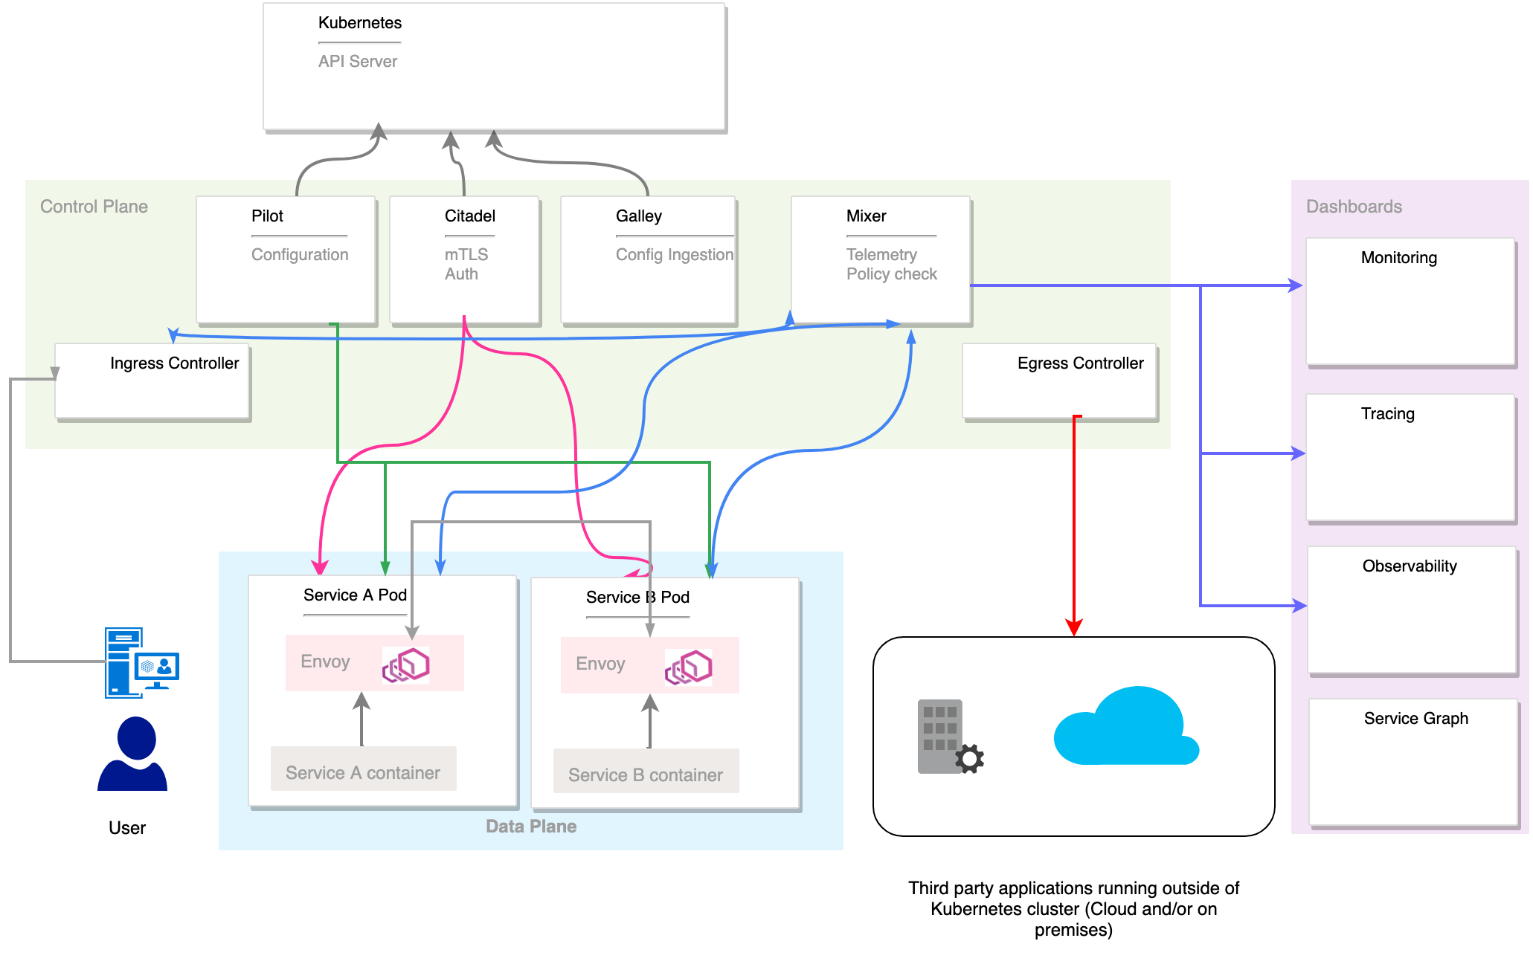
Istio Old Architecture – Old But Still Critical
Pilot – Configuration & Traffic Management
Watches Kubernetes API for services/endpoints and Istio configs.
Translates Istio routing rules into Envoy-compatible configs.
Pushes configurations to sidecar proxies using xDS APIs.
Enables advanced traffic control (canary, fault injection, retries, mirroring).

Slide 6
Istio Old Architecture – Old But Still Critical
Citadel – Security & mTLS Authority
Acts as Istio’s internal Certificate Authority (CA).
2) Issues and rotates X.509 certificates for workloads.
3) Distributes keys securely to Envoy sidecars via SDS.
4) Enables automatic mutual TLS (mTLS) between services.

Slide 7
Istio Old Architecture – Old But Still Critical
Galley – Config Validation & Distribution
1) Ingests Istio configuration (CRDs like VirtualService, DestinationRule).
2) Validates configurations against Istio schema before applying.
3) Ensures consistent, error-free configuration across the mesh.

Slide 8
Istio Old Architecture – Old But Still Critical
Mixer – Policy Enforcement & Telemetry (Deprecated in newer Istio)
1) Enforced policies such as quotas, ACLs, and rate limits.
2) Collected telemetry data (metrics, logs, traces) from sidecars.
3) Sent telemetry to monitoring backends like Prometheus, Grafana, Stackdriver.

Slide 9
Istio Old Architecture – Old But Still Critical
Egress Controller
Manages outbound traffic leaving the mesh.
Enforces policies on external service calls.

Slide 10
Istio Old Architecture – Old But Still Critical
Ingress Controller
Entry point for external traffic into the mesh.
Routes requests through Envoy to the correct internal service.

Slide 11
Istio Old Architecture – Old But Still Critical
Data Plane – Service Pods with Envoy Sidecars
Each service pod has an Envoy proxy sidecar.
2) Envoy handles service-to-service communication, mTLS, and telemetry.
3) Sidecars communicate with the control plane (Pilot, Citadel, etc.) for updates.

Slide 12
Istio Old Architecture – Old But Still Critical
Dashboards & Observability
1) Monitoring: Tracks health, latency, throughput.
2) Tracing: End-to-end request tracing (Jaeger, Zipkin).
3) Observability: Logs, metrics, and distributed traces.
4) Service Graph: Visual topology of service interactions.

Slide 13
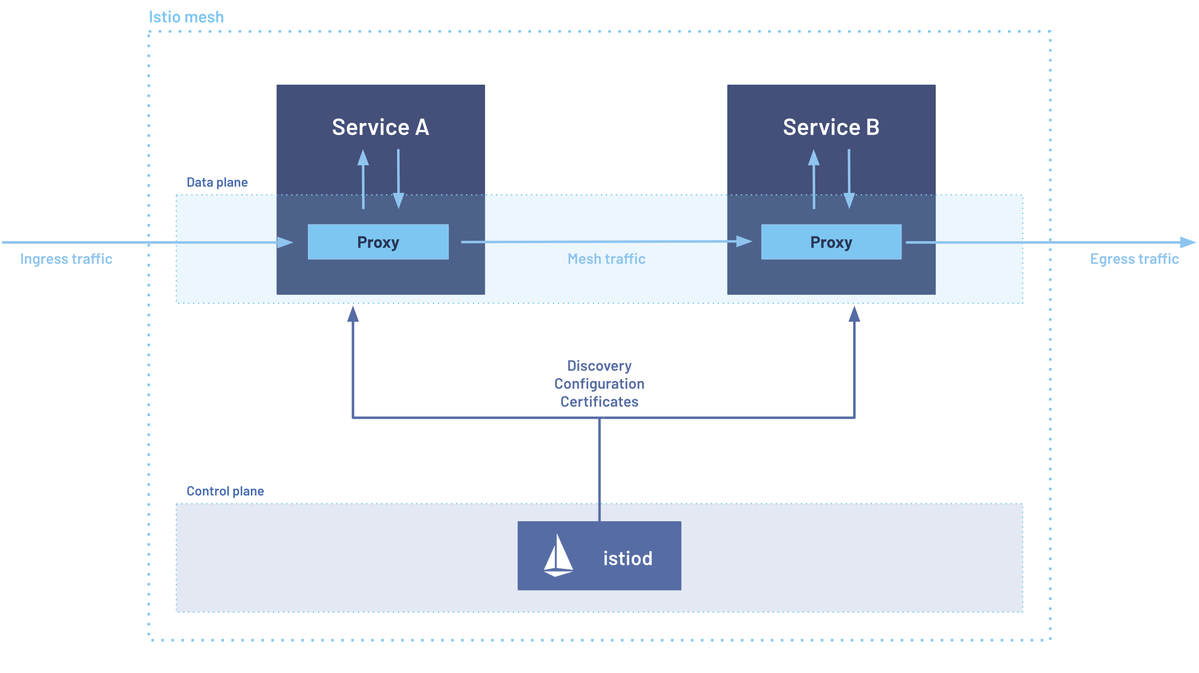
Istio New Architecture – An Inspiration from the Past
What changed (at a glance)
Then (≤1.4): Many control-plane pods — Pilot (traffic), Citadel (certs), Galley (config), Mixer (policy/telemetry).
Now (1.5+): One control-plane binary: istiod. Mixer removed; policy/telemetry handled by Envoy filters (“telemetry v2”).
One-line mapping (old → new)
Pilot → istiod: service discovery + xDS config pushes.
Citadel → istiod: CA; issues/rotates workload certs via SDS.
Galley → istiod: config validation/ingestion for Istio CRDs.
Mixer → (removed): replaced by native Envoy extensions + direct export to Prometheus/OTel.

