Slide 1
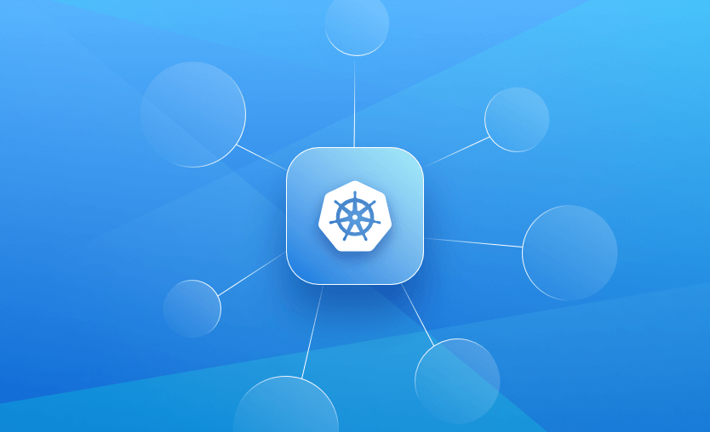
K8S and AKS Networking

Slide 2
Four Main Areas of Comms
Container to Container Communication
Pod to Pod Communication
Pod to Service Communication
External to Service Communication
Think of a “Service” as a typical way to expose multiple running backends under the same hood. Cleanest example is Azure Load Balancer which is a service of type “LoadBalancer”

Slide 3
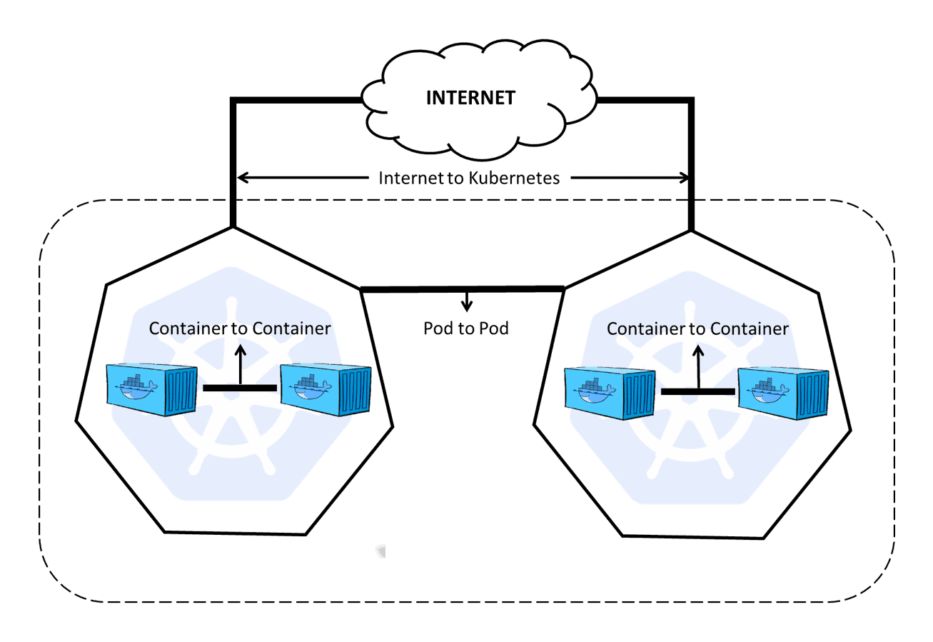
Some Key Points about K8S Networking….
The Kubernetes networking implementation allocates IP addresses, assigns DNS names, and maps ports to your Pods and Services. This process is generally automatic.
At a high level, the Kubernetes network model works by allocating each Pod a unique IP address that resolves within your cluster.
Pods can then communicate using their IP addresses, without requiring NAT or any other configuration.

Slide 4
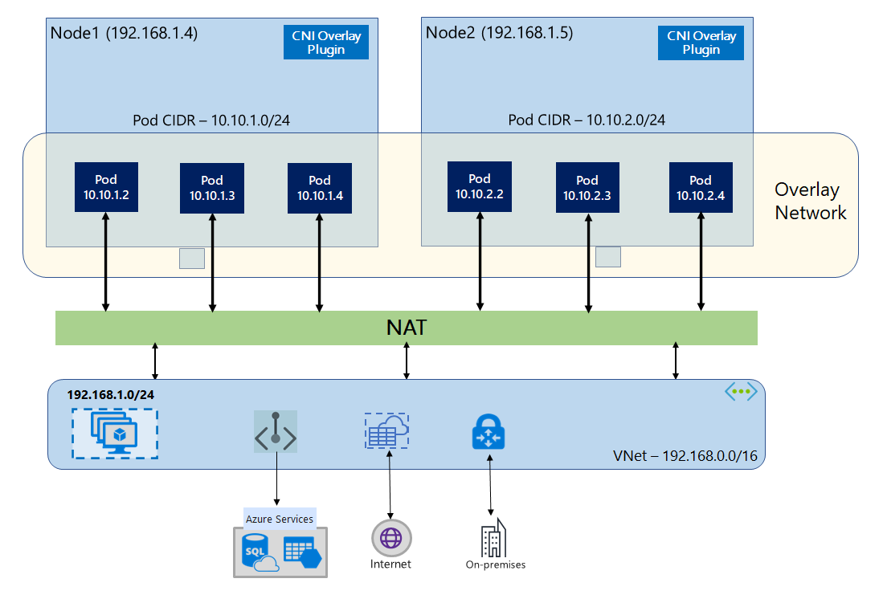
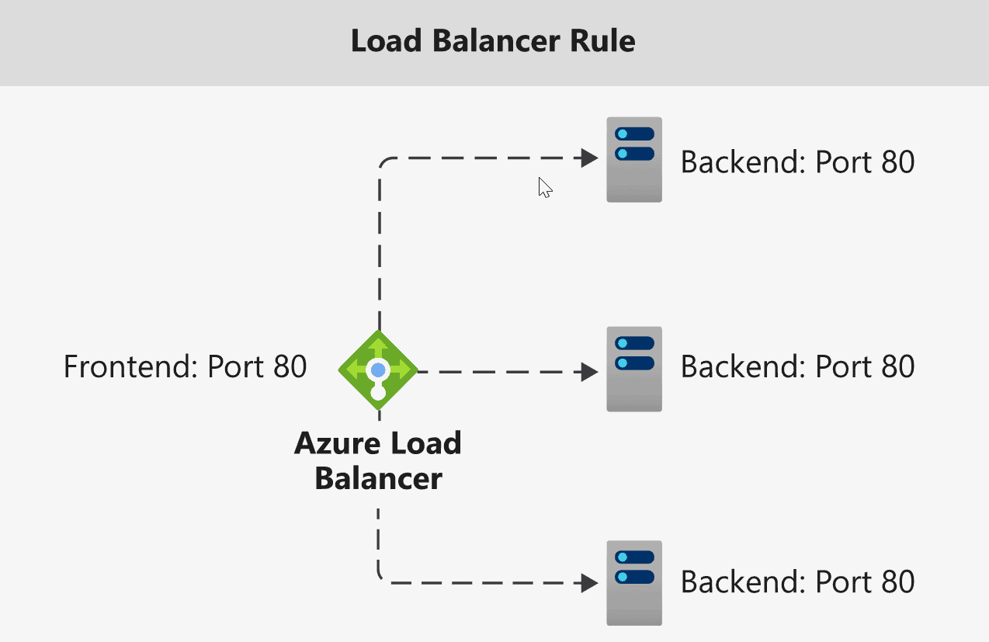

A Typical AKS Networking Setup
Azure CNI Overlay – Creates an overlay network and assigns Pods IP Addresses for the Pod CIDR to avoid Vnet IP exhaustion
The Azure CNI Overlay Plugin helps the Nodes maintain a Routing Table that maps Pod CIDR to the Azure Vnet IPv4 range via a Virtual LAN Tunnel
Service
Azure Load Balancer
Azure Load Balancer routing external traffic to the internal pods and AKS Cluster
VMSS (Virtual Machine Scale Sets) acting as scalable nodes
Azure Virtual Network
Range – [192.168.0.0 , 192.168.256.256]

Slide 5
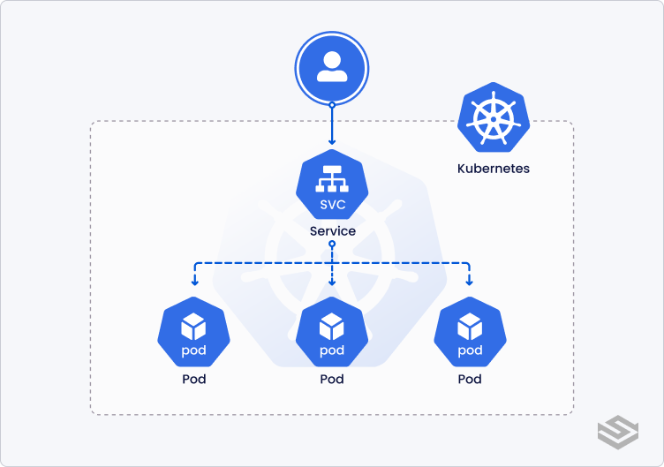
What Are “Services” in K8S
Services in K8S and AKS are important to expose multiple pods under a single IP Address or a DNS name.
Why Services Exist:
Pods are ephemeral — their IPs can change.
A Service gives a stable virtual IP (ClusterIP) to access backend pods reliably, even if pods die or restart.
Five main Types of Services:
1) ClusterIP
2) NodePort
3) LoadBalancer
4) ExternalName
5) Headless Service

Slide 6
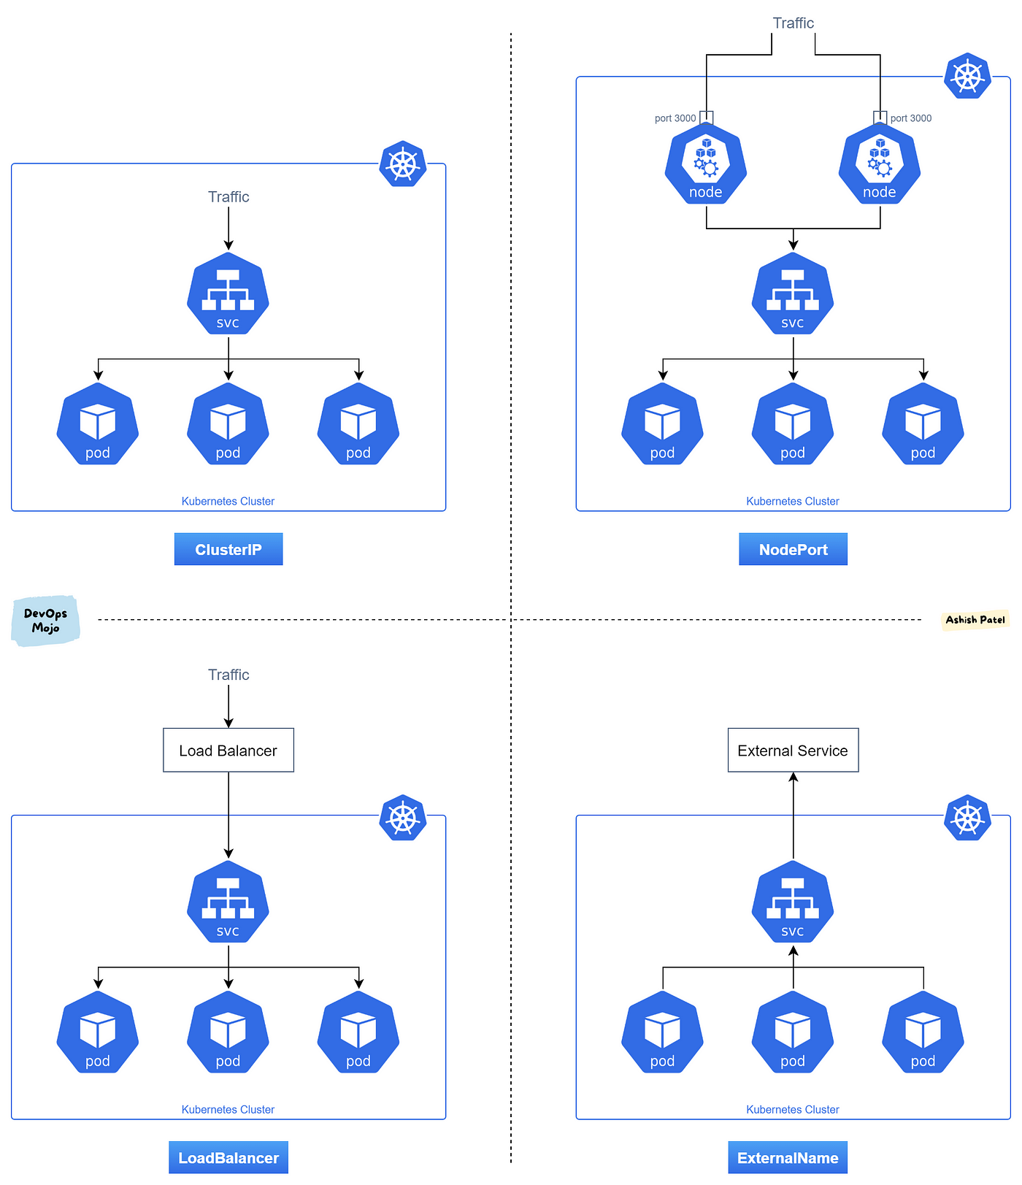
Exposes a port on each Node’s IP which routes to ClusterIP
Service of type “ClusterIP”
Exposes service only inside the cluster
Example use-Case: Accessing service externally without a LoadBalancer
Example use-Case: Internal APIs, DB services
Maps a service to an external DNS Name
Provisions an external IP via Azure Load Balancer
Example use-Case: db.mycompany.com as a service name
Example use-Case: Ingress, public-facing web services
Service of type “ClusterIP”

Slide 7
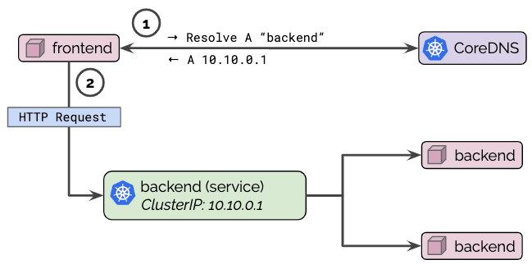
How DNS Works in Kubernetes Clusters
Kubernetes automatically assigns DNS names to Pods and Services in the following format:
Pod – pod-ip-address.pod-namespace-name.pod.cluster-domain.example (e.g. 10.244.0.1.my-app.svc.cluster.local)
Service – service-name.service-namespace-name.svc.cluster-domain.example (e.g. database.my-app.svc.cluster.local)
The applications running in your Pods should usually be configured to communicate with Services using their DNS names. Names are predictable, whereas a Service’s IP address will change if the Service is deleted and then replaced.

