Slide 1
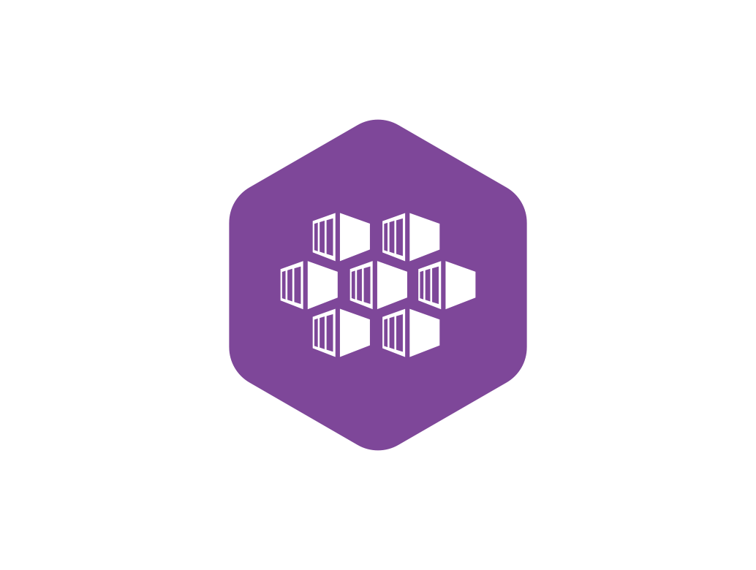
K8S Workload Objects

Slide 2
Consider a Scenario…….
Imagine you’re planning a trip with some friends. Which type of car would you choose ?
I know you have a soft spot for sports cars -just like me-, so you might immediately think of beasts like BMW, Audi, or Mercedes.
But what if I told you the trip is through the Sahara desert? Suddenly, even the top-tier sedan rocket, like the BMW M5 CS — my dream car, by the way — would be the worst choice imaginable.
The correct answer to this question is, “It depends!” It depends on the location, distance, weather, and many other factors.

Slide 3
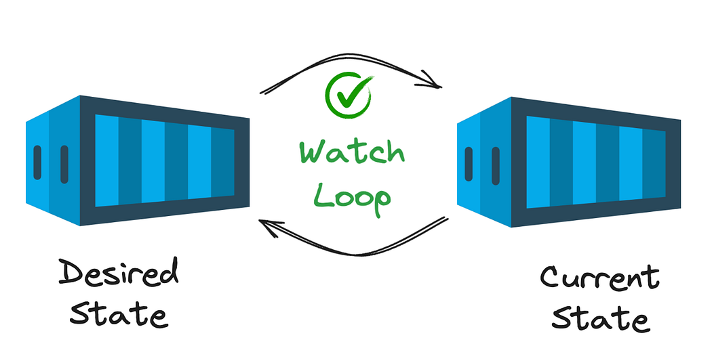
Similarly…..
Similarly, when deploying applications on Kubernetes, the choice of workload resource matters. Should you use Deployment, StatefulSet, DaemonSet, or perhaps a simple Job or CronJob?
Kubernetes Workload Objects manage the way your application (containers) are deployed in the pods. Some applications need to be stateful, some stateless while others need to only run for a short period of time and that too only on let’s say every fortnight owing to some business workflow.

Slide 4
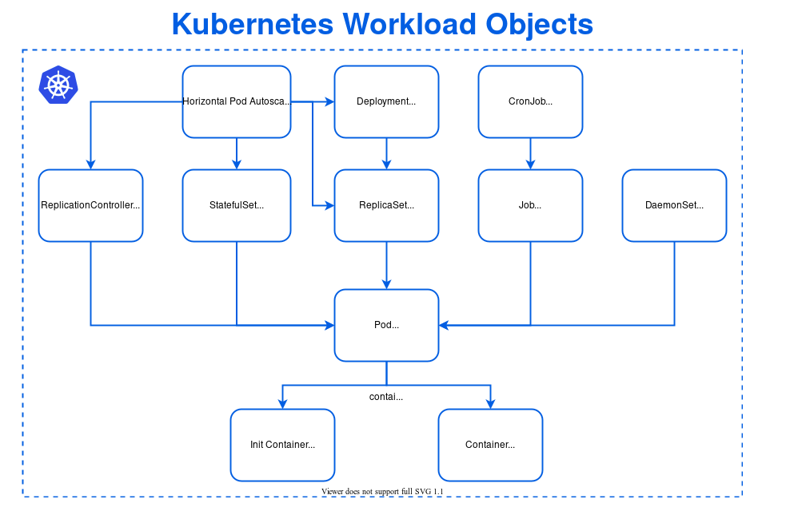
Main Areas of Focus!

Slide 5
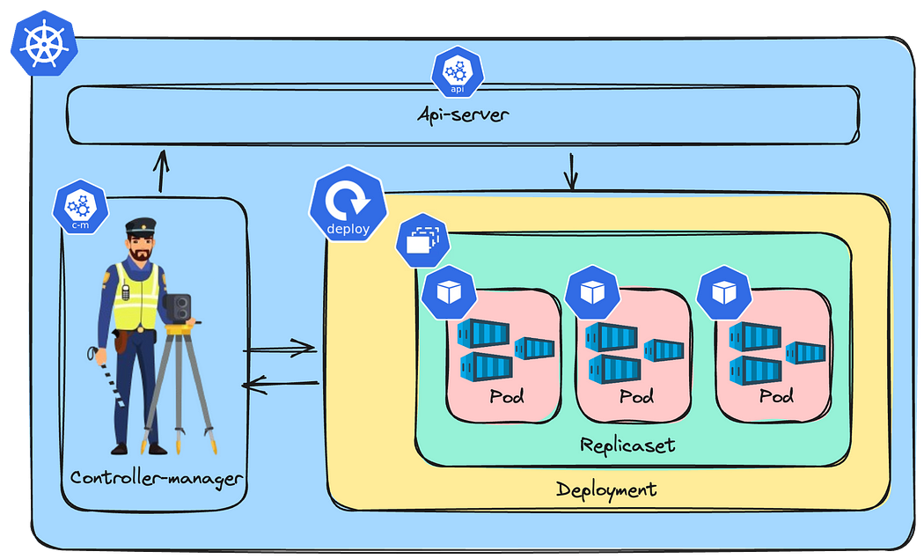
Kubernetes Deployment
Kubernetes Deployments is like your daily driving car, this is the workload resource you’ll interact with the most as a developer
These are the simplest Kubernetes workload objects and are primarily used for applications that are stateless

Slide 6
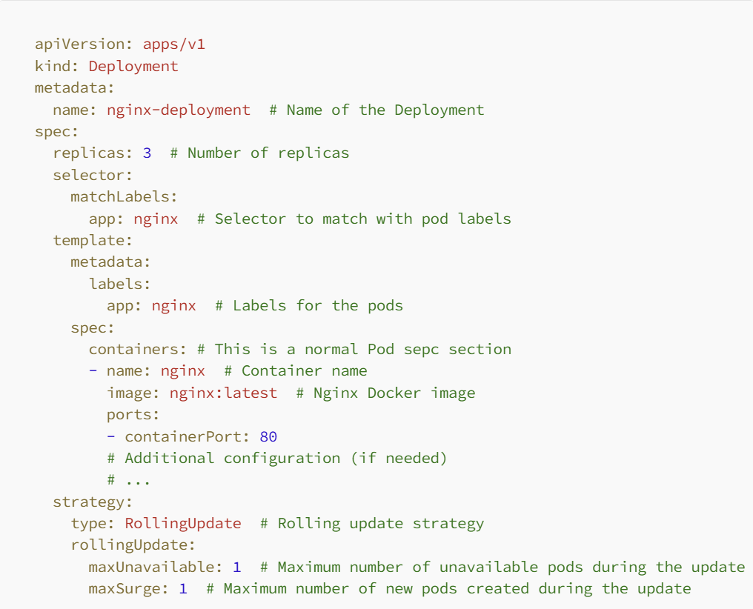
Example of a “Deployment”

Slide 7
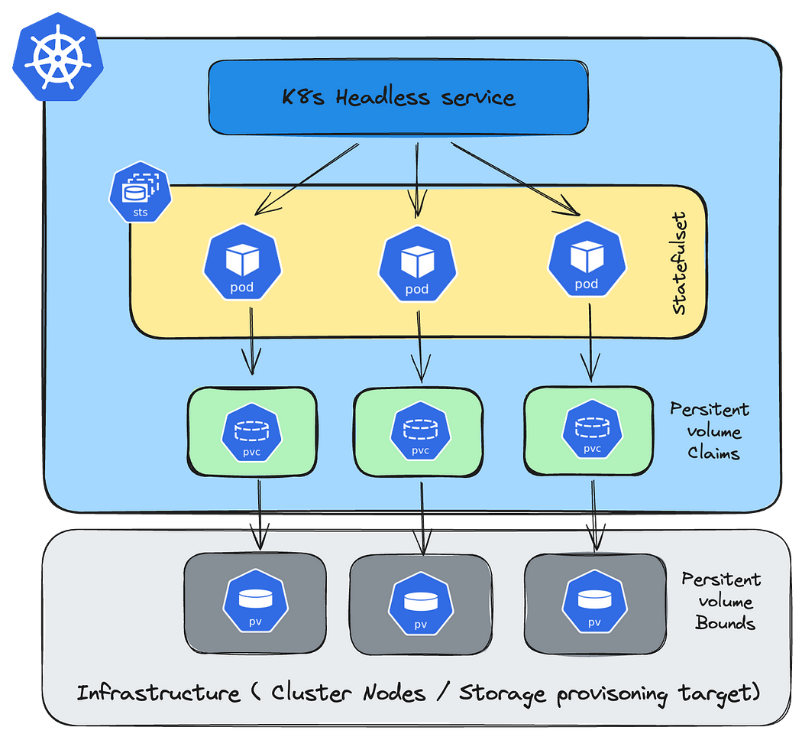
StatefulSets
Kubernetes StatefulSets are a level above Deployments. If Deployment is a simple Honda Sedan then StatefulSet is your glamorous but highly complicated “G-Wagon”
StatefulSets are primarily used for “Stateful” applications and workloads. Their power lies in the way that they bind to PVC (persistent Volume Claims) to provide data storage and persistence

Slide 8
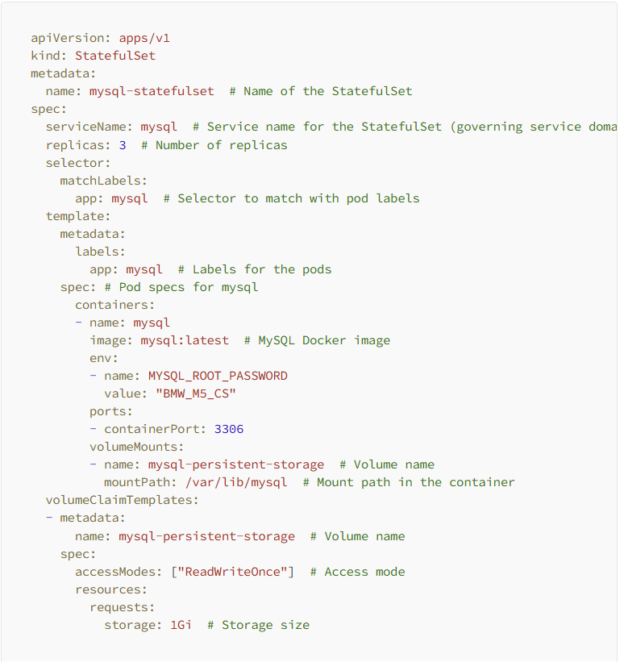
StatefulSet Example

Slide 9
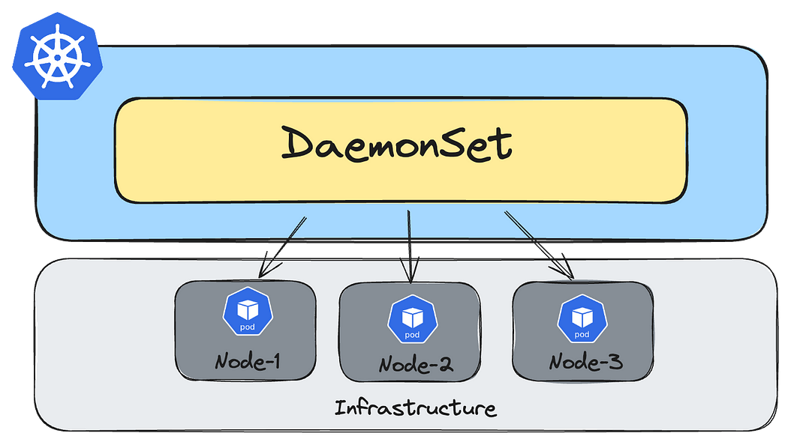
DaemonSet
Think of a taxi — a type of car you’d want available in every location or environment where it’s needed. Similarly, a DaemonSet ensures that all (or some) nodes run a copy of a pod.
A DaemonSet ensures that a particular process runs on every node (based on the configuration). The name “DaemonSet” is derived from the Unix daemon process, which runs continuously in the background.

Slide 10
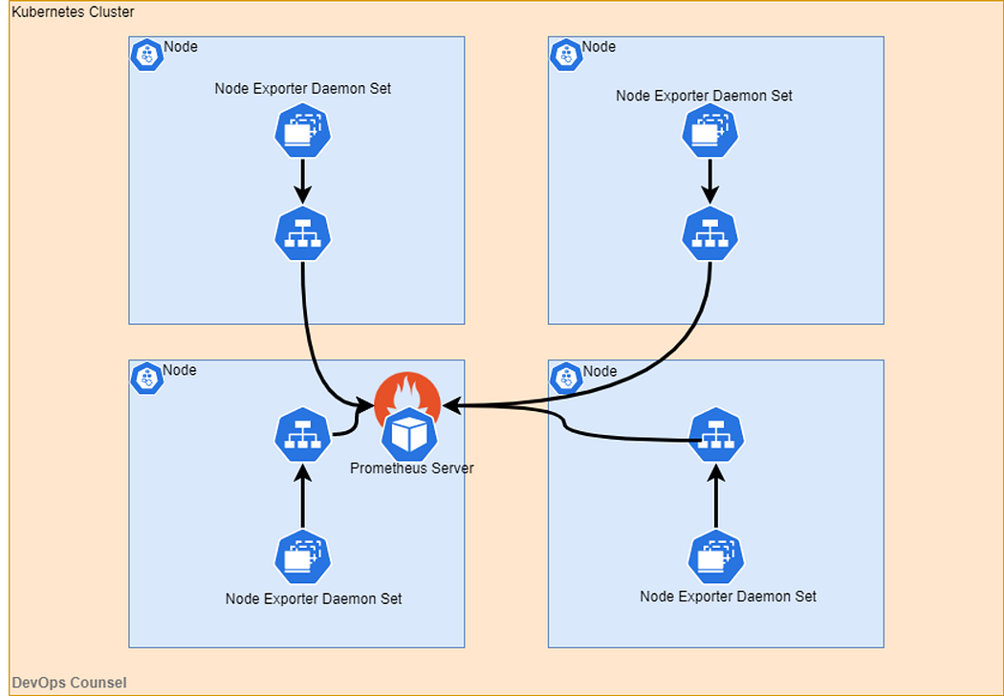
Prometheus Exporters – DaemonSet use-Case

Slide 11
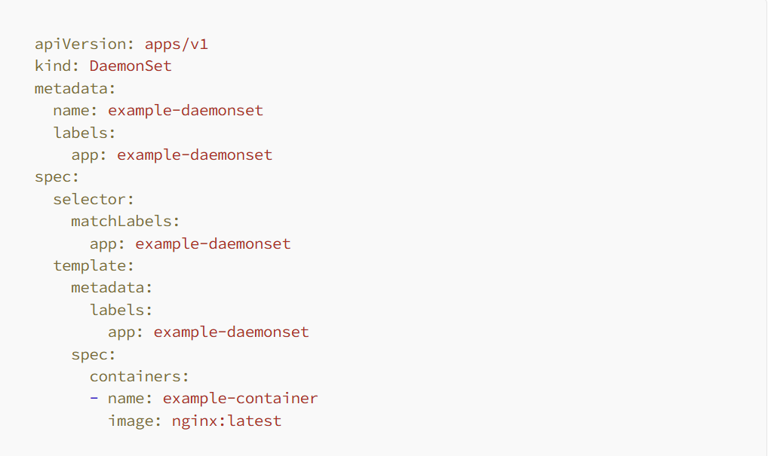
DaemonSet Example

Slide 12
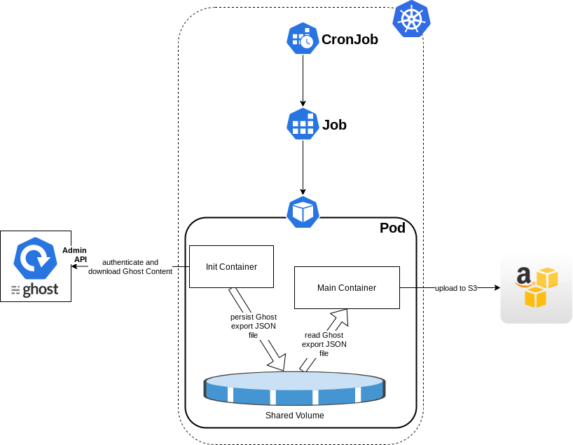
Job/CronJob
Imagine you’ve reached the Sahara Desert and have a destination nestled between the mountains that you’d like to explore. Renting a Cross Quad bike would be the perfect solution for this journey.
Similarly, a Kubernetes Job enables you to launch short-term, ephemeral processes

Slide 13
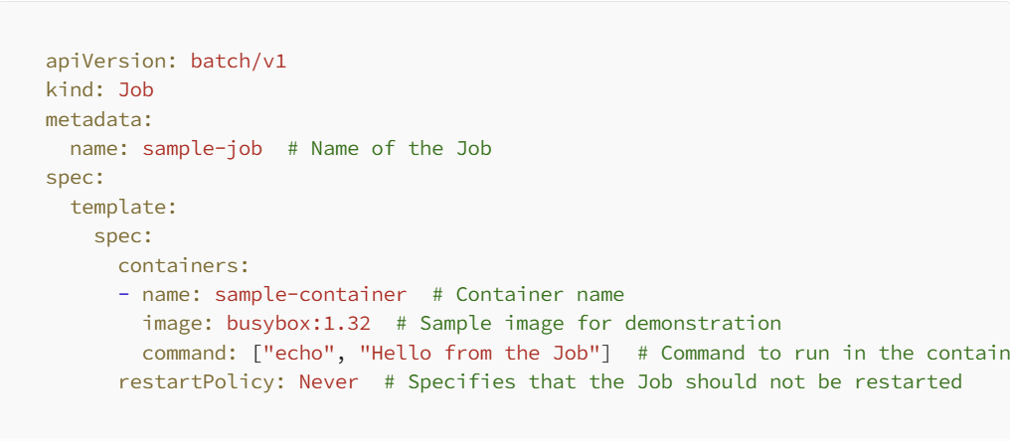
CronJob Example

