Slide 1
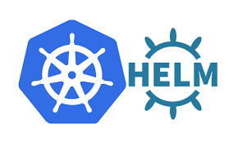
Understanding Helm Charts

Slide 2
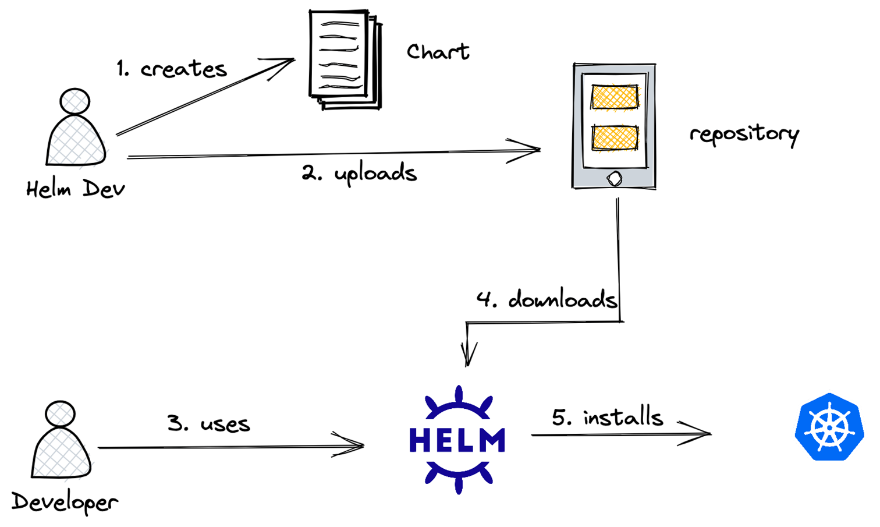
🔮 Imagine a scenario: You're building a scalable AI platform
You work for a startup called NeuroStack, which delivers AI-powered document understanding services. Your platform includes:
A model inference API (e.g., FastAPI + PyTorch model)
A Redis cache to store intermediate outputs
A PostgreSQL DB for user metadata
A frontend dashboard (React)
A prometheus + grafana stack for monitoring
You're deploying this system in a Kubernetes cluster — and managing everything with raw YAML is getting painful:
Too many files
Too hard to configure for different environments (dev, staging, prod)
Difficult to onboard new team members or automate deployments
🚀 Enter Helm Charts
Instead of hundreds of YAML files, you only create a Helm chart for your AI workload that deploys everything at the hit of a “button”.

Slide 3
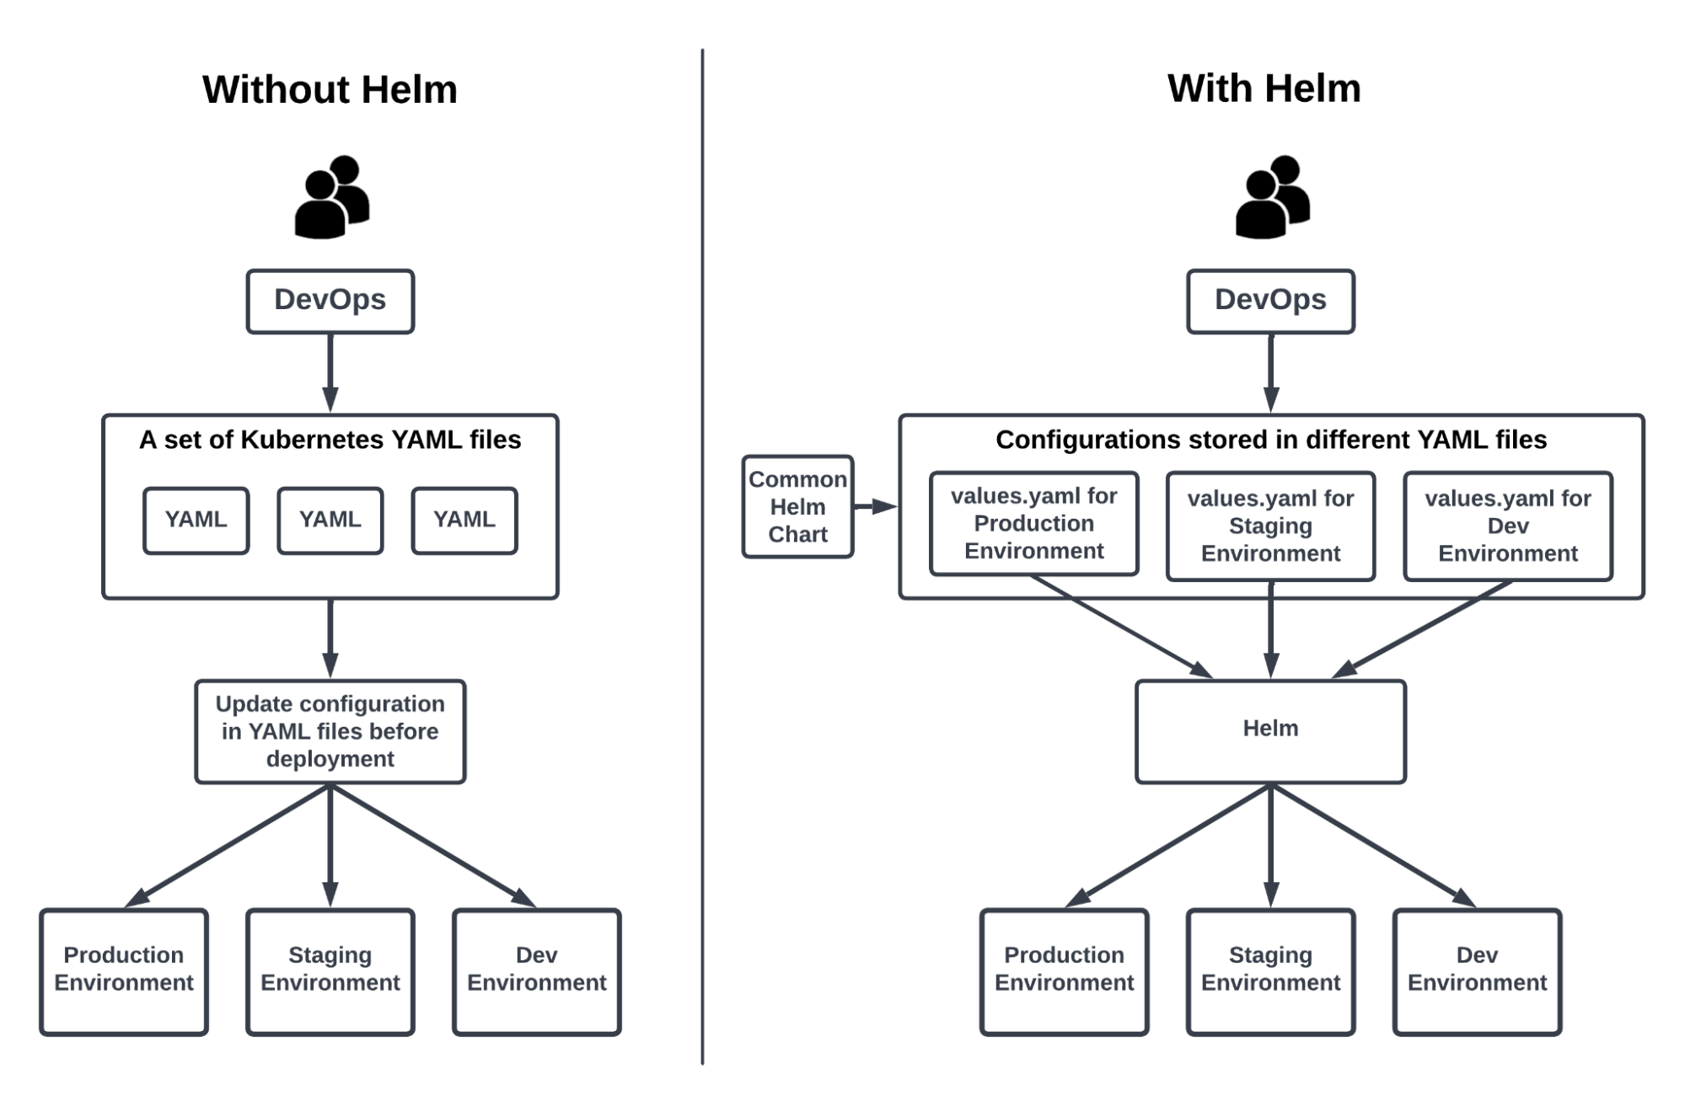
A Deeper Look at Helm

Slide 4
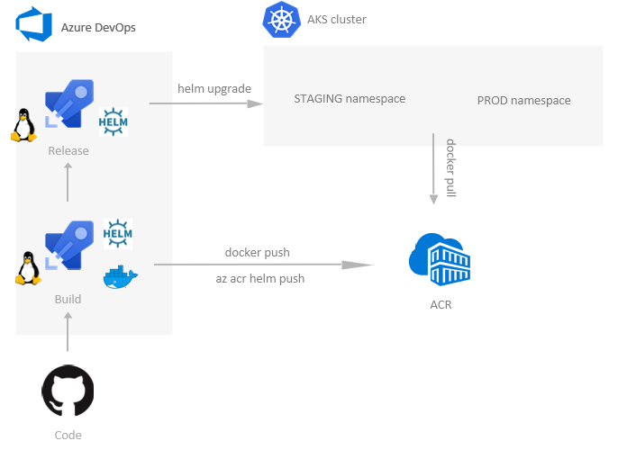
Helm Charts with ACR and AKS – E2E Workflow

