Slide 1
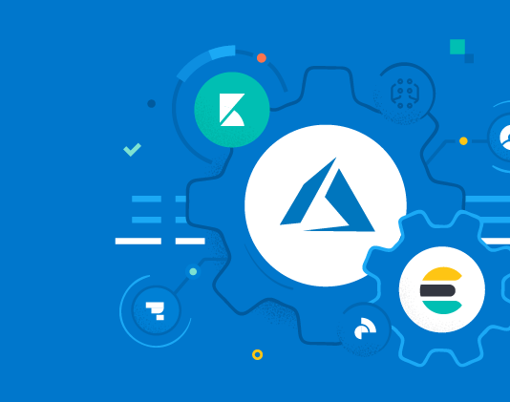
Ingress in AKS

Slide 2
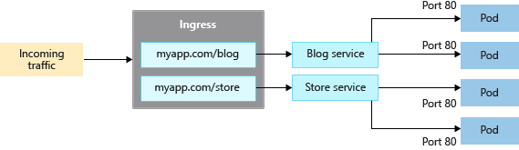
🔮 Imagine a scenario: AI-powered SaaS platform with multiple microservices
You're building an AI-powered SaaS platform called "VisionPro" that offers several computer vision APIs and dashboards:
api.visionpro.ai → REST API for inference requests
dashboard.visionpro.ai → React-based frontend for analytics
modelhub.visionpro.ai → UI for uploading and managing custom AI models
webhook.visionpro.ai → Internal endpoint for receiving model training events
Your Kubernetes cluster hosts all these services as separate Deployments, and you want to:
Expose all of them over HTTPS
Route traffic based on subdomains
Terminate TLS securely
Monitor usage logs

Slide 3
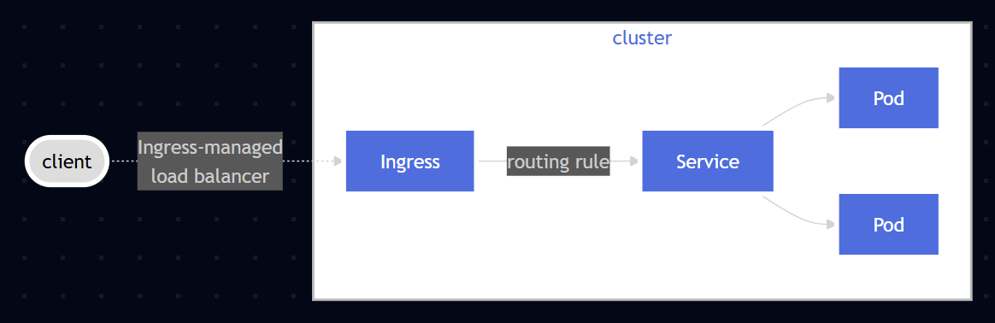
What is Ingress?
Ingress exposes HTTP and HTTPS routes from outside the cluster to services within the cluster. Traffic routing is controlled by rules defined on the Ingress resource.
In order for an Ingress to work in your cluster, there must be an ingress controller running. You need to select at least one ingress controller and make sure it is set up in your cluster.

Slide 4
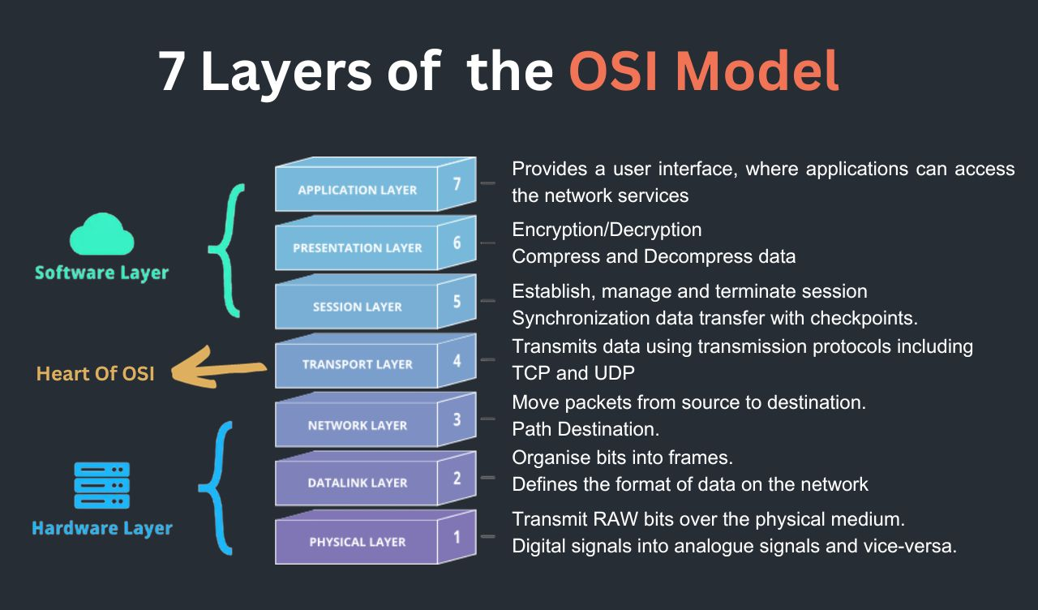
Load Balancer v/s Ingress Controller
🧠 Summary
1) Use Ingress Controller for smart HTTP routing and managing multiple services.
2) Use Load Balancer for basic external access to a single service (or to expose the Ingress Controller itself).
Ingress Controller
Load Balancer

Slide 5
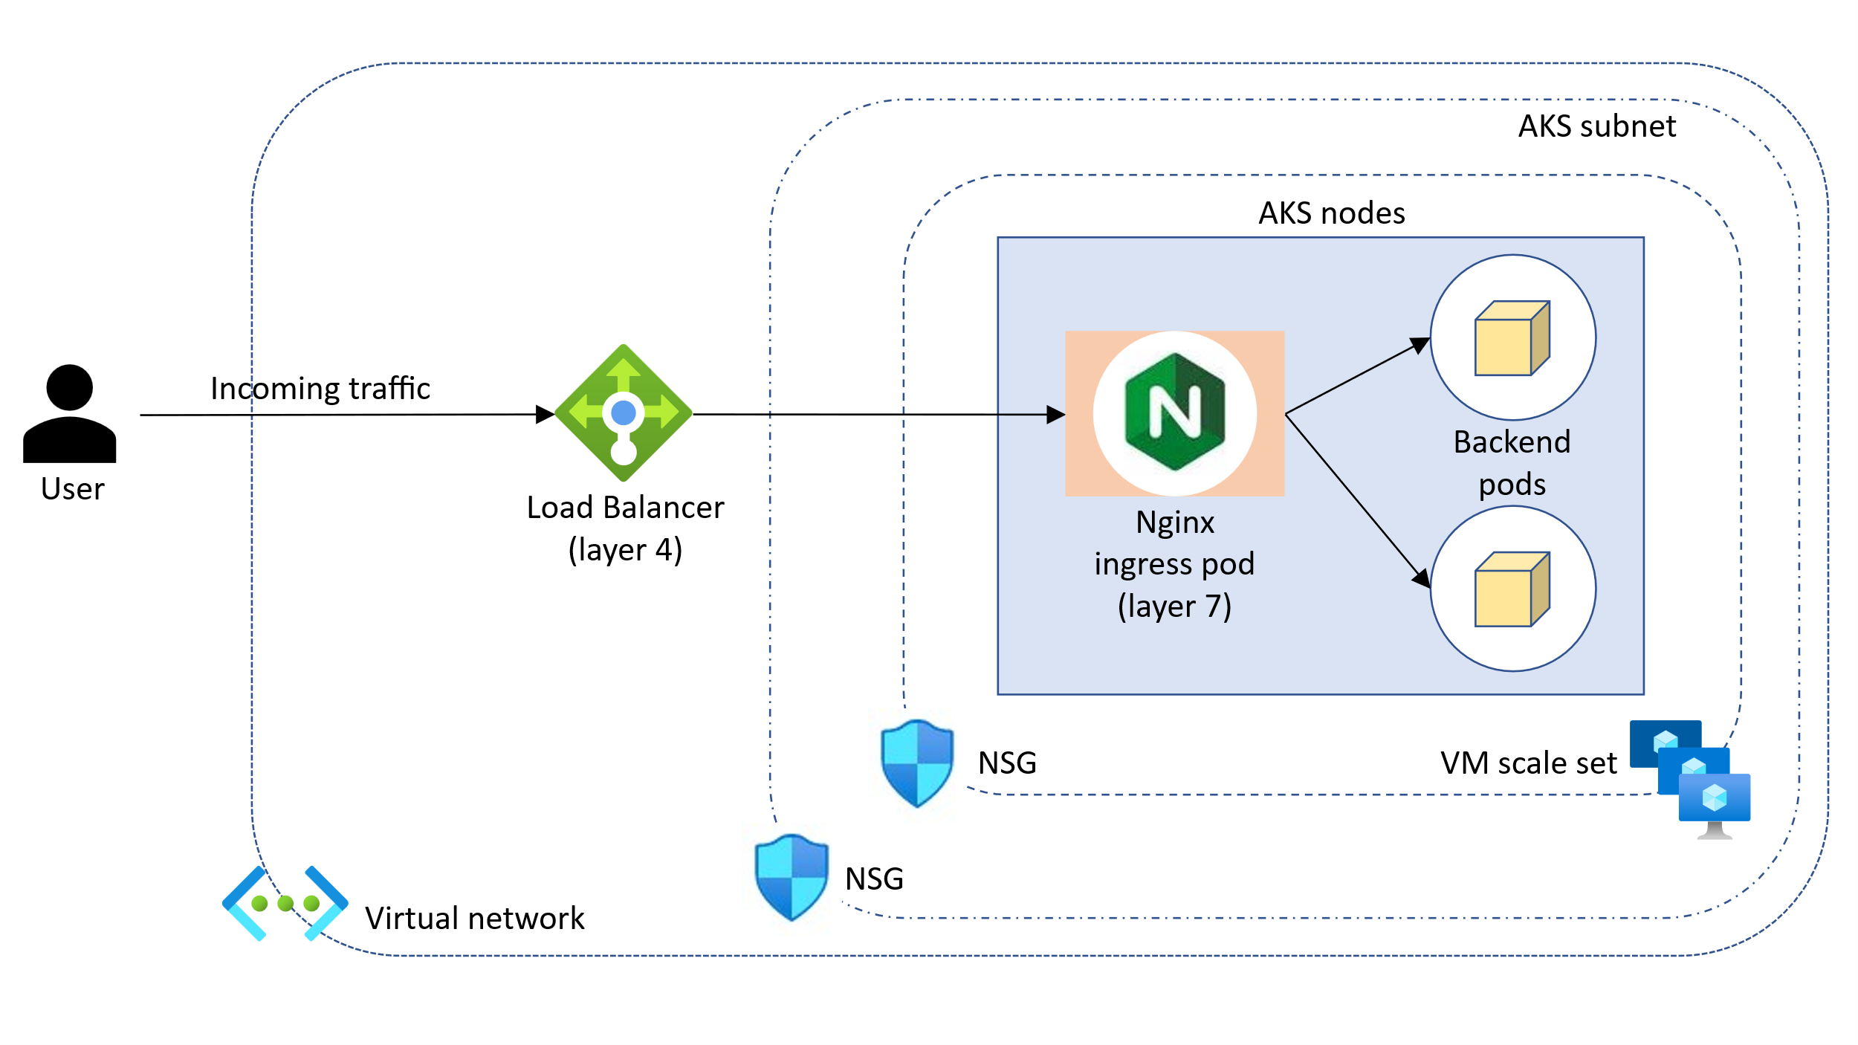

Slide 6
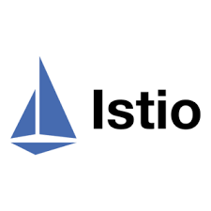

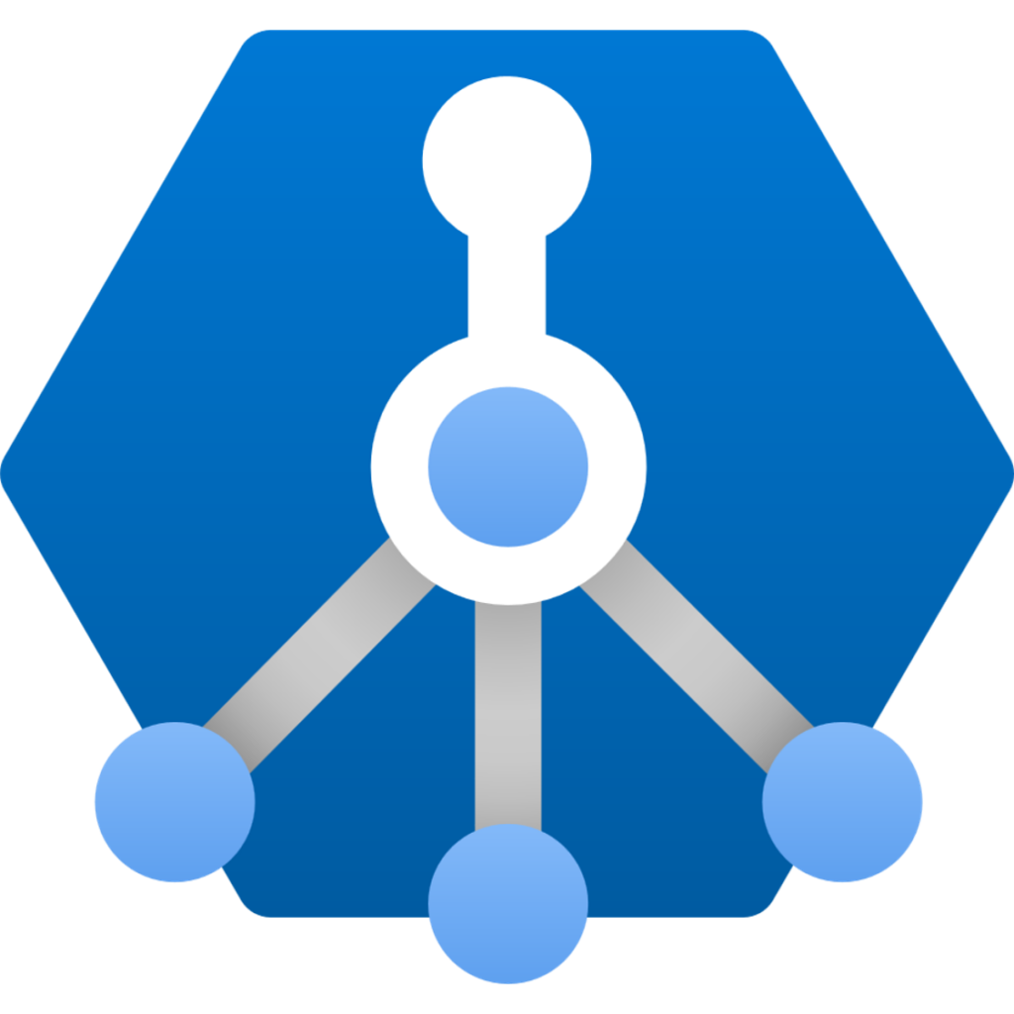
Ingress Options in Azure
Azure Managed NGINX
Application Gateway for Containers
Istio Ingress Gateway
• In-cluster hosted, customizable, and scalable NGINX ingress controllers.
• Basic load balancing and routing capabilities.
• Internal and external load balancer configuration.
• Static IP address configuration.
• Integration with Azure Key Vault for certificate management.
• Integration with Azure DNS Zones for public and private DNS management.
• Supports the Ingress API.
• Azure hosted ingress gateway.
• Flexible deployment strategies managed by the controller or bring your own Application Gateway for Containers.
• Advanced traffic management features such as automatic retries, availability zone resiliency, mutual authentication (mTLS) to backend target, traffic splitting / weighted round robin, and autoscaling.
• Integration with Azure Key Vault for certificate management.
• Integration with Azure DNS Zones for public and private DNS management.
• Supports the Ingress and Gateway APIs.
• Based on Envoy, when using with Istio for a service mesh.
• Advanced traffic management features such as rate limiting and circuit breaking.
• Support for mTLS

Slide 7
