Slide 1
HealthTrack’D
By Roshan Deepu Roy

Slide 2
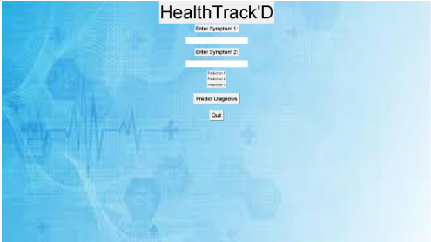
What is HealthTrack’D
A Python program that helps doctors guess diseases based on two symptoms. It uses smart tools to make quick predictions.

Slide 3
Why is it helpful
Doctors can work faster.
Easier to figure out diseases.
Helps doctors make better choices.

Slide 4
How does it work
Takes a list of symptoms and diseases from a file. Learns how to match symptoms to diseases. Let’s you type in two symptoms to guess a disease.

Slide 5
The Libraries Used
DecisionTreeClassifier - To match symptoms and diseases.
NumPy - To handle data.
Pandas - To load the symptom and disease file.
Tkinter - To make the app's interface.

Slide 6
What is Machine Learning
Machine learning is like teaching a computer how to think by showing it lots of examples.
How it Works:
The computer looks at data, like symptoms and diseases.
It finds patterns between them.
Later, it uses those patterns to guess new answers.
In HealthTrack’D:
It learns which symptoms match certain diseases.
It can make smart guesses by training the Machine

Slide 7
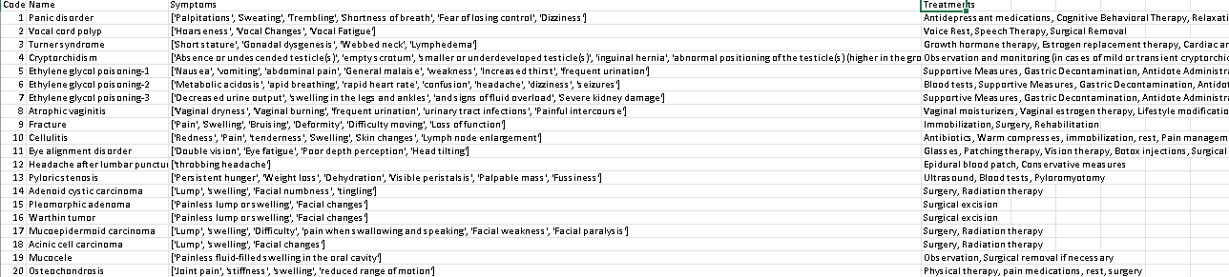
The Data
The data is like a big table. It has:
Diseases: Names of medical conditions.
Symptoms: Things people feel when they’re sick.
Treatments: Suggestions to help with the disease.
What the Program Does with the Data:
Loads it from a CSV file (a simple file like a spreadsheet).
Prepares a "symptom matrix," a special chart where each row represents a disease, and each column represents a symptom.
Uses this chart to train the program to match symptoms with diseases.
Why the Data is Important:
The Data is important and is the major source of knowledge of the program. Without it, the program won’t work.

Slide 8
Training the Model
How the Program Gets Smart:
Reads the Data: The program reads the CSV file with symptoms, diseases, and treatments.
Prepares a Matrix: It creates a chart where:
Rows = Diseases
Columns = Symptoms
Trains Three Models:
Uses three Decision Tree Classifiers (like three different brains) to learn from the data.
Why Three Models?
To make predictions more reliable. Each model gives its own guess.

Slide 9
The User Interface(UI)
What the Interface Looks Like:
A clean and simple design using Tkinter.
Symptom Boxes:
Two boxes where you can type in symptoms.
Example: "Fever" and "Cough."
Buttons:
Predict Button: Click to get results.
Quit Button: Close the program easily.
Predictions:
Shows three possible diagnoses from the models.

Slide 10
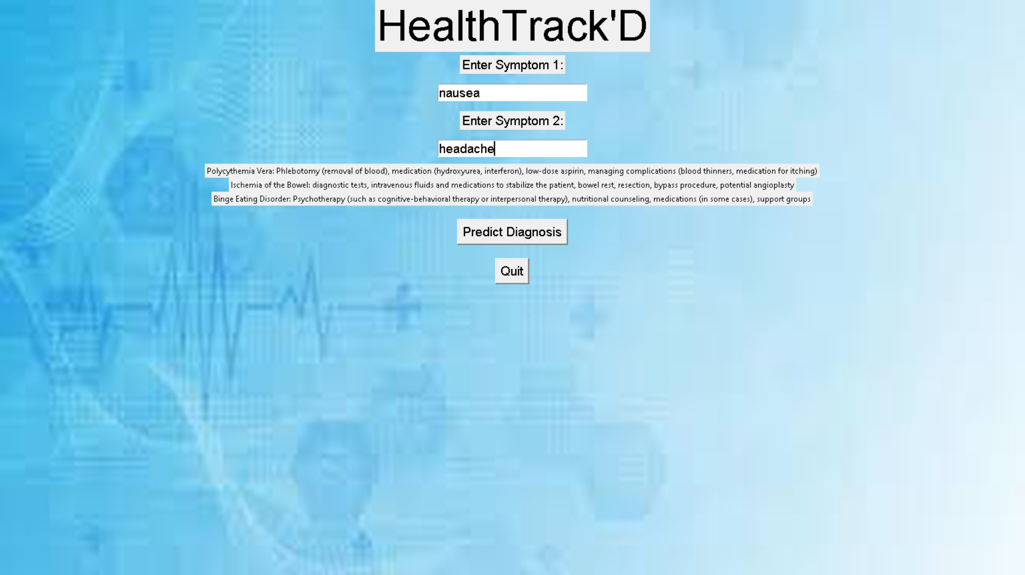
How Predictions Work
Step-by-Step Process:
Input: You type two symptoms in the boxes.
Check Validity:
The program checks if the symptoms are part of the known list.
If they’re not, it shows an error.
Encode Symptoms:
The symptoms are converted into a format the program understands (a symptom matrix).
Prediction Time:
Each of the three models gives a prediction.
You see all three possible results.

Slide 11
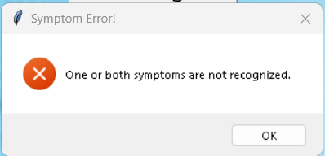
Error Checking
The program is careful!
If you type in a symptom the program doesn’t know, it won’t guess.
It shows a pop-up error message:
"One or both symptoms are not recognized."
This keeps the program accurate and reliable.

Slide 12
What Makes HealthTrack'D Stand Out?
Smart Predictions: Uses three models for better guesses.
Easy to Use: The interface is simple and doesn’t need special training.
Quick Results: Doctors save time during consultations.
Reliable Suggestions: Combines data with machine learning for accurate answers.

Slide 13
Future Updates
More Data: Add more diseases and symptoms.
Mobile App: Make a version for phones.
For Patients: Let anyone use it at home to understand their symptoms.
Health Records: Connect it with patient files for personalized suggestions.

Slide 14
Summary
Why HealthTrack'D:
Combines Python, machine learning, and user-friendly design.
Helps doctors guess diseases faster and better.
Has big plans, like working on phones and helping patients directly.

Slide 15
Thank You
Hope you enjoyed learning about HealthTrack’D

