Slide 1
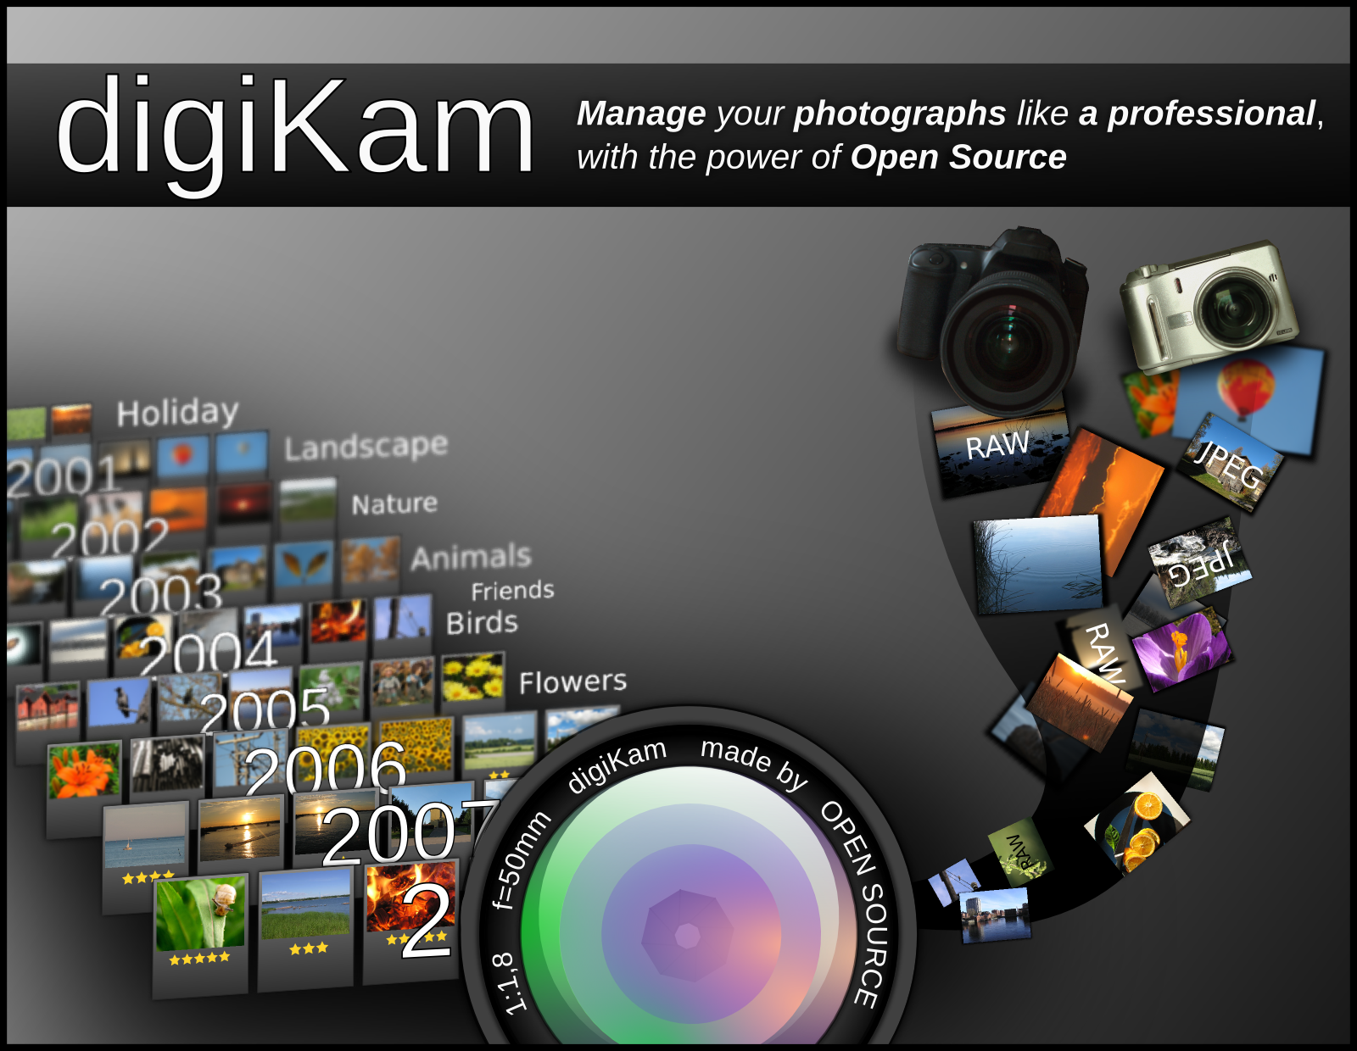
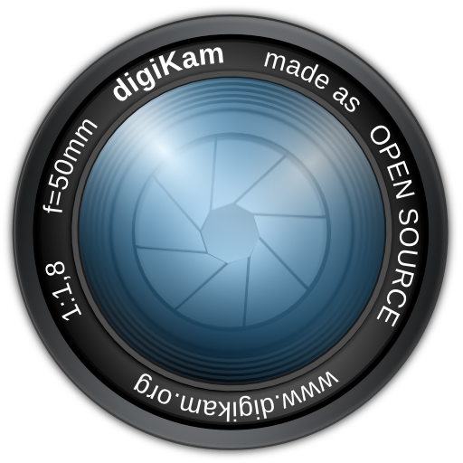

Slide 2

Summary :
* Digital photography
* Project overview
* digiKam 1.x:
- Main interface
- Camera interface
- Image Editor
- Plugin interfaces
- Light Table
- Search Tools
- Advanced search
- Geo-location
- Batch Queue
- Raw import
* To Conclude
Page : <numéro>/16 Gilles Caulier 2010/04/24

Slide 3
The world of digital photography:
In last few years:
* Digital photography revolution
* Workflow more complex
* Items increase (number and size)
* Need a good computer and software
Computerized photographer:
* Huge image collections
* Talking to the camera
* Digital image editing
* Image cataloging and publishing
An open-source solution : digiKam
Page : <numéro>/16 Gilles Caulier 2010/04/24

Slide 4
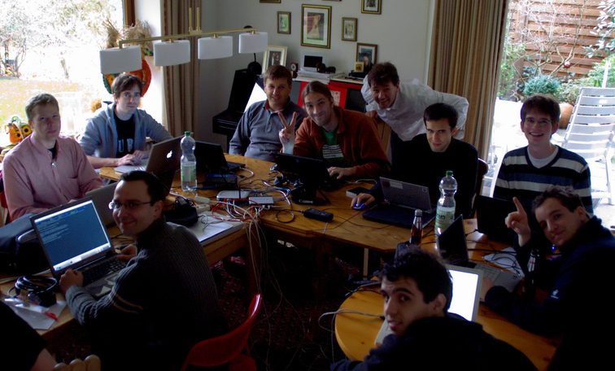
Project overview:
About the program:
* Started in 2002
* International team
* Open Source
* C++ (Qt / KDE)
* Linux / Windows / Mac
* IRC / mailing-lists
* Bugzilla
* Web site / wiki
* Community
* GoSC
Page : <numéro>/16 Gilles Caulier 2010/04/24

Slide 5
Goals:
* User friendly interface
* Photograph work-flow:
- Camera interface
- Album management
- Search tools
- Queue processing
- Export tools
* Expendable
* Handbook (as a book)
Page : <numéro>/16 Gilles Caulier 2010/04/24

Slide 6
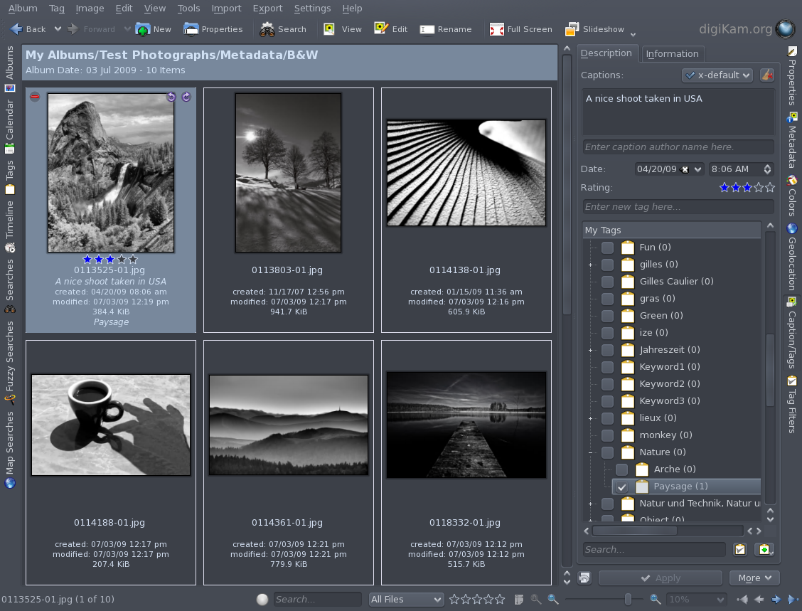
digiKam 1.x
- Designed for KDE4
- Photographers' tools:
* Albums view
* Image Editor
* Camera Interface
* Light Table
* Search Tools
* Queue
Page : <numéro>/16 Gilles Caulier 2010/04/24

Slide 7
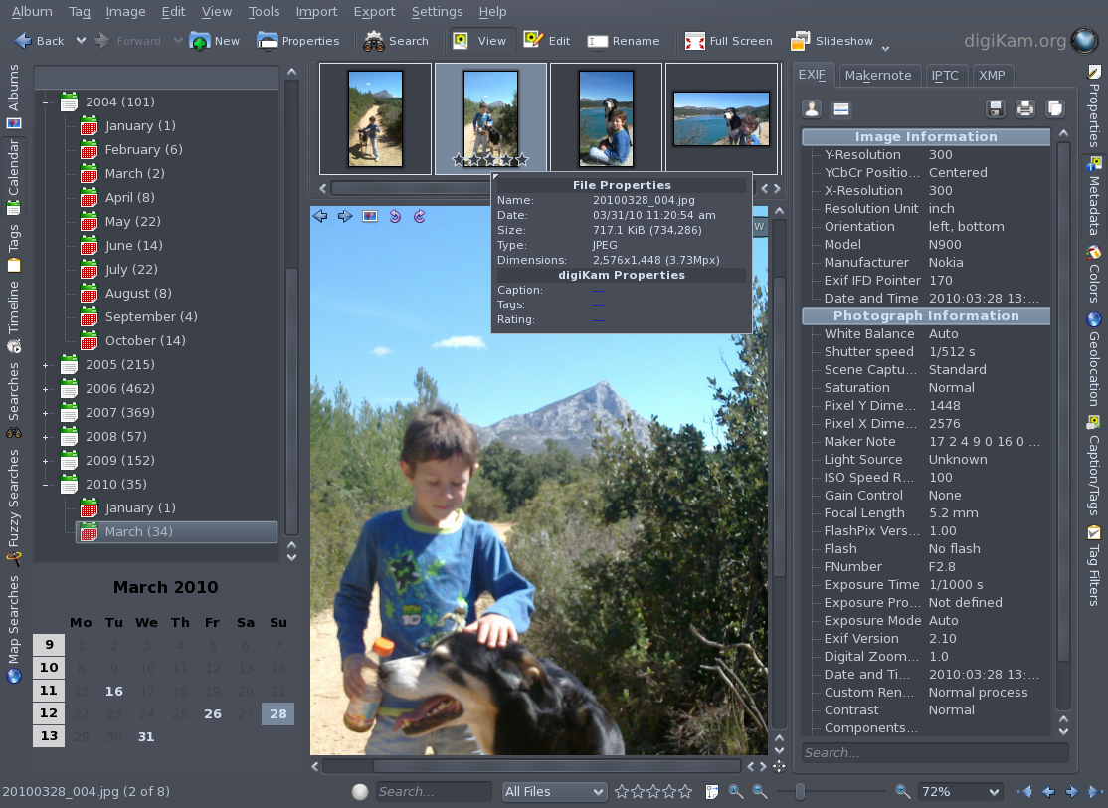
digiKam 1.x
- KDE4 components:
* Marble
* Solid
* Phonon
* Nepomuk
- Main features:
* Multiple repositories
* Remote storage
* Network transparency
* Expendable DB
* Advanced Search tools
* Geo-location
* Auto Lens correction
* Camera Capture tool
* XMP support
* Portability (Mac / Win)
Page : <numéro>/16 Gilles Caulier 2010/04/24

Slide 8
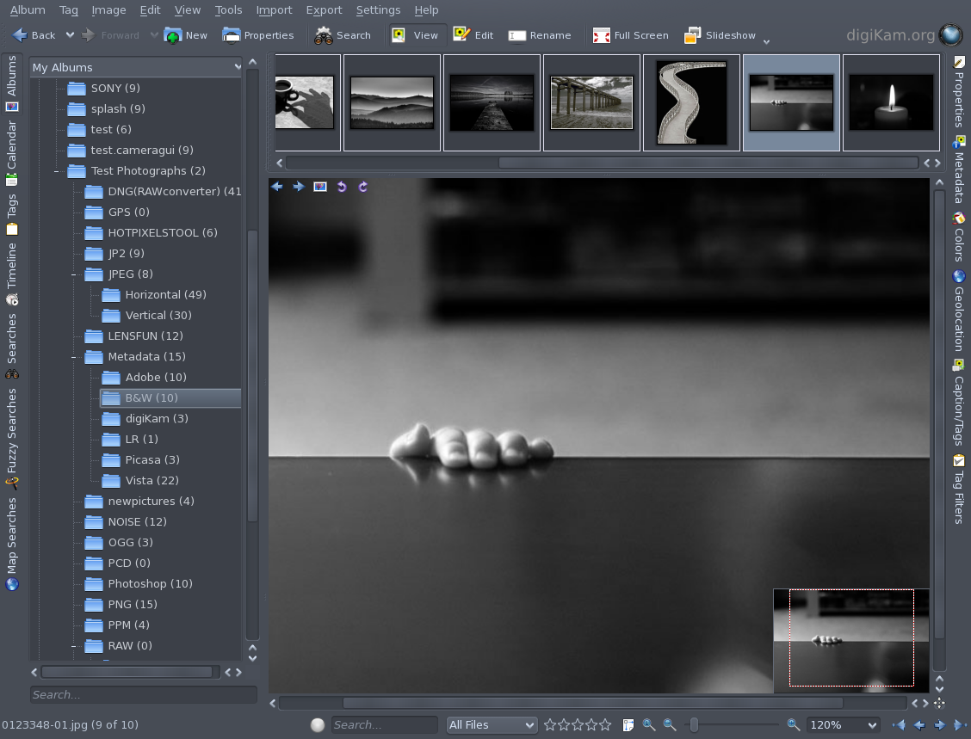
Main Interface: d
Management:
* Album Tree-view
* Icon-view
* Sidebars
* Fast preview
* Searching tools
* Sorting, filtering
* Comments, date
* Tags, rating
* Plugin interface
Photograph Features:
* Histogram
* Metadata
* Template
* Color profile
* Geolocation
Page : <numéro>/16 Gilles Caulier 2010/04/24

Slide 9
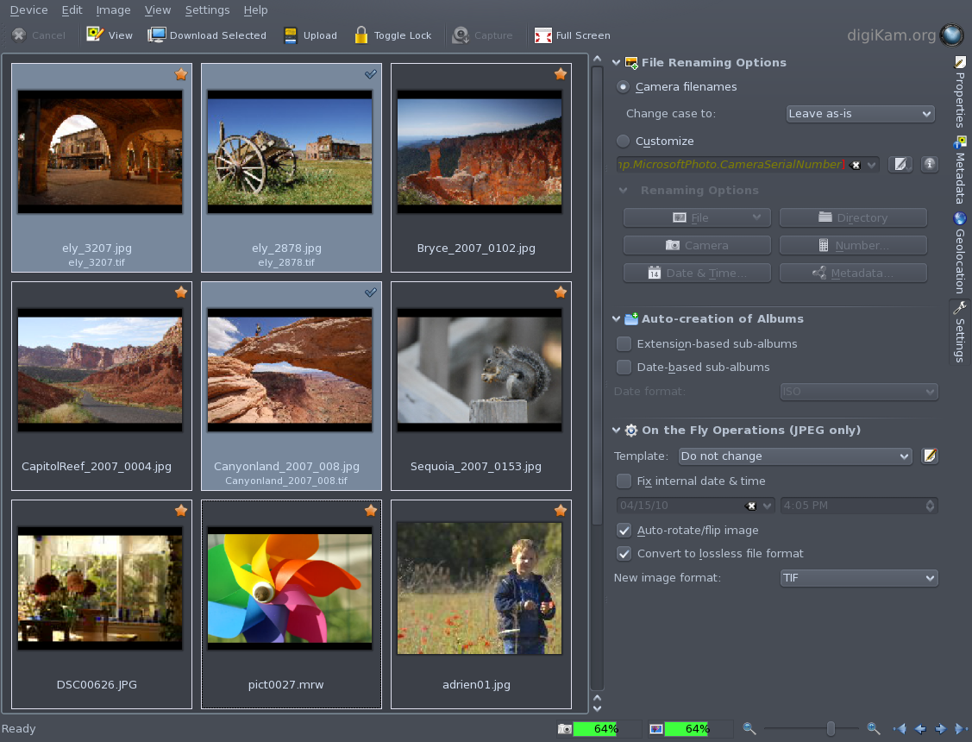
Camera Interface:
Features:
* GPhoto2 front-end
* More than 900 cameras
* USB/IEEE protocols
* PTP
* Proprietary protocols
* Background downloading
* Downloaded annotation
Tools:
* Auto-fix (rotation/date)
* Auto-album creation
* Files renaming
* Exif-data owner marking
* Lossless conversion
Page : <numéro>/16 Gilles Caulier 2010/04/24

Slide 10
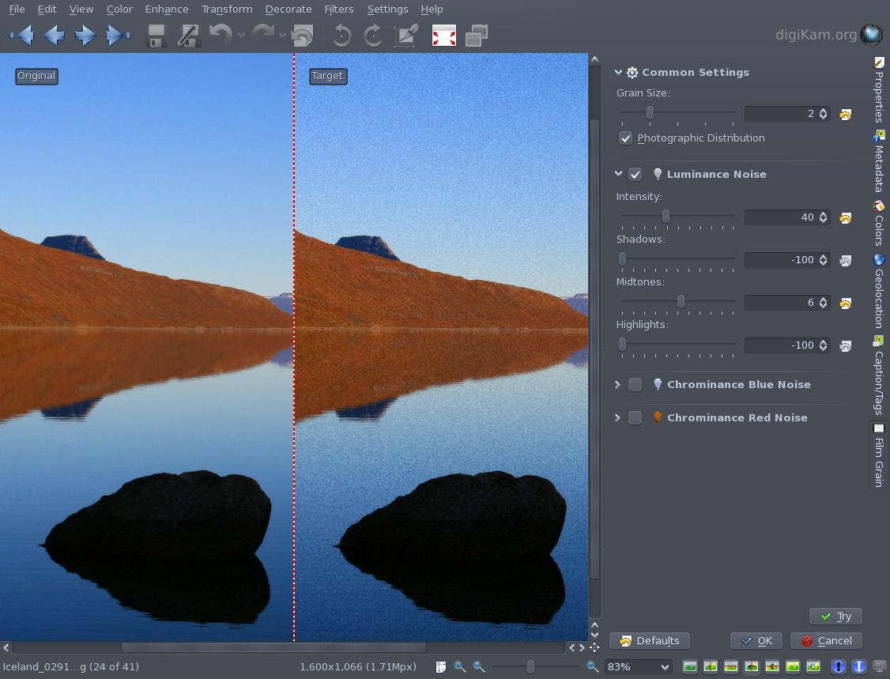
Image Editor: d
Features:
* Easy to use
* 16 bits color depth
* Raw support
* Color management
* Metadata preservation
* Plugin interface
* Stand-alone version
* Multi-threaded d
Tools:
* Refocus
* Noise reduction
* Red eyes
* Exposure/White balance
* Transform/Composition
* Decorations/Effects
Page : <numéro>/16 Gilles Caulier 2010/04/24

Slide 11
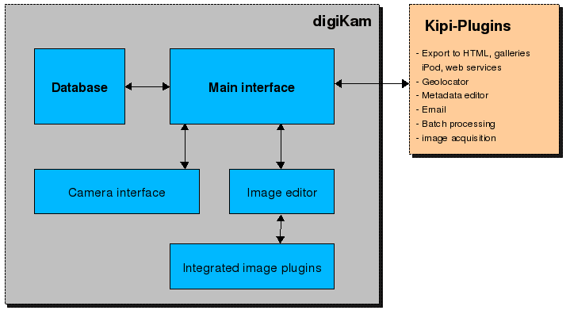
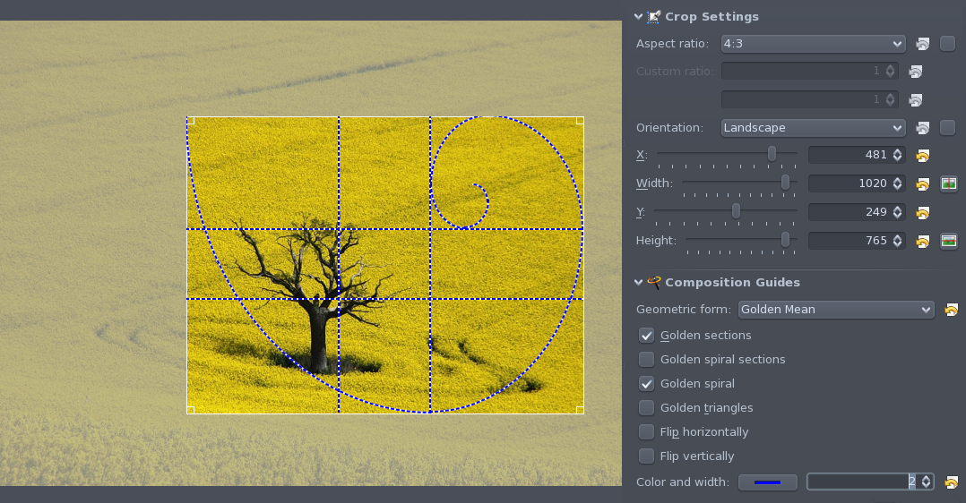
Plugin Interface: d
* Extended features
* 2 architectures d
Main Interface: d
* Export (email, html, galleries)
* Batch process
* Slide show (3D, DVD, flash) d
Image Editor: d
* Ratio Crop
* Composition guides
* Effects (Infrared, film grain, ...)
* Corrections:
- Restoration
- Lens
- Colors
- Noise
Page : <numéro>/16 Gilles Caulier 2010/04/24

Slide 12
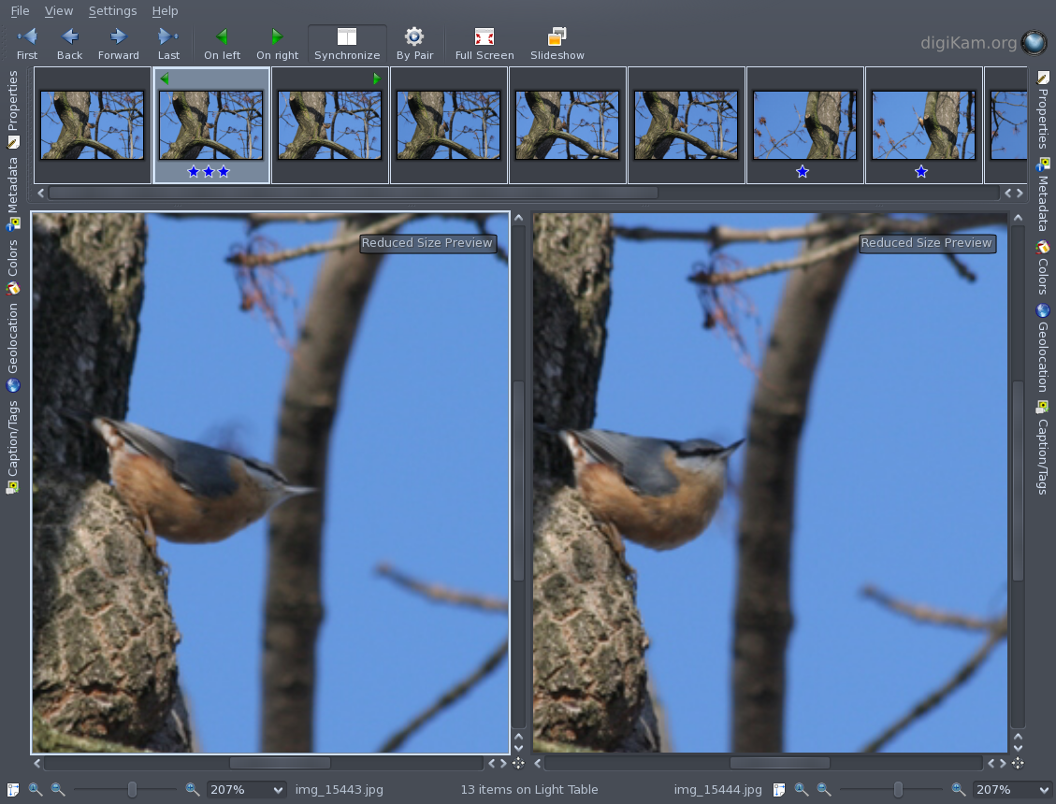
Light Table:
* Virtual container
* Thumb-bar
* Compare
* Side by side
* 2 canvases
* Sync
* Zoom / scroll
* Fast loading
To process:
* Sorting
* Selection
* Deletion
* Rating
Page : <numéro>/16 Gilles Caulier 2010/04/24

Slide 13
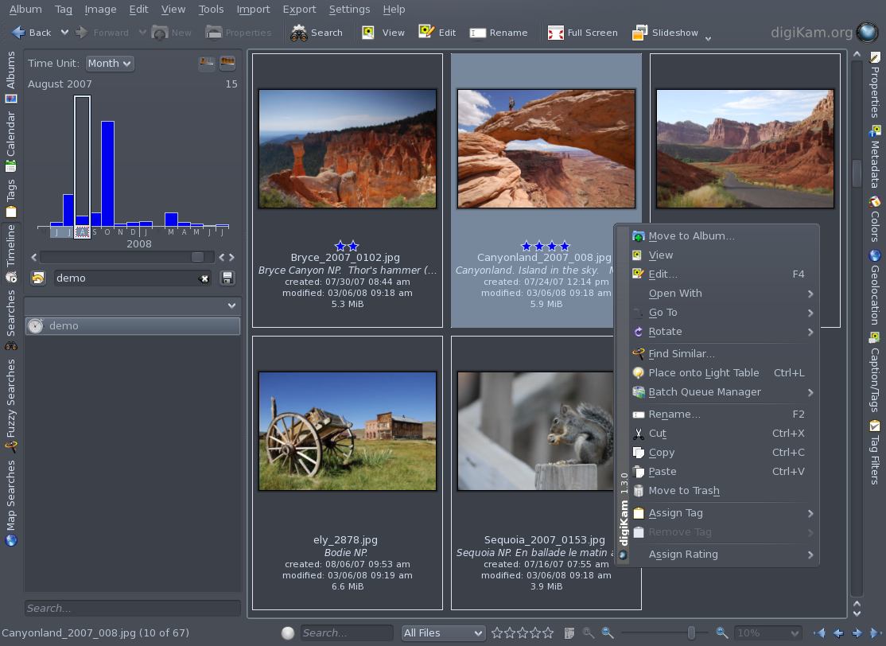
Search Tools: d
* Database
* Find photos
* By Date
* By time range
* By keywords
* By Geolocation
* By similarity
* Using Sketch
* Advanced:
- Template
- Metadata
- Tags
- Rating
- Photo properties
- Multiple queries
Page : <numéro>/16 Gilles Caulier 2010/04/24

Slide 14
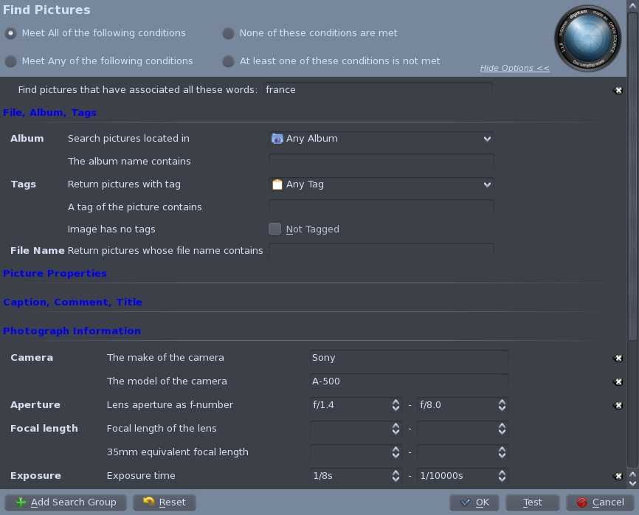
Advanced Search
- Database Storage:
=> Metadata
=> Photo properties
=> digiKam properties
- Complex queries:
=> Cascaded
=> Grouped
=> Boolean operators
- Results:
=> Saved
=> Virtual album
=> Updated
=> Exported
Page : <numéro>/16 Gilles Caulier 2010/04/24

Slide 15
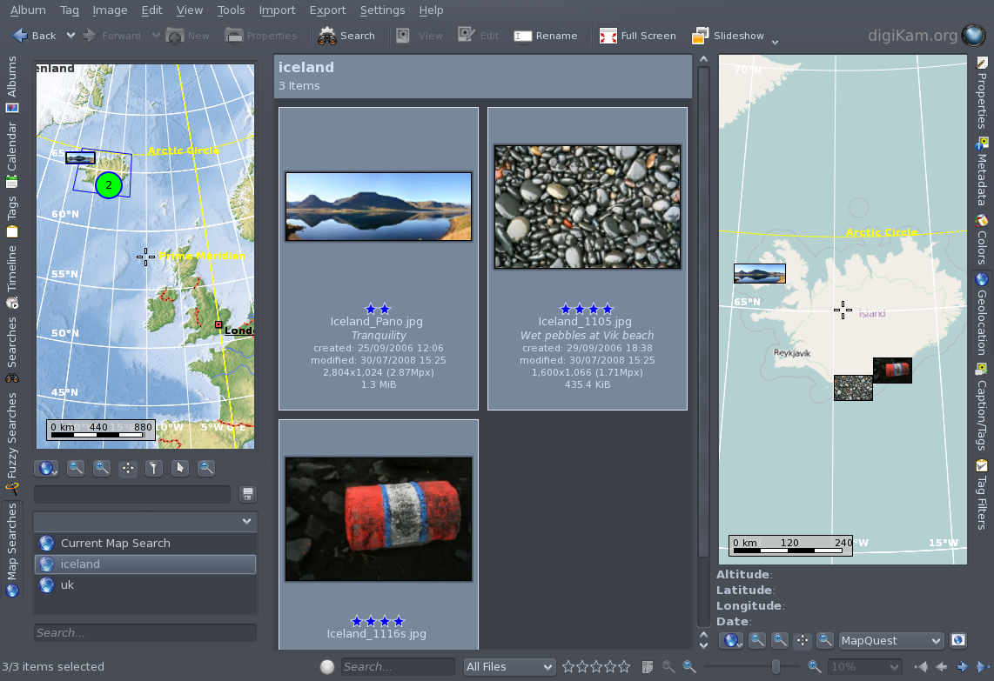
Geo-location
- GPS <=> camera
- Database => GPS info
- All file formats
- Plugin GPSSync
- GoogleMap: editing
- Marble: visualization
- Map locale or remote
- OpenStreetMap
- Search tool using map
Page : <numéro>/16 Gilles Caulier 2010/04/24

Slide 16
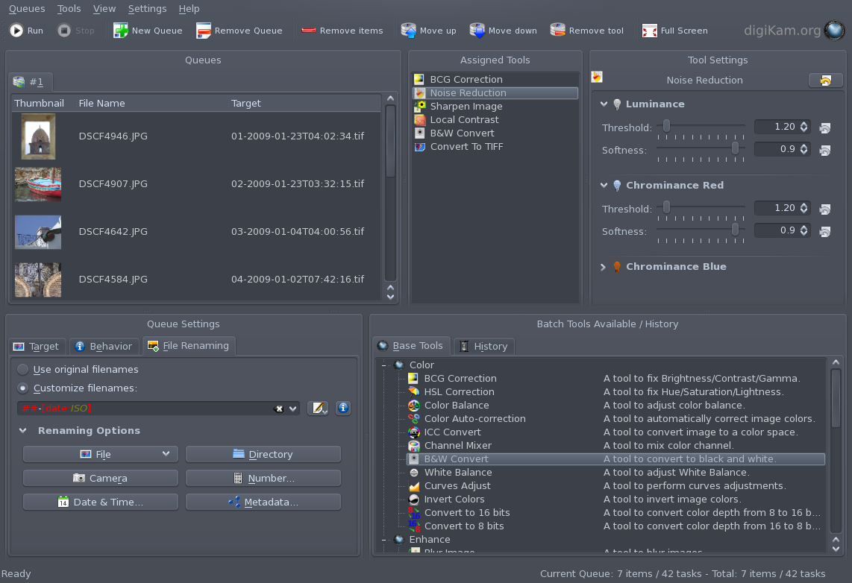
Batch Queue
- Queue Manager
- At the same time
=> items
=> actions
- Multi-threaded
- Running in Background
- Actions from editor
- Advanced renaming
Page : <numéro>/16 Gilles Caulier 2010/04/24

Slide 17
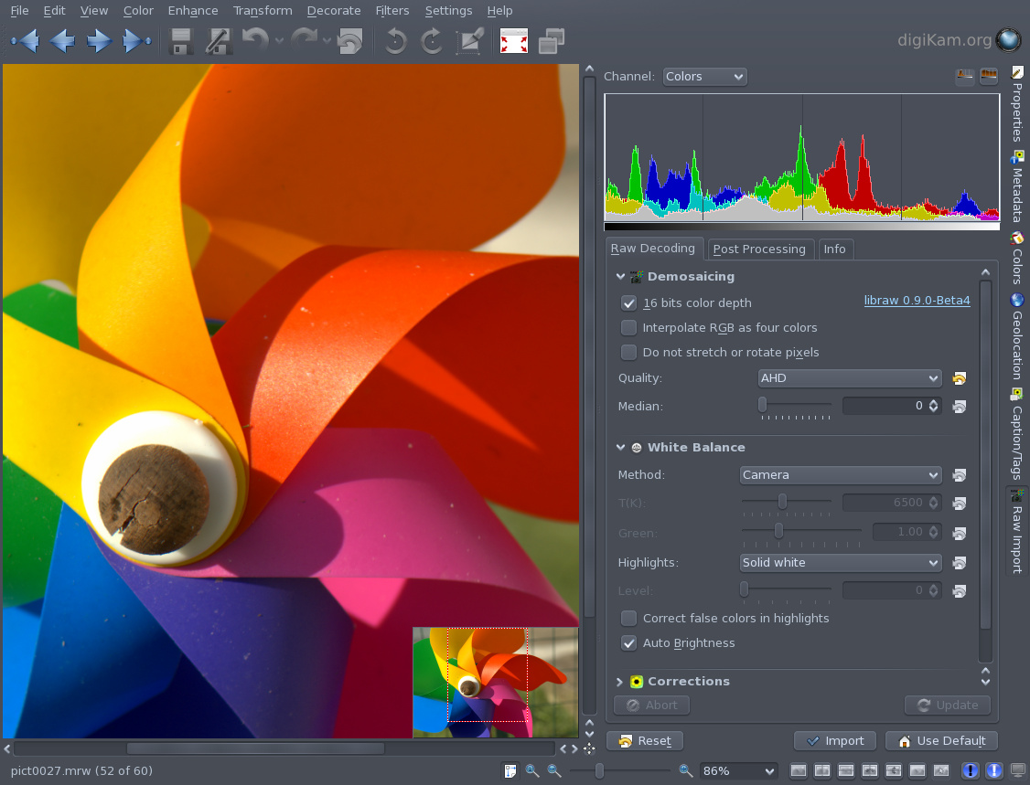
RAW Import
Pre-loading in editor
2 stages:
- Demosaicing:
* Customize settings.
* Apply corrections
(Lens, NR).
* Color Adjust.
- Post processing:
* Exposure.
* Linearity.
Provide:
- Zomming/panning.
- Mutithreaded.
Page : <numéro>/16 Gilles Caulier 2010/04/24

Slide 18
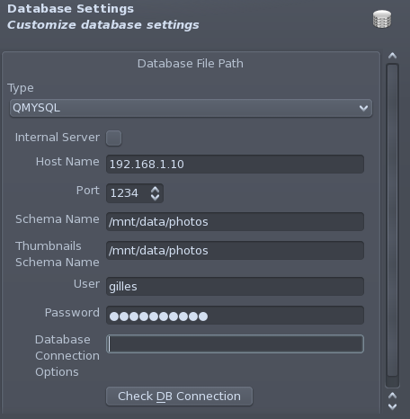
To conclude: digiKam goals:
* Be the most easy to use
* Adapts for casual photographers
* Provides advanced features for professional photographers
Future plan:
* Versioning
* Backup tool
* Face detection
* Manage multi-core CPU
* Remote database (Mysql, Postgresql)
More informations: www.digikam.org
Page : <numéro>/16 Gilles Caulier 2010/04/24

Slide 19
