Slide 1
Wi-Fi firmware for ESP32
Rafael Conceição - 41486
Eduardo Tavares – 49454
Advisors:
Diego Passos
Fernanda Passos

Slide 2
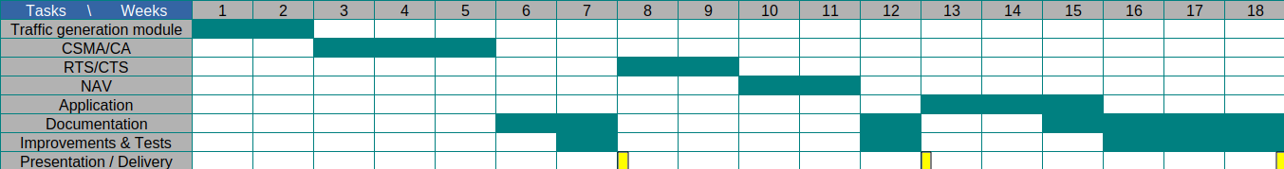
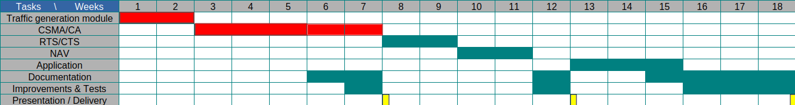
Original Plan
How It’s Going

Slide 3
Traffic Generator
The base of this model consists of two parts, the configurable time wait between the transmission of the packets, and the function sendData given as a parameter, which should already act in accordance with csma/ca, created with the help of the other modules in this project. Considering the function given is a responsibility of the rest of the code, this class is already fully functional, containing methods to stop and start this module at will, and supports configurable wait times.

Slide 4
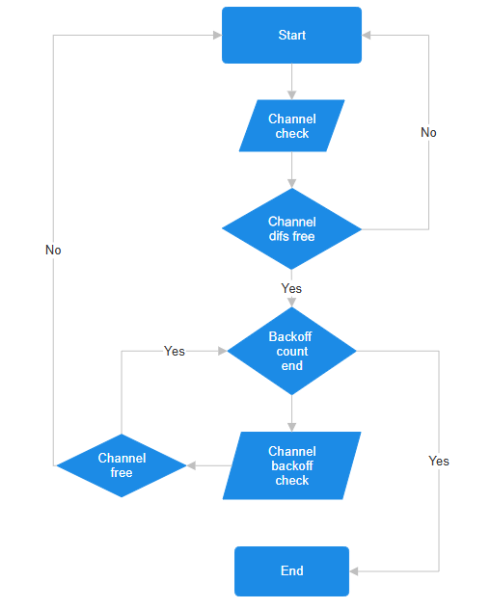
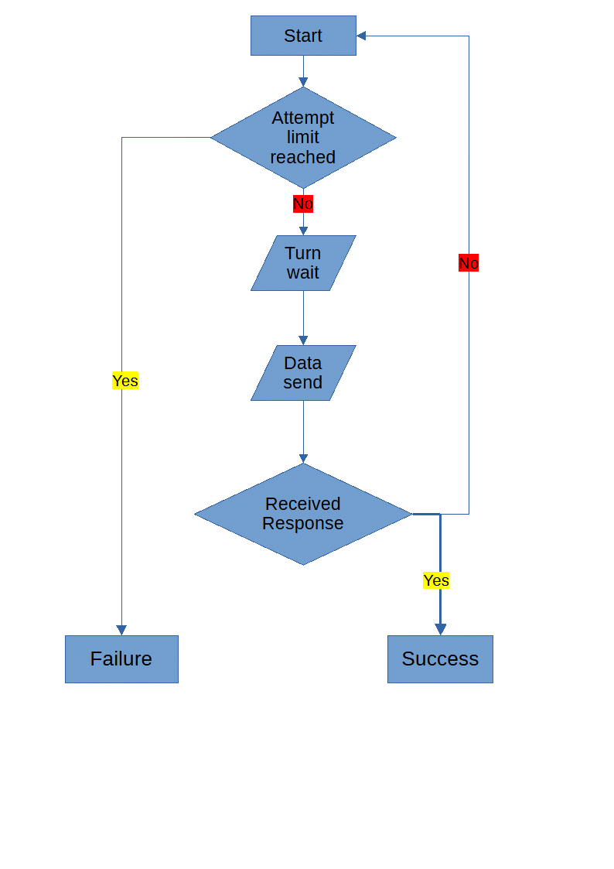
CSMA

Slide 5
Issues
Unpredictable crashes: Possibly more than one cause – could be our use of the radio and the timing, and/or a bug the radio firmware.

Slide 6
What Is Next
RTS/CTS
Network Allocation Vector (NAV)
Configuration Application
Improvements to current infrastructure and solve crashes

