Slide 1
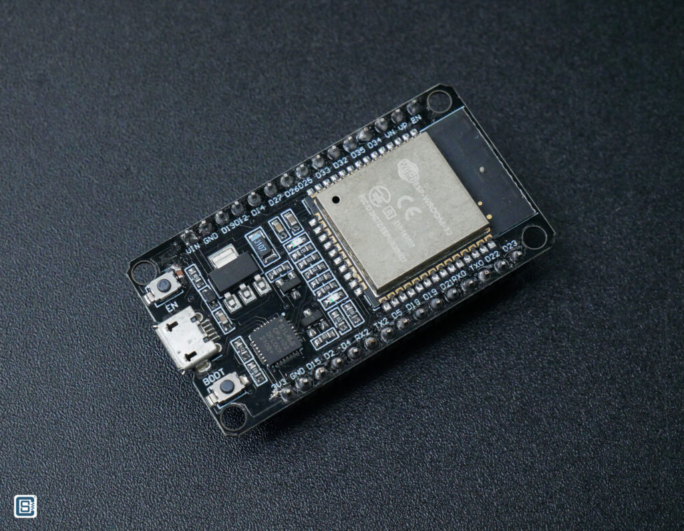
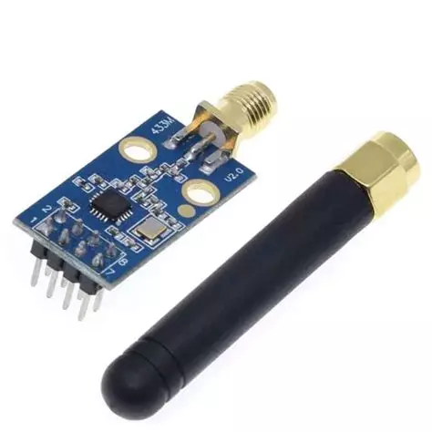
Wi-Fi firmware for ESP32
By:
Rafael Conceição, nº 41486
Eduardo Tavares, nº 49454
[2] ESP32
[1] CC1101 Radio

Slide 2

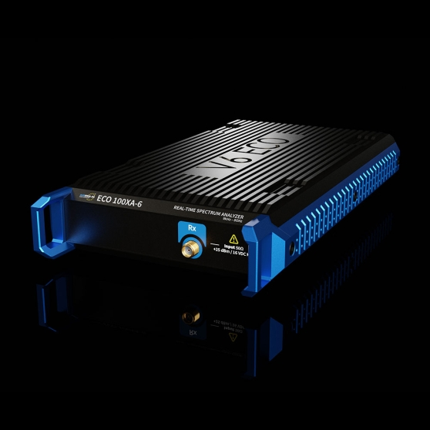
Existing Solutions
Software Defined Radios (SDR)
Very expensive (between 2.000€ and 60.000€)
Low efficiency (require a lot of power)
[3] SDR Supplier
[3] SPECTRAN® V6 ECO 100XA-6 - 2,498€

Slide 3
Requirements
Mandatory:
The system should use IEEE 802.11 CSMA/CA
The system should use IEEE 802.11 RTS/CTS
The system should use IEEE 802.11 NAV
The system should have a traffic generation module
Optional:
An application that allows for more fined tuned configuration of the nodes

Slide 4
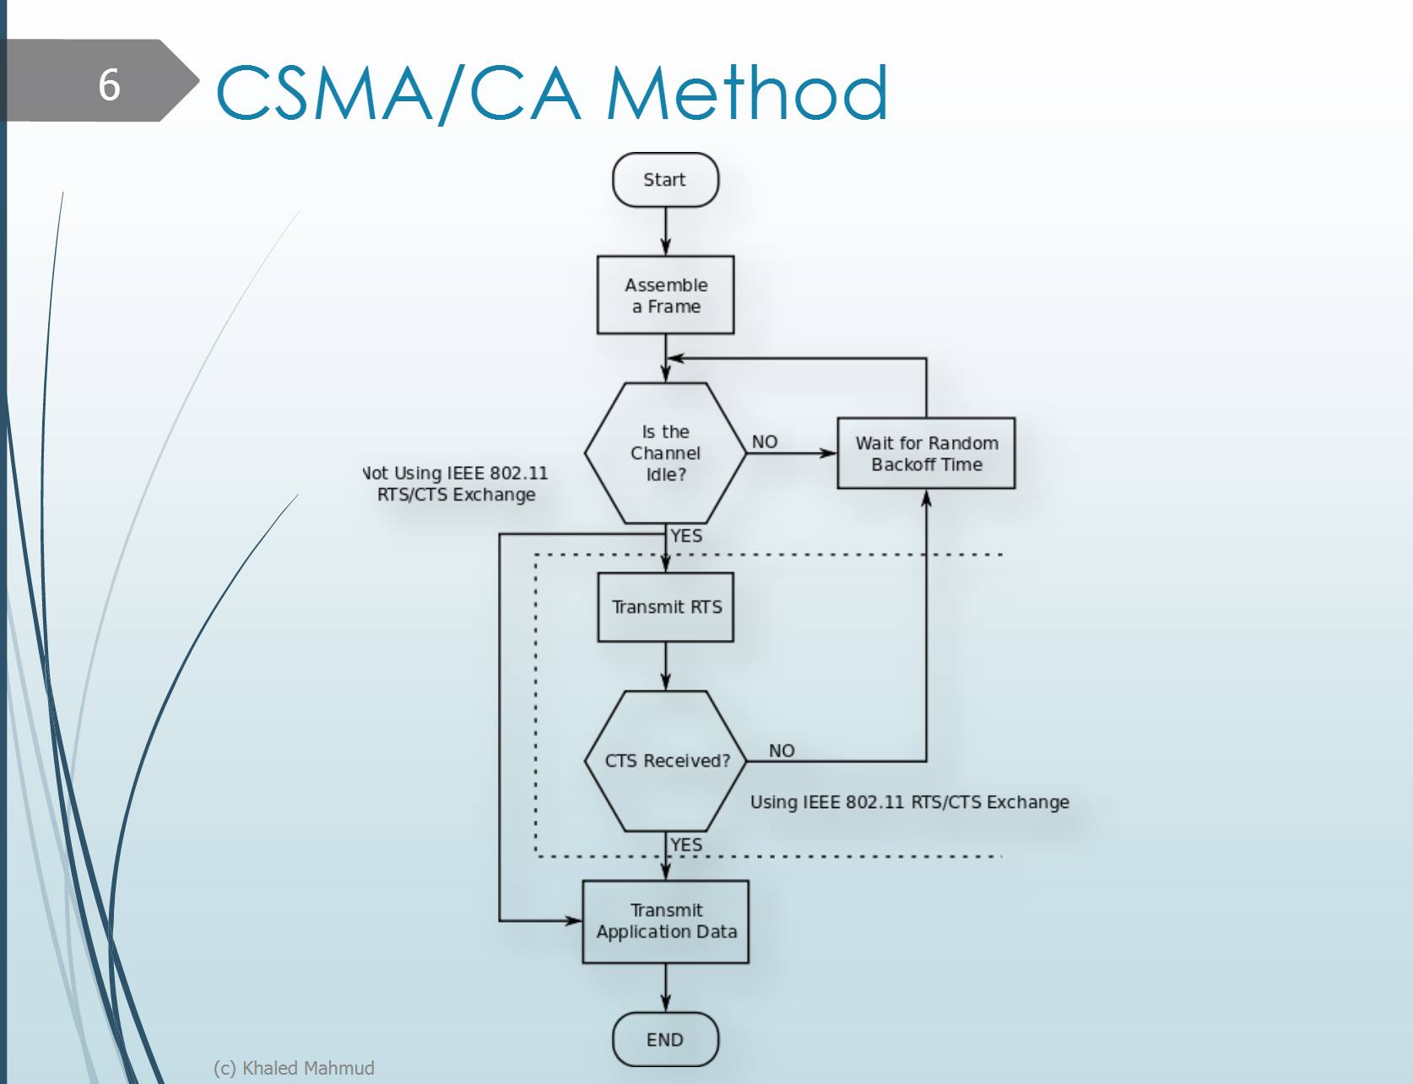
[4] CSMA/CA, with and without RTS/CTS

Slide 5
Image Sources
https://www.pcboard.ca/
https://www.circuitstate.com
https://aaronia.com
https://juliosueiras.github.io/wireless-site/posts/newest/

