Slide 1
Strategy Back-testing in the Cloud
Dan Wang, PhD, CFA
2025 Apr
danwang208@gmail.com
Chicago Trading Company

Slide 2
Backtesting is NOT
Alpha signal research tools.
Example: when Gold price goes up, technology sector tends to outperform the rest of the market.
Develop the alpha signals first.
A well defined alpha signal is developed first, and then used in the back-testing of strategies.

Slide 3
Backtesting categories
Historical Simulation
Cross validation: scenario
Simulation of Synthetic Data

Slide 4
Backtesting
Launch of New Strategy
Why run the backtesting?
Approximate the real-life investment process
Analyze portfolio returns, risk characteristics, style exposures, drawdowns etc.
Compare different strategies and select the optimal ones.
How to back-test a trading strategy
Define a set of investment rules and processes, key parameters, and apply those rules to historical data.
Key questions to answer:
which stocks/bonds to chose?
When to trigger the trade: at what price shall we entry or exit?
What quantity should we trade?
How long should we hold our positions?

Slide 5


Cloud computing
No
YES

Slide 6
Cloud computing
Cloud computing: cloud computing is the on-demand availability of computer systems resources. Instead of buying/owning/maintaining physical data centers and serves, one can access data storage and computing power, on an as-needed basis.
Advantage of cloud computing:
Pay-as-you-go: no fixed costs.
No physical on-site data center: reduced need for 24-hour electricity and maintenance.
Scalability: Large clouds providers have functions distributed over multiple locations, offering huge computation power.
Resource Sharing: Allows for efficient utilization of resources.
Familiarity: Cloud storage has similar structure as local storage, making it easy to use.

Slide 7
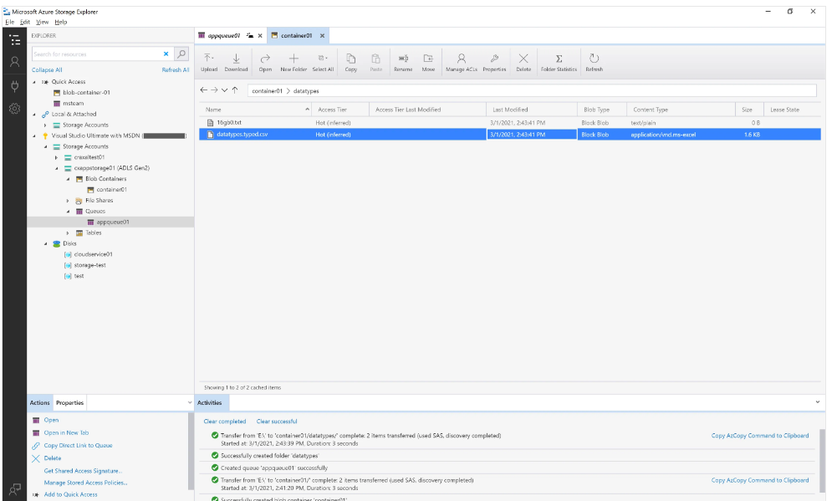
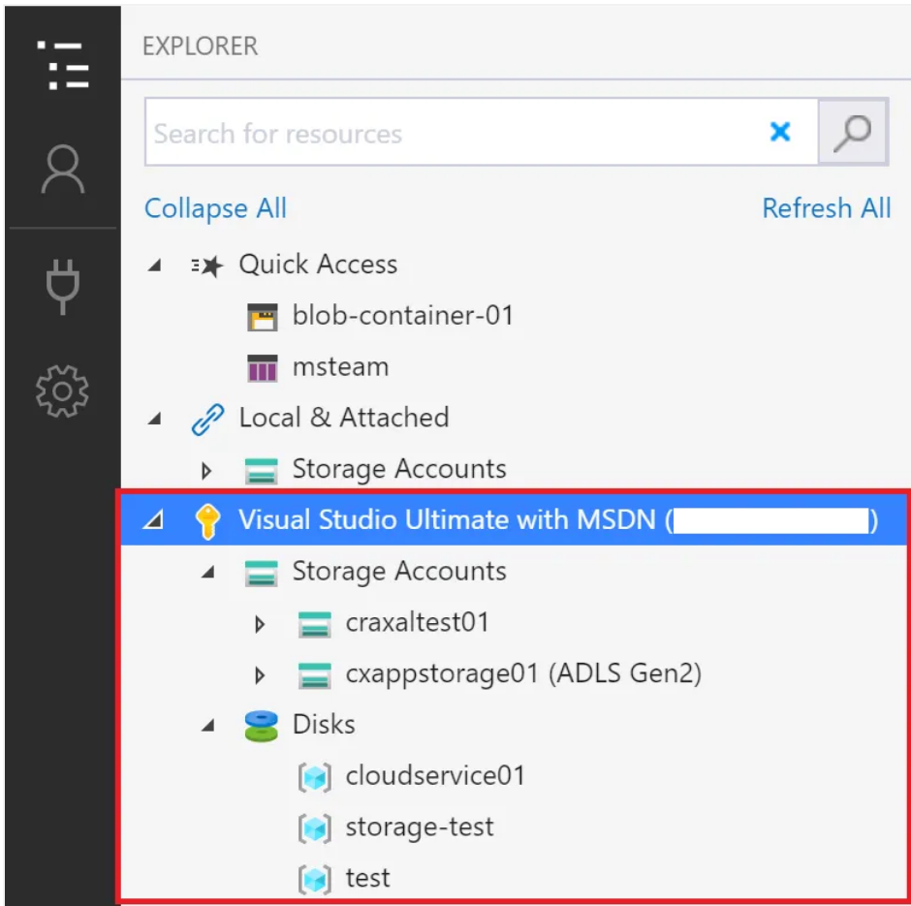
Microsoft Azure Storage Explorer Examples

Slide 8

Back-testing trading strategies
Back testing a trading strategy:
strategy design
historical investment simulation
analysis of back-testing output
run in production

Slide 9
Back-testing trading strategies
Performance metrics for back-testing
Net PnL/Sharpe
Risk adjusted returns
Market exposures
Volatility
Risk
Drawdowns
Average AUM / Capacity
Average Holding Period
Annualized Turnover
Correlation between different strategies

Slide 10
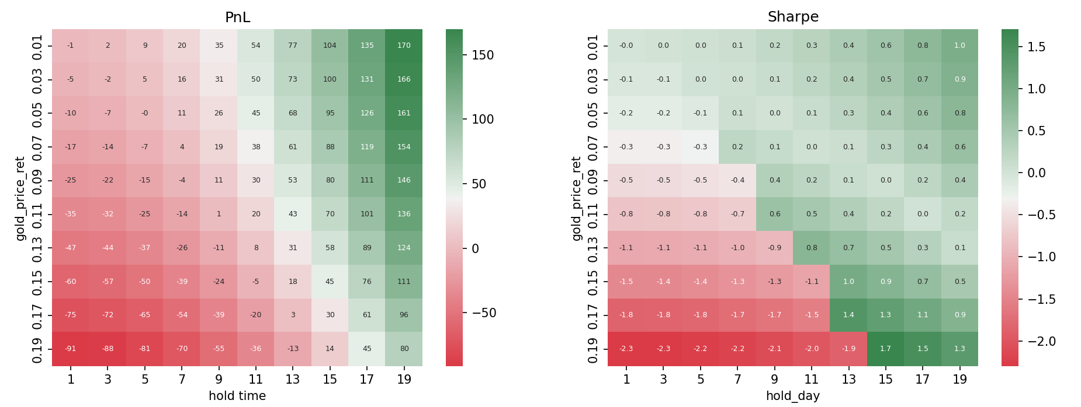
Back-testing Metrics Examples
Using earlier example, we want to visualize the performance of a strategy that enters a position when the previous day gold price return is x, and holds the position for n-days

Slide 11
Back-testing pitfalls
There are some subtle things need to consider during the back-testing:
In-sample testing:
Using the same data for both training and testing can inflate performance due to over-fitting.
Survival bias:
Index content changes over time. If we fail to consider excluded names, we introduce a 'picking the winners' bias.
Look-ahead bias:
Future data inadvertently "sneaking in" to the back-tester can distort results
Example: reporting lags for major economic data, revisions, index additions.

Slide 12
Back-testing pitfalls (cont.)
Market-regime change:
the market “parameters” are not stationary.
The recession period
The crisis period: 2008-global financial crisis; 2020 Covid
Periods of varying interest rates/Business cycles
Major technological changes: dot-com bubble, AI
Trading cost:
Fees, commission and borrow-cost.
Price impact:
The impact of the strategy’s trade on the market price.

Slide 13
Other issues
Trading opportunity:
back testing is easy when using ‘infinite’ paper money.
Considerations:
The fact that real-life strategy capital is constrained
Total strategy trading volume
Drawdown limits
Risk tolerance
Seasonality:
Is the trade flow at “end of month” or “year end” different than the rest of time?
Robustness of back-testing:
Varying the starting time of the strategy may change the result
Does it matter if the strategy starts on Monday or Tuesday
Varying the strategy parameters
Varying the pricing data sources
Bias-variance tradeoff:
the choice is art.

Slide 14
A few recommendations
Goal is to avoid overfitting, and reduce the chance of false discovery.
Develop models for entire asset classes or investment universe
Apply bagging. For a long/short portfolio, the strategy shall work on different set of instruments. Thus avoid affected by outliers.
Record every backtest result:
Repeat and reinvestigate.

Slide 15

Practical considerations when running in the cloud
Data:
Data needs to be stored in the cloud, local data cannot be accessed by the cloud.
To optimize performance on the cloud, it is essential to determine the best format to store the data.
The speed of loading/accessing the data needs to be considered.
Preprocessing the data can sometimes help optimize the usage of cloud.

Slide 16
Practical considerations when running in the cloud (cont.)
Cluster/workers:
With given or limited number of clusters/workers, consider ways to maximize the overall speed.
Estimation of the data size and total memory used for each run.
Cost needs to be considered.
Smooth process to improve productivity:
When running in the cloud, there is risk of losing connectivity (though most cloud platform have automatically reconnect features.)
Design and run the process step by step and save the intermediate steps.
Label the runs in a meaningful way.

Slide 17
Disclaimer
Views and opinions expressed in this presentations are those of the speaker and not necessarily reflect the views or opinions of Chicago Trading Company

