Slide 1
Drawdown Adaptive Moving Average

Slide 2
The Idea
Asset trends upward?
Extend lookback of an EMA to stay in the trend.
Asset trends down?
Reduce lookback of an EMA to get out faster, get back in sooner.
Reduce loss, increase gain.
Or so goes the idea.

Slide 3
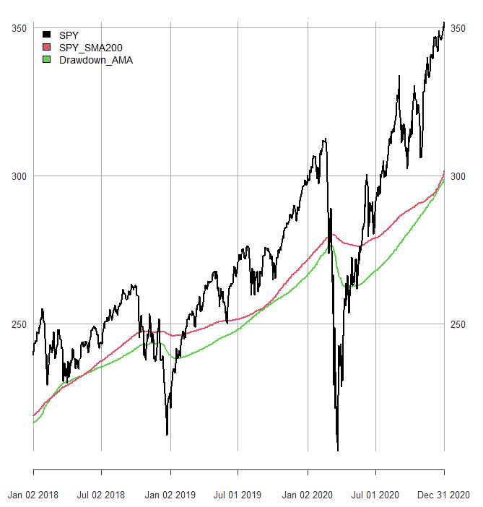
The Idea In One Picture
Compute pct rank of rolling drawdowns.
Dynamic EMA alpha =
1/((pct_rank * n_fast) +
((1-pct_rank) * n_slow))
EMA_t =
price/alpha +
EMA_t-1/(1-alpha)

Slide 4
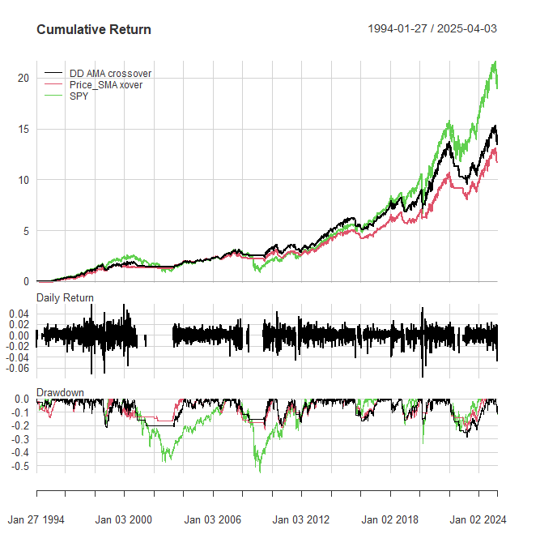
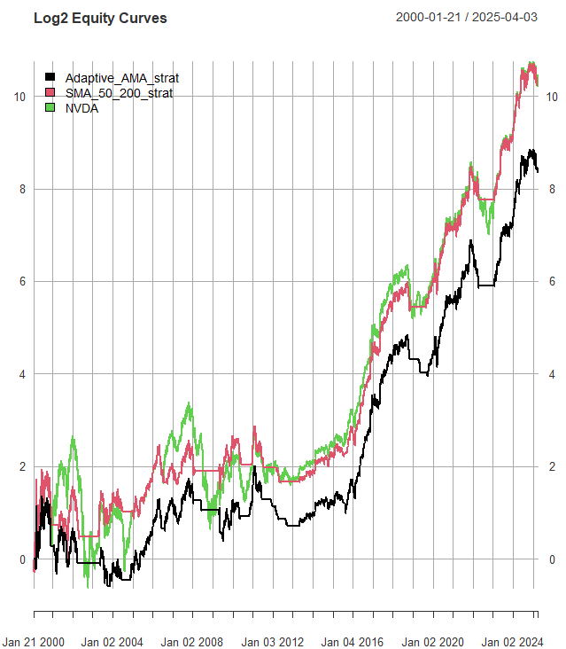
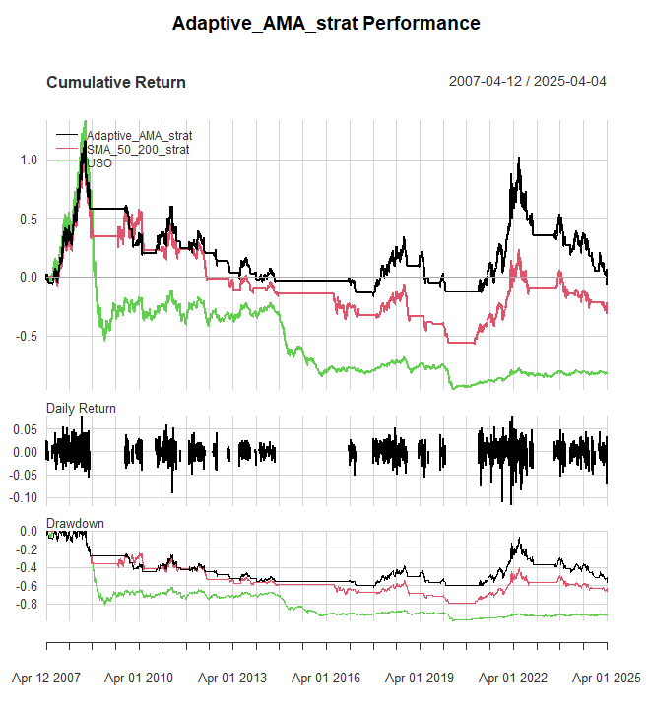
Does It Work?

Slide 5
Conclusions
Does it work? Not miraculously.
There are probably better ways to trend follow than moving averages.
There’s a new book in the works coming out that seeks to do just that.
Original source for the filter: https://cssanalytics.wordpress.com/2020/12/23/how-should-trend-followers-adjust-to-the-modern-environment-enter-adaptive-momentum/#:~:text=Notice%20that%20the%20adaptive%20moving,like%20vs%20typical%20static%20lookbacks:

