Slide 1
Signal Quantiling
& Signal Combination in the Cross-Section
Simple heuristics in an AI world
Killian Tattan
Quant Portfolio Manager, Paratus Capital
11-04-2025

Slide 2
Disclaimer
The details presented in this presentation should not be misconstrued as investment advice. The presentation is for informational and educational purposes only.
The opinions expressed in this presentation are those of the author only, and are not the opinions of the company, Paratus Capital.

Slide 3
Part i) Signal Quantiling
Context:
Systematic long / short signal (although can work with long only portfolios)
Signal expresses positions in terms of “portfolio weights” percentages
Signal weights can be negative for shorts
Problem: My signal works ok, but has long periods of flatness or drawdown. How can I squeeze more juice out of it (without changing the fundamentals and minimum effort)? i.e. Where is the greatest / weakest statistical power in my signal?

Slide 4
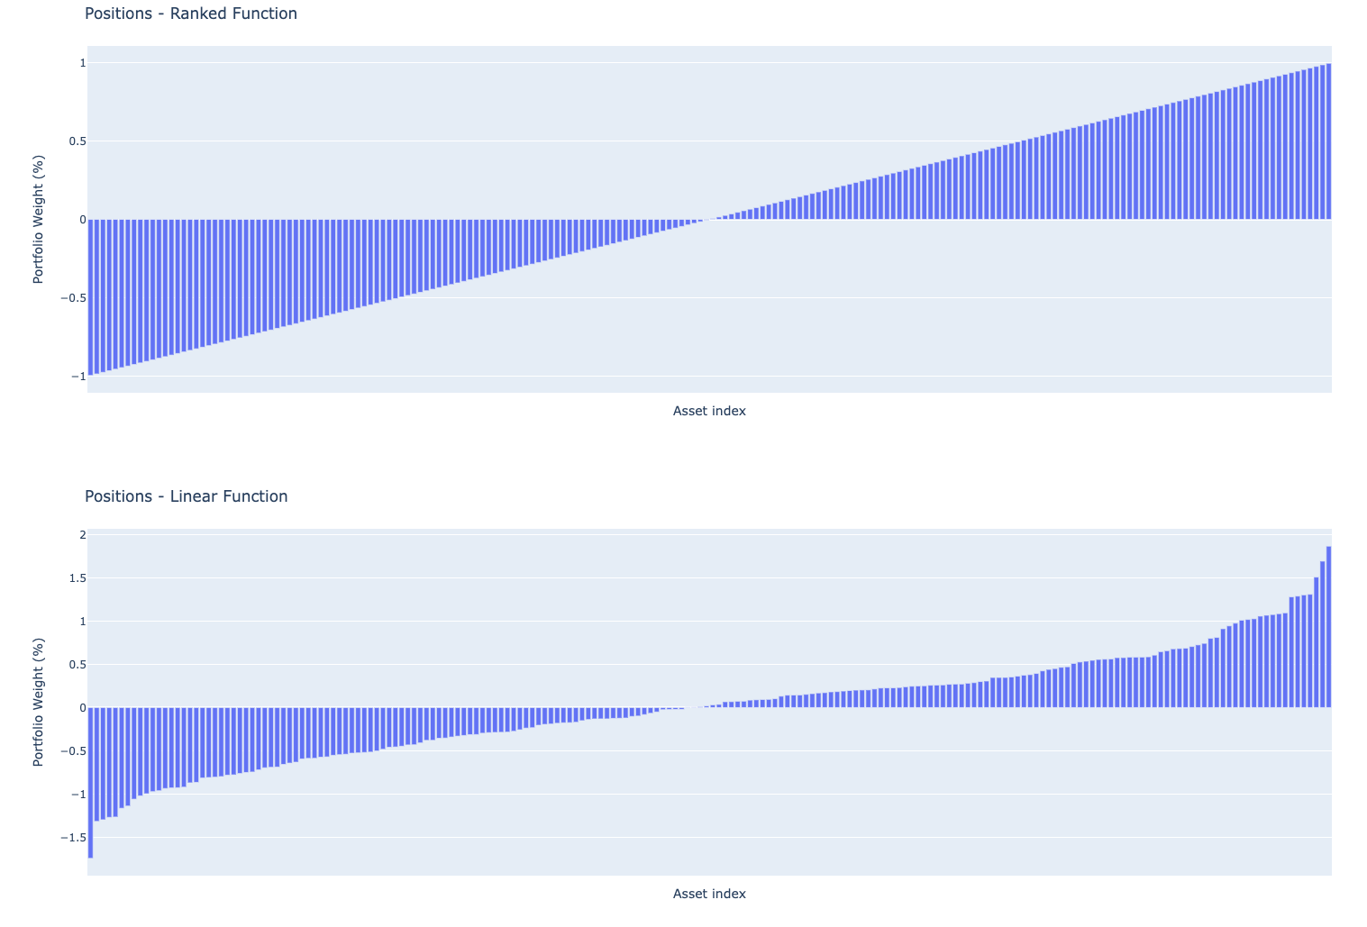
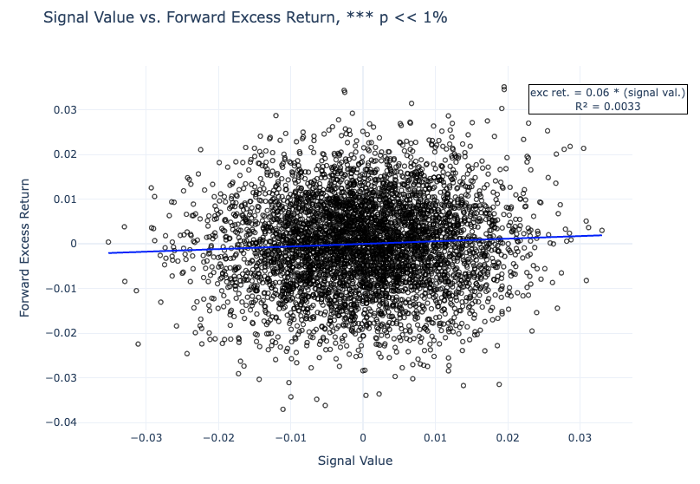
Naive Approach
Ranking, or linear value based approach to calculate signal positions.
Notes:
“Signal Value” here can be whatever stationary metric you want; z-score of P/E Ratio, Rolling average of returns

Slide 5
Quantiling Approach
Arik Ben Dor and Stephan Florig propose a unique yet intuitive approach.
Take the raw signal values:
Quantile them in the cross-section (XS)
Calculate the forward excess returns in each signal quantile
Calculate the average and std excess return for each quantile
Plot the Signal Quantile vs. Excess Returns
Fit a LOWESS model to the quantile data, or visually inspect and manually fit piecewise OLS models
The output of the previous regression can be easily transformed to positions!
Notes:
This paper was actually applied to Corporate Bonds, but the framework can be applied to any asset class

Slide 6
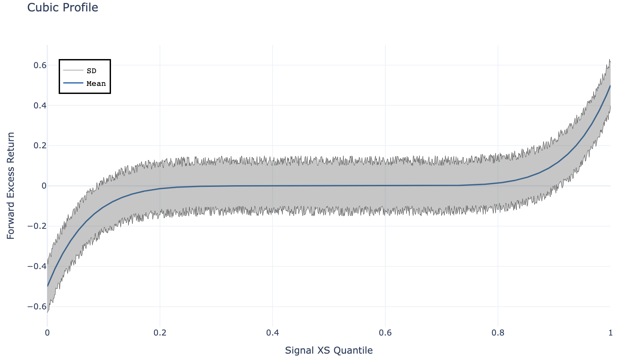
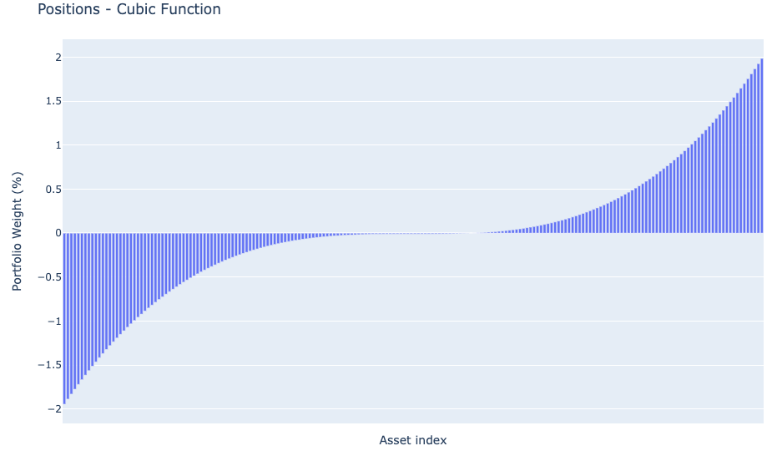
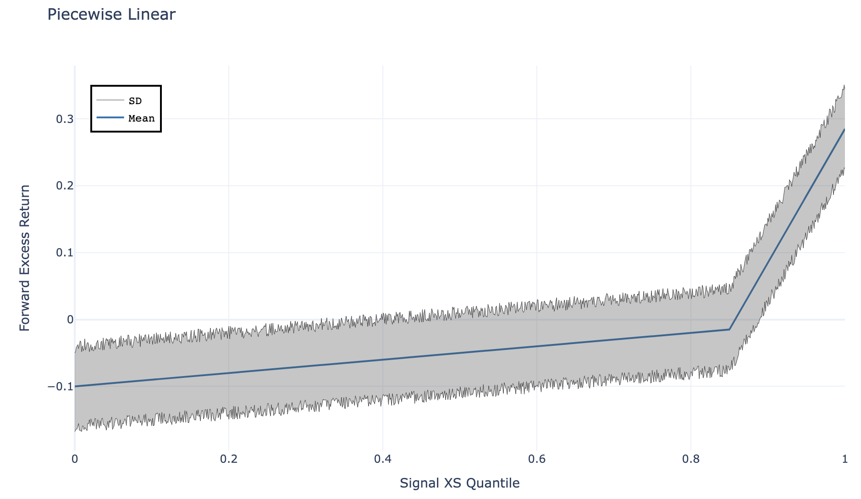
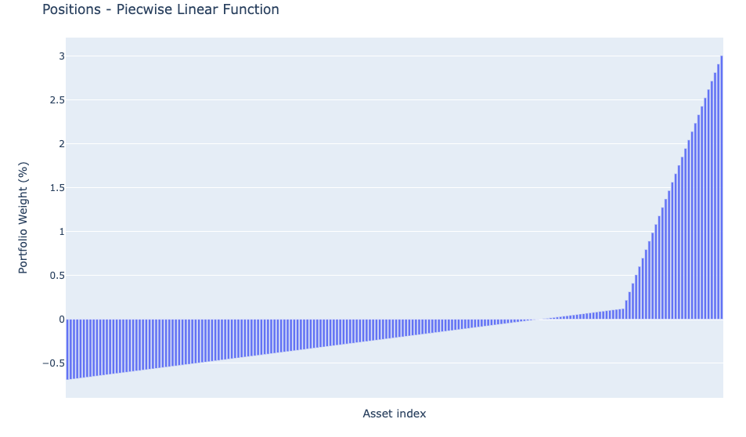
Common Profiles: Cubic & Weak-Short Signal
Notes:
This is typical of Momentum or Sentiment based signals - strong at the tails but not much power in the middle

Slide 7
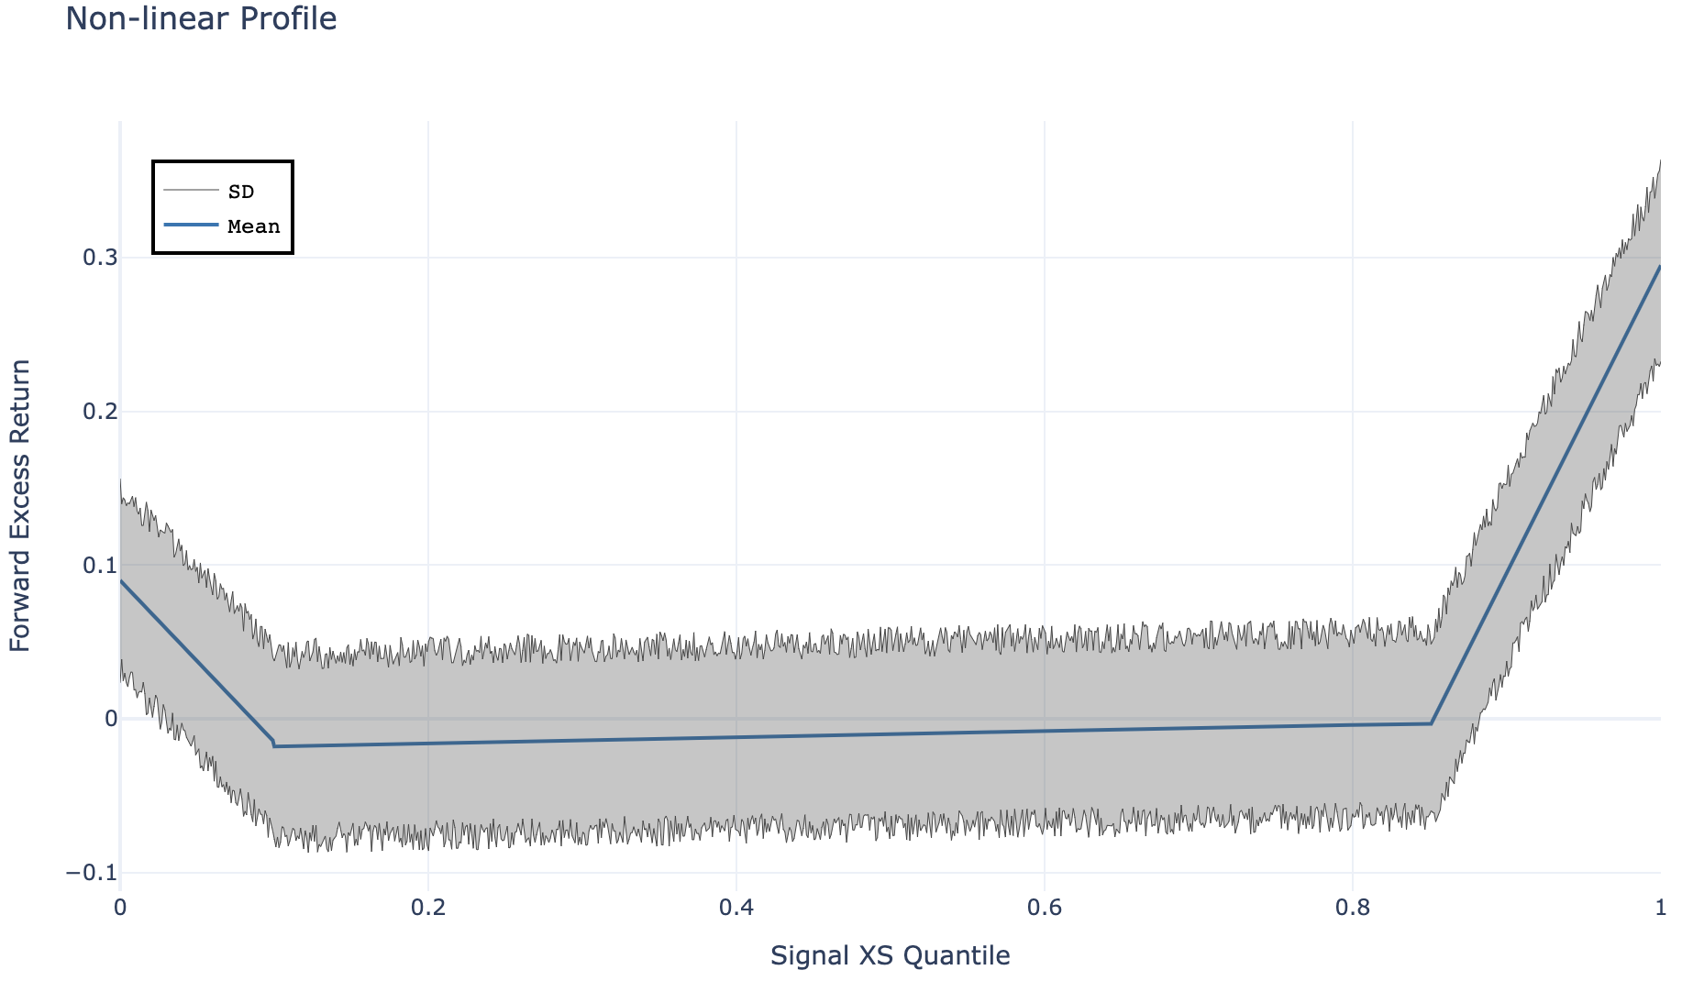
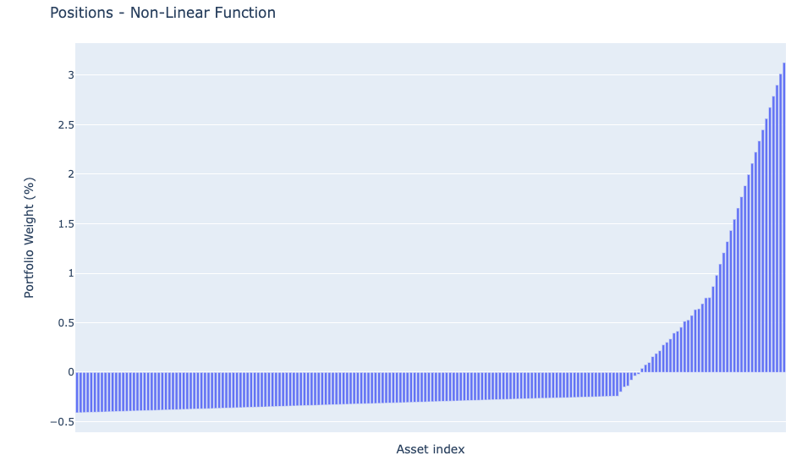
Some Surprising Profiles
The lowest decile actually has positive expected returns! Assets previously shorted in the naive approach are now long positions.
Notes:
This profile can actually occur in some behavioural finance based signals - Anchoring Bias

Slide 8
Monte-Carlo Simulation
MC setup
Generate series of correlated asset returns with student-T distribution (df=10)
Rank the asset returns in the XS
Change the sign of the asset returns in the bottom decile - this is the “real asset returns”
Generate two signals: - One is correlated to the asset returns with the change in sign in bottom decile - the quantiled approach - The other is correlated to the signal prior to changing the bottom decile sign - the baseline weaker correlation
Both signals have positive correlation to the “real asset returns” and have positive drift
N_assets = 200, N_days = 1,825 (5 years @ 365), N_sims = 1,000
No leverage applied so as not to skew results
Notes:
Key point is that both signals have positive correlation to real asset returns, but the quantiled signal picks up on the subtle

Slide 9
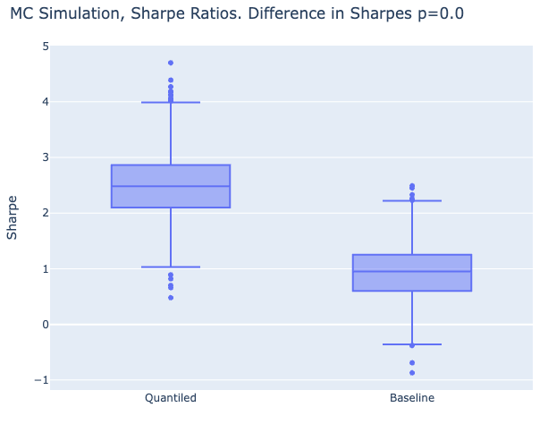
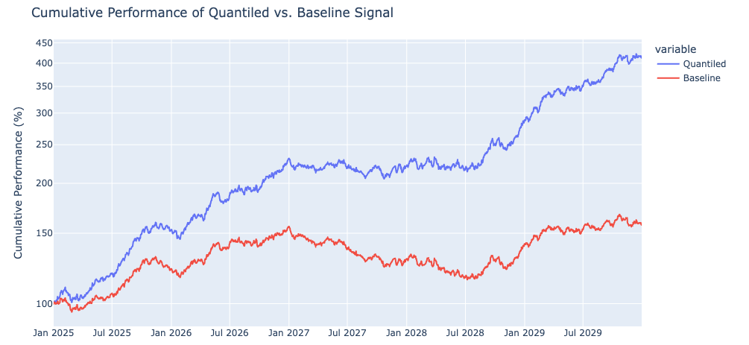
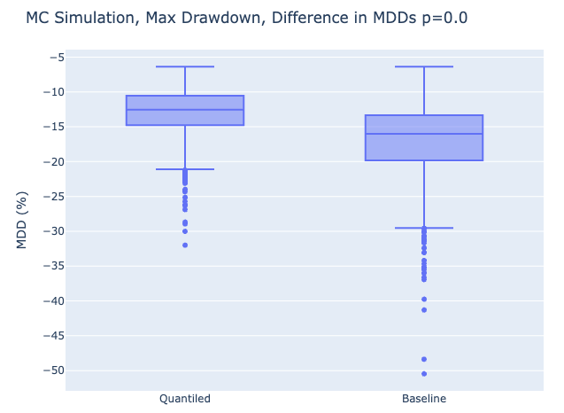
MC Results
Notes:
This is obviously an ideal example, we don’t expect to “double your Sharpe”, but most likely you will increase your Sharpe by taking this quantiling approach.

Slide 10
Part ii) Signal Combination
Problem: How do I assign capital / weight within a portfolio to a signal so as to maximise performance?
The problem is easy to understand, but requires some thought. The simplest approach is to equal weight the signals, or use some discretionary approach based on signal volatility. But what about using recent signal performance and correlation between signals? Two signals with 70% correlation but with Sharpe’s of 1 and 1.5 respectively, intuitively, should have more weight assigned to the second signal with higher Sharpe.
The baseline is equal weighting - can we beat this? It’s hard…

Slide 11
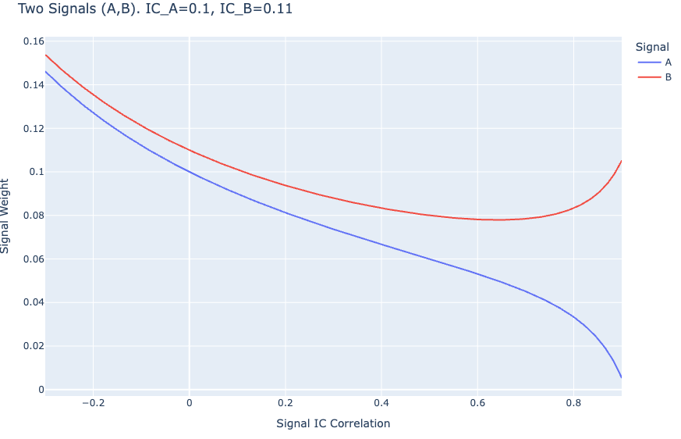
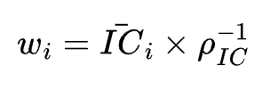
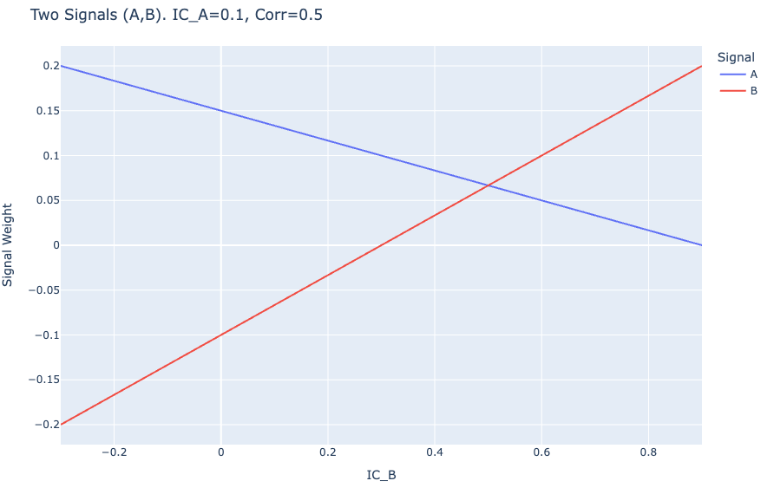
Integrating Performance & Correlation
Edward E. Qian has a closed form solution derived in an optimisation problem, which maximizes the portfolio IC.
Where the IC is the Information Coefficient for a signal i, rho is the correlation between IC values of signals and w_i are the weights assigned to each signal.
We took this formulation and played around with the values through an MC simulation.
Notes:
The output weights of this formula are not scaled, and can be negative (i.e short signal, bad)

Slide 12
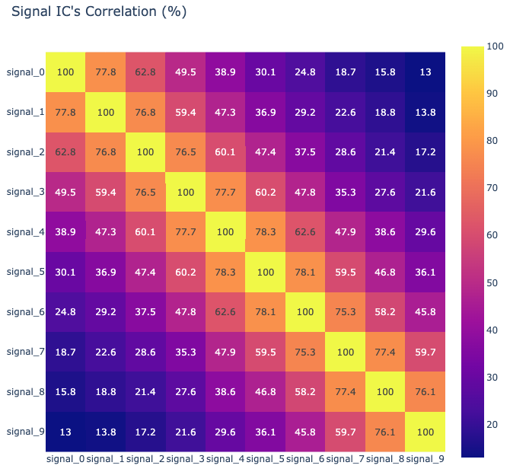
MC Setup
We have a similar MC setup to the signal quantiling, whereby we generate series of correlated asset returns with student-T distribution (df=10) and signal weights with low (0.2%-3%) correlation with the forward returns. The signals have positive correlation to each other on average for a more realistic scenario, and all signals have positive drift.
N_signals = 10, N_days = 1,825 (5 years @ 365), N_sims = 1,000
Type 1: IC weighting as shown in the previous slide, 365 day window to calculate average IC and IC correlation.
Type 2: Use 365 day rolling Sharpe ratio instead of IC, Sharpe correlations are used.
Type 3: Use 365 day rolling Sharpe ratio instead of IC, but signal returns are used in correlation.
Type 4: Use 365 day rolling Sharpe ratio only, no correlation used.
No leverage applied so as not to skew results, and we apply appropriate lags to mitigate look ahead bias.
Notes:
The correlation plot of signal IC’s is just one example in the MC - we generate 1000 like this

Slide 13
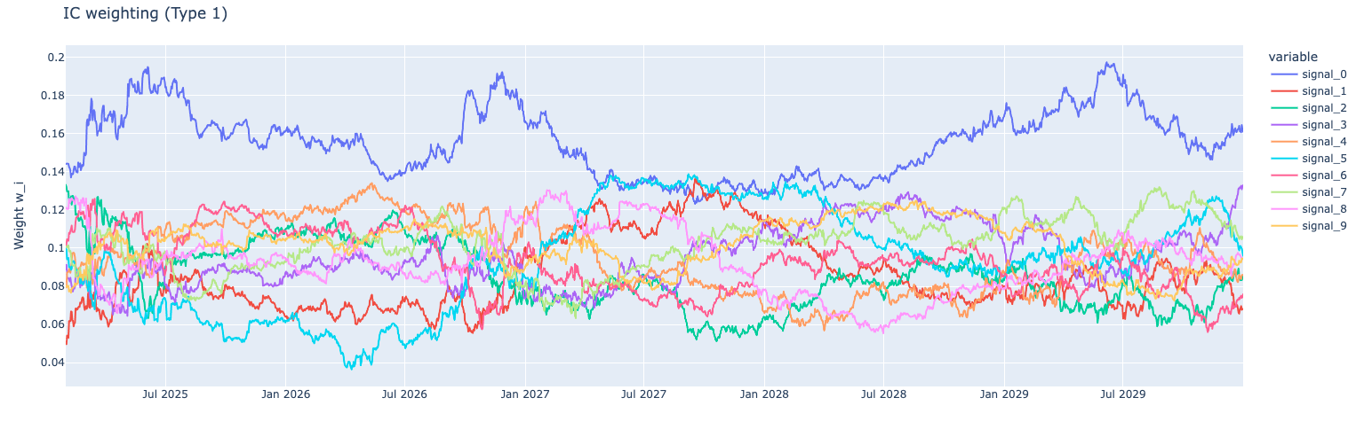
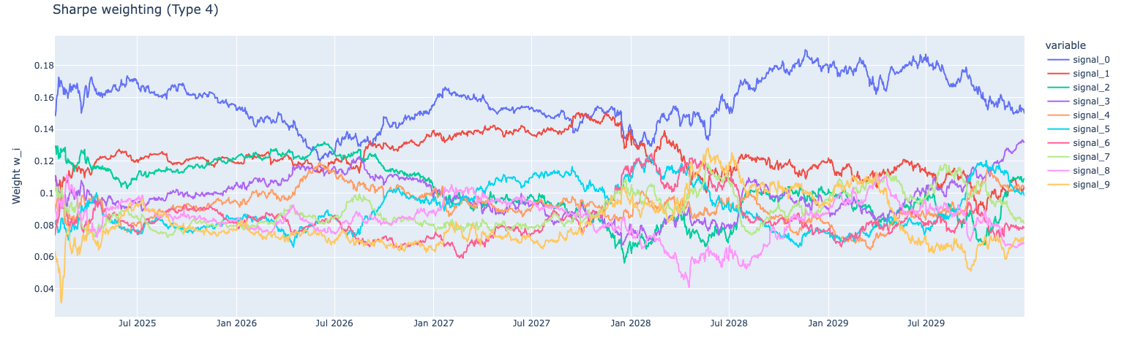
Examples of Weights

Slide 14
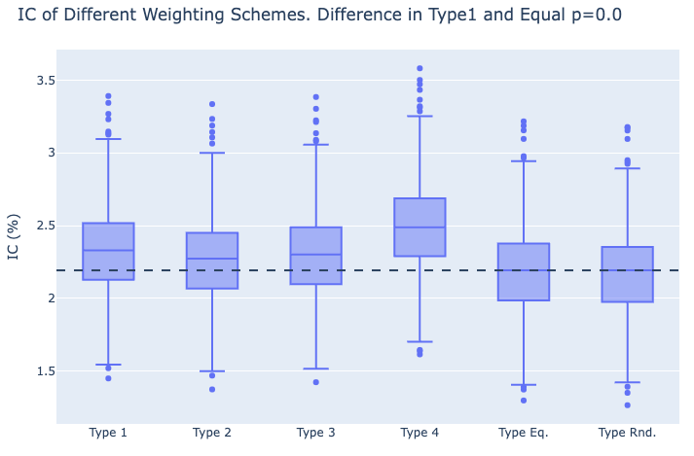
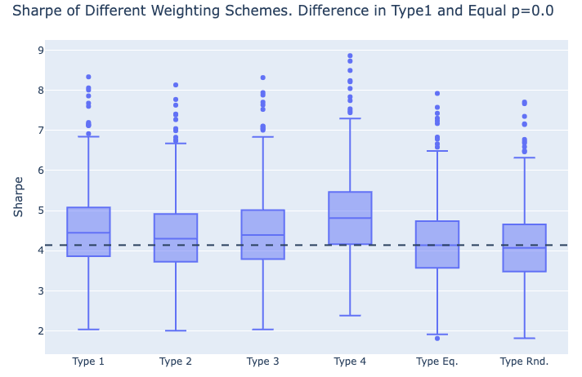
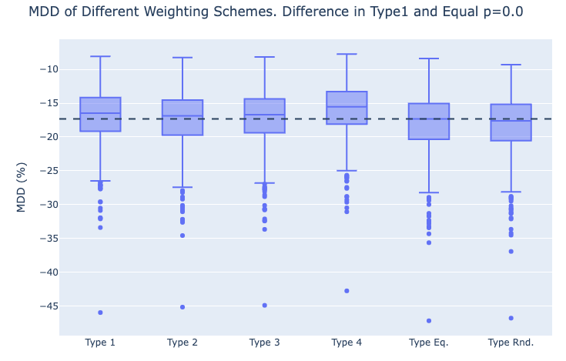
MC results

Slide 15
Caveats
The output weights can be negative; these weights should be scaled so you don’t short your signal (especially if the signal is already long / short)
This approach works better for uncorrelated (<40%) signals so that the inverse correlation matrix is stable
If using Sharpe instead of IC, careful on the length of the lookback window; very long windows (e.g. > 1-2 years) will produce autocorrelated time-series which will be slow to react

Slide 16
Thank you!
Contact me: killian@tattan.co

Slide 17
References
Arik Ben Dor, Stephan Florig; Integrating Multiple Signals in Systematic Corporate Bond Selection Strategies
Edward E. Qian et. al.; Quantitative Equity Portfolio Management Modern Techniques and Applications
Code: https://github.com/NervousEnergy1979/osqf

