Slide 1

Micro Alphas
ADMASTER-STAMP!20240515-3574236
Predicting the Equity Risk Premium
Authors: Blair Hull, Petra Bakosova, Francois Cocquemas, Euan Sinclair, Petri Fast
Published November 2024

Slide 2
Introduction
Micro Alphas: Weak signals that become predictive when combined.
Machine Learning Techniques (Elastic Net) used for equity risk premium prediction.

Slide 3
Why Do We Care?
This strategy is currently deployed in a publicly traded fund.
Contribution to the return predictability discussion.

Slide 4
Efficient Market Hypothesis
Theoretical Foundation: Investors can’t all beat the market.
Critique: Market Predictability challenged by Goyal & Welch (2008).
Robert Merton: “Predicting the market is a fool’s errand.”
Burton Malkiel: “Don’t try to time the market. No one can do it. It’s dangerous.”

Slide 5
What Has Changed
There has been an explosion of available data.
Computation costs have plummeted.
Advancements in AI and Machine Learning have accelerated progress.
Buy and sell SPY at closing auction which provides no slippage against the market close.

Slide 6
Our Approach
Features
Dynamic Transformations (DEoptim)
Elastic net regularization to avoid overfitting and manage multicollinearity
Cross-validation
Betting Scheme

Slide 7
Core Features
Broad Market & Macro: BAA yield, financial conditions, term spread.
Sentiment: Trading sentiment, speculation indicators.
Variance-Related: VIX index, volatility signals.
Seasonality and Events: FOMC dates, seasonal patterns.

Slide 8
Data Transformations
Feature transformations capture nonlinear relationships.
Expanding-window approach: Re-optimize every year to predict the next year’s daily excess return.

Slide 9
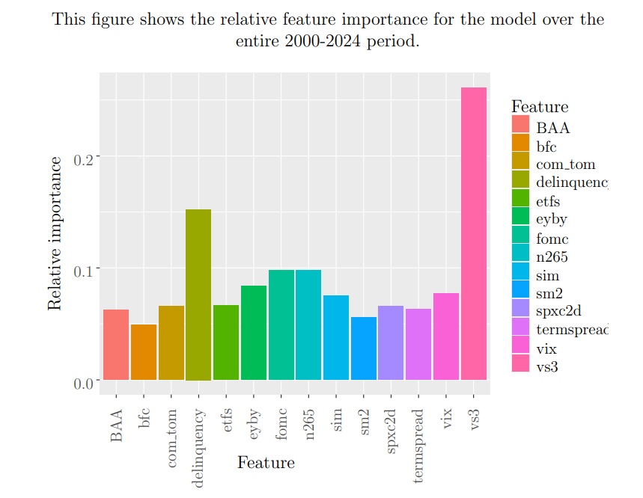
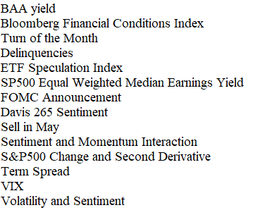
Relative Feature Importance

Slide 10
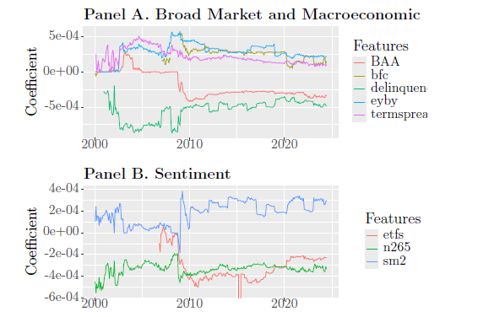
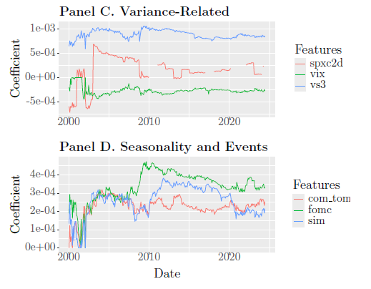
Feature Importance
Dynamic feature relevance reflects adaptability to market conditions.

Slide 11
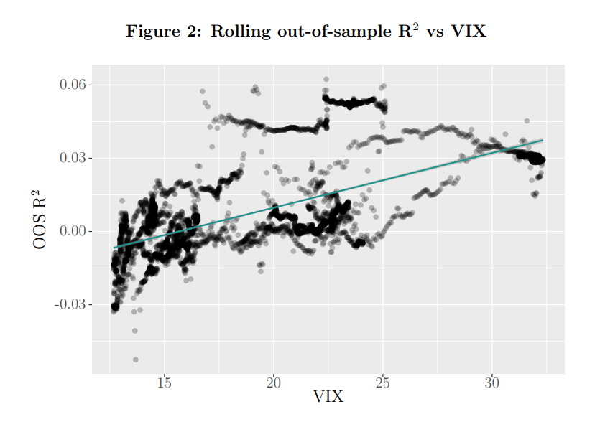
Evaluation Metrics
Out-of-sample R² , RMSE for accuracy.
Portfolio metrics: CAGR, Sharpe Ratio, Sortino Ratio, CAPM Alpha, Beta.

Slide 12
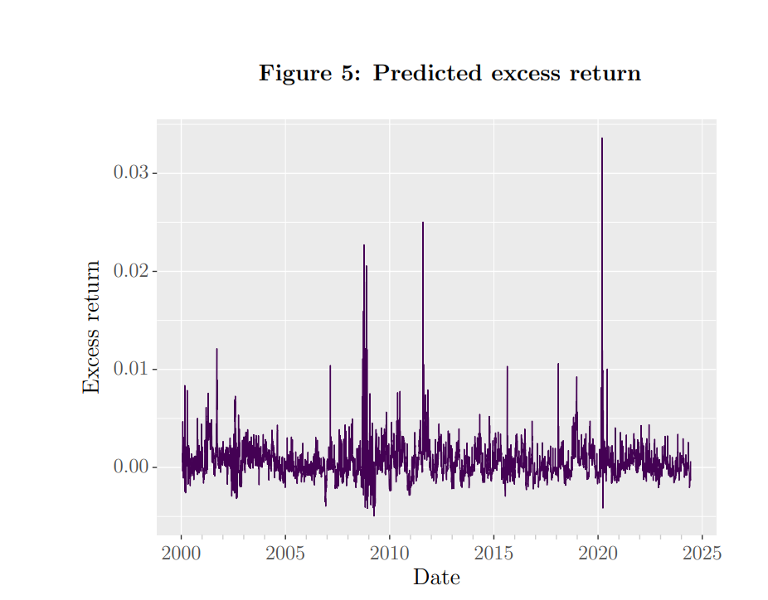
Results Overview
Full Sample (2000-2024)
CAGR: 14.0%
Sharpe Ratio: 0.556
Sortino Ratio: 1.074
CAPM Alpha: 6.4%

Slide 13
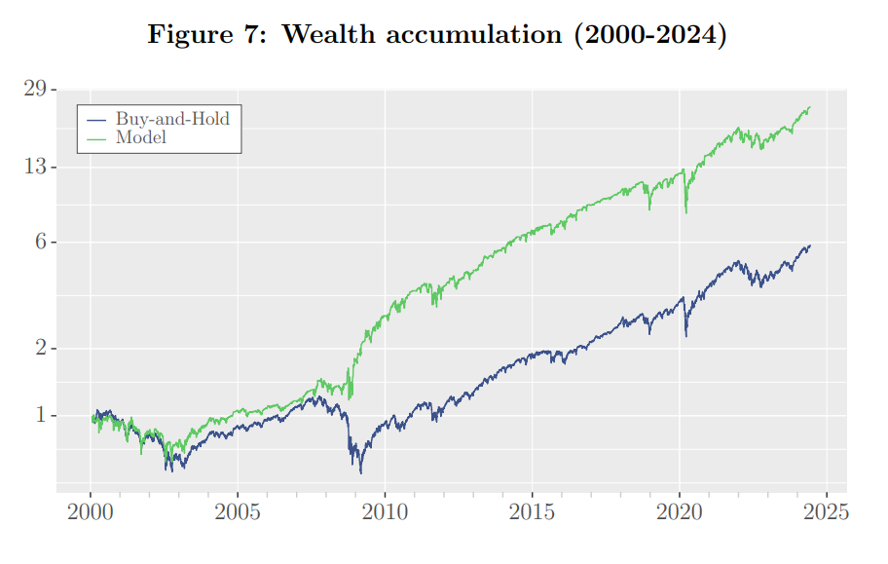
Performance During Market Stress
High predictive power during 2008 crisis and COVID-19.
Performance peaks in periods of high volatility (e.g., VIX > 18).

Slide 14
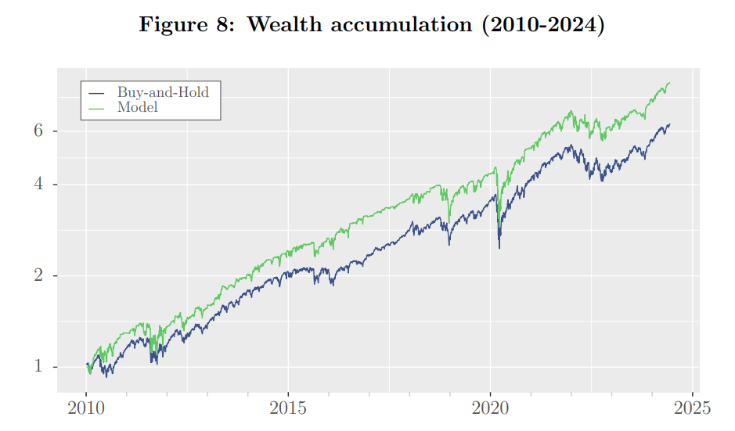
Subsample Analysis (2010 – 2024)
CAGR: 16.1%
Sharpe Ratio: 0.752
Improved performance in post crisis periods, robust across conditions.

Slide 15
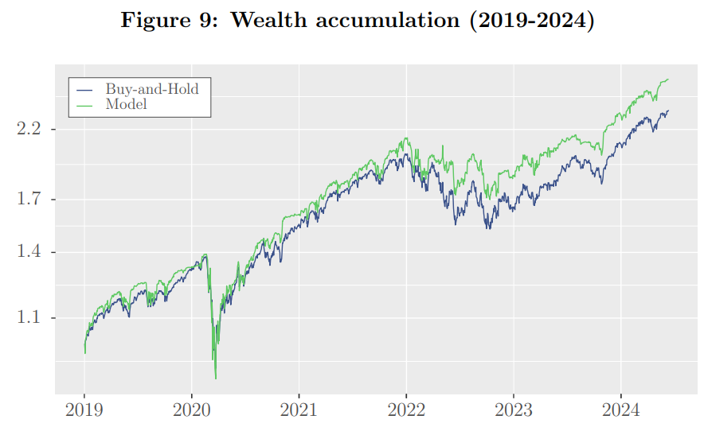
Subsample Analysis (2019 – 2024)
CAGR: 19.6%
Sharpe Ratio: 0.738
Consistent outperformance, particularly during COVID-19 volatility.

Slide 16
Comparison with Benchmark
Outperformance relative to S&P 500 across all periods.
Lower maximum drawdown and higher Sharpe ratio.
Resilience shown through subsample analysis.
Effective at capturing favorable market opportunities.

Slide 17
Limitations and Challenges
Potential for model overfitting.
Dependence on market conditions and volatility.

Slide 18
Future Directions
Further refinement with new data sources (e.g., social media sentiment).
Application to intraday returns and wagers.
Application to multi-asset portfolios for diversified alpha generation.

Slide 19
Conclusion
Micro alphas provide predictive edge through combined weak signals.
Machine learning models capturing weak signals gain practical traction.
Strategy achieves consistent outperformance and enhanced risk management.
Market timing once seen as speculative now proving effective.

Slide 20
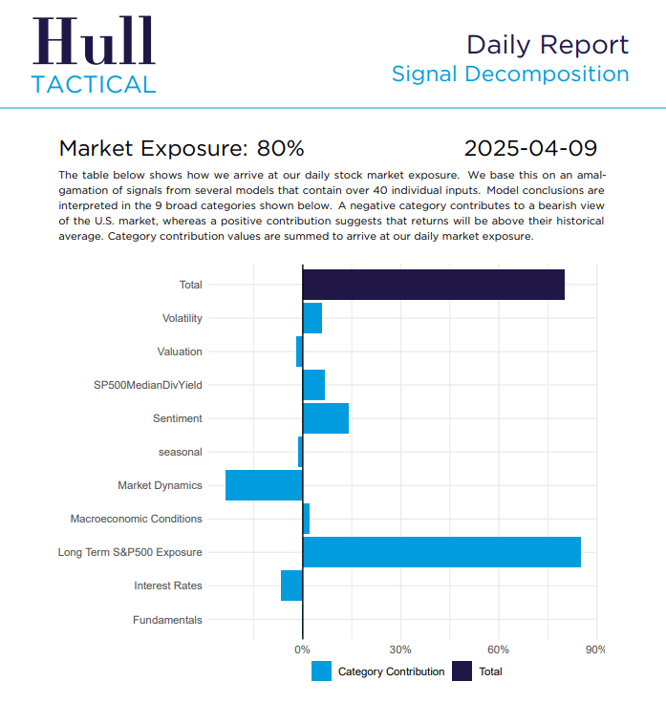
Live Updates

Slide 21


About Us
www.hulltactical.com www.hulltacticalfunds.com
@HullTactical

