Slide 1

Build a Better Elastic Net with Custom Penalties for Your Strategy
ADMASTER-STAMP!20240515-3574236
Petri Fast
Open Source Quantitative Finance
Chicago
April 12th, 2025

Slide 2
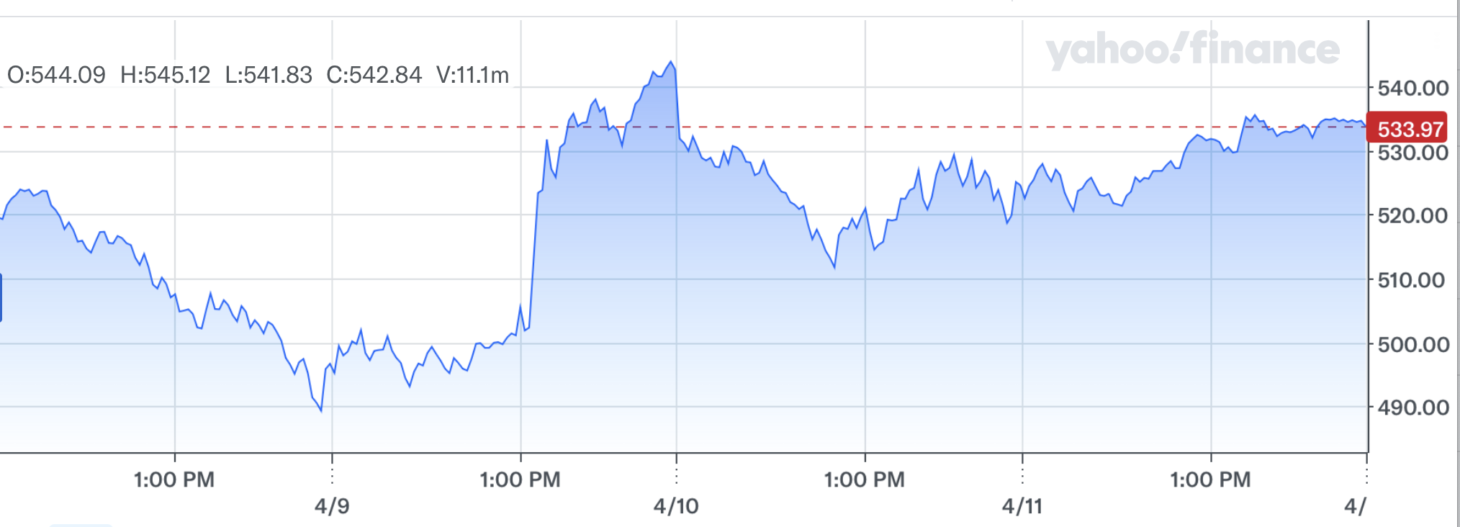
Can we predict S&P 500 tomorrow?
On Wednesday:
Thursday?

Slide 3
Can we predict S&P 500 tomorrow?
On Thursday:
Friday?

Slide 4
Can we predict S&P 500 tomorrow?
Monday?

Slide 5
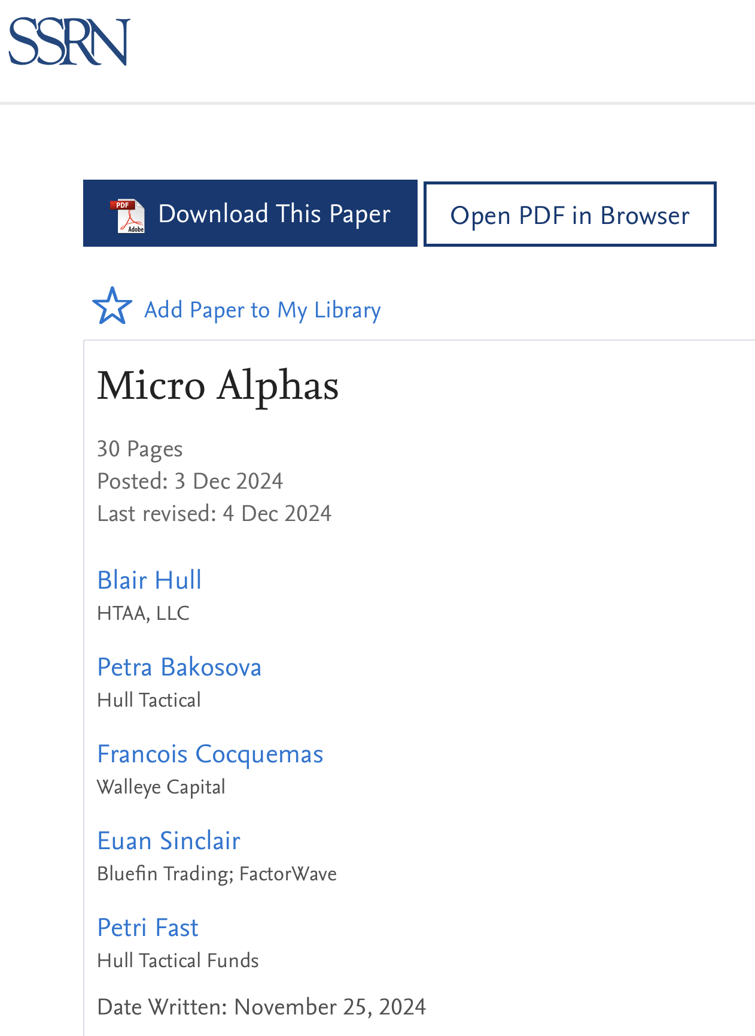
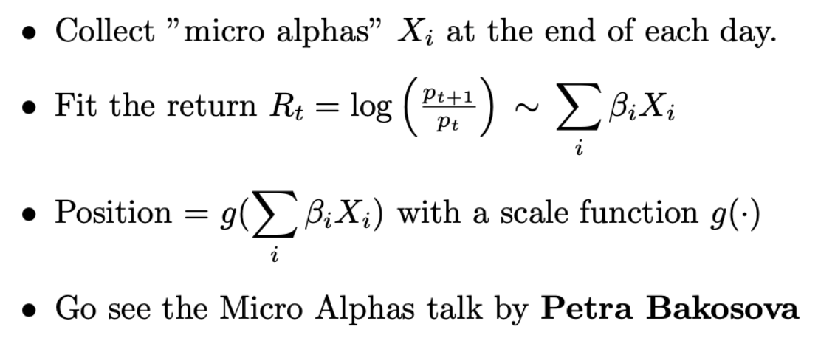
One day return forecasting

Slide 6
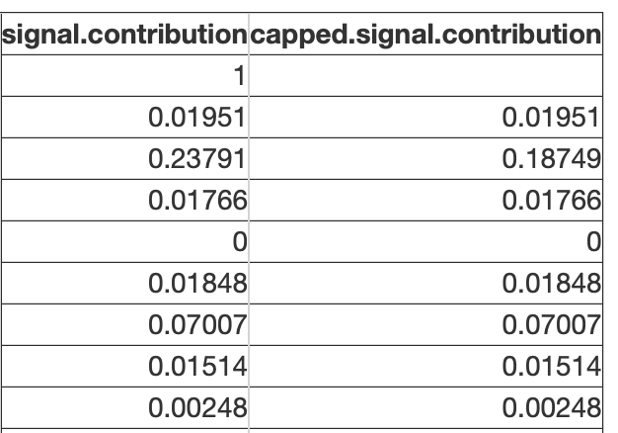
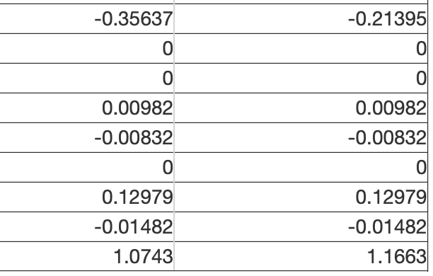

Large contributions by some features
Intercept
X₀
Question:
Can we
limit contribution
per feature?
Why?
Diversification
X_{P}
Position

Slide 7
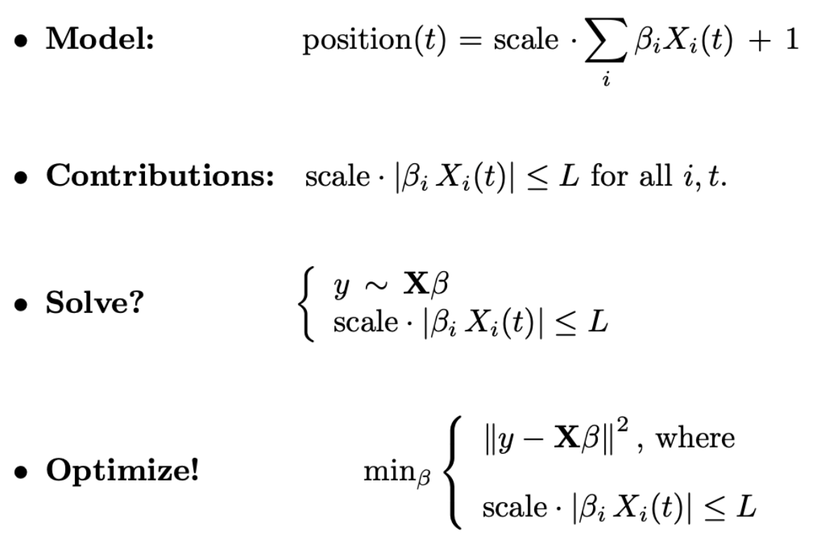
”Contribution Limit” penalty
“Hard constraint formulation?”

Slide 8
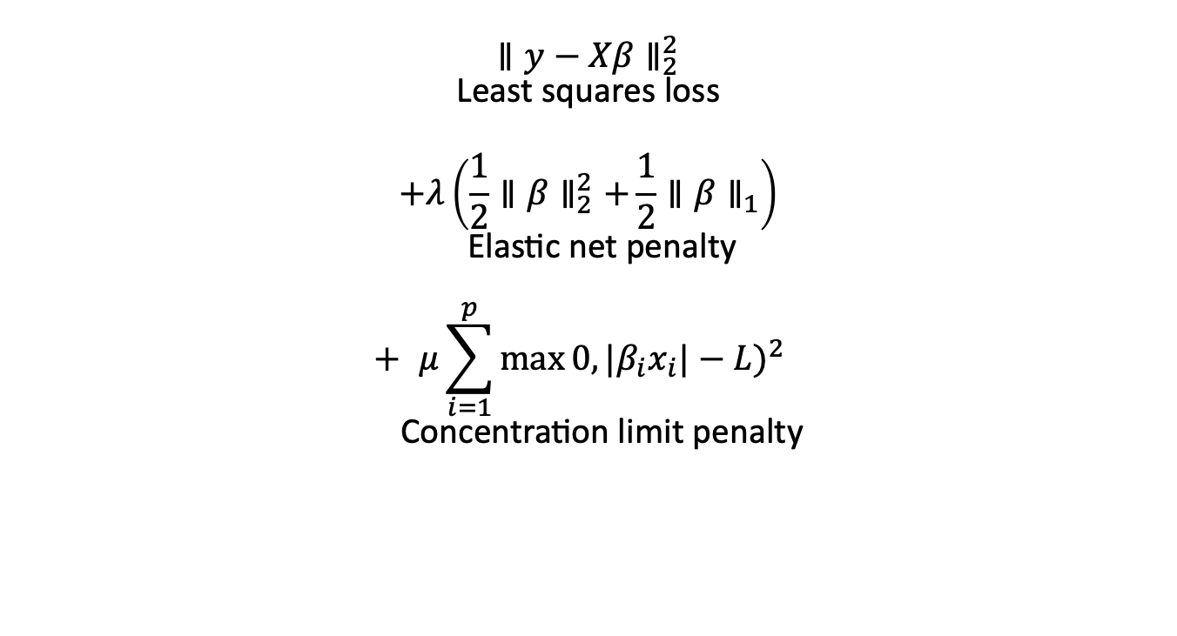
Objective Function
$$\underset{\text{Least} \text{squares} \text{loss}}{∥y−Xβ∥_{2}^{2}}$$
$$+\underset{\text{Elastic} \text{net} \text{penalty}}{λ\left(\frac{1}{2}∥β∥_{2}^{2}+\frac{1}{2}∥β∥_{1}\right)}$$
$$+\underset{\text{Concentration} \text{limit} \text{penalty}}{μ\sum_{i=1}^{p}{max}0,|β_{i}x_{i}|−L)^{2}}$$
Minimize
“Soft constraint formulation”
- Zou, Hui; Hastie, Trevor (2005). "Regularization and Variable Selection via the Elastic Net".

Slide 9
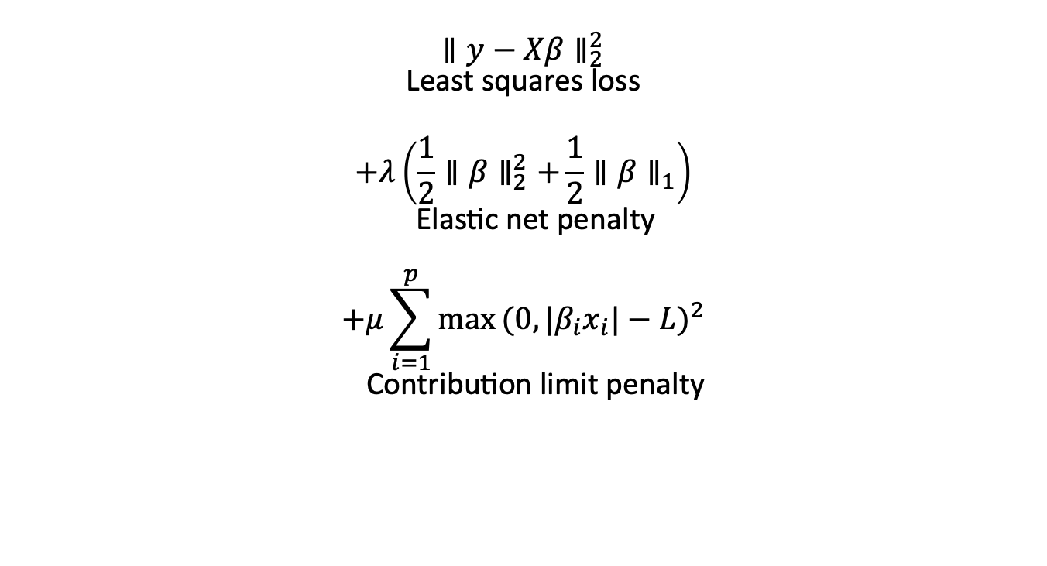
New Objective Function
$$\underset{\text{Least} \text{squares} \text{loss}}{∥y−Xβ∥_{2}^{2}}$$
$$+\underset{\text{Elastic} \text{net} \text{penalty}}{λ\left(\frac{1}{2}∥β∥_{2}^{2}+\frac{1}{2}∥β∥_{1}\right)}$$
$$+\underset{\text{C}\text{ontribution} \text{limit} \text{penalty}}{μ\sum_{i=1}^{p}{max}(0,|β_{i}x_{i}|−L)^{2}}$$
Minimize
“Soft constraint formulation”
“Soft constraint on contributions”
- Zou, Hui; Hastie, Trevor (2005). "Regularization and Variable Selection via the Elastic Net".
- James, Paulson, and Rusmevichientong (2019), “Penalized and Constrained Optimization"
- Gaines, Kim, and Hua Zhou (2018), “Algorithms for Fitting the Constrained Lasso”

Slide 10
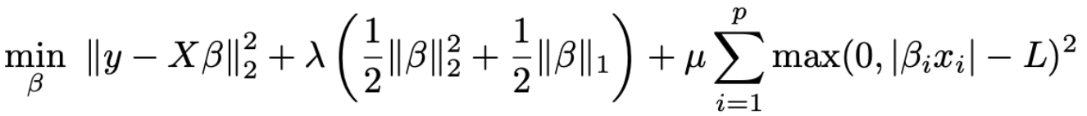

Key components
Elastic Net:
Balances L1 (sparsity) and L2 (shrinkage) penalties
Contribution Constraint:
Penalizes when any feature contribution $|β_{i}x_{i}|$ exceeds threshold $L$
Parameters:
$λ$: Controls overall regularization strength
$μ$: Controls enforcement strength of concentration limits
$L$: Maximum allowed contribution for any individual feature

Slide 11
Solve in R with ”optim”
objective <- function(beta) {
pred <- beta[1] + X %*% beta[-1]
loss <- sum((y - pred)^2) / (2*n)
elastic_penalty <- 0.5 * sum(abs(beta[-1])) + 0.5/2 * sum(beta[-1]^2))
# Contribution limit penalty
feature_contributions <- sweep(X, 2, beta, "*") # Multiply every X with beta
contribution_penalty <- sum(pmax(0, abs(feature_contributions) - L)^2)
# Total objective
total <- loss + lambda * elastic_penalty + mu * contribution_penalty
}

Slide 12
Solve in R with ”optim”…
objective <- function(beta) {…
The tricky part:
Hyper parameter values?
Easy for one elastic lambda value:
How would you solve for all lambda values quickly?

Slide 13
Example predicting SPY ETF
2019 – 2024 performance of capped vs uncapped model?
20 Features
End of each day at 2:55 pm CST
Fundamental variables, transforms of VIX, sentiment, price dynamics…
Predict the “excess equity risk premium”
ERP = Daily S&P 500 return – 3 month T-bill rate
Excess ERP = ERP – 10 year average (ERP)
Linear model
Fit with custom elastic net + contribution caps
Walk-forward fit from 1990 with annual refits

Slide 14
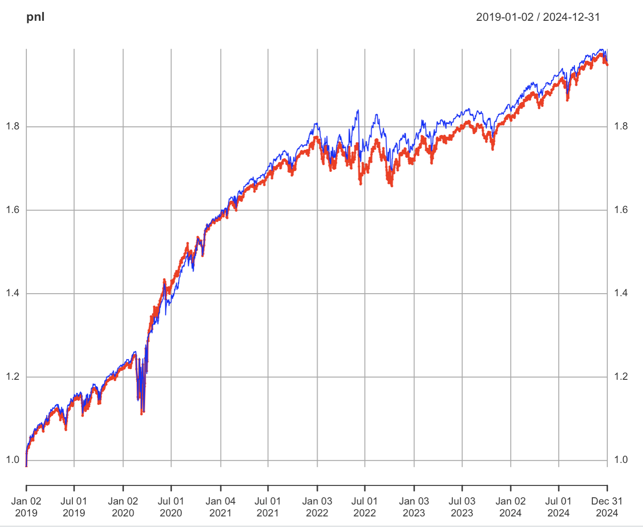
Backtested wealth accumulation
Original forecast
2019 - 2024
Capped Contribution Forecast

Slide 15
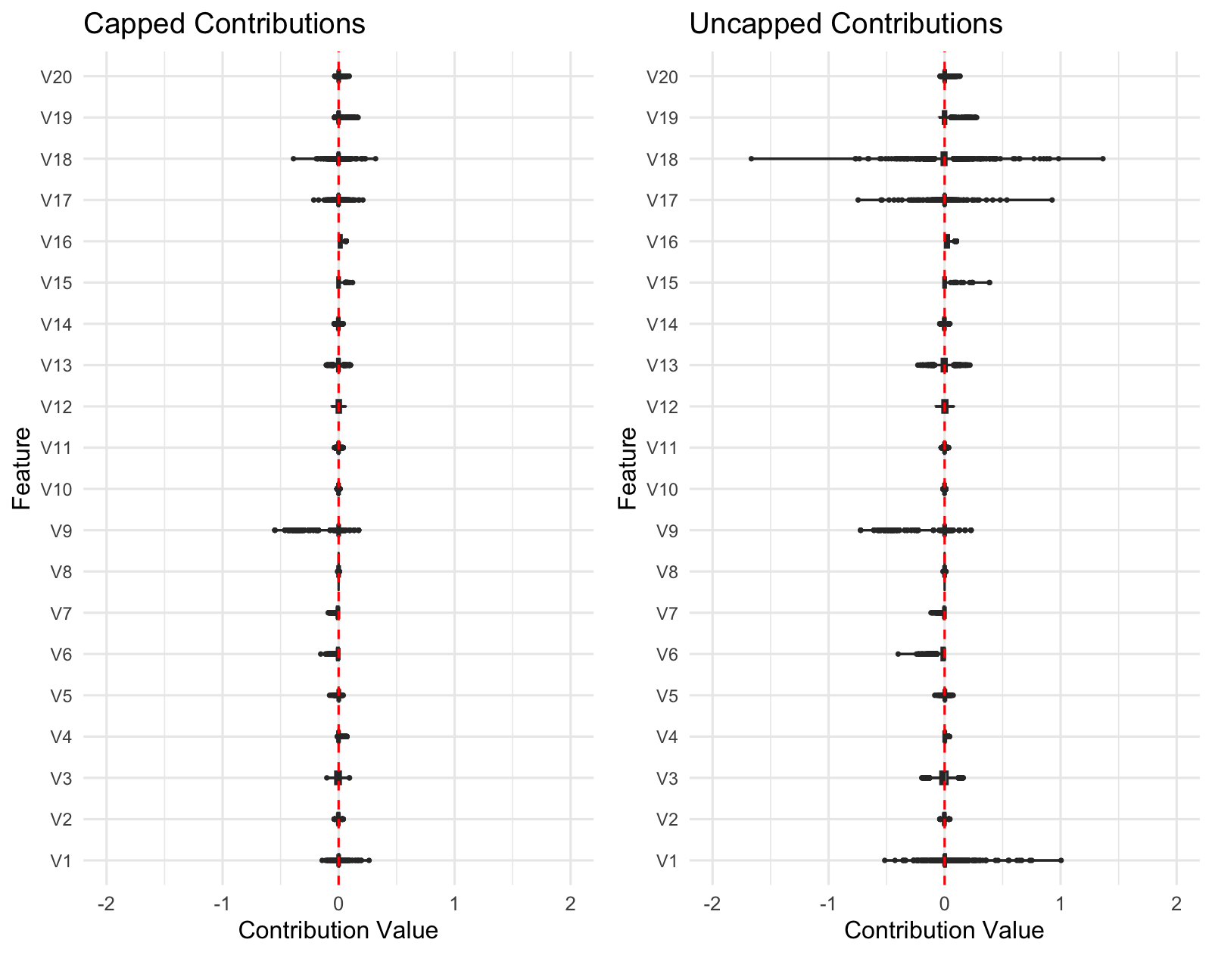
Contributions are capped
New forecast
Original forecast

Slide 16
Conclusions & Next Steps
“Bring Your Own Lasso” modeling
Add the constraints you need into an objective function
Solve directly by gradient descent etc.
Example of custom “contribution limits” in an Elastic Net
Next steps:
Soft constraints vs hard constraints? Different optimizers?
Efficient solution for every elastic ”lambda” value?
Choosing the penalty coefficients, the limit and other hyperparameters?

Slide 17

About us
www.hulltactical.com
@HullTactical

