Slide 1
INVESTMENT THEMES as Missing RISK Factors
Ryan Brown
OSQF / R-in-Finance
April 2025

Slide 2
Thematic investing
Examples of themes: artificial intelligence, carbon neutrality, covid sensitivity, inflation, drug legalization, onshoring, tariff-sensitive, meme stocks
Returns driven by a common economic narrative
Analogous to categorical variables in conventional risk models: industry, country, asset class, etc
Themes aren’t entirely spanned by conventional risk models

Slide 3
contribution
Ex-ante risks of thematic portfolios are too low using risk models
We supplement an existing vendor risk model to capture incremental risks linked to themes
This “joint” risk model produces larger risk estimates which are more aligned with realizations

Slide 4
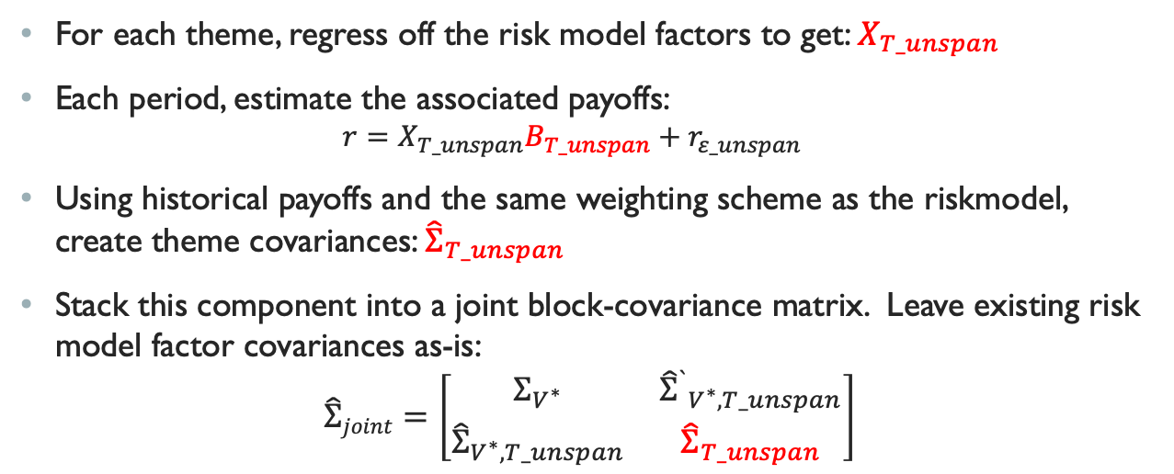
Technique
For each theme, regress off the risk model factors to get: $X_{T_unspan}$
Each period, estimate the associated payoffs:
$$r=X_{T_unspan}B_{T_unspan}+r_{ε_unspan}$$
Using historical payoffs and the same weighting scheme as the riskmodel, create theme covariances: ${\hat{Σ}}_{T_unspan}$
Stack this component into a joint block-covariance matrix. Leave existing risk model factor covariances as-is:
$$\hat{Σ}joint=\left[\begin{matrix}Σ_{V^{∗}} & {{\hat{Σ}}^{`}}_{V^{∗},T_unspan} \\ {\hat{Σ}}_{V^{∗},T_unspan} & {\hat{Σ}}_{T_unspan}\end{matrix}\right]$$

Slide 5
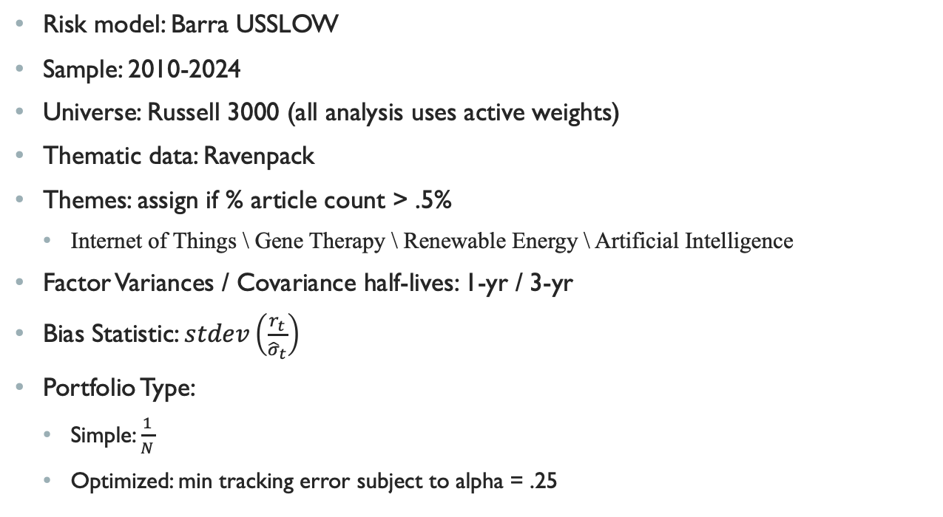
EMPIRICAL SETUP
Risk model: Barra USSLOW
Sample: 2010-2024
Universe: Russell 3000 (all analysis uses active weights)
Thematic data: Ravenpack
Themes: assign if % article count > .5%
Internet of Things \ Gene Therapy \ Renewable Energy \ Artificial Intelligence
Factor Variances / Covariance half-lives: 1-yr / 3-yr
Bias Statistic: $stdev\left(\frac{r_{t}}{{\hat{σ}}_{t}}\right)$
Portfolio Type:
Simple: $\frac{1}{N}$
Optimized: min tracking error subject to alpha = .25

Slide 6
Results
Risk Bias Statistics of Thematic Portfolios
theme | vendor | joint | vendor optimized | joint optimized
Artificial Intelligence | 1.24 | 1.11 | 1.20 | 0.80
Gene Therapy | 1.18 | 0.96 | 1.36 | 1.17
Internet of Things | 1.00 | 0.92 | 1.24 | 0.94
Renewable Energy | 1.31 | 1.15 | 1.41 | 1.13
Multi- theme | 1.11 | 0.99 | 1.20 | 1.01

Slide 7
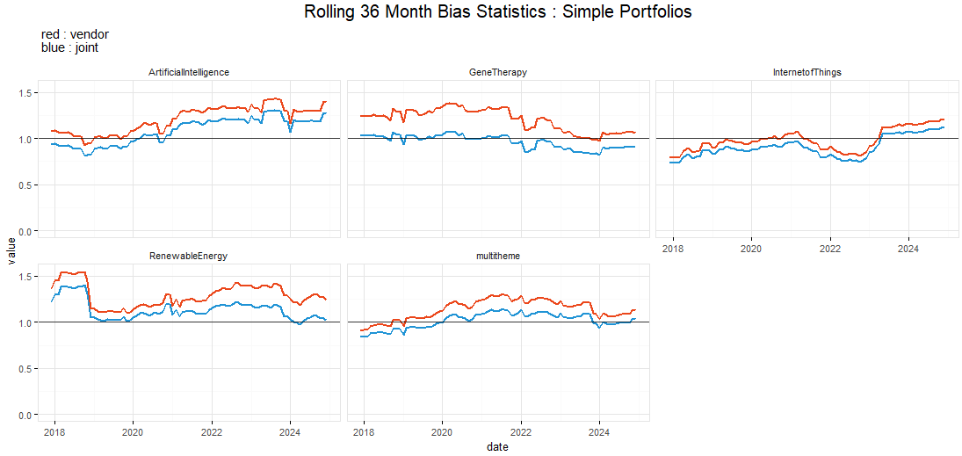
results

Slide 8
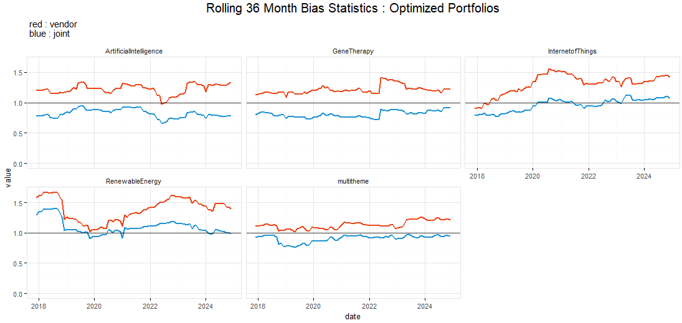
results

Slide 9
R Packages Used
ggplot & tidyverse
Rmarkdown
PerformanceAnalytics
quadprog

