Slide 1




Chen_zhe
A Speech Presented By Robert

Slide 2

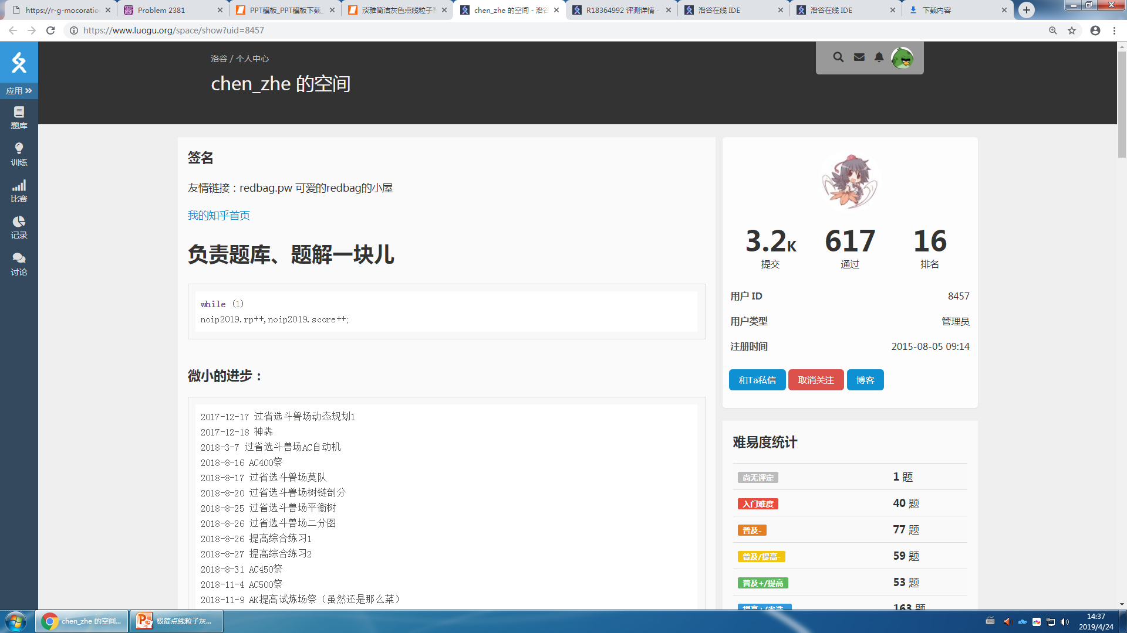
Who is chen_zhe?

Slide 3
Chen_zhe is a famous programmer (or Oier [n. ,信息学竞赛者]) in China. He lives in Shanghai and studies at a middle school. He is famous for his job at luogu.org [n. ,信息学网站]. He is an administrator [n. ,管理员] of the website [n. ,网站].

Slide 4
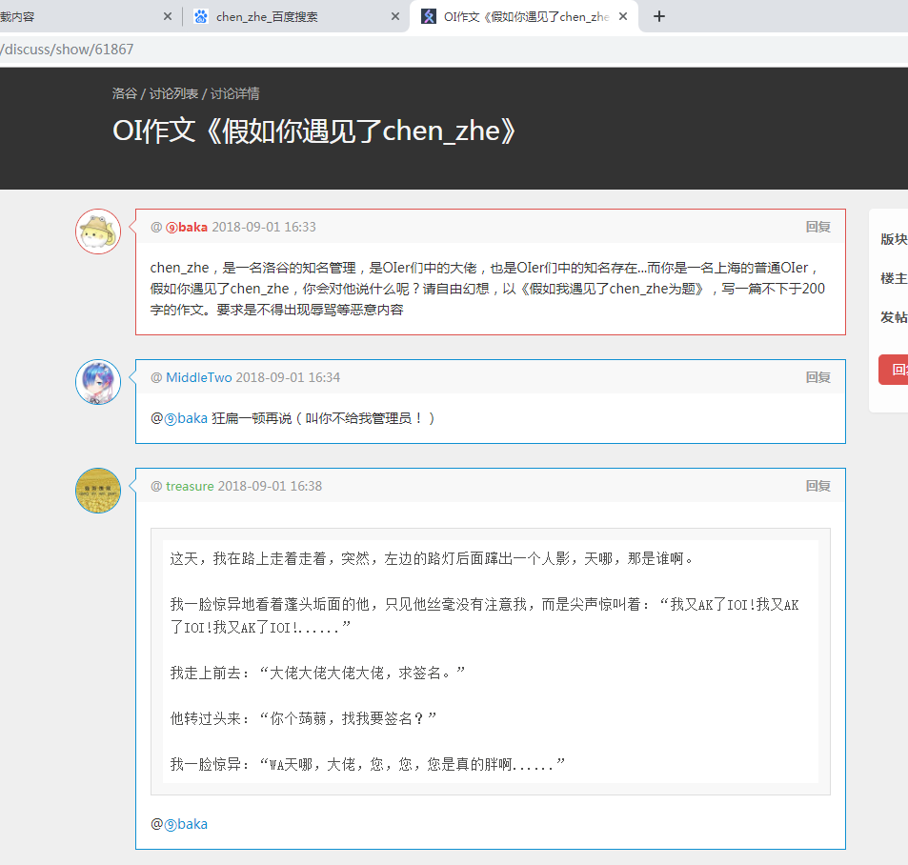
Everyone loves him. He always appears [v. ,出现] in front of others as a cute and little middle school student who is a little bit overweight [adj. ,超重的].

Slide 5
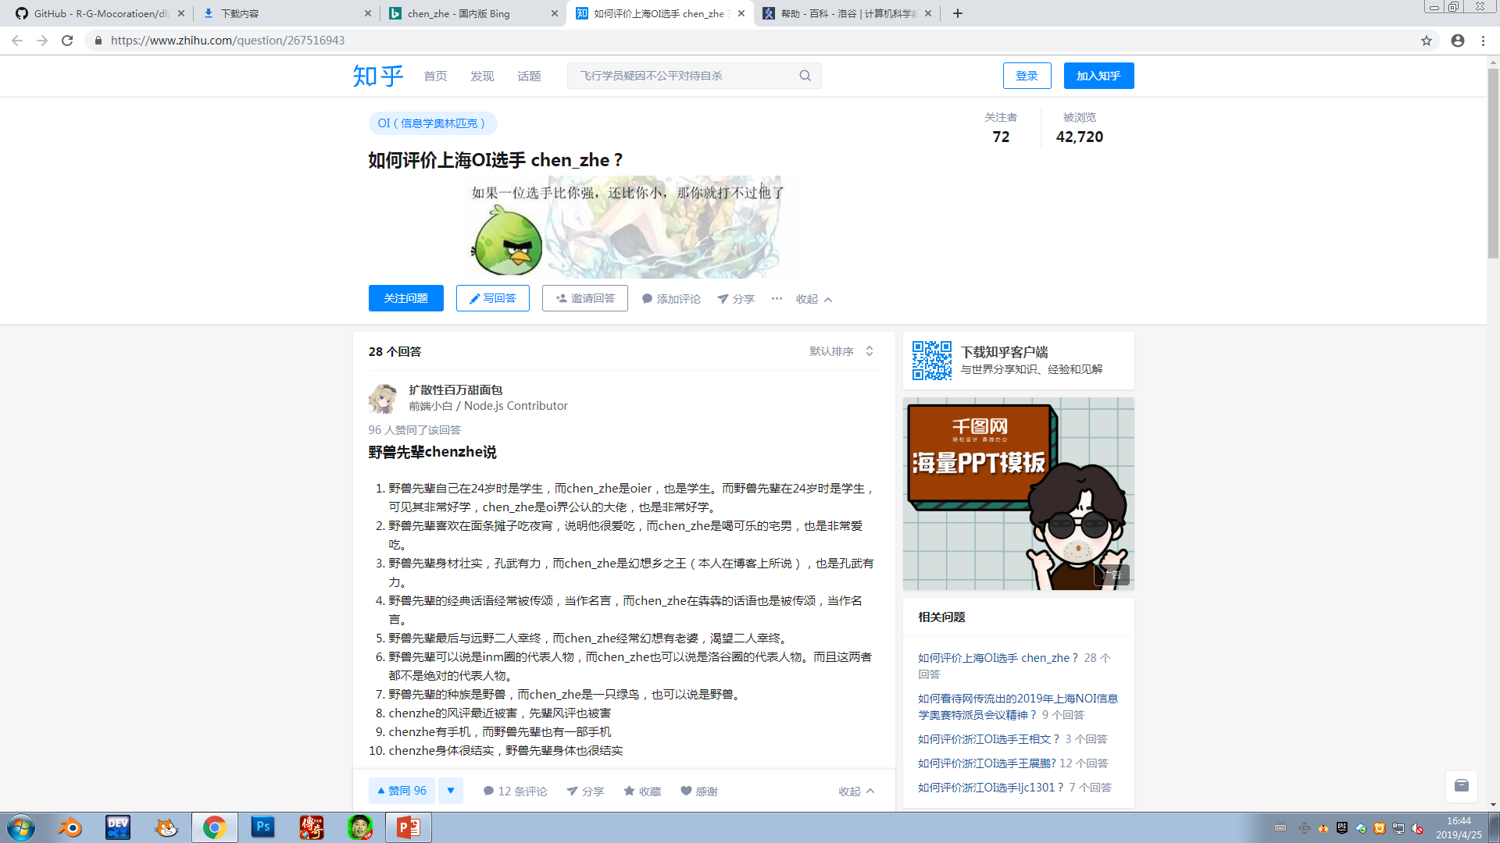

Slide 6
Chen_zhe is always praised [v. ,表扬] because of his power [n. ,能力] for solving [v-ing. ,解决] OI problems. However, some think that he has been flattered [adj. ,过奖的，被吹捧的]. They think he isn’t so powerful as others described [v-ed. ,描述] in real life.

Slide 7
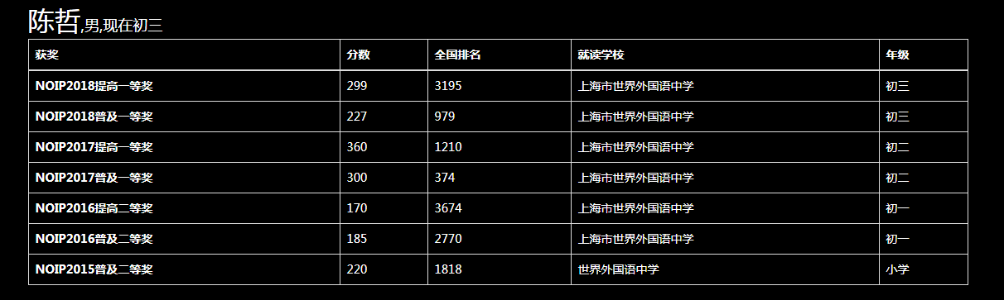
The reason why they say this is he sometimes cannot get good grades in important competitions.
This picture is a proof[n. ,证据].
You see, the grades of his in NOIP last year is less than me!

Slide 8
But why do I choose him to do my speech then?

Slide 9
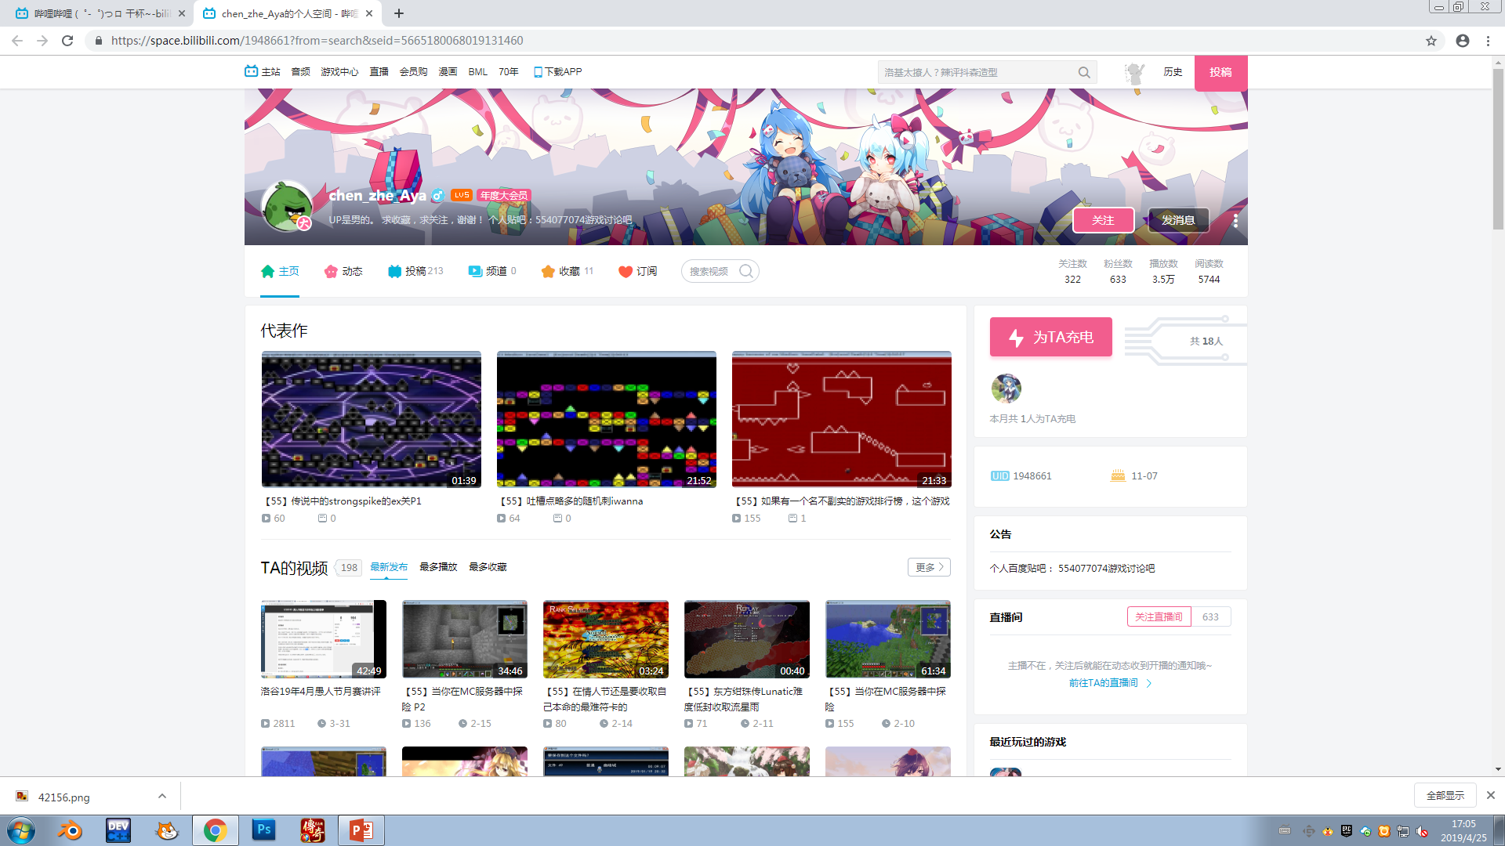
He is not only famous for coding, but also for his ability for:

Slide 10
He is not only famous for coding, but also for his ability for being a well-known uploader [n. ,up主]. on Bilibili!

Slide 11
The history of chen_zhe’s becoming famous is short. He became famous on Luogu first for his kindness [n. ,善良，亲和]. After a while, he became famous all over the Oiers.

Slide 12
That is the end of my speech [n. ,演说]. Thanks for listening!

