Slide 1



Chen_zhe
By Robert

Slide 2

01
Who is chen_zhe?

Slide 3
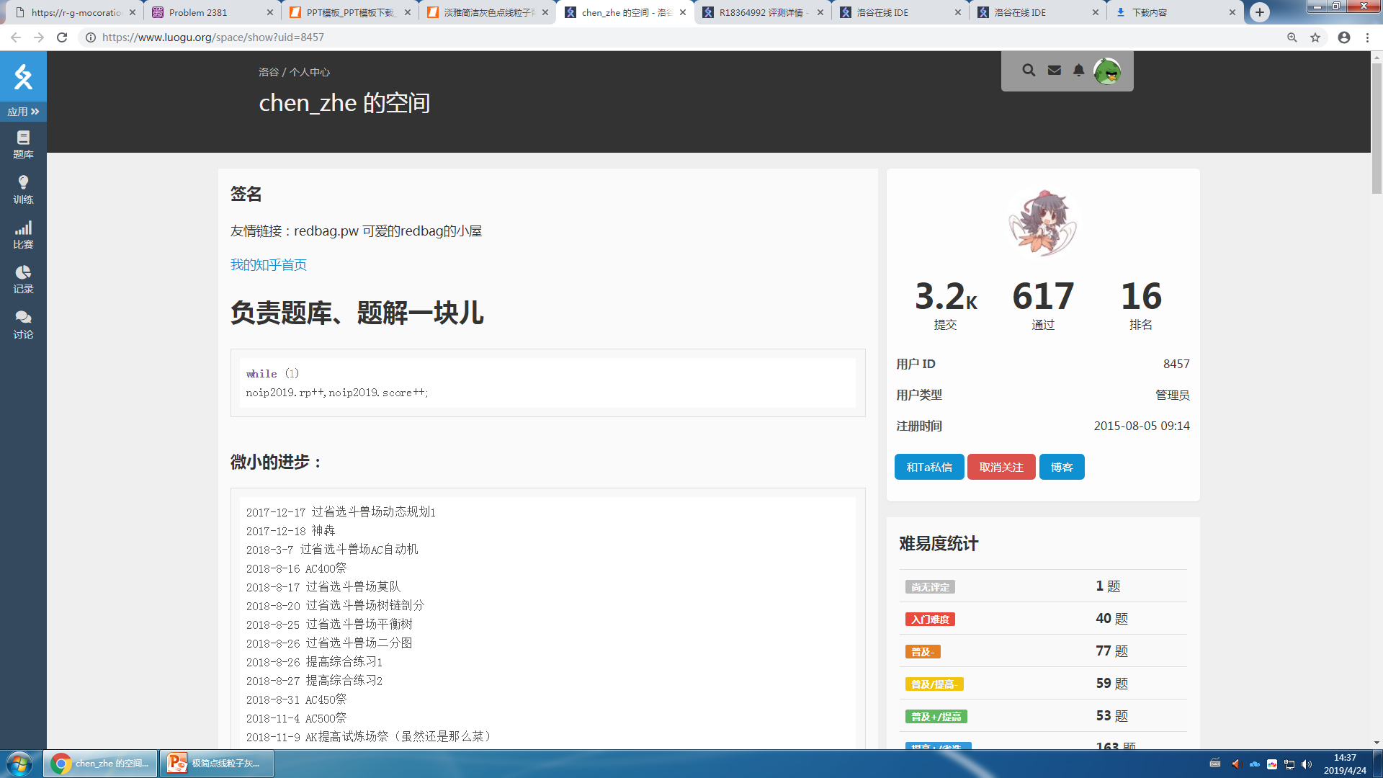
01

Slide 4
Chen_zhe is a famous programmer (or Oier [n. ,信息学竞赛者]) in China. He lives in Shanghai and studies at a middle school. He is famous for his job at luogu.org [n. ,信息学网站]) . He is an administrator [n. ,管理员]) of the website [n. ,网站]).

Slide 5
He loves

