Slide 1



Chen_zhe
A Speech Presented By Robert

Slide 2

We provide some notes on words so that everyone may get to know what I’m talking about.
在整个ppt中，为了使你们知道我在讲什么，我
增加了一些注释。可能会略微影响阅读体验。

Slide 3
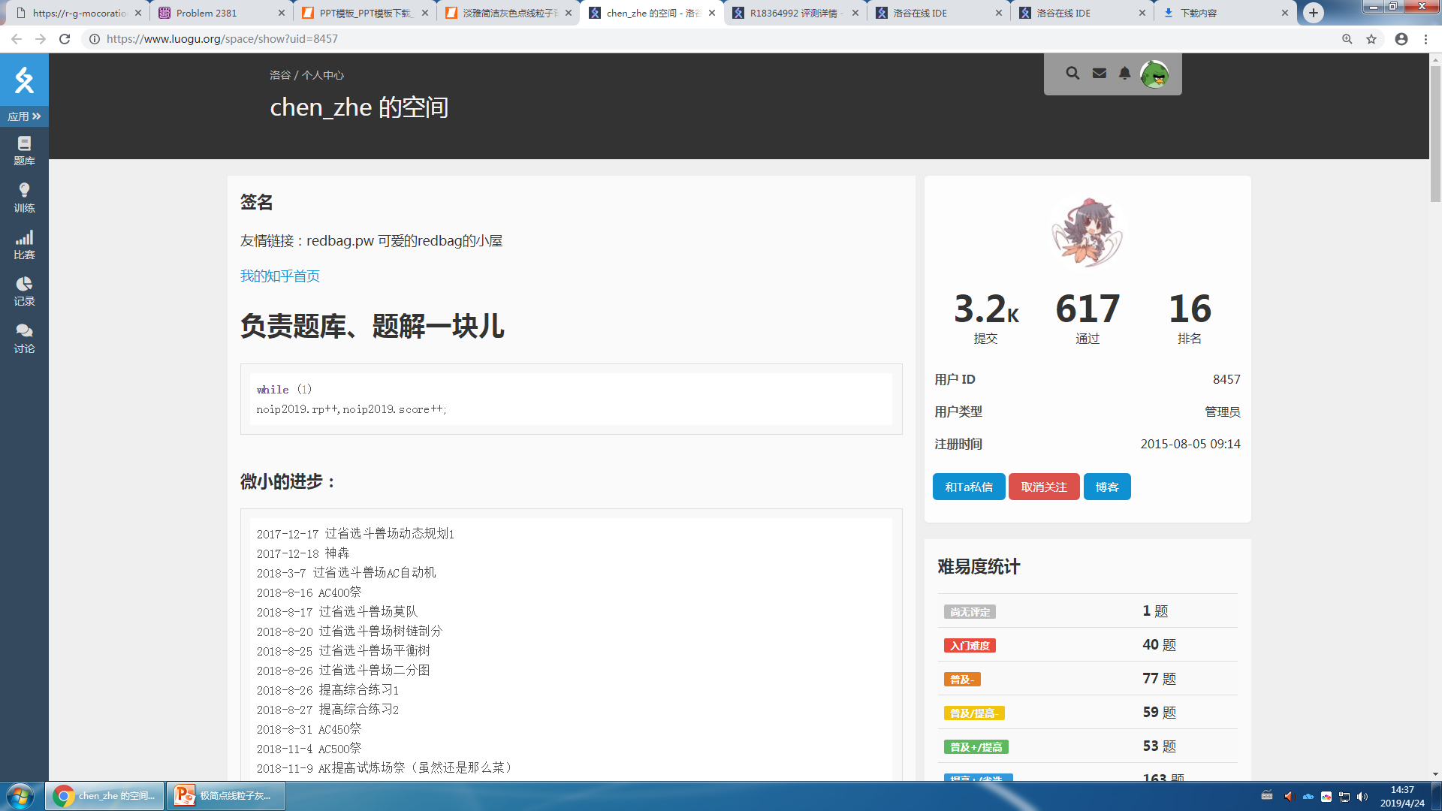
01 Who is chen_zhe?

Slide 4
Chen_zhe is a famous programmer (or Oier [n. ,信息学竞赛者]) in China. He lives in Shanghai and studies at a middle school. He is famous for his job at luogu.org [n. ,信息学网站]. He is an administrator [n. ,管理员] of the website [n. ,网站].

Slide 5
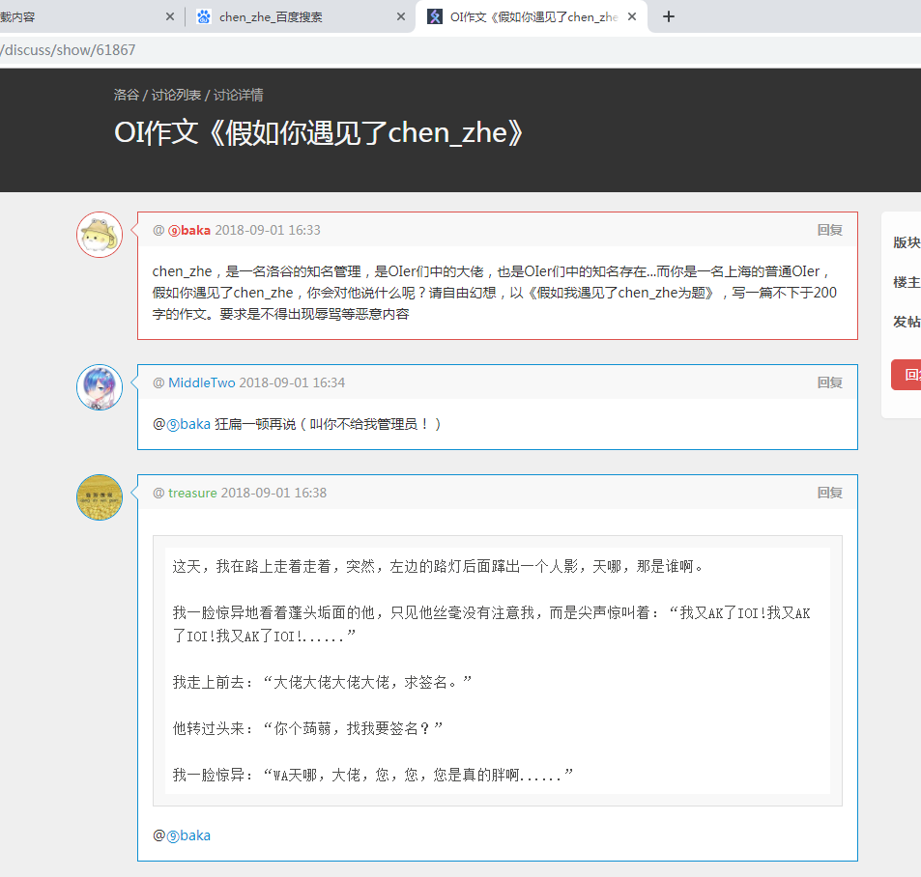
Everyone loves him.

Slide 6
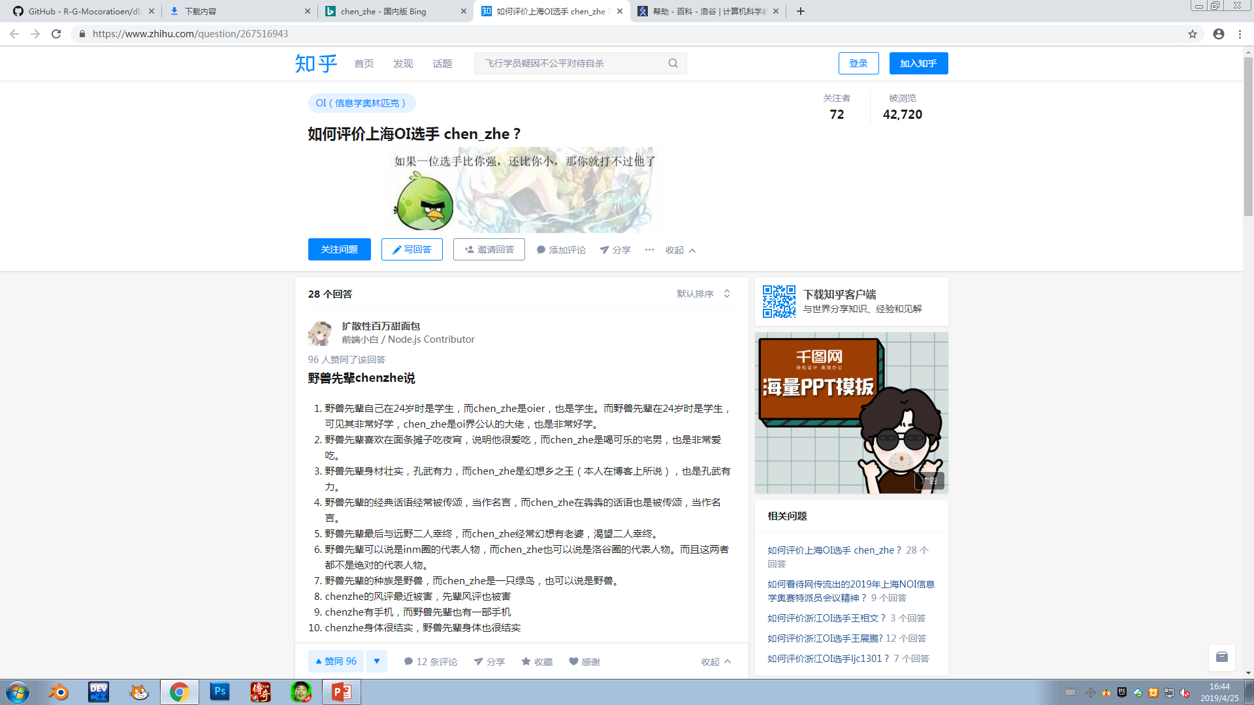

Slide 7
Chen_zhe is always praised [v. ,表扬] because of his power [n. ,能力] for solving [v-ing. ,解决] OI problems. However, some think that he has been flattered [adj. ,过奖的，被吹捧的]. They think he isn’t so powerful as others described [v-ed. ,描述] in real life.

Slide 8
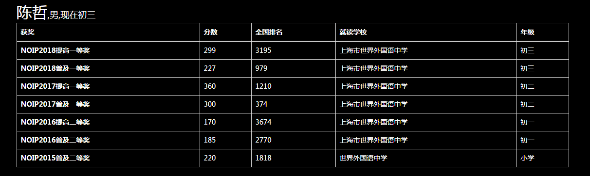
The reason why they say this is he sometimes cannot get good grades in important competitions.
This picture is a proof[n. ,证据].
You see, the grades of his in NOIP last year is less than me!

Slide 9
But why do I choose him to do my speech then?

Slide 10
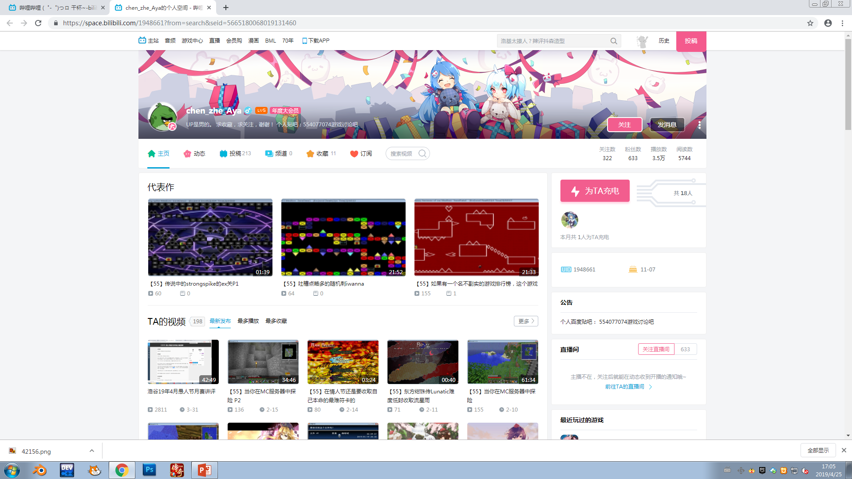
He is not only famous for coding, but also for his ability for:

Slide 11
He is not only famous for coding, but also for his ability for:

Slide 12
The history of chen_zhe’s becoming famous is short. He became famous on Luogu first for his kindness [n. ,善良，亲和]. After a while, he became famous all over the Oiers.

Slide 13
That is the end of my speech [n. ,演说]. Thanks for listening!

