Slide 1
Lecture 2 (cont’d) & Lecture 3: Advanced SQL – Part I

Slide 2
Announcements!
Lecture 2
You should be Jupyter notebook Ninjas!
Welcome Ting!
New TA-Office hours on website (room to be announced)
Project groups finalized!
If you do not have a group talk with us ASAP!
Problem Set #1 released

Slide 3
Lecture 2 (cont’d) & Lecture 3: Advanced SQL – Part I
Lecture 2

Slide 4
Today’s Lecture
Lecture 2
Recap from Lecture 2 & Multi-table queries
ACTIVITY: Multi-table queries
Set operators & nested queries
ACTIVITY: Set operator subtleties

Slide 5
Lecture 2 (cont’d): Introduction to SQL
Lecture 2

Slide 6
3. Multi-table queries
Lecture 2 > Section 3

Slide 7
What you will learn about in this section
Lecture 2 > Section 3
Primary keys and Foreign keys recap
Joins: SQL semantics
ACTIVITY: Multi-table queries

Slide 8
Keys and Foreign Keys
Lecture 2 > Section 3 > Foreign Keys
Company
A key is a minimal subset of attributes that acts as a unique identifier for tuples in a relation
CName | StockPrice | Country
GizmoWorks | 25 | USA
Canon | 65 | Japan
Hitachi | 15 | Japan
What is a foreign key vs. a key here?
Product
PName | Price | Category | Manufacturer
Gizmo | $19.99 | Gadgets | GizmoWorks
Powergizmo | $29.99 | Gadgets | GizmoWorks
SingleTouch | $149.99 | Photography | Canon
MultiTouch | $203.99 | Household | Hitachi
If two tuples agree on the values of the key, then they must be the same tuple!

Slide 9
Keys and Foreign Keys
Lecture 2 > Section 3 > Foreign Keys
Company
A foreign key is an attribute (or collection of attributes) in one table that uniquely identifies a row of another table.
CName | StockPrice | Country
GizmoWorks | 25 | USA
Canon | 65 | Japan
Hitachi | 15 | Japan
What is a foreign key vs. a key here?
Product
PName | Price | Category | Manufacturer
Gizmo | $19.99 | Gadgets | GizmoWorks
Powergizmo | $29.99 | Gadgets | GizmoWorks
SingleTouch | $149.99 | Photography | Canon
MultiTouch | $203.99 | Household | Hitachi
The foreign key is defined in a second table, but it refers to the primary key in the first table.

Slide 10
Declaring Foreign Keys
Lecture 2 > Section 3 > Foreign Keys
Company(CName: string, StockPrice: float, Country: string)
Product(PName: string, Price: float, Category: string, Manufacturer: string)
CREATE TABLE Product(
pname VARCHAR(100),
price FLOAT,
category VARCHAR(100),
manufacturer VARCHAR(100),
PRIMARY KEY (pname, manufacturer),
FOREIGN KEY (manufacturer) REFERENCES Company(cname)
)

Slide 11
Declaring Foreign Keys
Lecture 2 > Section 3 > Foreign Keys
CREATE TABLE Company(
cname VARCHAR(100),
stockprice FLOAT,
country VARCHAR(100),
PRIMARY KEY (cname),
FOREIGN KEY (cname) REFERENCES Product(pname, manufacturer)
)
CREATE TABLE Product(
pname VARCHAR(100),
price FLOAT,
category VARCHAR(100),
manufacturer VARCHAR(100),
PRIMARY KEY (pname, manufacturer)
)
Can we do this? What would be the problem?

Slide 12
Declaring Foreign Keys
Lecture 2 > Section 3 > Foreign Keys
CREATE TABLE Company(
cname VARCHAR(100),
stockprice FLOAT,
country VARCHAR(100),
PRIMARY KEY (cname),
FOREIGN KEY (cname) REFERENCES Product(pname, manufacturer)
)
CREATE TABLE Product(
pname VARCHAR(100),
price FLOAT,
category VARCHAR(100),
manufacturer VARCHAR(100),
PRIMARY KEY (pname, manufacturer)
)
Can we do this? What would be the problem?
We can have products without a registered company! Bad design! We’ll see more next week.

Slide 13
Declaring Foreign Keys
Lecture 2 > Section 3 > Foreign Keys
CREATE TABLE Company(
cname VARCHAR(100),
stockprice FLOAT,
country VARCHAR(100),
PRIMARY KEY (cname),
FOREIGN KEY (cname) REFERENCES Product(pname, manufacturer)
)
CREATE TABLE Product(
pname VARCHAR(100),
price FLOAT,
category VARCHAR(100),
manufacturer VARCHAR(100),
PRIMARY KEY (pname, manufacturer)
)
If the primary key is a set of columns (a composite key), then the foreign key also must be a set of columns that corresponds to the composite key.
Notes:
One key cannot reference two product.

Slide 14
Joins
Lecture 2 > Section 3 > Joins: Basics
Product
Company
PName | Price | Category | Manuf
Gizmo | $19 | Gadgets | GWorks
Powergizmo | $29 | Gadgets | GWorks
SingleTouch | $149 | Photography | Canon
MultiTouch | $203 | Household | Hitachi
Cname | Stock | Country
GWorks | 25 | USA
Canon | 65 | Japan
Hitachi | 15 | Japan
SELECT PName, Price FROM Product, Company WHERE Manufacturer = CName
AND Country=‘Japan’ AND Price <= 200
PName | Price
SingleTouch | $149.99

Slide 15
An example of SQL semantics
Lecture 2 > Section 3 > Joins: semantics
SELECT R.A
FROM R, S
WHERE R.A = S.B
Output
A
3
3
A
1
3
A | B | C
1 | 2 | 3
1 | 3 | 4
1 | 3 | 5
3 | 2 | 3
3 | 3 | 4
3 | 3 | 5
Cross Product
Apply Projection
Apply Selections / Conditions
B | C
2 | 3
3 | 4
3 | 5
A | B | C
3 | 3 | 4
3 | 3 | 5

Slide 16
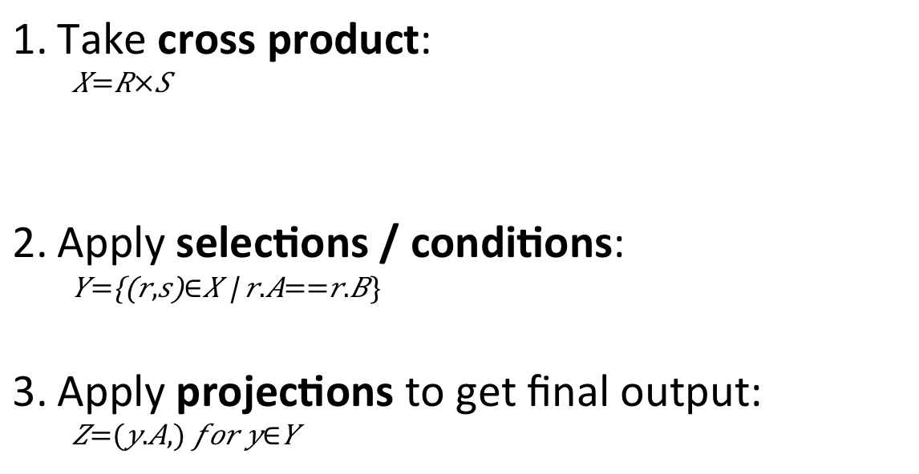
Note the semantics of a join
Lecture 2 > Section 3 > Joins: semantics
SELECT R.A
FROM R, S
WHERE R.A = S.B
Take cross product:
$$X=R×S$$
Apply selections / conditions:
$$Y=\left\{\left(r,s\right)∈X \right| r.A==r.B\}$$
Apply projections to get final output:
$$Z=(y.A,) for y∈Y$$
Recall: Cross product (A X B) is the set of all unique tuples in A,B
Ex: {a,b,c} X {1,2}
= {(a,1), (a,2), (b,1), (b,2), (c,1), (c,2)}
= Filtering!
= Returning only some attributes
Remembering this order is critical to understanding the output of certain queries (see later on…)

Slide 17
Note: we say “semantics” not “execution order”
Lecture 2 > Section 3 > Joins: semantics
The preceding slides show what a join means
Not actually how the DBMS executes it under the covers

Slide 18
A Subtlety about Joins
Lecture 2 > Section 3 > ACTIVITY
Lecture 2 > Section 3 > Joins: semantics
Product(PName, Price, Category, Manufacturer)
Company(CName, StockPrice, Country)
Find all countries that manufacture some product in the ‘Gadgets’ category.
SELECT Country FROM Product, Company WHERE Manufacturer=CName AND Category=‘Gadgets’

Slide 19
A subtlety about Joins
Lecture 2 > Section 3 > Joins: semantics
Lecture 2 > Section 3 > ACTIVITY
Product
Company
PName | Price | Category | Manuf
Gizmo | $19 | Gadgets | GWorks
Powergizmo | $29 | Gadgets | GWorks
SingleTouch | $149 | Photography | Canon
MultiTouch | $203 | Household | Hitachi
Cname | Stock | Country
GWorks | 25 | USA
Canon | 65 | Japan
Hitachi | 15 | Japan
SELECT Country FROM Product, Company WHERE Manufacturer=Cname
AND Category=‘Gadgets’
Country
?
?
What is the problem ?
What’s the solution ?
Notes:
?

Slide 20
ACTIVITY: Lecture-2-3.ipynb
Lecture 2 > Section 3 > ACTIVITY

Slide 21
An Unintuitive Query
Lecture 2 > Section 3 > ACTIVITY
SELECT DISTINCT R.A
FROM R, S, T
WHERE R.A=S.A OR R.A=T.A
What does it compute?

Slide 22
An Unintuitive Query
Lecture 2 > Section 3 > ACTIVITY
SELECT DISTINCT R.A
FROM R, S, T
WHERE R.A=S.A OR R.A=T.A
S
T
R
But what if S = φ?
Computes R ∩ (S ∪ T)
Go back to the semantics!

Slide 23
An Unintuitive Query
Lecture 2 > Section 3 > ACTIVITY
SELECT DISTINCT R.A
FROM R, S, T
WHERE R.A=S.A OR R.A=T.A
Recall the semantics!
Take cross-product
Apply selections / conditions
Apply projection
If S = {}, then the cross product of R, S, T = {}, and the query result = {}!
Must consider semantics here.
Are there more explicit way to do set operations like this?

Slide 24
Lecture 3: Advanced SQL – Part I

Slide 25
1. Set Operators & Nested Queries
Lecture 3 > Section 1

Slide 26
What you will learn about in this section
Lecture 3 > Section 1
Multiset operators in SQL
Nested queries
ACTIVITY: Set operator subtleties

Slide 27
An Unintuitive Query
Lecture 3 > Section 1 > Set Operators
SELECT DISTINCT R.A
FROM R, S, T
WHERE R.A=S.A OR R.A=T.A
What does it compute?
S
T
R
But what if S = φ?
Computes R ∩ (S ∪ T)
Go back to the semantics!

Slide 28
An Unintuitive Query
Lecture 3 > Section 1 > Set Operators
SELECT DISTINCT R.A
FROM R, S, T
WHERE R.A=S.A OR R.A=T.A
Recall the semantics!
Take cross-product
Apply selections / conditions
Apply projection
If S = {}, then the cross product of R, S, T = {}, and the query result = {}!
Must consider semantics here.
Are there more explicit way to do set operations like this?
Notes:
Apply projection?

Slide 29
What does this look like in Python?
Lecture 3 > Section 1 > Set Operators
S
T
SELECT DISTINCT R.A
FROM R, S, T
WHERE R.A=S.A OR R.A=T.A
R
R ∩ (S ∪ T)
Semantics:
Take cross-product
Apply selections / conditions
Apply projection
Joins / cross-products are just nested for loops (in simplest implementation)!
If-then statements!

Slide 30
What does this look like in Python?
Lecture 3 > Section 1 > Set Operators
S
T
SELECT DISTINCT R.A
FROM R, S, T
WHERE R.A=S.A OR R.A=T.A
R
R ∩ (S ∪ T)
output = {}
for r in R:
for s in S:
for t in T:
if r[‘A’] == s[‘A’] or r[‘A’] == t[‘A’]:
output.add(r[‘A’])
return list(output)
Can you see now what happens if S = []?

Slide 31
Multiset Operations
Lecture 3 > Section 1 > Set Operators

Slide 32
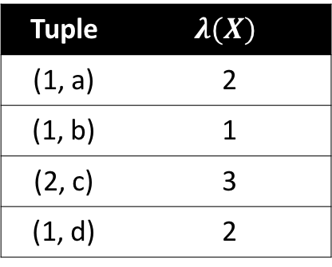
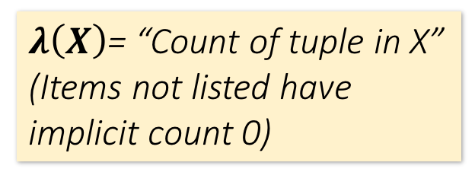
Recall Multisets
Lecture 3 > Section 1 > Set Operators
$λ\left(X\right)$= “Count of tuple in X”
(Items not listed have implicit count 0)
Multiset X
Tuple
(1, a)
(1, a)
(1, b)
(2, c)
(2, c)
(2, c)
(1, d)
(1, d)
Multiset X
Tuple | $$λ(X)$$
(1, a) | 2
(1, b) | 1
(2, c) | 3
(1, d) | 2
Equivalent Representations of a Multiset
Note: In a set all counts are {0,1}.

Slide 33
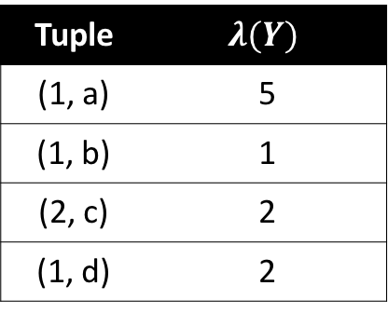





Generalizing Set Operations to Multiset Operations
Lecture 3 > Section 1 > Set Operators
Multiset X
Multiset Y
Multiset Z
Tuple | $$λ(X)$$
(1, a) | 2
(1, b) | 0
(2, c) | 3
(1, d) | 0
Tuple | $$λ(Y)$$
(1, a) | 5
(1, b) | 1
(2, c) | 2
(1, d) | 2
Tuple | $$λ(Z)$$
(1, a) | 2
(1, b) | 0
(2, c) | 2
(1, d) | 0
$$∩$$
$$=$$
For sets, this is intersection
$$λ\left(Z\right)=min(λ\left(X\right),λ\left(Y\right))$$

Slide 34



Generalizing Set Operations to Multiset Operations
Lecture 3 > Section 1 > Set Operators
Multiset X
Multiset Y
Multiset Z
Tuple | $$λ(X)$$
(1, a) | 2
(1, b) | 0
(2, c) | 3
(1, d) | 0
Tuple | $$λ(Y)$$
(1, a) | 5
(1, b) | 1
(2, c) | 2
(1, d) | 2
Tuple | $$λ(Z)$$
(1, a) | 5
(1, b) | 1
(2, c) | 3
(1, d) | 2
$$∪$$
$$=$$
For sets,
this is union
$$λ\left(Z\right)=max(λ\left(X\right),λ\left(Y\right))$$

Slide 35
Multiset Operations in SQL
Lecture 3 > Section 1 > Set Operators

Slide 36
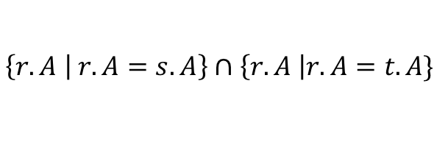
Explicit Set Operators: INTERSECT
Lecture 3 > Section 1 > Set Operators
SELECT R.A
FROM R, S
WHERE R.A=S.A
INTERSECT
SELECT R.A
FROM R, T
WHERE R.A=T.A
$$\left\{r.A | r.A=s.A\right\}∩\left\{r.A \right|r.A=t.A\}$$
Q₁
Q₂

Slide 37
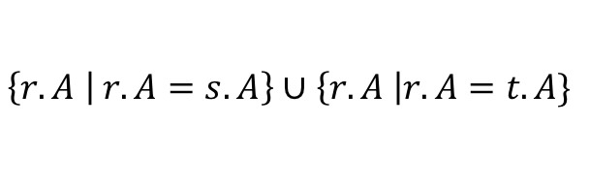
UNION
Lecture 3 > Section 1 > Set Operators
SELECT R.A
FROM R, S
WHERE R.A=S.A
UNION
SELECT R.A
FROM R, T
WHERE R.A=T.A
$$\left\{r.A | r.A=s.A\right\}∪\left\{r.A \right|r.A=t.A\}$$
Q₁
Q₂
Why aren’t there duplicates?
What if we want duplicates?

Slide 38
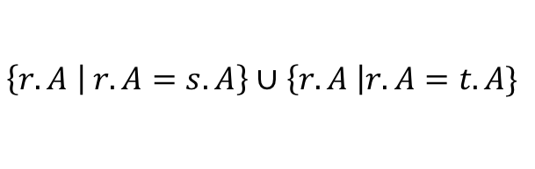
UNION ALL
Lecture 3 > Section 1 > Set Operators
SELECT R.A
FROM R, S
WHERE R.A=S.A
UNION ALL
SELECT R.A
FROM R, T
WHERE R.A=T.A
$$\left\{r.A | r.A=s.A\right\}∪\left\{r.A \right|r.A=t.A\}$$
Q₁
Q₂
ALL indicates the Multiset disjoint union operation

Slide 39


Generalizing Set Operations to Multiset Operations
Lecture 3 > Section 1 > Set Operators
Multiset X
Multiset Y
Multiset Z
Tuple | $$λ(X)$$
(1, a) | 2
(1, b) | 0
(2, c) | 3
(1, d) | 0
Tuple | $$λ(Y)$$
(1, a) | 5
(1, b) | 1
(2, c) | 2
(1, d) | 2
Tuple | $$λ(Z)$$
(1, a) | 7
(1, b) | 1
(2, c) | 5
(1, d) | 2
$$=$$
For sets,
this is disjoint union
$$λ\left(Z\right)= λ\left(X\right)+ λ\left(Y\right)$$

Slide 40
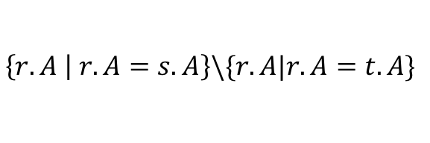
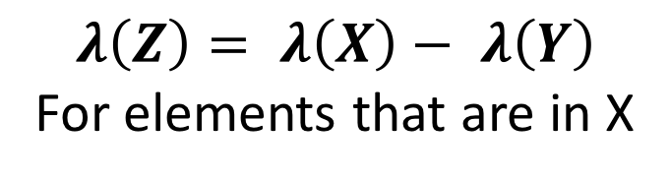
EXCEPT
Lecture 3 > Section 1 > Set Operators
SELECT R.A
FROM R, S
WHERE R.A=S.A
EXCEPT
SELECT R.A
FROM R, T
WHERE R.A=T.A
$$\left\{r.A | r.A=s.A\right\}\backslash \{r.A|r.A=t.A\}$$
Q₁
Q₂
What is the multiset version?
$$λ\left(Z\right)= λ\left(X\right)− λ\left(Y\right)$$
For elements that are in X

Slide 41
INTERSECT: Still some subtle problems…
Lecture 3 > Section 1 > Set Operators
Company(name, hq_city)
Product(pname, maker, factory_loc)
SELECT hq_city
FROM Company, Product
WHERE maker = name
AND factory_loc = ‘US’
INTERSECT
SELECT hq_city
FROM Company, Product
WHERE maker = name
AND factory_loc = ‘China’
“Headquarters of companies which make gizmos in US AND China”
What if two companies have HQ in US: BUT one has factory in China (but not US) and vice versa? What goes wrong?

Slide 42
INTERSECT: Remember the semantics!
Lecture 3 > Section 1 > Set Operators
Example: C JOIN P on maker = name
Company(name, hq_city) AS C
Product(pname, maker, factory_loc) AS P
C.name | C.hq_city | P.pname | P.maker | P.factory_loc
X Co. | Seattle | X | X Co. | U.S.
Y Inc. | Seattle | X | Y Inc. | China
SELECT hq_city
FROM Company, Product
WHERE maker = name
AND factory_loc=‘US’
INTERSECT
SELECT hq_city
FROM Company, Product
WHERE maker = name
AND factory_loc=‘China’

Slide 43
INTERSECT: Remember the semantics!
Lecture 3 > Section 1 > Set Operators
Example: C JOIN P on maker = name
Company(name, hq_city) AS C
Product(pname, maker, factory_loc) AS P
C.name | C.hq_city | P.pname | P.maker | P.factory_loc
X Co. | Seattle | X | X Co. | U.S.
Y Inc. | Seattle | X | Y Inc. | China
SELECT hq_city
FROM Company, Product
WHERE maker = name
AND factory_loc=‘US’
INTERSECT
SELECT hq_city
FROM Company, Product
WHERE maker = name
AND factory_loc=‘China’
X Co has a factory in the US (but not China)
Y Inc. has a factor in China (but not US)
But Seattle is returned by the query!
We did the INTERSECT on the wrong attributes!

Slide 44
One Solution: Nested Queries
Lecture 3 > Section 1 > Nested Queries
Company(name, hq_city)
Product(pname, maker, factory_loc)
“Headquarters of companies which make gizmos in US AND China”
SELECT DISTINCT hq_city
FROM Company, Product
WHERE maker = name
AND name IN (
SELECT maker
FROM Product
WHERE factory_loc = ‘US’)
AND name IN (
SELECT maker
FROM Product
WHERE factory_loc = ‘China’)
Note: If we hadn’t used DISTINCT here, how many copies of each hq_city would have been returned?

Slide 45
High-level note on nested queries
Lecture 3 > Section 1 > Nested Queries
We can do nested queries because SQL is compositional:
Everything (inputs / outputs) is represented as multisets- the output of one query can thus be used as the input to another (nesting)!
This is extremely powerful!

Slide 46
Nested queries: Sub-queries Returning Relations
Lecture 3 > Section 1 > Nested Queries
Another example:
Company(name, city) Product(name, maker) Purchase(id, product, buyer)
SELECT c.city
FROM Company c
WHERE c.name IN (
SELECT pr.maker
FROM Purchase p, Product pr
WHERE p.product = pr.name
AND p.buyer = ‘Joe Blow‘)
“Cities where one can find companies that manufacture products bought by Joe Blow”

Slide 47
Nested Queries
Lecture 3 > Section 1 > Nested Queries
Is this query equivalent?
SELECT c.city
FROM Company c,
Product pr,
Purchase p
WHERE c.name = pr.maker
AND pr.name = p.product
AND p.buyer = ‘Joe Blow’
Beware of duplicates!

Slide 48
Nested Queries
Lecture 3 > Section 1 > Nested Queries
SELECT DISTINCT c.city
FROM Company c,
Product pr,
Purchase p
WHERE c.name = pr.maker
AND pr.name = p.product
AND p.buyer = ‘Joe Blow’
SELECT DISTINCT c.city
FROM Company c
WHERE c.name IN (
SELECT pr.maker
FROM Purchase p, Product pr
WHERE p.product = pr.name
AND p.buyer = ‘Joe Blow‘)
Now they are equivalent

Slide 49
Subqueries Returning Relations
Lecture 3 > Section 1 > Nested Queries
You can also use operations of the form:
s > ALL R
s < ANY R
EXISTS R
ANY and ALL not supported by SQLite.
Ex:
Product(name, price, category, maker)
SELECT name
FROM Product
WHERE price > ALL(
SELECT price
FROM Product
WHERE maker = ‘Gizmo-Works’)
Find products that are more expensive than all those produced by “Gizmo-Works”

Slide 50
Subqueries Returning Relations
Lecture 3 > Section 1 > Nested Queries
You can also use operations of the form:
s > ALL R
s < ANY R
EXISTS R
Ex:
Product(name, price, category, maker)
Find ‘copycat’ products, i.e. products made by competitors with the same names as products made by “Gizmo-Works”
SELECT p1.name
FROM Product p1
WHERE p1.maker = ‘Gizmo-Works’
AND EXISTS(
SELECT p2.name
FROM Product p2
WHERE p2.maker <> ‘Gizmo-Works’
AND p1.name = p2.name)
<> means !=

Slide 51
Nested queries as alternatives to INTERSECT and EXCEPT
Lecture 3 > Section 1 > Nested Queries
INTERSECT and EXCEPT not in some DBMSs!
(SELECT R.A, R.B
FROM R) INTERSECT
(SELECT S.A, S.B
FROM S)
SELECT R.A, R.B
FROM R WHERE EXISTS(
SELECT * FROM S WHERE R.A=S.A AND R.B=S.B)
If R, S have no duplicates, then can write without sub-queries (HOW?)
(SELECT R.A, R.B
FROM R) EXCEPT
(SELECT S.A, S.B
FROM S)
SELECT R.A, R.B
FROM R WHERE NOT EXISTS(
SELECT * FROM S WHERE R.A=S.A AND R.B=S.B)

Slide 52
Correlated Queries
Lecture 3 > Section 1 > Nested Queries
Movie(title, year, director, length)
Find movies whose title appears more than once.
SELECT DISTINCT title
FROM Movie AS m
WHERE year <> ANY(
SELECT year
FROM Movie
WHERE title = m.title)
Note the scoping of the variables!
Note also: this can still be expressed as single SFW query…

Slide 53
Complex Correlated Query
Lecture 3 > Section 1 > Nested Queries
Product(name, price, category, maker, year)
SELECT DISTINCT x.name, x.maker
FROM Product AS x
WHERE x.price > ALL(
SELECT y.price
FROM Product AS y
WHERE x.maker = y.maker
AND y.year < 1972)
Find products (and their manufacturers) that are more expensive than all products made by the same manufacturer before 1972
Can be very powerful (also much harder to optimize)

Slide 54
Activity-3-1.ipynb
Lecture 3 > Section 1 > ACTIVITY

Slide 55
Basic SQL Summary
Lecture 3 > Section 1 > Summary
SQL provides a high-level declarative language for manipulating data (DML)
The workhorse is the SFW block
Set operators are powerful but have some subtleties
Powerful, nested queries also allowed.

