Slide 1

A Simplified Model of the Cost-Effectiveness of Screening: An Open-Source Teaching and Research Tool Coded in R
James O'Mahony, PhD¹, Yi-Shu Lin, MSc, MBA¹
¹Centre for Health Policy and Management, Trinity College Dublin.
23/02/2022

Slide 2
Conflict of Interest Declaration
None to declare
Notes:
This study has no conflict of interest.

Slide 3
Background
Screening cost-effectiveness analyses models typically address specific policy questions.
Tend to be large and complex.
Not suited to teaching the fundamentals of screening modelling or demonstrating methods issues.

Slide 4
Objectives
Research and teaching
No specific disease or intervention
Prioritising transparency over speed
Strategy comparators
Efficient frontiers
ICER generation
Model parameters
1. position
2. shape (convexity)

Slide 5


How to use the model?
Input – Excel
Excel interface
Defines parameter values and screening strategies
Save values into files with VBA
Model – R
A de novo model: discrete event simulation
Largely vectorised (with some loops)
Single file with markup: approximately 600 lines of code
Published in GitHub
Output – Excel / R
R ShinyApp for exploration of results, options in visual interface

Slide 6
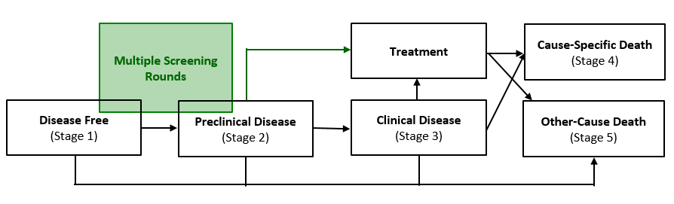
Model Diagram

Slide 7
Simplifying assumptions
There can be only one lesion per lifetime.
The lesion has a single grade.
Screen test result is binary (healthy/sick).
Treatment outcome is binary (cured/uncured).
Cure is perfect.
Screening imposes no morbidity.
Triage testing is not explicitly modelled.

Slide 8
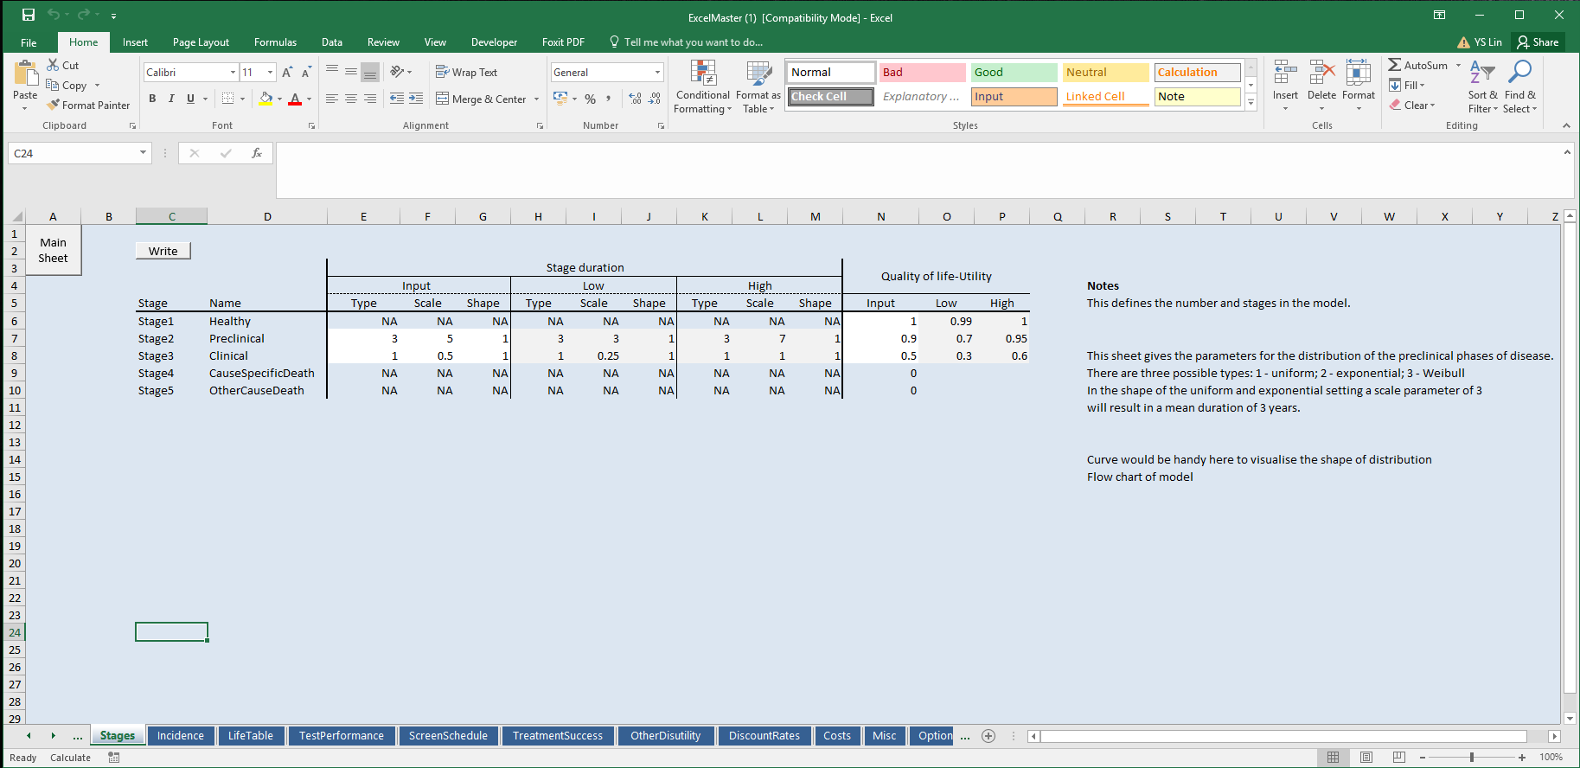
Example of Excel inputs:
Explanatory text describing file inputs
Visual Basic Macro button
for writing input to file
Tabs for defining
other input parameters

Slide 9
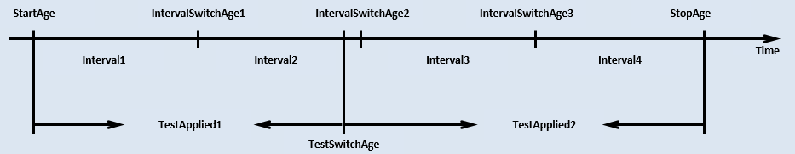
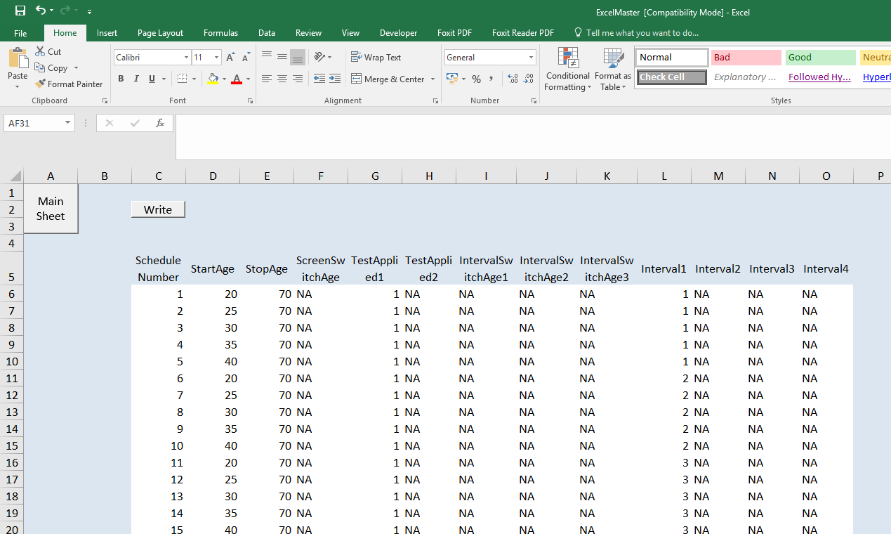
Defined Intervention

Slide 10
Model parameters
Stage duration
Stage utility
Incidence
Life table (mortality)
Test performance
Harms from screening (test disutility)
Probability of treatment success
Discounting
Costs (screening and treatment)
Sample size
Threshold
CE plot (file type, axis, optimal strategy…)

Slide 11
Model output
Costs
Effects
Main
Overall costs
Life-years
Quality-adjusted life-years
Screen costs
Triage costs
Early treatment costs
Late treatment costs
(Discounted/ undiscounted)
Disease history
Age distribution of health state
Number of screens
Number of true positives
Number of false positives
Number of cancer deaths
Number of over-diagnosed
Number of clinical cases
Intermediate

Slide 12
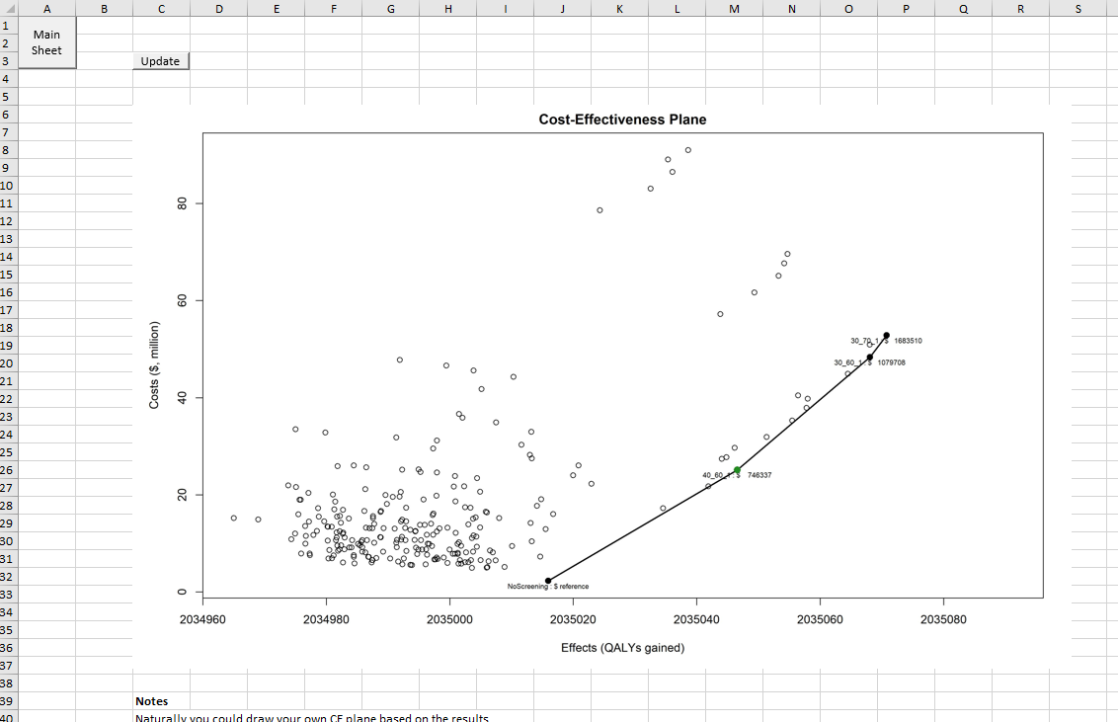
Model output
CE plane in excel
Notes:
.

Slide 13
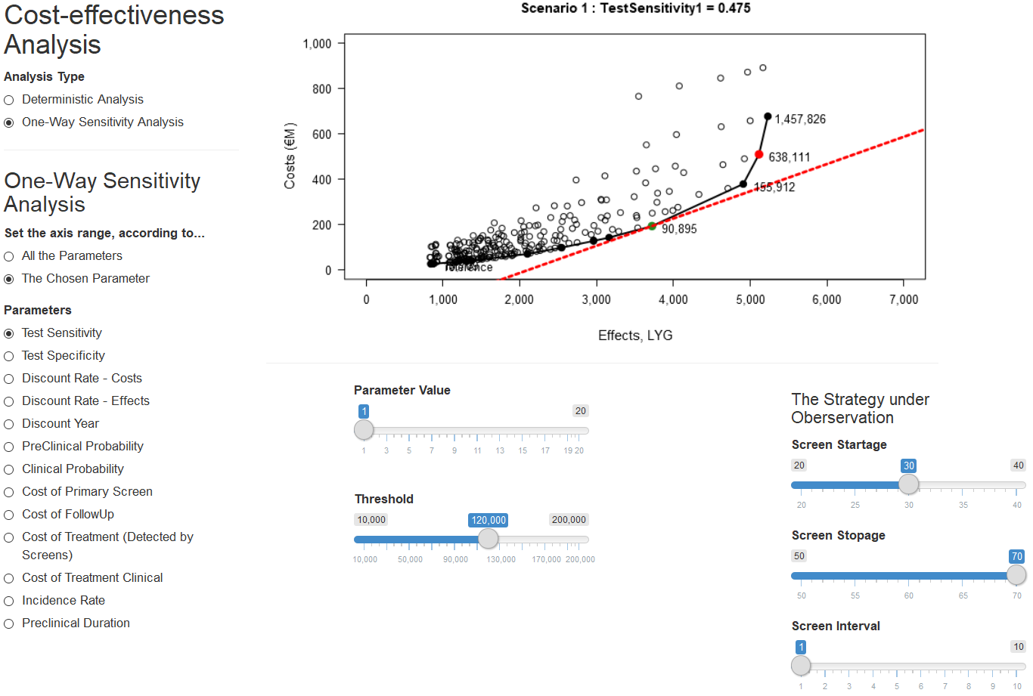
Model output
R Shiny: handling several outputs simultaneously
Help validation and calibration

Slide 14
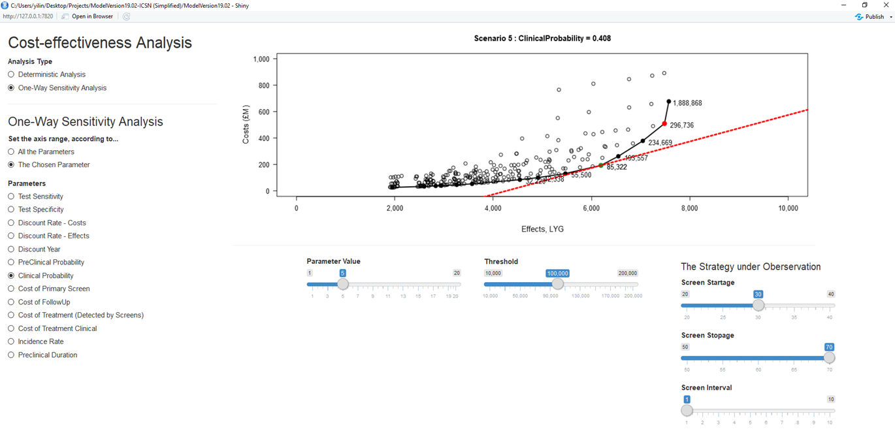
R ShinyApp
Axis setting
The optimal strategy
Parameter value
Choice of parameters
Threshold

Slide 15
Model application
Starting Age
20-100
Stop Age
20-100
Screening Interval
1-10 year
We use an illustrative example of
a CEA of 8,141 screening strategies:
We use arbitrary illustrative values for disease incidence, preclinical duration, test performance, treatment effects and the costs of screening and treatment.
We estimate the costs and effects (LYs and QALYs) of these strategies
We identify the efficient frontier, incremental cost-effectiveness ratios (ICERs) and the optimal strategy for a given threshold.

Slide 16
Model application
We vary the input parameter values one at a time: one-way sensitivity analysis (OWSA).
We simulate higher and lower values relative to the basecase.
The OWSA demonstrates the effect of parameter variation on the efficient frontier.

Slide 17
Results:
3.2 GHz I7-8700 processor with 32 GB RAM
Number of Simulations | Run Time
1 (251 strategies) | 1.9 minutes
1 (8141 strategies) | 1.45 hours
25 (8141 strategies) (for OWSA) | 22.46 hours (53.9 minutes per run)
Notes:
.

Slide 18
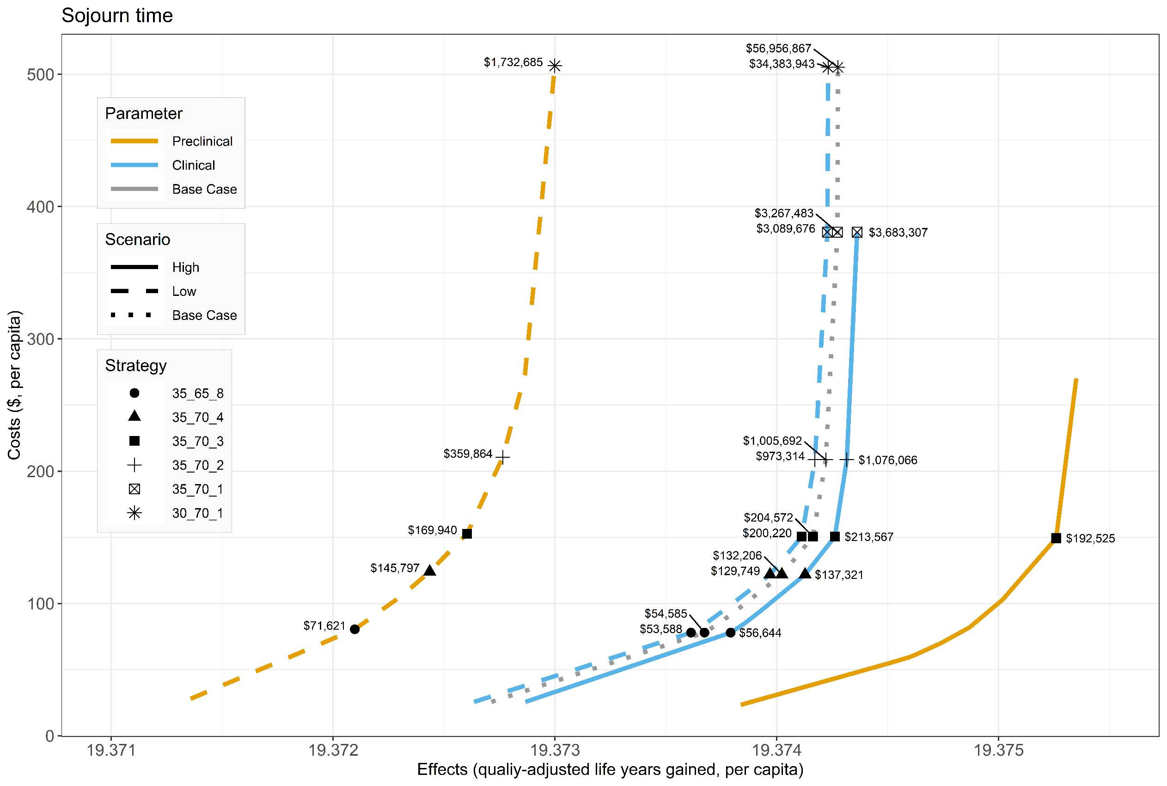
Efficient frontier (1/4)

Slide 19
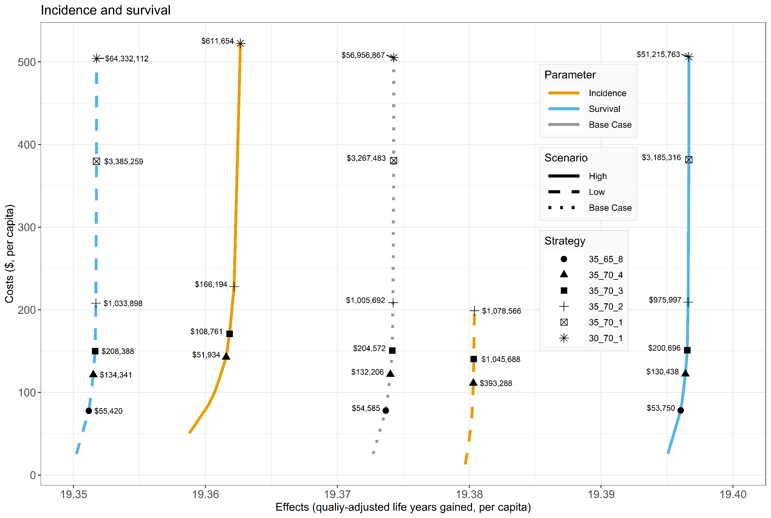
Efficient frontier (2/4)

Slide 20
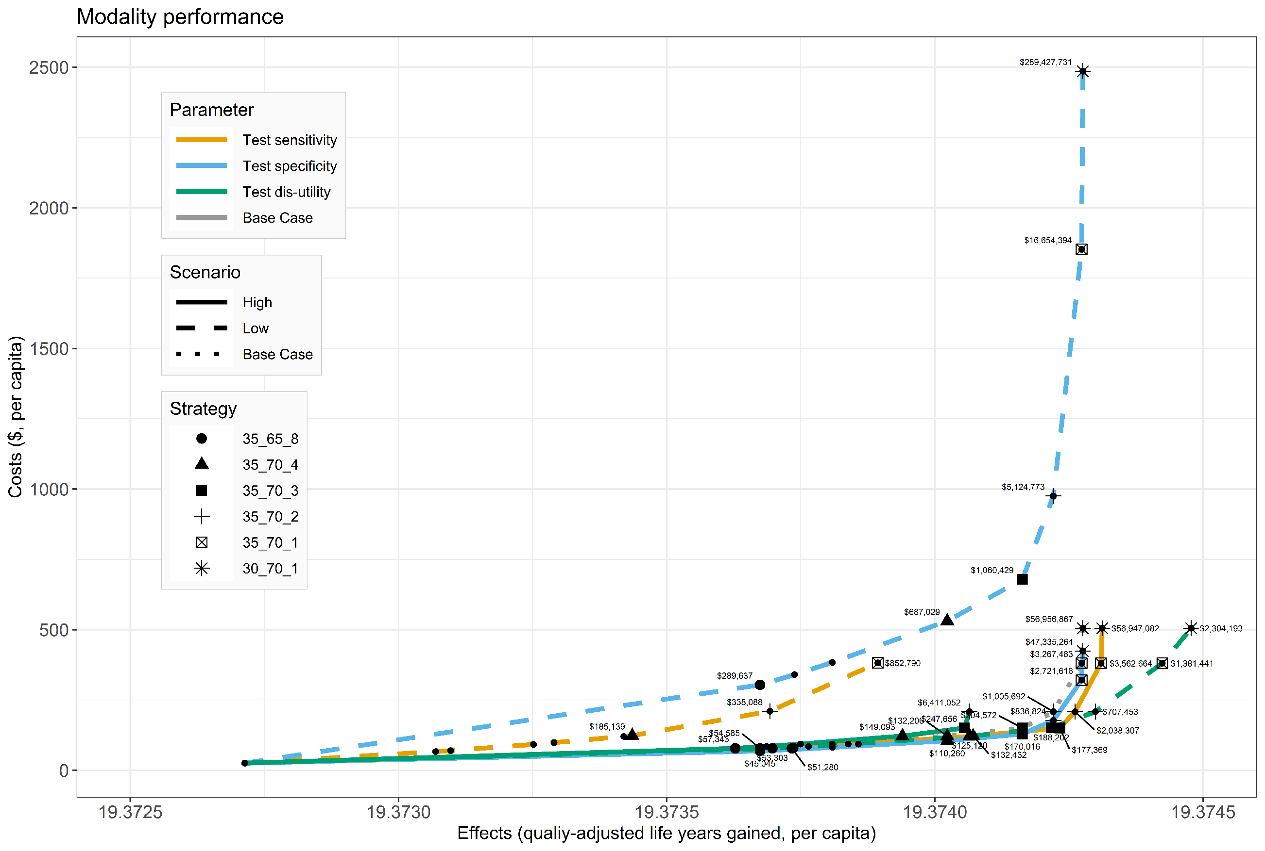
Efficient frontier (3/4)

Slide 21
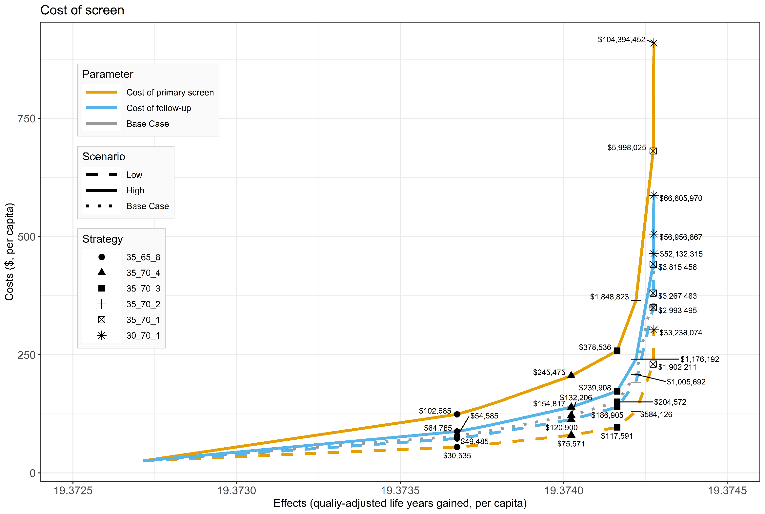
Efficient frontier (4/4)

Slide 22
Limitations
Complexity accumulates quickly when adding features.
Extensions
More representative model assumptions (with trade-off of additional complexity):
multiple disease stages, transition probabilities and test outcomes.
More generalised code to avoid hard-coded structures.
Probabilistic sensitivity analysis (PSA) and calibration.

Slide 23
Join us!
If you are not familiar with CEA in R
1. Learn with our shared model code
2. Give us your learning feedback
If you are familiar with CEA in R
1. Please apply our model
2. Suggest improvements or extensions

Slide 24

Any questions and suggestions?
James O'Mahony, PhD
jfomahon@tcd.ie
Yi-Shu Lin, MSc, MBA
yilin@tcd.ie
Centre for Health Policy & Management
Trinity College Dublin
Ireland
https://github.com/yishu-lin/Pedagogical-CEA-Model-of-Screening

