Slide 1
Replication and Improvement of ‘The Impact of Campaign Finance Laws on Party Competition’ by Joshua D. Potter and Margit Tavits (2013)
Ruairí Hallissey

Slide 2
R Markdown
This is an R Markdown presentation. Markdown is a simple formatting syntax for authoring HTML, PDF, and MS Word documents. For more details on using R Markdown see http://rmarkdown.rstudio.com.
When you click the Knit button a document will be generated that includes both content as well as the output of any embedded R code chunks within the document.
## Warning: package 'ggplot2' was built under R version 4.2.3
## Warning: package 'MASS' was built under R version 4.2.2
## Warning: package 'arm' was built under R version 4.2.3
## Loading required package: Matrix
## Warning: package 'Matrix' was built under R version 4.2.2
## Loading required package: lme4
## Warning: package 'lme4' was built under R version 4.2.2
## ## arm (Version 1.13-1, built: 2022-8-25)
## Working directory is C:/Users/User/OneDrive - TCDUD.onmicrosoft.com/Documents/GitHub/StatsII_Spring2023/Replication/Presentation

Slide 3
Slide with Bullets
Bullet 1
Bullet 2
Bullet 3

Slide 4
Slide with R Output
summary(cars)
## speed dist ## Min. : 4.0 Min. : 2.00 ## 1st Qu.:12.0 1st Qu.: 26.00 ## Median :15.0 Median : 36.00 ## Mean :15.4 Mean : 42.98 ## 3rd Qu.:19.0 3rd Qu.: 56.00 ## Max. :25.0 Max. :120.00

Slide 5
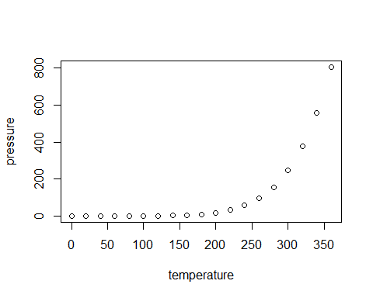
Slide with Plot

