Slide 1


Team Details
  Team name: Second Voice
  Team leader name: Ritik Singh
  Problem Statement: BFSI. AI to detect and stop fraud that bypasses today's controls: authorised push payment (coercion) scams on UPI, such as digital arrest.

Slide 2
Brief about the idea
Second Voice is a coercion-aware payment interruptor for UPI.
THE GAP TODAY
Account takeover
Stolen credentials, new device, odd location. Detected by every bank today.
Every bank fraud system asks one question: is this really the account holder? In digital arrest, parcel and investment scams the answer is yes. The victim is on her own phone, typing her own PIN, because a caller posing as a CBI officer told her to. Device, location and credential checks see nothing.
Second Voice sits in the payer bank's authorisation hook, before the debit. It scores whether the account holder is being manipulated right now, from eight signals around the moment of payment, and answers with a Gemini-driven conversation built from the suspected scam script, not a warning banner.
The receiving bank runs the same service on its own accounts and shares one word back during address validation: a receiver risk band. If the customer overrides anyway, the receiving bank holds the credit before it can be cashed out.
Authorised push payment fraud
Real customer, real PIN, under coercion. Looks legitimate to every rule. The only intervention in production is a static banner, dismissed in two seconds.
Rising fast in India (digital arrest, task and investment scams). The UK now makes sending and receiving banks reimburse victims 50:50.

Slide 3
Opportunities
HOW IT IS DIFFERENT
HOW IT SOLVES THE PROBLEM
USP
Models coercion, not takeover
Two banks, two chances
A network, not a rule
Existing fraud engines model account takeover. Second Voice models coercion: payee novelty, amount against the customer's own history, an active call, a remote-access app, fan-in from our other customers, and a band from the receiving bank.
The response is a conversation shaped by the suspected scam script, with questions the scammer did not coach the victim for.
Payer side: pause before the debit, ask, offer a trusted-contact call and a cooling-off, then release, hold or cancel.
Receiver side: the beneficiary bank scores its own accounts (age, KYC depth, first-time inflow fan-in, sweep-out speed) and holds credits to High-band accounts, so money stays inside the banking system even after an override.
One field added to the existing UPI address-validation lookup carries the receiver band. Every bank that joins sharpens every other bank's score.
Graduated tiers mean low-risk payments see nothing. Fraud teams get the full reasoning, transcript and a Gemini summary, plus a payee blocklist and I4C report in one click.

Slide 4
List of features offered by the solution
Coercion score
Script-aware intervention
Graduated friction
Weighted model over eight interpretable signals, each shown with its contribution. Tiers: low, medium, high, very high.
Gemini names the scam script (digital arrest, parcel, KYC expiry, investment group, task fraud) and runs an adaptive conversation.
Low: nothing. Medium: one question. High: hold, trusted-contact call, cooling-off. Very high: block and route to a specialist.
Receiver risk band
Credit hold at the receiver
Fraud operations
The receiving bank scores its own accounts and answers address validation with Low, Elevated or High. No account data crosses the wall.
An override still lands on a 24-hour hold at the beneficiary bank when the account is High band.
Live case queue, signals, transcript with the agent's reasoning, Gemini case summary, one-click payee blocklist and I4C report.

Slide 5
Process flow
1 Tap Pay
2 Address check
3 Coercion score
4 Tier
5 Gemini talks
Bank A app. SDK attaches device context.
Bank A asks Bank B for the name. Bank B answers with name + risk band.
History, payee reputation, device, band, registry. Eight signals, one score.
Low: allow. Medium/High: hold and talk. Very high: block.
Script-aware questions. Re-scored on every turn.
OUTCOMES
Release
Trusted-contact hold
Cancel
Override
Fraud ops
Customer knows the payee. Payment completes.
Daughter is called. 24-hour pause. Nothing moves.
Customer cancels. Case closed, payee blocklisted if confirmed.
10-second cooling-off, then debit. Bank B holds the credit if High band.
Transcript, summary, outcome label, I4C report. Outcomes retrain the score.

Slide 6
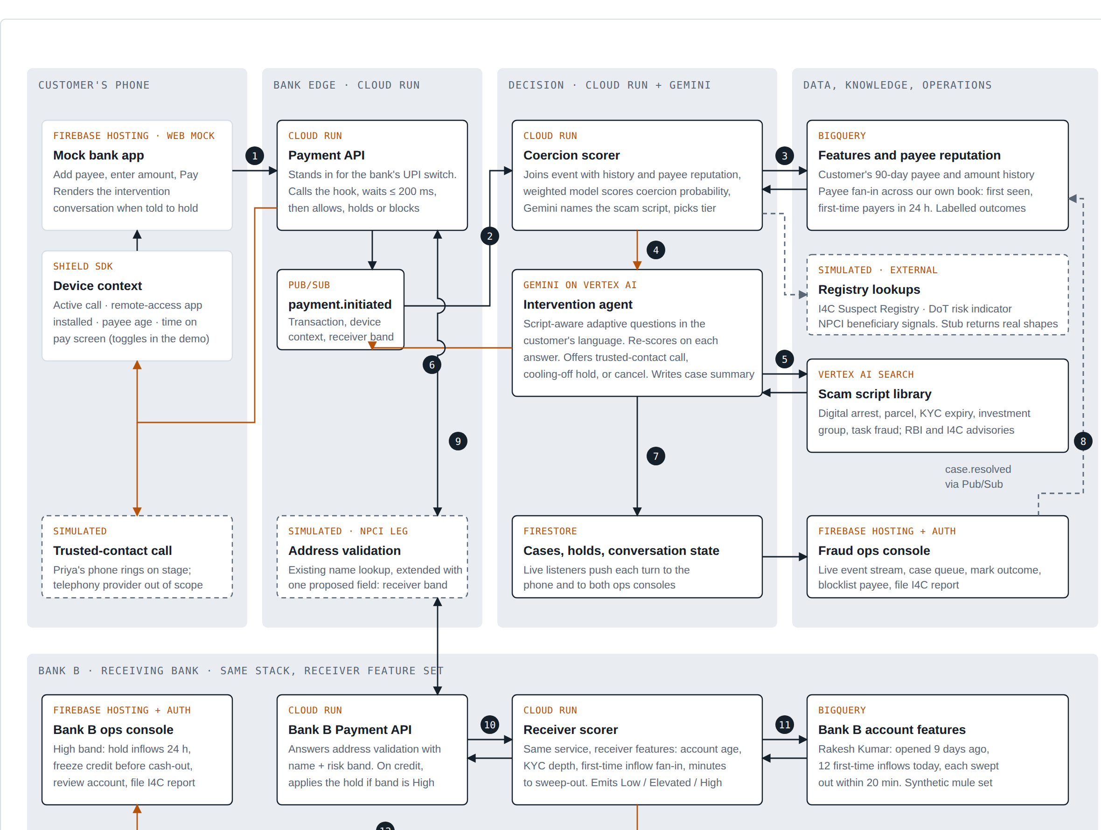
Architecture
One codebase, two banks
The same Cloud Run service is deployed as bank-a (payer hook) and bank-b (receiver band). Firestore is the only state; live listeners drive the phone and both consoles.
Flow
1 App sends pay request + device context
2 Payment API validates the address with Bank B, gets the band
3 Scorer joins history, fan-in, band, registry; Gemini names the script
4 Medium and above: Gemini intervention agent, turns in Firestore
5 Decision persists; ops console updates live
6 Override: credit to Bank B, held if High band
7 Outcomes labelled by ops feed back into the score
Dashed boxes are simulated in the prototype: device signals (toggles), registry lookups, the NPCI leg, the trusted-contact call.

Slide 7
Technologies used in the solution
Cloud Run
Firestore
Both bank services from one container. Payment API, scorer, Gemini agent, address validation, credit hold. One minimum instance each, asia-south1.
Customers, 90-day history, receiver accounts, cases, holds, conversation turns. Composite indexes for the fan-in queries. Live listeners to every screen.
Firebase Hosting + Auth
Gemini 2.5 Flash on Vertex AI
Mock bank app and two ops consoles as static sites. Anonymous auth gates Firestore reads; all writes come from Cloud Run.
Names the scam script from the signal pattern, runs the intervention turns with a per-script system prompt, writes the case summary. JSON-mode responses.
FastAPI, Python 3.12, uv
Firebase JS SDK 10
Service code, weighted scoring model, receiver mule score, Firestore Admin SDK, httpx between banks.
Phone app and consoles in plain HTML/JS; onSnapshot listeners for cases, turns, accounts, holds, events.
Cloud Build, Artifact Registry
Planned
Source-to-container deploys through gcloud run deploy --source.
BigQuery analytics copy of history and outcomes, Pub/Sub event stream, Vertex AI Search over the scam-script corpus, trained model from labelled cases.

Slide 8
Estimated implementation cost
Prototype as deployed (per month, indicative, asia-south1 list prices)
At bank scale
Scoring is a few Firestore or BigQuery lookups per payment: compute cost is negligible against existing fraud-engine spend.
Gemini is called only for the small share of payments that reach medium tier or above. At 1 to 2 percent of volume and three calls per case, a bank doing 10 million UPI payments a month spends on the order of a few hundred dollars on the model.
The real cost is integration: the SDK in the bank's app, the hook in the payment switch, and the band field in address validation.
Set against reimbursement liability for authorised push payment fraud, which the UK now splits between sending and receiving banks.
Cloud Run, 2 services, 1 min instance each, 512 MB
~ $14 to $20
Firestore, demo-scale reads and writes
within free tier
Gemini 2.5 Flash, ~3 calls per flagged payment
~ $0.002 per intervention
Firebase Hosting and Auth
free tier
Total
~ $15 to $25 per month

Slide 9
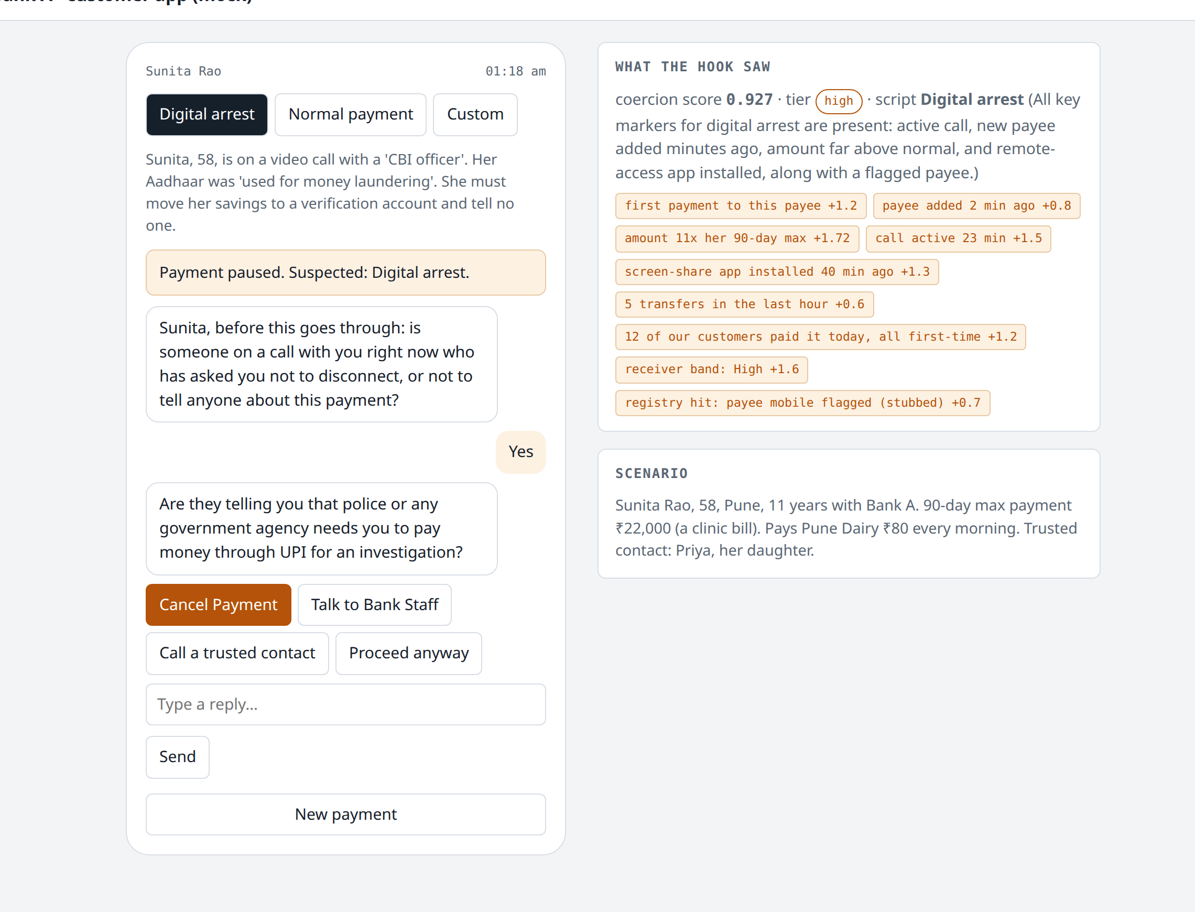
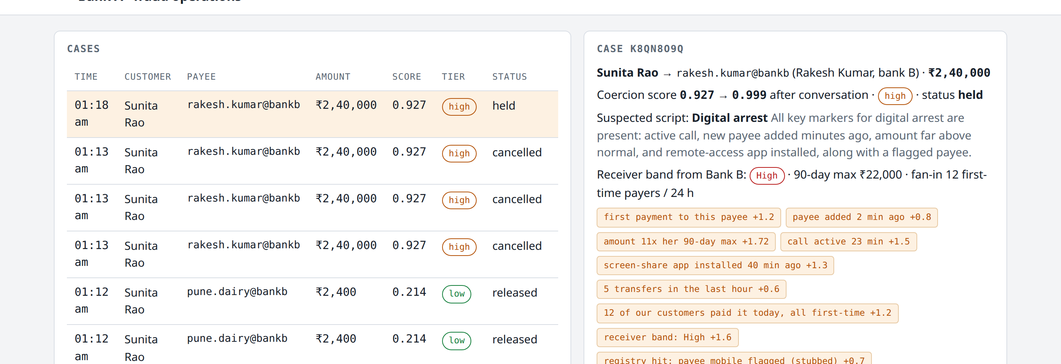
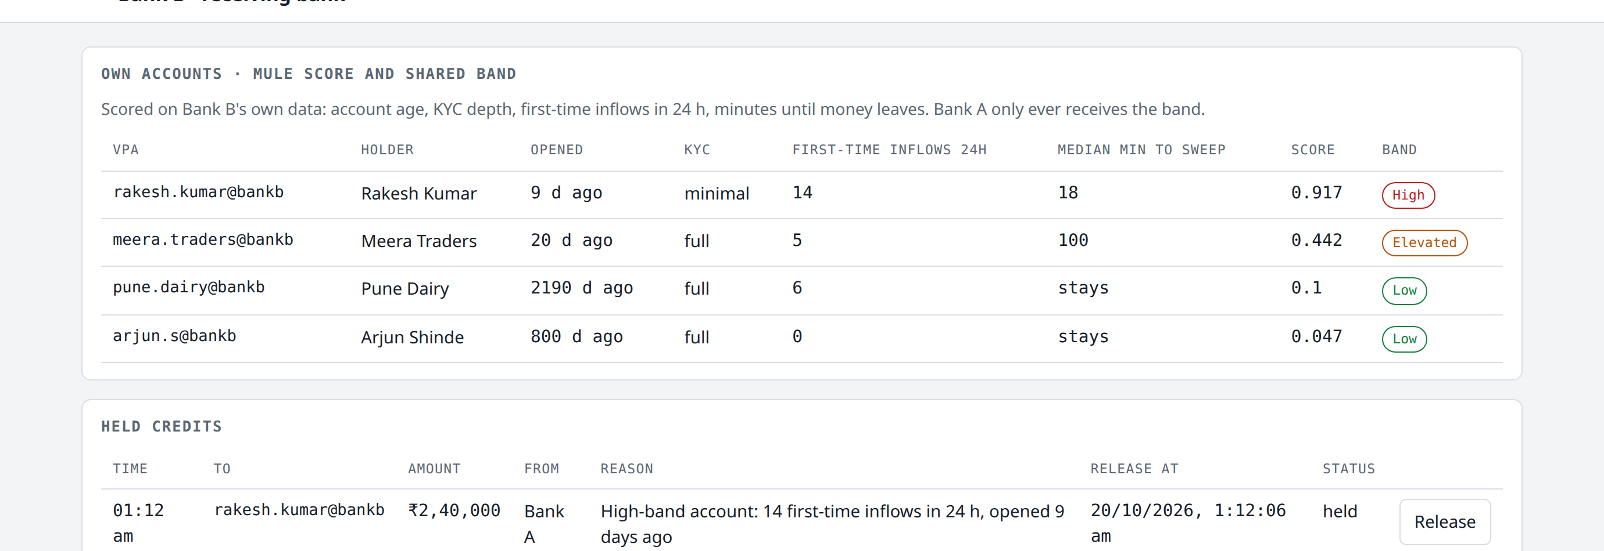
Snapshots of the prototype
PHONE APP: PAYMENT PAUSED, GEMINI CONVERSATION, SIGNALS
BANK A FRAUD CONSOLE: CASE, SIGNALS, TRANSCRIPT
BANK B RECEIVER CONSOLE: MULE BANDS, HELD CREDITS
Live at fabled-ray-512016-k5.web.app. No login. Pick Digital arrest, tap Pay.

Slide 10
Prototype performance report
Latency on the live deployment, 19 Oct 2026
Scoring outcomes on the seeded scenarios
Service health check
0.2 s
Sunita, digital arrest, ₹2,40,000 to a new payee on a 23-min call
0.909
high
Address validation, Bank A to Bank B, with band
0.23 s
Sunita, ₹2,400 to her regular milk vendor
0.178
low
Low-risk payment: score and allow (no model call)
0.5 to 0.6 s
New payee, 3x her usual amount, no call
0.386
medium
Flagged payment: score, Gemini script classification, hold
7.5 to 10 s
Bank B: Rakesh Kumar, 9 days old, 12 first-time inflows, 18-min sweep
0.917
High
Gemini conversation turn
3 to 5 s
Bank B: Pune Dairy, 6 years old, full KYC
0.054
Low
Receiver credit hold at Bank B
under 1 s
Scoring itself is sub-second. The 7 to 10 s on flagged payments is the synchronous Gemini classification; the next revision returns the hold immediately on the rule-based script guess and lets Gemini refine it in the background.
Bank B: Meera Traders, 20 days old, 5 first-time inflows
0.442
Elevated
Gemini named the script correctly in every live run (digital arrest, confidence 0.95) and produced valid JSON turns and summaries; stub fallbacks never triggered.

Slide 11
Future development
Real device signals
Learned model
Shared registries
Android SDK reading call state, recently installed remote-access apps and payee age, replacing the demo toggles.
Train the coercion score on labelled case outcomes from the ops console; BigQuery as the analytics store, Pub/Sub for the event stream.
Live lookups to the I4C Suspect Registry and the DoT Financial Fraud Risk Indicator; file I4C reports automatically.
Receiver band on the rails
Languages and voice
Script corpus
Propose the risk-band field for the UPI address-validation response so any bank pair can exchange it.
Hindi and Marathi turns; a spoken intervention for customers who cannot read under pressure.
Vertex AI Search over fresh scam scripts and RBI advisories, so the agent learns new patterns without a redeploy.

Slide 12
Links
GitHub public repository
https://github.com/R-I-T-I-K/second-voice
Demo video (3 to 4 minutes)
Demo video link: to be added after upload
Final product link
https://fabled-ray-512016-k5.web.app/
The product link needs no login. Open the Digital arrest scenario and tap Pay; the two consoles update live in other tabs.

Slide 13


