Slide 1
Linear Layouts:
Robust Code Generation of Efficient Tensor Computation Using F₂
Reg
Thr
Wrp
q₀
q₁
t₀
t₁
t₂
t₃
t₄
w
j₀
1
0
0
0
0
0
0
0
j₁
0
0
1
0
0
0
0
0
j₂
0
0
0
1
0
0
0
0
ASPLOS ’26 paper presentation · March 22–26, 2026 · DOI 10.1145/3760250.3762221
j₃
0
0
0
0
1
0
0
0
Paper authors: Keren Zhou; Mario Lezcano-Casado; Adam P. Goucher; Akhmed Rakhmati; Jeff Niu; Justin Lebar; Pawel Szczerbuk; Peter Bell; Phil Tillet; Thomas Raoux; Zahi Moudallal
i₀
0
1
0
0
0
0
0
0
i₁
0
0
0
0
0
1
0
0
Keren Zhou — George Mason University (also listed with OpenAI); the remaining authors are listed with OpenAI affiliations in the paper.
i₂
0
0
0
0
0
0
1
0
i₃
0
0
0
0
0
0
0
1
Layout A from §4.1: hardware bits → tensor-coordinate bits, over F₂
Ragimanu Jeevan | Student No. 26965
M.Tech CSA, IISc Bangalore
E0358 Advanced Techniques in Compilation and Programming for Parallel Architectures
Notes:
[~0:30]
Good morning everyone. I am Ragimanu Jeevan, and I will present the ASPLOS 2026 paper "Linear Layouts: Robust Code Generation of Efficient Tensor Computation Using F2".
The central question of the paper: how can a compiler describe and transform the complex mappings between tensor indices and hardware — registers, threads, warps, and memory — without writing a custom rule for every pair of layouts?
The answer is in the small matrix on the right. It is a real layout from the paper, written as a matrix of zeros and ones. By the end of the talk you will be able to read it: each column is one hardware bit, each row is one bit of a tensor coordinate, and multiplying with XOR and AND tells you which tensor element a register holds.
Authorship note: Keren Zhou is at George Mason University (the paper also lists an OpenAI affiliation for him); the other authors are listed with OpenAI.

Slide 2
Where we are going
ROADMAP
1
2
3
4
5
Why layouts matter
Linear Layouts math
Code-generation uses
Evaluation
Takeaways
GPU hierarchy, Triton, legacy layout zoo
§4 — definitions 4.1–4.14, completeness, closure
§5 — vectorization, broadcast, shuffles, swizzling, gather
§6 — micro-benchmarks and 265 real cases
Limitations, source code, Q&A
Technical core — every definition and algorithm gets a worked binary-matrix example
Through-line: represent a layout as a bit-level linear map → compose / invert maps to derive conversions → lower them to registers, shuffles, vector loads and swizzled shared memory.
Notes:
[~0:30]
Five parts. First, why tensor layouts matter on GPUs and why the old approach in Triton was painful. Second — the technical core — Section 4 of the paper: layouts as linear maps over the two-element field, with definitions, propositions and theorems. Third, also core: Section 5, where these matrices are used to generate code — vectorized loads, broadcasting, mixed precision, shared-memory instructions, layout conversions with warp shuffles, bank-conflict-free swizzling, and gather.
For every definition and algorithm in Sections 4 and 5 I will show a small worked example with actual binary matrices, so we can follow each algebraic step instead of talking in the abstract.
Then the evaluation numbers, and the takeaways. The through-line: represent layouts as bit-level linear maps, compose and invert them to derive conversions, then lower those conversions to efficient GPU instructions.

Slide 3
What the paper contributes
§1 INTRODUCTION · CONTRIBUTIONS
1
REPRESENTATION
2
SYSTEM
3
ALGORITHMS
4
EVALUATION
Linear layouts
Built into Triton
New algorithms
Faster and more robust
Tensor layouts as linear maps over F₂: binary matrices on index bits
Layouts compose, invert and divide in one unified framework
Fully integrated into Triton’s GPU backend
A layout engine that automatically chooses and propagates layouts for any Triton operation
Optimal swizzling: provably max vectorization, min bank conflicts
Optimal warp-shuffle generation
Generic lowering of hardware intrinsics for the whole family
Synthetic + real DL workloads: up to 1.40×, avg 1.07× over 265 cases
Fixes many pre-existing layout bugs in Triton
In this talk: §4
In this talk: §4.4
In this talk: §5
In this talk: §6
“One composable representation instead of case-by-case layout conversion code.”
Source: Contributions list in §1 Introduction, p. 134; Abstract, p. 132
Notes:
[~0:50]
The paper lists four contributions, and they build on each other — the talk follows the same order.
One, the representation: linear layouts use linear algebra over F2 to represent tensor layouts and to compose them inside one unified framework. A layout becomes a binary matrix acting on the bits of a hardware index. This is Section 4.
Two, the system: linear layouts are fully integrated into Triton's GPU backend, with a layout engine that automatically chooses and propagates layouts for any operation in Triton. That is Section 4.4.
Three, the algorithms built on top: automatic optimal swizzling, which provably maximizes read and write vectorization and minimizes bank conflicts; automatic optimal warp-shuffle generation for layout conversions; and generic lowering of hardware intrinsics for every layout in this family, instead of one implementation per layout. That is Section 5, where I will spend most of the time on worked examples.
Four, the evidence: on synthetic and real deep-learning workloads, linear layouts outperform baseline Triton — up to 1.40×, average 1.07×, across 265 real benchmark cases — and they make Triton more robust by fixing many pre-existing layout bugs. That is Section 6. Note the end-to-end gains are modest on average; the large numbers come from micro-benchmarks.
So the one-line summary: one composable representation instead of case-by-case layout conversion code.

Slide 4
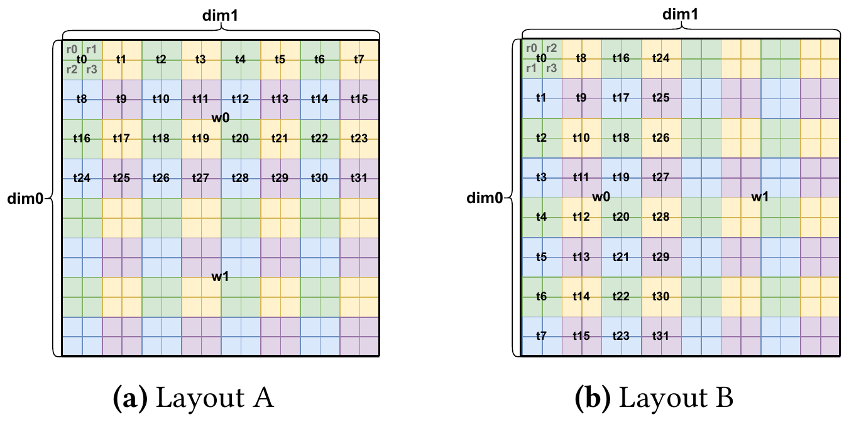
Same 16×16 tensor, two different layouts
MOTIVATION
A logical shape does not determine who holds which element.
Layout A: each thread owns a 2×2 tile; threads tile rows of 8 → coalesced reads for a row-major tensor.
Layout B: the same values with threads running down columns → access efficiency changes.
A layout = a mapping from hardware locations to tensor elements.
Figure 1. Two layouts storing a 16×16 tensor using two warps (wᵢ warp, tⱼ thread, rₖ register).
Source: Figure 1 and §1 Introduction, p. 133
Notes:
[~1:00]
This is Figure 1 of the paper. Both pictures store the same 16 by 16 tensor with two warps. Each small cell is one tensor element. The labels tell us who owns it: w_i is warp i, t_j is thread j, r_k is register k.
In Layout A on the left, each thread owns a 2 by 2 tile — four registers r0..r3 — and the 32 threads of warp 0 are arranged 4 rows by 8 columns, so warp 0 covers the top 8 rows and warp 1 the bottom 8 rows.
In Layout B on the right, threads are arranged down the columns instead: t0..t7 go down the first column of tiles.
The logical tensor is identical; only the ownership changes. The paper notes that if the tensor sits in row-major order in memory, loading it into Layout A is more efficient than into Layout B, because neighbouring threads touch neighbouring addresses — the loads are coalesced.
So a layout is a hardware mapping, not just a shape or a row-major/column-major label. Keep Layout A in mind: in a few minutes we will write it as the 8 by 8 binary matrix from the title slide.

Slide 5
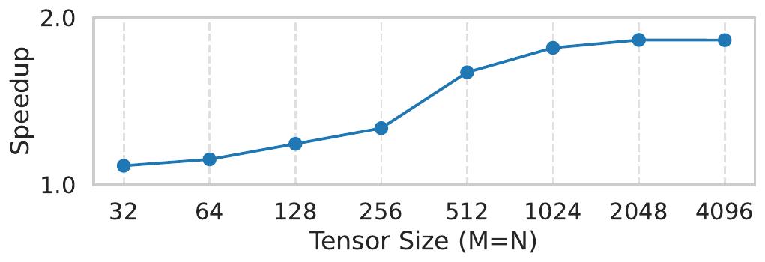
Why the legacy approach is painful
MOTIVATION
Legacy layouts are separate types: Blocked, Sliced, MMA, MMA Input, Unswizzled, Swizzled.
Each type implements its own properties, indexing and conversions case by case.
New layouts multiply maintenance and correctness burden — the paper reports 12% of Triton bugs filed were layout-related.
Figure 2. Speedups over the padding heuristic in a float8 transpose kernel (M×N tensors).
Blk
Slc
MMA
MMAi
Uns
Swz
Blk
Illustrative: 6 layout types → up to 6×5 = 30 hand-written source→destination conversion paths (quadratic growth).
Slc
MMA
With Linear Layouts, a conversion is derived from two matrices instead of being written for each pair.
MMAi
Uns
Swz
Source: §1 Introduction and Figure 2, pp. 132–133; §3 Overview, p. 135
Notes:
[~0:50]
In legacy Triton, layouts were separate types: Blocked, Sliced, MMA, MMA Input, and for memory Unswizzled and Swizzled. Each type had to implement its own interface — elements per thread, contiguous elements, indexing — and every conversion between a pair of types had to be written by hand.
The sketch at bottom left shows the problem: with N layout types you can face up to N squared source-destination combinations. Adding one new layout means touching many places. The paper reports that, at the time cited, 12% of the bugs filed in Triton's GitHub repository were layout-related. That is the paper's observation at that time, not a claim about compilers in general today.
Figure 2 on the right is an early teaser: a float8 transpose kernel, Linear Layouts compared with Triton's padding heuristic for shared memory. Speedup grows with tensor size, approaching about 1.8 to 1.9× at the largest sizes. The full evaluation comes later.

Slide 6
GPU background: where can a tensor element live?
BACKGROUND · §2.1
CTA (thread block)
Registers — private to each thread (lane).
Warp shuffle — lane-to-lane exchange inside a warp, no memory round-trip.
Shared memory — cooperative on-chip storage, split into banks.
MMA / WGMMA (NVIDIA), MFMA (AMD) — matrix multiply-accumulate instructions that dictate operand and output layouts.
Warp w₀ (32 lanes)
Warp w₁ (32 lanes)
t₀
t₁
t₂
…
t₀
t₁
t₂
…
r₀
r₀
r₀
r₀
r₀
r₀
r₀
r₀
r₁
r₁
r₁
r₁
r₁
r₁
r₁
r₁
r₂
r₂
r₂
r₂
r₂
r₂
r₂
r₂
r₃
r₃
r₃
r₃
r₃
r₃
r₃
r₃
registers are private to a lane
registers are private to a lane
Shared memory
Global memory (HBM/GDDR)
Tensor memory
on-chip, shared by the CTA, banked
large, off-chip
special unit memory (e.g. Blackwell)
Source: §2.1 GPU Architectures, pp. 133–134
Notes:
[~1:00]
Quick hardware vocabulary, since the matrices use it.
A CTA — cooperative thread array — is roughly a CUDA thread block. It contains several warps. A warp is a group of hardware threads that execute together: 32 on NVIDIA, 32 or 64 on AMD. Each thread, also called a lane, has private registers; when one thread holds several tensor elements they sit in several registers, which is why "Reg" is the first input dimension of a layout.
Data can move in a few ways. Within a thread: just rename registers — free. Within a warp: warp shuffle instructions let lanes exchange values without memory. Across warps: through shared memory, an on-chip scratchpad shared by the CTA, organised in banks — that becomes important for swizzling. Global memory (HBM or GDDR) is the large off-chip memory. Newer GPUs add special memories such as Tensor Memory on Blackwell.
Finally, matrix-multiply instructions: mma on NVIDIA tensor cores, wgmma (warp-group MMA, Hopper) and mfma on AMD. These instructions dictate exactly which lane and register must hold which operand element. That is the source of many required layouts. I will use NVIDIA names, but the paper notes AMD and Intel have analogous instructions.

Slide 7
Triton and its compiler pipeline (conceptual)
BACKGROUND · §2.2
compile time
run time
Python
TTIR
TTGIR
LLVM IR
PTX / AMDGCN
GPU
Triton kernel (tiles)
tt dialect
ttg dialect: tensors carry layouts
loads, shuffles, math
target ISA
execution
▲ Linear Layouts live here: layout assignment, propagation and conversion
Triton is a Python-like DSL for GPU kernels; the programmer thinks in tiles per CTA.
Values in TTGIR carry layouts; layout analysis and instruction selection happen at compile time.
The GPU only executes the generated loads, shuffles, math and stores — it never "solves" a layout matrix.
Source: §2.2 Triton Language and Compiler, p. 134; upstream triton-lang/triton
Notes:
[~0:45]
Triton is a Python-like domain-specific language for writing GPU kernels at the level of tiles. A kernel follows the single-program-multiple-data model: you write the program for one CTA, and a tensor in Triton means a tile.
Compilation goes through MLIR dialects. Python is turned into the Triton dialect, tt, then into the TritonGPU dialect, ttg. In ttg every tensor value carries a layout attribute. For example, operands of tt.dot get the mma layout so tensor cores can be used. Then it is lowered to LLVM IR and to PTX for NVIDIA or AMDGCN for AMD. Exact stages differ by target, so treat this as a conceptual pipeline.
The important point is the dashed line: all layout reasoning happens at compile time. The GPU is not multiplying 8 by 8 binary matrices for every element at run time. The compiler uses the matrices to decide which loads, shuffles, register moves and stores to emit; at run time the GPU just executes those instructions. Where an index really depends on runtime values, the generated code is a few XORs and shifts.

Slide 8
The only algebra we need: F₂
BACKGROUND · §2.4
⊕ (XOR) | 0 | 1
0 | 0 | 1
1 | 1 | 0
· (AND) | 0 | 1
0 | 0 | 0
1 | 0 | 1
Row view
1
1
1
0
y₀ = 1·1 ⊕ 1·1 = 1 ⊕ 1 = 0
y₁ = 0·1 ⊕ 1·1 = 0 ⊕ 1 = 1
×
=
0
1
1
1
F₂ = {0, 1}. Addition = XOR, multiplication = AND. So 1 ⊕ 1 = 0.
A
x
y
Matrix product: c₍ᵢⱼ₎ = ⊕ₖ aᵢₖ · bₖⱼ (AND, then XOR).
Bit vectors are written least-significant bit first.
All sizes are powers of two → every index is a bit vector.
Column view (used throughout the talk)
A x = XOR of the columns of A where x has a 1:
1
1
0
Column k = image of hardware bit k (Triton calls these the bases).
⊕
=
0
1
1
col 0
col 1
y
Source: §2.4 F₂ Mathematics, p. 135; column view as in LinearLayout.h comments
Notes:
[~1:30]
Everything in this paper uses arithmetic over F2, the field with two elements, 0 and 1. Addition is XOR: 1 plus 1 is 0. Multiplication is AND. These are the truth tables on the left.
A matrix-vector product works as usual, except we multiply with AND and add with XOR. Take A = [[1,1],[0,1]] and x = [1,1]. Row by row: the first output bit is 1·1 XOR 1·1 = 1 XOR 1 = 0. The second is 0·1 XOR 1·1 = 1. So y = [0,1]. In real-number arithmetic we would have got [2,1]; here, modulo 2, we get [0,1].
The second view on the right is the one we will use constantly: Ax is the XOR of the columns of A selected by the 1-bits of x. Here both bits of x are 1, so y = column 0 XOR column 1 = [1,0] XOR [1,1] = [0,1]. Same answer.
Why this matters for layouts: column k of a layout matrix tells you where hardware bit k "points" in the tensor. The value of any hardware index is the XOR of the columns for its set bits. Triton's source code calls these columns the "bases" of the layout.
Convention for the whole talk: bit vectors are written least-significant bit first, as in the paper. All the dimensions are powers of two, so every index is exactly a bit vector.

Slide 9
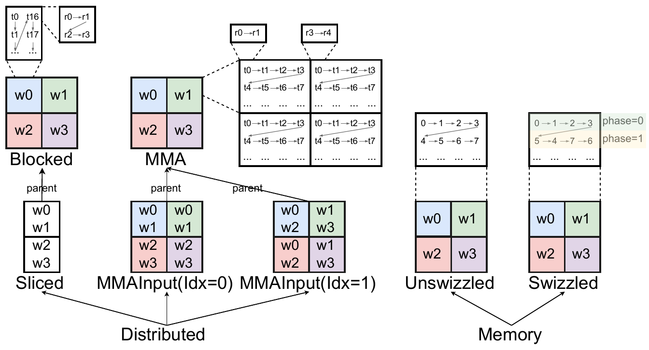
Legacy Triton layouts: two families
OVERVIEW · §3
Distributed: Reg × Thr × Wrp → (i, j)
Blocked — general tiling across regs/threads/warps
Sliced — parent with one dim removed (reductions, broadcasts)
MMA — output of mma / wgmma / mfma
MMA Input — operands of those instructions
Memory: offset → (i, j)
Unswizzled — plain row-major offsets
Swizzled — XOR a row phase into column groups to avoid bank conflicts
Figure 3. Legacy layouts in Triton (wᵢ warp, tⱼ thread, rₖ register).
Source: §3 Overview and Figure 3, p. 135
Notes:
[~0:45]
Figure 3 is the taxonomy of legacy layouts in Triton — it is a classification, not a runtime pipeline.
Distributed layouts say how tensor elements are distributed across execution units: they map register, thread and warp to logical coordinates. Blocked is the general tiling layout used for contiguous memory access. Sliced is derived from a parent layout by removing one dimension — the input to a broadcast or the output of a reduction such as tt.sum. MMA layouts are the outputs of matrix-multiply instructions; MMA Input layouts are their operands, with an operand index 0 or 1.
Memory layouts map a memory offset to a logical coordinate. Unswizzled is plain row-major storage. Swizzled XORs the column-group index with a row-dependent phase, to avoid shared-memory bank conflicts; notice the phase=0 and phase=1 rows in the figure.
Each of these was its own class in the legacy code. Section 4 shows that all of them become linear layouts.

Slide 10
Linear Layouts: the mathematics
§4
Definitions 4.1–4.5, completeness (Props 4.6–4.8, Thm 4.9), distributed and memory layouts (Defs 4.10–4.14), closure under Triton operations — each with a worked F₂ example.
Notes:
[~0:10] Now the technical core, Section 4. For every definition I will put a small binary matrix on the screen and do the algebra step by step.

Slide 11
What is a Linear Layout?
§4.2 · DEFINITION 4.1
Definition 4.1. A Linear Layout is a linear map between labelled vector spaces over F₂.
Layout P
Reg
Thr
r₀
t₀
t₁
t₀
t₁
t₂
t₃
L : Reg × Thr × Wrp → F₂ⁿ × F₂ᵐ
y = A x (over F₂)
e₀
1
0
0
0
1
2
3
4
5
6
7
e₁
0
1
0
thread → [r₀, r₁] holds elements
e₂
0
0
1
reg_bases=[[1]] lane_bases=[[2],[4]]
“Given a hardware location, which logical tensor element does it hold?”
Layout Q
Input = hardware index bits; output = logical coordinate bits.
A function: each location holds one element — but many-to-one is allowed (duplication).
Labels record which bits are Reg / Thr / Wrp and i / j; L_Reg = the register columns.
Column k = L(eₖ): the element held when only hardware bit k is set.
Reg
Thr
r₀
t₀
t₁
t₀
t₁
t₂
t₃
e₀
0
1
0
0
4
1
5
2
6
3
7
e₁
0
0
1
thread → [r₀, r₁] holds elements
e₂
1
0
0
reg_bases=[[4]] lane_bases=[[1],[2]]
Illustrative example — not the paper’s exact kernel layout
Source: Definition 4.1, p. 136; basis-vector view from LinearLayout.h (upstream Triton)
Notes:
[~1:15]
Definition 4.1: a linear layout is a linear map between labelled vector spaces over F2.
For a distributed layout, the input space is the hardware index: the register bits, thread bits and warp bits, written Reg × Thr × Wrp. The output space is the bits of the logical tensor coordinate. So the question the layout answers is: given a hardware location, which logical tensor element does it hold?
It must be a function: one hardware location holds one element. But it does not have to be one-to-one: several hardware locations may hold the same element — that is duplication or broadcasting, and we will see it as zero columns. Triton's source code explains why the direction is hardware → tensor: the reverse would not be a function when values are duplicated.
The labels matter: we keep track of which input bits are Reg, Thr, Wrp and which output bits are row i or column j. L_Reg means the block of columns that act on register bits.
Worked example on the right, an 8-element vector held by 4 threads with 2 registers each. That is 1 register bit, 2 thread bits, and 3 output bits e0, e1, e2.
Layout P is the identity: register bit r0 points to element 1, thread bit t0 to element 2, t1 to element 4. So thread 0 holds 0,1; thread 1 holds 2,3; and so on.
Layout Q has the same hardware but a different matrix: r0 points to element 4, t0 to 1, t1 to 2. Now thread 0 holds 0 and 4, thread 1 holds 1 and 5.
Read the columns: column k is where hardware bit k lands — Triton stores exactly these columns, called reg_bases and lane_bases. These two layouts reappear later as the source and destination in Figure 4's warp-shuffle example.

Slide 12
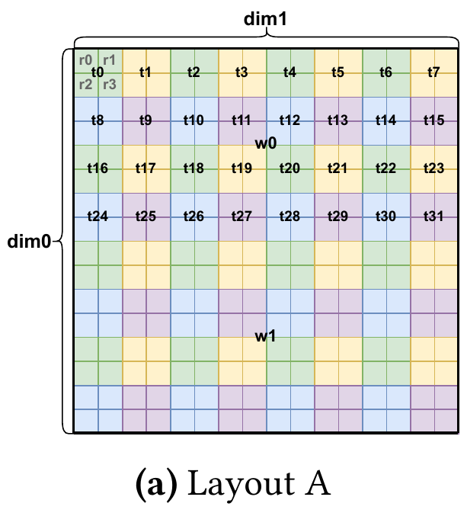
Layout A in bits: 16×16 tensor, 2 warps
§4.1 · MOTIVATING EXAMPLE
Dimension | Size | Bits | Names
Tensor rows i | 16 | 4 | i₀ i₁ i₂ i₃
Tensor cols j (fastest) | 16 | 4 | j₀ j₁ j₂ j₃
Registers / thread | 2×2 = 4 | 2 | q₀ q₁
Threads / warp | 4×8 = 32 | 5 | t₀ … t₄
Warps / CTA | 2×1 = 2 | 1 | w
Table 1 (excerpt)
(i, j) | Reg | Thr | Wrp
(0,0) | r₀ 0b0 | t₀ | w₀
(0,1) | r₁ 0b1 | t₀ | w₀
(0,2) | r₀ 0b0 | t₁ | w₀
(1,0) | r₂ 0b10 | t₀ | w₀
(1,1) | r₃ 0b11 | t₀ | w₀
(2,2) | r₀ 0b0 | t₉ 0b1001 | w₀
(2,3) | r₁ 0b1 | t₉ 0b1001 | w₀
(3,3) | r₃ 0b11 | t₉ 0b1001 | w₀
Input: 2 + 5 + 1 = 8 hardware bits. Output: 4 + 4 = 8 coordinate bits → A is an 8×8 matrix over F₂.
Every r₀ sits where the last bits of i and j are 0; r₁ flips j₀; r₂ flips i₀.
Bit vectors are LSB-first; j (fastest) bits come before i bits in y.
Figure 1(a): Layout A
Source: §4.1, Figure 1(a) and Table 1, p. 136
Notes:
[~0:50]
Back to Layout A from Figure 1. The paper notes that almost everything in GPU programming is a power of two: warps of 32 or 64 threads, warp groups of 4 warps, MMA tiles of 16 by n. Triton also restricts tensor dimensions and layout sub-divisions to powers of two. That is what lets us write every index as a bit vector.
Layout A: the tensor is 16 by 16, so a coordinate (i, j) needs 4 bits for the row i and 4 bits for the column j: 8 output bits.
On the hardware side: each thread holds a 2 by 2 tile, so 4 registers — 2 register bits, which I call q0 and q1. Each warp has 32 threads arranged 4 by 8 — 5 thread bits t0 to t4. Two warps stacked vertically — 1 warp bit w. Total 2 + 5 + 1 = 8 input bits. So the layout is an 8 by 8 binary matrix.
Table 1 of the paper lists a few elements in binary. Look at register 0: every r0 sits at a coordinate whose last bit of i and last bit of j are both 0. r1 has j's last bit equal to 1 — it is one column to the right. That observation is the whole idea: each register bit flips exactly one coordinate bit. Note the convention: j is the fastest-moving dimension, so the output vector lists the j bits first, then the i bits.

Slide 13
Building the 8×8 matrix A column by column
§4.1 · THE PAPER’S MATRIX
Reg
Thr
Wrp
Read each column = where that hardware bit points
q₀
q₁
t₀
t₁
t₂
t₃
t₄
w
j
j₀
1
0
0
0
0
0
0
0
q₀ → j₀
register bit 0: one column right in the 2×2 tile
j₁
0
0
1
0
0
0
0
0
q₁ → i₀
register bit 1: one row down in the tile
j₂
0
0
0
1
0
0
0
0
t₀ t₁ t₂ → j₁ j₂ j₃
8 threads across: steps of 2, 4, 8 columns
j₃
0
0
0
0
1
0
0
0
i
i₀
0
1
0
0
0
0
0
0
t₃ t₄ → i₁ i₂
4 thread-rows down: steps of 2, 4 rows
i₁
0
0
0
0
0
1
0
0
w → i₃
warp 1 sits 8 rows below warp 0
i₂
0
0
0
0
0
0
1
0
Exactly one 1 in every column and every row → A is a permutation matrix (under this bit ordering).
i₃
0
0
0
0
0
0
0
1
A (8×8 over F₂)
Paper’s exact matrix
Source: Matrix A in §4.1, p. 136
Notes:
[~1:30]
Here is the paper's exact matrix A. Columns are input bits in the order q0, q1 | t0..t4 | w — the dashed lines separate Reg, Thr and Wrp. Rows are output bits j0..j3 then i0..i3.
Read it one column at a time, using the column view from the F2 slide. Column k answers: if only hardware bit k is 1, which coordinate do I get?
- q0 has its 1 in row j0: register bit 0 moves one column to the right inside the 2 by 2 tile.
- q1 has its 1 in row i0: register bit 1 moves one row down.
- t0, t1, t2 go to j1, j2, j3: the 8 threads along a row step across tiles of width 2 — so thread bit t0 is worth 2 columns, t1 is 4, t2 is 8.
- t3, t4 go to i1, i2: the 4 thread-rows step down by 2 and 4 rows.
- w goes to i3: warp 1 is 8 rows below warp 0.
Every column has exactly one 1 and every row has exactly one 1 — under this bit ordering A is a permutation matrix. That is the typical shape of a blocked layout.
One caution: this is the paper's chosen example layout. The compiler picks a layout based on the operations, the target and its optimization policy; this matrix is not a universal default.

Slide 14
Trace: register r₁ of thread t₉ in warp w₀
§4.1 · WORKED EXAMPLE
Reg
Thr
Wrp
① Encode hardware location (LSB first)
q₀
q₁
t₀
t₁
t₂
t₃
t₄
w
r₁ = 0b01 → [q₀,q₁] = [1,0]
t₉ = 0b01001 → [t₀…t₄] = [1,0,0,1,0]
w₀ = 0 → [w] = [0]
x = [1,0 | 1,0,0,1,0 | 0]ᵀ
j
j₀
1
0
0
0
0
0
0
0
1
1
j₁
0
0
1
0
0
0
0
0
0
1
j₂
0
0
0
1
0
0
0
0
1
0
j₃
0
0
0
0
1
0
0
0
0
0
×
=
i
i₀
0
1
0
0
0
0
0
0
0
0
② Multiply = XOR the highlighted columns
i₁
0
0
0
0
0
1
0
0
1
1
y = col(q₀) ⊕ col(t₀) ⊕ col(t₃) → rows j₀, j₁, i₁ set
i₂
0
0
0
0
0
0
1
0
0
0
i₃
0
0
0
0
0
0
0
1
0
0
③ Decode output bits
[j₀…j₃] = [1,1,0,0] = 0b0011 → j = 3
[i₀…i₃] = [0,1,0,0] = 0b0010 → i = 2
L(r₁, t₉, w₀) = (i, j) = (2, 3) ✓ Table 1
A
x
y
Paper’s example
Source: §4.1 and Table 1, p. 136
Notes:
[~1:30]
This is the key proof-of-understanding example, and it is the paper's own.
Step 1, encode the hardware location in bits, least-significant bit first. Register 1 is 0b01, so [q0, q1] = [1, 0]. Thread 9 is binary 01001, so LSB-first [t0..t4] = [1, 0, 0, 1, 0]. Warp 0 gives w = 0. Stack them: x = [1,0 | 1,0,0,1,0 | 0].
Step 2, multiply. Each output bit is the XOR of the input bits selected by that row — or, in the column view, y is the XOR of the highlighted columns: the columns where x has a 1, which are q0, t0 and t3. q0 contributes j0, t0 contributes j1, t3 contributes i1.
Step 3, decode. The j bits [j0..j3] = [1,1,0,0] = 0b0011 = 3. The i bits [i0..i3] = [0,1,0,0] = 0b0010 = 2. So L(r1, t9, w0) = (i, j) = (2, 3), which matches row "(2,3) → r1, t9, w0" of Table 1.
Watch the ordering: the bit lists are LSB-first, and y lists j bits before i bits, but the familiar coordinate is written (i, j).

Slide 15
Columns = hierarchical offsets: loc_reg ⊕ loc_thr ⊕ loc_warp
§4.1 · COLUMN VIEW
Paper’s example: r₁, t₉, w₀
Practice: r₃, t₁₄, w₁
r₃ = 0b11 → q₀ = q₁ = 1; t₁₄ = 0b01110 → t₁, t₂, t₃ = 1; w = 1
j₀
1
0
0
1
active bit | column of A (j₀..j₃ | i₀..i₃) | i | j
q₀ | 1000 | 0000 | 0 | 1
q₁ | 0000 | 1000 | 1 | 0
t₁ | 0010 | 0000 | 0 | 4
t₂ | 0001 | 0000 | 0 | 8
t₃ | 0000 | 0100 | 2 | 0
w | 0000 | 0001 | 8 | 0
XOR | 1011 | 1101 | 11 | 13
j₁
0
1
0
1
j₂
0
0
0
0
j₃
0
⊕
0
⊕
0
=
0
i₀
0
0
0
0
i₁
0
1
0
1
i₂
0
0
0
0
i₃
0
0
0
0
loc_r₁
loc_t₉
loc_w₀
y
Check with Figure 1: t₁₄ is thread-row 1, thread-col 6 → rows 2–3, cols 12–13; warp 1 adds 8 rows; r₃ = bottom-right → (11, 13) ✓
(0, 1)
(2, 2)
(0, 0)
(2, 3)
Bits never overlap here, so XOR = +. The matrix is the hierarchy written in one place.
Source: §4.1 (register → loc_thread, thread → loc_warp, warp → loc), p. 136
Notes:
[~0:45] (optional — skip if short on time)
The paper explains the same computation hierarchically. Each hardware level contributes an offset inside an ever larger tile, and you XOR them.
For r1 in t9 in w0: the register map puts r1 at loc = (0,1), the second column of the thread's tile. The thread map puts thread 9's tile at (2,2) inside the warp tile. The warp map puts warp 0 at (0,0). XOR: (0 ⊕ 2 ⊕ 0, 1 ⊕ 2 ⊕ 0) = (2, 3). Same answer as the matrix product — because these offsets are exactly sums of columns of A grouped by level.
Second example, mine, to practise: register r3, thread t14, warp w1.
r3 = 0b11, so q0 = q1 = 1. t14 = 0b01110, so t1, t2, t3 are set. w = 1.
Active columns: q0 → (0,1); q1 → (1,0); t1 → (0,4); t2 → (0,8); t3 → (2,0); w → (8,0).
XOR the i parts: 1 ⊕ 2 ⊕ 8 = 11. XOR the j parts: 1 ⊕ 4 ⊕ 8 = 13. So (11, 13).
Sanity check with the picture: thread 14 is in thread-row 1, thread-column 6 of the 4 by 8 grid, so its tile covers rows 2–3 and columns 12–13; warp 1 adds 8 rows, giving rows 10–11; register 3 is the bottom-right of the tile: (11, 13). Because the bit positions do not overlap, XOR here equals addition.

Slide 16
Composition: L₂ ∘ L₁ is the matrix product M₂M₁
§4.2 · DEFINITION 4.2
Definition 4.2. L₁: U → V, L₂: V → W. (L₂ ∘ L₁)(u) = L₂(L₁(u)). Matrix: M₂ M₁ over F₂ (label-wise).
Illustrative example — not the paper’s exact kernel layout
L₁: who owns (i, j)
Reg
Thr
Reg
Thr
j=0
1
2
3
j₀
j₁
i₀
i₁
r₀
r₁
t₀
t₁
r₀
r₁
t₀
t₁
i=0
t0r0
t0r1
t1r0
t1r1
j₀′
0
0
1
0
j₀
1
0
0
0
j₀′
0
1
0
0
1
t0r2
t0r3
t1r2
t1r3
j₁′
0
0
0
1
j₁
0
0
1
0
j₁′
0
0
0
1
2
t2r0
t2r1
t3r0
t3r1
·
=
i₀′
1
0
0
0
i₀
0
1
0
0
i₀′
1
0
0
0
3
t2r2
t2r3
t3r2
t3r3
i₁′
0
1
0
0
i₁
0
0
0
1
i₁′
0
0
1
0
M₂ = P (transpose i↔j)
M₁ = L₁
M₂M₁
Entry (j₀′, r₁) = row j₀′ of P · col r₁ of L₁ = [0,0,1,0]·[0,0,1,0] = 1
Columns of M₂M₁: r₀→i₀′, r₁→j₀′, t₀→i₁′, t₁→j₁′ — the transposed tensor’s layout, no data moved.
Source: Definition 4.2, p. 136
Notes:
[~1:00]
Definition 4.2: given L1 from U to V and L2 from V to W, the composition L2 ∘ L1 sends u to L2(L1(u)). With matrices M1 and M2, the composition is the matrix product M2 M1 over F2 — note the order: the map applied first is on the right.
Worked example with a small layout I will reuse: L1 is a 4 by 4 tensor held by 4 threads with a 2 by 2 tile each — a mini version of Layout A. Register bit r0 → j0, r1 → i0, thread bit t0 → j1, t1 → i1. The grid shows who owns each cell.
L2 is a transpose of the logical tensor: it swaps the i bits with the j bits. As a matrix, P has a 1 in row j0' column i0, row j1' column i1, and so on.
Multiply: entry (row j0', column r1) of M2 M1 is row j0' of P — which selects i0 — dotted with column r1 of L1, which is e_i0. That is 1. Doing every entry gives the right-hand matrix. Read its columns: r0 now points to i0', r1 to j0', t0 to i1', t1 to j1'. That is the layout of the transposed tensor — same registers, same threads, no data moved. That is exactly how tt.trans becomes a no-op in Section 4.4.

Slide 17
Composition trace: two routes, one answer
§4.2 · WORKED EXAMPLE
x = register r₁, thread t₂ → [r₀,r₁ | t₀,t₁] = [1,0 | 0,1]
Route 1: apply L₁, then P
r₀
r₁
t₀
t₁
j₀
1
0
0
0
1
1
j₀′
0
j₁
0
0
1
0
×
0
=
0
P
j₁′
1
i₀
0
1
0
0
0
0
i₀′
1
i₁
0
0
0
1
1
1
i₁′
0
L₁
x
(2, 1)
(1, 2)
Route 2: apply M₂M₁ directly
r₀
r₁
t₀
t₁
Chaining maps = multiplying matrices once, at compile time. Layout conversion later is just another composition: B⁻¹ ∘ A.
0
1
0
0
1
0
0
0
0
1
×
0
=
1
1
0
0
0
0
1
0
0
1
0
1
0
M₂M₁
x
(1, 2) ✓
Source: Definition 4.2, p. 136
Notes:
[~0:40]
Let us check associativity concretely: take register r1 of thread t2. In bits, r1 = 0b01 → [r0, r1] = [1, 0]; t2 = 0b10 → [t0, t1] = [0, 1]. So x = [1, 0, 0, 1].
Route 1, step by step. First L1: columns r0 and t1 are active, giving j0 and i1, so (i, j) = (2, 1) — row 2, column 1 of the original tensor; you can verify in the ownership grid on the previous slide that t2 r1 holds (2,1). Then apply P, the transpose: (2, 1) becomes (1, 2).
Route 2, directly with the product matrix M2 M1: the same active columns r0 and t1 now give i0' and j1', i.e. (1, 2).
Same answer. This is the property the compiler exploits: once a layout and a transformation are matrices, chaining them is a single matrix product computed at compile time. Later, layout conversion is exactly a composition: B inverse composed with A.

Slide 18
Product: independent pieces give a block-diagonal matrix
§4.2 · DEFINITION 4.3
Definition 4.3. (L₁ × L₂)(u₁, u₂) = (L₁(u₁), L₂(u₂)). Matrix = diag(M₁, M₂) — block diagonal.
Reg
Thr
Wrp
q₀
q₁
t₀
t₁
t₂
t₃
t₄
w
q₀
q₁
t₀
t₁
t₂
t₃
t₄
w
j₀
1
0
×
j₁
1
0
0
0
0
i₃
1
j₀
1
0
0
0
0
0
0
0
i₀
0
1
j₂
0
1
0
0
0
L_Wrp
i₀
0
1
0
0
0
0
0
0
L_Reg
j₃
0
0
1
0
0
×
2×1 warps
j₁
0
0
1
0
0
0
0
0
2×2 tile per thread
i₁
0
0
0
1
0
=
j₂
0
0
0
1
0
0
0
0
i₂
0
0
0
0
1
j₃
0
0
0
0
1
0
0
0
L_Thr
i₁
0
0
0
0
0
1
0
0
4×8 threads per warp
i₂
0
0
0
0
0
0
1
0
Current upstream Triton builds Blocked layouts exactly this way:
i₃
0
0
0
0
0
0
0
1
identityStandardND("register", sizePerThread, order) *
identityStandardND("lane", threadsPerWarp, order) *
identityStandardND("warp", warpsPerCTA, order)
M₀ = L_Reg × L_Thr × L_Wrp
Source: Definition 4.3, p. 136; BlockedEncodingAttr::toLinearLayout in LinearLayoutConversions.cpp (upstream)
Notes:
[~0:50]
Definition 4.3, the product. Given L1 from U1 to V1 and L2 from U2 to V2, the product L1 × L2 maps the pair (u1, u2) to (L1(u1), L2(u2)). The two pieces do not interact, so the matrix is block diagonal: M1 in the top-left, M2 in the bottom-right, zeros elsewhere. The paper's footnote says this is usually called the direct sum; they call it a product to avoid confusion with the XOR symbol.
The paper says the product is how you build a complex layout incrementally — registers, then threads, then warps. Let us build Layout A that way.
- The register level: (q0, q1) → (j0, i0), an identity I2 — the 2 by 2 tile.
- The thread level: (t0..t4) → (j1, j2, j3, i1, i2), an identity I5 — the 4 by 8 thread grid.
- The warp level: w → i3, an identity I1.
Their product is block diagonal, here the 8 by 8 identity, with the output rows grouped level by level: j0, i0 | j1, j2, j3, i1, i2 | i3.
This is literally how current upstream Triton builds a blocked layout: identity for registers, times identity for lanes, times identity for warps. On the next slide we regroup the output bits by tensor dimension and recover A exactly.

Slide 19
Recover A: regroup the output bits by tensor dimension
§4.2 · PRODUCT + COMPOSITION
Reg
Thr
Wrp
Reg
Thr
Wrp
q₀
q₁
t₀
t₁
t₂
t₃
t₄
w
q₀
q₁
t₀
t₁
t₂
t₃
t₄
w
j₀
1
0
0
0
0
0
0
0
j₀
1
0
0
0
0
0
0
0
i₀
0
1
0
0
0
0
0
0
j₁
0
0
1
0
0
0
0
0
j₁
0
0
1
0
0
0
0
0
j₂
0
0
0
1
0
0
0
0
j₂
0
0
0
1
0
0
0
0
j₃
0
0
0
0
1
0
0
0
j₃
0
0
0
0
1
0
0
0
i₀
0
1
0
0
0
0
0
0
i₁
0
0
0
0
0
1
0
0
i₁
0
0
0
0
0
1
0
0
i₂
0
0
0
0
0
0
1
0
i₂
0
0
0
0
0
0
1
0
i₃
0
0
0
0
0
0
0
1
i₃
0
0
0
0
0
0
0
1
M₀ (rows grouped by level)
A = P · M₀ (paper’s matrix ✓)
P reorders rows: [j₀, i₀ | j₁ j₂ j₃ i₁ i₂ | i₃] → [j₀ j₁ j₂ j₃ | i₀ i₁ i₂ i₃]
Layout A = Blocked encoding: sizePerThread [2,2], threadsPerWarp [4,8], warpsPerCTA [2,1], order [1,0]. Product builds the levels; composition with a permutation arranges bits per dimension.
Source: Definitions 4.2–4.3 and matrix A, p. 136 (pedagogical factorization)
Notes:
[~0:30] (optional — skip if short on time)
The product M0 groups output bits level by level. But the tensor coordinate wants all the j bits together, then all the i bits. Regrouping is a permutation of output rows — a matrix P — so by composition the full layout is P times M0.
P picks rows of M0 in the order 0, 2, 3, 4, 1, 5, 6, 7: that is j0, then the thread's j1, j2, j3, then i0, then i1, i2, then i3. Because M0 is the identity here, the result is exactly P, and P is exactly the paper's matrix A — I checked this equality programmatically while building the slides.
In Triton's implementation this regrouping happens automatically, because outputs are labelled: when you take the product, bits of the same named dimension are stacked, lower levels first. This is a teaching factorization showing both definitions at work; I am not claiming the compiler literally multiplies these two matrices internally.
One more remark: Layout A is a Blocked encoding with sizePerThread [2,2], threadsPerWarp [4,8], warpsPerCTA [2,1], and order [1,0] — j fastest.

Slide 20
Left division: does the layout contain a hardware tile?
§4.2 · DEFINITION 4.4
Definition 4.4. M is left-divisible by M₁ if M = [ M₁ 0 ; 0 M₂ ]. Then M /ℓ M₁ = M₂ (label-wise).
Example 1 — divisible ✓
Example 2 — not divisible ✗
Reg
Thr
Reg
Thr
r₀
r₁
t₀
t₁
r₀
r₁
t₀
t₁
o₀
1
0
0
0
o₀
0
0
1
0
Top-left block (Reg → o₀,o₁) is 0, not T. A thread’s registers sit at offsets t, t+4, t+8, t+12 — no 4-wide vector access.
r₀
r₁
t₀
t₁
o₁
0
1
0
0
o₀
1
0
o₂
1
0
o₁
0
0
0
1
/ℓ
=
o₂
0
0
1
0
o₁
0
1
o₃
0
1
o₂
1
0
0
0
o₃
0
0
0
1
T = id₂
L /ℓ T
o₃
0
1
0
0
L: (Reg,Thr) → Off
L′: (Reg,Thr) → Off
Thread t’s registers → offsets 4t … 4t+3: one 128-bit vector store per thread.
Illustrative example — not the paper’s exact kernel layout
Source: Definition 4.4, p. 137; used by Theorem 5.1 (§5.3)
Notes:
[~1:00]
Definition 4.4. A matrix M is divisible on the left by M1 if M has the block structure [[M1, 0],[0, M2]]. Then we write M divided-on-the-left by M1 equals M2. It is the inverse of the product: it peels an independent block off the top-left. In a labelled layout this is done label by label.
Why we care: a hardware instruction handles a small fixed mapping — a tile T. If the layout literally contains T as an independent block, the instruction can be used, and the quotient tells us how the remaining bits are laid out.
Example 1. Four threads each hold 4 fp32 values; L maps (register, thread) to a shared-memory offset. Here L is the identity: registers r0, r1 → offset bits o0, o1; threads → o2, o3. The tile T for a 4-wide vector store maps 2 register bits to the 2 low offset bits — I2. The top-left block of L is T, the off-diagonal blocks are zero, so L /ℓ T = I2: thread t writes its 4 values at offsets 4t to 4t+3 with one vector instruction.
Example 2. Now registers point to o2, o3 — each thread's values are 4 apart — and threads point to the low bits. The top-left Reg-to-low-offset block is zero, not T: no division, so no 4-wide vector store.
This is a structural compatibility test — not ordinary division of numbers.

Slide 21
Right inverse: from a logical element back to hardware
§4.2 · DEFINITION 4.5
Definition 4.5. A surjective L: U → V has a right inverse: M⁻¹ is an n×m least-squares solution of M X = Iₘ, found by Gaussian elimination over F₂.
r₀
1
0
Gaussian elimination
r₀
r₁
r₂
1
0
0
1
0
·
=
Pivots: r₀, r₁
Free (slack) variable: r₂
Set slack = 0 → R: element e → register e (r0–r3)
Not unique: R′ also gives M R′ = I
Right inverse picks one preimage — §5.4 chooses minimal Hamming weight
e₀
1
0
0
r₁
0
1
0
1
0
0
1
e₁
0
1
0
r₂
0
0
M
I₂
R (slack = 0)
M (2×3)
r₂ is ignored → zero column
r₀
1
0
element e | preimages (register #)
0 | r0, r4
1 | r1, r5
2 | r2, r6
3 | r3, r7
1
0
0
1
0
·
=
r₁
0
1
0
1
0
0
1
r₂
1
0
M
I₂
R′ (slack ≠ 0)
Illustrative example — not the paper’s exact kernel layout
Source: Definition 4.5, p. 137
Notes:
[~1:00]
Definition 4.5: a surjective linear layout L from U to V has a right inverse. If M is m by n, M inverse is defined as an n by m least-squares solution of M X = I_m, computed with Gaussian elimination over F2. It is used whenever we need to recover hardware indices from logical coordinates.
Why "right" inverse and not a normal inverse? Because layouts can be many-to-one. Example: 3 register bits but only 4 logical elements, so M is 2 by 3: r0 → e0, r1 → e1, and r2 → nothing — a zero column. Then registers 0 and 4 both hold element 0, registers 1 and 5 hold element 1, and so on: the table shows every logical element has two hardware preimages.
Solve M X = I2 by Gaussian elimination: M is already in reduced form. Columns 0 and 1 are pivots; column 2 — register bit r2 — is a free, or slack, variable. Setting the slack variable to 0 gives R = [[1,0],[0,1],[0,0]]. Check: M R = I2.
But R' with a 1 in the slack position also works: M R' = I2 too. So the right inverse is not unique; it picks one representative preimage. The convention of setting slack variables to zero — the minimum Hamming-weight choice — becomes a design decision in Section 5.4 for layout conversion.

Slide 22
Blocked layouts are linear layouts — at any tensor size
§4.3 · PROPOSITION 4.6
Proposition 4.6. Blocked layouts are linear layouts.
Tile smaller than tensor: 32×16
Tile larger than tensor: 8×16
Reg
Thr
Wrp
Reg
Thr
Wrp
q₀
q₁
q₂
t₀
t₁
t₂
t₃
t₄
w
q₀
q₁
t₀
t₁
t₂
t₃
t₄
w
j
j₀
1
0
0
0
0
0
0
0
0
j
j₀
1
0
0
0
0
0
0
0
j₁
0
0
0
1
0
0
0
0
0
j₁
0
0
1
0
0
0
0
0
j₂
0
0
0
0
1
0
0
0
0
j₂
0
0
0
1
0
0
0
0
j₃
0
0
0
0
0
1
0
0
0
j₃
0
0
0
0
1
0
0
0
i
i₀
0
1
0
0
0
0
0
0
0
i
i₀
0
1
0
0
0
0
0
0
i₁
0
0
0
0
0
0
1
0
0
i₁
0
0
0
0
0
1
0
0
i₂
0
0
0
0
0
0
0
1
0
i₂
0
0
0
0
0
0
1
0
i₃
0
0
0
0
0
0
0
0
1
warp bit w → zero column
i₄
0
0
1
0
0
0
0
0
0
Both warps hold the same 8×16 data: duplication = a zero column (surjective, not injective).
new register bit q₂ → i₄
Each thread now holds 2 tiles (8 registers): the tile repeats down the tensor.
Illustrative example — not the paper’s exact kernel layout
Source: Proposition 4.6, p. 137; Triton combineCtaCgaWithShape behaviour (upstream)
Notes:
[~0:50]
Proposition 4.6: blocked layouts are linear layouts. We already saw why for Layout A: a blocked layout is a product of identities for registers, threads and warps, regrouped by dimension. The paper generalizes the example of Section 4.1 to the whole family.
The interesting part is what happens when the tensor does not match the tile. The blocked layout of Layout A covers a 16 by 16 tile.
Left: the same layout on a 32 by 16 tensor. The tile is smaller than the tensor, so it repeats. A tensor coordinate now needs a fifth row bit i4. Who covers it? A new register bit q2: each thread now holds two tiles, 8 registers. So the matrix grows a column q2 with its 1 in row i4. Still a permutation matrix — still linear.
Right: the same layout on an 8 by 16 tensor. The tile is larger than the tensor. The row coordinate only has 3 bits, i0..i2, so the warp bit has nowhere to point: its column becomes zero. Both warps hold the same 8 by 16 data — duplication. The matrix is still linear and still surjective; it just stopped being injective.
So both "replicate the tile" and "duplicate across hardware" become simple column operations, rather than special cases. This is exactly what Section 5.1 exploits for broadcasting.

Slide 23
MMA layouts are linear layouts
§4.3 · PROPOSITION 4.7
Proposition 4.7. The input and output layouts of mma and wgmma are linear layouts (AMD / Intel analogues too).
PTX mma.m16n8k16 accumulator fragment (f32)
Reg
Thr (lane)
r₀
r₁
t₀
t₁
t₂
t₃
t₄
groupID = lane >> 2; tig = lane & 3
c0, c1: row = groupID
c2, c3: row = groupID + 8
ck : col = 2*tig + (k & 1)
j
j₀
1
0
0
0
0
0
0
j₁
0
0
1
0
0
0
0
j₂
0
0
0
1
0
0
0
i
i₀
0
0
0
0
1
0
0
Trace: lane 5, register c₃
i₁
0
0
0
0
0
1
0
c₃ = 0b11 → r₀ = r₁ = 1; lane 5 = 0b00101 → t₀ = t₂ = 1
Active columns r₀, r₁, t₀, t₂ (highlighted)
j = j₀ ⊕ j₁ = 1 + 2 = 3; i = i₀ ⊕ i₃ = 1 + 8 = 9
PTX: groupID = 1 → row 1 + 8 = 9; col = 2·1 + 1 = 3 ✓
i₂
0
0
0
0
0
0
1
i₃
0
1
0
0
0
0
0
r₁ → i₃: “+8 rows” is just a column
L_mma : (Reg, Lane) → (i, j)
Illustrative example — not the paper’s exact kernel layout
Source: Proposition 4.7, p. 137; fragment formula from NVIDIA PTX ISA (mma.m16n8k16, f32 accumulators) [35]
Notes:
[~0:50]
Proposition 4.7: the input and output layouts of mma and wgmma are linear layouts. The paper says the same constructive argument works for AMD's and Intel's matrix instructions; this family is called MMA layouts.
To make it concrete I use the accumulator fragment of NVIDIA's mma.m16n8k16 instruction with f32 accumulators, as documented in the PTX ISA. A warp computes a 16 by 8 output tile; each lane holds 4 values c0..c3. With groupID = lane / 4 and threadID_in_group = lane mod 4, the PTX manual says: c0 and c1 are at row groupID, columns 2·threadID_in_group and +1; c2 and c3 are the same but 8 rows lower.
Written as bits that is a 7 by 7 matrix. Register bit r0 → j0 (the +1 column). Lane bits t0, t1 → j1, j2 (threadID_in_group times 2). Lane bits t2, t3, t4 → i0, i1, i2 (groupID). And register bit r1 → i3 — the "+8 rows". Notice the unusual feature: a register bit points at the most significant row bit. Still exactly one 1 per column: a permutation matrix. I verified this matrix against the PTX formula for all 32 lanes and 4 registers.
Trace lane 5, register c3: lane 5 = 0b00101, so t0 = 1 and t2 = 1; c3 = 0b11, so r0 = r1 = 1. j = 1 + 2 = 3, i = 1 + 8 = 9. The PTX formula: groupID 1 + 8 = row 9; column 2·1 + 1 = 3. Same.
This is an illustration of the proposition, not the paper's proof; the paper handles mma and wgmma generally.

Slide 24
Slicing deletes output rows: still linear, maybe not injective
§4.3 · PROPOSITION 4.8 + REMARK
Proposition 4.8. The slice of a linear layout is a linear layout. Remark: slicing removes rows; the result is surjective but may not be injective.
Reg
Thr
Wrp
Paper’s matrix A
q₀
q₁
t₀
t₁
t₂
t₃
t₄
w
j₀
1
0
0
0
0
0
0
0
Reg
Thr
Wrp
j₀
j₁
j₂
j₃
i₀
i₁
i₂
i₃
j₁
0
0
1
0
0
0
0
0
q₀
q₁
t₀
t₁
t₂
t₃
t₄
w
i₀
0
0
0
0
1
0
0
0
i₀
0
1
0
0
0
0
0
0
i₁
0
0
0
0
0
1
0
0
j₂
0
0
0
1
0
0
0
0
i₁
0
0
0
0
0
1
0
0
·
j₃
0
0
0
0
1
0
0
0
=
i₂
0
0
0
0
0
0
1
0
i₂
0
0
0
0
0
0
1
0
i₃
0
0
0
0
0
0
0
1
i₀
0
1
0
0
0
0
0
0
i₃
0
0
0
0
0
0
0
1
i₁
0
0
0
0
0
1
0
0
D = [0 | I₄] (drop j)
i₂
0
0
0
0
0
0
1
0
A_slice = D·A
i₃
0
0
0
0
0
0
0
1
A (j rows removed)
Columns q₀, t₀, t₁, t₂ become zero: those bits only moved along j.
Surjective: rank 4 = 4 rows — every row i is still held.
Not injective: 2⁴ = 16 locations (2 registers × 8 threads) hold each i, e.g. i = 2.
Source: Proposition 4.8 and Remark, p. 137; slicing by composition, p. 137
Notes:
[~0:50]
Proposition 4.8: the slice of a linear layout is a linear layout. Proof: removing a dimension is a linear map. A sliced layout is what you get after a reduction such as tt.sum over one axis — the result has one dimension fewer, but stays in the same threads.
Example: reduce Layout A over the columns j, i.e. tt.sum with axis = 1. Each row i now has one value.
As a matrix operation this is a composition with a projection D that keeps the i rows and drops the j rows: D is [0 | I4]. The paper mentions this in the text: composition can extract a slice by mapping a parent dimension to zero. D times A simply deletes the four j rows of A.
The Remark in the paper: the sliced matrix keeps its surjectivity — every row i is still held by someone; its rank is 4 — but loses injectivity. Columns q0, t0, t1, t2 are now zero, because those bits only moved along j. So for any row i there are 2^4 = 16 hardware locations holding the same value: 2 registers times 8 threads. For example i = 2 is held by 16 locations. That duplication information is what code generation needs, e.g. to avoid counting duplicates twice in a later reduction.

Slide 25
Distributed layouts = permutation matrices with zero columns
§4.3 · THEOREM 4.9 + DEFINITION 4.10
Theorem 4.9. Every distributed layout is a linear layout.
Definition 4.10. A distributed layout is a surjective linear layout Reg×Thr×Wrp → tensor where every column has at most one 1 and no two non-zero columns are equal.
r₀
r₁
r₂
r₀
r₁
r₂
r₀
r₁
r₂
r₀
r₁
r₂
e₀
1
0
0
e₀
1
0
1
e₀
1
0
1
e₀
1
0
0
e₁
0
1
0
e₁
0
1
1
e₁
0
1
0
e₁
0
0
0
✓ distributed
✗ rejected
✗ rejected
✗ rejected
permutation + zero column (duplicate along r₂)
column r₂ has two 1s
non-zero column repeated (r₀ = r₂)
not surjective (row e₁ never reached)
Paper’s A passes: one 1 per column, all columns distinct, rank 8. The family is strictly larger than legacy layouts (e.g. it contains the transpose of an MMA layout).
Source: Theorem 4.9 and Definition 4.10, p. 137
Notes:
[~1:00]
Theorem 4.9: every distributed layout is a linear layout. This follows from the previous propositions: blocked, MMA and sliced cover the distributed family in Triton.
Then the paper turns the informal notion into a definition. Definition 4.10: a distributed layout is a surjective linear layout from registers, threads and warps to the logical tensor, where every column of the matrix has at most one non-zero bit, and no two non-zero columns are repeated. In words: a permutation matrix with zero columns interleaved.
Let me check four small candidates, each mapping 3 hardware bits to 2 element bits.
1. [[1,0,0],[0,1,0]]: each column has at most one 1, the non-zero columns are different, rank 2 so surjective. Valid — and the zero column means hardware bit r2 is a duplication bit.
2. [[1,0,1],[0,1,1]]: the third column has two 1s. Rejected. Flipping r2 would change both e0 and e1 at once — that is a swizzle-like map, which is allowed for memory layouts but not here.
3. [[1,0,1],[0,1,0]]: r0 and r2 have the same column. Rejected: the duplication must come from a whole hardware bit being ignored, not from two bits cancelling — register 5 would hold element 0.
4. [[1,0,0],[0,0,0]]: element bit e1 is never produced; elements 2 and 3 are held by nobody. Not surjective, rejected.
And the paper's matrix A passes. The significance: what used to be informal English in the legacy code is now a precise, checkable property in linear algebra. The paper also notes this family is strictly larger than the legacy one — for example it contains the transpose of an MMA layout.

Slide 26
MMA swizzling: XOR a row phase into the column group
§4.3 · DEFINITION 4.11
Definition 4.11. offset(i, j) = ( ( ⌊i / per_phase⌋ mod max_phase ) ⊕ ⌊j / vec⌋ ) · vec ⊕ ( j mod vec )
Unswizzled: slot holds column
Swizzled: slot holds column
vec — adjacent elements kept together, in order
per_phase — rows sharing one phase
max_phase — number of phases before cycling
All powers of two; ⊕ = XOR. 2D picture: off = row_stride·i + j′
s0
s1
s2
s3
s0
s1
s2
s3
i=0
0
1
2
3
ph 0
0
1
2
3
i=1
0
1
2
3
ph 1
2
3
0
1
i=2
0
1
2
3
ph 0
0
1
2
3
Worked: 4×4, vec = 2, per_phase = 1, max_phase = 2 — row i = 1 (phase 1)
i=3
0
1
2
3
ph 1
2
3
0
1
j | ⌊j/2⌋ | ⊕ phase | ·2 ⊕ (j mod 2) | slot j′
0 | 0 | 1 | 2 ⊕ 0 | 2
1 | 0 | 1 | 2 ⊕ 1 | 3
2 | 1 | 0 | 0 ⊕ 0 | 0
3 | 1 | 0 | 0 ⊕ 1 | 1
Physical slot sₖ in each row (memory offset 4i + k) holds the logical column shown. Phase-1 rows swap the two column groups.
Same values, permuted offsets. Group bits and in-group bits never overlap, so “⊕” and “+” agree.
Illustrative example — not the paper’s exact kernel layout
Source: Definition 4.11, p. 137; Figure 3 (Swizzled) for visual context
Notes:
[~1:20]
Now memory layouts. The simplest is unswizzled: offset (i, j) is just row-major. But when distributed layouts such as the MMA family read or write it, many threads may hit the same shared-memory bank — bank conflicts, which serialize accesses. mma swizzling was introduced to fix that.
Definition 4.11. Parameters vec, per_phase and max_phase, all powers of two. vec is the size of a group of adjacent elements that stays together and in order. per_phase is how many consecutive rows share one phase. max_phase is how many distinct phases there are before cycling. The phase of row i is (i / per_phase) mod max_phase. The column group index j / vec is XORed with the phase, scaled back by vec, and the position inside the group, j mod vec, is kept. The paper's formula gives the offset within the row, counted in elements; for a 2D picture I add the row base, row_stride times i.
Worked example: a 4 by 4 tile, vec = 2, per_phase = 1, max_phase = 2. Phases by row: 0, 1, 0, 1. Take row 1, phase 1. j = 0: group 0 XOR 1 = 1, times 2 = 2, plus 0 → slot 2. j = 1 → slot 3. j = 2: group 1 XOR 1 = 0 → slot 0. j = 3 → slot 1. So in phase-1 rows, the physical slots hold logical columns [2, 3, 0, 1]; phase-0 rows are unchanged.
Same values, only the offsets are permuted. Since the group part and the within-group part occupy different bits, the XOR and plus in the formula agree. Swizzling aims to reduce bank conflicts and keep vectorized access; it does not guarantee improvement for every access pattern.

Slide 27
Swizzling spreads a column across banks
§4.3 · WHY SWIZZLE?
Unswizzled (row-major)
Swizzled: vec=1, per_phase=1, max_phase=4 (j′ = j ⊕ i)
bank 0
bank 1
bank 2
bank 3
bank 0
bank 1
bank 2
bank 3
row 0
(0,0)
(0,1)
(0,2)
(0,3)
row 0
(0,0)
(0,1)
(0,2)
(0,3)
row 1
(1,0)
(1,1)
(1,2)
(1,3)
row 1
(1,1)
(1,0)
(1,3)
(1,2)
row 2
(2,0)
(2,1)
(2,2)
(2,3)
row 2
(2,2)
(2,3)
(2,0)
(2,1)
row 3
(3,0)
(3,1)
(3,2)
(3,3)
row 3
(3,3)
(3,2)
(3,1)
(3,0)
Threads read column 0 → all in bank 0 → 4-way conflict (serialized).
Column 0 lands in banks 0, 1, 2, 3 → conflict-free. Row reads remain conflict-free.
Each cell shows the logical (i, j) stored there. Model: 4 banks, slot k of every row is bank k (illustrative; real NVIDIA shared memory has 32 four-byte banks).
Illustrative example — not the paper’s exact kernel layout
Source: Motivation for Definition 4.11 (bank conflicts), p. 137; simplified bank model
Notes:
[~0:45]
Why does XORing help? A small bank model: 4 banks, one element per bank per row, so physical slot k of every row is in bank k. Shared memory can serve one address per bank per cycle; two threads hitting different addresses in the same bank are serialized.
Now four threads each read one element of logical column 0 — one per row. This is typical when a row-major tile is read in a transposed, column-wise layout, for example by an MMA operand.
Left, unswizzled: column 0 lives in slot 0 of every row, so all four reads hit bank 0. A 4-way bank conflict: four serialized accesses.
Right, swizzle with vec = 1, per_phase = 1, max_phase = 4, so j' = j XOR i. Column 0 of row i lands in slot i: banks 0, 1, 2, 3. Conflict-free. Row-wise reads also stay conflict-free, because within one row the XOR is just a permutation of slots.
The values are identical; only the address assignment changed. In Section 5.4 we will see that the paper does not pick swizzle parameters by hand: it computes an optimal swizzled layout from the source and destination layouts.

Slide 28
MMA swizzling is linear and invertible: M = [ Iₙ C ; 0 Iₘ ]
§4.3 · PROPOSITION 4.12
Proposition 4.12. mma-swizzled layouts are linear (and invertible). Matrix: [ Iₙ C ; 0 Iₘ ], column cᵢ of C = ( vec · ( ⌊2ⁱ / per_phase⌋ mod max_phase ) ) mod 2ⁿ.
Example: vec = 2, per_phase = 1, max_phase = 2 (n = m = 2)
Trace offset 6 (row 1, slot 2)
Inverse: XOR the phase twice
c₀ = 2·(1 mod 2) = 2 → [0,1]ᵀ
c₁ = 2·(2 mod 2) = 0 → [0,0]ᵀ
1
0
0
0
0
0
1
0
0
0
1
0
0
0
1
0
0
0
0
1
1
0
1
0
0
1
1
0
·
0
1
1
0
=
0
1
0
0
slot
row
×
=
0
0
1
0
0
0
1
0
0
0
1
0
o₀
o₁
o₂
o₃
0
0
1
0
1
1
0
0
0
1
0
0
0
1
0
0
0
1
j₀
1
0
0
0
0
0
0
1
0
0
M⁻¹ = M: same [I C; 0 I] structure.
j₁
0
1
1
0
col(o₁) ⊕ col(o₂) = j₁ ⊕ (j₁ ⊕ i₀) = i₀ → (i, j) = (1, 0) ✓
i₀
0
0
1
0
i₁
0
0
0
1
For vec = 1, max_phase = 4 (bank slide): c₀ = 1, c₁ = 2 → C = I₂, i.e. j′ = j ⊕ i.
M : Off → (i, j)
Illustrative example — not the paper’s exact kernel layout
Source: Proposition 4.12 and the structure of C, pp. 137–138
Notes:
[~1:00]
Proposition 4.12: mma swizzled layouts are linear layouts. Proof idea from the paper: the operations — integer division and mod by powers of two, XOR — are linear on the bits of i and j. The map is injective and surjective, so it has an inverse, and the inverse is a linear layout from logical coordinates to offsets.
Computing the matrix for a 2^m by 2^n tensor gives the block structure [[I_n, C],[0, I_m]], where column i of C is (vec · (2^i / per_phase mod max_phase)) mod 2^n.
Our 4 by 4 example: n = m = 2, vec = 2, per_phase = 1, max_phase = 2.
Column 0 of C: 2 · (1 mod 2) = 2 → bits [0, 1].
Column 1 of C: 2 · (2 mod 2) = 0 → [0, 0].
So C = [[0,0],[1,0]]: row bit i0 toggles the high column bit j1 — the phase flips the column group, exactly what we saw in the table.
Rows of M are logical bits j0, j1, i0, i1; columns are offset bits o0..o3, where o0, o1 are the slot within the row and o2, o3 the row.
Trace offset 6 = 0b0110: o1 = o2 = 1. Columns o1 and o2 give j1 from o1 and j1 plus i0 from o2: j1 cancels! Result j = 0, i = 1: logical (1, 0). The table said row 1, slot 2 holds column 0. Correct.
Inverse: M times M is the identity — XORing the same phase twice cancels — so the inverse has the same structure; here M is its own inverse. For the bank example with vec = 1 and max_phase = 4, the same formula gives C = I2. I checked M against the formula for all 16 elements.

Slide 29
Memory layouts: invertible, columns with one or two 1s
§4.3 · THEOREM 4.13 + DEFINITION 4.14
Theorem 4.13. Every memory layout is a linear layout. Definition 4.14. A memory layout is an invertible linear layout whose columns have 1 or 2 non-zero bits.
 | Distributed (Def 4.10) | Memory (Def 4.14)
Maps | Reg × Thr × Wrp → (i, j) | Offset → (i, j)
Must be | surjective (duplicates allowed) | invertible (stored once)
Column rule | ≤ one 1, no repeated columns | one or two 1s
Typical form | permutation + zero columns | permutation + XOR (swizzle)
1
0
0
0
1
0
0
0
0
1
0
0
0
1
1
0
0
0
1
0
0
0
1
0
0
0
0
1
0
0
0
1
✓ unswizzled I
✓ swizzled M
Not every invertible matrix qualifies — the family has structure, which §5.4 exploits to search for optimal swizzles.
1
0
0
0
1
0
1
0
0
1
0
0
0
1
1
0
0
0
1
0
0
0
1
0
0
0
0
0
0
0
1
1
✗ zero column → not invertible
✗ a column with three 1s
Source: Theorem 4.13 and Definition 4.14, p. 138
Notes:
[~0:40]
Theorem 4.13: similar computations for the other swizzling strategies show that every memory layout in Triton is a linear layout.
Definition 4.14 then characterizes the family: a memory layout is an invertible linear layout whose matrix columns have either one or two non-zero bits.
Compare with distributed layouts in the table. A distributed layout maps Reg × Thr × Wrp to the tensor; it must be surjective and may be many-to-one, with at most one 1 per column. A memory layout maps an offset to the tensor; it must be invertible, since each element is stored exactly once, and a column may have two 1s — that second 1 is the swizzle XOR.
Checks: the unswizzled identity — one 1 per column, invertible — is a memory layout. Our swizzled M — column o2 has two 1s, still invertible — is a memory layout. A matrix with a zero column, like a broadcast distributed layout, is not invertible, so not a memory layout. A matrix with a column of three 1s is invertible but violates the one-or-two rule.
So not every invertible matrix is a valid memory layout in this family; the definition imposes structure. Section 5.4 will compute optimal memory layouts of exactly this form.

Slide 30
Shape operations only relabel or reshape the matrix
§4.4 · CLOSURE UNDER TRITON OPERATIONS
tt.trans
reshape → [16]
reshape → [2,8]
r₀
r₁
t₀
t₁
r₀
r₁
t₀
t₁
r₀
r₁
t₀
t₁
r₀
r₁
t₀
t₁
j₀
1
0
0
0
j₀′
0
1
0
0
k₀
1
0
0
0
j₀
1
0
0
0
j₁
0
0
1
0
j₁′
0
0
0
1
k₁
0
0
1
0
j₁
0
0
1
0
i₀
0
1
0
0
i₀′
1
0
0
0
k₂
0
1
0
0
j₂
0
1
0
0
i₁
0
0
0
1
i₁′
0
0
1
0
k₃
0
0
0
1
i₀
0
0
0
1
L₁: [4,4]
P·L₁ (rows swapped)
same matrix, rows renamed
same bits, regrouped
Operation | Effect on the layout matrix | Data movement
tt.trans | compose with output permutation P | none
tt.reshape | rename / regroup output bits | none
tt.expand_dims | add a size-1 dim (0 bits) | none
tt.broadcast | zero columns get the new dim’s bits (reverse of slicing) | none
tt.join / tt.split | add / remove one output bit (e.g. on a register bit) | none
Def. 4.10’s family is forward and backward closed under these ops, so each becomes a no-op. Legacy layouts could not even express e.g. the transpose of an MMA layout → extra conversions.
Illustrative example — not the paper’s exact kernel layout
Source: §4.4 “Propagation Through Shape Operations”, p. 138
Notes:
[~0:50]
Section 4.4. Triton operations fall into four categories: computation, memory, layout conversion, and shape operations. Shape operations are tt.trans, tt.reshape, tt.join, tt.split, tt.expand_dims and tt.broadcast.
The claim: for every input distributed layout there is an output layout in the same family such that the shape operation is a no-op — no data moves — and the same backwards. The paper proves the family of Definition 4.10 is forward and backward closed under these operations.
With matrices this is almost visible. Take our mini layout L1 for a 4 by 4 tensor.
- tt.trans: compose with the swap P — we did this already. Same hardware, new labels.
- tt.reshape from [4,4] to [16]: flattening row-major, the flat index k has bits k0 k1 = j0 j1 and k2 k3 = i0 i1. The matrix is unchanged; only the row names change.
- reshape to [2,8]: again the same bits, regrouped as (j0, j1, j2 | i0), where the new j2 is the old i0.
- expand_dims adds a dimension of size 1 — zero bits, nothing changes.
- broadcast is the reverse of slicing: zero columns of a sliced layout get pointed at the new dimension's bits.
- join and split add or remove a size-2 dimension, i.e. one bit, typically handed to a register bit.
Why does this matter? Legacy layouts could not even represent some results — for example the transpose of an MMA layout — so the compiler inserted unnecessary layout conversions, i.e. real data movement. With linear layouts the engine stays generic, and the paper says this is what lets optimizations like Section 5.2 be written at the Python level at zero runtime cost.

Slide 31
Layout engine: anchor, propagate, resolve, rematerialize
§4.4 · TRITON’S LAYOUT ENGINE
1
Anchors
%a = tt.load %pa // anchor: Blocked
%b = tt.load %pb // anchor: Blocked
%c = arith.addf %a, %b // forward: Blocked
%d = ttg.convert_layout %c
: Blocked → DotOperand(MMA)
%e = tt.dot %d, %w, %acc // anchor: MMA
// backward: could %a,%b,%c be recomputed
// directly in DotOperand layout cheaply?
Blocked for global loads/stores; MMA for tt.dot operands
2
Forward pass
propagate candidate layouts along use chains
3
Resolve conflicts
heuristic (e.g. prefer Blocked for load/store); insert conversions
Illustrative IR
Linear layouts make the engine generic: every candidate is a matrix, conversions are derived (§5.4), and equivalent layouts are detected by comparing matrices.
4
Backward pass
rematerialize cheap producers in the target layout → drop conversions
Source: §4.4 “Triton’s Layout Engine”, p. 138; RemoveLayoutConversions.cpp comments (upstream)
Notes:
[~0:50]
How does Triton decide layouts for a whole kernel? The layout engine.
Step 1, anchors: Triton initially assigns blocked layouts to global memory operations, and to computation operations that need a specific input layout — mma or wgmma, exposed through tt.dot. These are anchor layouts.
Step 2, forward pass: layouts propagate along use chains. An operation with several inputs may receive several candidate layouts.
Step 3, conflicts are resolved with a heuristic model — the paper's example is favouring blocked layouts for load and store operations — and layout conversions are inserted to standardize values that have several candidates.
Step 4, backward pass: conversions are rematerialized in reverse through the definition chain. If the instructions along the chain are cheap, the whole chain can be recomputed in the target layout and the conversion disappears.
The small IR on the right is illustrative: two loads get blocked layouts, the add inherits blocked, tt.dot needs an MMA operand layout, so a convert_layout is inserted between them. "Backward" here is compiler layout propagation, not neural-network back-propagation. And all of this is compile time; the GPU only runs the resulting instructions. The current upstream file RemoveLayoutConversions.cpp describes these same steps in its comments.

Slide 32
Code generation with linear layouts
§5
Layout utilities, mixed precision, SIMD primitives (Thm 5.1), optimal layout conversion with warp shuffles, optimal swizzling, gather — each with a worked binary-matrix example.
Notes:
[~0:10] Section 5 is where the algebra pays off. Every subsection is a code-generation decision; for each one I will show which matrix operation answers it, on a small example.

Slide 33
Contiguous elements: the identity prefix of L_Reg⁻¹
§5.1 · LAYOUT UTILITIES
Find the largest u with L_Reg⁻¹(i) = i for all i ≤ u: walk the register columns; column m must equal eₘ of the flattened index.
[512, 2] × fp8, row-major: k = 2i + j → k₀ = j₀, k₁ = i₀, k₂ = i₁, k₃ = i₂ …
Thread owns an 8×2 block, j fastest
Same block, registers walk rows first
q₀
q₁
q₂
q₃
q₀
q₁
q₂
q₃
k₀ (j₀)
1
0
0
0
q₀ | q₁ | q₂ | q₃
e₀ ✓ | e₁ ✓ | e₂ ✓ | e₃ ✓
k₀ (j₀)
0
0
0
1
q₀ = e₁ ≠ e₀ → u = 1. (§5.3: a register permutation can fix this.)
k₁ (i₀)
0
1
0
0
k₁ (i₀)
1
0
0
0
k₂ (i₁)
0
0
1
0
u = 2⁴ = 16 fp8 = 128 bits → v4.b32. Legacy heuristic: last dim = 2 → 16 bits (v1.b16).
k₂ (i₁)
0
1
0
0
k₃ (i₂)
0
0
0
1
k₃ (i₂)
0
0
1
0
k₄ (i₃)
0
0
0
0
k₄ (i₃)
0
0
0
0
L_Reg (flattened)
L_Reg (flattened)
Per-thread vectorization is not coalescing across threads; alignment and dtype still constrain the instruction.
Illustrative example — not the paper’s exact kernel layout
Source: §5.1 “Contiguous elements”, p. 138; Table 3, p. 142
Notes:
[~1:00]
First utility: how many contiguous elements does each thread own? This decides the width of vectorized global loads and stores.
Legacy Triton used a heuristic: look at the fastest-running dimension and assume that determines contiguity. With a tensor of shape [512, 1] or [512, 2] the last dimension is tiny, so the heuristic finds only 1 or 2 contiguous elements, even when a thread's elements are contiguous across rows.
With linear layouts the paper's rule is: find the largest u such that L_Reg inverse of i equals i for every i up to u — the register map is the identity on an initial block. In the column view: walk the register columns in order and check that column m is the unit vector e_m of the flattened memory index.
Example, illustrative but consistent with Table 3's widths: a [512, 2] tensor of fp8, row-major, so the flat index is k = 2i + j, with k0 = j0 and k1, k2, k3 = i0, i1, i2. Suppose each thread owns an 8 by 2 block with j fastest. Then q0 → k0, q1 → k1, q2 → k2, q3 → k3. All four columns pass: u = 2^4 = 16 contiguous fp8 = 128 bits — one v4.b32 access. The legacy heuristic sees only the last dimension of size 2: 2 fp8 = 16 bits, a v1.b16. That is exactly Table 3's [512,2] × f8 row: 16 bits → 128 bits.
Counter-example: same elements per thread, but the registers walk down the rows first. Column q0 is e1, not e0, so the prefix stops immediately — u = 1. Section 5.3 shows how permuting registers can recover this case.
Careful: this is per-thread vectorization, not coalescing across threads, and alignment, dtype and hardware still constrain the final instruction. A wider instruction does not mean proportionally faster runtime.

Slide 34
Duplicated data = zero columns in the layout matrix
§5.1 · BROADCASTING
Reg
register | q₀q₁q₂ | (i, j)
r0 | 000 | (0, 0)
r1 | 100 | (0, 1)
r2 | 010 | (1, 0)
r3 | 110 | (1, 1)
r4 | 001 | (0, 0)
r5 | 101 | (0, 1)
r6 | 011 | (1, 0)
r7 | 111 | (1, 1)
Tile smaller than tensor → tile repeats (more register bits).
Tile larger than tensor → registers / threads / warps hold duplicates.
Duplicates = zero columns once tiling is a Product (Def. 4.3).
Zero Reg / Thr / Wrp column ⇒ that hardware bit is a “don’t care”.
q₀
q₁
q₂
j
j₀
1
0
0
j₁
0
0
0
j₂
0
0
0
j₃
0
0
0
i
i₀
0
1
0
i₁
0
0
0
i₂
0
0
0
i₃
0
0
0
Registers 4–7 map to the same tensor elements as registers 0–3.
A_Reg + zero column
Paper’s example
Source: §5.1 “Broadcasting”, pp. 138–139 (the zero-column example is the paper’s)
Notes:
[~0:40]
Second utility: broadcasting and duplication. Legacy blocked and MMA layouts are defined by an initial tile distributed over registers, threads and warps. If the tile is smaller than the tensor it is replicated, increasing registers per thread. If the tile is larger, several threads or warps hold duplicated data. Getting that right in LLVM code generation — especially for reductions and scans — was a persistent source of bugs in Triton, with several bug reports cited.
With linear layouts, tiling is just the Product, and duplicates are visible directly: a zero column.
This is the paper's own example: take A_Reg from Section 4.1 — the two register columns q0 → j0 and q1 → i0 — and add a zero column q2. Now there are 8 registers. Registers 0 to 3 map to (0,0), (0,1), (1,0), (1,1). Registers 4 to 7 have q2 = 1, which contributes nothing, so they map to exactly the same four elements.
The same reading works for every hardware dimension: a zero Thr column means pairs of threads duplicate data; a zero Wrp column means warps duplicate data. Once you know which bits are "don't care", reductions can avoid counting duplicates twice and stores can avoid writing the same value several times — next slide.

Slide 35
Use the zero columns: who must store, who is a copy?
§5.1 · BROADCASTING IN PRACTICE
b = [10, 20, 30, 40] broadcast along rows: out[i, j] = x[i, j] + b[j]
Reg
Thr
What each (thread, register) holds
r₀
r₁
t₀
t₁
r₀
r₁
r₂
r₃
j₀
1
0
0
0
t₀
b[0]=10
b[1]=20
b[0]=10
b[1]=20
j₁
0
0
1
0
t₁
b[2]=30
b[3]=40
b[2]=30
b[3]=40
L_b = rows j of L₁
t₂
b[0]=10
b[1]=20
b[0]=10
b[1]=20
Zero columns → mask: r₁ and t₁ are “don’t care” bits
t₃
b[2]=30
b[3]=40
b[2]=30
b[3]=40
Store: only slots with r₁ = 0 and t₁ = 0 write → 4 writes instead of 16 (green).
Paper: generic reductions on all tested layouts and up to 76% fewer shared-memory store instructions (Table 4).
Reduce: count each logical value once — the same mask tells codegen which copies to skip.
Illustrative example — not the paper’s exact kernel layout
Source: §5.1 “Broadcasting”, pp. 138–139; Table 4 and “Broadcasting” paragraph, p. 142
Notes:
[~0:50]
Let me make broadcasting concrete with a bias vector b = [10, 20, 30, 40] added to every row of a 4 by 4 tile — think x + b[None, :]. The 4 by 4 tile uses our mini layout L1. The bias lives in the sliced layout: take L1 and keep only the j rows.
That leaves the 2 by 4 matrix shown. Columns r1 and t1 are zero — they used to move along i, which no longer exists for b. So the zero-column mask says: register bit r1 and thread bit t1 are "don't care".
The grid shows what each of the 16 (thread, register) slots holds. Every value appears four times: in registers r and r+2 of threads t and t+2.
Use 1, stores: only slots with all masked bits zero — r1 = 0 and t1 = 0 — need to write. That is 4 writes instead of 16, one per logical element, highlighted in green. Use 2, reductions: when summing b, each logical value must be counted once, so the same mask tells the code generator which copies to skip.
The paper reports that this generic handling lets Triton-Linear support reductions on all tested layouts and reduce shared-memory store instructions by up to 76% in its micro-benchmark — that is Table 4, which we will see in the evaluation. Physical copies may still exist in registers; the gain is avoiding redundant loads, stores, and miscounting.

Slide 36
MXFP4 scales: derive the scale layout by composition
§5.2 · MIXED PRECISION: SOFTWARE EMULATION
MXFP4: each group of 32 values shares one 8-bit scale. Emulation: upcast mxfp4 → bf16 with the group’s scale; scales follow the value layout via reshape / transpose / broadcast.
Conceptually: scales [M, K/32] → reshape [M, K/32, 1] → broadcast [M, K/32, 32] → reshape [M, K]
r₀
r₁
t₀
t₁
k₀
k₁
k₂
m₀
k₀
1
0
0
0
r₀
r₁
t₀
t₁
Zero cols r₀, r₁: all 4 registers of a thread share one scale → load once, broadcast in registers.
g₀
0
0
1
0
k₁
0
1
0
0
g₀
0
0
1
0
m₀
0
0
0
1
·
k₂
0
0
1
0
=
m₀
0
0
0
1
D (drop k₀,k₁)
m₀
0
0
0
1
scale layout
V (r₀,r₁ → k₀,k₁)
r₀
r₁
t₀
t₁
k₀
k₁
k₂
m₀
k₀
1
0
0
0
r₀
r₁
t₀
t₁
Zero cols r₀, t₀: threads 2k and 2k+1 share a scale — derived, not hand-coded.
g₀
0
0
1
0
k₁
0
0
1
0
g₀
0
1
0
0
m₀
0
0
0
1
·
k₂
0
1
0
0
=
m₀
0
0
0
1
D (drop k₀,k₁)
m₀
0
0
0
1
scale layout
V′ (t₀ → k₁)
Illustrative example — not the paper’s exact kernel layout
Source: §5.2 “Software Emulation”, p. 139
Notes:
[~1:00]
Section 5.2, mixed-precision matrix multiplication. MXFP4 is a quantized microscaling format: groups of 32 floating-point values share a single 8-bit exponent, the scale. B200 and MI350x support it natively, but on older GPUs Triton has to emulate it: for mxfp4 × bf16, upcast the mxfp4 values to bf16, multiplying in the right scale.
The difficulty: each value must meet its group's scale in the same thread. The paper notes that each set of 8 threads in a warp — a row of the mma layout — shares the same scale. With legacy layouts this needed a new layout plus conversions to and from every other layout; alternatively, load scales in a blocked layout and share them with warp shuffles, which is slower.
Linear layouts: write the scale broadcast with shape operations — reshape, transpose, broadcast — and the layout engine derives the scale layout. Algebraically, it is a composition with a projection.
Illustrative, scaled down: group size 4 instead of 32. Logical bits of the value tensor: k0, k1 (inside a group), k2 (which group), m0 (row). The scale index g0 is k2, so the projection D keeps k2 and m0 and drops k0, k1.
Case 1: value layout V is the identity: registers r0, r1 → k0, k1. Scale layout S = D·V: the register columns become zero. Reading: all four registers of a thread use the same scale — load one scale per thread and broadcast it in registers.
Case 2: V' splits a group across threads: r0 → k0, t0 → k1, r1 → k2. Now S' = D·V' has zero columns r0 and t0: neighbouring threads t and t XOR 1 share a scale. That is the kind of "threads share a scale" fact the paper states for the real mma layout — derived, not hand-coded.
The [M, G, 32] reshape view is a conceptual illustration, not literal code from the paper.

Slide 37
Pre-shuffle one operand so the other loads contiguously
§5.2 · MIXED PRECISION: DATA SHUFFLING
Σₖ A[m,k]·B[k,n] = Σₖ A[m,π(k)]·B[π(k),n] — permuting K identically in both operands leaves the product unchanged.
Reg
Lane
r₀
r₂
t₀
t₁
k₀
k₁
k₂
k₃
r₀
r₂
t₀
t₁
r₀
r₂
t₀
t₁
k₀
1
0
0
0
k₀′
1
0
0
0
k₀
1
0
0
0
k₀′
1
0
0
0
k₁
0
0
1
0
k₁′
0
0
0
1
k₁
0
0
1
0
k₁′
0
1
0
0
→
·
=
k₂
0
0
0
1
k₂′
0
1
0
0
k₂
0
0
0
1
k₂′
0
0
1
0
k₃
0
1
0
0
k₃′
0
0
1
0
k₃
0
1
0
0
k₃′
0
0
0
1
L_K (operand, K rows)
Π (bit permutation of K)
L_K
Π·L_K = I
thread group 0 needs K = {0, 1, 8, 9}
Before: registers need K = {0, 1, 8, 9} → only 2-wide contiguous loads.
After: same thread needs K′ = {0, 1, 2, 3} → wider vector load. The other operand (bf16) is stored pre-shuffled by Π once, in HBM.
Illustrative example — not the paper’s exact kernel layout
Fragment from PTX mma.m16n8k16 (f16 A operand): a₀a₁ k-pair, a₄–a₇ at k+8.
Source: §5.2 “Data Shuffling” and footnote 3, p. 139
Notes:
[~0:50]
Second mixed-precision trick: data shuffling. Loading low-precision data and then upcasting before the tensor-core instruction is often inefficient. For mxfp4 × bf16 the paper says the mxfp4 data cannot be loaded with vectorized instructions, because the wgmma instruction requires two registers per thread for each row of the operand: the K elements a thread needs are not contiguous.
The fix: pre-shuffle the higher-precision bf16 operand in HBM before the computation, which allows wider vectorization of the mxfp4 operand. The Machete framework implemented this with several thousand lines of code and a CUTLASS dependency; with linear layouts it is five lines of Python using shape operations. Footnote 3: for mma no pre-shuffle is needed, since mma takes both operands in registers.
Why is this legal? The dot product sums over k, and a sum does not care about order: permuting K the same way in both operands gives the same result.
Illustration with the documented mma.m16n8k16 A-operand fragment — not the exact wgmma/mxfp4 case. Restricted to K, register bit r0 → k0, register bit r2 → k3 (the "+8 columns" half), lane bits t0, t1 → k1, k2. So thread group 0 needs K = {0, 1, 8, 9}: only pairs are contiguous.
Choose a bit permutation Π with k'0 = k0, k'1 = k3, k'2 = k1, k'3 = k2. Then Π·L_K is the identity: in the permuted order the same thread needs K' = {0, 1, 2, 3}, four contiguous elements, so a wider vector load. Store the other operand with the same Π once, in HBM, and the product is unchanged.
Same logical values, different physical layout — and the benefit is workload- and hardware-dependent.

Slide 38
Shared memory: L = A⁻¹ ∘ B, then test L /ℓ T
§5.3 · THEOREM 5.1
A: offset → logical (memory, invertible). B: (Reg,Thr,Wrp) → logical (distributed). Hardware → offset: L = A⁻¹ ∘ B.
Theorem 5.1. An instruction with tile T can lower L if L /ℓ T exists.
Reg
Thr
Reg
Thr
T = id₂ (Reg → o₀,o₁)
v4.b32: 4 × 32 bits = 128 bits
L /ℓ T = id₂ (Thr → o₂,o₃) ✓
Thread t: one st.shared.v4.b32 at offsets 4t … 4t+3
j₀
j₁
i₀
i₁
r₀
r₁
t₀
t₁
r₀
r₁
t₀
t₁
o₀
1
0
0
0
j₀
1
0
0
0
o₀
1
0
0
0
o₁
0
1
0
0
j₁
0
1
0
0
o₁
0
1
0
0
·
=
o₂
0
0
1
0
i₀
0
0
1
0
o₂
0
0
1
0
o₃
0
0
0
1
i₁
0
0
0
1
o₃
0
0
0
1
A⁻¹ (row-major)
B (thread t owns row t)
L = A⁻¹B
thread | t₀ | t₁ | t₂ | t₃
offsets | 0–3 | 4–7 | 8–11 | 12–15
Illustrative example — not the paper’s exact kernel layout
Source: §5.3 Theorem 5.1 and “Shared Memory Load and Store”, p. 139
Notes:
[~1:00]
Section 5.3, SIMD hardware primitives. Moving data between registers and a shared-memory layout used to need a hand-written implementation per layout pair, supporting only a subset of layouts.
Linear layouts give a generic recipe. A is the memory layout: offset → logical coordinate, invertible by Definition 4.14. B is the distributed layout: register, thread, warp → logical coordinate. We want, for each hardware location, which memory offset to touch: first B gives the logical element, then A inverse gives its offset. So L = A⁻¹ ∘ B, a map from hardware to offsets.
Theorem 5.1: an instruction with tile T can lower L if L divided on the left by T exists. T is the small mapping the instruction implements; left division asks whether L contains T as an independent block. Proof: from the definitions of the tile and left division.
Worked example: four threads each hold one row of a 4 by 4 fp32 tile: r0, r1 → j0, j1 and t0, t1 → i0, i1. B is the identity. Memory is unswizzled row-major, so A is the identity and A⁻¹ too. L = A⁻¹ B = I4, from (Reg, Thr) to offset bits.
The vectorized st.shared tile of 2^n bits is the identity from registers to offsets. For v4.b32 with fp32 — 4 elements of 32 bits = 128 bits — T is id2 from (r0, r1) to (o0, o1). Top-left block of L is T, off-diagonal blocks zero: divisible. The quotient id2 from (t0, t1) to (o2, o3) says thread t writes at offset 4t. So each thread issues one 128-bit store at offsets 4t to 4t+3.
It is a structural compatibility test, not a promise that every layout works with every instruction.

Slide 39
Same registers, swizzled memory: only 2-wide vectors fit
§5.3 · THEOREM 5.1, SECOND CASE
T = id₂ (v4.b32)? ✗
off-diagonal entry (o₁, t₀) = 1: odd rows flip the column group → not block-diagonal
thread | r₀ | r₁ | r₂ | r₃
t0 | 0 | 1 | 2 | 3
t1 | 6 | 7 | 4 | 5
t2 | 8 | 9 | 10 | 11
t3 | 14 | 15 | 12 | 13
Reg
Thr
r₀
r₁
t₀
t₁
o₀
1
0
0
0
o₁
0
1
1
0
o₂
0
0
1
0
T = id₁ (v2.b32)? ✓
row o₀ and column r₀ isolated → two 64-bit stores per thread
Memory offset of each register. Odd threads: {6,7} and {4,5} — two contiguous pairs.
o₃
0
0
0
1
L = A_swz⁻¹ · B = M
Vector width is capped by the swizzle’s vec: why §5.4’s optimal swizzle first preserves the vectorization subspace V.
Illustrative example — not the paper’s exact kernel layout
Source: §5.3 Theorem 5.1, p. 139; swizzle of Definition 4.11 (vec = 2, per_phase = 1, max_phase = 2)
Notes:
[~0:40] (optional — skip if short on time)
Same distributed layout B, but now shared memory uses our swizzle from Definition 4.11 with vec = 2, per_phase = 1, max_phase = 2. We saw M is its own inverse, so A⁻¹ = M and L = M · B = M.
Check the tiles. For a 4-wide vector, T = id2 on (r0, r1) → (o0, o1). The top-left 2 by 2 block is the identity, but the off-diagonal block is not zero: column t0 has a 1 in row o1. Thread bit t0 — odd rows — flips the column group. So L is not left-divisible by id2: no 128-bit store.
For a 2-wide vector, T = id1 on r0 → o0. Row o0 and column r0 are isolated: divisible. So the compiler emits two v2.b32 stores per thread.
Check with actual offsets: thread 1 (odd row, phase 1) has registers holding logical (1,0), (1,1), (1,2), (1,3), which live at offsets 6, 7, 4, 5. Two contiguous pairs, not one run of four. The algebra and the table agree: vectorization is limited by the swizzle's vec parameter. This is exactly why the optimal-swizzle algorithm in Section 5.4 starts by preserving the vectorization subspace.

Slide 40
ldmatrix / stmatrix tile: id_k(Reg, Off) × id₂(Thr, Off)
§5.3 · LDMATRIX / STMATRIX
fp8: w = 1, k = 2
fp16: w = 2, k = 1
fp32: w = 4, k = 0
Worked: mma accumulator (fp16) → row-major 16×8 shared
Reg
Thr
Reg
Thr
Thr
Reg
Lane
r₀
r₁
t₀
t₁
r₀
t₀
t₁
t₀
t₁
r₀
r₁
t₀
t₁
t₂
t₃
t₄
o₀
1
0
0
0
o₀
1
0
0
o₀
1
0
o₀
1
0
0
0
0
0
0
o₁
0
1
0
0
o₁
0
1
0
o₁
0
1
o₁
0
0
1
0
0
0
0
o₂
0
0
1
0
o₂
0
0
1
o₂
0
0
0
1
0
0
0
o₃
0
0
0
1
o₃
0
0
0
0
1
0
0
k = log₂(4 / w): each thread moves 4 contiguous bytes; 4 threads (t₀, t₁) = one 16-byte row; 8 groups of 4 threads → 8 rows.
o₄
0
0
0
0
0
1
0
o₅
0
0
0
0
0
0
1
o₆
0
1
0
0
0
0
0
r₁
t₂
t₃
t₄
o₃
0
1
0
0
Quotient: lanes t₂…t₄ pick one of 8 rows; r₁ picks the second 8×8 matrix.
L = A⁻¹B
o₄
0
0
1
0
o₅
0
0
0
1
Tile cells (green: r₀ → o₀, t₀ t₁ → o₁ o₂) are isolated from the rest → L /ℓ T exists → stmatrix-style store.
o₆
1
0
0
0
L /ℓ T (quotient)
Illustrative example — not the paper’s exact kernel layout
Source: §5.3 “ldmatrix/stmatrix”, p. 139; accumulator fragment from PTX ISA (mma.m16n8k16)
Notes:
[~1:00]
Now the matrix load and store instructions, ldmatrix and stmatrix. The paper's description: each thread handles 4 contiguous bytes, and 8 groups of 4 threads collaborate to store one row each. For an element type of byte width w, the tile is id_k from registers to offsets, times id_2 from threads to offsets, with k = log2(4 / w).
So: fp8, w = 1: k = 2 — four values per thread fill the 4 bytes. fp16, w = 2: k = 1, two values. fp32, w = 4: k = 0, one value. In all three cases two thread bits extend it: 4 threads × 4 bytes = 16 bytes per row.
v4.b32 notation reminder: four 32-bit transfer units = 128 bits = 16 bytes; b32 is the transfer-unit width, not necessarily the tensor dtype — fp8 values can be packed inside 32-bit words.
Worked example, illustrative: the mma accumulator from Proposition 4.7, converted to fp16, stored into a row-major 16 by 8 shared tile (offset = 8i + j). L = A⁻¹ B maps r0 → o0, t0, t1 → o1, o2 — that's exactly the fp16 tile, highlighted green — and r1 → o6, t2, t3, t4 → o3, o4, o5. The tile's rows and columns are isolated, so L divides by T. The quotient says: lane bits t2..t4 choose which of 8 rows — the 8 groups of 4 threads — and register bit r1 chooses which 8 by 8 matrix. That is the shape of an stmatrix with two 8 by 8 matrices.
Exact instruction semantics are architecture-specific; this is the paper's abstract tile characterization, not a claim that every case maps to the same instruction.

Slide 41
Not divisible? Permute the registers: L′ = P_Reg L
§5.3 · GENERALIZED VECTORIZATION
Reg
Thr
r₀
r₁
t₀
t₁
r₀
r₁
t₀
t₁
r₀′
r₁′
t₀
t₁
o₀
0
1
0
0
r₀
0
1
0
0
o₀
1
0
0
0
Emit one v4 store with operands (r₀, r₂, r₁, r₃): no data moves, only operand order.
o₁
1
0
0
0
r₁
1
0
0
0
o₁
0
1
0
0
·
=
o₂
0
0
1
0
t₀
0
0
1
0
o₂
0
0
1
0
o₃
0
0
0
1
t₁
0
0
0
1
o₃
0
0
0
1
L: regs hold 0, 2, 1, 3
P_Reg (swap r₀, r₁)
L′ divisible by id₂ ✓
When it cannot help
r₀
r₁
t₀
t₁
o₀
1
0
0
0
Registers hold offsets 0, 1, 4, 5: no register bit points to o₁ → no permutation gives id₂. Best: id₁ → two v2 stores. Truly strided addresses stay strided.
o₁
0
0
1
0
o₂
0
1
0
0
o₃
0
0
0
1
Illustrative example — not the paper’s exact kernel layout
Source: §5.3 “Generalized Vectorization”, p. 139
Notes:
[~0:40]
What if L does not have the structure to be divided by T? If the problem is only the order of registers — for example a column-major register order — the paper defines L' = P_Reg L, where P_Reg permutes the registers. Since the division algorithm processes the columns of L and T in order, it can determine P_Reg while computing the division. In our matrix picture, permuting registers reorders the Reg columns.
Example: registers r0..r3 of a thread hold offsets 0, 2, 1, 3 — register bit r0 points to o1 and r1 to o0. The top-left block is [[0,1],[1,0]], not the identity, so L is not divisible by id2. Swap r0 and r1: the block becomes the identity, L' is divisible, and the compiler emits one 4-wide vector store, simply passing registers in the order r0, r2, r1, r3. No data moves; only the operand order of the instruction changes.
Counter-example: registers hold offsets 0, 1, 4, 5 — r1 points to o2. No permutation of register columns can produce Reg → {o0, o1}, because no register bit points to o1 at all. The best is id1: two 2-wide stores. A register permutation cannot turn truly strided addresses into contiguous ones; the memory layout must permit it.

Slide 42
Layout conversion: y = B⁻¹ ∘ A (x)
§5.4 · OPTIMAL CODEGEN FOR LAYOUT CONVERSIONS
Reg
Thr
Reg
Thr
Trace element 5
e₀
e₁
e₂
r
t₀
t₁
r
t₀
t₁
In A: thread 2, register 1
x = [r, t₀, t₁] = [1, 0, 1]
y = (B⁻¹A) x = col(r) ⊕ col(t₁)
= t₀′ ⊕ r′ = [1, 1, 0]
→ destination thread 1, register 1
B: thread 1 holds [1, 5] ✓
Reg column → a thread bit: data crosses threads. No warp bits: stays inside the warp → shuffles.
r′
0
0
1
e₀
1
0
0
r′
0
0
1
t₀′
1
0
0
·
e₁
0
1
0
=
t₀′
1
0
0
t₁′
0
1
0
e₂
0
0
1
t₁′
0
1
0
B⁻¹
A (source)
B⁻¹A: source → destination
r′
t₀′
t₁′
e₀
0
1
0
A:
0
1
2
3
4
5
6
7
e₁
0
0
1
e₂
1
0
0
B:
0
4
1
5
2
6
3
7
B (destination)
t₀
t₁
t₂
t₃
Matrices from Figure 4
Source: §5.4, p. 140; matrices A and B of Figure 4
Notes:
[~1:15]
Section 5.4: converting a tensor from distributed layout A to distributed layout B. Careful with names: in this section A and B are the source and destination distributed layouts — not the memory and distributed layouts of Section 5.3.
Source location x holds logical element A(x). We need the destination location y with B(y) = A(x). So y = B⁻¹(A(x)). B need not be invertible, but it is surjective — it covers the whole tensor — so a right inverse exists. The conversion map is B⁻¹ ∘ A.
Worked with the paper's Figure 4 matrices: 8 elements, 4 threads, 2 registers. Source A: thread t holds 2t and 2t+1 — the identity. Destination B: thread t holds t and t+4 — register bit → e2, thread bits → e0, e1. B is a permutation here, so B⁻¹ is its transpose.
Multiply: B⁻¹ A. Read its columns: the source register bit becomes destination thread bit t0'; source t0 becomes destination t1'; source t1 becomes the destination register bit r'.
Trace element 5: in A it is thread 2, register 1: x = [r=1, t0=0, t1=1]. Then y = [r' = 1, t0' = 1, t1' = 0]: destination thread 1, register 1. Check in B: thread 1 holds 1 and 5, and 5 is in register 1. Correct.
Reading components: the register column of the conversion points to a thread bit, so data must cross threads; there are no warp bits, so everything stays within a warp — candidates for warp shuffles instead of shared memory.

Slide 43
Two criteria: keep warps put, read duplicates from one place
§5.4 · CHOOSING AMONG VALID CONVERSIONS
① Minimize inter-thread / inter-warp movement: if Aᵢ = Bᵢ, make (B⁻¹∘A)ᵢ the identity, i ∈ {Reg, Thr, Wrp}.
② Promote broadcasting: solve B X = A with slack variables = 0 → minimal Hamming weight.
Reg
Thr
Wrp
r
t₀
t₁
w
r₀′
r₁′
t₀′
t₁′
A column | solutions x | pick
r → e₀ | 0010 or 0110 | 0010
t₀ → e₁ | 0001 or 0101 | 0001
t₁ → e₂ | 1000 or 1100 | 1000
r′
0
0
1
0
e₀
0
0
1
0
t₀′
1
0
0
0
Warp block = identity → no element changes warp.
e₁
0
0
0
1
t₁′
0
1
0
0
e₂
1
0
0
0
w′
0
0
0
1
B (r₁′ duplicates)
bits listed as [r₀′ r₁′ t₀′ t₁′]
r
t₀
t₁
B⁻¹A with warp bit w → e₃ in both
r₀′
0
0
1
Both copies (r₁′ = 0 / 1) read the same source unit.
r₁′
0
0
0
t₀′
1
0
0
t₁′
0
1
0
X (row r₁′ = 0)
Illustrative example — not the paper’s exact kernel layout
Source: §5.4 criteria 1–2, p. 140; Hamming weight [1]
Notes:
[~0:50]
When the right inverse is not unique, the paper picks B⁻¹ ∘ A to satisfy two criteria.
Criterion 1, minimize inter-warp and inter-thread data movement: if A_i equals B_i for a hardware dimension i in Reg, Thr, Wrp, then the conversion is the identity on that component. Example: extend Figure 4 with a warp bit that maps to e3 in both layouts. The product B⁻¹A then has an identity block for the warp — highlighted — and zeros elsewhere in that row and column: no element changes warp, so no shared-memory round trip between warps is needed.
Criterion 2, promote broadcasting: when B duplicates data — here destination register bit r1' has a zero column — the system B X = A has several solutions. The paper sets the slack variables to zero, which gives the solution X of minimal Hamming weight, the fewest 1-bits. Intuitively, all destination copies of the same logical value read from the same source execution unit.
Worked: for the source column r we need B X = e0. The solutions are t0' and t0' + r1' — weights 1 and 2. Pick t0'. Same for the other two columns. The resulting X has an all-zero r1' row: the duplicate register bit is never used to address the source, so both destination copies come from one source location.

Slide 44
Thread block of B⁻¹A is identity: just rename registers
§5.4 · INTRA-THREAD DATA EXCHANGE
Reg
Thr
r₀
r₁
t₀
t₁
r₀
r₁
t₀
t₁
r₀
r₁
t₀
t₁
e₀
1
0
0
0
e₀
0
1
0
0
r₀′
0
1
0
0
e₁
0
1
0
0
e₁
1
0
0
0
r₁′
1
0
0
0
→
e₂
0
0
1
0
e₂
0
0
1
0
t₀′
0
0
1
0
e₃
0
0
0
1
e₃
0
0
0
1
t₁′
0
0
0
1
A
B (register bits swapped)
B⁻¹A
thread 0, A:
0
1
2
3
thread 0, B:
0
2
1
3
Illustrative example — not the paper’s exact kernel layout
Thread block = identity (green), Reg↔Thr blocks zero → no communication. Register block (amber) = permutation → rename registers, zero instructions.
Source: §5.4 “Intra-thread Data Exchange”, p. 140; gl.convert_layout(…, assert_trivial=True) in the Gluon tutorial (upstream)
Notes:
[~0:30]
The simplest case. The register component of B⁻¹ ∘ A is the register permutation needed to transform A into B.
Example: source A gives thread 0 the elements 0, 1, 2, 3 in registers r0..r3. Destination B swaps the two register bits: r0 → e1, r1 → e0, so thread 0 holds 0, 2, 1, 3. Threads are mapped identically.
B⁻¹ A: the thread block is the identity and the Reg-to-Thr blocks are zero. Nothing crosses a thread. The register block is a permutation: destination register 1 takes source register 2 and vice versa.
So the conversion costs no instructions: the compiler just renames SSA values. Upstream Triton's Gluon tutorial says the same thing from the user's side: conversions that only reorder registers within a thread are free, and you can assert that with convert_layout(..., assert_trivial=True).

Slide 45
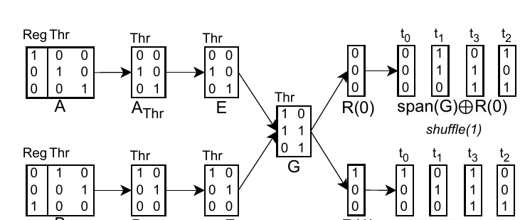
Warp shuffles, step 1: sets V, I, E, F and G
§5.4 · INTRA-WARP DATA EXCHANGE (FIGURE 4)
V = A_Reg ∩ B_Reg
A_Reg = {100}, B_Reg = {001} → V = ∅ → 2⁰ = 1 element per shuffle
I = A_Thr ∩ B_Thr
compare per thread bit: t₀: 010 vs 100, t₁: 001 vs 010 → I = ∅ (paper)
E = A_Thr \ I, F = B_Thr \ I
E = (010, 001), F = (100, 010)
Figure 4 (right half): the matrices of the shuffle construction.
G = { eᵢ ⊕ fᵢ }
g₁
g₂
010 ⊕ 100 = 110, 001 ⊕ 010 = 011
e₀
1
0
span(V ∪ I ∪ G) = elements in shuffle round 1
e₁
1
1
Vectors are element bits [e₀ e₁ e₂] (LSB first); element 0…7.
e₂
0
1
Figure 4 example
G
Source: §5.4 “Intra-warp Data Exchange” and Figure 4, p. 140
Notes:
[~1:00]
If the warp component of B⁻¹ ∘ A is the identity, data can be exchanged with warp shuffles. Assume no broadcasting for simplicity. The paper builds the shuffle schedule from subspaces.
Step 1, vectorization: V is the largest common subset of A_Reg and B_Reg — the register directions shared by both layouts. Each shuffle can move 2^|V| elements, typically up to 32 bits per shuffle on NVIDIA and AMD. In Figure 4, A_Reg = {e0} and B_Reg = {e2}: nothing in common, so V is empty — one element per shuffle.
Step 2: I is A_Thr ∩ B_Thr, the thread directions that do not move. E is A_Thr minus I, F is B_Thr minus I. In Figure 4: A_Thr has columns e1 (for t0) and e2 (for t1); B_Thr has e0 (for t0) and e1 (for t1). The paper states I is empty here; the comparison is per thread bit — t0 maps to e1 in A but e0 in B, t1 to e2 versus e1 — so E keeps both columns of A_Thr and F both columns of B_Thr, exactly as the figure draws them.
Since there is no broadcasting, |E| = |F|. Pair them in order and set G = {e_i ⊕ f_i}: e1 ⊕ e0 = [1,1,0] and e2 ⊕ e1 = [0,1,1]. G spans a subspace in which every element belongs to a different thread of A and a different thread of B — I check that explicitly on the next slide. V ∪ I ∪ G is a basis of the elements taking part in the first shuffle round.

Slide 46
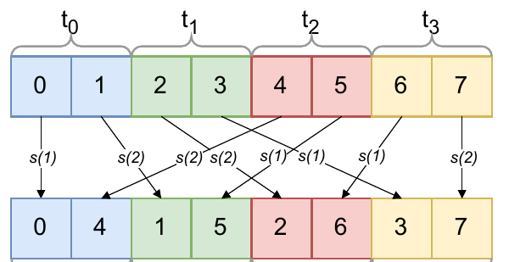
Warp shuffles, step 2: cosets of span(G) are the rounds
§5.4 · INTRA-WARP DATA EXCHANGE (FIGURE 4)
Round 1: {0, 3, 6, 5}
Round 2: {2, 1, 4, 7}
elem | from (A) | to (B)
0 | t0 r0 | t0 r0
3 | t1 r1 | t3 r0
6 | t3 r0 | t2 r1
5 | t2 r1 | t1 r1
elem | from (A) | to (B)
2 | t1 r0 | t2 r0
1 | t0 r1 | t1 r0
4 | t2 r0 | t0 r1
7 | t3 r1 | t3 r1
Figure 4 (left): s(1), s(2) = shuffle rounds.
span(G) = {000, 110, 011, 101} = {0, 3, 6, 5}
R(0) = 000, R(1) = 010 (text) or 100 (figure)
→ same coset, since 010 ⊕ 100 = 110 ∈ span(G)
2^|R| = 2 rounds; each round = one coset
Each round: every thread sends one value and receives one (sources distinct, destinations distinct) → one warp shuffle per round, no shared memory.
Grey = value already in the right thread (only the register changes).
Figure 4 example
Source: §5.4 and Figure 4, p. 140
Notes:
[~1:15]
Step 2 continued: tile the complement. span(G) = {000, 110, 011, 101} = elements 0, 3, 6, 5. Extend V ∪ I ∪ G to a basis of the whole space F2^3; the extension is R. Here one extra vector suffices, so there are 2^|R| = 2 rounds: R(0) = 000 and R(1). Each affine subspace R(i) ⊕ span(V ∪ I ∪ G) contains exactly one vectorized element per thread in both A and B, so it can be exchanged in one shuffle round.
A detail: the paper's text says R(1) = [0,1,0]; the figure draws R(1) = [1,0,0]. Both give the same round, because their XOR, 110, is in span(G) — a coset does not depend on which representative you pick.
Round 1 = span(G) = {0, 3, 6, 5}. Look up each element's source with A⁻¹ and its destination with B⁻¹. Element 0: stays in thread 0. Element 3: thread 1 sends it to thread 3. Element 6: thread 3 → thread 2. Element 5: thread 2 → thread 1. Every thread sends exactly one value and receives exactly one.
Round 2 = R(1) ⊕ span(G) = {2, 1, 4, 7}: thread 1 sends 2 to thread 2, thread 0 sends 1 to thread 1, thread 2 sends 4 to thread 0, thread 3 keeps 7.
Compare with the arrows labelled s(1) and s(2) in Figure 4: they match. Two shuffle rounds instead of a round trip through shared memory — that's the source of Figure 7's conversion speedups. The 4-thread picture generalizes to any power-of-two warp.

Slide 47
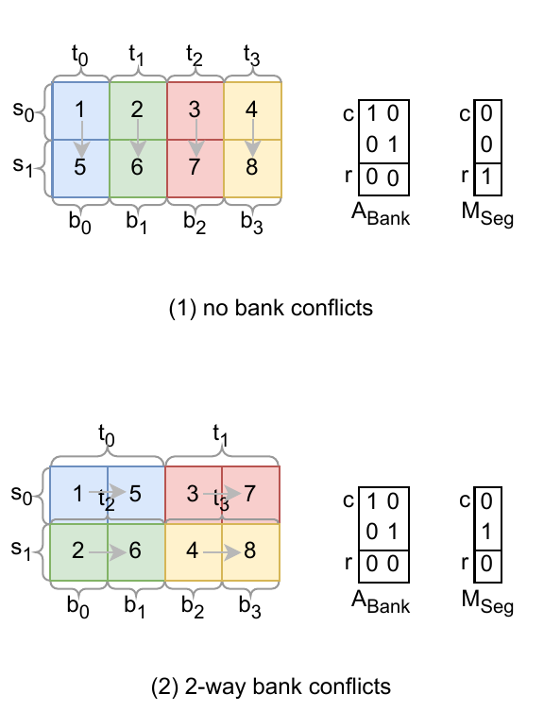
Bank conflicts in the linear-layout language
§5.4 · OPTIMAL SWIZZLING
M : Vec × Bank × Seg → tensor. Same bank, different segment ⇔ logical difference ∈ span(M_Seg).
No bank conflicts ⇔
P ∩ span(M_Seg) = {0}, where P spans what one transaction accesses.
(1) segment bit = r
(2) segment bit = c₁
c₀
c₁
r
c₀
c₁
r
c₀
c₁
r
c₀
c₁
r
1
0
0
0
0
1
1
0
0
0
1
0
0
1
0
M_Seg
0
1
0
M_Seg
A_Bank
A_Bank
span(A_Bank) = {000, 100, 010, 110}
span(M_Seg) = {000, 001}
∩ = {000} → conflict-free ✓
span(A_Bank) = {000, 100, 010, 110}
span(M_Seg) = {000, 010}
∩ = {000, 010} → 2-way conflict ✗
Figure 5 (1) no conflicts, (2) 2-way conflicts.
Vectors written as bits (c₀ c₁ r); A_Bank, M_Seg drawn as rows here for compactness.
Source: §5.4 “Optimal Swizzling” and Figure 5 (1)–(2), pp. 140–141
Notes:
[~0:50]
Shared memory is organized in banks. A bank conflict happens when different threads in the same transaction access different addresses in the same bank — the accesses are serialized. Values stay correct; only performance suffers.
The paper models a shared-memory layout as M from Vec × Bank × Seg to the logical tensor: Vec is the vectorized elements, Bank the bank index inside a segment, Seg the segment index. Figure 5 simplifies to four threads, segments of four banks.
The key observation: two elements land in the same bank of different segments exactly when their logical difference lies in span(M_Seg). Let P be the span of the logical directions accessed together in one transaction. Then the condition for no bank conflicts is P ∩ span(M_Seg) = {0}.
Figure 5 panel (1): the threads in a transaction differ along the column bits c0 and c1 — A_Bank spans {000, 100, 010, 110}. The segment column of M is r, the row bit. The intersection is just zero: no bank conflicts.
Panel (2): the segment column is c1, which is inside the span of A_Bank. So two threads whose elements differ by c1 hit the same bank in different segments: a 2-way conflict — t0 and t2 contend, as do t1 and t3, as the paper says.
So "is this layout conflict-free?" becomes a subspace intersection test.

Slide 48
Apply the test: why j′ = j ⊕ i removes column conflicts
§5.4 · WORKED CHECK
Bank
Seg
o₀
o₁
o₂
o₃
j₀
1
0
0
0
Access | P | span(M_Seg) | P ∩ span(M_Seg) | Result
column 0, unswizzled | {0000, 0010, 0001, 0011} | {0000, 0010, 0001, 0011} | {0000, 0010, 0001, 0011} | 4-way ✗
column 0, swizzled | {0000, 0010, 0001, 0011} | {0000, 1010, 0101, 1111} | {0000} | free ✓
row, swizzled | {0000, 1000, 0100, 1100} | {0000, 1010, 0101, 1111} | {0000} | free ✓
j₁
0
1
0
0
i₀
0
0
1
0
i₁
0
0
0
1
unswizzled M = I
Bank
Seg
o₀
o₁
o₂
o₃
j₀
1
0
1
0
j₁
0
1
0
1
Bits written (j₀ j₁ i₀ i₁). Four threads read one column (differ in i) or one row (differ in j).
i₀
0
0
1
0
Same conclusion as the bank picture in §4.3 — derived from subspace intersections, so the compiler can construct a layout instead of guessing offsets.
i₁
0
0
0
1
swizzled M = [I I; 0 I]
Illustrative example — not the paper’s exact kernel layout
Source: Condition P ∩ span(M_Seg) = {0} from §5.4, p. 140; layouts from the §4.3 bank example
Notes:
[~0:40] (optional — skip if short on time)
Let's apply the subspace test to the bank example from Section 4. Four banks; offset bits o0, o1 select the bank, o2, o3 the segment (the row of memory). Logical bits are (j0, j1, i0, i1).
Four threads read logical column 0, one row each. Their elements differ only in i0, i1, so P = span{i0, i1} = {0000, 0010, 0001, 0011}.
Unswizzled: M is the identity, so M_Seg's columns are i0 and i1. span(M_Seg) equals P — the intersection is all four vectors: 4-way conflict. That matches the picture where column 0 sat in bank 0 four times.
Swizzled with C = I2: M's segment columns are [1,0,1,0] and [0,1,0,1] — o2 now flips both i0 and j0. span(M_Seg) = {0000, 1010, 0101, 1111}. The intersection with P is only 0000: conflict-free.
And row reads, P = span{j0, j1}: the intersection with the swizzled span(M_Seg) is again only zero, so row access stays conflict-free.
This reproduces the earlier picture purely with set algebra — which is what lets the compiler search for a good layout instead of guessing offsets.

Slide 49
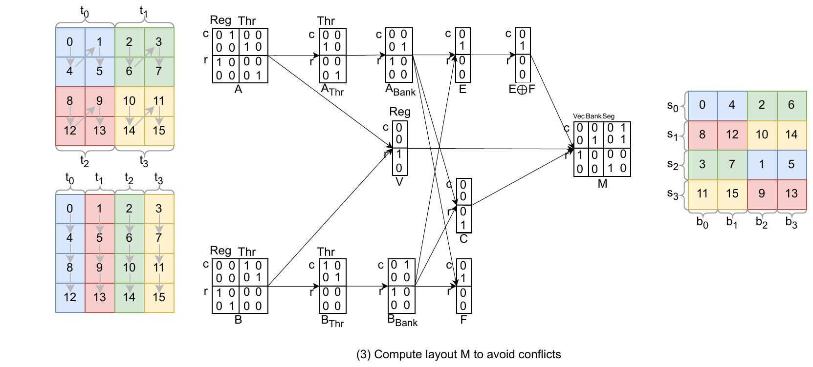
Optimal swizzle, part 1: what must not collide (P)
§5.4 · OPTIMAL SWIZZLING (FIGURE 5 (3))
Reg
Thr
Reg
Thr
reg₀
reg₁
thr₀
thr₁
reg₀
reg₁
thr₀
thr₁
c₀
0
1
0
0
c₀
0
0
1
0
c₁
0
0
1
0
c₁
0
0
0
1
r₀
1
0
0
0
r₀
1
0
0
0
r₁
0
0
0
1
r₁
0
1
0
0
A (writer)
B (reader)
V = A_Reg ∩ B_Reg = {r₀}
Figure 5 (3). Compute layout M to avoid conflicts.
both register bit 0 → element +4: vectors (e, e+4), v = 1
d = 4, b = 1, s = d − v − b = 2
Elements in one transaction differ by a vector in P → segment directions must avoid P.
4 banks per segment = two 2-element vectors per transaction
A_Bank = {c₁}, B_Bank = {c₀}
thread bit shared within one transaction (A: +2, B: +1)
P = span(V ∪ A_Bank) ∪ span(V ∪ B_Bank)
Elements e = 4r + c; bits (c₀ c₁ r₀ r₁). A owns 2×2 blocks (regs 0,4,1,5); B owns columns.
= {0, 4, 2, 6} ∪ {0, 1, 4, 5} = {0, 1, 2, 4, 5, 6}
Figure 5 example
Source: §5.4 “Optimal Swizzling” and Figure 5 (3), pp. 140–141
Notes:
[~0:50]
Now the algorithm that constructs a swizzled layout which maximizes vectorization and minimizes bank conflicts, for two given layouts: we write with A and read with B. This is the paper's Figure 5, panel 3.
Logical tensor: 4 by 4, elements numbered 4r + c, logical bits (c0, c1, r0, r1). Layout A — the writer: register bits point to r0 and c0, thread bits to c1 and r1, so each thread owns a 2 by 2 block, registers in the order 0, 4, 1, 5. Layout B — the reader: register bits r0, r1, thread bits c0, c1: each thread owns a column.
Step 1, vectorization: V is a basis of A_Reg ∩ B_Reg. Both have register bit 0 pointing to r0 — element 4 — so V = {r0}: pairs (e, e+4) are written and read as 2-element vectors. v = 1.
Dimensions: d = 4 logical bits, v = 1 vector bit, b = 1 bank bit in this simplified figure — four banks per segment hold two 2-element vectors — so s = d − v − b = 2 segment bits.
Step 2: A_Bank and B_Bank are the thread directions that share one transaction: two threads per transaction, so one thread bit each. A_Bank = {c1}: threads t0 and t1 of A differ by 2. B_Bank = {c0}: B's threads t0 and t1 differ by 1.
P = span(V ∪ A_Bank) ∪ span(V ∪ B_Bank) = {0, 4, 2, 6} ∪ {0, 1, 4, 5}. Any two elements in one transaction differ by something in P, so the segment directions must avoid P. The figure draws A_Bank and B_Bank together with the Vec column; the span is the same.

Slide 50
Optimal swizzle, part 2: build H, complete with C, assemble M
§5.4 · OPTIMAL SWIZZLING (FIGURE 5 (3))
E = A_Bank \ B_Bank
F = B_Bank \ A_Bank
H = {e ⊕ f}
C (complement of P)
Vec
Bank
Seg
o₀
o₁
o₂
o₃
c₀
0
1
1
0
c₀
0
0
0
1
c₁
1
0
1
0
c₁
0
1
0
1
r₀
0
0
0
0
r₀
1
0
0
0
r₁
0
0
0
1
r₁
0
0
1
0
c₁ (element 2)
c₀ (element 1)
c₀⊕c₁ = 3 ∉ P ✓
r₁ = 8; span{3,8} ∩ P = {0} ✓
M (matches Fig. 5)
|H| + |C| = 2 ≥ s = 2 → M_Seg = {r₁, c₀⊕c₁}; Bank completes the basis → c₁; Vec = r₀
If |H| + |C| < s, conflicts are unavoidable: fill the rest from A_Bank.
Printed figure: F and E⊕F boxes show [0,1,0,0]. The text’s definitions give F = [1,0,0,0], E⊕F = [1,1,0,0] — exactly M’s second Seg column. We follow the text; M is unchanged.
Figure 5 example
Source: §5.4 “Optimal Swizzling” and Figure 5 (3), p. 141
Notes:
[~1:00]
Step 3: E = A_Bank \ B_Bank = {c1}, F = B_Bank \ A_Bank = {c0}. Assume |E| ≤ |F| and pair them: H = {e_i ⊕ f_i} = {c0 ⊕ c1} = [1,1,0,0], element 3. Check: 3 is not in P = {0,1,2,4,5,6}. So H is a segment direction that never puts two elements of one transaction into the same bank.
Step 4: we need s = 2 segment vectors but have only |H| = 1. The paper constructs a basis C of a complementing subspace of P; if |H| + |C| ≥ s, select s vectors from H ∪ C; otherwise bank conflicts are unavoidable and the remaining vectors come from A_Bank. Here C = {r1} (element 8), as in the figure. Check span{3, 8} = {0, 3, 8, 11}: it meets P only in 0. So M_Seg = {r1, c0⊕c1}.
Step 5: complete the columns of M to a basis of F2^4, like the shuffle algorithm. Vec = r0, Seg = r1 and c0⊕c1; the bank column must make it a basis — c1 works (c0 would too). M = [r0 | c1 | r1, c0⊕c1].
A note on the printed figure: its F and E⊕F boxes both show [0,1,0,0]. Applying the text's definitions to the printed A_Bank and B_Bank gives F = [1,0,0,0] and E⊕F = [1,1,0,0] — which is exactly the second Seg column of the printed M. So I follow the text; the final M matches the paper either way. Next slide verifies M against the figure's offset grid.

Slide 51
Optimal swizzle, part 3: check M — vectorized and conflict-free
§5.4 · OPTIMAL SWIZZLING (FIGURE 5 (3))
Offsets from M (Seg × Bank)
# | Reads with B (thread: elements) | banks
1 | t0: 0,4 t1: 1,5 | b0 b1 b2 b3 | ✓
2 | t2: 2,6 t3: 3,7 | b2 b3 b0 b1 | ✓
3 | t0: 8,12 t1: 9,13 | b0 b1 b2 b3 | ✓
4 | t2: 10,14 t3: 11,15 | b2 b3 b0 b1 | ✓
b₀
b₁
b₂
b₃
s₀
0
4
2
6
s₁
8
12
10
14
s₂
3
7
1
5
s₃
11
15
9
13
# | Writes with A (thread: elements) | banks
1 | t0: 0,4 t1: 2,6 | b0 b1 b2 b3 | ✓
2 | t2: 8,12 t3: 10,14 | b0 b1 b2 b3 | ✓
3 | t0: 1,5 t1: 3,7 | b2 b3 b0 b1 | ✓
4 | t2: 9,13 t3: 11,15 | b2 b3 b0 b1 | ✓
= Figure 5’s final grid ✓ Pairs (e, e+4) are adjacent → 2-wide vectors on both sides.
Paper: “t₀ reads 0 (b₀) and 4 (b₁), t₁ reads 1 (b₂) and 5 (b₃); then t₂ reads 2 (b₂), 6 (b₃) and t₃ reads 3 (b₀), 7 (b₁).” ✓ Every transaction touches 4 distinct banks.
Figure 5 example
Source: §5.4, Figure 5 (3) and text, p. 141
Notes:
[~0:40]
Verification. Apply M to every offset: offset bit o0 is Vec, o1 is Bank, o2 and o3 are Seg. This reproduces the grid on the right of Figure 5 exactly: segment 0 holds 0, 4, 2, 6; segment 1 holds 8, 12, 10, 14; segment 2 holds 3, 7, 1, 5; segment 3 holds 11, 15, 9, 13. I asserted this equality in code.
Vectorization: every pair (e, e+4) sits at consecutive offsets, so both layouts read and write 2-element vectors.
Reads with B, as the paper describes: first transaction, t0 reads 0 and 4 from banks b0, b1, and t1 reads 1 and 5 from b2, b3. Second transaction, t2 reads 2 and 6 from b2, b3, and t3 reads 3 and 7 from b0, b1. All four banks distinct in each transaction. The remaining two read transactions — elements 8 to 15 — also hit distinct banks.
Writes with A: t0 writes the pair (0,4) and t1 writes (2,6): banks 0,1 and 2,3. And so on — every write transaction is conflict-free too.
So the constructed M gives maximal vectorization and no bank conflicts for both sides of the conversion. Unswizzled storage, by contrast, would put 0 and 4 four offsets apart: no vectorization at all.

Slide 52
Gather with shuffles: is the axis inside one warp?
§5.5 · OPTIMIZED CODEGEN FOR GATHER
out[i, j] = src[i, index[i, j]]. Shuffle path allowed iff L^axis_Wrp = 0 (axis rows of the warp columns are all zero).
Reg
Lane
Wrp
Reg
Lane
Wrp
r₀
t₀
t₁
t₂
w
r₀
t₀
t₁
t₂
w
axis
j₀
1
0
0
0
0
axis
j₀
1
0
0
0
0
j₁
0
1
0
0
0
j₁
0
1
0
0
0
j₂
0
0
1
0
0
j₂
0
0
0
0
1
i₀
0
0
0
1
0
i₀
0
0
1
0
0
i₁
0
0
0
0
1
i₁
0
0
0
1
0
L (src and index)
L′ (warp bit → j₂)
L^axis_Wrp = [0,0,0]ᵀ → each gathered row lives in one warp → warp shuffles ✓
L′^axis_Wrp = [0,0,1]ᵀ ≠ 0 → a row spans two warps → shared-memory path
Illustrative example — not the paper’s exact kernel layout
Source: §5.5, p. 141; GatherOpToLLVM.cpp isWarpLocal (upstream)
Notes:
[~0:40]
Section 5.5, gather. tl.gather extracts elements from a source tensor along an axis using indices from an index tensor: out[i, j] = src[i, index[i, j]]. Triton's baseline always went through shared memory.
The optimization: if all elements along the axis dimension of src and index reside in the same warp, use warp shuffles. The paper's test: all elements of L^axis_Wrp are zero, where L is the layout of src and index. In matrix terms: take the warp column — or columns — and look only at the rows for the axis bits. All zero means moving along the axis never changes the warp.
Illustrative example: a [4, 8] tensor, gather along axis 1 (j, 3 bits), with a toy warp of 8 lanes and 2 warps. Layout L: register bit → j0, lanes t0, t1 → j1, j2, lane t2 → i0, warp bit → i1. The axis rows j0..j2 of the warp column are 000: warp-local, shuffles allowed.
Layout L': the warp bit points to j2 instead. The axis rows of the warp column contain a 1: the gathered row spans two warps, so shuffles are not enough and the shared-memory path is needed.
The upstream implementation's isWarpLocal check states the same condition in its comments: moving along the gather axis must not change the warp.

Slide 53
Gather with shuffles: from index value to (lane, register)
§5.5 · OPTIMIZED CODEGEN FOR GATHER
pos j | owner (lane, reg) | index | source (lane, reg)
0 | lane 0, r0 | 6 | lane 3, r0
1 | lane 0, r1 | 1 | lane 0, r1
2 | lane 1, r0 | 4 | lane 2, r0
3 | lane 1, r1 | 4 | lane 2, r0
4 | lane 2, r0 | 0 | lane 0, r0
5 | lane 2, r1 | 2 | lane 1, r0
6 | lane 3, r0 | 7 | lane 3, r1
7 | lane 3, r1 | 3 | lane 1, r1
Lowering for one position (pos j = 5)
① read index(pos) = 2
② apply L⁻¹ to (0, 2) → source lane 1, register 0
③ round 0: v₀ = shfl(reg 0, from lane 1)
round 1: v₁ = shfl(reg 1, from lane 1)
④ select v₀ (source register = 0) → store in r₁
Row i = 0 of the toy layout L; index row = [6, 1, 4, 4, 0, 2, 7, 3].
Rounds per position = registers along the axis per thread (here 2). Paper: n = 2^|L^axis_Thr|; its round-i description and the upstream code iterate over source registers.
Fig. 8: up to 14.20× — but gains fall for large gather axes (e.g. [512, 32]) as rounds multiply.
Illustrative example — not the paper’s exact kernel layout
Source: §5.5, p. 141; GatherOpToLLVM.cpp emitWarpLocalGather (upstream); Figure 8, p. 143
Notes:
[~0:45]
The lowering, step by step. For each position pos along the axis: read index(pos), apply L — really its inverse — to find the source register L(index(pos))_Reg and source lane L(index(pos))_Thr. Then perform rounds of warp shuffles: in round i every thread sends its i-th value and receives a value from the source lane; it keeps the received value only if i equals the source register.
Worked, row i = 0 of our toy layout, index row [6, 1, 4, 4, 0, 2, 7, 3]. Take position j = 5: it is owned by lane 2, register 1. index = 2. Element (0, 2) sits in lane 1, register 0. So the destination emits shuffle round 0 — every lane offers its register 0, we read lane 1 — and round 1 — every lane offers register 1, again reading lane 1 — then selects the round-0 value because the source register is 0. The table gives the same for all 8 positions.
Number of rounds: the paper writes n = 2^|L^axis_Thr|. In its own per-round description, round i ships each thread's i-th value, and the current upstream code loops over the source registers per gathered column — here 2 — with one shuffle each, then a select. I follow that enumeration in the example.
That is why Figure 8 shows up to 14.20× speedup, but the gain falls for larger gather dimensions such as [512, 32]: more registers along the axis means more shuffle rounds, which eventually outweighs saving the shared-memory accesses.

Slide 54
Each code-generation question is one F₂ operation
§5 · RECAP
Code-generation question | F₂ operation | Where
How many contiguous elements per thread? | identity prefix of L_Reg⁻¹ | §5.1
Which locations hold duplicates? | zero columns (after Product) | §5.1
Which scale goes with which value (MXFP4)? | compose with a projection (reshape/broadcast) | §5.2
Can one operand be loaded wider? | permute K in both operands (pre-shuffle) | §5.2
Which SIMD / ldmatrix instruction fits? | L = A⁻¹B, then L /ℓ T (P_Reg if needed) | §5.3
Where does each value go in a conversion? | B⁻¹A, right inverse with minimal Hamming weight | §5.4
Which values move in each shuffle round? | V, I, G = {eᵢ ⊕ fᵢ}; cosets of span(V ∪ I ∪ G) | §5.4
Which shared layout avoids bank conflicts? | H = {eᵢ ⊕ fᵢ}, C with span ∩ P = {0}; complete M | §5.4
Can gather use warp shuffles? | L^axis_Wrp = 0 | §5.5
Source: §5.1–§5.5, pp. 138–141
Notes:
[~0:20] (optional — skip if short on time)
A one-slide recap of Section 5, useful for questions. Every code-generation question we saw reduces to one algebraic operation on the layout matrices:
contiguity is the identity prefix of the inverse register map; duplication is zero columns; scale layouts for mixed precision come from composing with a projection; shared-memory instruction selection is A⁻¹B followed by left division by the instruction tile, with register permutations as a fallback; layout conversion is B⁻¹A with a right inverse chosen by the two criteria; warp shuffles come from spans and cosets; optimal swizzling is a subspace-avoidance problem; and gather is a zero test on the warp sub-block.
None of these needs a hand-written rule for a specific pair of layouts — that is the main engineering win of the paper.

Slide 55
Where the ideas live in current upstream Triton
IMPLEMENTATION · TRITON-LANG/TRITON
1
include/triton/Tools/LinearLayout.h
Representation + long explanatory comment: bases, XOR linearity rule, examples (identity, transpose, broadcast, swizzle), why hardware → tensor.
2
lib/Tools/LinearLayout.cpp
Operations: compose, invertAndCompose (B⁻¹∘A), pseudoinvert, divideLeft (Def 4.4), operator* (product), sublayout, removeZeroBasesAlongDim.
3
…/TritonGPU/IR/LinearLayoutConversions.{h,cpp}
Legacy encodings → LL: Blocked = id(reg) × id(lane) × id(warp); NVIDIA MMA, AMD MFMA/WMMA, Slice, swizzled shared.
4
…/TritonGPU/Transforms/RemoveLayoutConversions.cpp
Layout engine: anchors → propagate → resolve conflicts (insert converts) → rewrite → backward rematerialization.
5
python/tutorials/gluon/02-layouts.py
User view: explicit layouts, convert_layout(assert_trivial=True), DistributedLinearLayout(reg_bases, lane_bases, warp_bases…); links the paper.
README.md is mostly install/build help; the header comments and the Gluon tutorial are the explanatory docs.
Source: github.com/triton-lang/triton (main branch, read Oct 2026) — current upstream, not the paper’s exact evaluation revision
Notes:
[~0:40]
The paper's implementation home is the official Triton repository, triton-lang/triton; no separate companion repository is needed. Five places are worth knowing.
1. include/triton/Tools/LinearLayout.h — the representation. Its long comment block is the best written explanation: a linear layout maps a hardware location to a logical tensor index; you only specify the values at power-of-two inputs — the bases — and every other value is the XOR of bases. It walks through examples: identity, zeros, a 2D transpose, a 1D permutation, a broadcast layout, and a swizzled layout (t, w ⊕ t). It also explains why the direction is hardware → tensor: duplicates would make the reverse not a function. It credits the idea to Adam P. Goucher.
2. lib/Tools/LinearLayout.cpp — the operations: compose, invertAndCompose (the B⁻¹ ∘ A of Section 5.4), pseudoinvert, divideLeft (Definition 4.4), the product operator, sublayout and removeZeroBasesAlongDim.
3. LinearLayoutConversions.h and .cpp — converting legacy encodings to linear layouts: BlockedEncodingAttr::toLinearLayout is literally identity for registers times identity for lanes times identity for warps; there are NVIDIA MMA, AMD MFMA/WMMA, slice and shared-memory swizzled conversions.
4. lib/Dialect/TritonGPU/Transforms/RemoveLayoutConversions.cpp — the layout engine: find anchors, propagate, resolve conflicts by inserting convert-layout ops, rewrite, and backward rematerialization.
5. python/tutorials/gluon/02-layouts.py — user-facing: explicit layouts, convert_layout, equivalent layouts, DistributedLinearLayout with reg_bases, lane_bases, warp_bases; it points to LinearLayout.h and to the paper.
The top-level README is mostly installation and build help. And an important caveat: main is actively maintained, so treat this as the current upstream implementation illustrating the design — not a line-for-line snapshot of the revision measured in the paper.

Slide 56
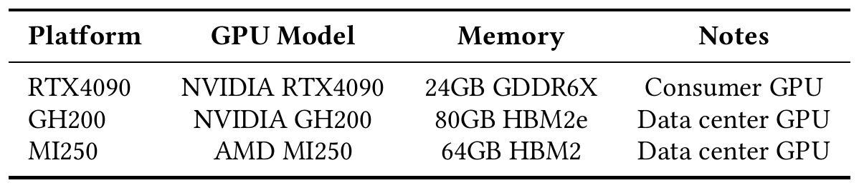
Evaluation setup: three GPUs, micro-benchmarks + TritonBench
§6 · SETUP
Triton-Linear (linear layouts + §5 codegen) vs baseline Triton (legacy layouts, shared-memory conversions).
Micro-benchmarks: 4 warps, 1 CTA (mixed-precision matmul: 4 warps/CTA, varying CTAs).
Each run 10×, median reported.
Real workloads: 21 TritonBench benchmarks, 265 input cases.
Table 2. Hardware platforms evaluated.
Some cases need GH200’s large shared memory or TMA descriptors (absent on RTX 4090 / MI250). A missing case is not a zero speedup.
Source: Table 2 and §6, pp. 141–143
Notes:
[~0:30]
The comparison is Triton-Linear — Triton with linear-layout-based optimizations — against baseline Triton, which uses legacy layouts and always goes through shared memory for conversions.
Three platforms, Table 2: an NVIDIA RTX 4090 with 24 GB GDDR6X, a consumer GPU; an NVIDIA GH200 with 80 GB HBM2e, a data-centre GPU; and an AMD MI250 with 64 GB HBM2, data-centre.
Method: micro-benchmarks use 4 warps and a single CTA, except mixed-precision matmul, which uses 4 warps per CTA and a varying number of CTAs. Each benchmark is repeated 10 times and the median reported. For real workloads: 21 TritonBench benchmarks, 265 input cases in total.
Not every benchmark runs on every platform: some need the large shared memory only GH200 has, some rely on TMA tensor descriptors absent on RTX 4090 and MI250. A missing case is not a zero speedup — it is simply not measured.

Slide 57
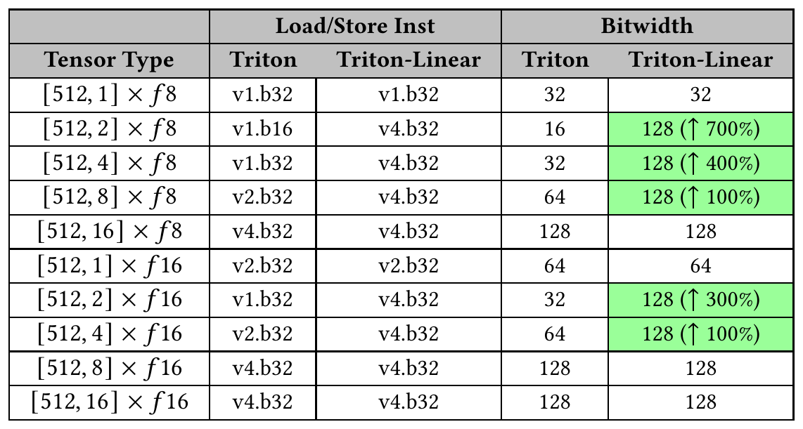
Table 3: up to 128-bit accesses where legacy Triton saw 16
§6.1 · LOAD/STORE CONTIGUITY (§5.1 IN ACTION)
[512,2] × f8: v1.b16 → v4.b32, 16 → 128 bits (8× the width = +700%; the text says “up to 7× increase”).
[512,2] × f16: v1.b32 → v4.b32, 32 → 128 bits (“↑300%”).
Arithmetic note: [512,4] × f8 is 32 → 128 bits, i.e. 4× width = +300%; the table prints “↑400%”. Other labels use “+ increase”.
v4.b32 = four 32-bit units = 128 bits per access; fp8 values are packed inside b32 words. Wider instruction ≠ proportional runtime gain.
Table 3. Load/store instructions and bit widths (paper’s table; highlights added).
Source: Table 3 and “Load/Store Contiguity”, p. 142
Notes:
[~0:45]
Table 3 tests the contiguity utility from Section 5.1: tensors [512, n] with small last dimensions, fp8 and fp16.
Highlighted rows: [512, 2] × f8 goes from v1.b16, 16 bits, to v4.b32, 128 bits — eight times the width; the paper labels it ↑700%. [512, 2] × f16 goes from v1.b32, 32 bits, to 128 bits, labelled ↑300%. Rows where the baseline already reaches 128 bits are unchanged.
Notation: v4.b32 means four 32-bit transfer units — 128 bits in one access; b32 is the transfer width, so fp8 values are packed four per 32-bit unit.
One arithmetic caution I want to flag honestly. The [512, 4] × f8 row goes from 32 to 128 bits and is labelled ↑400%. 32 to 128 is 4× the width, which is a 300% increase over the baseline. The other labels follow the "increase" definition — 16 to 128 is +700%, 32 to 128 for f16 is +300%, 64 to 128 is +100% — so the 400% appears to be a typo in the table. I quote the widths exactly.
The text summarizes this as "up to 7× increase in the bitwidth" — consistent with +700%, i.e. 8 times the original width. The key result is up to 8× wider accesses for [512, 2] × f8 — instruction width, not 8× runtime.

Slide 58
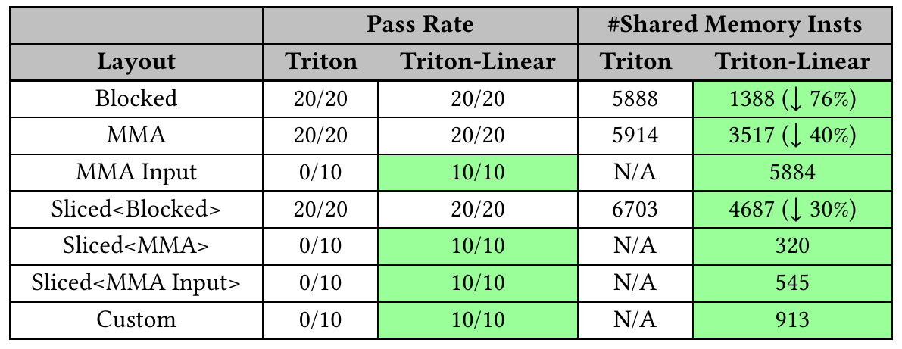
Table 4: every layout now works; far fewer shared-memory ops
§6.1 · BROADCASTING AND REDUCTIONS (§5.1)
0/10 → 10/10
MMA Input, Sliced<MMA>, Sliced<MMA Input>, Custom
↓76%
Blocked: 5888 → 1388 shared-memory instructions
Table 4. Layout support (pass rate) and number of shared-memory instructions.
↓40% / ↓30%
MMA: 5914 → 3517; Sliced<Blocked>: 6703 → 4687
Pass rate = test cases compiling and correct. N/A = baseline failed, no count. Counts are micro-benchmark instruction counts, not runtime.
Source: Table 4 and “Broadcasting”, p. 142
Notes:
[~0:40]
Table 4 tests broadcasting, from Section 5.1: a reduction applied across the most common Triton layouts, on shapes [128,16], [128,128], [32,128], [32,32] and [16,16].
Pass rate counts test cases that compile and produce correct results for each layout. Baseline Triton passes Blocked, MMA and Sliced-of-Blocked, but fails every case for MMA Input, Sliced of MMA, Sliced of MMA Input and a custom layout — 0 out of 10. Triton-Linear passes all of them: 10 out of 10.
Shared-memory instruction counts: Blocked drops from 5888 to 1388, minus 76%; MMA from 5914 to 3517, minus 40%; Sliced-of-Blocked from 6703 to 4687, minus 30%. N/A means the baseline failed, so there is no count to compare.
These counts are for these micro-benchmarks only — 76% fewer shared-memory instructions is not 76% less runtime.

Slide 59
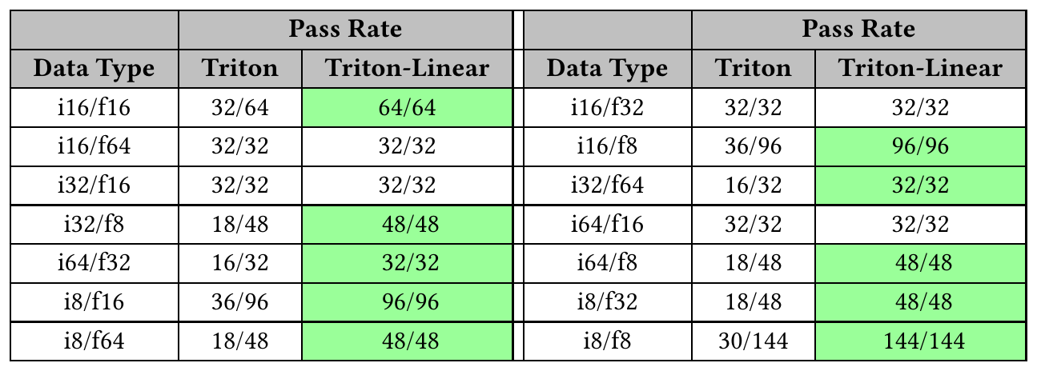
Table 5: from 366/784 to 784/784 mixed-precision cases passing
§6.1 · MIXED-PRECISION MATMUL CORRECTNESS
784 / 784
Triton-Linear (100%)
vs 366 / 784 baseline (46.6%)
Table 5. Pass rate per data-type pair (Triton vs Triton-Linear).
Worst baseline pairs: i8/f8 30/144, i8/f16 36/96, i64/f32 16/32.
Cause (paper): small shapes and low-precision types; no MMA layouts with > 32 consecutive bits in the tile’s last dimension.
14 data-type pairs × shapes = 784 cases. Reported for the paper’s revision.
Source: Table 5 and “Mixed Precision Matmul”, p. 142
Notes:
[~0:40]
Table 5: mixed-precision matrix multiplication correctness. All common data-type pairs in Triton, each tested on a simple matmul kernel across shapes: 14 pairs, 784 cases in total.
Baseline Triton passes 366 of 784 — 46.6%. Triton-Linear passes all 784.
Some pairs were already fine — i16/f64, i32/f16, i64/f16 at 32 of 32. Others were badly broken: i8/f8 passed only 30 of 144, i8/f16 36 of 96, i64/f32 16 of 32.
The paper attributes the failures mainly to small matrix shapes and low-precision types: legacy Triton could not support MMA layouts with more than 32 consecutive bits in the last dimension of the tile. Linear layouts support every valid distributed layout in matrix multiplication.
This is the paper's reported benchmark at its revision — not a guarantee about every current Triton version or every possible type.

Slide 60
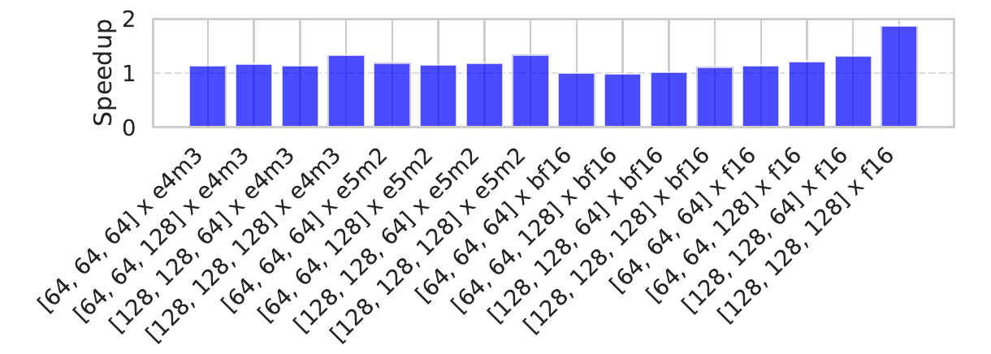
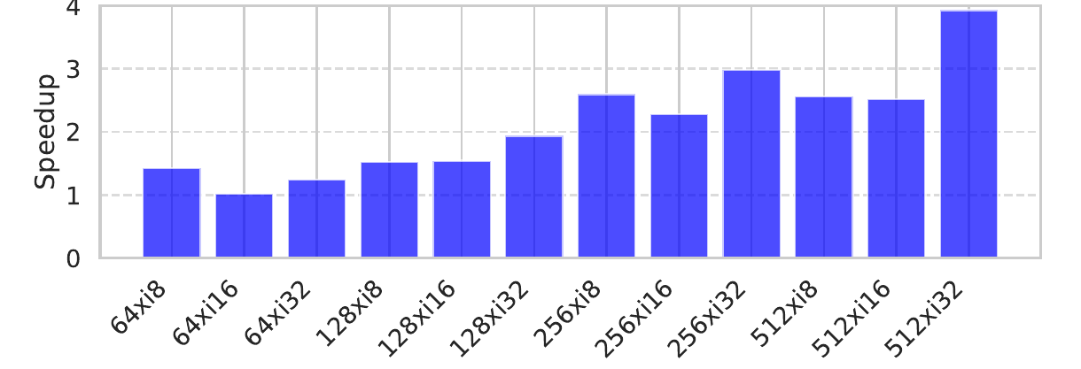
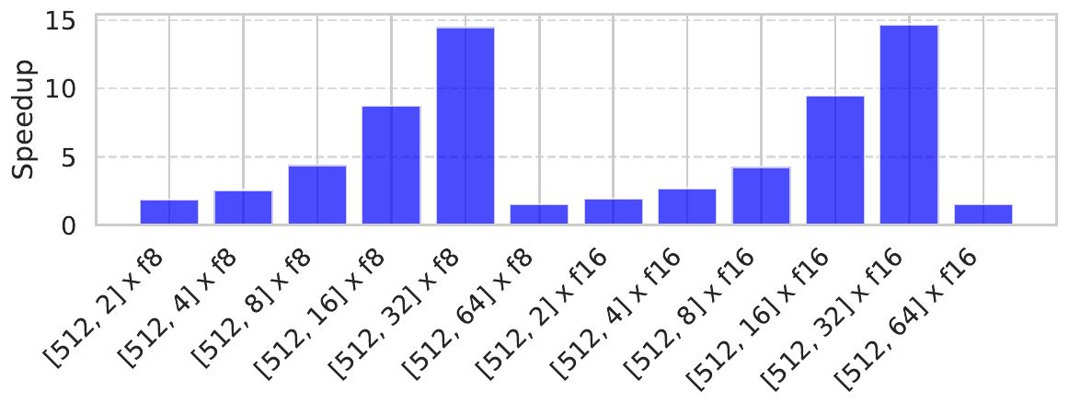
Figures 6–8: mixed precision, conversions, gather
§6.1 · MICRO-BENCHMARK PERFORMANCE (GH200)
Figure 6 · MXFP4 matmul
Figure 7 · layout conversion
Figure 8 · gather
Fig. 6: Up to 1.87× (mxfp4 × f16; baseline also lacked wgmma for f16).
Fig. 7: Up to 3.93×: warp shuffles vs shared-memory round trips.
Fig. 8: Up to 14.20×; drops for large axes ([512,32]) as shuffle rounds grow.
Speedup = baseline ÷ Triton-Linear runtime (> 1 = faster); each figure isolates one operation — not end-to-end.
Source: Figures 6–8 and §6.1 text, pp. 142–143
Notes:
[~1:00]
Three micro-benchmarks on GH200. Speedup is baseline runtime divided by Triton-Linear runtime, so above 1 means Triton-Linear is faster.
Figure 6: MXFP4 matmul with the data-shuffling optimization from Section 5.2 — one operand fixed to mxfp4, the other varied: e4m3, e5m2, bf16, f16. Triton-Linear is consistently faster thanks to higher-throughput vectorized shared-memory instructions; the mxfp4 × f16 series reaches 1.87×, partly because the authors also fixed a baseline issue where Triton did not use wgmma for f16 mixed precision.
Figure 7: layout conversions — this is the warp-shuffle algorithm from Section 5.4, compared with the baseline that always goes through shared memory. Up to 3.93×, growing with tensor size.
Figure 8: gather with warp shuffles from Section 5.5: up to 14.20×. Notice the drop at [512, 32] and [512, 64]: more shuffle rounds outweigh the saved shared-memory accesses.
Keep these maxima separate from end-to-end numbers: they isolate one operation each.

Slide 61
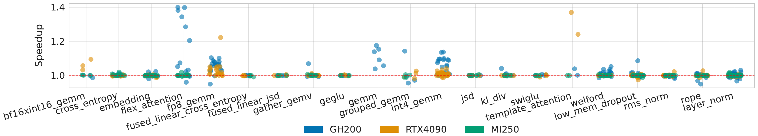
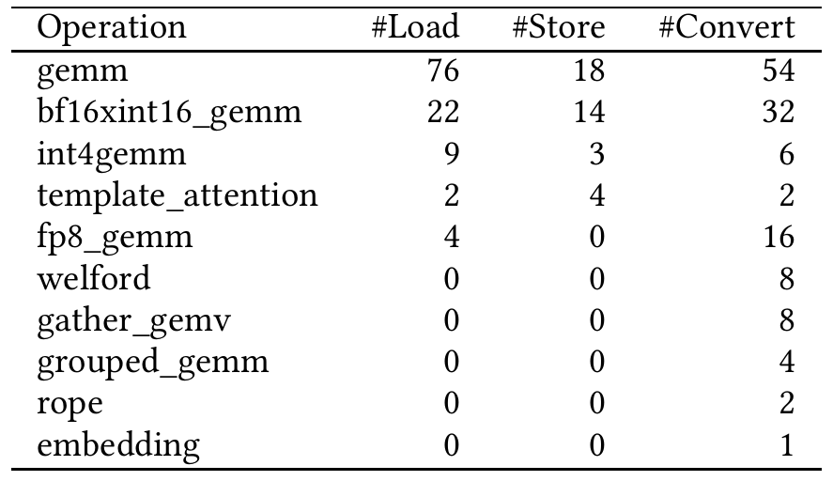
Table 6 and Figure 9: 265 TritonBench cases on three GPUs
§6.2 · REAL BENCHMARKS
Figure 9. Speedups of real benchmarks on RTX 4090, GH200 and MI250 (each dot = one input case).
Table 6: shared-memory loads / stores / converts in TTGIR
GH200
0.96× – 1.40×
int4_gemm, gemm, flex_attention; welford conversion → no-op
RTX 4090
0.97× – 1.37×
template_attention: mma → ldmatrix path
MI250
1.00× – 1.03×
fewer efficient primitives (no ldmatrix)
Source: Table 6, Figure 9 and §6.2, pp. 143–144
Notes:
[~1:00]
Real kernels: 21 TritonBench benchmarks, 265 cases, three GPUs. Figure 9 plots each case as a dot.
GH200: 0.96× to 1.40×. The biggest gains are int4_gemm, gemm and flex_attention, where efficient primitives such as ldmatrix and stmatrix are used in layout conversion and shared-memory traffic. For welford, Triton-Linear detects that a conversion is between equivalent layouts — legacy Triton could not compare, say, Blocked and Sliced — so the conversion becomes a no-op.
RTX 4090: 0.97× to 1.37×. template_attention gains more on the 4090 than on GH200 because of mma versus wgmma: on GH200 wgmma reads the right operand directly from shared memory, so only on the 4090 is it lowered to ldmatrix after the optimizations.
MI250: 1.00× to 1.03×. Smaller gains, which the paper attributes to the lack of efficient primitives such as ldmatrix on AMD in the evaluated implementation.
Below-1.0 cases come mostly from runtime noise on small inputs, per the authors.
Table 6 counts local, i.e. shared-memory, loads, stores and convert_layout operations in the TritonGPU IR for benchmarks where they occur — static IR counts, not dynamic instruction counts. It confirms the benefits come from optimizing exactly these operations: gemm has 76 loads, 18 stores and 54 conversions.

Slide 62
Overall analysis and caveats
§6 · ANALYSIS
Robustness
Code generation
End-to-end
More layouts supported; mixed-precision tests 366/784 → 784/784; reductions on all tested layouts.
Up to 128-bit vector accesses; up to 76% fewer shared-memory instructions; shuffle-based conversion (3.93×) and gather (14.20×).
Average 1.07×, max 1.40× over 265 real cases; varies by GPU and workload.
Amdahl’s law: if 10% of a kernel’s time is in conversions and that part gets 4× faster, the kernel improves by 1 / (0.9 + 0.1/4) ≈ 1.08×. Micro-benchmark maxima ≠ end-to-end speedups.
Caveats: hardware-specific primitives (AMD gains small), platform-dependent benchmark availability, noise on small inputs.
Source: Abstract, §1 and §6, pp. 132–133, 142–144
Notes:
[~0:45]
Three columns to summarise.
Robustness: layouts that legacy Triton could not handle now work — MMA Input, sliced MMA, custom layouts — and mixed-precision correctness goes from 46.6% to 100% of the tested cases.
Code generation: wider vectorized accesses, up to 128 bits; fewer shared-memory instructions; warp-shuffle lowering for conversions and gather instead of shared-memory round trips.
End-to-end: an average of 1.07× and a maximum of 1.40× over the 265 real cases, varying by GPU and workload.
Why are the end-to-end numbers so much smaller than 14.20× or 3.93×? Amdahl's law: a kernel spends only part of its time in layout conversions or gathers. If 10% of the runtime is accelerated 4×, the whole kernel gets about 1.08×. The big numbers are operation-specific micro-benchmarks.
Caveats: results are hardware-specific — AMD gains are small; benchmarks differ by platform availability; some below-1.0 cases are noise on small inputs. And the strongest argument for the paper is arguably robustness and engineering simplicity, with the performance as a bonus.

Slide 63
Conclusion and limitations
§8 · CONCLUSIONS
Represent layouts as linear maps over F₂ (hardware bits → coordinate bits).
Compose / invert / divide maps to derive conversions instead of hand-writing pairs.
Lower to register permutations, warp shuffles, vectorized accesses, ldmatrix/stmatrix, swizzled shared memory.
Result: stronger layout coverage and robustness, plus measurable speedups.
Limitations (paper)
Power-of-two shapes only; workaround: larger tensors + masking out-of-bounds elements.
Flips and slices are not y = Ax; captured by affine layouts y = Ax ⊕ b.
Future: combine with hardware measurements in a performance model for autotuning.
Example: flipping 8 elements, e → 7 − e, is e → e ⊕ 111: affine (b = 111), not linear (it moves 0).
Source: §8 Conclusions, p. 144
Notes:
[~0:45]
To conclude. Linear layouts represent layouts as linear maps over F2: hardware bits to tensor-coordinate bits. Because they are matrices, layouts compose, invert and divide, so conversions are derived rather than hand-written. The derived maps lower to concrete hardware mechanisms: register renaming, warp shuffles, wide vector accesses, ldmatrix and stmatrix, and swizzled shared-memory layouts constructed to avoid bank conflicts. The paper calls this the first theoretical foundation and implementation for resource mapping between complex hardware and logical tensors, with completeness under Triton's shape operators.
The results: much better layout coverage and robustness, plus measurable performance gains.
Limitations, as stated by the authors: the restriction to power-of-two shapes — mitigated by defining larger tensors and masking out-of-bounds elements. Operations such as flipping and slicing are not expressible as y = Ax, but can be captured by the simple extension to affine layouts, y = Ax ⊕ b. Future work: integrate linear layouts with hardware measurements into a performance model for autotuning.
The paper's baseline discussion should not be read as saying current implementations have no extensions beyond it.

Slide 64
Questions?
Thank you
1
0
0
0
0
0
0
0
0
0
1
0
0
0
0
0
0
0
0
1
0
0
0
0
0
0
0
0
1
0
0
0
0
1
0
0
0
0
0
0
0
0
0
0
0
1
0
0
0
0
0
0
0
0
1
0
0
0
0
0
0
0
0
1
Paper: https://doi.org/10.1145/3760250.3762221
arXiv: https://arxiv.org/abs/2505.23819
Code: https://github.com/triton-lang/triton
Notes:
[~5:00] Q&A.
Likely questions and short answers:
- Why hardware → tensor and not the reverse? Duplicates make the reverse not a function; right inverses pick one preimage when needed.
- Non-power-of-two shapes? Pad to a power of two and mask (paper's stated workaround); LinearLayout.h also notes LLs cannot represent padded layouts.
- How does this compare to CuTe? Paper §7: CuTe is a user-facing layout algebra; linear layouts are integrated into the compiler, labelled, include swizzling as part of the layout, and enable automatic conversion/codegen. LinearLayout.h has a similar comparison.
- Is anything solved at runtime? No — all matrix work is compile-time; runtime executes generated loads/shuffles/stores (index math is XOR/shift).
- Why are end-to-end gains small? Amdahl: conversions are a fraction of kernel time; AMD lacks ldmatrix-like primitives in the evaluated implementation.

Slide 65
Sources
REFERENCES
K. Zhou, M. Lezcano-Casado, A. P. Goucher, A. Rakhmati, J. Niu, J. Lebar, P. Szczerbuk, P. Bell, P. Tillet, T. Raoux, Z. Moudallal. Linear Layouts: Robust Code Generation of Efficient Tensor Computation Using F₂. ASPLOS ’26. DOI 10.1145/3760250.3762221 · arXiv 2505.23819
Triton repository: github.com/triton-lang/triton (README: installation/build)
include/triton/Tools/LinearLayout.h — representation and in-source explanation
lib/Tools/LinearLayout.cpp — composition, inversion, division, product
include/…/TritonGPU/IR/LinearLayoutConversions.h and lib/…/LinearLayoutConversions.cpp — legacy encodings → linear layouts
lib/Dialect/TritonGPU/Transforms/RemoveLayoutConversions.cpp — layout propagation and rematerialization
lib/Conversion/TritonGPUToLLVM/GatherOpToLLVM.cpp — warp-local gather lowering
python/tutorials/gluon/02-layouts.py — Gluon layout tutorial; docs/index.rst — documentation index
NVIDIA PTX ISA — mma.m16n8k16 fragment layouts (used for illustrative MMA examples)
Source code read from the current main branch (Oct 2026); it may differ from the paper’s evaluated revision.
Notes:
[not presented] Reference slide for readers of the deck.

