Slide 1

Making a resume using RMarkdown
Or: mucking around and see what I can create

Slide 2



Slide 3


Slide 4
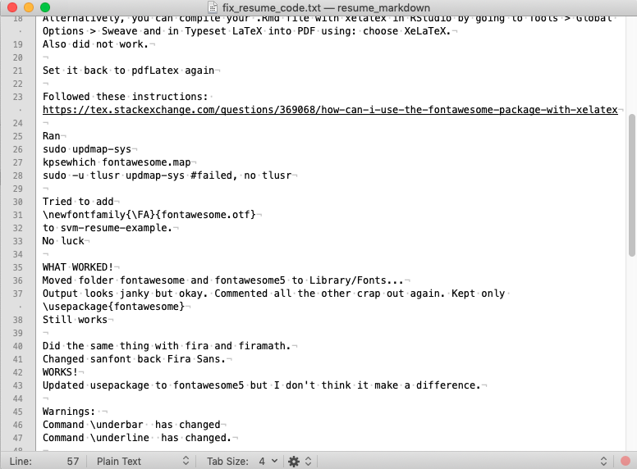
One of my habits - notes

Slide 5

Rmarkdown basics
It can create static and dynamic outputs:
HTML
pdf
MS Word documents
Books
Shiny applications
Websites
etc
Rmarkdown
A way to create documents that include code, outputs and regular text
https://vimeo.com/178485416
Notes:
Write code in an Rmarkdown file, click/use knitr, which converts the document to markdown, then pandoc converts it to any other document type you want (pandoc also includes a system for automatic citations and bibliographies!)

Slide 6
To get started
Install “rmarkdown”
Go to File -> New File -> R Markdown
Choose what you want to create, and the type of output
You will now see a template with:
A YAML header (YAML = Yet Another Markup Language)
R code surrounded by ``` (“chunks”)
Text with simple text formatting (markdown)

Slide 7
A few links for further reading
Rmarkdown introduction: https://rmarkdown.rstudio.com/lesson-1.html
markdown: https://www.markdownguide.org/getting-started/
pandoc: https://pandoc.org/
“R Markdown: The Definitive Guide”: https://bookdown.org/yihui/rmarkdown/

Slide 8
So I got started…
I started off with googling (of course) and found Steve Miller’s templates: http://svmiller.com/stevetemplates/
So I went ahead and installed the package, found the original code for the example, and tried to recreate the resume with some of my information (http://svmiller.com/blog/2020/09/rmarkdown-template-non-academic-resume/)

Slide 9
It did not go well…
I ran into lots of issues – mostly related to using certain fonts, using fontawesome and compiling the LaTex file.
Changed the font (after unsuccessfully trying to update a font package)
Managed to get fontawesome to work (we’ll get back to that)
Tried installing the recommended LaTex version (XeLaTeX)
Tried updating LaTex as per the Rmarkdown book (tinytex)
Despite getting an output, I kept getting errors about compiling…

Slide 10
Changing gears…
I had now spent considerable time on troubleshooting, but was running out of steam
The big issue is / was that I do not know LaTex and I was not in a place where I could spend considerable time learning it
I was probably also doing something wrong with using the package; but I could not figure out from the website and repo what
So – different option!

Slide 11
Another template
Files -> New File -> R Markdown -> From Template -> HTML resume (comes with the “pagedown” package)

Slide 12
Customization
Involved using HTML and CSS…
HTML, “HyperText Markup Language”, makes up web pages and online application. It determines the style and structure of a document:
Headings, paragraphs, links
Sections
Images
Browsers use HTML to interpret the content of a page
CSS, “Cascading Style Sheets”, defines the look and layout of the content

Slide 13
Customization
I looked up the original html and css files with the resume template:
pagedown/inst/resources/css/resume.css
pagedown/inst/resources/html/resume.html
I created a new css file to customize things for my resume:
resume_klarenberg_additions.css

Slide 14
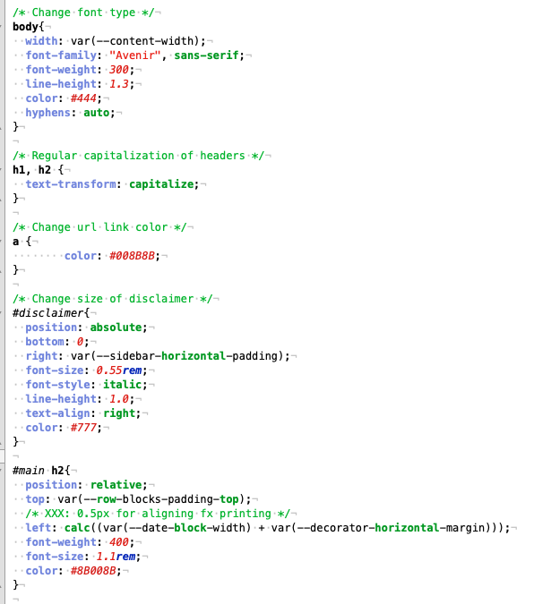
The css file
- changed font
- changed header from all capitals to regular capitalized
- changed url link color to purple (for colors, just google css colors)
- Moved text under education closer together: remove data-concise = true in the Rmarkdown
Used part of the original as a template (and google)
Edit in a text editor (I use TextMate or Sublime Text)
Literally just trial-and-error-ed it

Slide 15
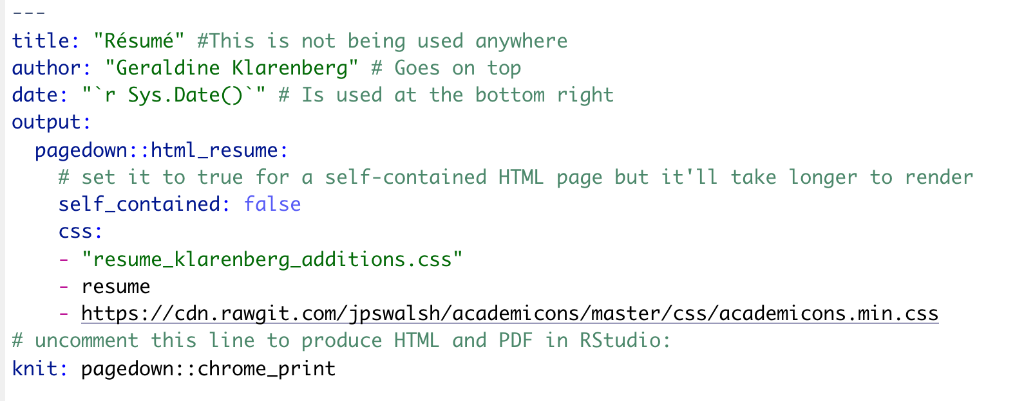
Added css file in the YAML header
As well as: https://cdn.rawgit.com/jpswalsh/academicons/master/css/academicons.min.css

Slide 16

Academic icons!
https://jpswalsh.github.io/academicons/

Slide 17
Icons
Use fontawesome; https://fontawesome.com/v5/search
I had to download (and update) this package (https://fontawesome.com/kits/c5710c4819/use)
I got it working by moving the folders fontawesome and fontawesome5 to Library/Fonts (I use a Mac)
The resume template in the GitHub repo has some commented out code that might work for others. This also involves an html file (“myheader.html”), which is also available in the repo – but is not used in the current version of the resume

Slide 18
Let’s have a look at the .Rmd file
Grey bar
Headers
HTML to add links to webpages, and add icons
Main document (body)

Slide 19
More resources
HTML: https://www.w3schools.com/html/default.asp
CSS: https://www.w3schools.com/css/default.asp
https://towardsdatascience.com/create-your-resume-with-pagedown-package-in-r-123ca6310d52

