Slide 1
Intro to R & rstudio
Rladies gainesville

Slide 2
What is R?
Resource link: https://www.r-project.org/about.html
Notes:
Think combination of Microsoft tools
Statistical software: spss, sas, matlab
Visualization tool: publication quality figures

Slide 3
What is R?
“R is a language and environment for statistical computing and graphics”
Data manipulation, calculation and graphical display
Includes conditionals, loops, user-defined recursive functions
Allows the user to add functionality by defining new functions
Links to C, C++ and Fortran code
Extensions via packages

Slide 4
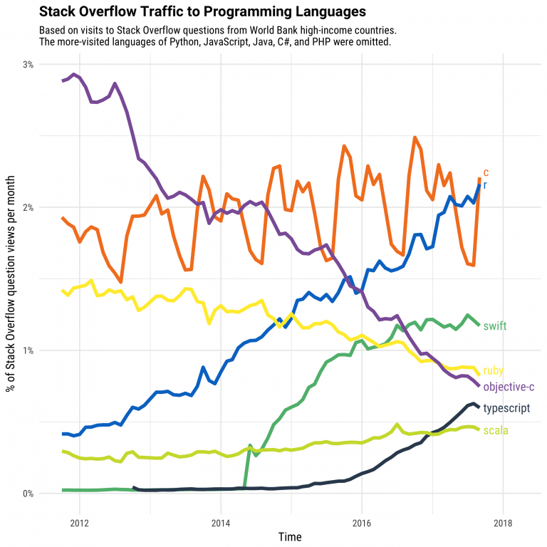
Why learn R?
Growth https://stackoverflow.blog/2017/10/10/impressive-growth-r/
Reproducibility
Keeping up with the field
Communicate with others
Notes:
Emphasize the communication part. You may not become a quantitative ecologist, but it is always helpful to know how to communicate with one.
Also, click the link on the website to show the other figures that show academic as being a big area.

Slide 5
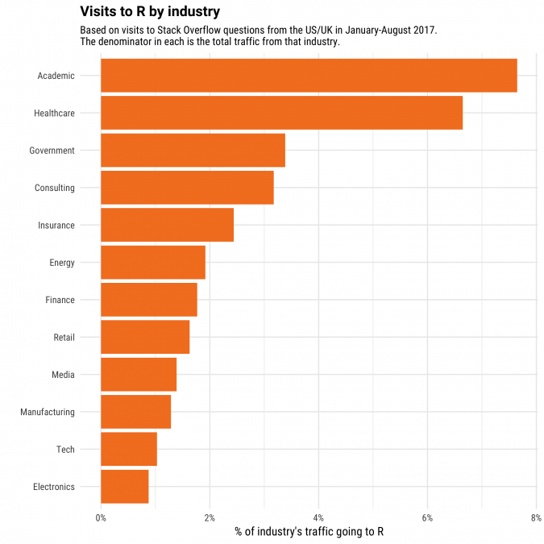
https://stackoverflow.blog/2017/10/10/impressive-growth-r/

Slide 6
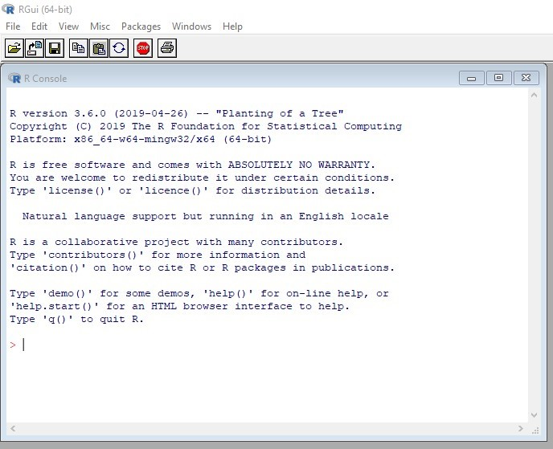

This Photo by Unknown Author is licensed under CC BY-SA

Slide 7
What is r studio?
Notes:
Here, go to demo. Show the different panes.

Slide 8
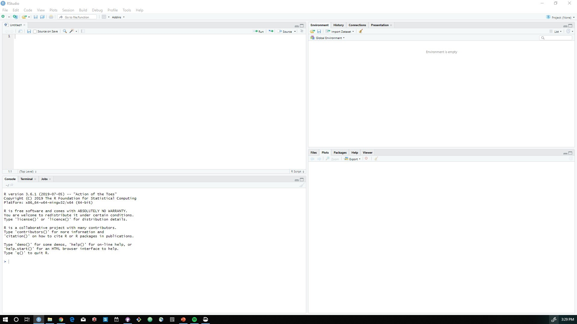
https://rstudio.com/products/rstudio/features/

Slide 9
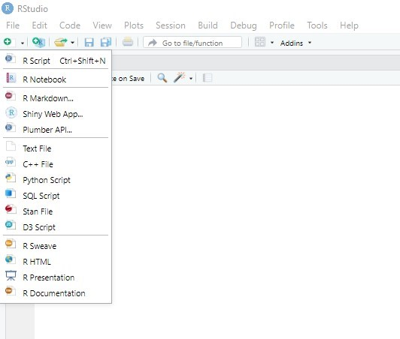

Slide 10
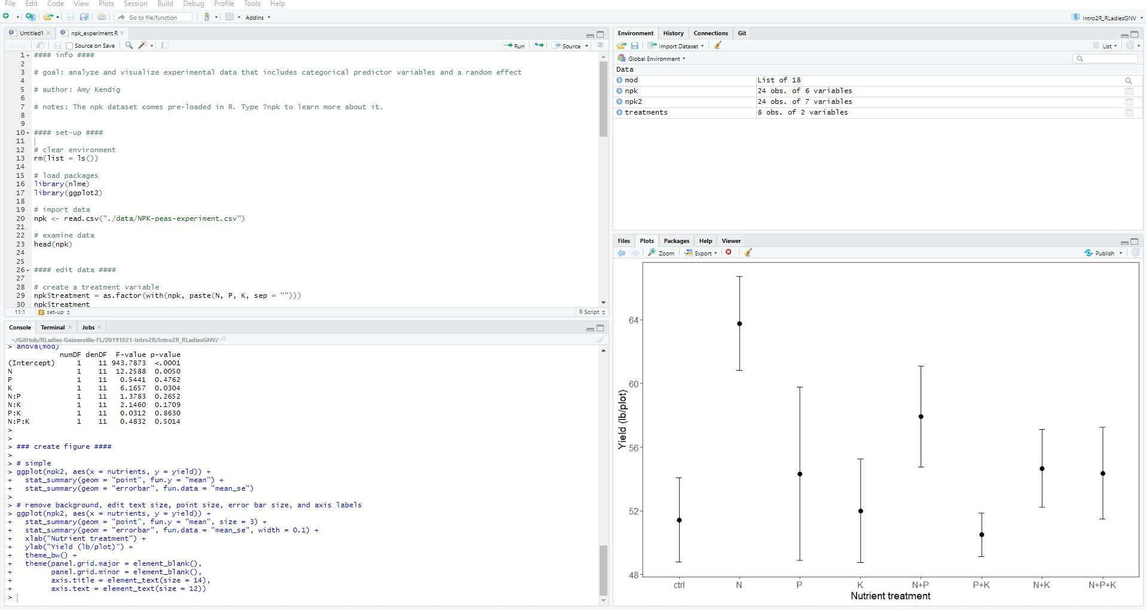

Slide 11
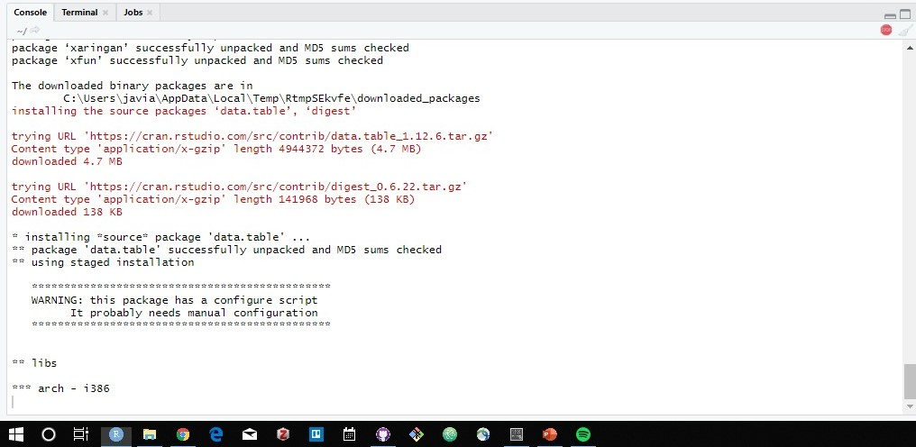

Slide 12
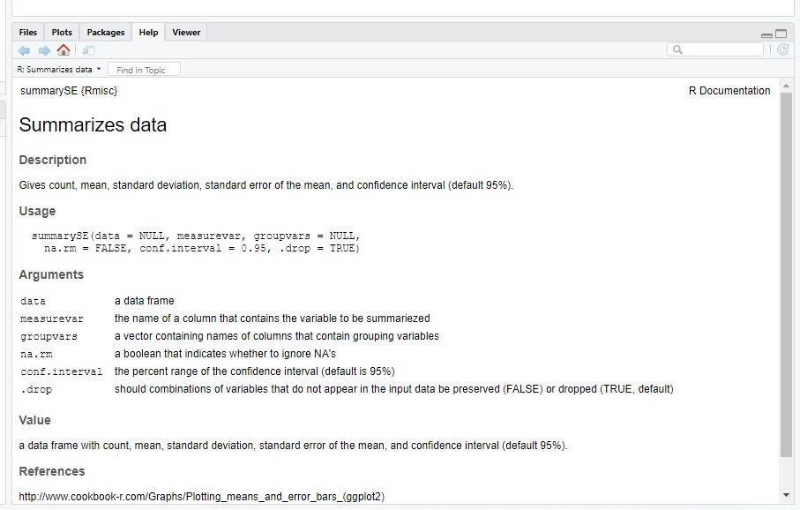

Slide 13
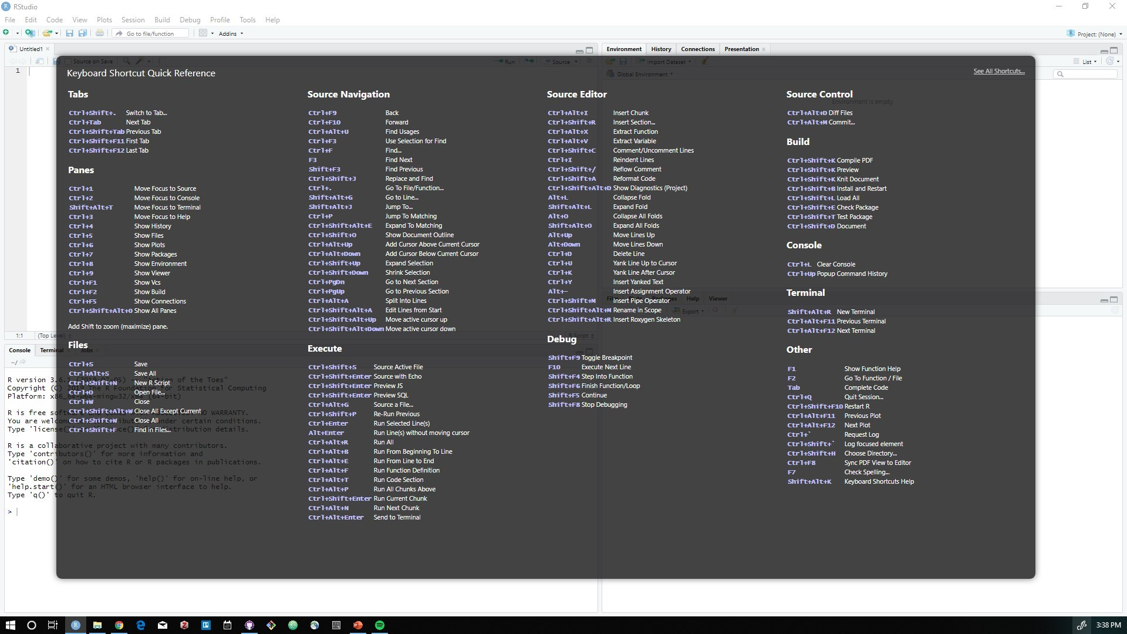
Tools -> Keyboard shortcuts

Slide 14
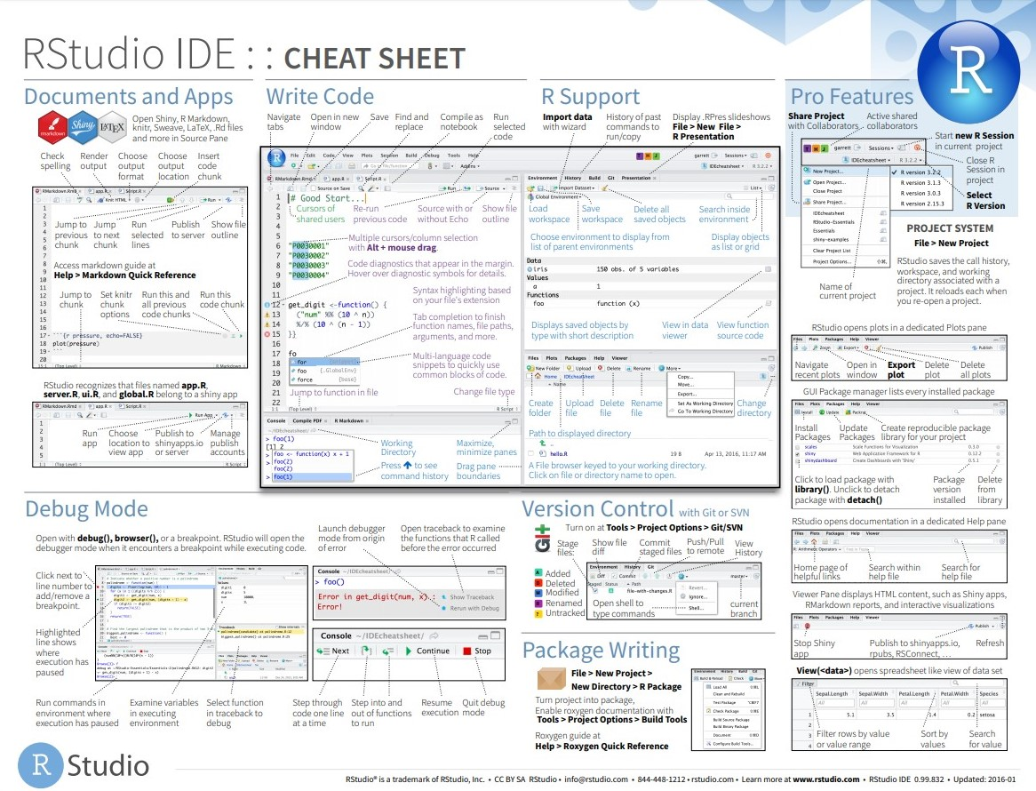

Slide 15
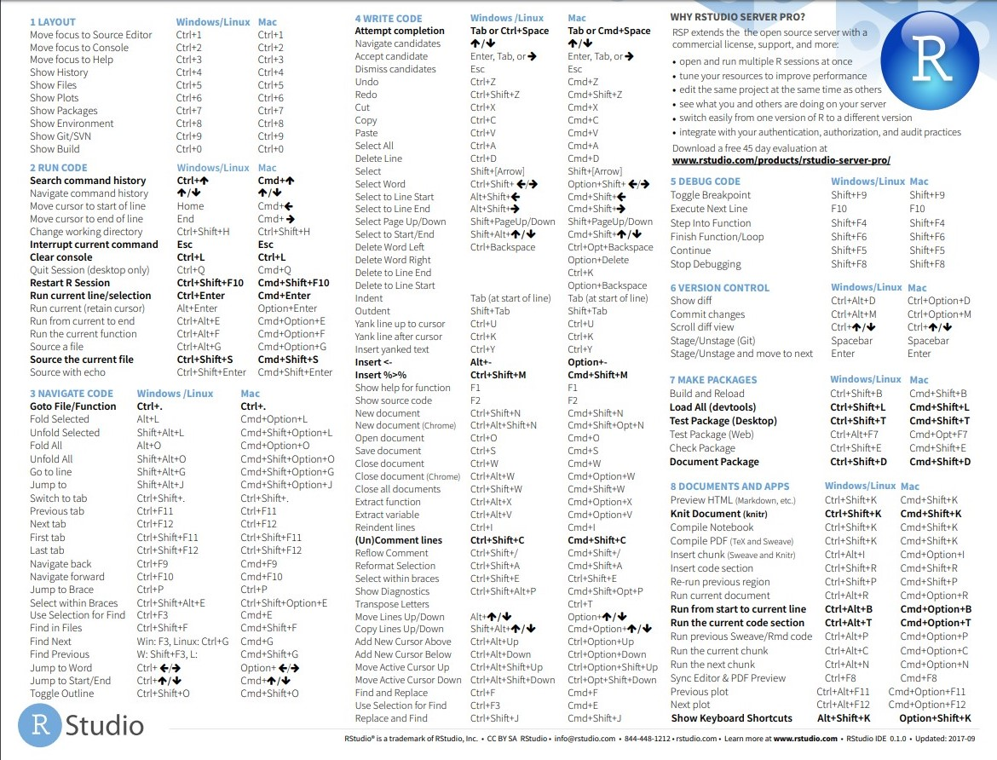

Slide 16
Useful concepts
What is a script?
Any file that has the extension .R
What is a directory?
A location in your computer’s system of files
What is the working directory?
The folder in your computer where you are currently working and where files will be saved and accessed from.
How do you set your working directory?
Session > Set working directory > choose directory
Using projects (like the one we will be using today)
What is a library? What is a package?
A package is the bundle of functions you can install. You load these packages using the library() function.

Slide 17
Scalars, vectors, matrices and lists
Scalars: a single number
Vector: a row of numbers
Matrix: two-dimensional array of numbers
Data frame: like a matrix but with names at the top of columns
Lists: a collection of vectors, matrices or dataframes
lists

Slide 18
Resources:
https://datacarpentry.org/R-ecology-lesson/index.html
https://cran.r-project.org/doc/contrib/Torfs+Brauer-Short-R-Intro.pdf
https://www.rstudio.com/resources/cheatsheets/
https://resources.rstudio.com/webinars
https://datacarpentry.org/
https://stackoverflow.com/questions
https://www.r-bloggers.com/
https://training.it.ufl.edu/linkedin/ UF courses to learn R

Slide 19
Navigate
https://tinyurl.com/Intro2R-RLadiesGNV
Move
downloaded folder to your desktop
Click
Intro2R_RLadiesGNV.Rproj
Accessing materials

Slide 20

Feedback
Green sticky note
Place on the top of your computer to indicate that you’ve completed a task and you don’t have any questions.
~ At the end of the lesson, write one thing that worked for you ~
Pink sticky note
Place on the top of your computer when you need help or have a question.
~ At the end of the lesson, write one thing that could be improved ~

