Slide 1
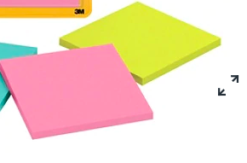
Feedback
Green sticky note
Place on the top of your computer to indicate that you’ve completed a task and you don’t have any questions.
~ At the end of the lesson, write one thing that worked for you ~
Pink sticky note
Place on the top of your computer when you need help or have a question.
~ At the end of the lesson, write one thing that could be improved ~

