Slide 1
flexdashboard
Easy interactive dashboards for R Kaushik Lakshman

Slide 2
Motivation
Journey to discovering flexdashboard
What is flexdashboard’s place in data science?
Introduction to the package

Slide 3
The Data Science Venn Diagram
Computer Science – Programming, Data Engg, Data Ingestion etc
Mathematics – Probability, Statistics, Machine Learning
Communication – Domain knowledge, visualisations, end user products

Slide 4
Journey towards flexdashboard
Exploratory Analysis
Understanding Problem -> Data Wrangling -> Analysis -> Visualisations -> Pitch back to business/end users
Putting things back into power point was double work & inconvenient
R Markdown output did the job, but it felt more like an academic report – not the most convenient for business users
Operational Models
Data Ingestion -> Data Wrangling -> Feature Engineering -> Predictive Model -> Delivery to business/end user
Result Tracking needed on periodical basis again – Rmarkdown once again did the job, but wasn’t crisp enough
Existing Options like Tableau/Qlik
Cost and effort involved in setting up, licenses etc.
Code portability across systems
Enter - flexdashboard

Slide 5
What is flexdashboard?
R Package (Thanks RStudio!) designed to produce simple, flexible, elegant dashboards easily
Underlying structure using R Markdown
Use markdown to describe boxes and space division to specify layout
Specify content to fill these boxes
Create combinations of boxes and set them into rows or columns
Go one level higher by putting colums/rows into tabs and pages
Layout adjusts automatically based on browser/mobile etc
All R Graphics (including HTML Widgets) can be included
Ggplot2, knitr kable etc can all go into boxes
Interactive HTML Widgets (plotly, leaflet etc) also can be used in static host end products (html files)
Interactivity allowed with Shiny commands
Needs to be deployed on a shiny server
Difference with shinydashboard – simplicity v complexity but constraints v flexibility

Slide 6
Getting started
What flex dashboards look like?
How to get started in building them

Slide 7
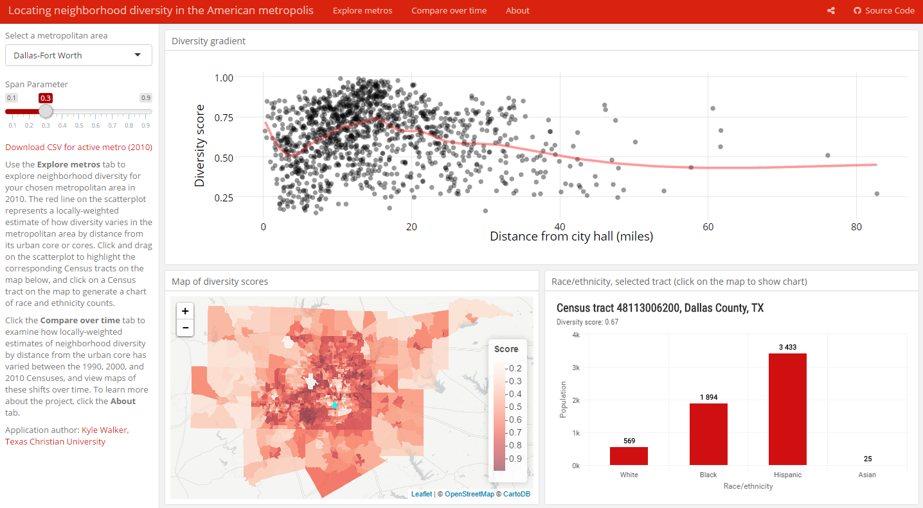
An example flexdashboard

Slide 8

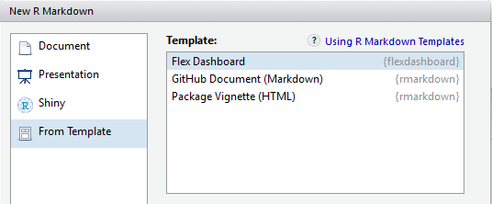
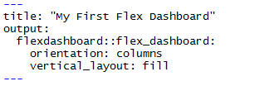
Building our first flexdashboard
1. Install the package from CRAN
2. New R Markdown -> From Template
3. YAML Header (just like R Markdown)
4. Specify layouts or orientations
rows or columns
tabset
fill or scroll

Slide 9
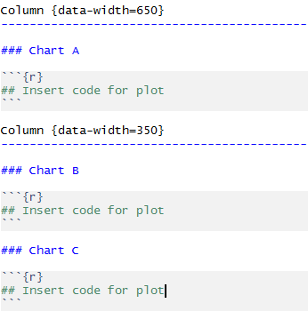
Building our first flexdashboard
5. Specify content using markdown headers
======= for pages
----------- for columns
### for boxes
*** for storyboards
> for text notes
6. Code and Content
Text after ### is title of the box
Code inside R chunk produces output in that box
Text outside code chunks appears as plain text

Slide 10
Layouts
What are the different layouts available?
Whare are the reasons for using them and why?
Syntax and usage of layouts

Slide 11

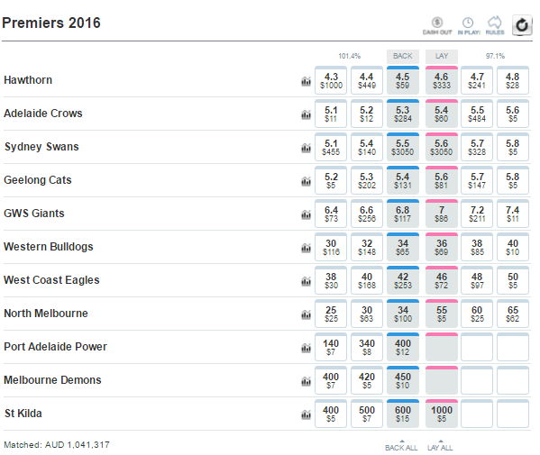
Introduction to Betfair
What’s Betfair?
World’s largest betting exchange
You don’t bet against the house – but against other users of the platform
Absolutely fascinating data sets – which we will see a bit of in this presentation
Terms and definitions
Back Bet – Betting for an outcome (I back Hawthorn to win the 2016 AFL)
Lay Bet – Betting against an outcome (I lay Hawthorn or I bet against Hawthorn to win the 2016 AFL)
Odds – Ratio of payout amount to original stake (If I bet $10 on Hawthorn at odds 4.5, I receive $45 when they win the 2016 AFL)
Implied Probability – Likelihood of an event occurring (If the odds of Hawthorn winning is 4.5, the probability of the outcome is 1/4.5 = 0.22)
Turnover/Matched Volume – Total amount of money staked in a market (The AFL market has ~$1m matched volume)
Overround – Sum of all implied probabilities in a given market (Margin or Inefficiency of a market is how much this number is over 100%)

Slide 12
Layouts – The Brexit Dashboard
What is Brexit? - The United Kingdom European Union membership referendum, known within the United Kingdom as the EU referendum and the Brexit referendum, was a non-binding referendum that took place on Thursday 23 June 2016 in the UK and Gibraltar to gauge support for the country's continued membership in the European Union. The referendum resulted in an overall vote to leave the EU, by 51.9%
Multiple ways to follow the event, its reactions, implications etc. One such way to do so – Brexit Betfair Market
Brexit Market was Betfair’s largest ever market in terms of money traded (~ A$200m)
Odds and weight of money reflect public opinion (Odds = 1/Probability) as well as other proxies – Stock market; news reports; tweets; currency rates etc.

Slide 13
Layouts – The Brexit Dashboard
Story 1 – Odds of Vote Leave vs Vote Remain prior to the day of the vote
Vote Remain was the favourite, never having an implied probability < 0.5
Odds slightly varied but remained largely constant for nearly 12 months
Story 2 – Odds of Vote Leave vs Vote Remain on the day of the vote, as results were being announced
As the votes were being counted, the implied probability of Vote Remain started dropping
For a couple of hours, both Vote Remain and Vote Leave alternated being in the lead
Ultimately Vote Leave moved close to an implied probability of 1
Story 3 – A funny and cheeky consequence of the GBP dropping and its effect on AUD
As the GBP started dropping in value, even though more money was coming into the market, the total matched volume figure displayed in AUD was reducing

Slide 14
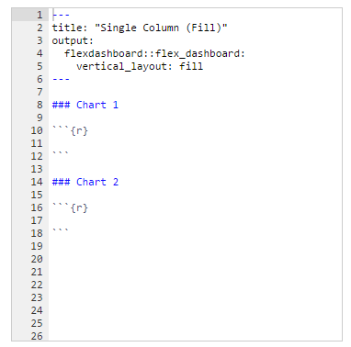
Rows, Columns and Tabsets
Specify if you want a column layout or a row layout using the YAML header section and orientation tag
Specify if you want fill or scroll layout
All visualisations fit into screen with fill (preferable for fewer visualisations)
All visualisations occupy natural heights and have browser scrolls when space is needed
Single Column Fill

Slide 15
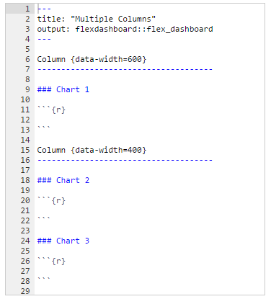
Rows, Columns and Tabsets
Specify if you want a column layout or a row layout using the YAML header section and orientation tag
Specify if you want fill or scroll layout
All visualisations fit into screen with fill (preferable for fewer visualisations)
All visualisations occupy natural heights and have browser scrolls when space is needed
Multiple Column

Slide 16
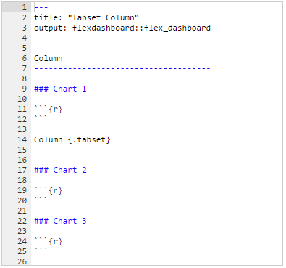
Rows, Columns and Tabsets
Specify if you want a column layout or a row layout using the YAML header section and orientation tag
Specify if you want fill or scroll layout
All visualisations fit into screen with fill (preferable for fewer visualisations)
All visualisations occupy natural heights and have browser scrolls when space is needed
Tabset

Slide 17
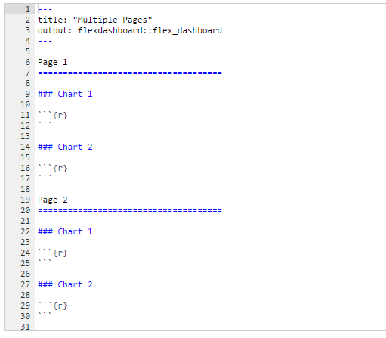
Pages and Storyboards
For multiple pages use level 1 markdown header (====)
Pages take the orientation of the document by default but it can be overridden by {data-orientation}
Flexibility to create unique navigation bar if you don’t want default property of each page getting a tab
Pages

Slide 18
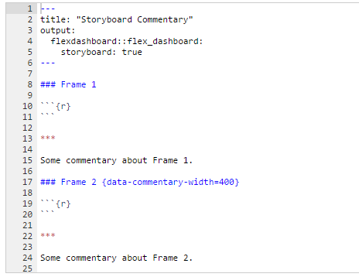
Pages and Storyboards
Storyboards are alternatives to row/column format
Each dashboard component gets its own frame
Level 3 markdown header (###) section title will be used as navigation caption
Commentary alongside frame using ***
Storyboards

Slide 19
Components
What are the different components available?
Basic components, interactive components and how to use them

Slide 20
Components – Sports on Betfair Dashboard
Australia loves its sports.
There is some sport on all year round, and different people enjoy different types of sports.
Different sports have different characteristics – Speed, scoring, duration, season etc.
One perspective of observing these differences is through betting (in our case – Betfair) data
Is there seasonality involved in sporting events?
Are some events more important than others and do they generate more interest?
Do people from different parts of the country prefer different sports?
Does length of a game/match impact how much interest there is in sports?
Story 1 – Time Series plot to get a glance at seasonality in different sports
Story 2 – Geo Spatial mapping to get a glance of where customers interested in different sports come from
Story 3 – How are patterns different between betting on matches pre-play (before the start of the game/match) or in-play (during the course of the game/match)?
Dashboard built to tell these stories highlighting the variety of static interactive components available that can be used apart from the regular R components like base plots, ggplot, kable and so on.

Slide 21
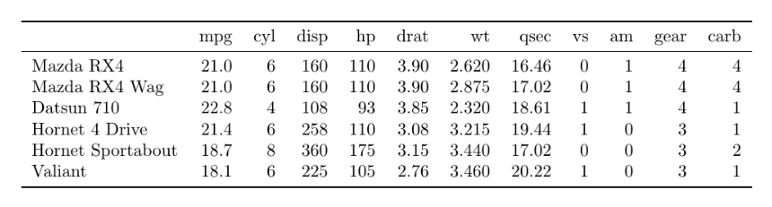

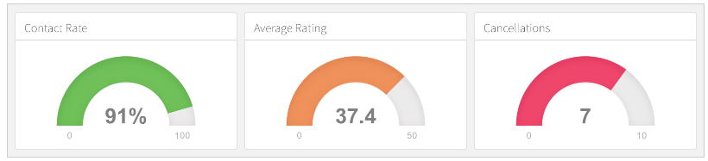
R Graphics and Other Components
Any plot created with R graphics can be used – base, lattice, ggplot2 etc
Tabular output can also be displayed using knitr::kable()
While creating interactive documents (using Shiny) plots can dynamically change using renderPlot() and tables can dynamically change using renderTable()
Value boxes can be used to display single and simple values that can convey highly summarised data.
Gauge boxes can be used to display values on a meter when depicting ranges
Value boxes and Gauge boxes can contain href links to other sections or pages of dashboards
Respective function for interactive documents (using Shiny) are renderGauge() and renderValueBox()

Slide 22
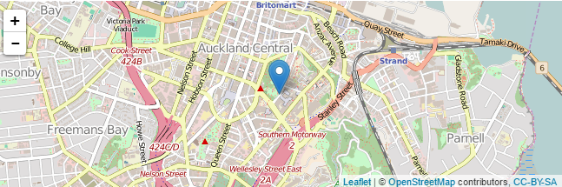
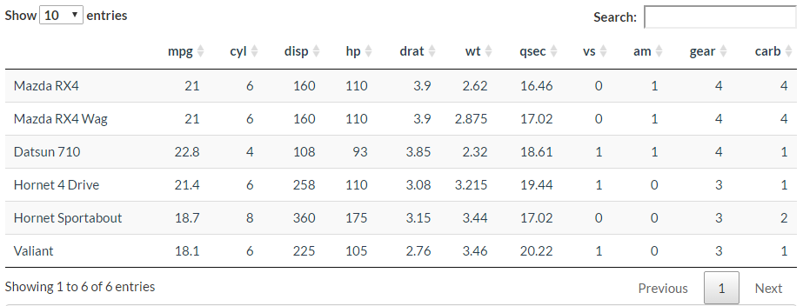
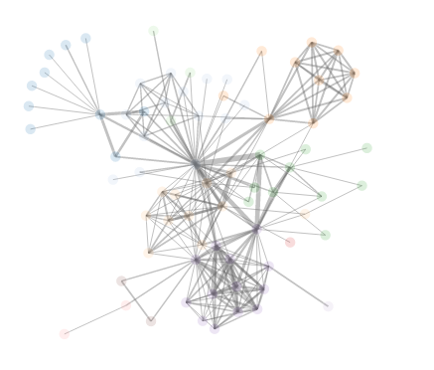
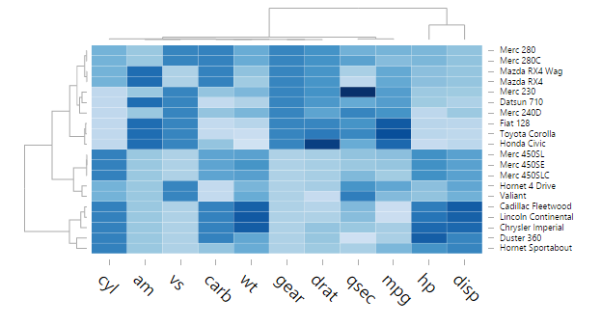
HTML Widgets
HTML Widgets are just like R plots, but they produce interactive web visualisations using Javascript that can be rendered on webpages
Some available widgets
Leaflet – Create dynamic maps that support panning and zooming - http://rstudio.github.io/leaflet/
Dygraphs – Visualise time series data with many interactive features like highlighting, zooming, panning - http://rstudio.github.io/dygraphs
Plotly – Translate ggplot2 objects into interactive web based objects, or develop from scratch using the plot_ly functions - https://plot.ly/r/
NetworkD3 – Create D3 Java Script network graphs from R - http://christophergandrud.github.io/networkD3/
D3heatmap – Interactive heatmaps with D3 including support for highlighting and zooming - https://github.com/rstudio/d3heatmap
DataTables – Display R matrices or data frames as interactive HTML tables with filtering, pagination, sorting etc - http://rstudio.github.io/DT/
Rhandsontable – Minimalist Excel like editor for tables - https://github.com/jrowen/rhandsontable/
Well documented and easy to code with just 2-3 lines to make dashboards more interactive and visually appealing.

Slide 23
Interactivity
What are the different options for interactivity?
How to build an interactive dashboard
Features offered by Shiny

Slide 24
Interactivity – Melbourne Cup Dashboard
Melbourne Cup – The race that stops the nation, is one of the biggest horse races in the world. Horse racing and betting are synonymous, and without a doubt it is a huge market on Betfair too.
Horse racing markets typically are slow to form
90+% of activity in the last 10 minutes
Nobody wants to reveal their hand early
Network builds slowly
People tend to follow the weight of money, hence it’s a chicken and egg problem
Peak efficiency reached very late
Melbourne Cup bucks the trend on most of these marks
Dashboard to view market formation at any point of time X leading up to the Melbourne Cup
What does the network effect look like at point X?
How much money is matched at point X?
How many customers have placed bets at point X?
Which horses are favoured according to the weight of money?

Slide 25
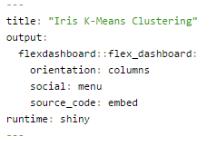
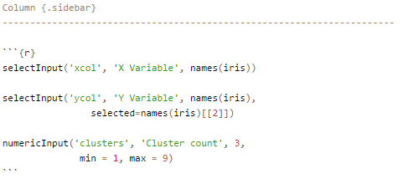
Overview
Add Shiny features to include interactivity in dashboards by specifying runtime: shiny in the YAML header
Interactive dashboards need to be deployed to a Shiny Server to be shared (unlike static dashboards that can be passed on as .html files)
Add {.sidebar} attribute to the first column of the dashboard to make it a host of Shiny inputs like – selectInput, sliderInput, radioButtons etc.

Slide 26
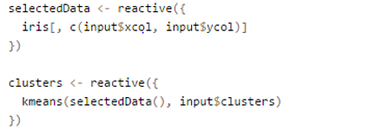
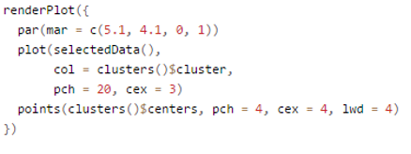
Overview
Use reactive function to change underlying data based on input parameters
Use the render* style functions to display components based on reactive objects. For example – renderPlot, renderTable etc.
For dashboards with multiple pages, a globar sidebar can be built by specifying it also like a page

Slide 27
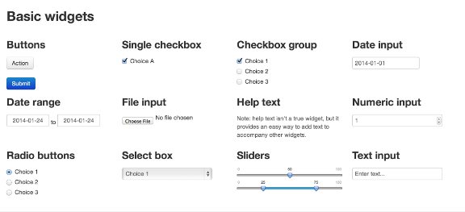
Introduction to Shiny Objects
Shiny is a web application framework that lets you turn analyses into interactive web applications using R (without HTML, CSS, Javascript)
Shiny offers several widgets to use as input/output options
Input widgets
checkboxInput
radioButton
selectInput
sliderInput
Other widgets
actionButton
downloadButton
fileInput
Input widgets generate an input vector that contains all the parameters entered by the user – input$select; input$checkbox; input$radio

Slide 28
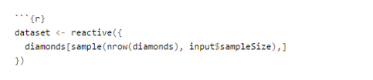
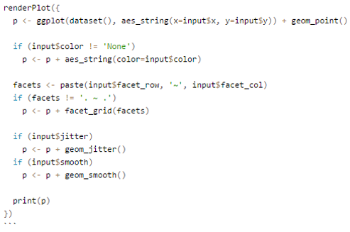
Introduction to Shiny Objects
Reactive functions listen for input vector changes and adjust objects accordingly
Output functions react to changes and need to render code to display the updated output. Shiny provides multiple render functions
renderTable
renderPlot
renderText
renderPlotly
Interactive documents must be deployed to a shiny server (or shinyapps.io) the same way that shiny applications are. Instead of ui.R & server.R you deploy your filename.Rmd
Location of the dashboard will be shinyserver.location:port/filename.Rmd
Advanced topics
Inputs and Outputs in a single flexdashboard panel
Create shiny modules that can be used in multiple dashboards

Slide 29
Conclusion – A cheatsheet
Flexdashboards use R Markdown to publish groups of related visualisations as a dashboard
Install from CRAN -> Create new R Markdown document from flexdashboard template
Easy to specify layout in YAML header – Rows or Columns; Fill or Scroll;
Fill content in boxes specified by ###; Escape row/column with layouts or storyboards; Add multiple pages with ====
Include any R graphics to fill boxes – base, lattice, ggplot, kable, text
Static interactivity can be introduced by using HTML Widgets for graphics
Value boxes, gauges, text annotations etc provide additional components to include in dashoards
Dynamic interactivity can be introduced by specifying runtime as shiny in YAML header
First column by default as sidebar to take in user inputs; Global sidebar for multi page dashboard specified as a page
Shiny input widgets used for capturing user input; Render functions capture reactive inputs and adjust outputs accordingly
Interactive dashboards must be published to shiny server to be shared; Static dashboards can be shared as .html files

Slide 30
Thank you!
Kaushik Lakshman
kaushiklakshman@gmail.com
Documentation - http://rmarkdown.rstudio.com/flexdashboard/
Code and Examples - https://github.com/kaushiklakshman/melbURN-flexdashboard

