Slide 1



Version Control with Git and RStudio
library(dplyr)
r-ladies_global %>%
filter(city = ’Melbourne')

Slide 2
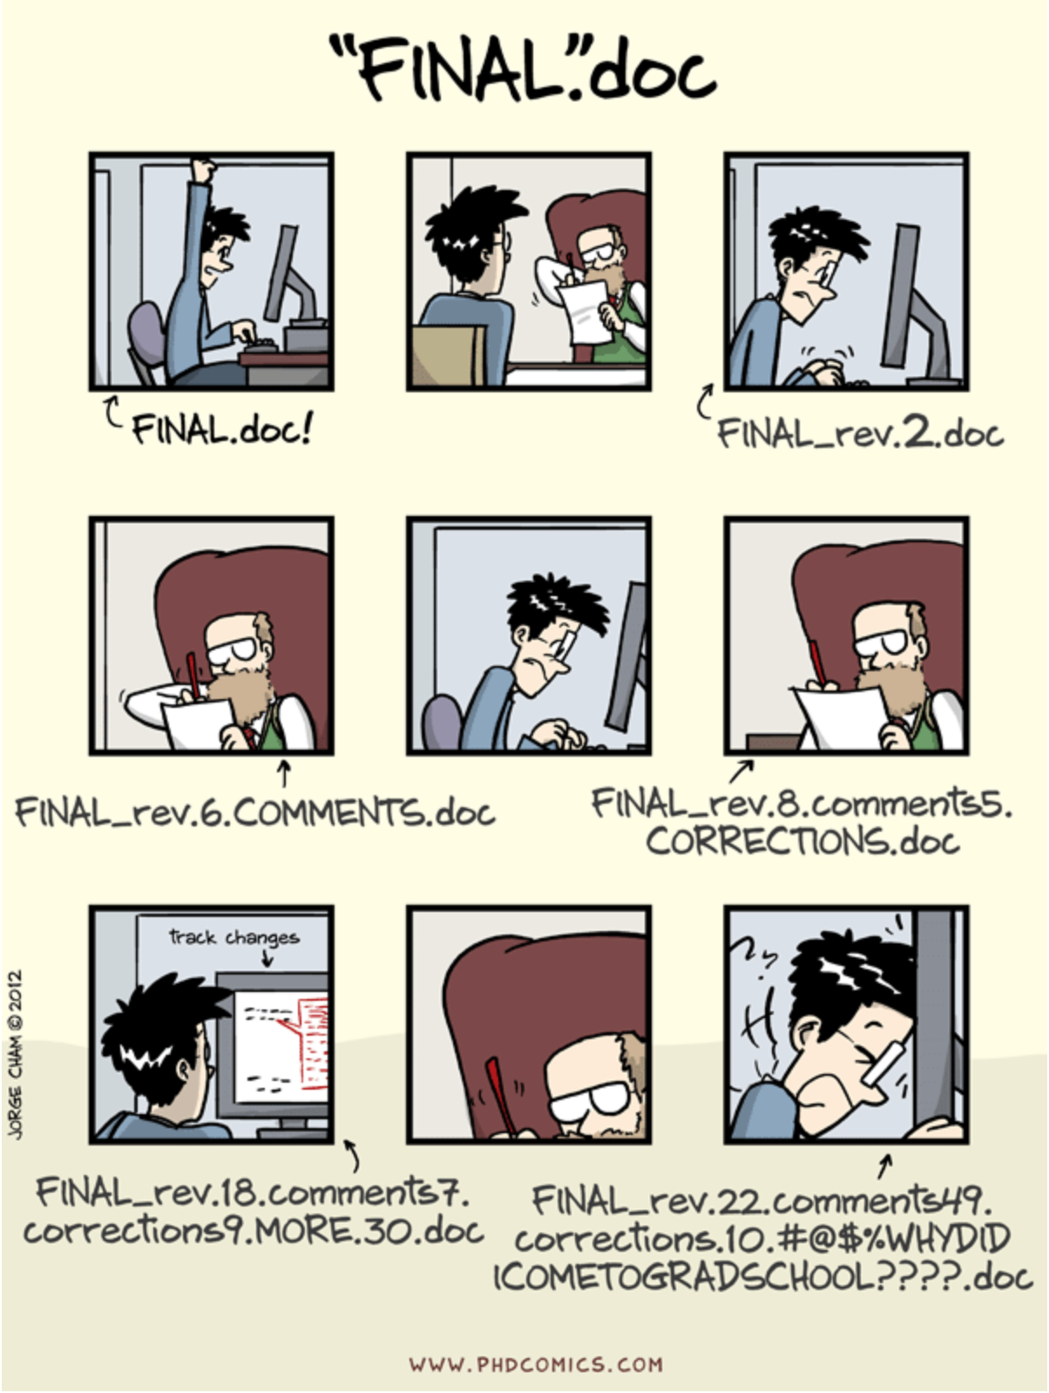
Why need Version Control?
Keep track of changes in the long-term
Collaboration
e.g. tidyverse

Slide 3
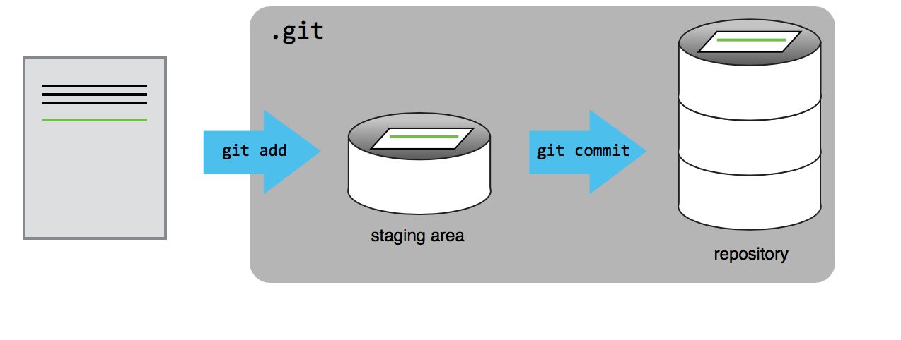
Git
Explained

Slide 4
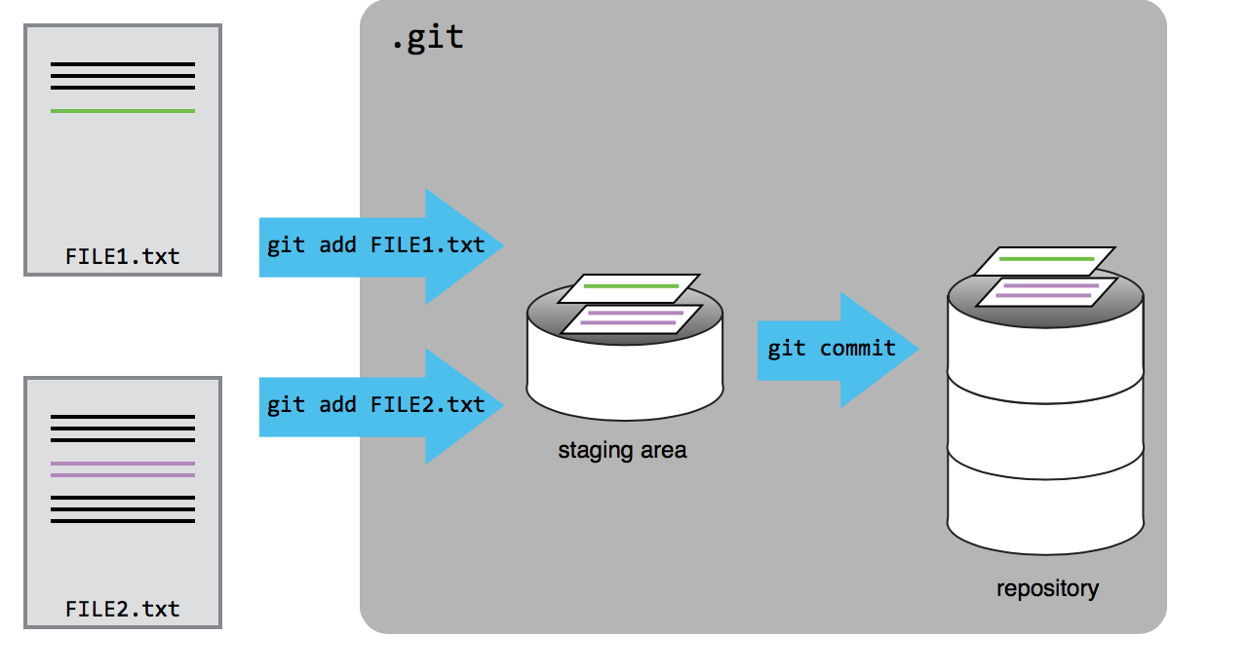
Git
Explained

Slide 5
Git commands At a glance
Things to do once:
Setup git
git config --global user.name “username”
git config --global user.email “email”
Setup a new project directory
git init
git remote add origin repo.git
Always do:
git add –u/./filename/*txt
git status
git diff
git commit –m “message”
git log
git push –u origin master
git pull
git reset

Slide 6
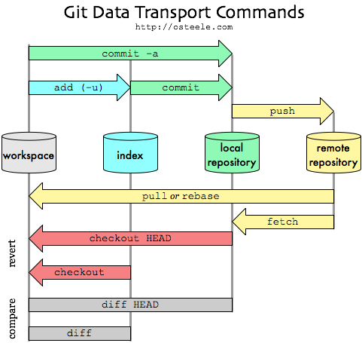
Git in picture

