Slide 1




@RLadiesMelb
Producing publication-ready documents with Rmd Anna Quaglieri, Soroor Hediyeh-zadeh
Feb 2019
Please participate in our survey:
https://goo.gl/forms/3YmhRA2MGs9shwjT2

Slide 2



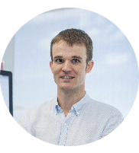

A big thank you...
To our amazing and faithful sponsors
Matt Ritchie
Notes:
CSL provides funding for events, Zendesk provides us space and drinks for some of our events, WEHI - occasional location for meetings and events

Slide 3
Special thanks to
NOUS
for sponsoring this event
https://www.nousgroup.com/
Notes:
Award winning management consulting firm based in Australia and UK who have provided today’s venue.

