Slide 1
Intro to Data Analysis and Graphics with R
R-Ladies Melbourne
Tobey Zhang

Slide 2




CONTENTS
Intro to Data Analysis and Graphics with R
Section 1
Why Graphics
About Data
Section 2
Section 3
Descriptive Statistics
Section 4 Title
Element in diagrams

Slide 3

Why Graphics
Intro to Data Analysis and Graphics with R
Help you think about the data
Show some unexpected findings
Help you illustrate your findings to others

Slide 4

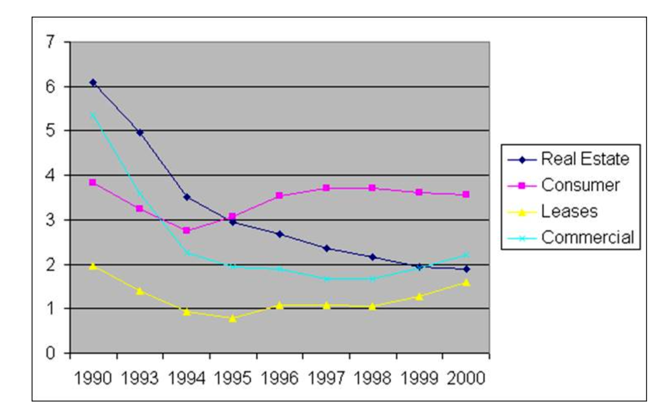
Bad Diagrams
Notes:
(1) The units on the vertical axis are not labeled. The reader has no idea what is being depicted.
(2) There is no title on the chart. This also detracts from the reader's ability to figure out what is being depicted.
(3) The x-axis is divided into 1-year intervals except the years 1991 and 1992 are missing.
http://old.briarcliff.edu/departments/cis/excel/2013/006-charts-bad%20examples.htm

Slide 5
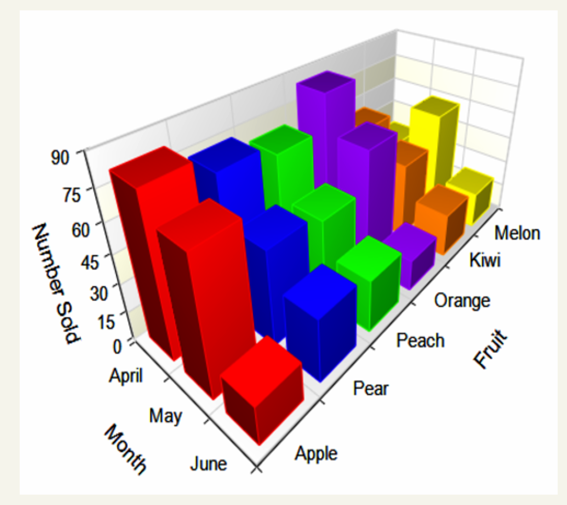
Bad Diagrams
Notes:
This graph looks really fancy, but some of the elements may not be clear in this case. The three axises are not clear for us to do analysis, because there may lots of things happening and thus screw up a little bit. Also, some of the elements may be hidden by other boxes(e.g. melon in April).
https://kaijiezhou.wordpress.com/2016/01/27/examples-of-good-and-bad-visualization/

Slide 6

Good Diagram
Single idea per diagram
Clear and meaningful label
Clear and informative title
Avoid using “fancy” one (select propriate diagram)

Slide 7
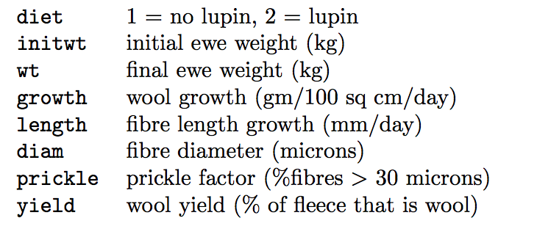
About Data
In 1994, some second year Agriculture students at this university conducted an experiment at the Mount Derrimut experimental farm. Its purpose was to study the rates of growth of ewes and of their wool, and to study the e↵ectiveness of a lupin diet supplement on increasing ewe and wool growth and quality.
A total of 30 ewes were used, with 15 randomly selected to receive the lupin supplement. The ewes were initially weighed before the experiment began, and then weighed again after two months on the supplement (or not). The ewes were then shorn and several measurements of their wool growth and quality were made. The variables were:
Data from: Dr Julia Polak, University of Melbourne, Thinking and Reasoning with Data

Slide 8

THANK YOU!
Tobey Zhang
Email:
zhuowenz@student.unimelb.edu.au
LinkedIn:
https://www.linkedin.com/in/zhuowen-tobey-zhang-943b32106/

