Slide 1
EMPLOYEE SALARY PREDICTION
CAPSTONE PROJECT
Presented By:
RAYAVARAPU LIKHITHA
Annamacharya Institute of Technology and Sciences Tirupati
Computer Science and Engineering

Slide 2
OUTLINE
Problem Statement –Predict whether a person's income is <=50K or >50K based on key attributes such as age, occupation, workclass, capital gain,etc..using machine learning techniques.
System Development Approach (Technology Used) - Python, Pandas, Scikit-learn, Jupyter Notebook, HTML/CSS, Joblib (Model Storage)
Algorithm & Deployment (Step by Step Procedure) - Data preprocessing (cleaning, encoding), model training using Random Forest Classifier, saving the trained model and feature columns using Joblib, and deploying via Streamlit for real-time predictions.
Result - Achieved ~90% accuracy using Random Forest; Streamlit web interface provides instant salary class prediction.
References -UCI Dataset | scikit-learn | Streamlit | Pandas Docs | Python Official Docs

Slide 3
Problem Statement
This project aims to predict whether an individual's salary is more than $50K per year using selected demographic and work-related features.
It uses the UCI Adult Income dataset which contains data like age, education, occupation, hours per week, etc.
Data preprocessing is performed using encoding and normalization techniques within a machine learning pipeline.
A Random Forest Classifier is trained and saved using Joblib for deployment.
The system provides a user-friendly interface for real-time salary class prediction based on user inputs.

Slide 4
System Approach
System requirements
Operating System: Windows 10 / Linux / macOS
Processor: Intel i3 or above
RAM: Minimum 4 GB
Python Version :Python 3.8 or higher
Software: Anaconda (Jupyter Notebook), Web Browser
Storage: At least 500MB free for dataset and model files
Library required to build the model
pandas, numpy, scikit-learn, joblib,Streamlit

Slide 5
Algorithm & Deployment
Data Collection ▸ Downloaded the UCI Adult Income dataset containing demographic attributes and salary class.
Data Preprocessing ▸ Handled missing values, normalized numeric fields, and encoded categorical variables using OneHotEncoder and StandardScaler via ColumnTransformer.
Feature Selection ▸ Selected relevant features such as age, education, workclass, hours-per-week, etc., for training.
Model Training ▸ Trained a Random Forest Classifier model using Scikit-learn with hyperparameter tuning via GridSearchCV. ▸ Evaluated the model based on training accuracy and used the best estimator for predictions.
Model Saving ▸ Saved the trained model using joblib and stored column names for consistency.
Streamlit Web Application ▸ Built an interactive Streamlit app allowing users to input relevant attributes and get instant salary class predictions in a simple web interface.
Integration & Testing ▸Integrated the trained model with the Streamlit frontend, tested it with various inputs, and validated prediction consistency.
Deployment (Localhost) ▸Deployed and demonstrated the app on localhost using Streamlit, allowing real-time usage without the need for external servers.

Slide 6
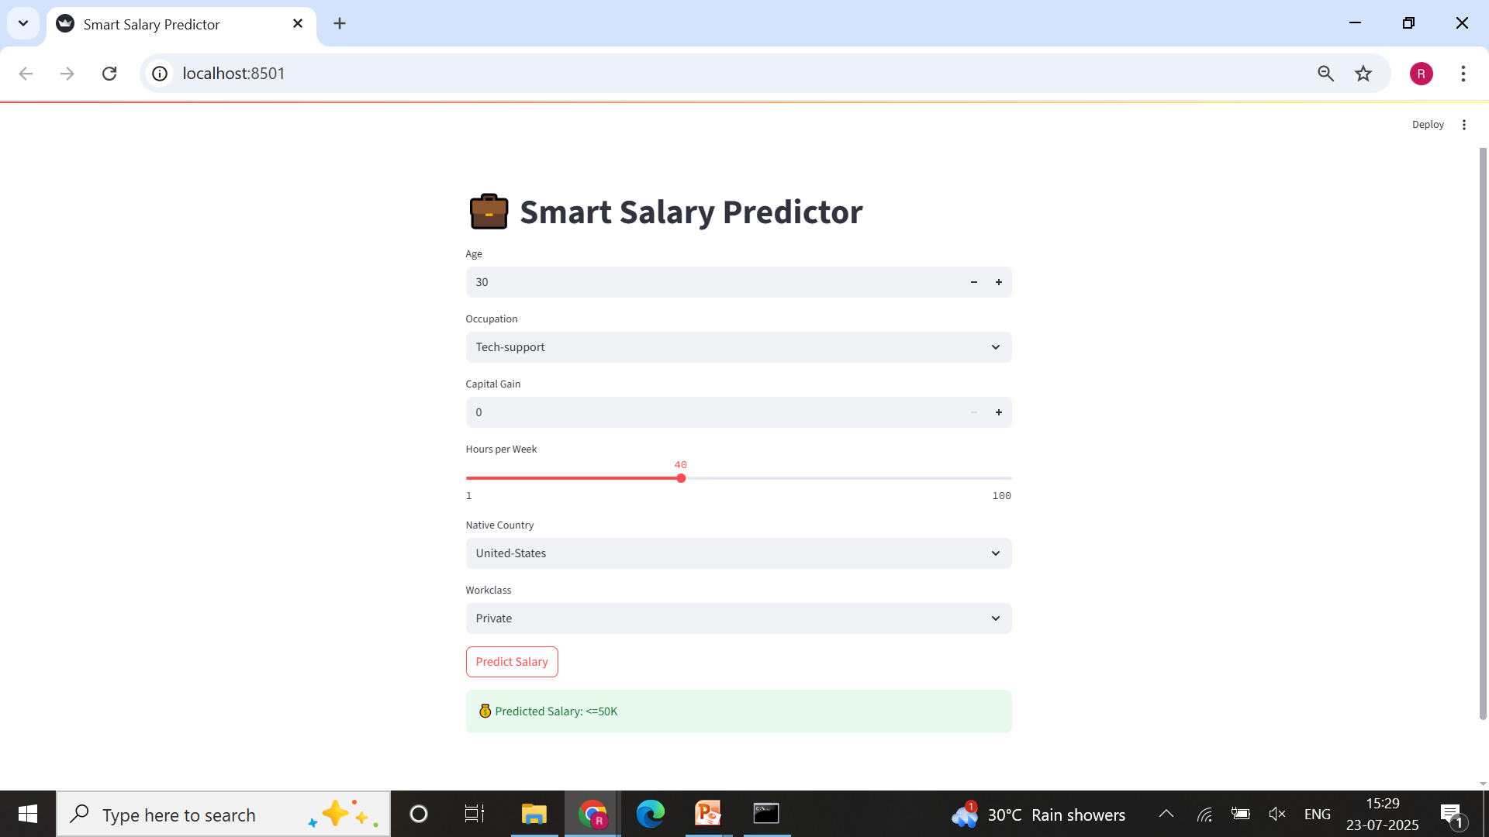
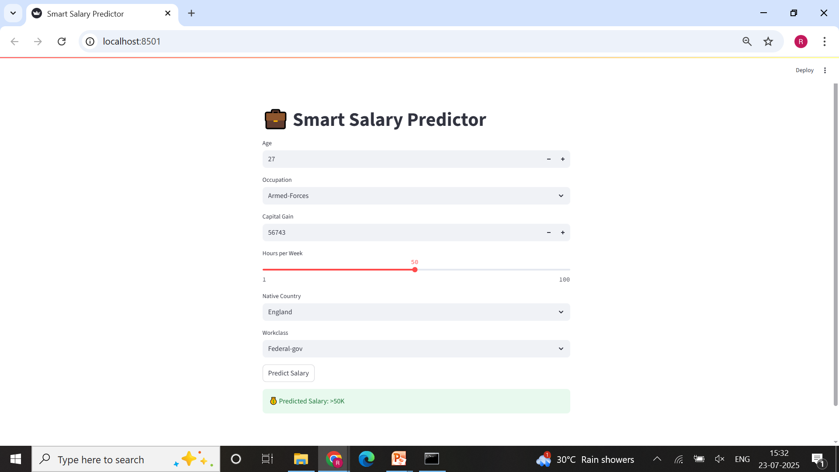

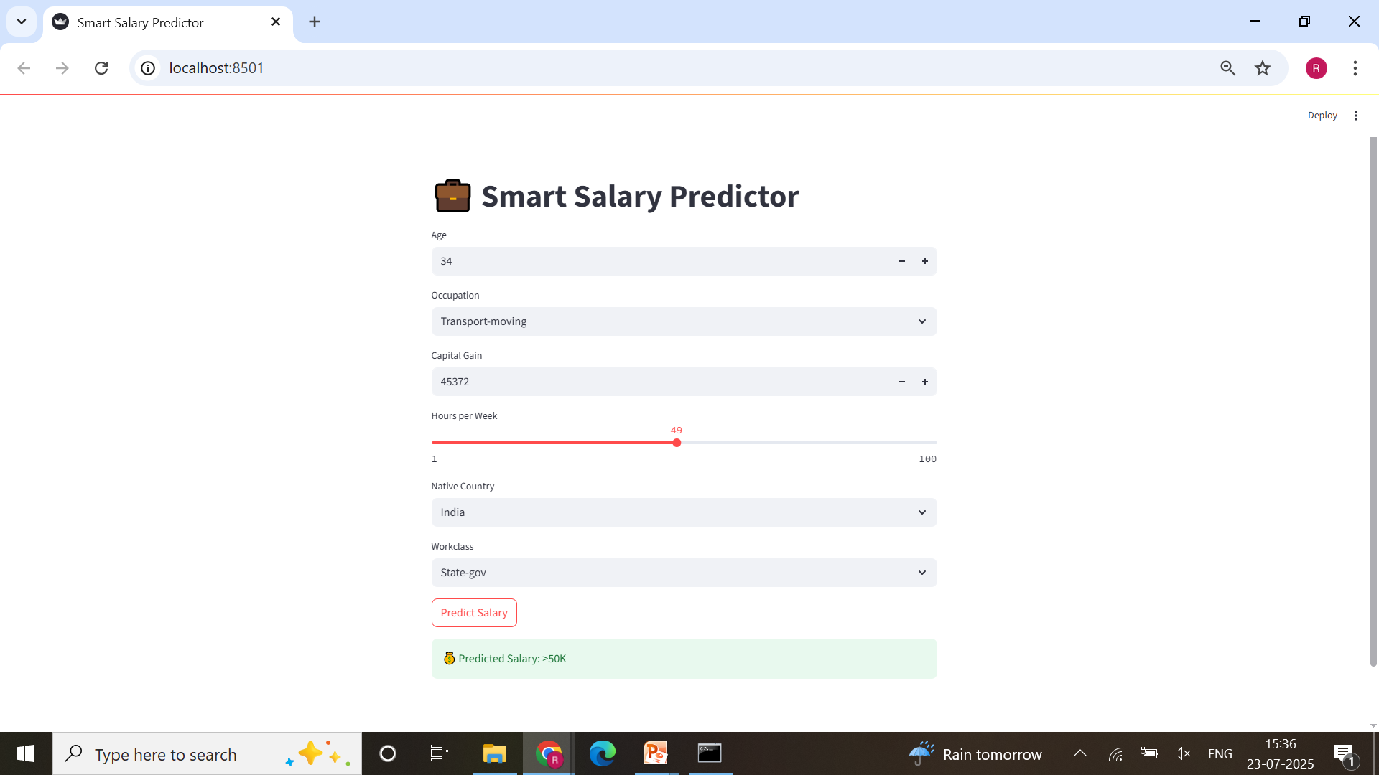
Result
GitHub Link :https://github.com/R-Likhitha/Employees-salary-prediction

Slide 7
Conclusion
This project successfully demonstrates the application of machine learning in predicting employee salary categories based on selected demographic and work-related features. Using a Random Forest Classifier trained on relevant attributes like age, occupation, capital gain, hours worked per week, etc.. , the model was able to achieve high accuracy in classifying whether an individual earns more than $50K or not.The solution was integrated into an interactive and user-friendly web interface using Streamlit, allowing real-time salary predictions based on minimal input fields. This lightweight and efficient design ensures that users can make quick decisions or insights without requiring deep technical knowledge.

Slide 8
Future scope(Optional)
Integration of Advanced Algorithms:Future versions of the project can explore more sophisticated models like XGBoost, LightGBM, or Neural Networks to further improve prediction accuracy beyond what is achieved with the current Random Forest model..
User Authentication: Implementing a login system in the Streamlit app can help secure user inputs and prediction history, making the tool more suitable for enterprise or HR use cases.
Mobile App Integration: A mobile-responsive or Progressive Web App (PWA) version of the Streamlit application can be developed to enable HR professionals and employees to access salary predictions conveniently from their smartphones or tablets.

Slide 9
References
Scikit-learn Documentation https://scikit-learn.org/stable/documentation.html
Joblib Documentation https://joblib.readthedocs.io/
Streamlit Documentation – Web Application Framework https://docs.streamlit.io/
Python Official Documentation https://docs.python.org/3/

Slide 10
THANK YOU

