Slide 1
oRAL PATHOLOGY TUTOR MANAGE MENT SYSTEM
Team Members: Jinrong Liu; Yiyuan Xie
Xiangyu Ding; Zhaoxuan Ren
Client: Dr. Elizabeth Bilodeau from the School of Dental Medicine collaborated with SIS Prof. Babichenko

Slide 2
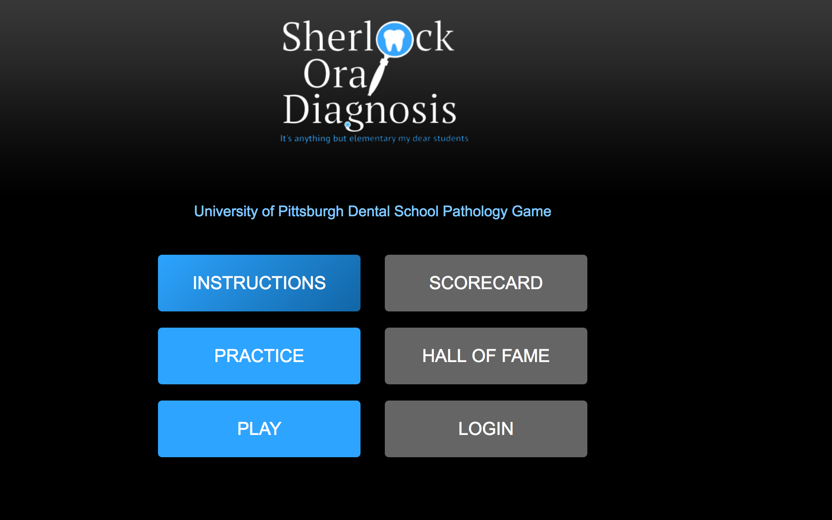
System Introduction

Slide 3
System Instructions
How to use our “Question Add” page:
Click “Add” button to add new questions. “Category” => Choose the level of questions => Input new diagnosis name and hint
If input one diagnosis name which has already existed => ”Diagnosis name already exists!”
If you added new diagnosis name successfully, the page will go to another new page which shows “Question successfully added!” Then, you can choose upload images or back to question lists.

Slide 4
Requirements about images upload: Names can not be repeated. Can not upload the same image; Image must within Xkb; Allowed format: .JPG, .jpeg, .png, .gif
Next, when upload successfully, you can choose upload another image or back to the question list.

Slide 5
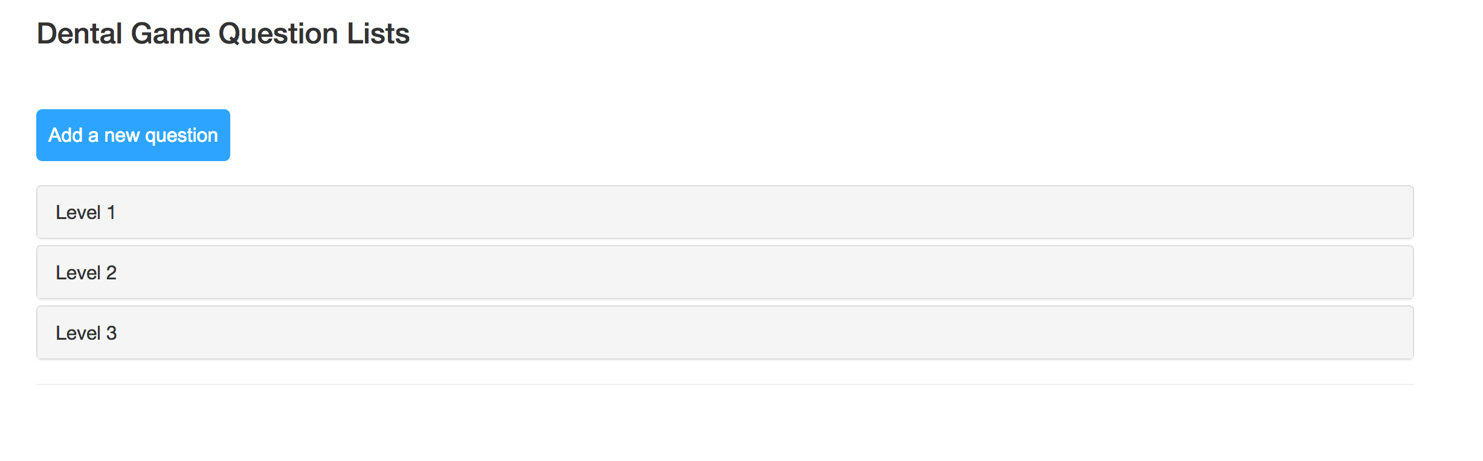
Improvement 1
We have improved the original level question from accordion form to tabbed label

Slide 6
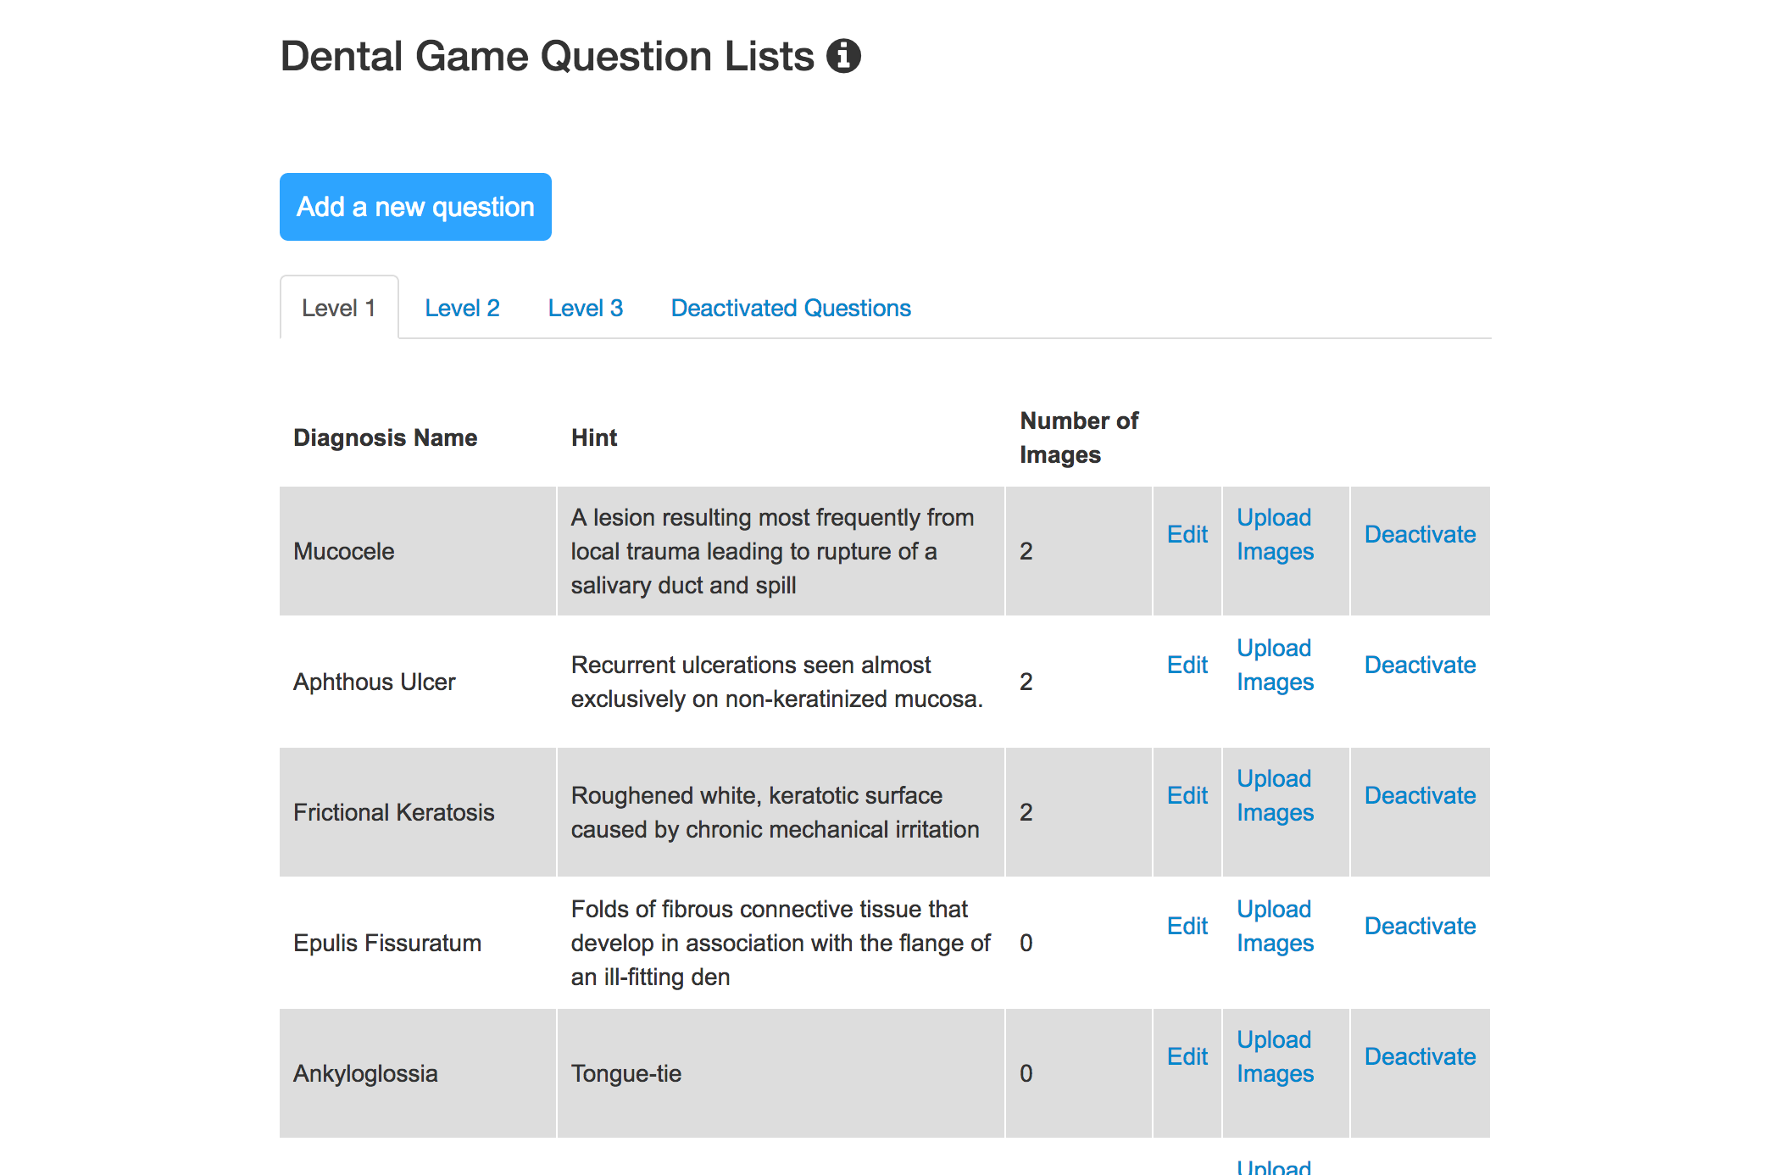
Improvement 1
We have improved the original level question from accordion form to tabbed label

Slide 7
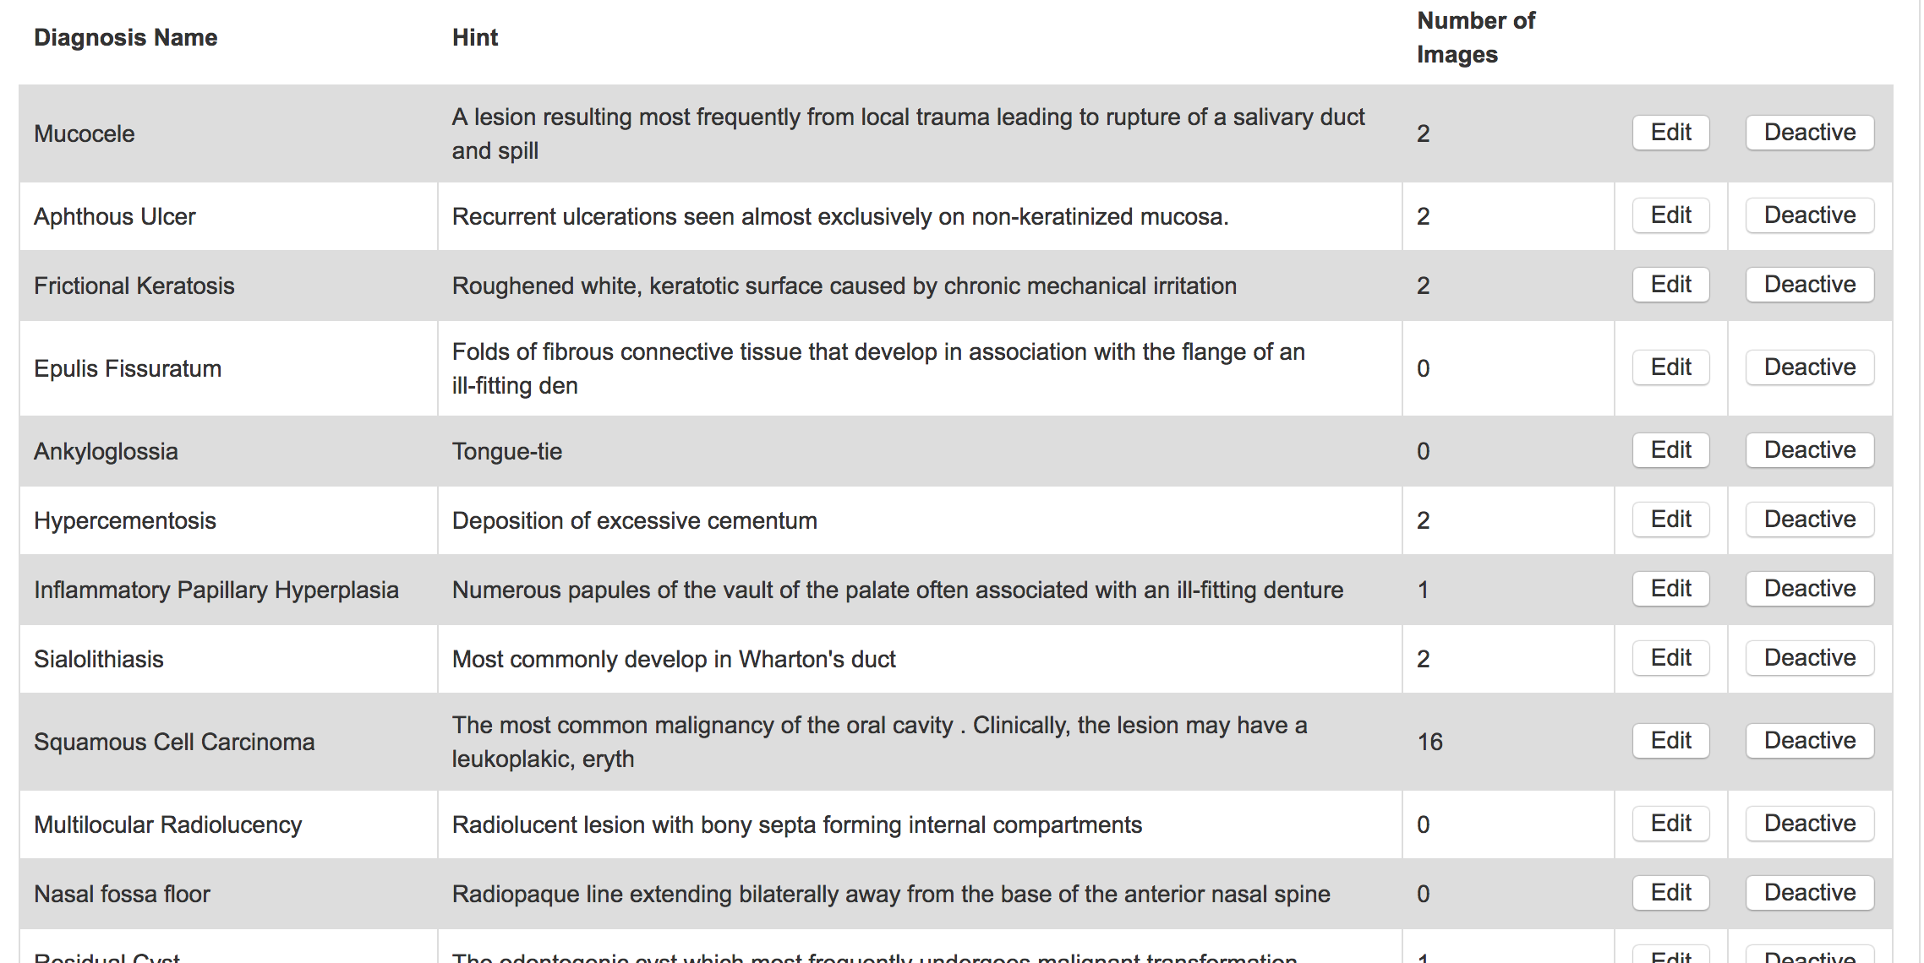
Improvement 2
We have improved the questions modify approach from “button” to “link”

Slide 8
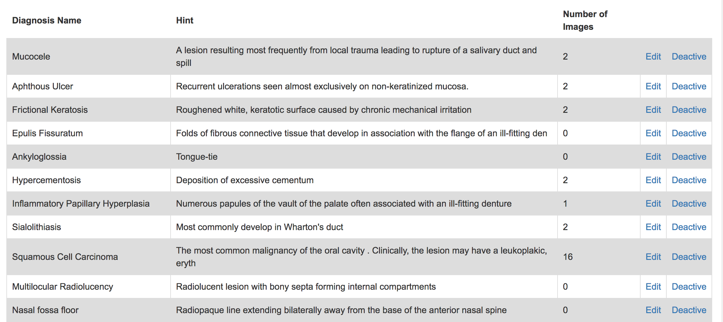
Improvement 2
We have improved the questions modify approach from “button” to “link”

Slide 9
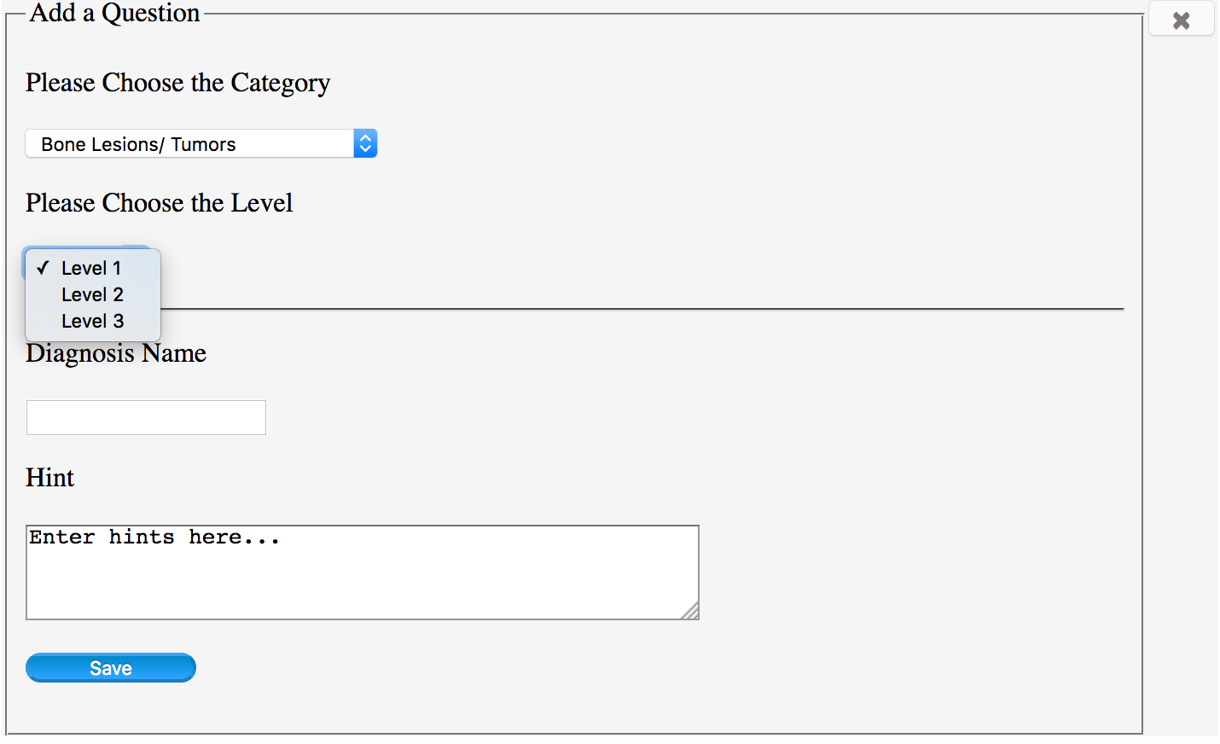
Improvement 3
We have improved the multiple choice of question levels

Slide 10
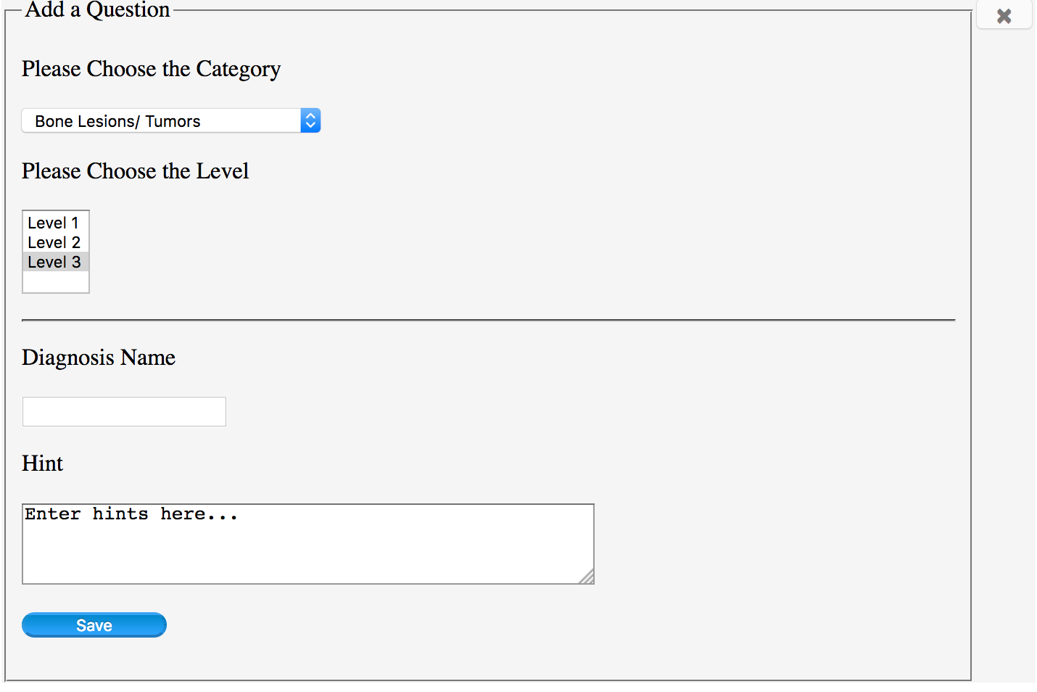
Improvement 3
We have improved the multiple choice of question levels

Slide 11
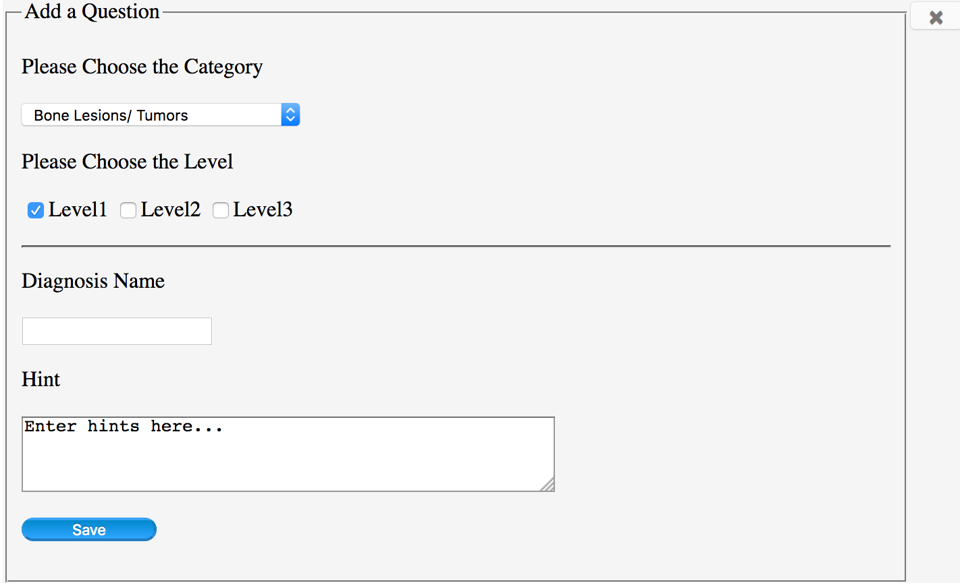
Improvement 3
We have improved the multiple choice of question levels

Slide 12
Improvement 4
We have added “help” icon which enable to show users instruction

Slide 13
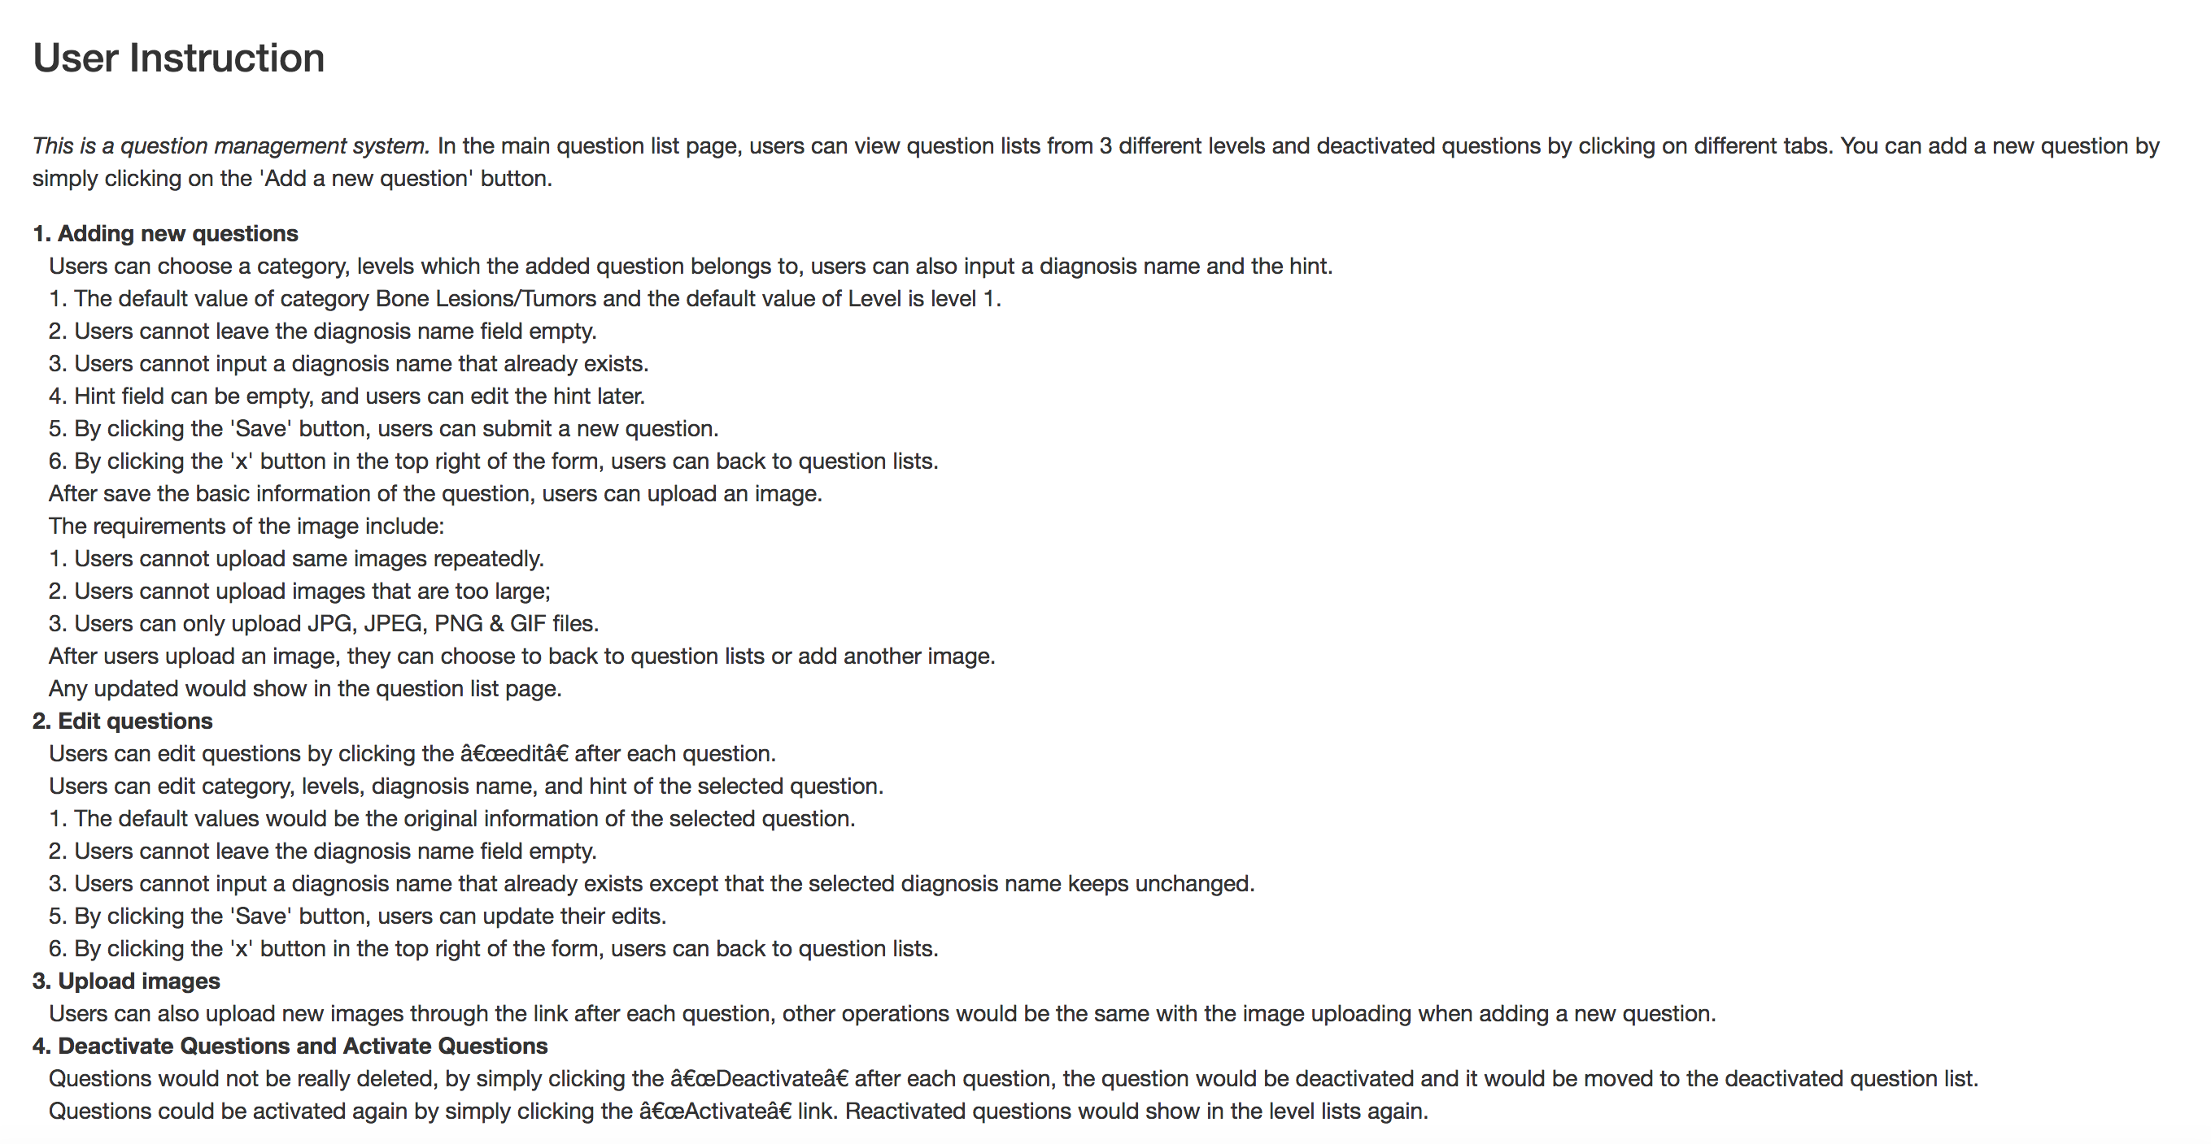
Improvement 4
We have added “help” icon which enable to show users instruction

Slide 14
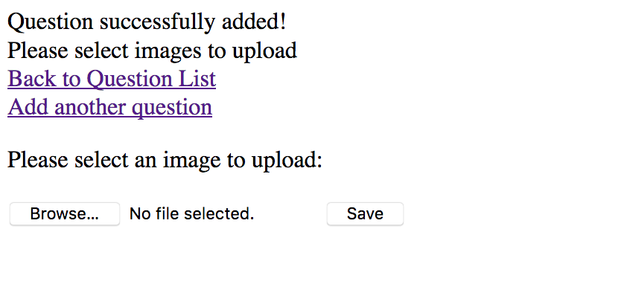
Improvement 5
We have improved the information display function (Good error messages)

Slide 15
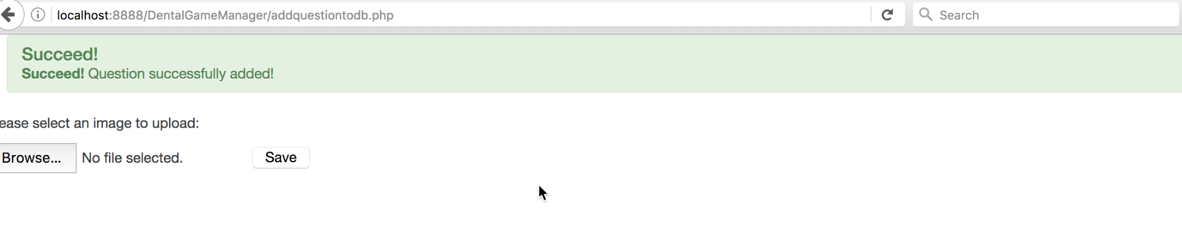
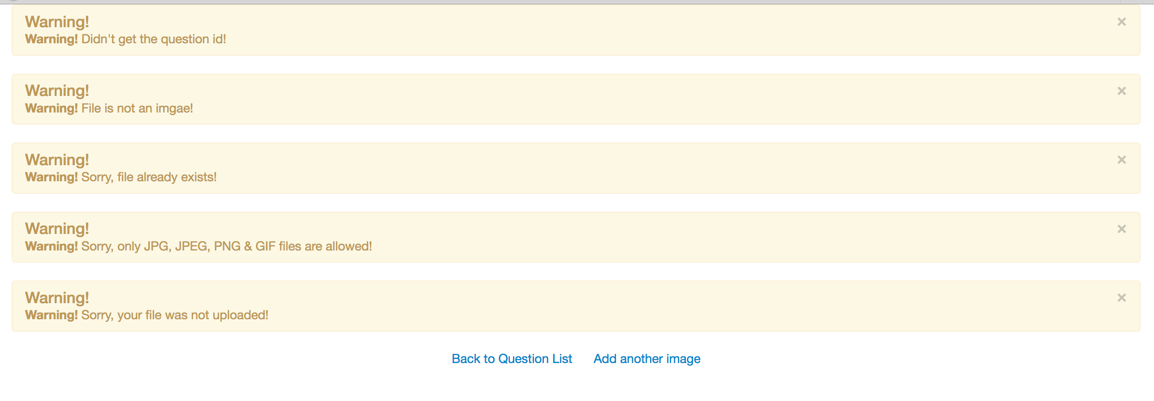
Improvement 5
We have improved the information display function (Good error messages)

Slide 16
User Study
User study is conducted in two parts: the evaluation of old vrsion and the improvement feedback of new version.
Each interviewee will be given a brief introduction of the whole system, then they will be required to use the system to complete some tasks in order to test the whole system. The tasks cover all the functions the client required. The interviewee will be required to complete a question list. After that, an interview of specifying the details of the reslut of question list according to the question list will be conducted.
According to the result of the first version of the interview, we made improvements and do the interview agian.

Slide 17
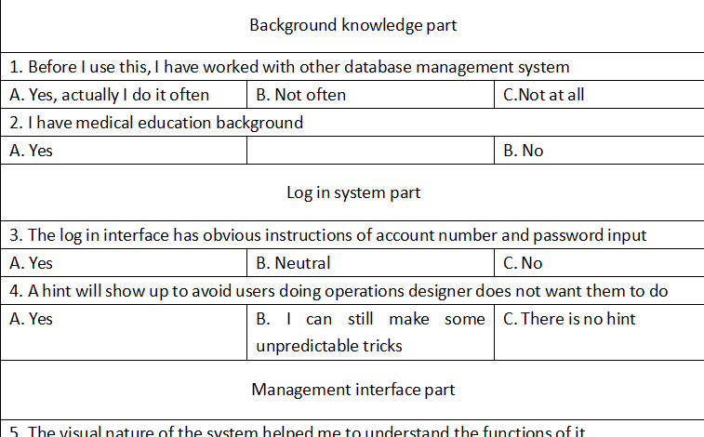
Part of the question list

Slide 18
First feedback of the user study interview
a. users are confused about whether they upload the images successfully or not due to there has no feedbacks during the operation
b. users like the second version of interface
c. sorting function is needed
d. question list is too long to read
e. lacking of multiple mthods of question uploading

Slide 19
Second feedback of the user study interview
A more friendly level choosing level which allows multiple level question
Now support multiple methods of uploading images
A clear exit button is provided
Sorting function now is available

Slide 20
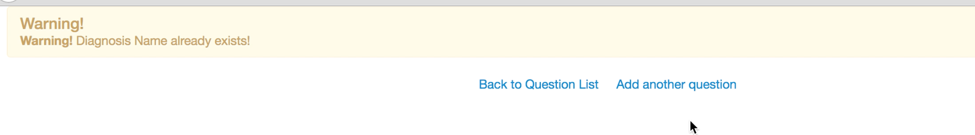
Good Features
Provide feedback: We will update the current status information (Success or Failure)

Slide 21
Good Features
Provide clearly marked exits: Can go back to main page via “x” button

Slide 22
Good Features
Good error messages: We provide clearly error message for users which enable them to understand why they uploaded failed, as well as how to operate correctly.

Slide 23
Good Features
Prevent errors: we set default value in advance and do not allow users input null value

Slide 24
Good Features
Simple and natural dialog: We use reasonable layout to store questions data, users can find what they need easily.

Slide 25
Thanks!

