Slide 1
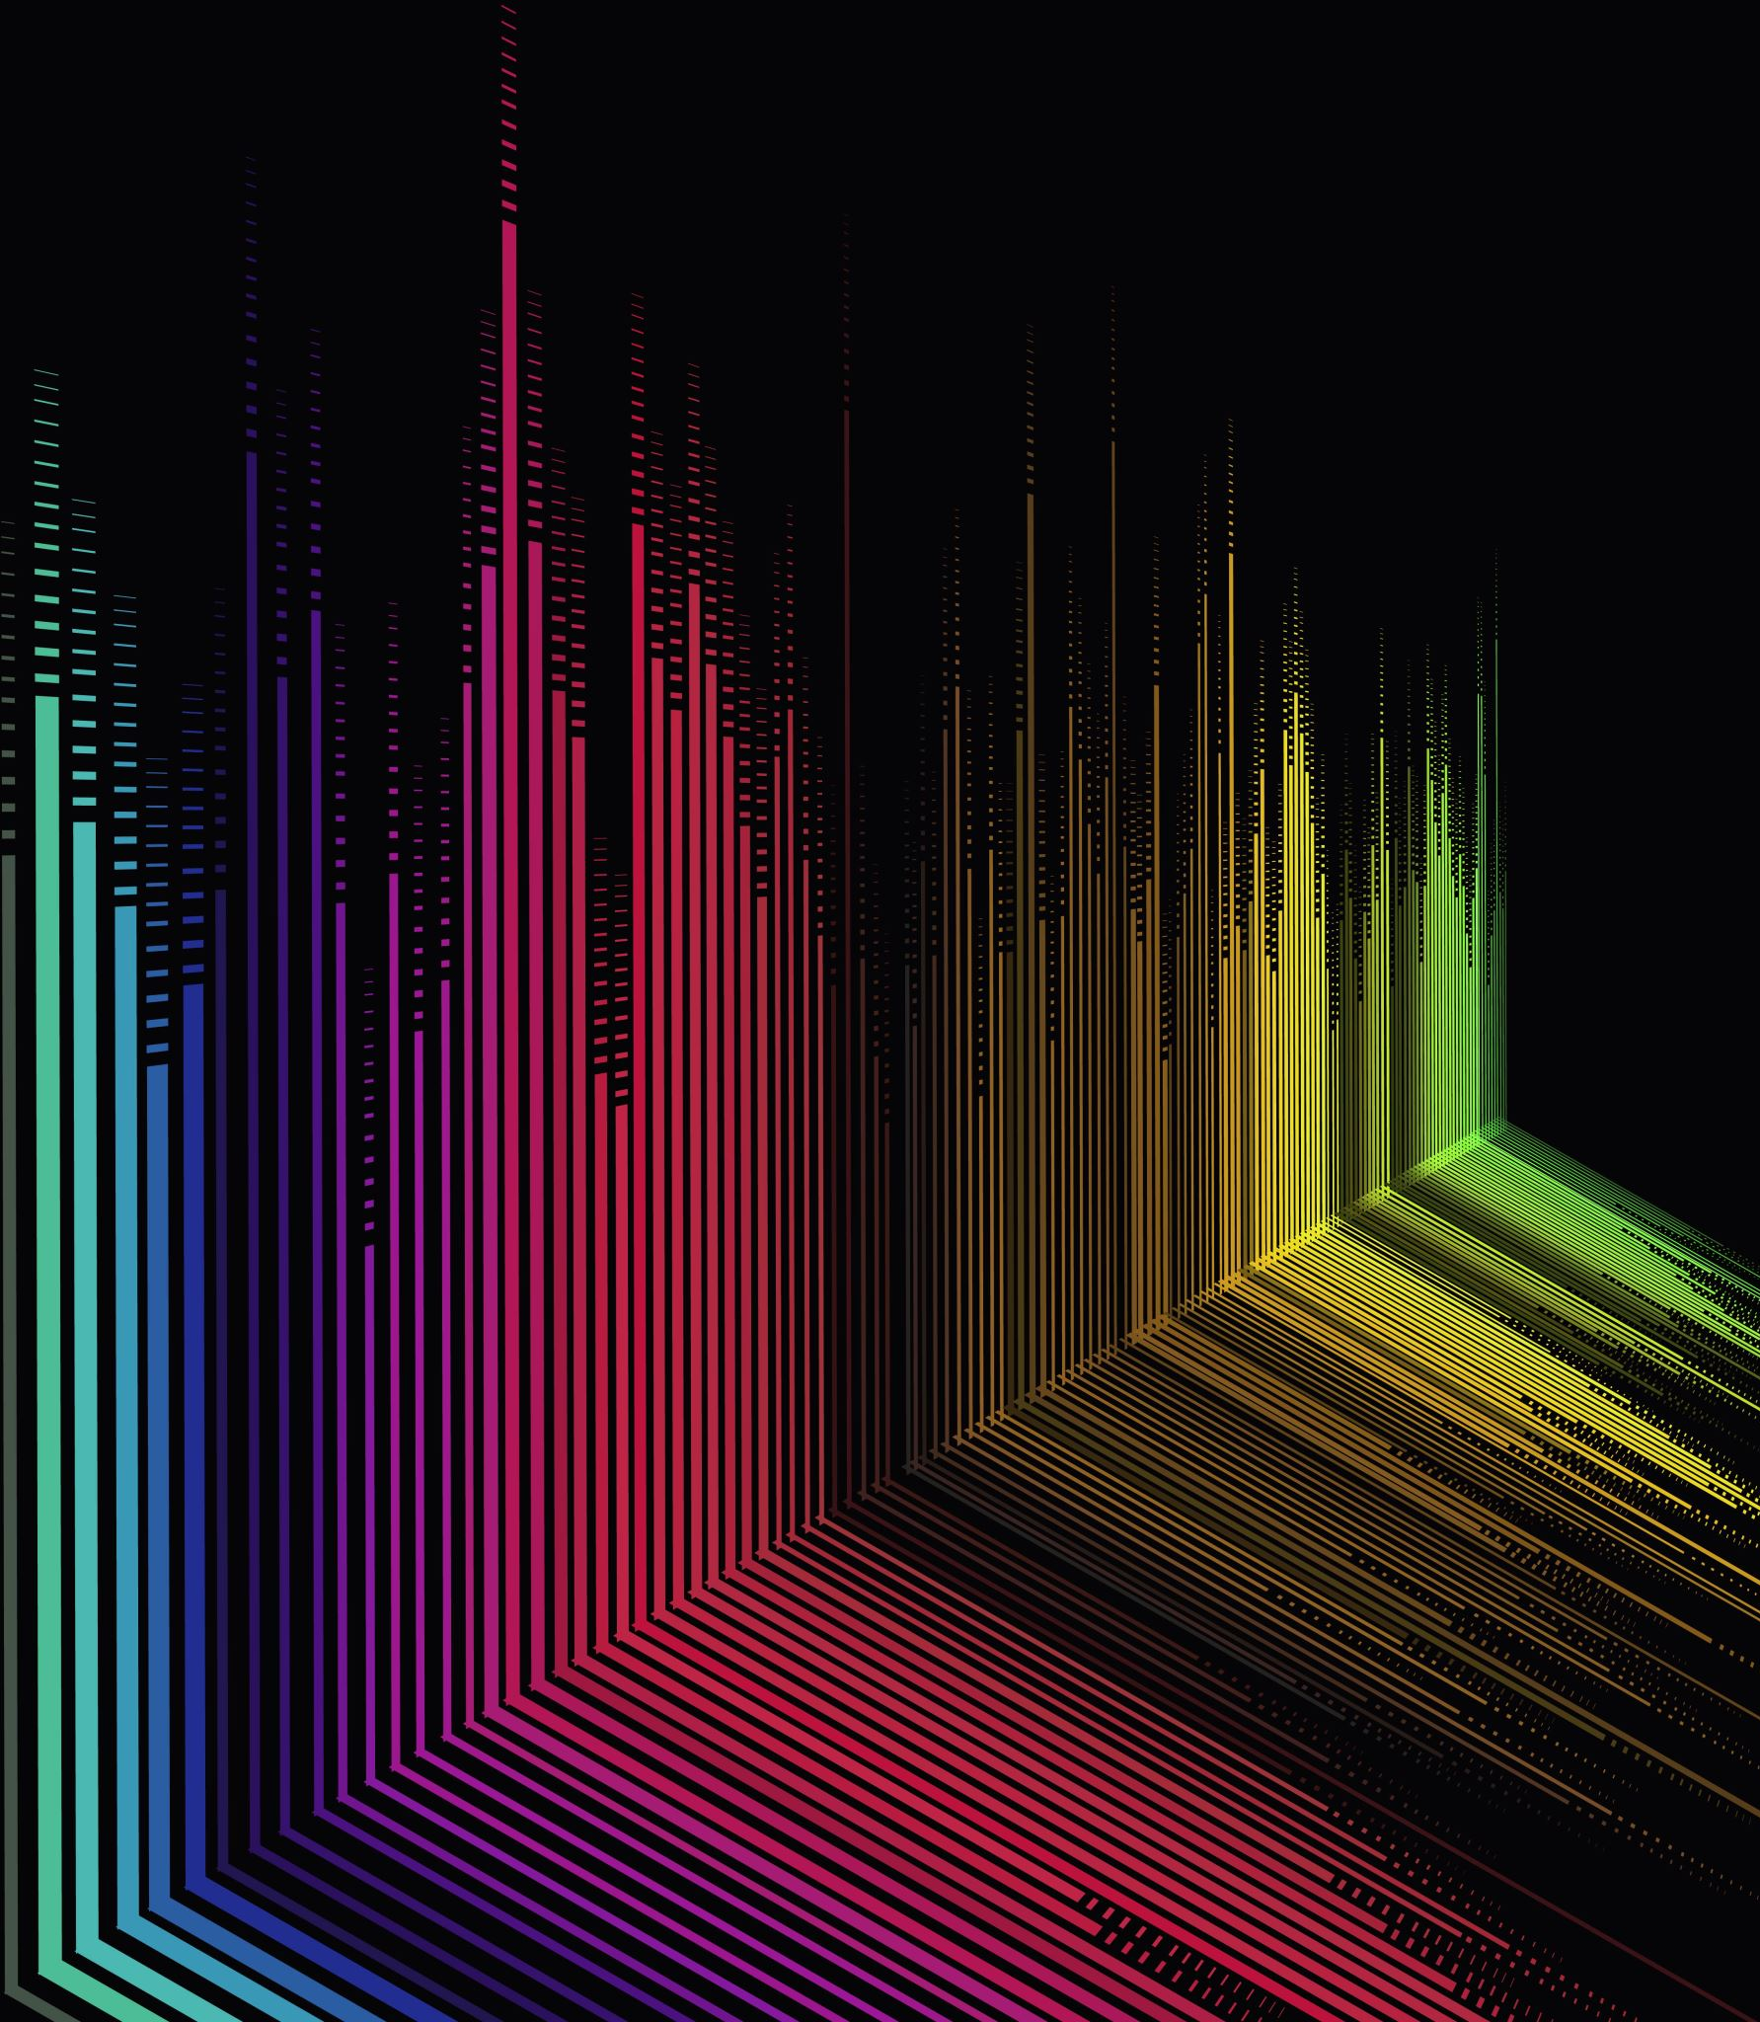
Efficient Rendering of Semi-Transparent Circles Using Serial and Parallel Algorithms

Slide 2
Introduction
Challenge: Rendering semi-transparent shapes efficiently, particularly managing colors and overlap.
Compare serial and parallel rendering techniques for circles with transparency effects.
Designe circles con terminal, using numbers and letters to represents different shapes of color.

Slide 3
Algorithmic Approach: Serial Algorithm
Steps:
Initialize canvas with uncolored pixels.
Create circles with different colors and coordinates.
Sort circles by Z-coordinate.
Iterate through each pixel to check if it lies within any circle and adjust transparency.
Output rendered canvas.
High computation time due to nested loops.

Slide 4
Serial Algorithm Code (Snippet)
void renderCircles(const std::vector<Circle>& circles, std::vector<std::vector<std::string>>& canvas, int width, int height) {
std::vector<Circle> sortedCircles = circles;
std::sort(sortedCircles.begin(), sortedCircles.end(), [](const Circle& a, const Circle& b) {
return a.z > b.z; // Sort from highest to lowest z to manage precedence
});
for (const auto& circle : sortedCircles) {
for (int y = 0; y < height; ++y) {
for (int x = 0; x < width; ++x) {
if (isWithinCircle(x, y, circle)) {
canvas[y][x] += circle.color; // Add the color to the string at the pixel
}

Slide 5
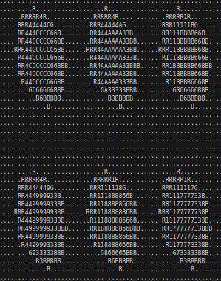

Output

Slide 6
Algorithmic Approach: Parallel Algorithm
Steps:
Initialize canvas similarly.
Sort circles by Z-coordinate.
Use OpenMP to parallelize the pixel processing loop.
Ensure thread safety with critical sections or atomic operations.
Output rendered canvas.
Reduced execution time. Increased complexity and workload for the graphics card.

Slide 7
Parallel Algorithm Code (Snippet)
void renderCircles(int numThreads, int numParticles, const std::vector<Circle>& circles, std::vector<std::vector<std::string>>& canvas, int width, int height) {
std::vector<Circle> sortedCircles = circles;
std::sort(sortedCircles.begin(), sortedCircles.end(), [](const Circle& a, const Circle& b) {
return a.z > b.z; // Sort from highest to lowest z to manage precedence
});
for (const auto& circle : sortedCircles) {
#pragma omp parallel for num_threads(numThreads)
for (int y = 0; y < height; ++y) {
for (int x = 0; x < width; ++x) {
if (isWithinCircle(x, y, circle)) {
#pragma omp critical
canvas[y][x] += circle.color; // Add the color to the string at the pixel
}

Slide 8
Performance Evaluation
Test Setup:
Canvas size: 100x60 pixels.
Various circles with different colors and overlaps.
Results:
Serial Execution Time: 0.000701058 seconds.
Parallel Execution Time: 0.000871662 seconds 1 thread
Parallel Execution Time: 0.000580405 seconds 2 threads
Parallel Execution Time: 0.00055863 seconds 3 threads
Parallel Execution Time: 0.000500736 seconds 4 threads
Conclusion: Parallel processing significantly reduces rendering time while maintaining accuracy.

Slide 9
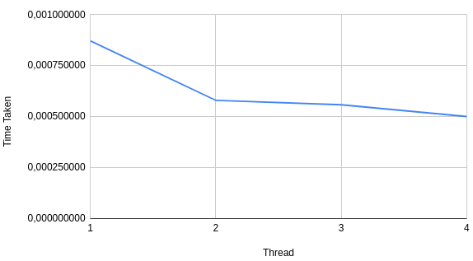
Threads vs Total time taken

