Slide 1
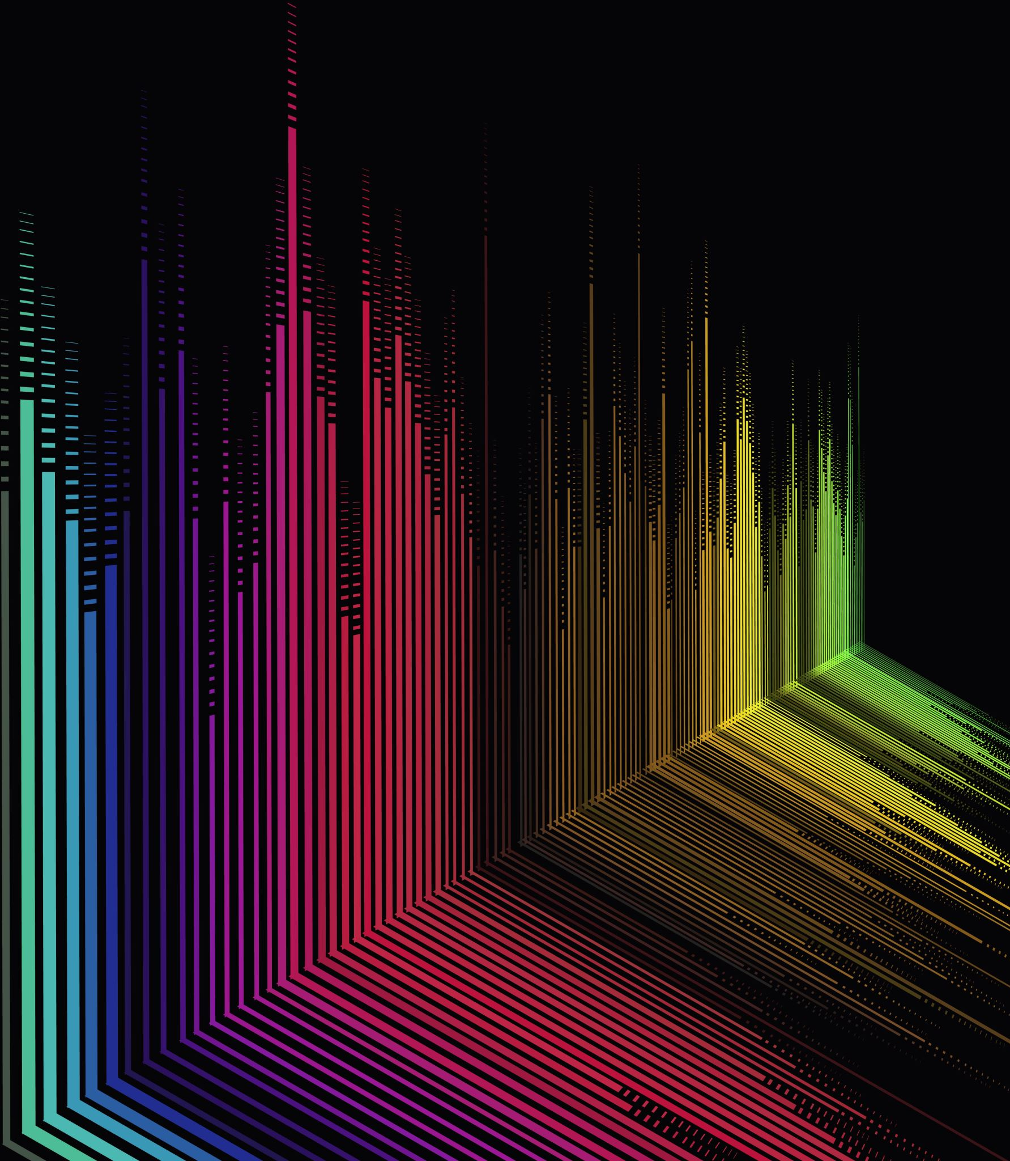
Efficient Rendering of Semi-Transparent Circles Using Serial and Parallel Algorithms

Slide 2
Introduction
Graphics Rendering: Key in games, simulations, and data visualization.
Challenge: Rendering semi-opaque shapes efficiently, particularly managing transparency and overlap.
Approach: Compare serial and parallel rendering techniques for circles with transparency effects.

Slide 3
Problem Statement
Challenges: Rendering semi-transparent shapes efficiently, especially in real-time applications.
Performance issues: Serial algorithms are slow when handling multiple or high-resolution shapes.

Slide 4
Algorithmic Approach: Serial Algorithm
Steps:
Initialize canvas with fully transparent pixels.
Sort circles by Z-coordinate.
Iterate through each pixel to check if it lies within any circle and adjust transparency.
Output rendered canvas.
Pros: Accurate rendering.
Cons: High computation time due to nested loops.

Slide 5
Serial Algorithm Code (Snippet)
void renderCircles(const std::vector<Circle>& circles, std::vector<std::vector<float>>& canvas, int width, int height) {
std::vector<Circle> sortedCircles = circles;
std::sort(sortedCircles.begin(), sortedCircles.end(), [](const Circle& a, const Circle& b) { return a.z < b.z; });
for (const auto& circle : sortedCircles) {
for (int y = 0; y < height; ++y) {
for (int x = 0; x < width; ++x) {
if (isWithinCircle(x, y, circle)) {
canvas[y][x] = std::max(canvas[y][x], circle.transparency);
}
}
}
}
}

Slide 6
Algorithmic Approach: Parallel Algorithm
Steps:
Initialize canvas similarly.
Sort circles by Z-coordinate.
Use OpenMP to parallelize the pixel processing loop.
Ensure thread safety with critical sections or atomic operations.
Output rendered canvas.
Pros: Reduced execution time.
Cons: Increased complexity and workload for the graphics card.

Slide 7
Parallel Algorithm Code (Snippet)
void renderCircles(const std::vector<Circle>& circles, std::vector<std::vector<float>>& canvas, int width, int height) {
std::vector<Circle> sortedCircles = circles;
std::sort(sortedCircles.begin(), sortedCircles.end(), [](const Circle& a, const Circle& b) { return a.z < b.z; });
for (const auto& circle : sortedCircles) {
#pragma omp parallel for
for (int y = 0; y < height; ++y) {
for (int x = 0; x < width; ++x) {
if (isWithinCircle(x, y, circle)) {
#pragma omp critical
canvas[y][x] = std::max(canvas[y][x], circle.transparency);
}
}
}
}
}

Slide 8
Performance Evaluation
Test Setup:
Canvas size: 80x60 pixels.
Various circle sizes and transparency levels.
Results:
Serial Execution Time: 0.0001595 seconds.
Parallel Execution Time: 0.0001832 seconds.
Conclusion: Parallel processing significantly reduces rendering time while maintaining accuracy.

Slide 9
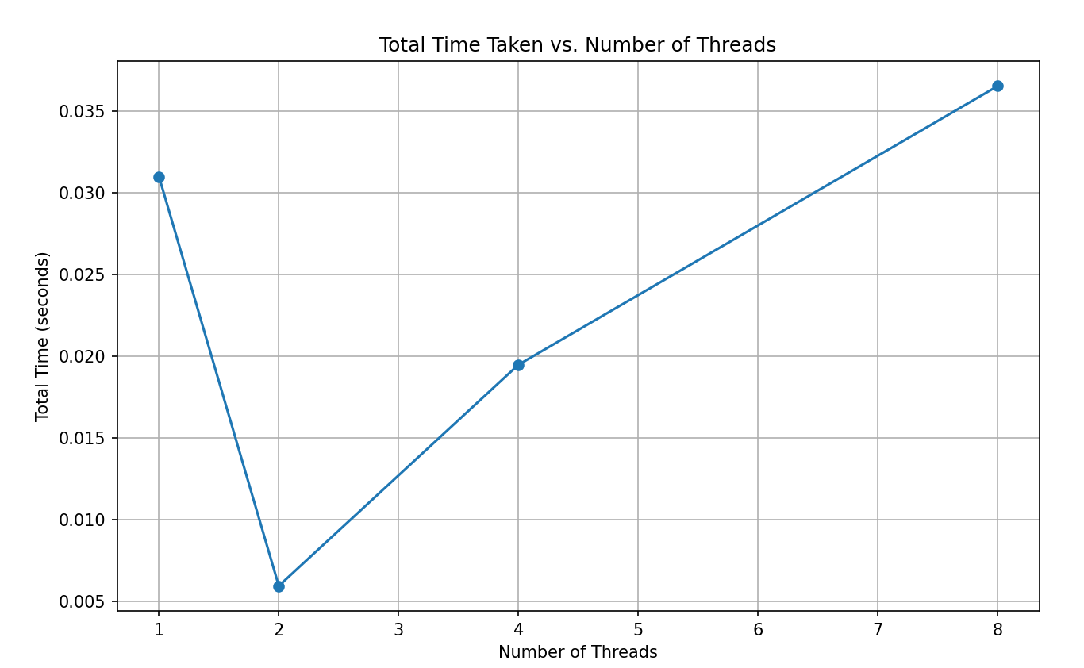
Threads vs Total time taken

Slide 10
Conclusion
Summary: Parallel processing improves performance in rendering semi-transparent circles.
Advantages:
Faster processing.
Effective for complex and real-time applications.
Future Work: Explore further optimizations and applications in more extensive and complex graphics tasks.

