Slide 1

Rhys Morton T1A3 Terminal App
Booking System

Slide 2

Restaurant booking system
A terminal app, designed for use by restaurant staff to input customer bookings with details, getting stored locally.
This app is built with the following features
Add booking, with customer details, time and amount of people
View bookings for each service (breakfast, lunch, dinner or all)
Search and edit bookings

Slide 3
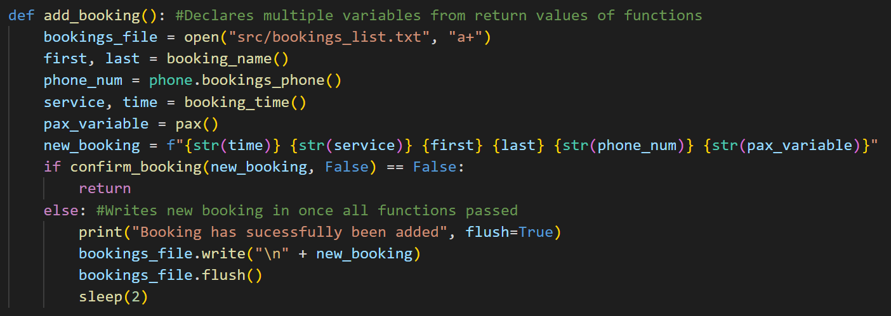
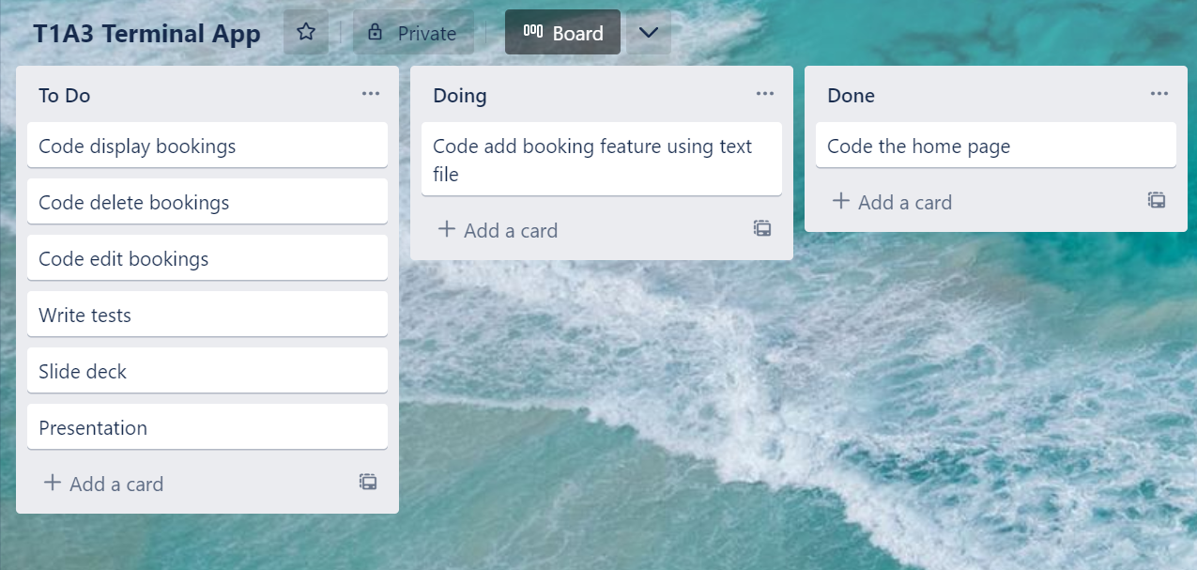
Add booking feature
From the home page this function is called. Nice and simple, calling the functions for each customer detail required and saving their return values to variables.
At the end, all the variables are combined into one and written into the text file

Slide 4
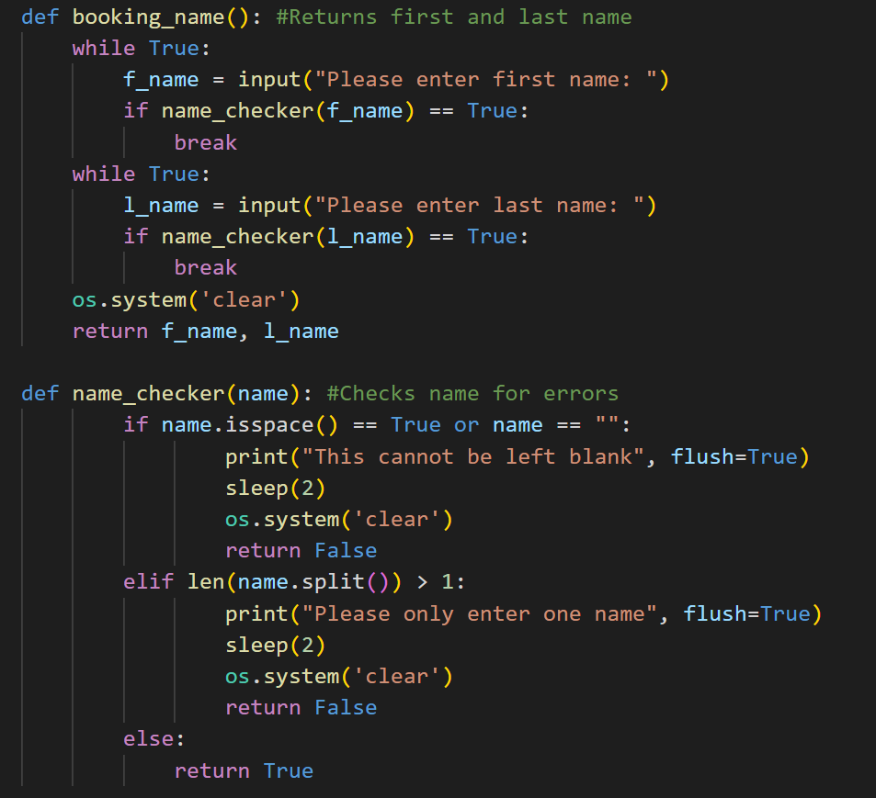
Booking name
‘booking_name()’ just asks the user to input the customer name, using ‘name_checker()’ for error checking, ensuring that the user can’t leave it blank

Slide 5
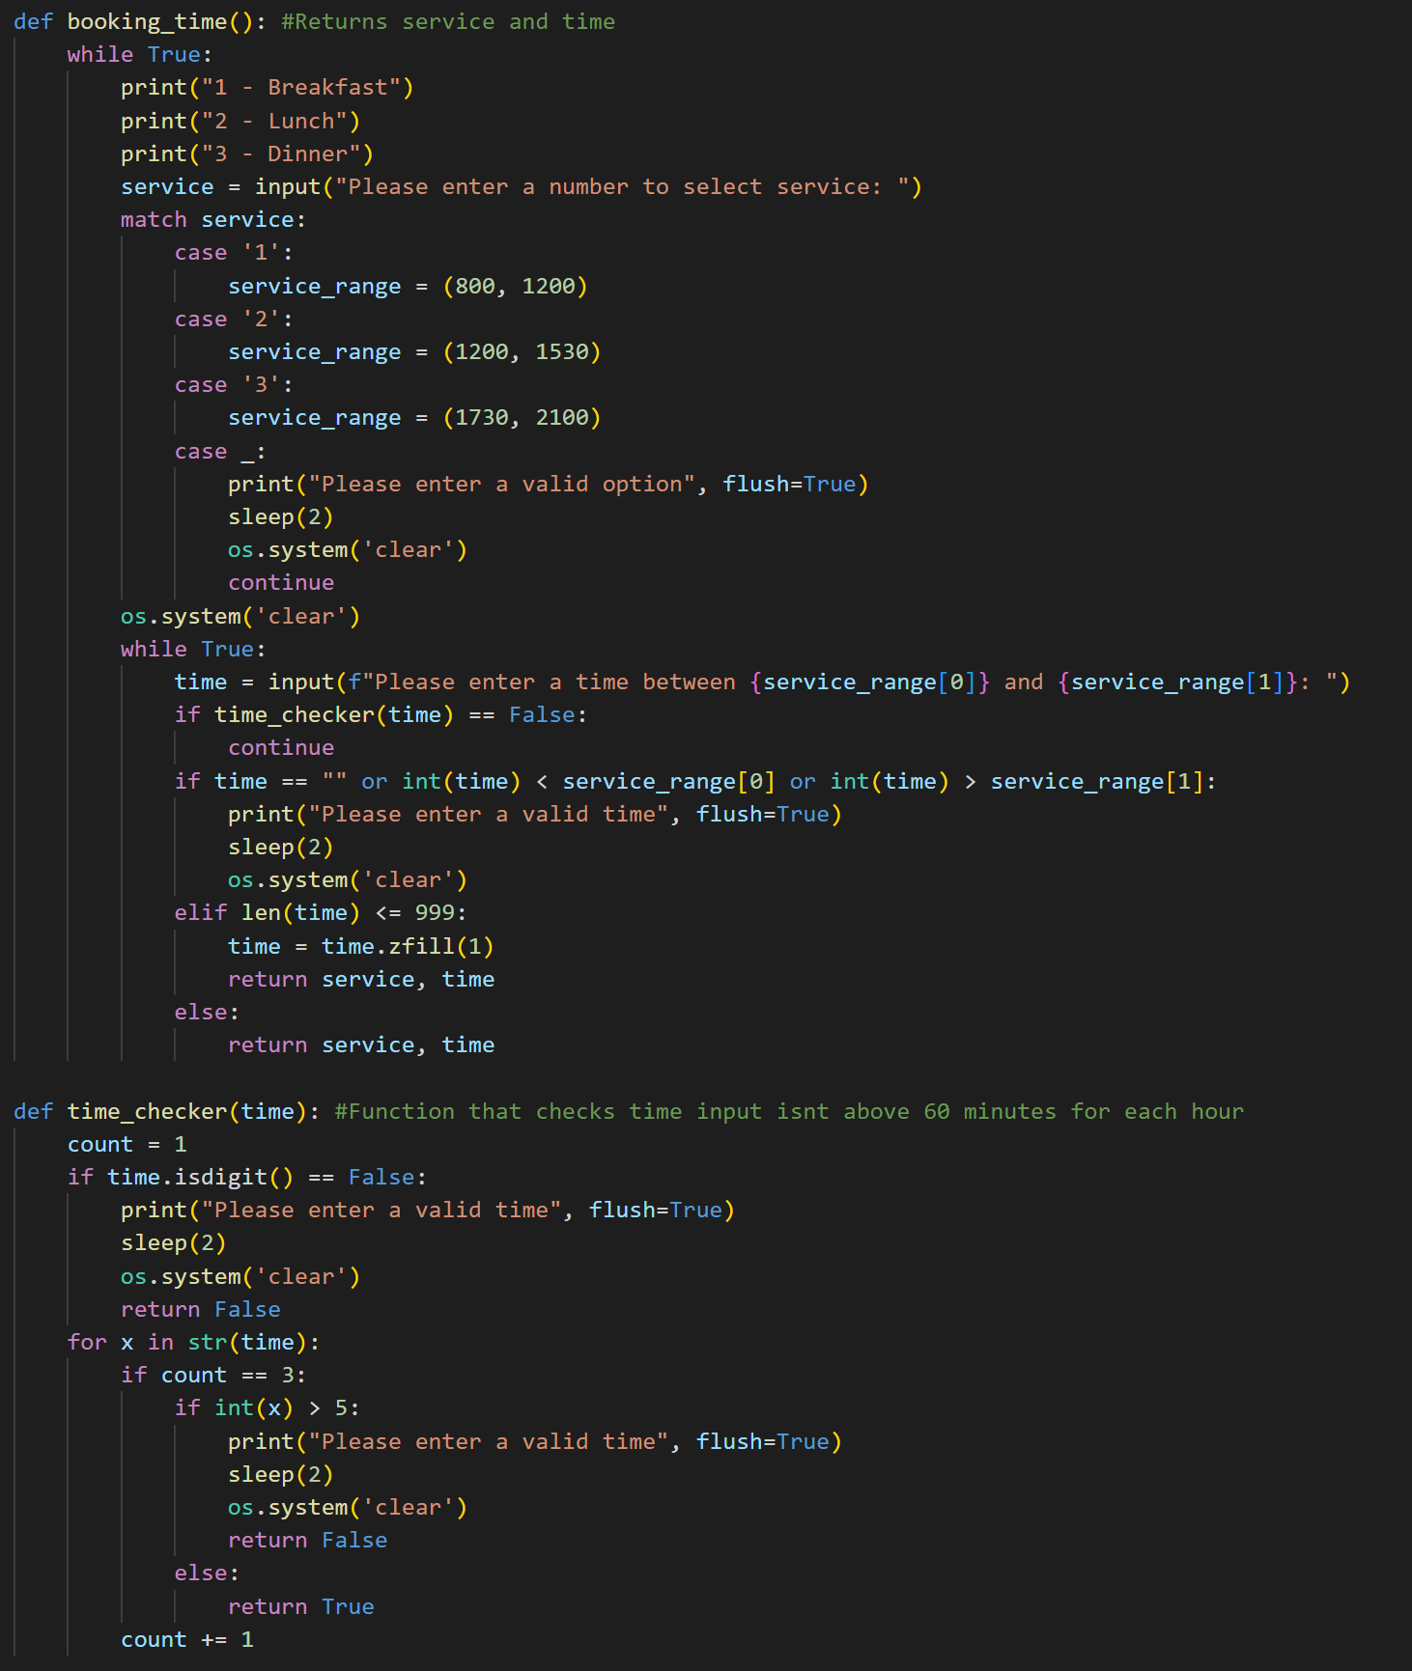
Booking time
‘booking_time()’ asks the user to input a service and then a corresponding time, using 24hour time.
‘time_checker()’ ensures that the user can’t enter a time in minutes above 60.

Slide 6
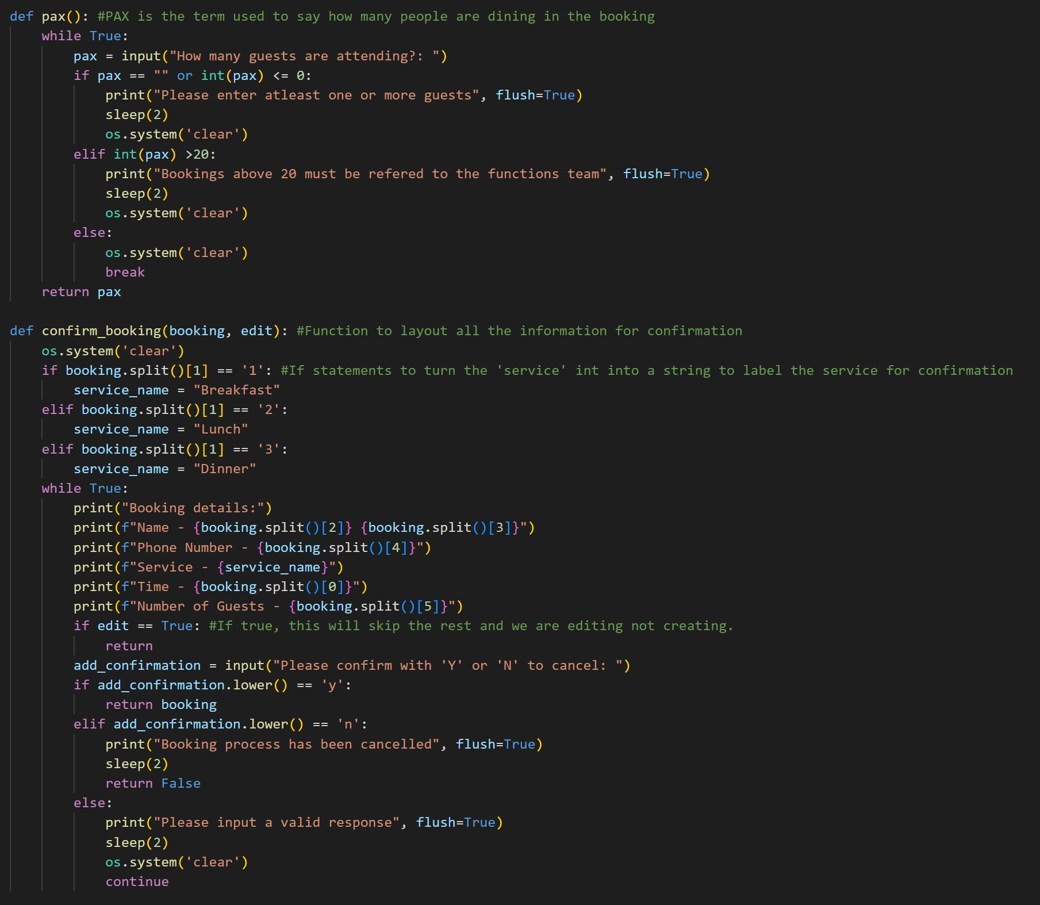
Booking pax and confirm
Pax (amount of people attending) is saved through ‘pax()’, with some error checking.
‘confirm_booking()’ takes all of the details combined and prints it all out for the user to see to confirm before being written to the text file.

Slide 7
Bookings.txt
When confirmed, this is what gets written to the text file in this specific order.
Booking time
Service number
First name
Last name
Phone number
Pax

